Slide 1
Comments on forecasting and scenario projections
Ian Painter 2021-06-01
ian.painter@doh.wa.gov
All opinions are solely my own, and are presented to facilitate discussion

Slide 2
Main Points
Forecast means different things to different people
- Unconstrained prediction (public interpretation?)
Projection under current conditions (modeler interpretation?)
Unconstrained predictions cannot be both accurate and provide information that policy makers can use to alter the course of COVID-19
- Projections under current conditions appear to do worst when things are rapidly changing
Scenario projections can be extremely useful for policy
However, at the state level, we see model projections that are difficult to take at face value
Need to consider information needs of policy makers and how these relate to decisions and options for action
Black box models difficult to present to policy makers and base action on- need to be able to explain ‘reason’ for projection
This is challenging with ensemble based projections

Slide 3
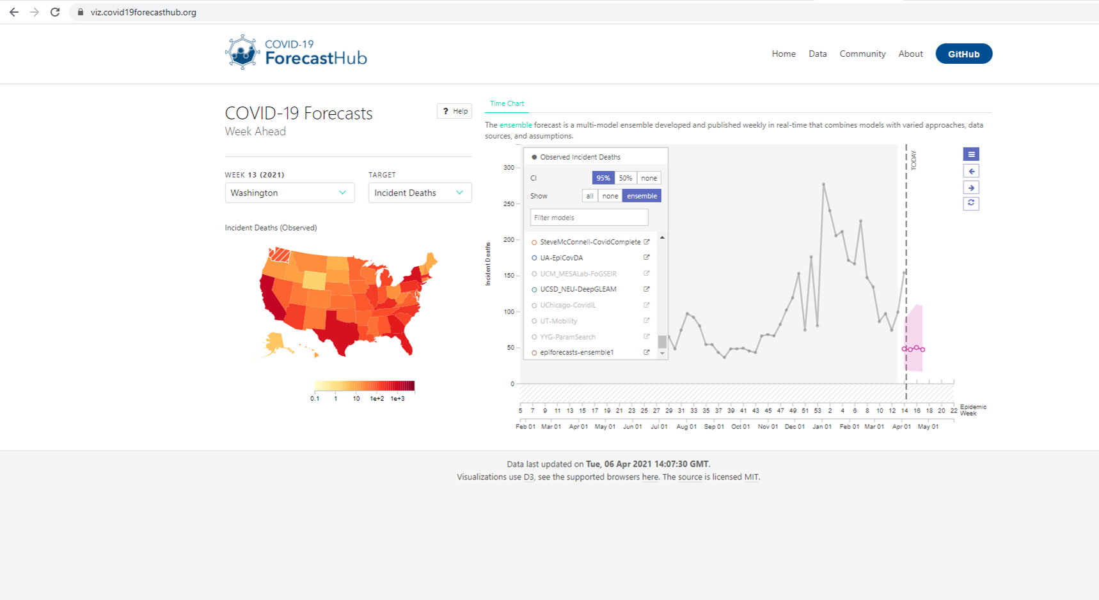
Face validity issues

Slide 4
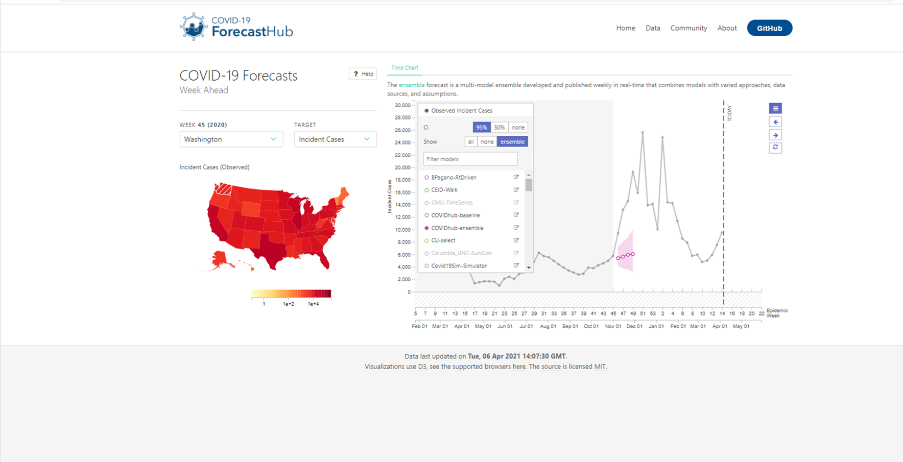
Underestimated uncertainty

Slide 5
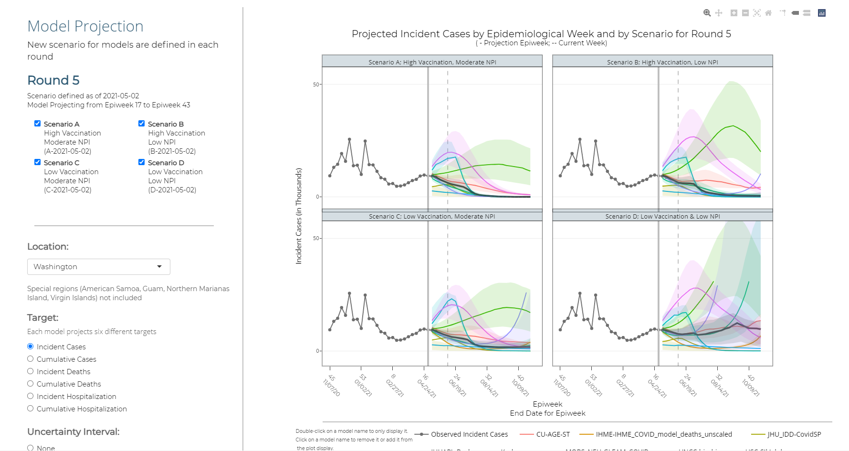

Slide 6
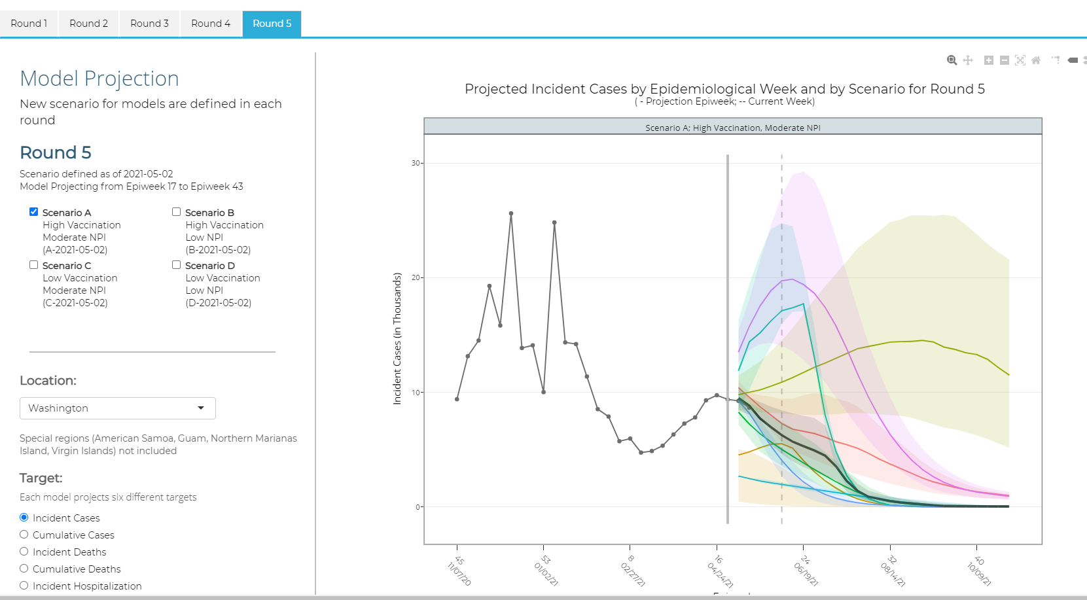

Slide 7
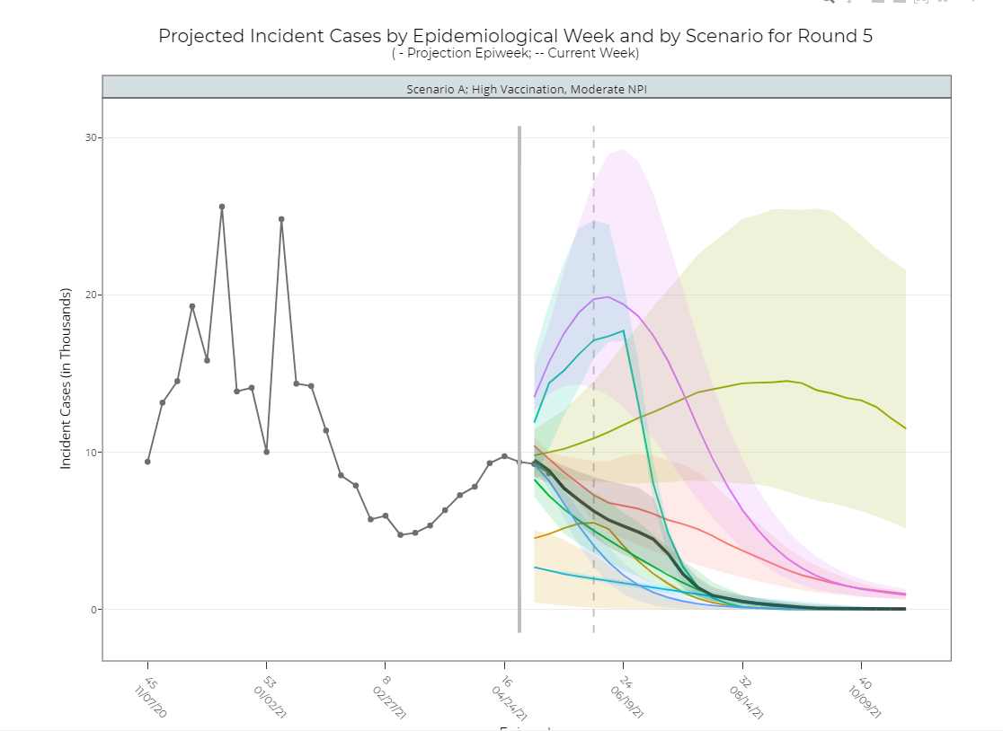
Huh?

Slide 8
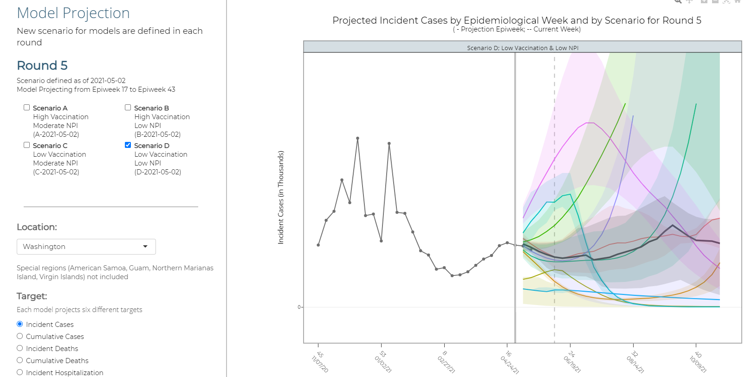
This model projects essentially same outcome under all 4 scenarios

Slide 9
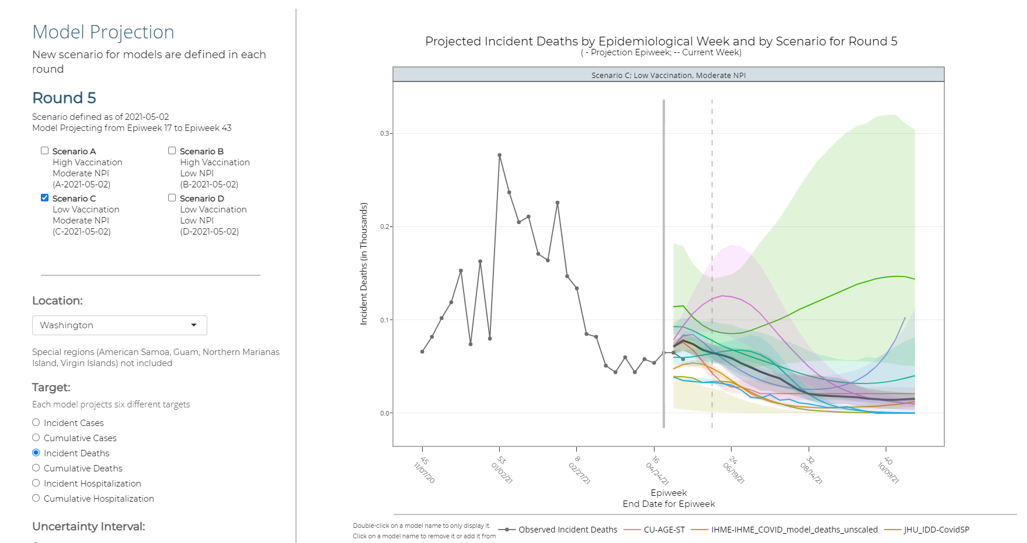

Slide 10
Interpretation
There is considerable uncertainty on long term outcomes under all scenarios
This uncertainty is considerably greater under low NPI scenarios
Higher vaccination rates are better, especially in low NPI scenario
Policy implications
Encourage NPI to extent feasible
Focus on increasing vaccination rate
Because there is considerable uncertainty, remain vigilant as to current situation

Slide 11
Other points
Scenario projections can be very useful for understanding, even when action is not feasible
Relatively simple (i.e. SEIR) models can be useful in terms of estimating population level parameters of interest
- disease prevalence
- disease transmission
- population immunity

