Slide 1


Multi-model planning scenarios for informing the COVID-19 response
Justin Lessler for the SMH Coordinating Committee and participating teams
CSTE/CDC Forecasting Workgroup Monthly Call – June 1, 2021

Slide 2
What is the scenario modeling hub?
“…beyond week-to-week glimpses…”*
*All together now: the most trustworthy covid-19 model is an ensemble | MIT Technology Review

Slide 3
Initiated in Dec 2020 to generate 6-month projections of COVID19 cases, hospitalizations and deaths nationally and by US state.
Combine projections for 4 scenarios focused on vaccination, NPI, and new variants
Generated 5 rounds of projections, with participation from an increasing number of teams (5 -> 9)

Slide 4
Why a multi-modeling approach?
“ridiculously overconfident and wildly unreliable” *
*Tilmann Gneiting in All together now: the most trustworthy covid-19 model is an ensemble | MIT Technology Review

Slide 5
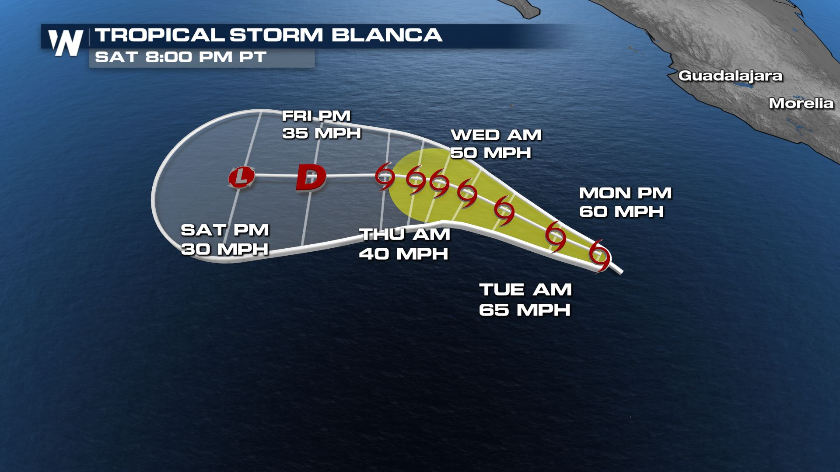
From Tropical Storm Blanca Strengthens in the Eastern Pacific - WeatherNation (weathernationtv.com)

Slide 6
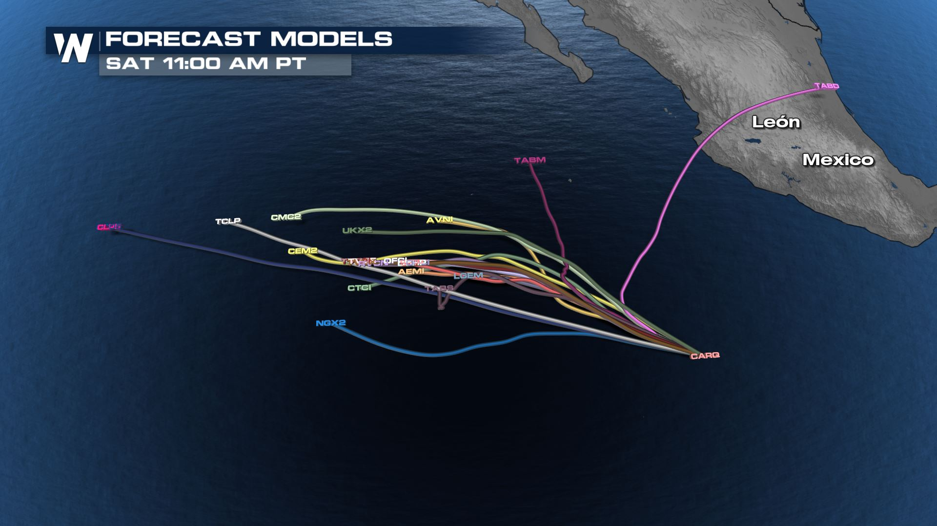
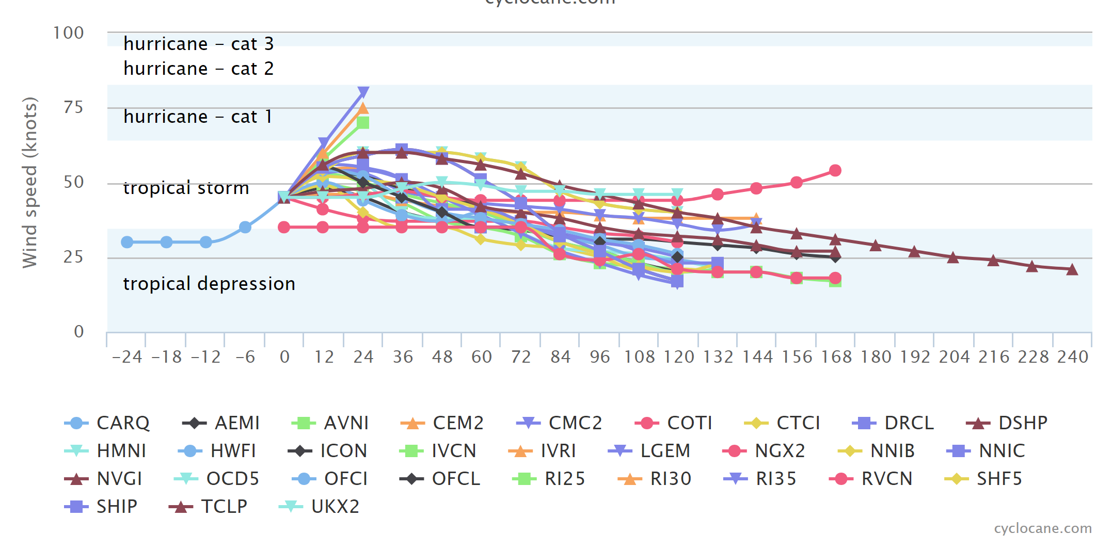
From Tropical Storm Blanca Strengthens in the Eastern Pacific - WeatherNation (weathernationtv.com) / cyclocane.com

Slide 7

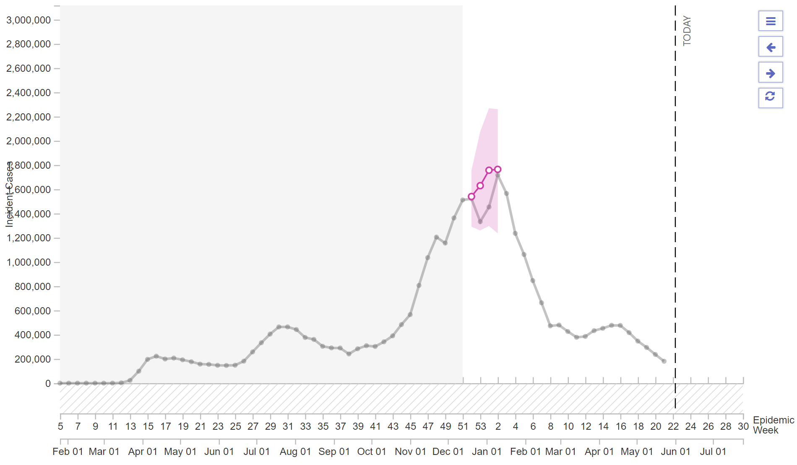
https://covid19forecasthub.org/

Slide 8
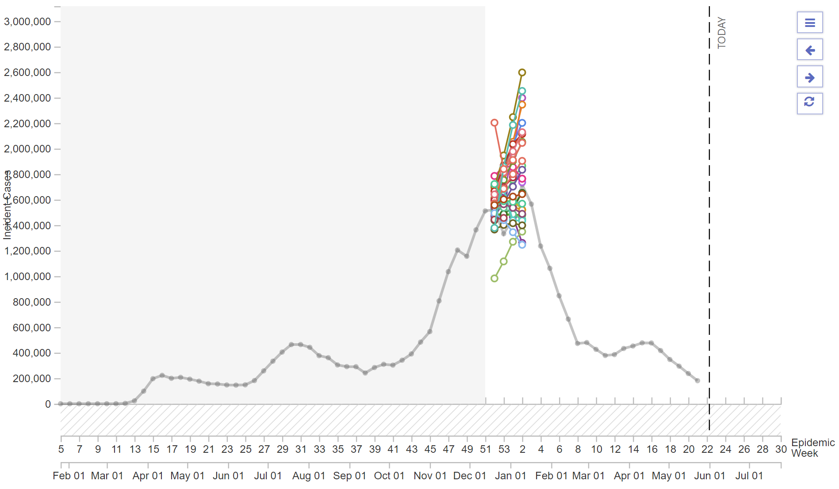
https://covid19forecasthub.org/

Slide 9
Why do we need scenarios when we have forecasts?
“Models are not oracles…Any model is providing an answer that is conditional on certain assumptions.”*
*Alessandro Vespignani in All together now: the most trustworthy covid-19 model is an ensemble | MIT Technology Review

Slide 10
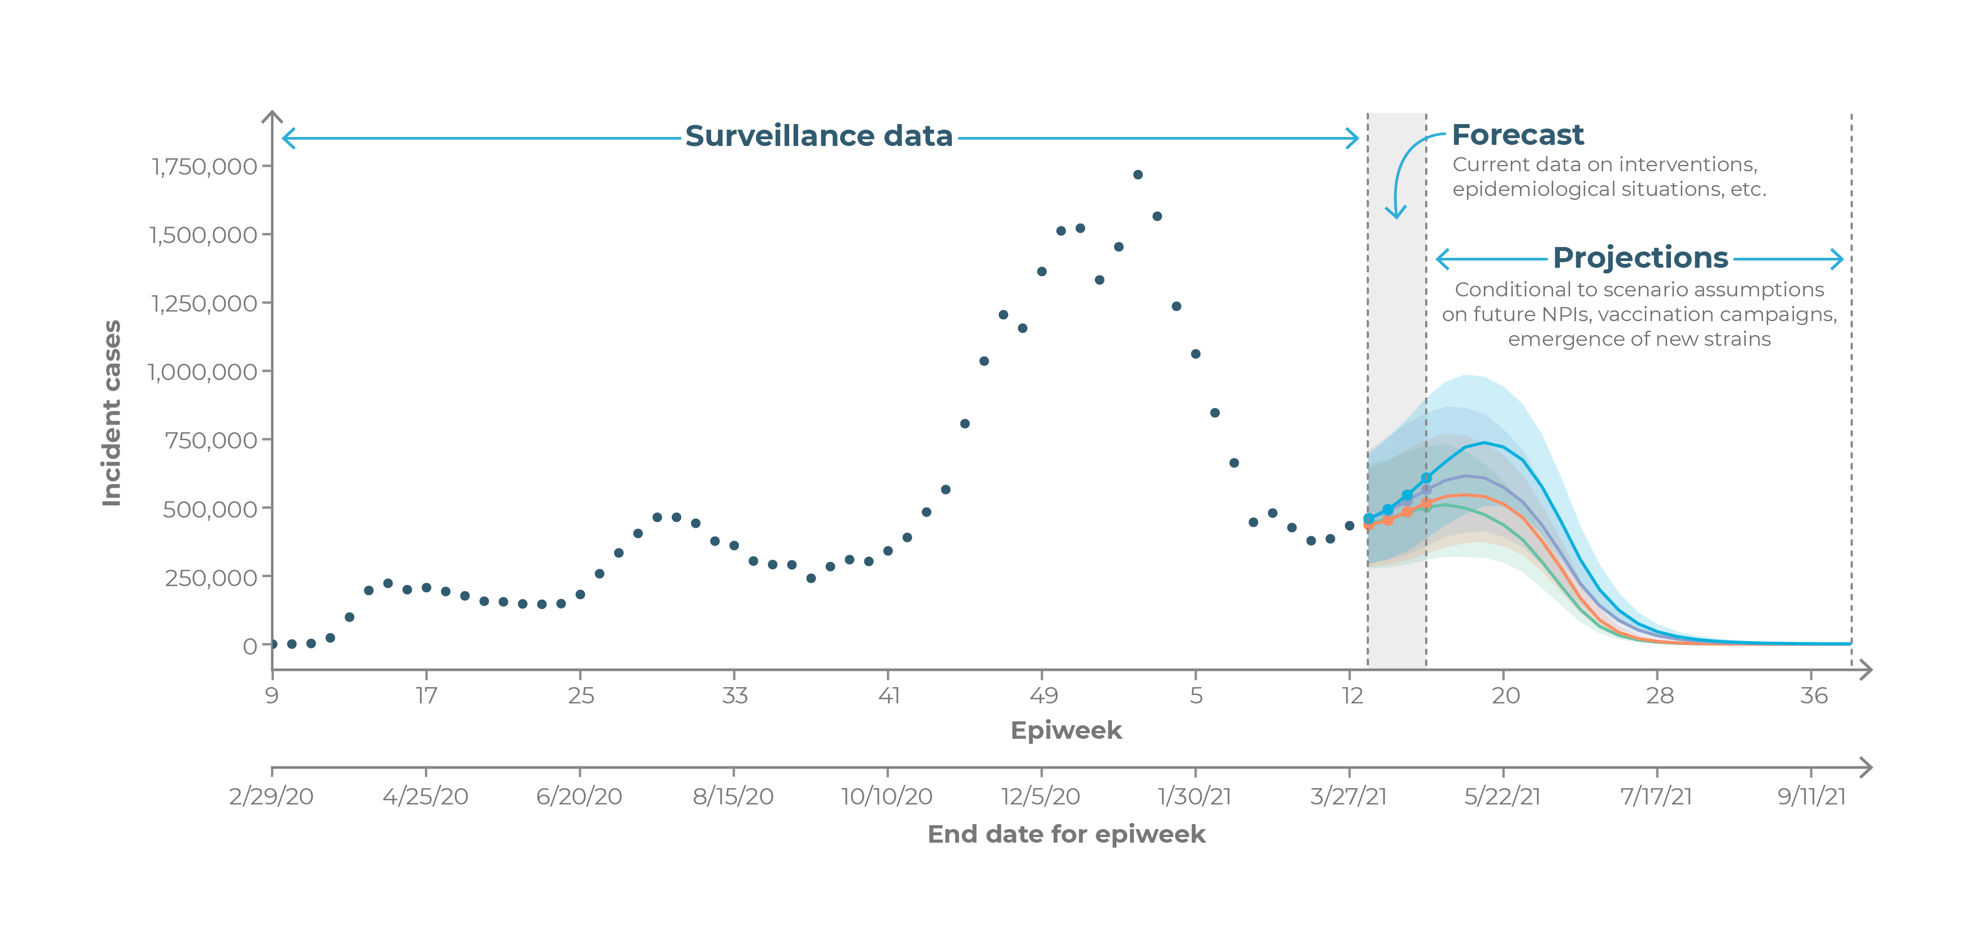

Slide 11
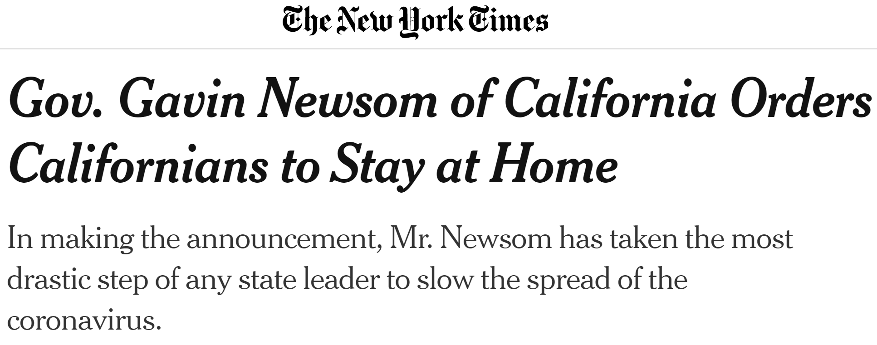
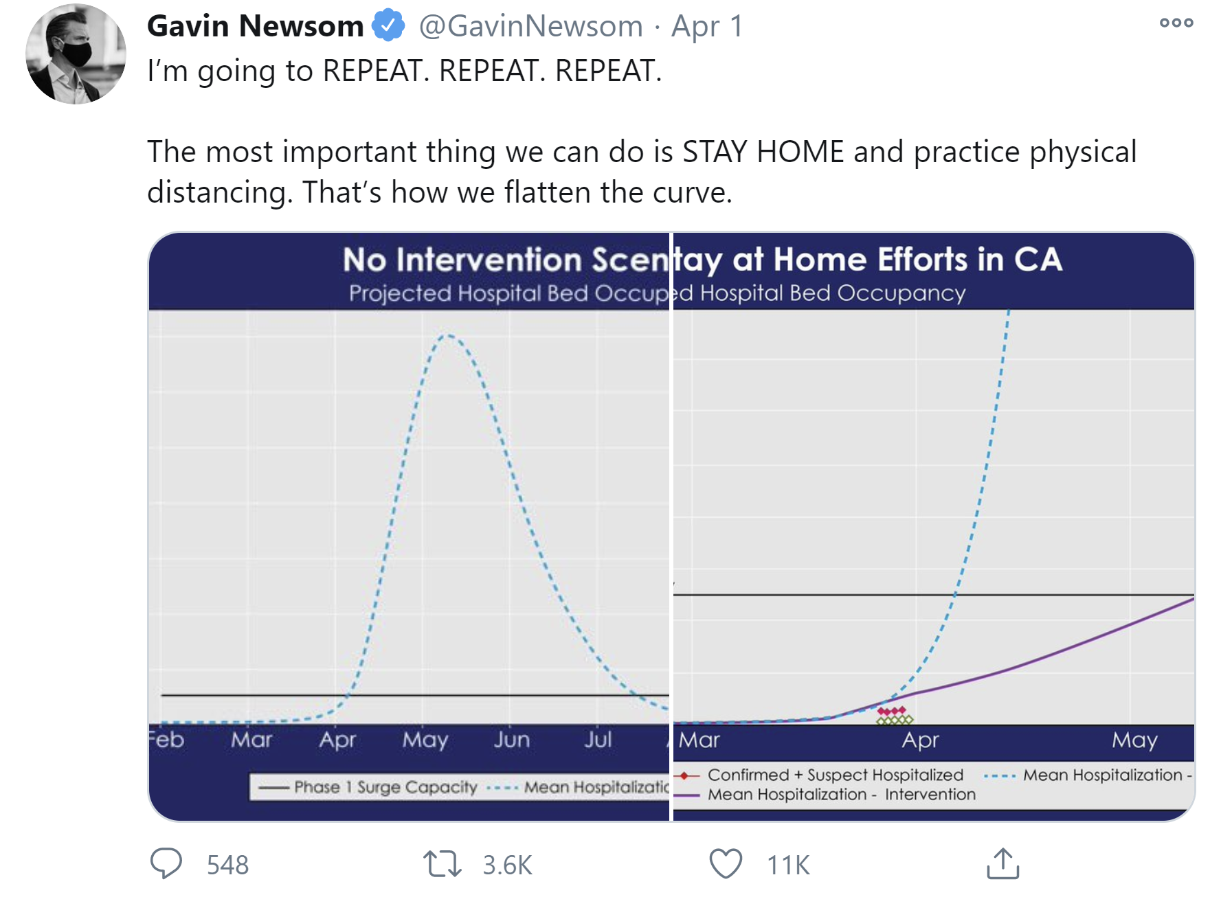
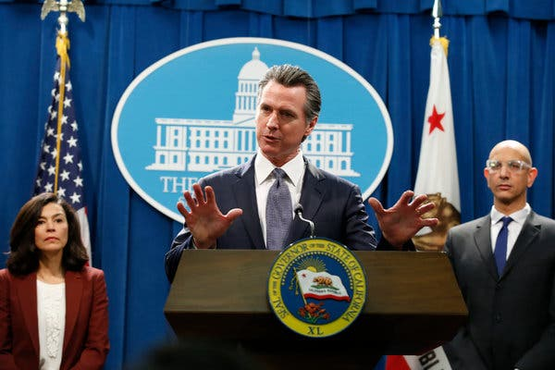
New York Times, March 19, 2020

Slide 12
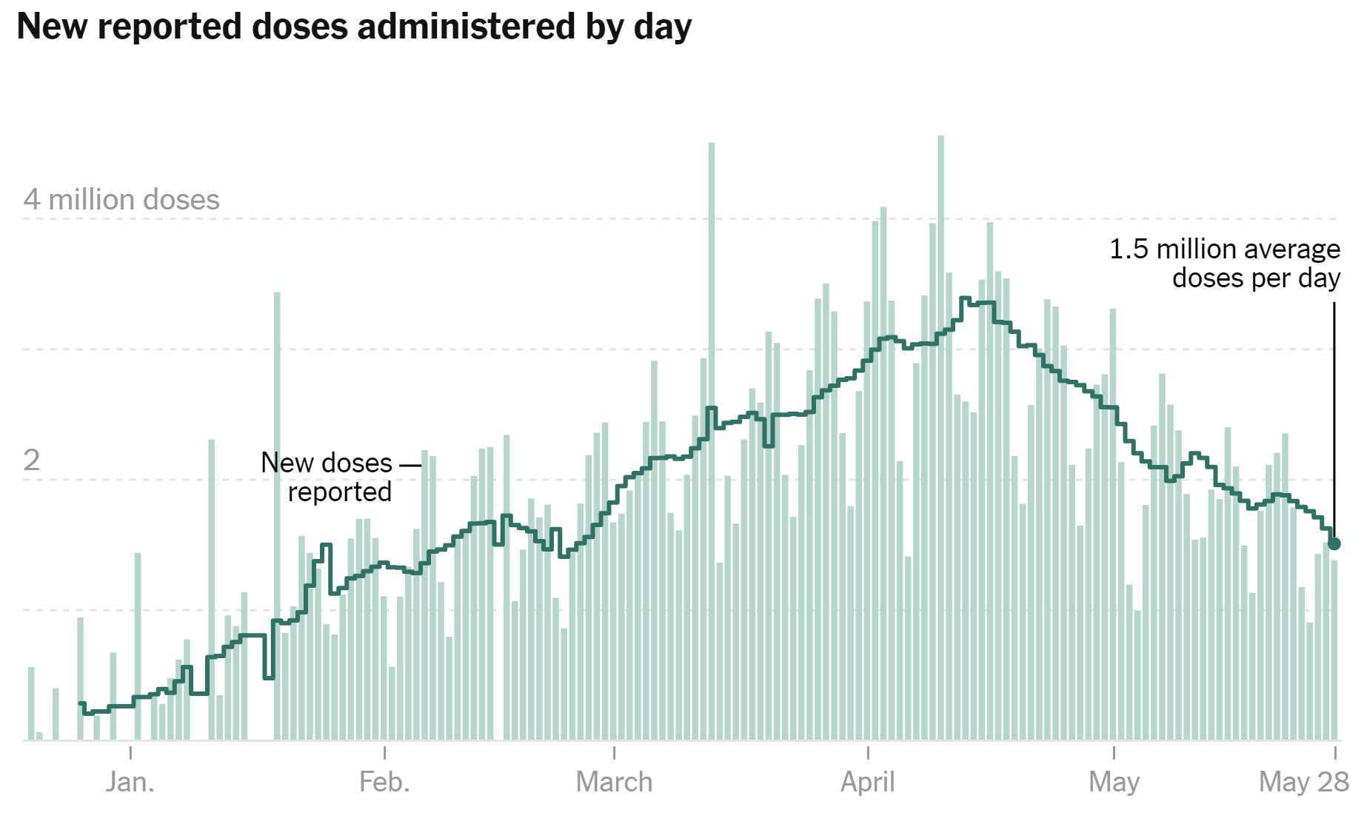
nytimes.com

Slide 13
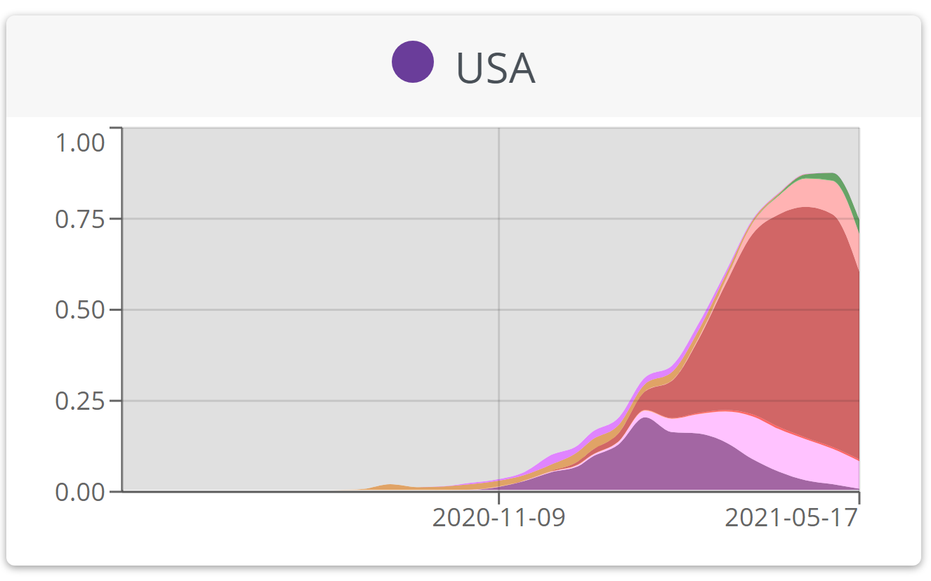
https://covariants.org/

Slide 14
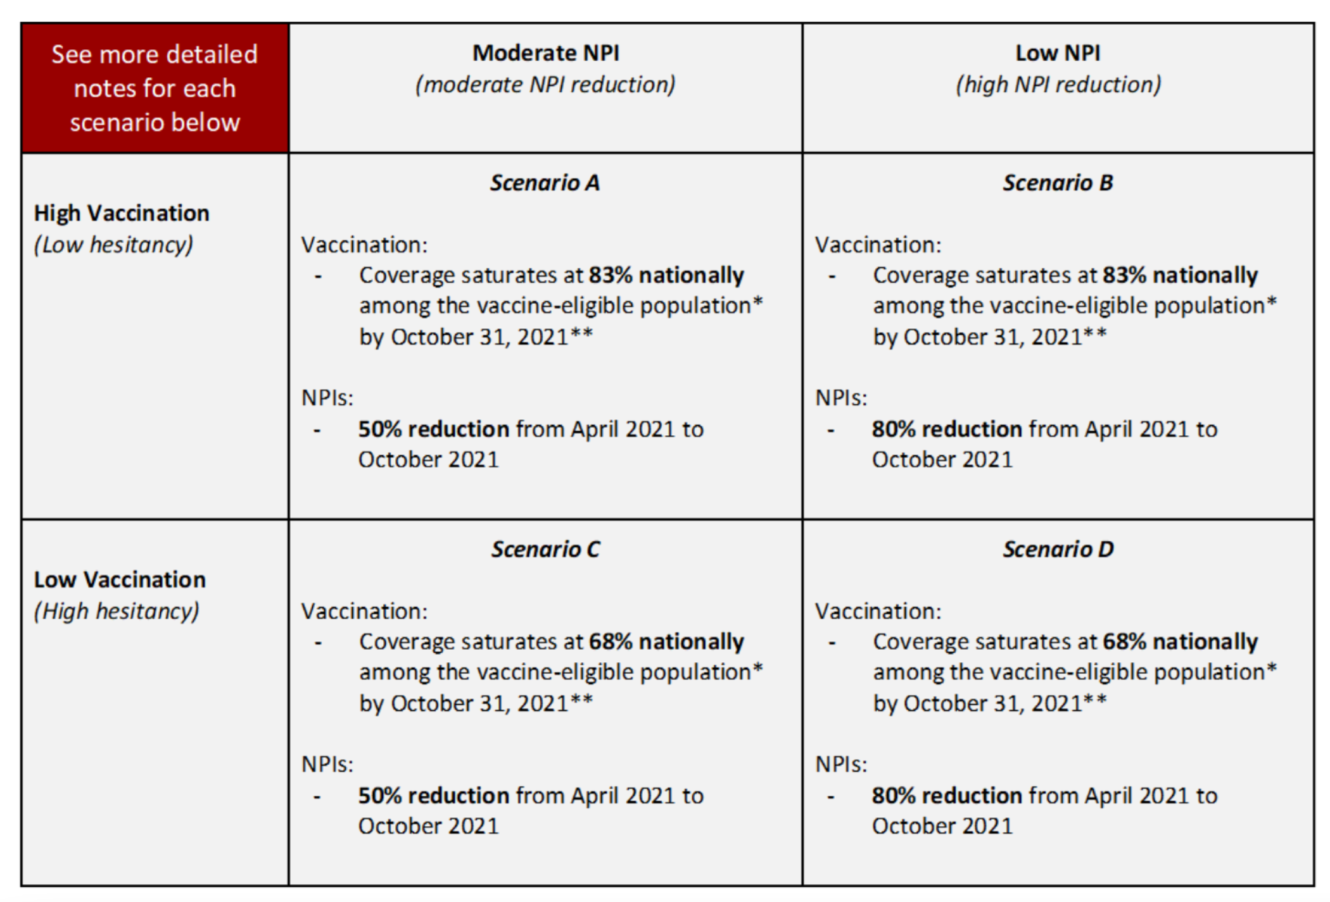
Planning scenarios, not forecasts

Slide 15
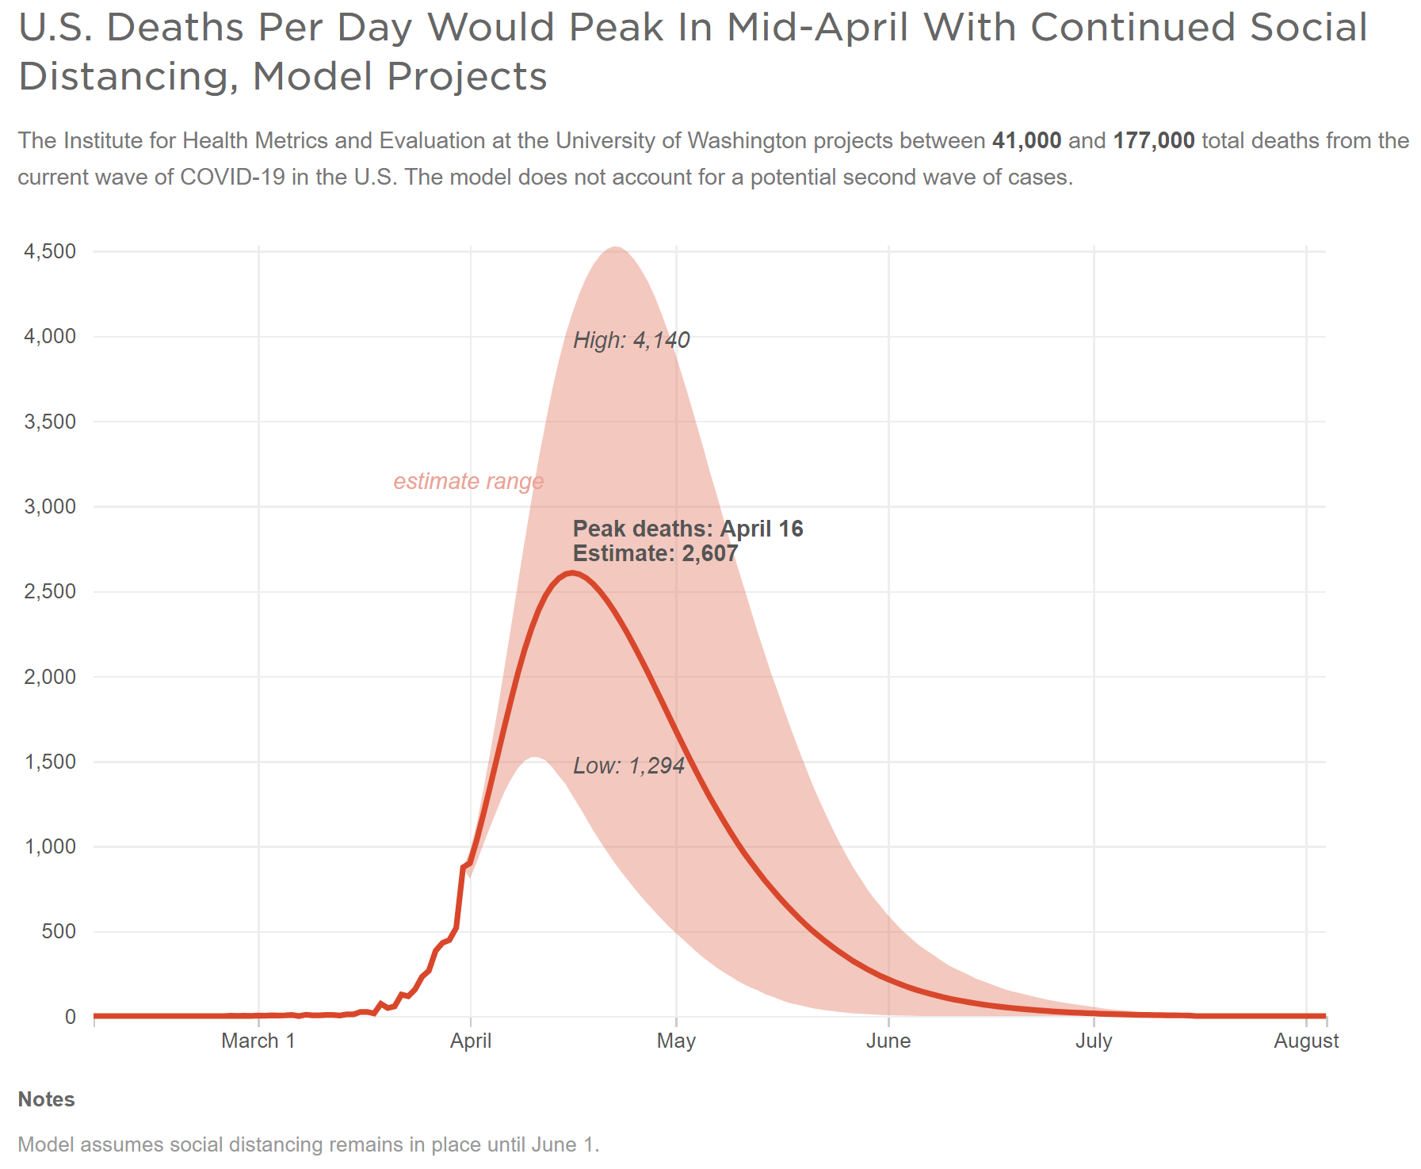
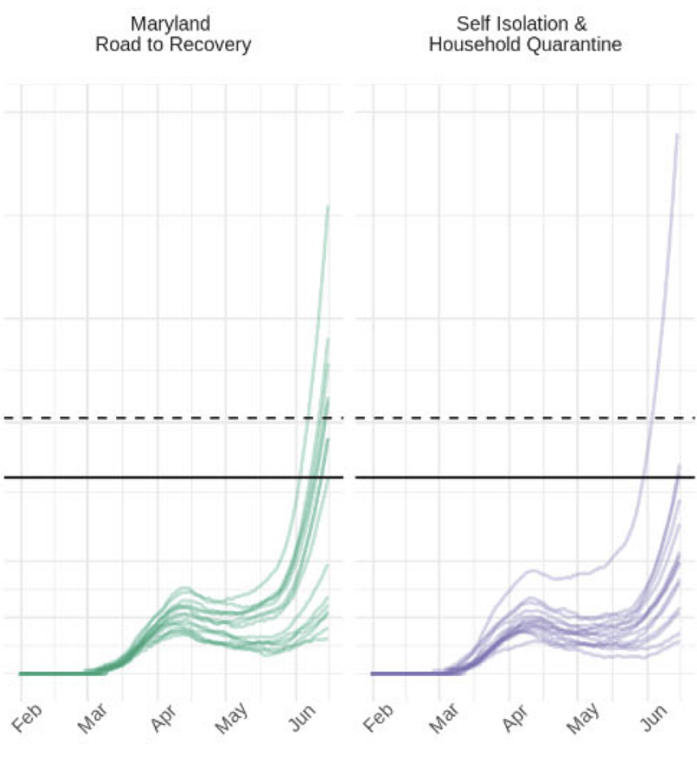
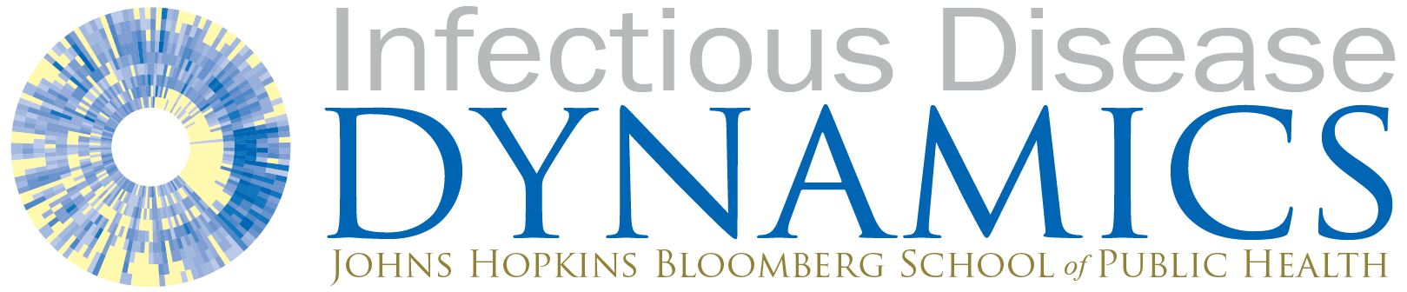
https://www.npr.org/sections/health-shots/2020/04/01/824744490/5-key-facts-the-white-house-isnt-saying-about-their-covid-19-projections

Slide 16
COVID-19 Scenario Modeling Hub Results

Slide 17
Model rounds:
Vaccine supply and non-pharmaceutical interventions [2020-12-22]
More transmissible variant (B.1.1.7) and NPIs [2021-01-22]
Vaccine supply and NPIs [2021-3-5]
Vaccine supply and NPIs [2021-3-28]
Vaccine hesitancy and NPIs [2021-5-2]
More transmissible variant and vaccine hesitancy [in progress]
Immune escape and XXX? [planned]

Slide 18
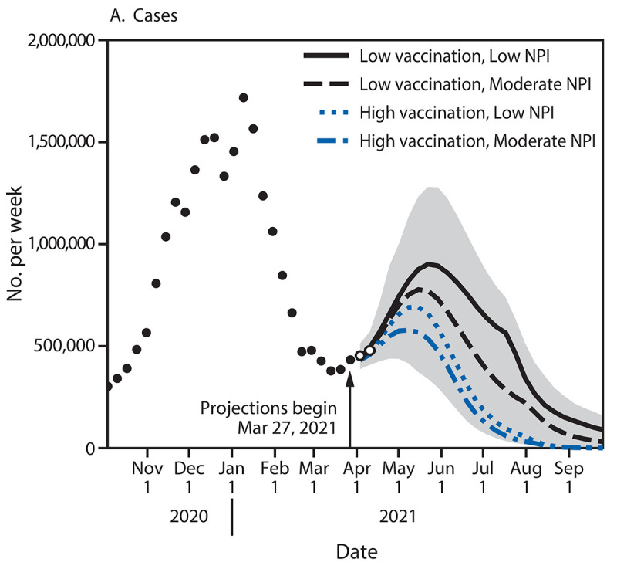
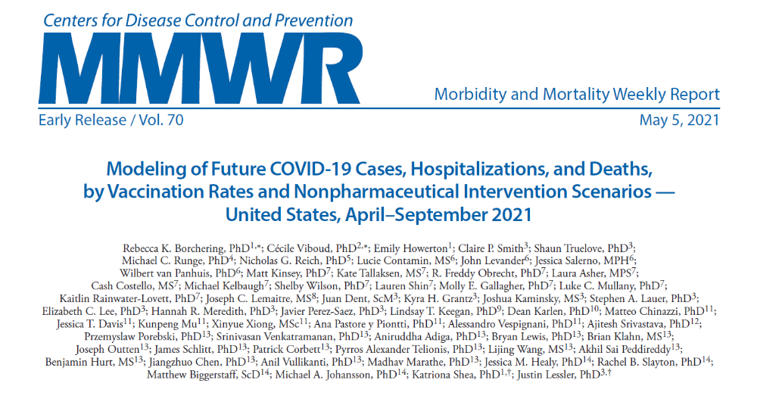
Round 4

Slide 19
Round 5 scenarios

Slide 20
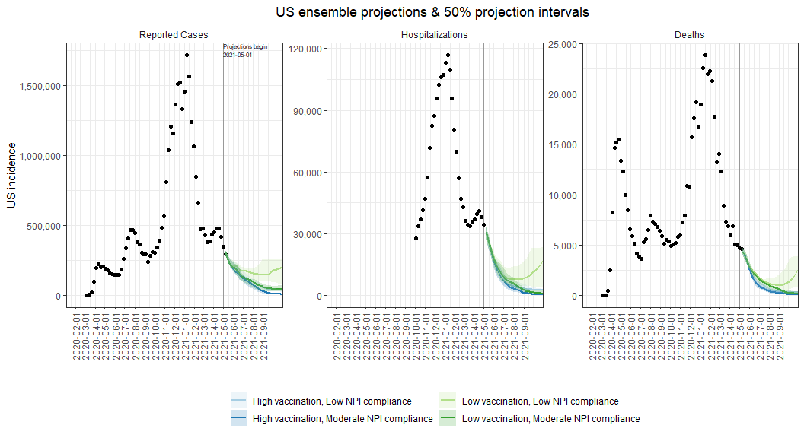
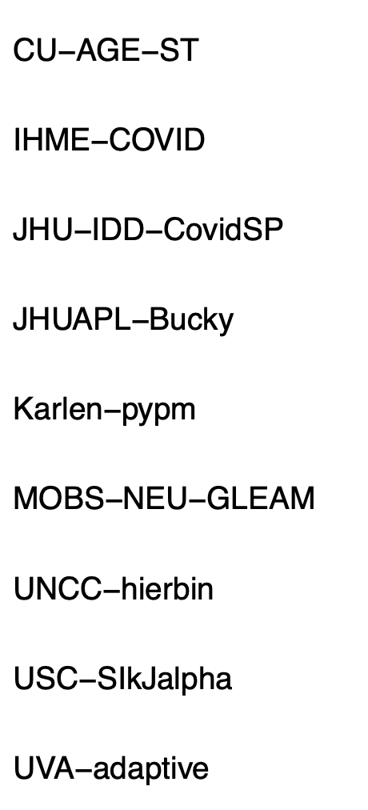
Round 5: National ensemble projections
Contributing Teams:

Slide 21
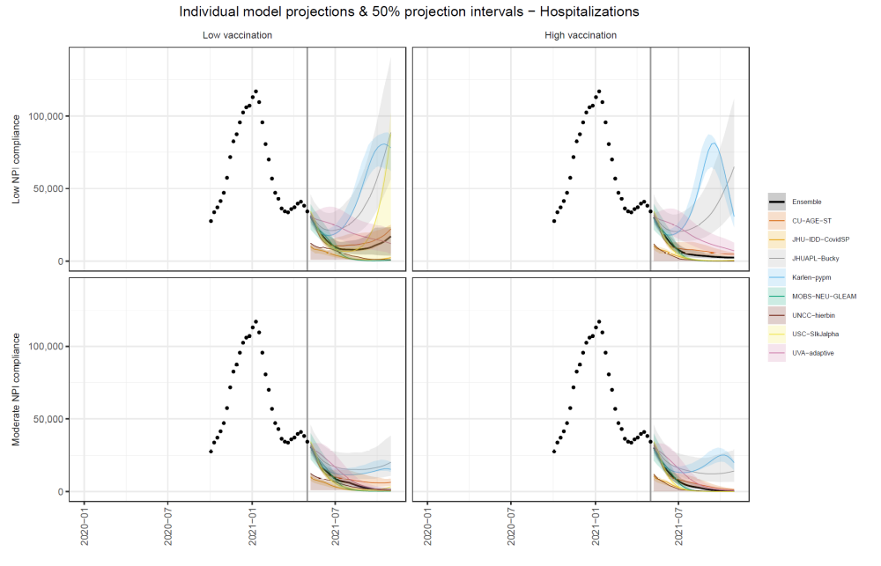
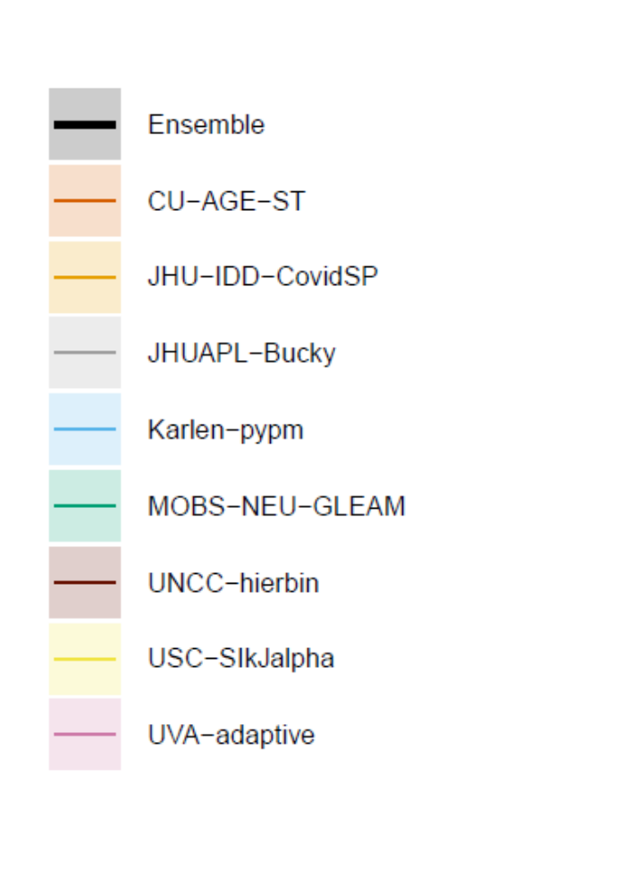

Slide 22
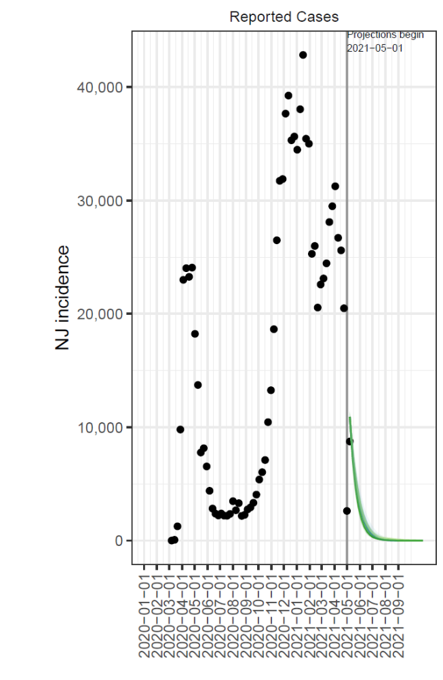
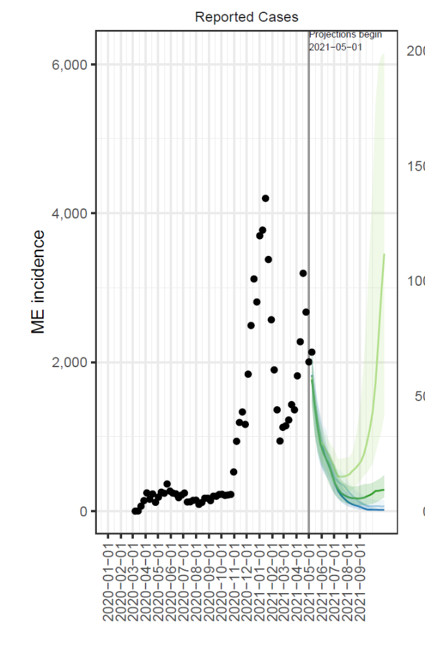
New Jersey
Maine

Slide 23
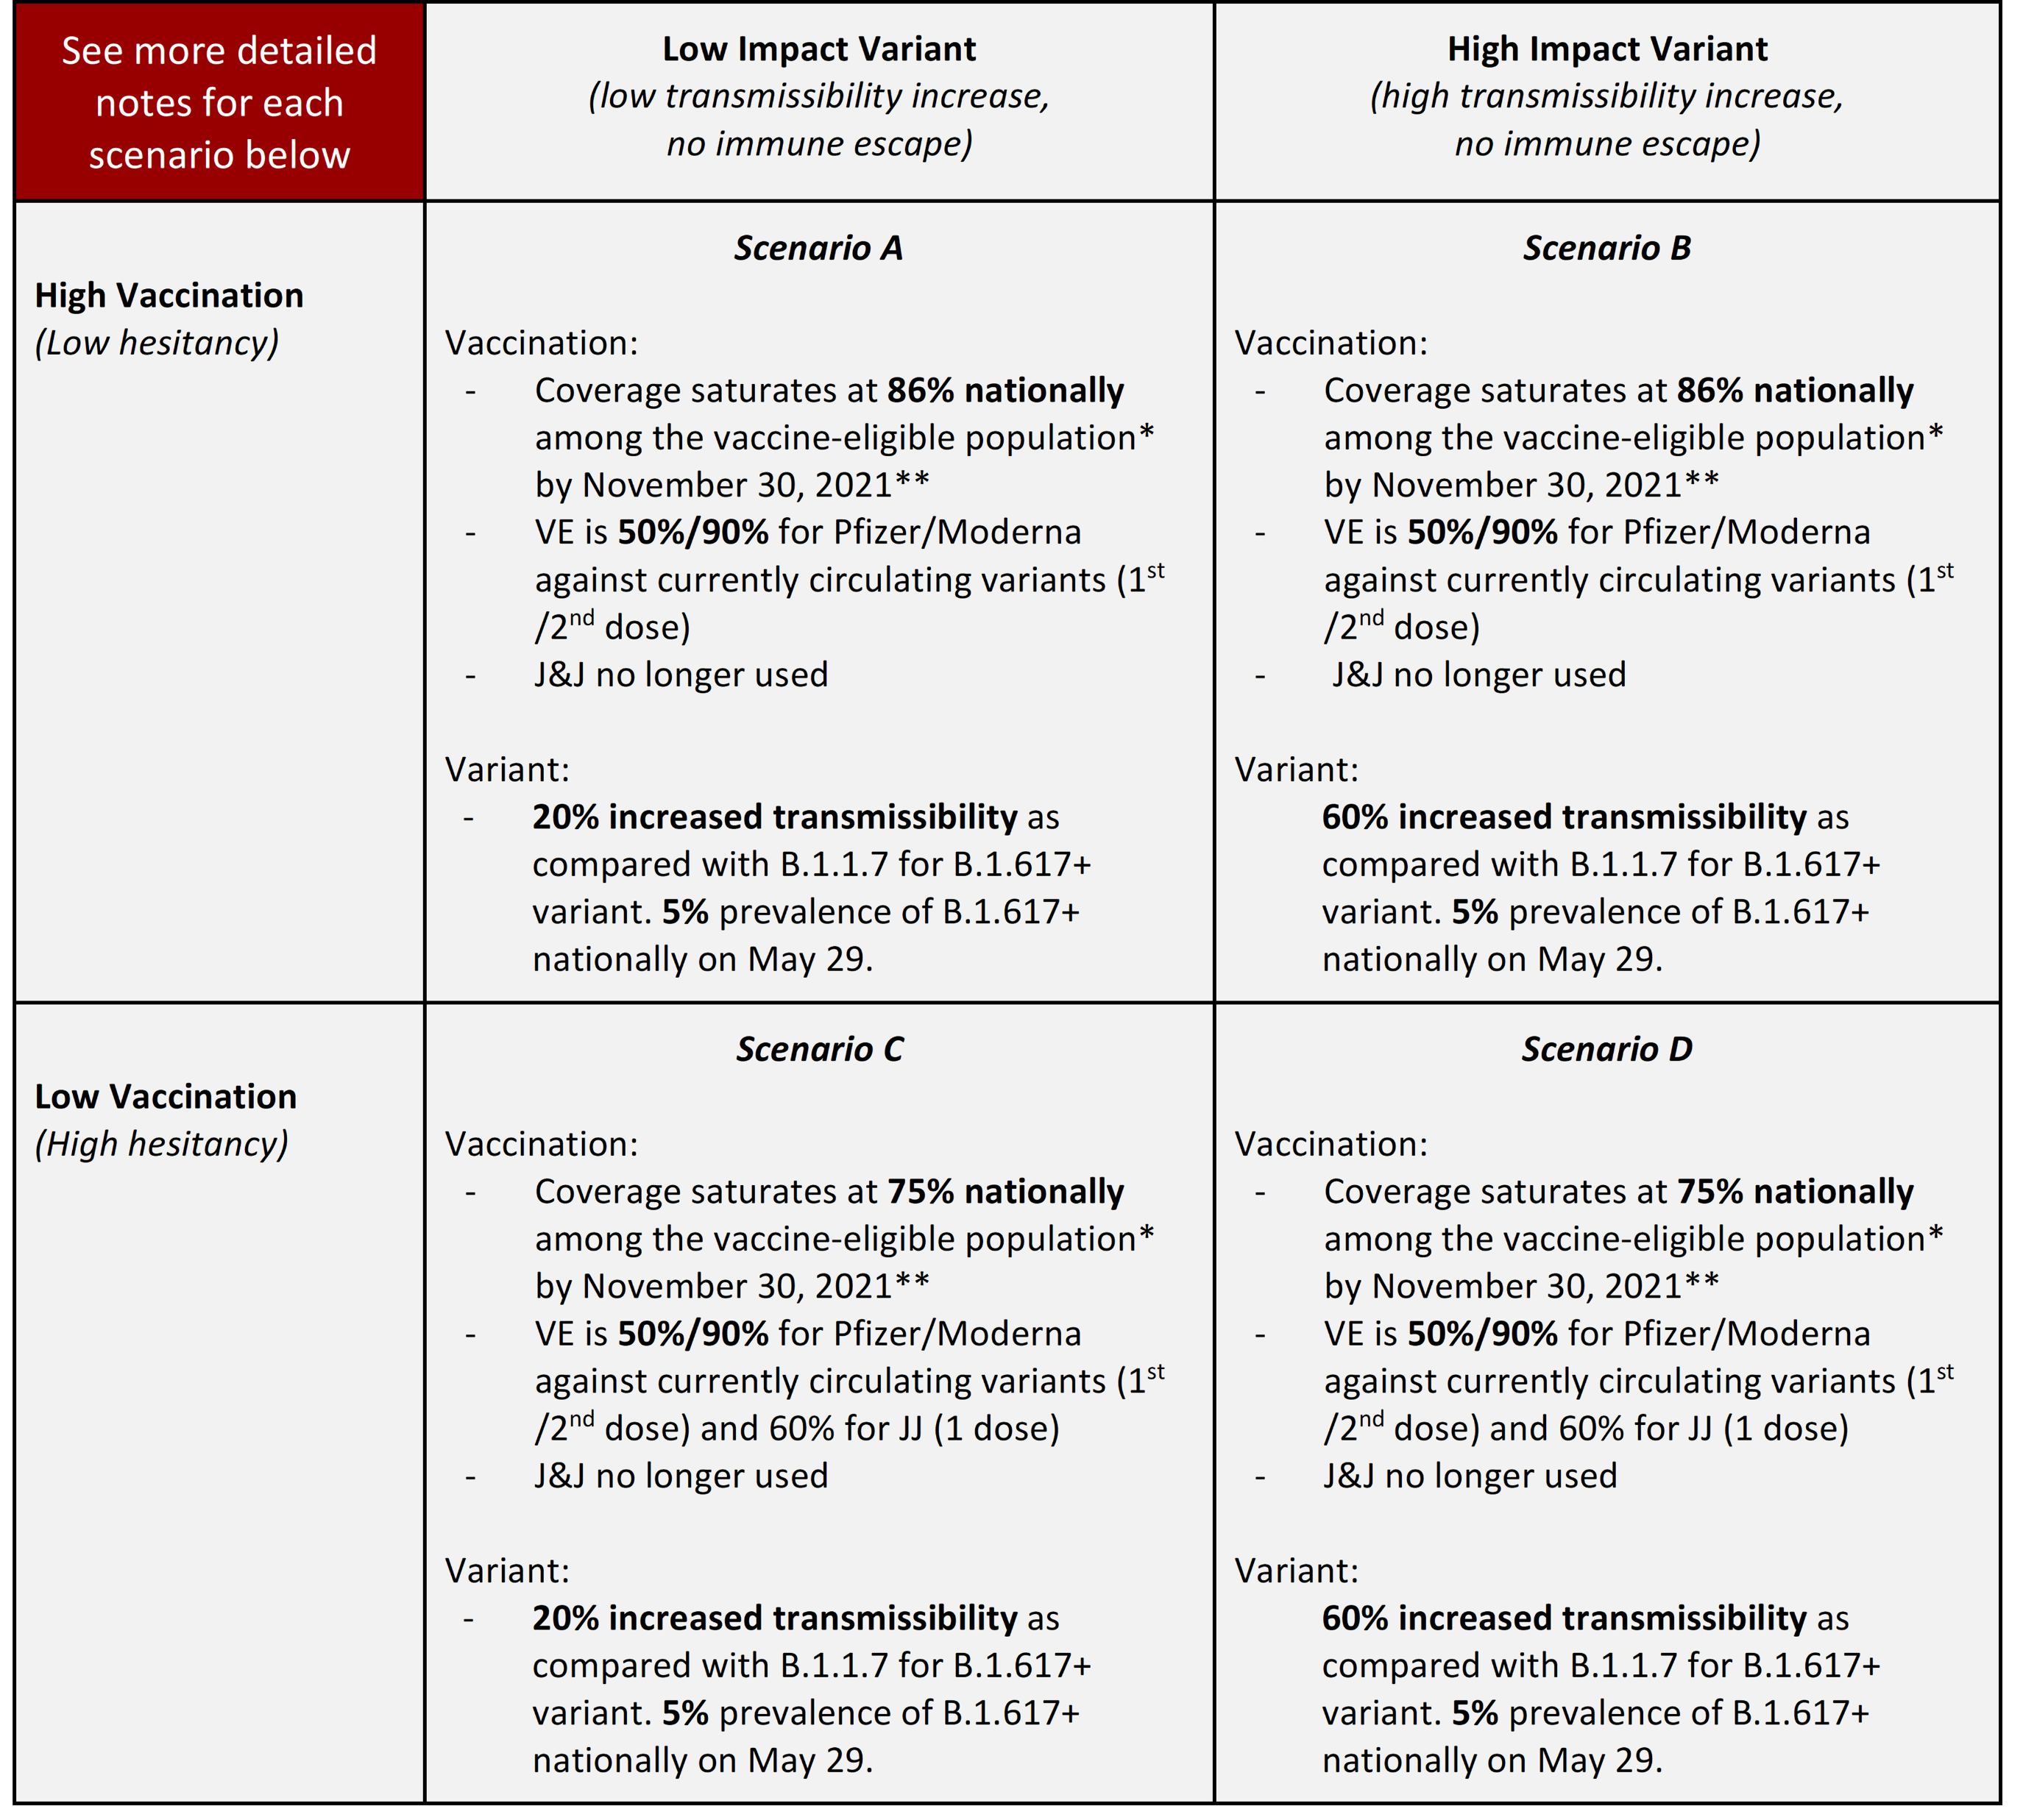
Round 6 scenarios

Slide 24
Results highlights, after 5 rounds
In early rounds:
  Potential impact of rapid vaccine rollout in first half of 2021
  Maintaining NPI was important as B117 progressed and vaccination ramped up in early Spring
In recent rounds:
  Possible case rebounds in fall if vaccine hesitancy is high, NPI are fully relaxed, especially if new variants are on the higher end of plausible R0s.
Variability in the trajectory of individual states, based on history of natural infections, vaccination, and NPI mandates

Slide 25
Model rounds:
Vaccine supply and non-pharmaceutical interventions [2020-12-22]
More transmissible variant (B.1.1.7) and NPIs [2021-01-22]
Vaccine supply and NPIs [2021-3-5]
Vaccine supply and NPIs [2021-3-28]
Vaccine hesitancy and NPIs [2021-5-2]
More transmissible variant and vaccine hesitancy [in progress]
Immune escape and XXX? [planned]

Slide 26
You are our most important audience!
See results:
  https://covid19scenariomodelinghub.org/
Contribute and see in process scenarios:
  https://github.com/midas-network/covid19-scenario-modeling-hub
Questions, scenario ideas, anything else…
  scenariohub@midasnetwork.us
  justin@jhu.edu

Slide 27

Modeling Groups Contributing Projections
Coordination Team
Katriona Shea, Justin Lessler, Cécile Viboud, Rebecca Borchering, Emily Howerton, Shaun Truelove, Claire Smith, Nick Reich, Michael Runge, Lucie Contamin, John Levander, Jessica Salerno, Wilbert van Panhuis
Columbia University – Age-Stratified Model: Marta Galanti, Teresa Yamana, Sen Pei, Jeffrey Shaman
Institute for Health Metrics and Evaluation – IHME COVID
John Hopkins University-APL: Matt Kinsey, Kate Tallaksen, R.F. Obrecht, Laura Asher, Cash Costello, Michael Kelbaugh, Shelby Wilson
John Hopkins University-IDD-COVIDSP: Joseph C. Lemaitre, Juan Dent Hulse, Kyra H. Grantz, Joshua Kaminsky, Stephen A. Lauer, Elizabeth C. Lee, Justin Lessler, Hannah R. Meredith, Javier Perez-Saez, Shaun A. Truelove, Claire P. Smith, Lindsay T. Keegan, Kathryn Kaminsky, Sam Shah, Josh Wills, Pierre-Yves Aquilanti, Karthik Raman, Arun Subramaniyan, Greg Thursam, Anh Tran
Karlen PyPm: Dean Karlen
Northeastern University MOBS GLEAM COVID: Matteo Chinazzi, Jessica T. Davis, Kunpeng Mu, Xinyue Xiong, Ana Pastore y Piontti, Alessandro Vespignani
University of North Carolina at Charlotte – UNCC-hierbin: Shi Chen, Rajib Paul, Daniel Janies, Jen-Claude Thill
University Southern California SlkJalpha: Ajitesh Srivastava
University of Virginia-adaptive: Przemyslaw Porebski, Srini Venkatramanan, Anniruddha Adiga, Bryan Lewis, Brian Klahn, Joseph Outten, James Schlitt, Patric Corbett, Pyrros Alexander Telionis, Lijing Wang, Akhil Sai Peddireddy, Benjamin Hurt, Jiangzhou Chen, Anil Vullikanti, Madhav Marathe
Collaborators: Matthew Biggerstaff, Michael Johansson, Rachel Slayton, Jessica Healey (CDC); Nicole Samay (Northeastern University)
Notes:
27
27
5/31/2021
27
27

Slide 28
Thank you!
https://github.com/midas-network/covid19-scenario-modeling-hub
https://covid19scenariomodelinghub.org/
Contact: scenariohub@midasnetwork.us
Notes:
Hoping to complete Round 3 early to mid-March

