Slide 1
Influenza Forecasting Update – week 1
Full forecasts, including individual states, at https://predict.cdc.gov

Slide 2
U.S. Forecasting Summary
There is about a 64% chance that the peak week will occur by the end of January
Forecasts give a slightly lower chance for a high severity season than the historical average (3% from forecasts vs. 8% historically)
ILI activity is likely to stay near 3.5% week 2 and then slowly increase over the next 2 to 4 weeks

Slide 3
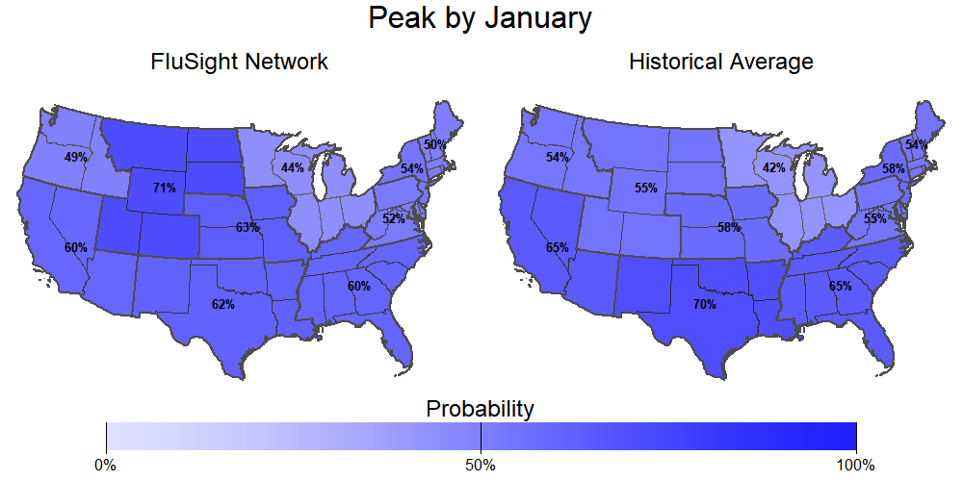
Season peak
64% chance of U.S. peak by January (historically is 57%).

Slide 4
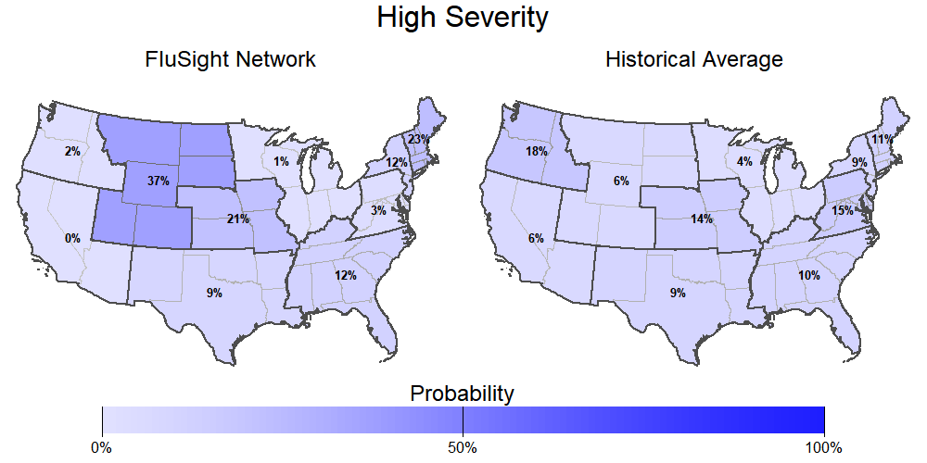
Season intensity
3% chance U.S. has a high severity season (historically is 8%).

Slide 5
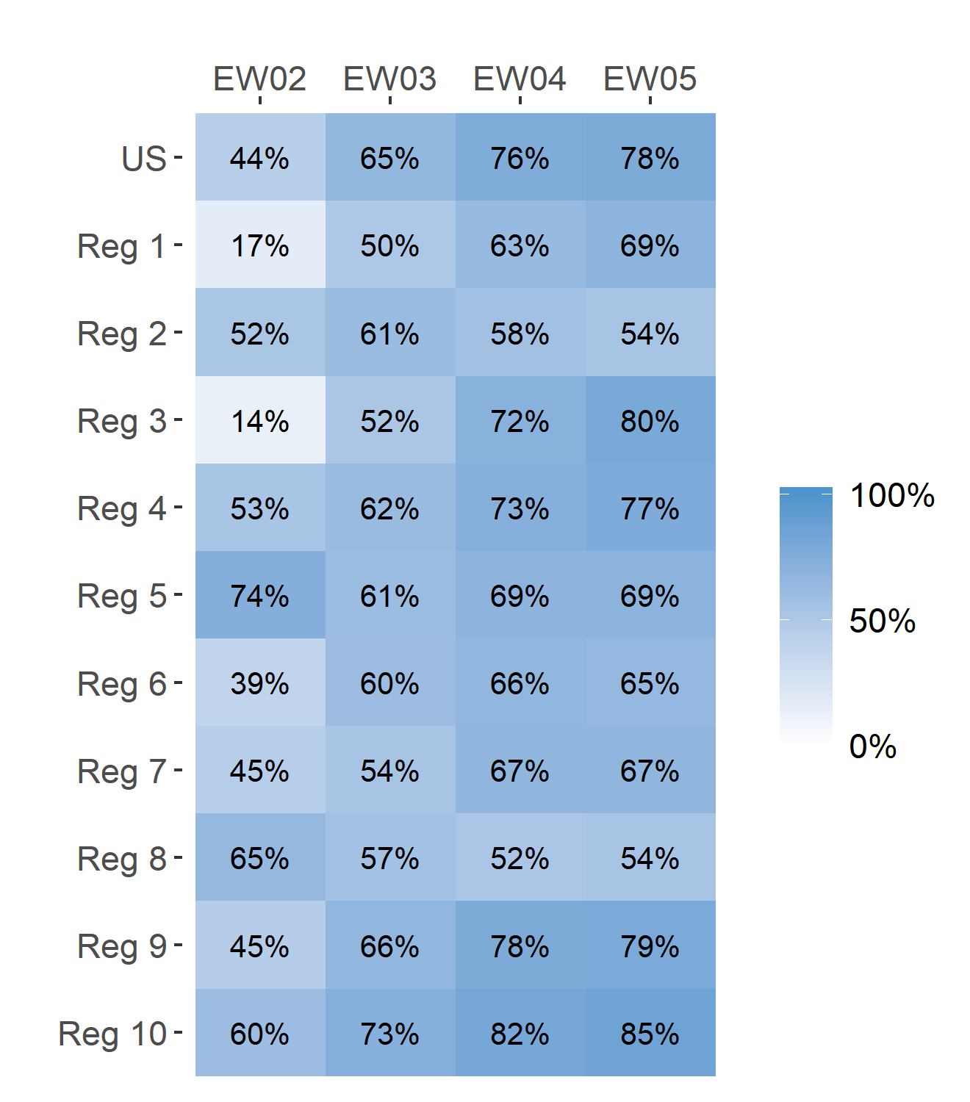
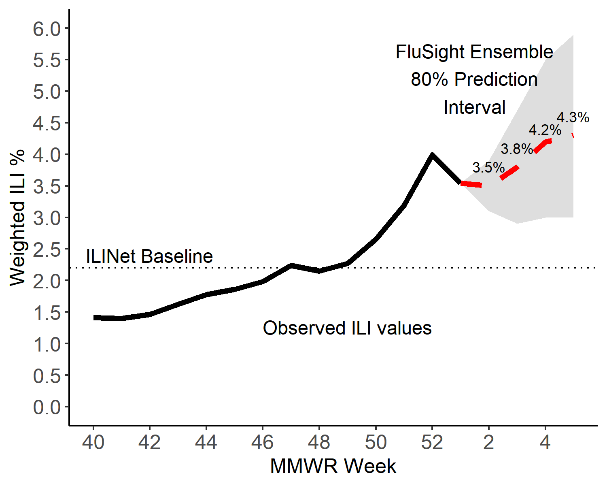
Short-Term ILI Predictions
Prob. ILI will be above last published value
US Short-Term Predictions

Slide 6
Extra Slides

Slide 7
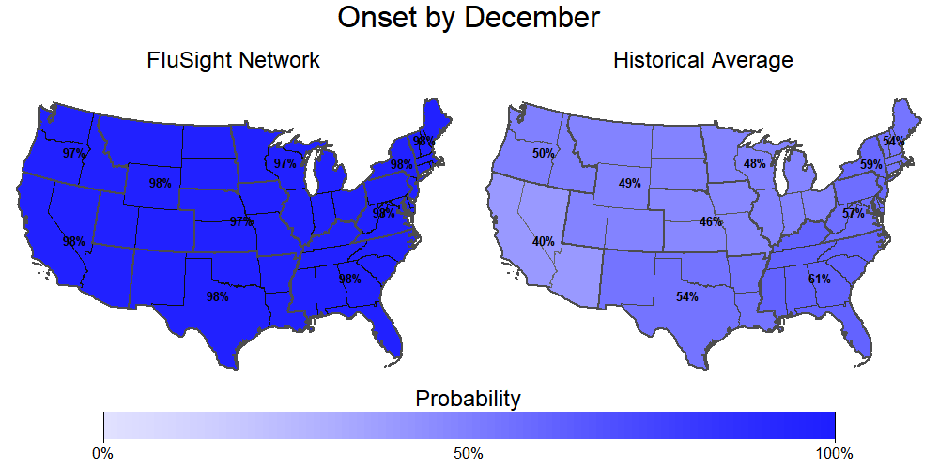
Season onset
99% chance of U.S. onset by December (historically is 66%).

Slide 8
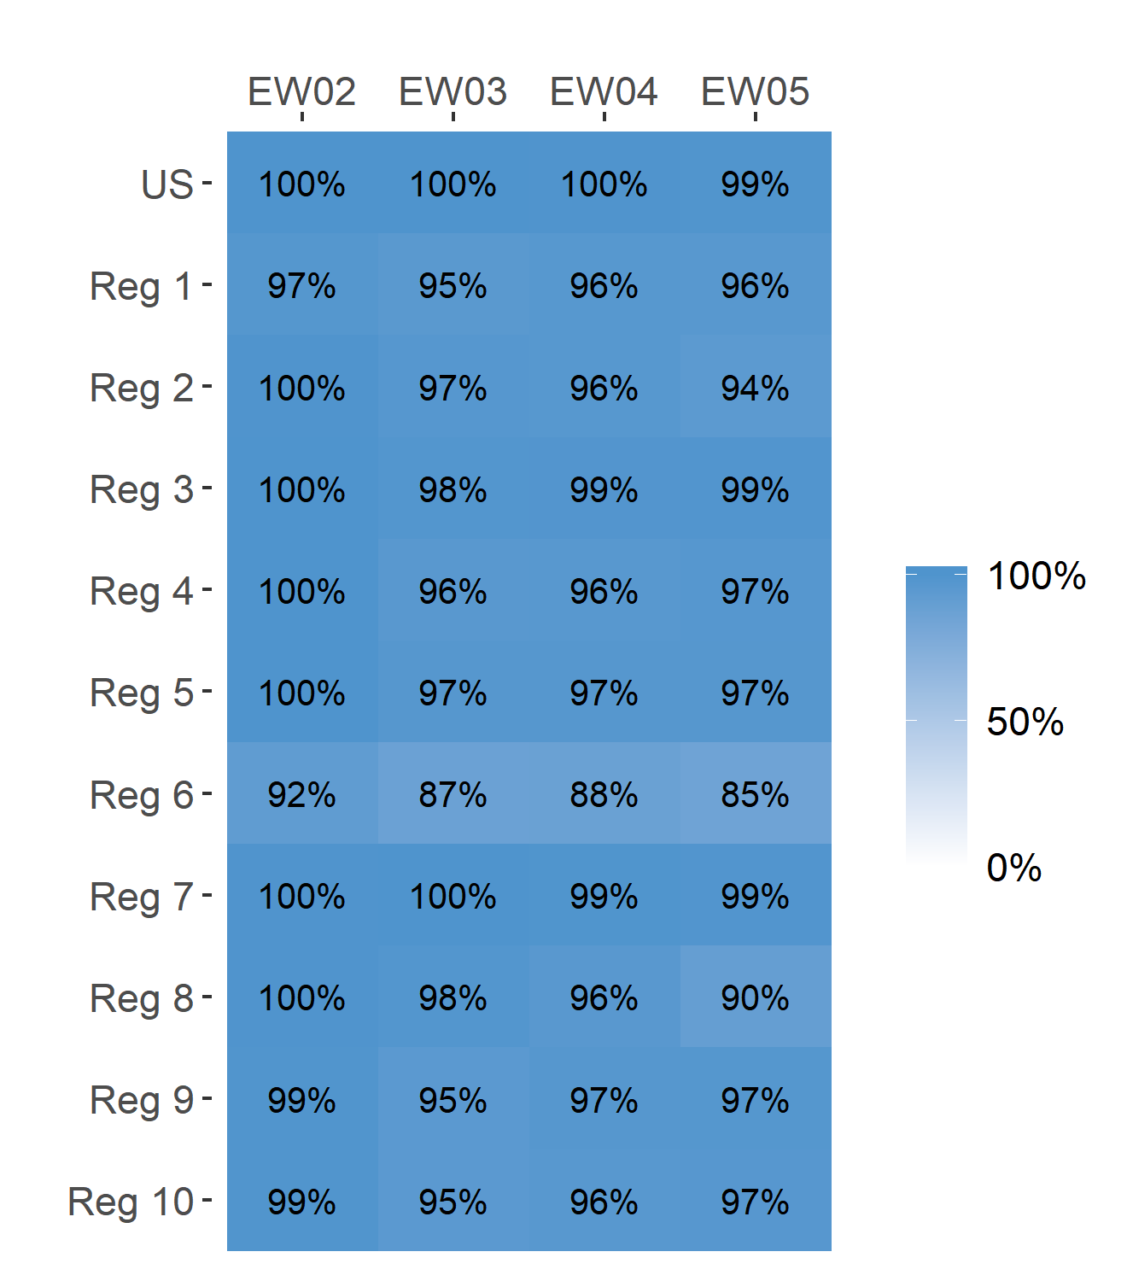
Short-Term ILI Predictions
Prob. ILI will be at or above baseline
US Short-Term Predictions

