Slide 1
Influenza Forecasting Update – week 4
Full forecasts, including individual states, at https://predict.cdc.gov

Slide 2
U.S. Forecasting Summary
Forecasts predict increasing ILI activity over the next 2 weeks
There is about a 60% chance that the peak week will occur in February
Forecasts give a lower chance for a high severity season than the historical average (1% from forecasts vs. 8% historically)

Slide 3
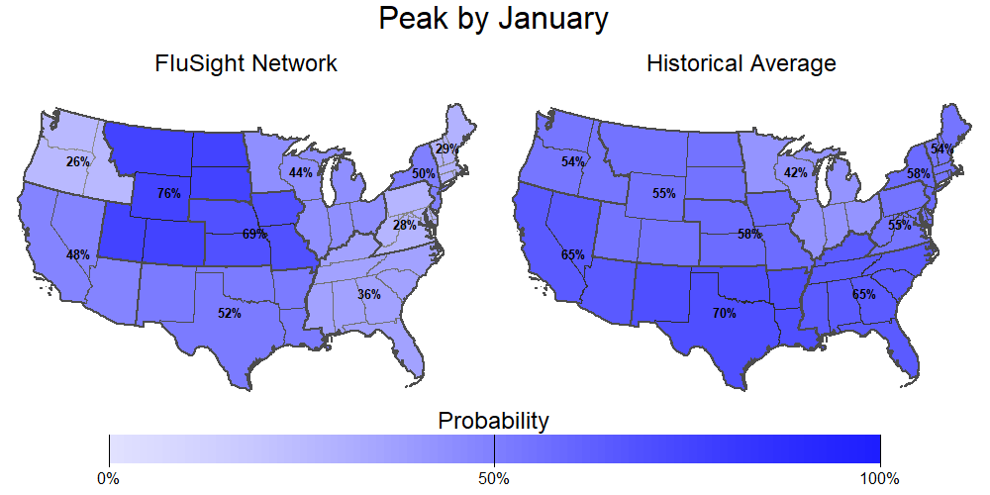
Season peak
41% chance of U.S. peak by January (historically is 57%).

Slide 4
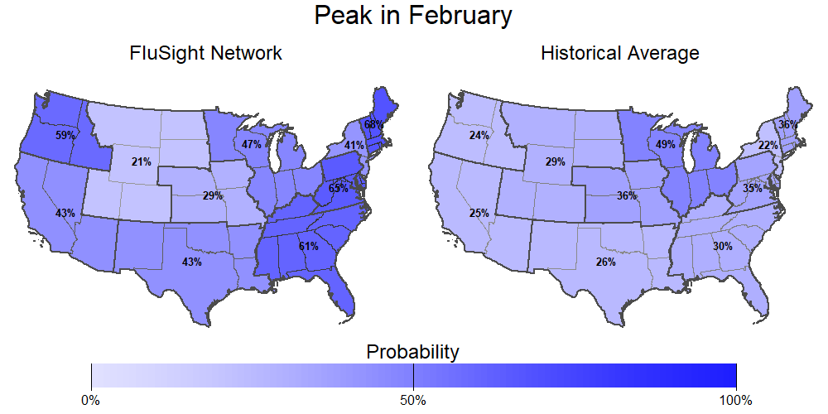
Season peak
57% chance of U.S. peak in February (historically is 37%).

Slide 5
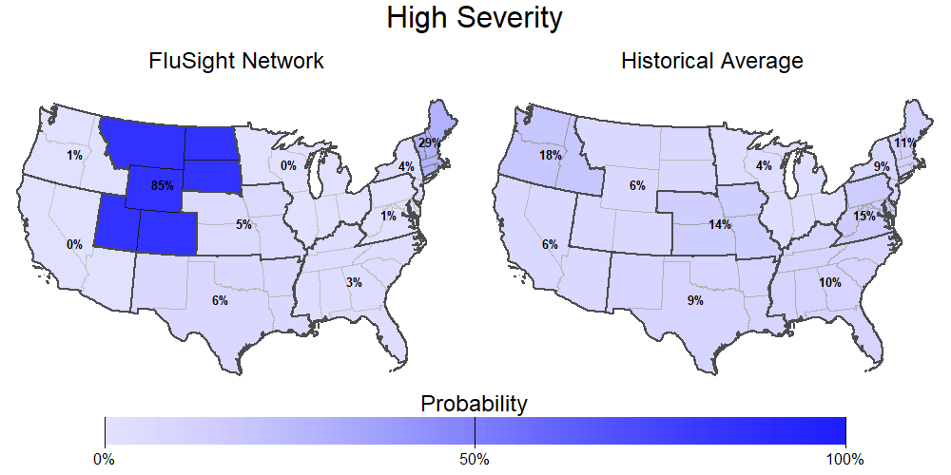
Season intensity
1% chance U.S. has a high severity season (historically is 8%).

Slide 6
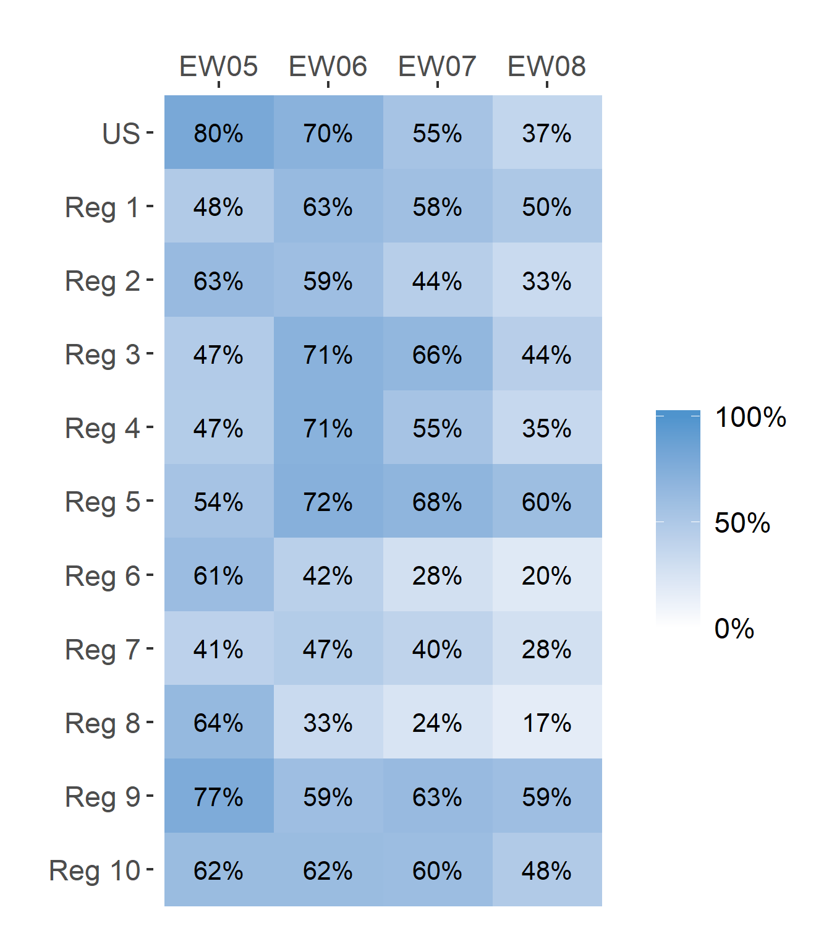
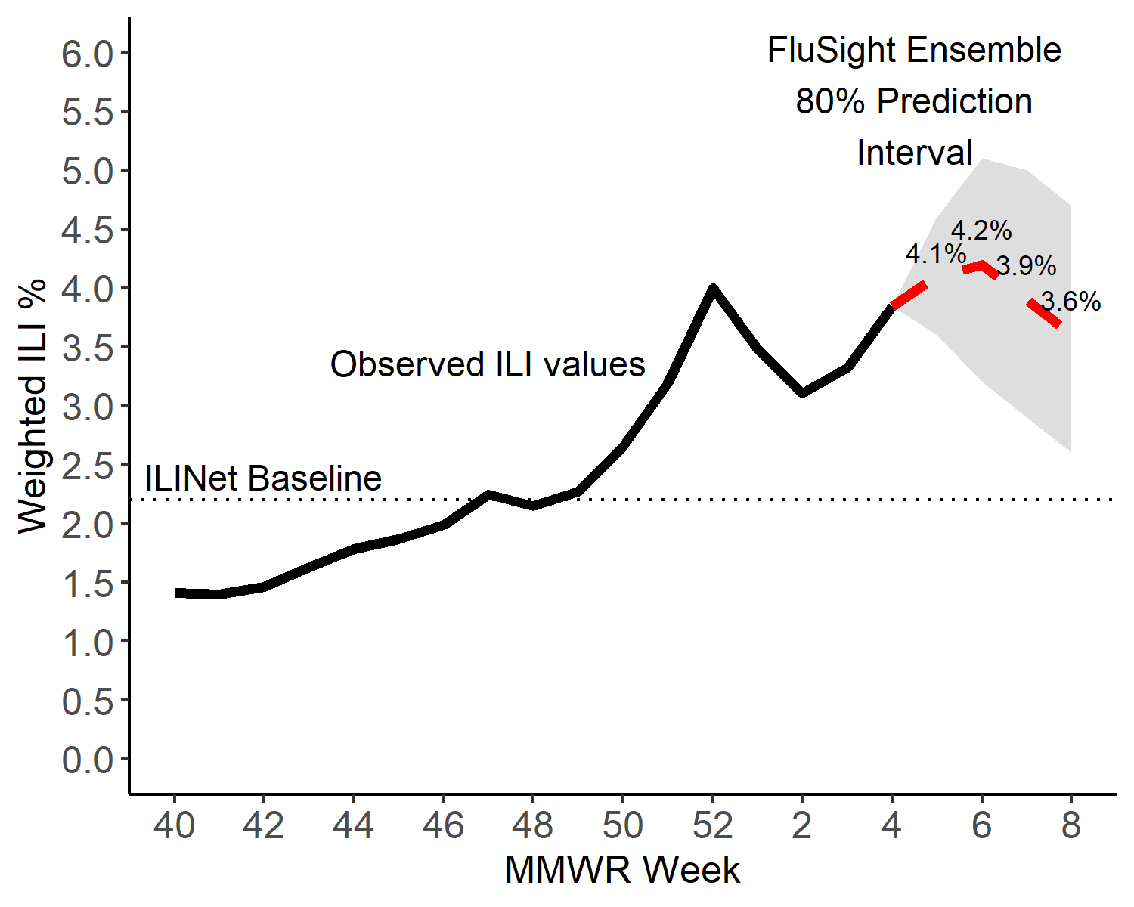
Short-Term ILI Predictions
Prob. ILI will be above last published value
US Short-Term Predictions

Slide 7
Extra Slides

Slide 8
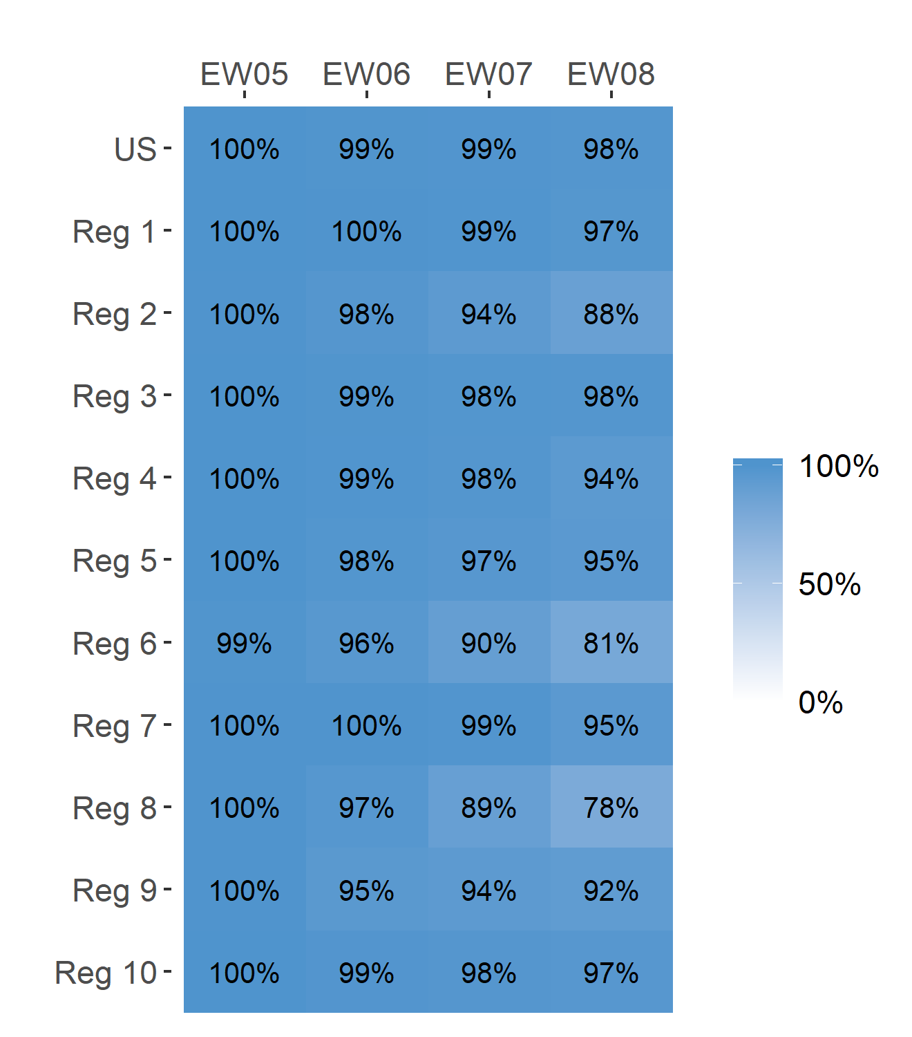
Short-Term ILI Predictions
Prob. ILI will be at or above baseline
US Short-Term Predictions

