Slide 1
Influenza Forecasting Update – week 6
Full forecasts, including individual states, at https://predict.cdc.gov

Slide 2
U.S. Forecasting Summary
Forecasts predict steady ILI activity for week 6 but for ILI to start decreasing weeks 7–9
ILI activity is likely to remain above baseline for the next 4 weeks
There is about a 40% chance that the flu season peaked last week (week 6), a 40% chance that the peak will be week 7, and a 10% chance that the peak will be week 8
Forecasts give a lower chance for a high severity season than the historical average (<1% from forecasts vs. 8% historically)

Slide 3
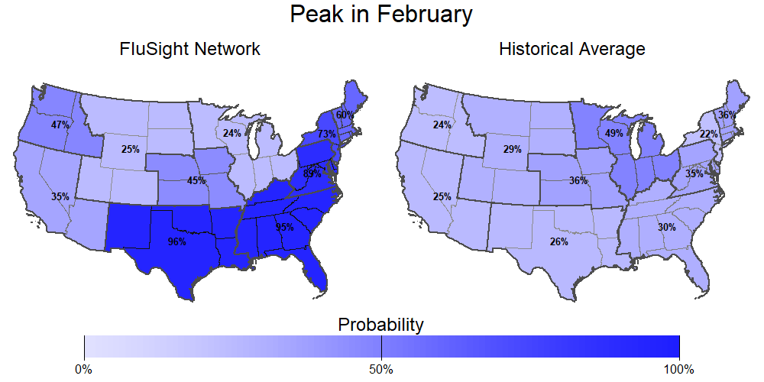
Season peak
95% chance of U.S. peak in February (historically is 37%).

Slide 4
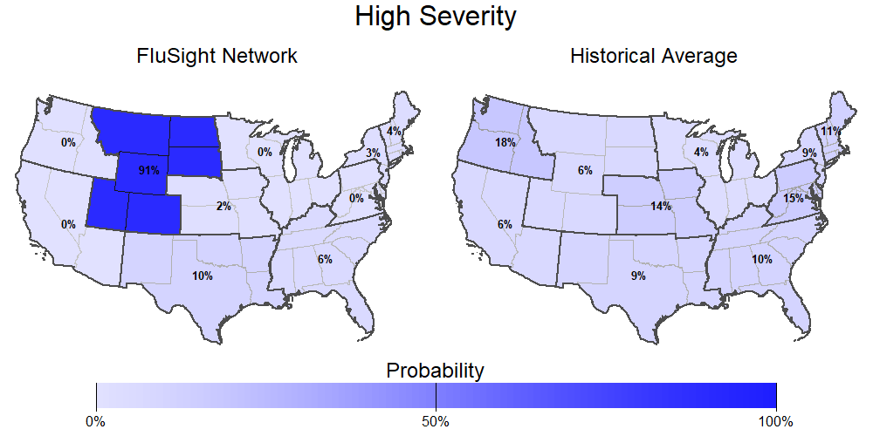
Season intensity
<1% chance U.S. has a high severity season (historically is 8%).

Slide 5
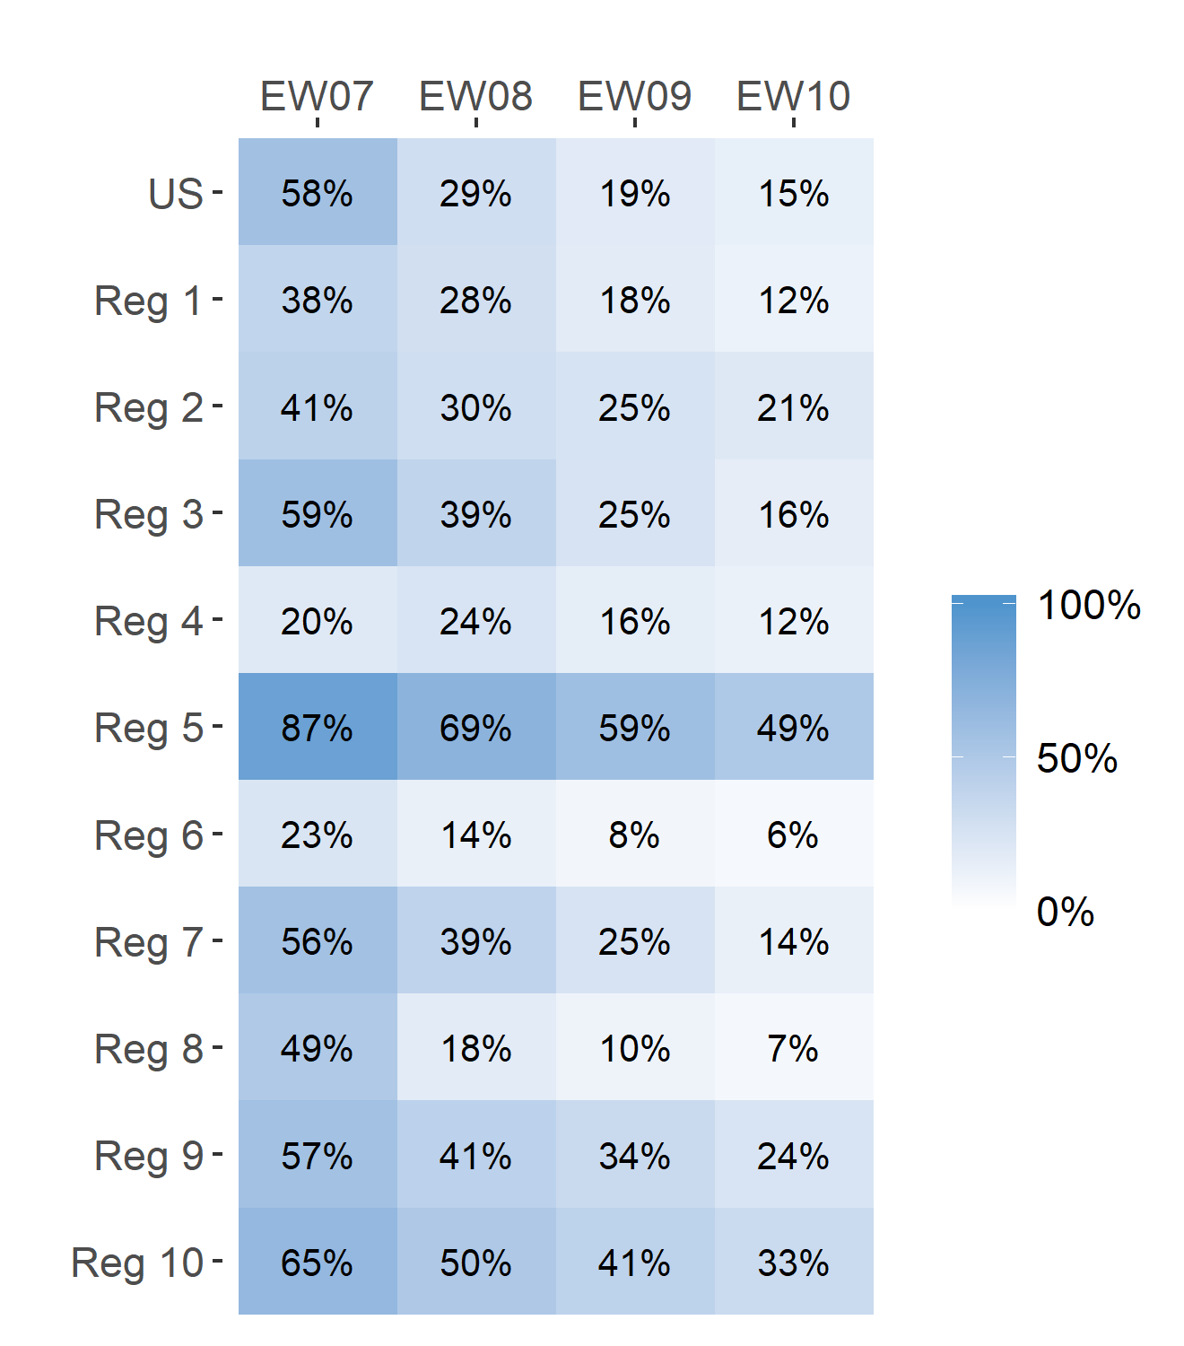
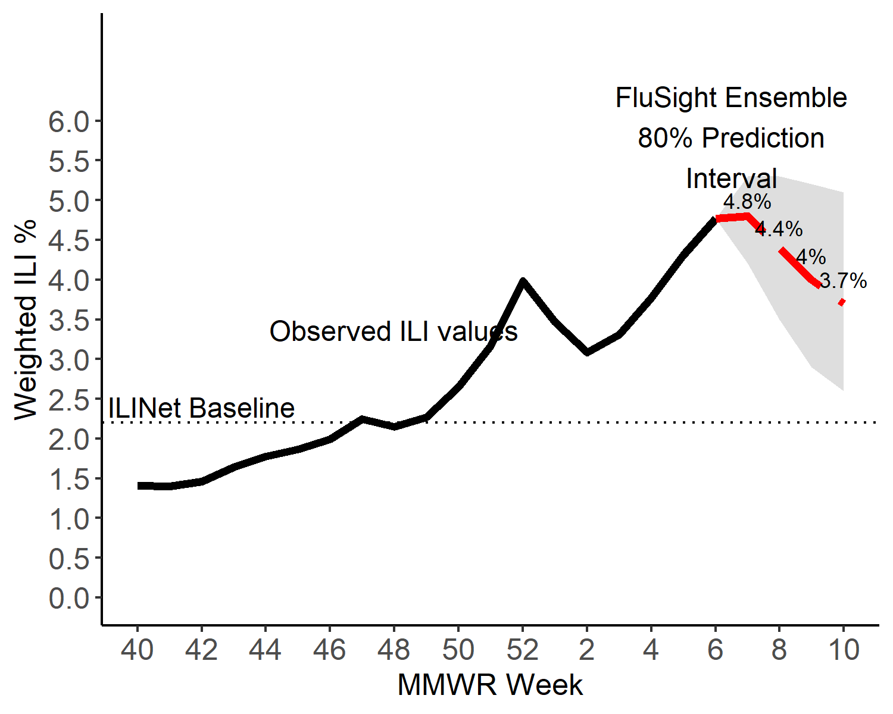
Short-Term ILI Predictions
Prob. ILI will be above last published value
US Short-Term Predictions

Slide 6
Extra Slides

Slide 7
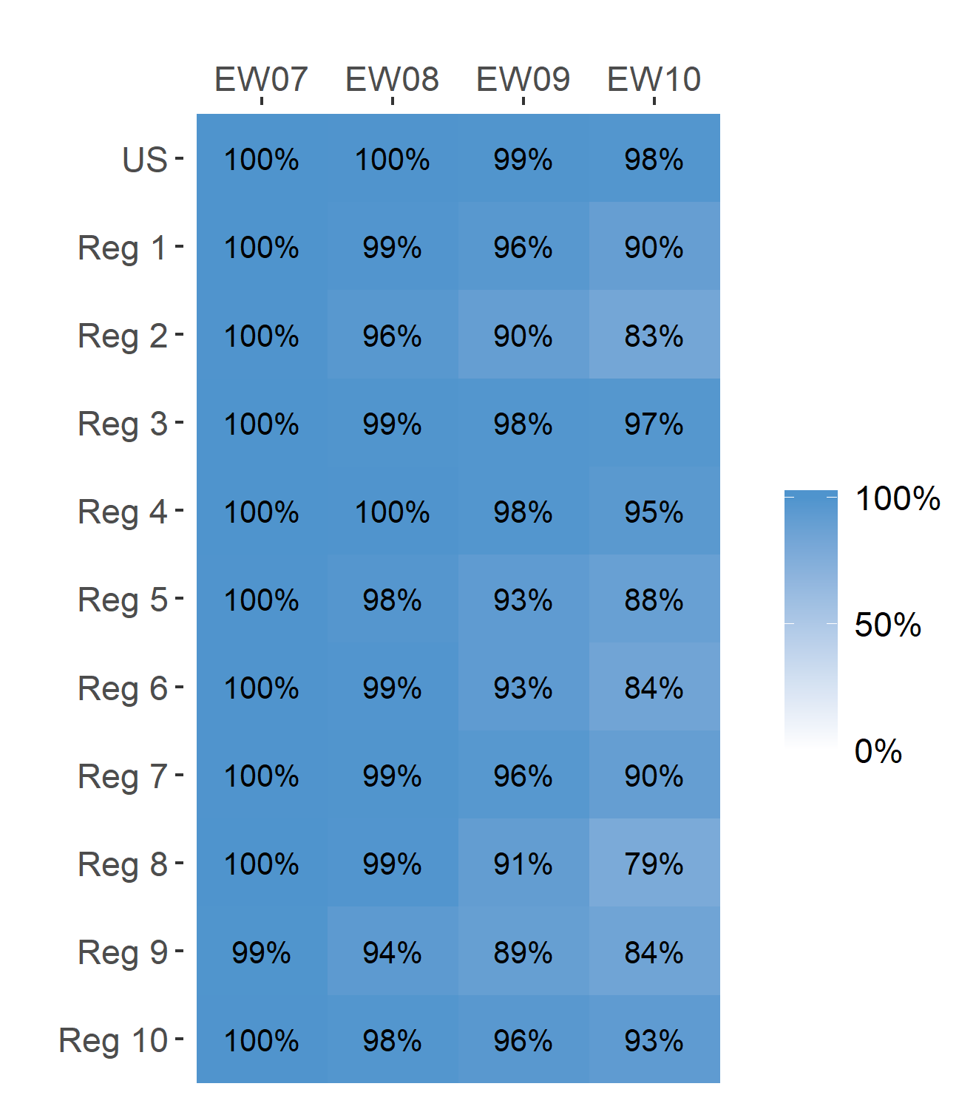
Short-Term ILI Predictions
Prob. ILI will be at or above baseline
US Short-Term Predictions

