Slide 1
Influenza Forecasting Update – week 42
Full forecasts, including individual states, at https://predict.cdc.gov

Slide 2
U.S. Forecasting Summary
Forecasts generally agree with historical average.
A 10% chance onset before December begins, compared to a 4% historically.
Short term forecasts predict slow increase towards baseline over the next 4 weeks.

Slide 3
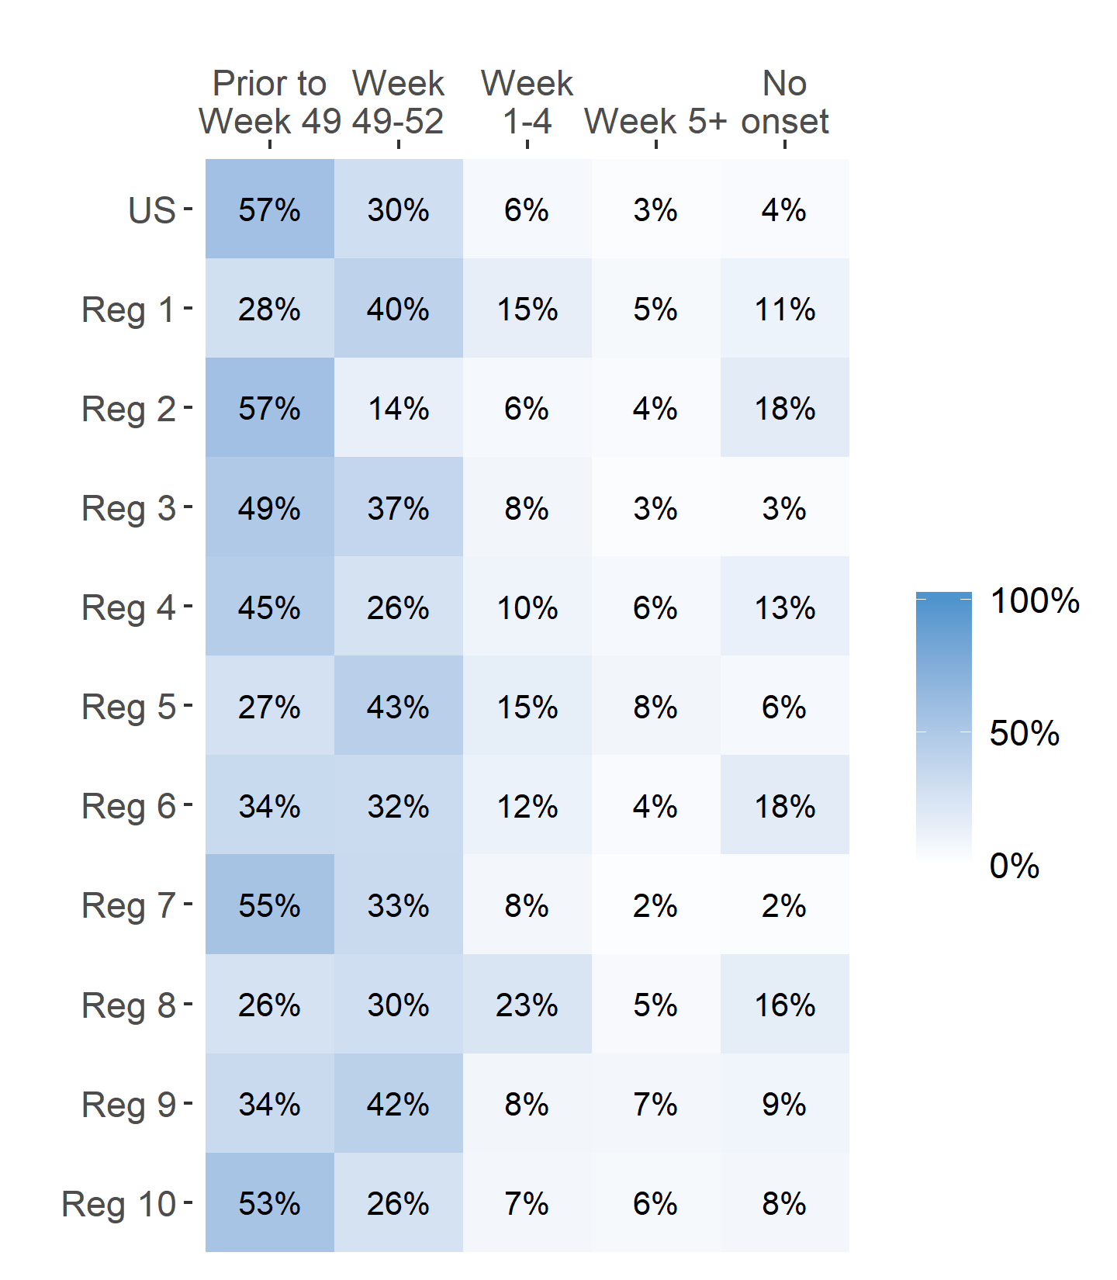
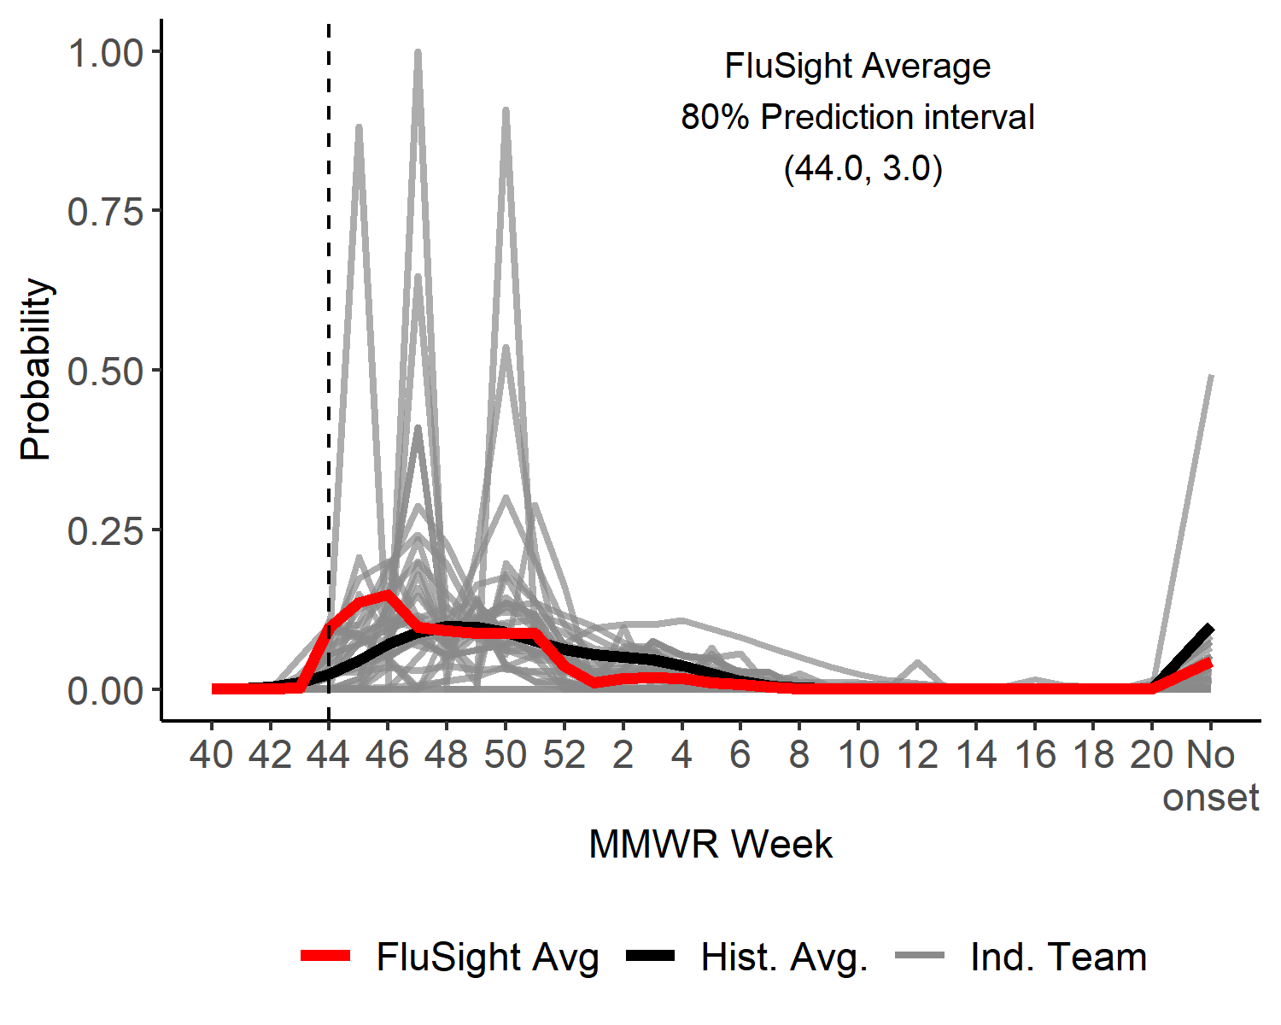
Season onset
US Onset Predicted Probability

Slide 4
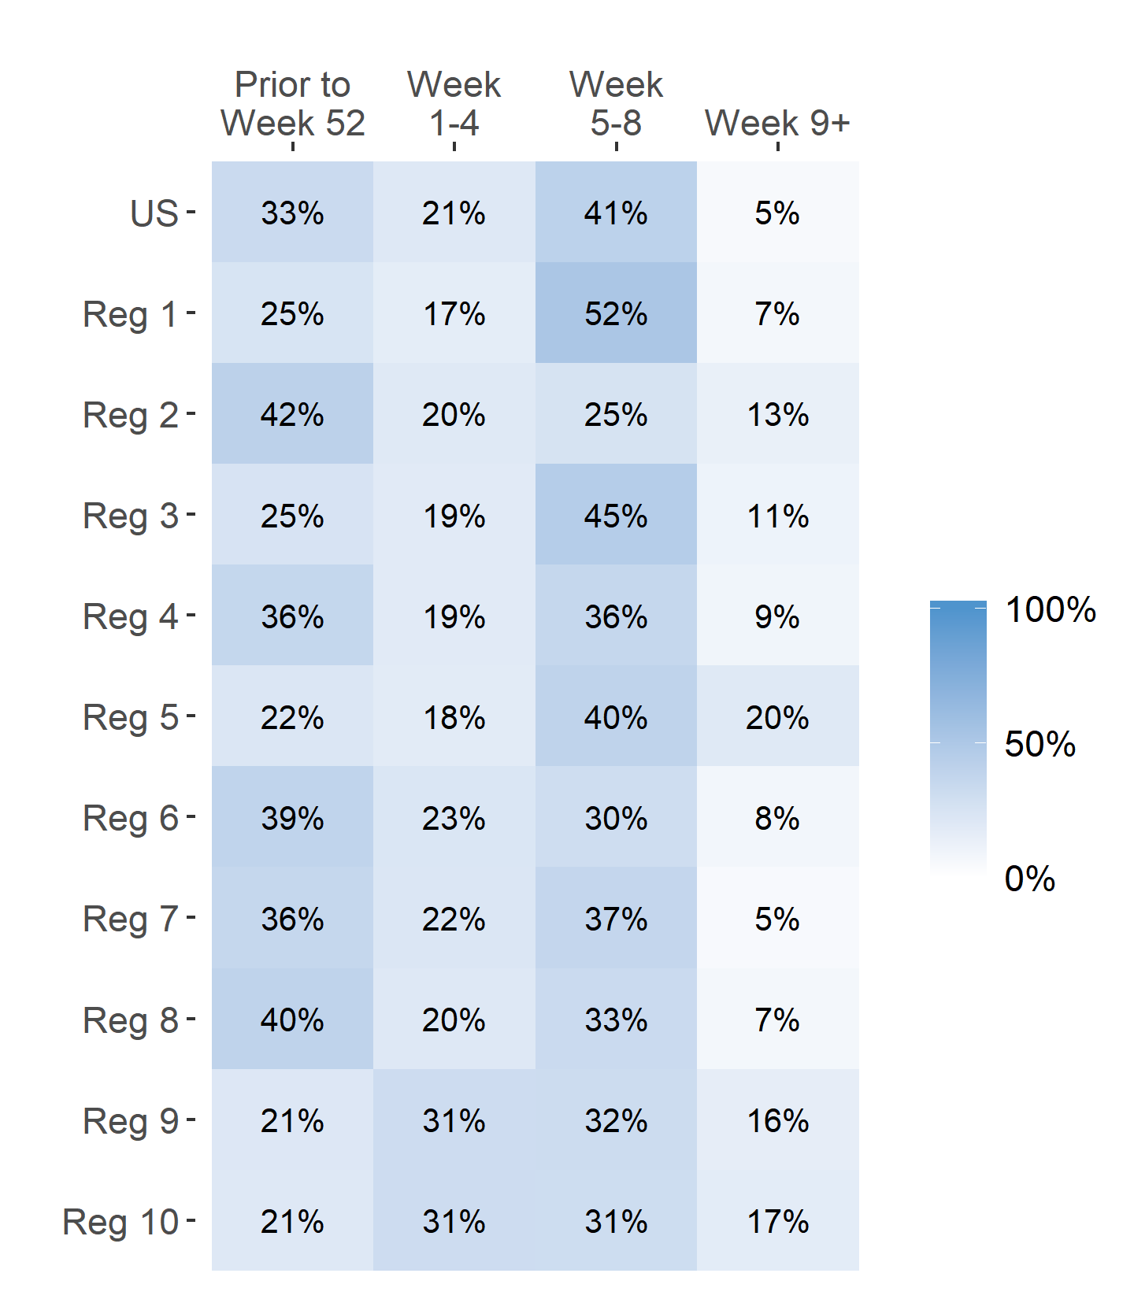
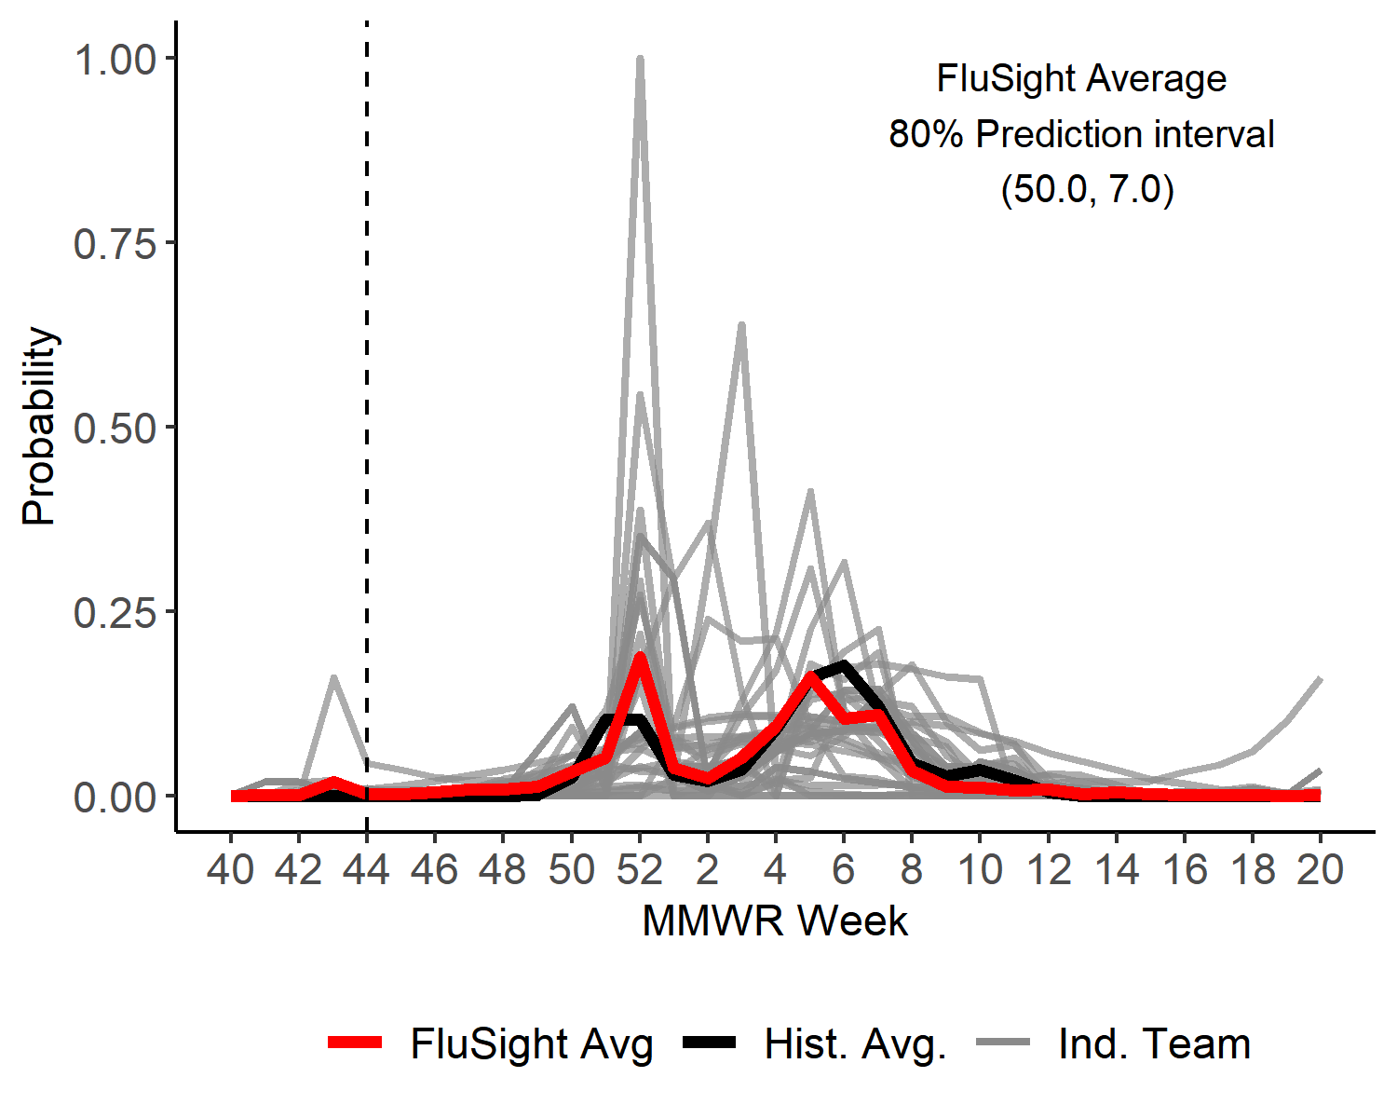
Season peak week
US Peak Week Predicted Probability

Slide 5
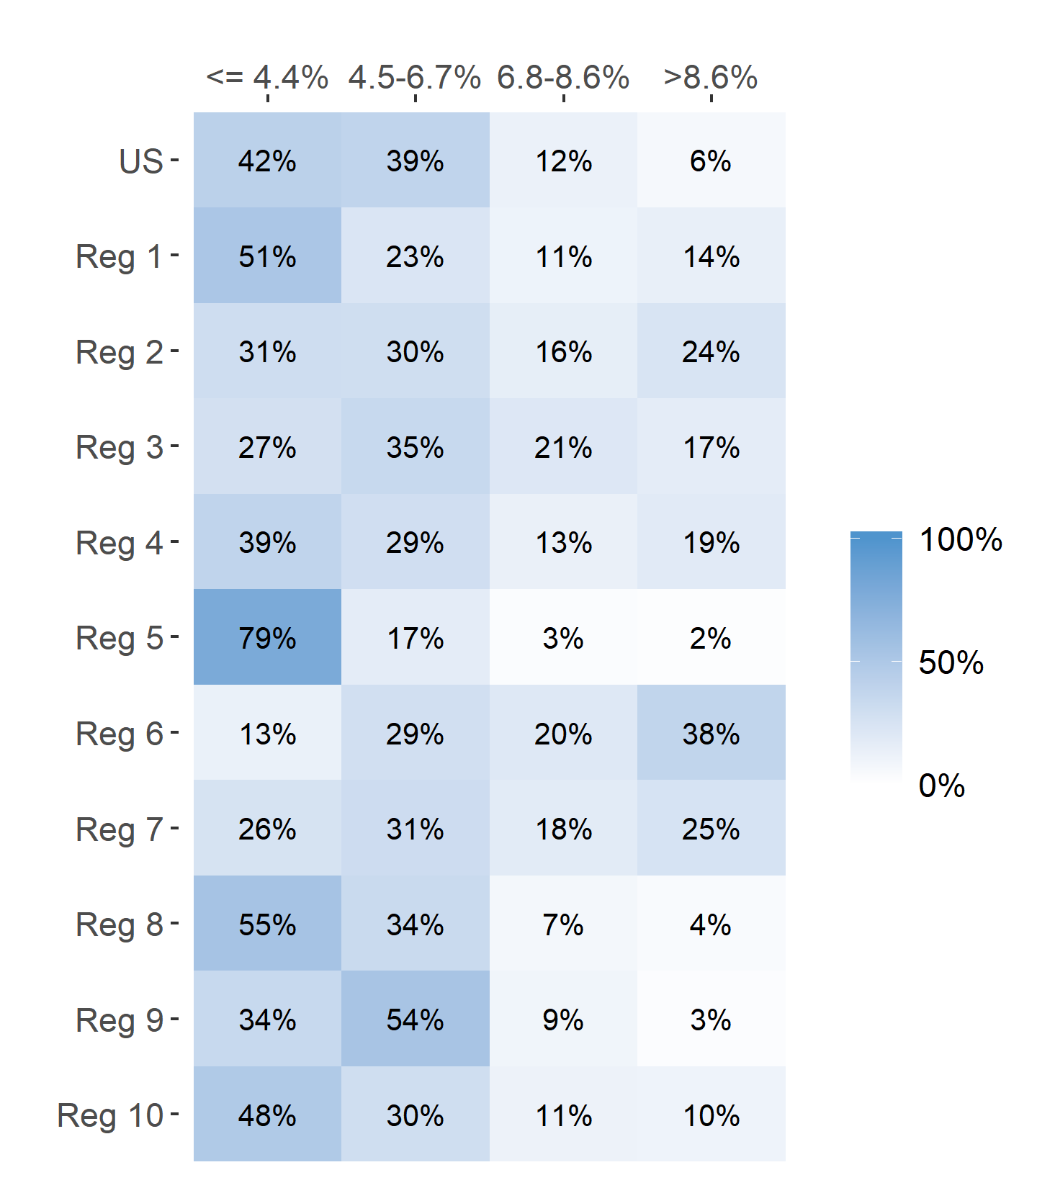
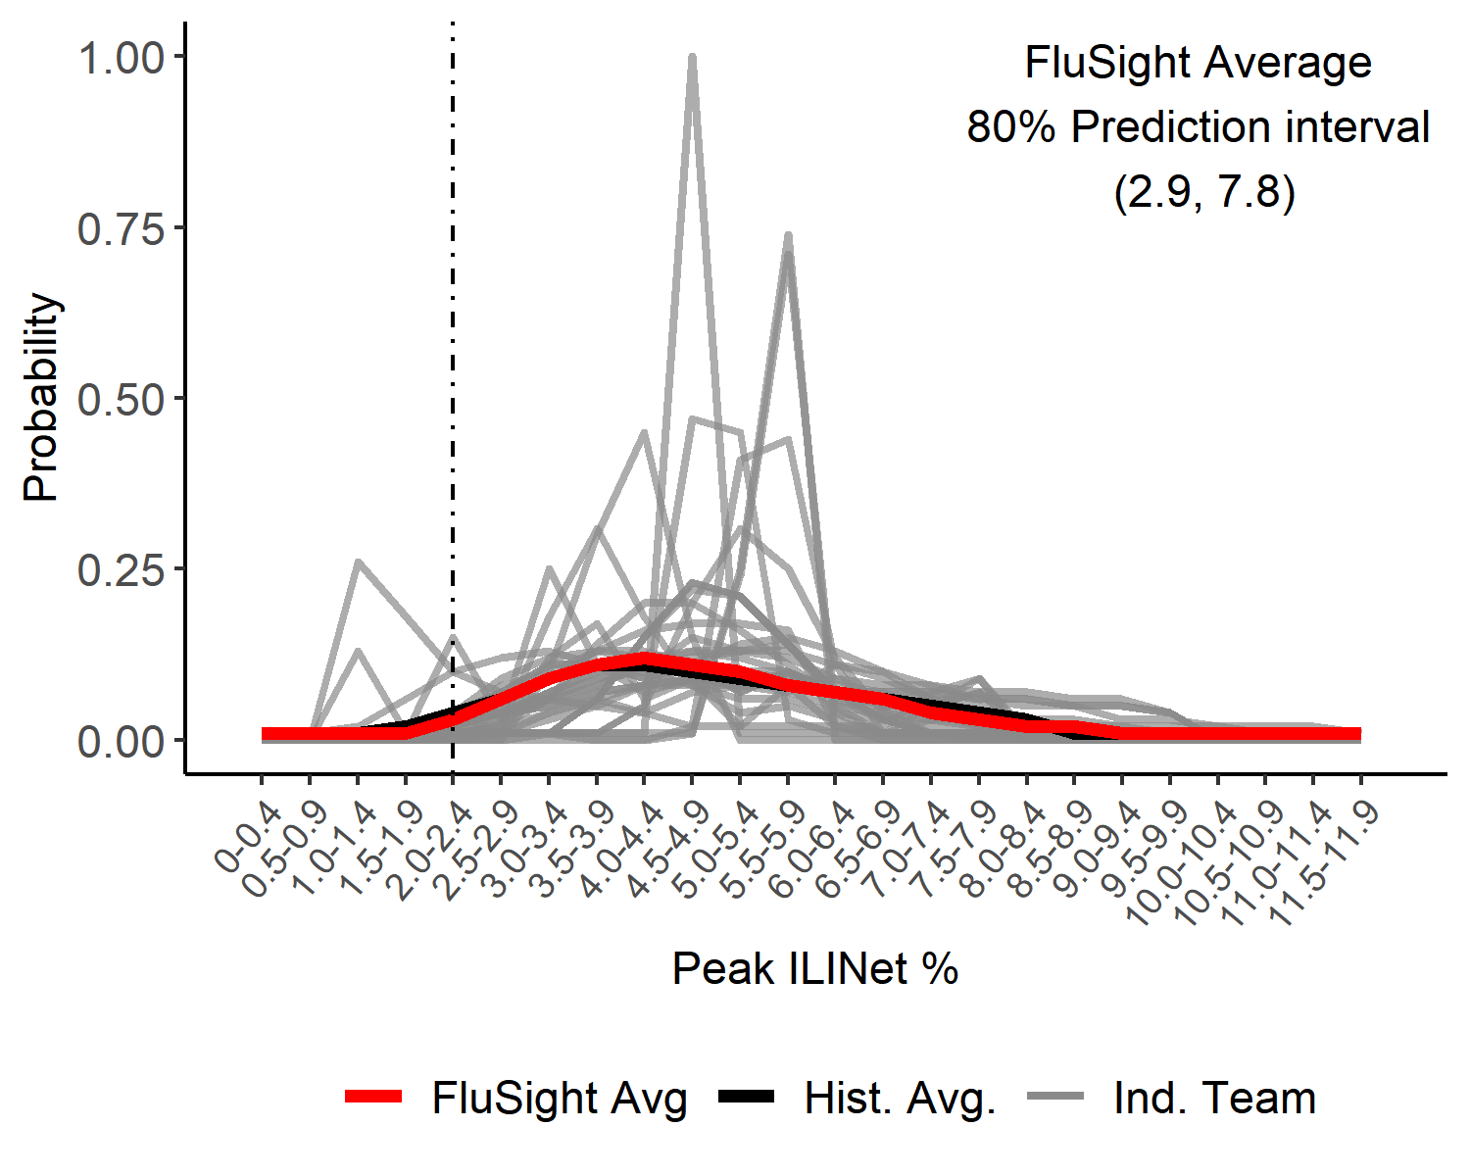
Season Peak ILI %
US Peak ILI % Predicted Probability

Slide 6
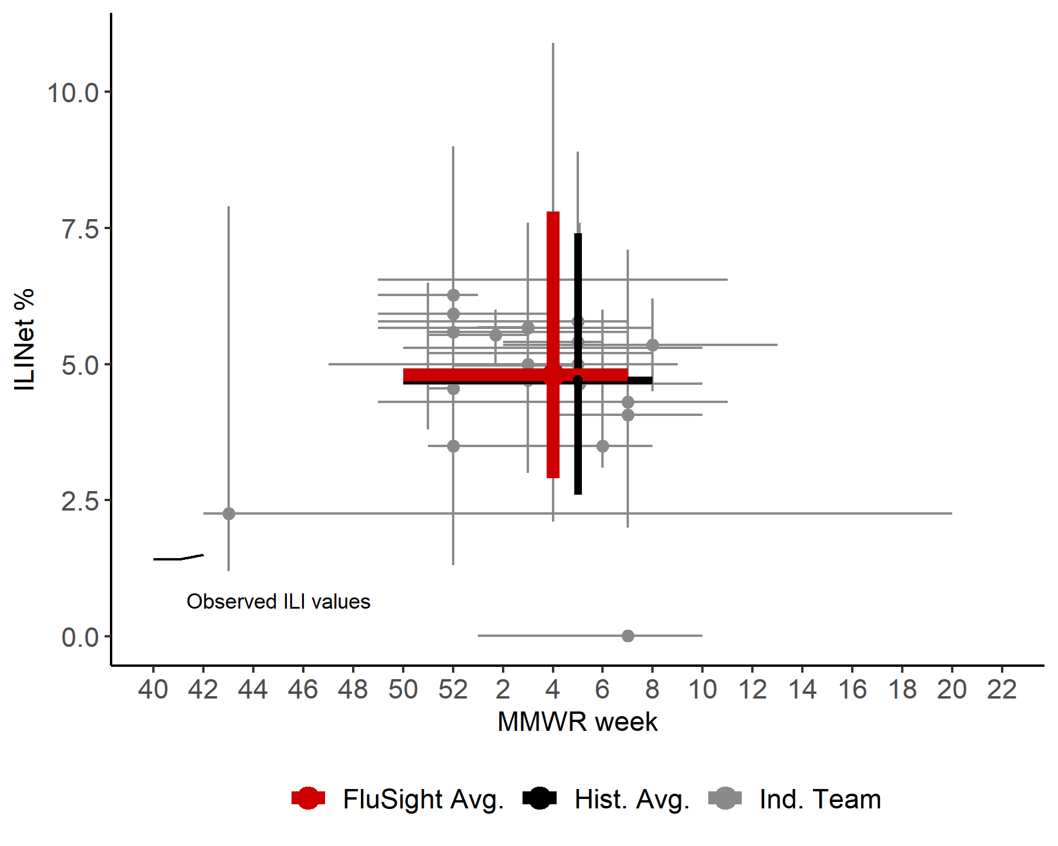
US Season Peak Week and Peak ILI %
Point forecasts with 80% prediction intervals

Slide 7
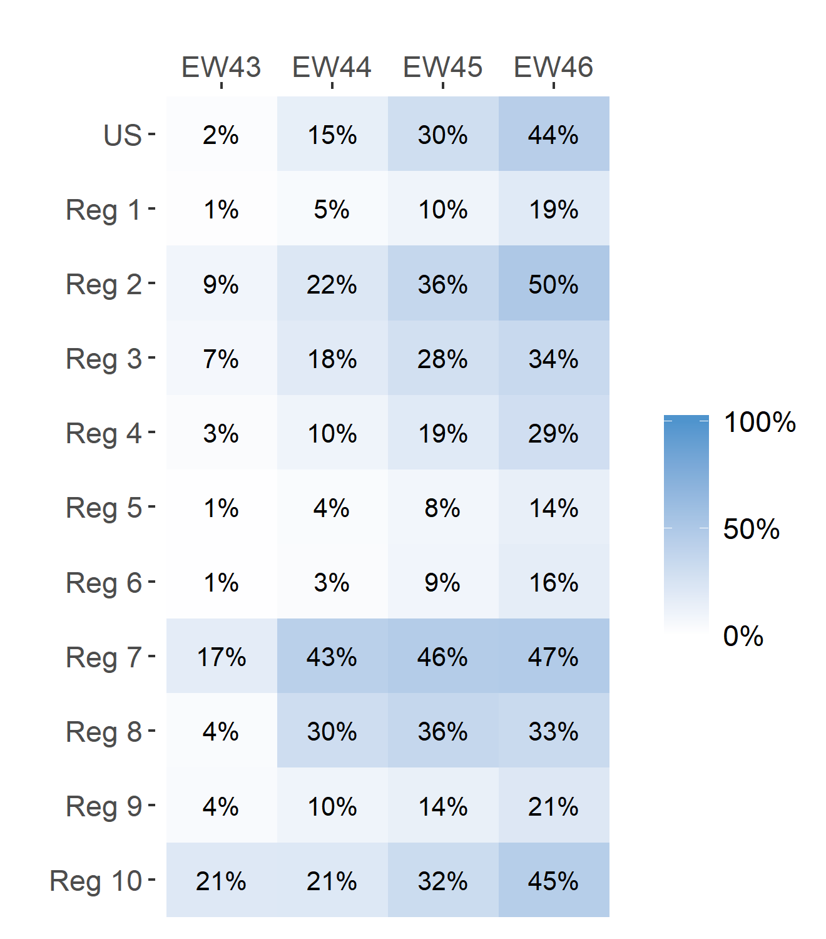
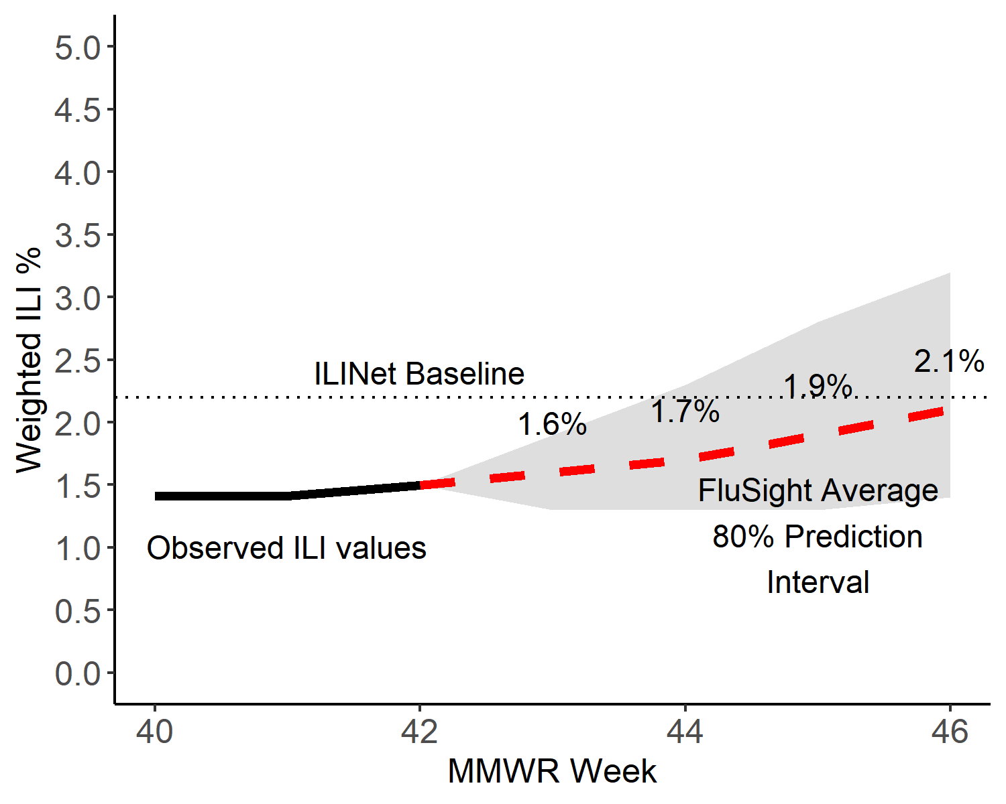
Short-Term ILI Predictions
Prob. ILI will be at or above baseline
US Short-Term Predictions

