Slide 1
Influenza Forecasting Update – week 46
Full forecasts, including individual states, at https://predict.cdc.gov

Slide 2
U.S. Forecasting Summary
Received 34 forecasts from 19 groups
41% chance of onset during December versus 32% historically
Forecast for peak week and peak percent are similar to historical average
Short-term forecasts show a steady increase in ILI over the next 4 weeks
  50% chance of ILI activity being at or above baseline for week 47

Slide 3
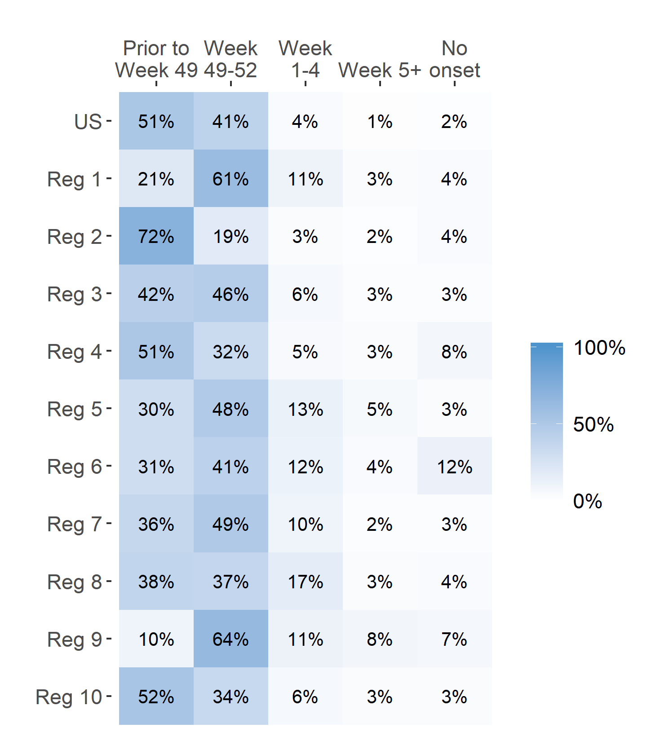
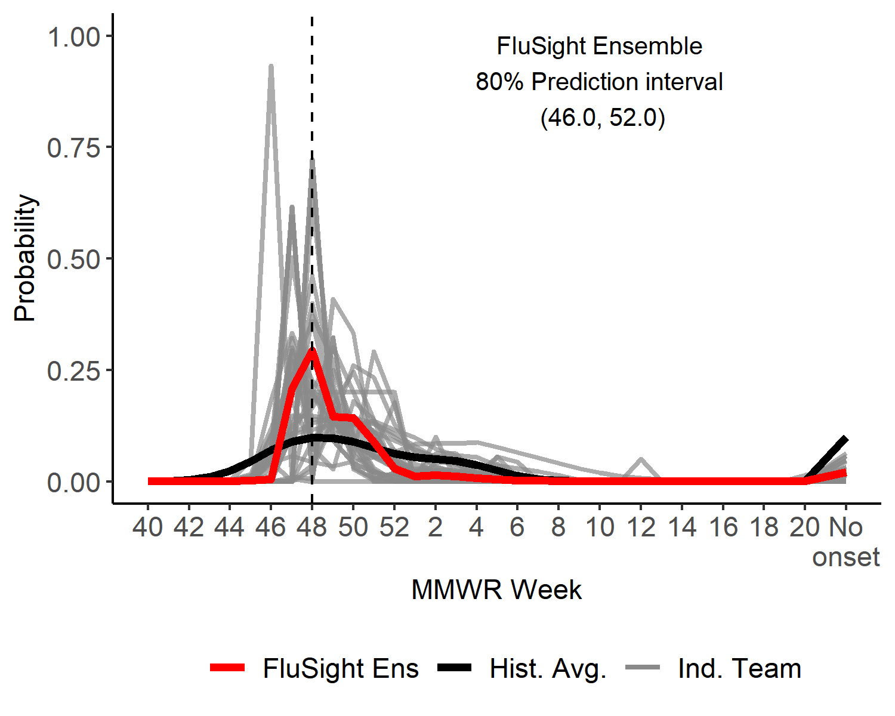
Season onset
US Onset Predicted Probability

Slide 4
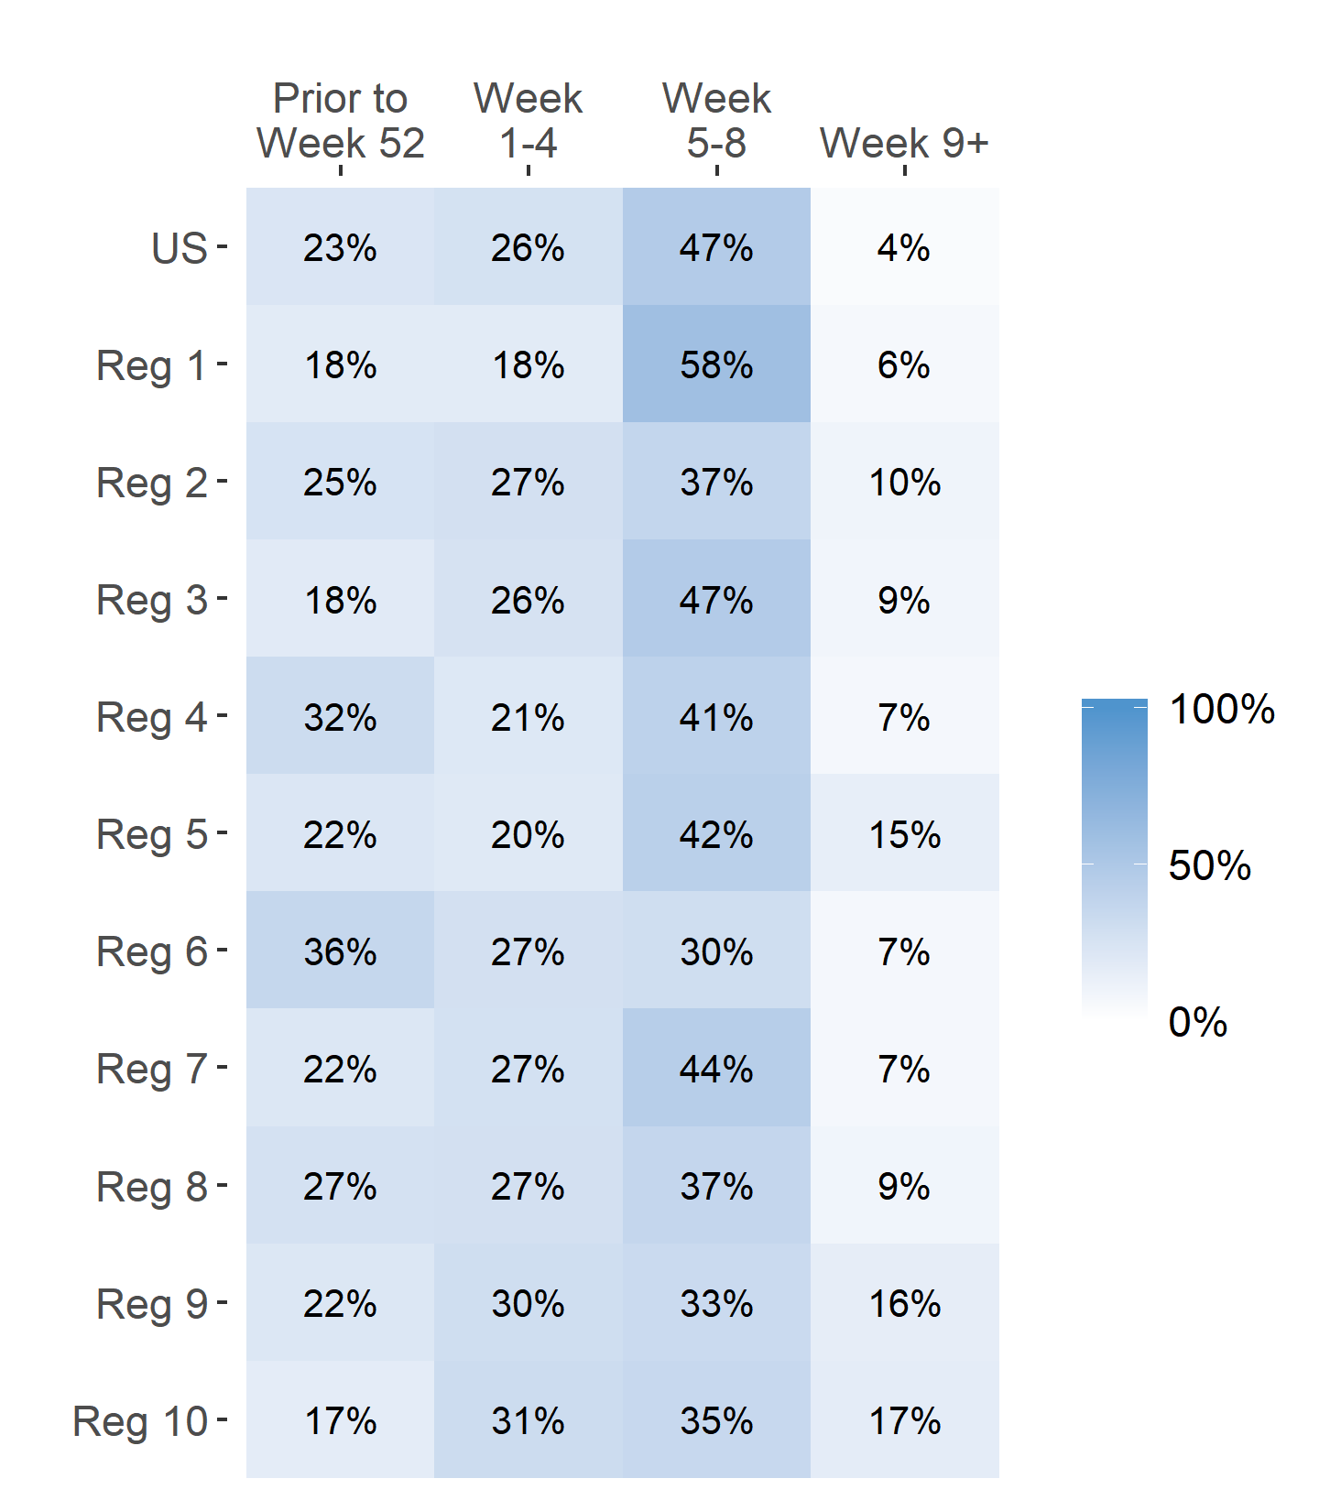
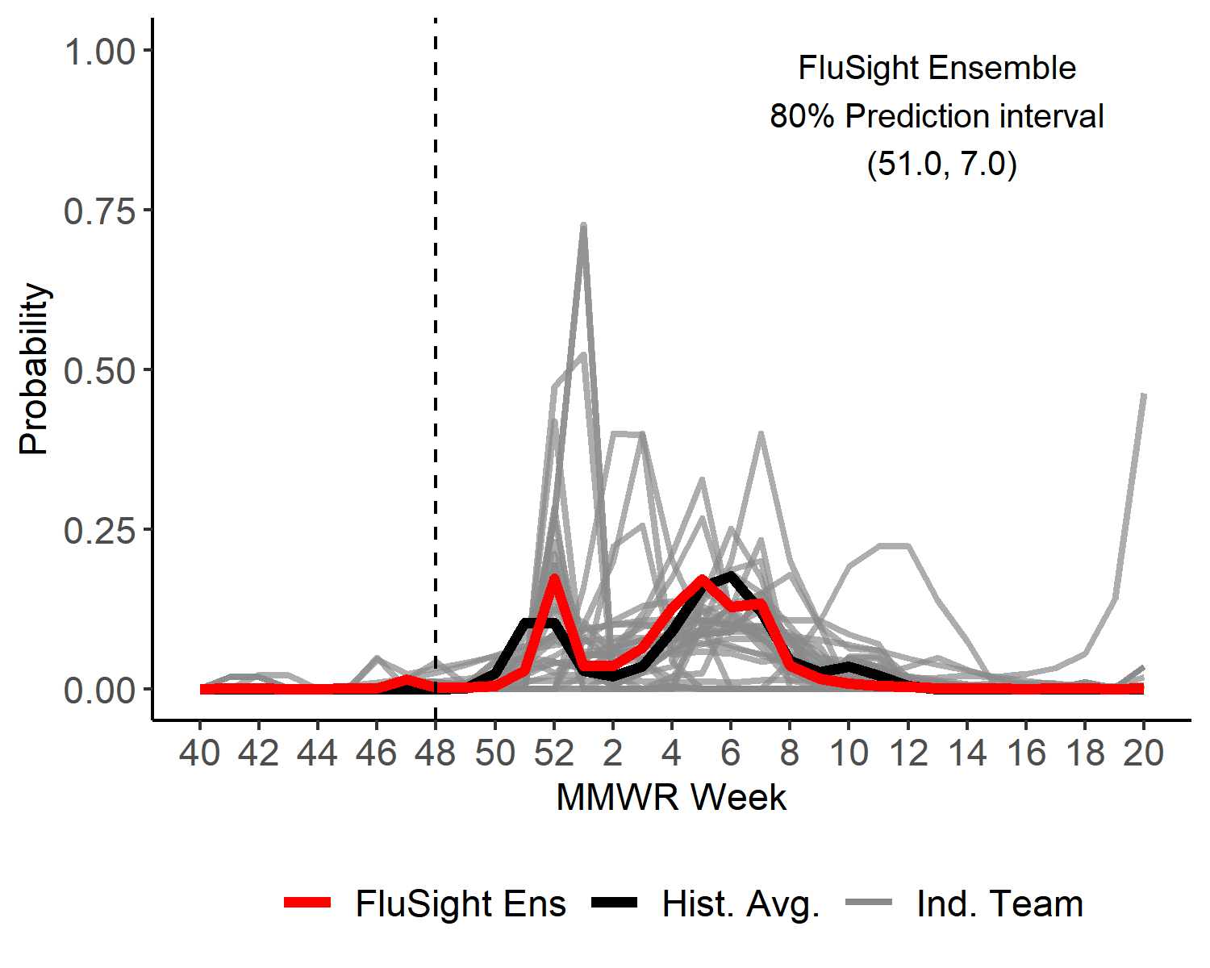
Season peak week
US Peak Week Predicted Probability

Slide 5
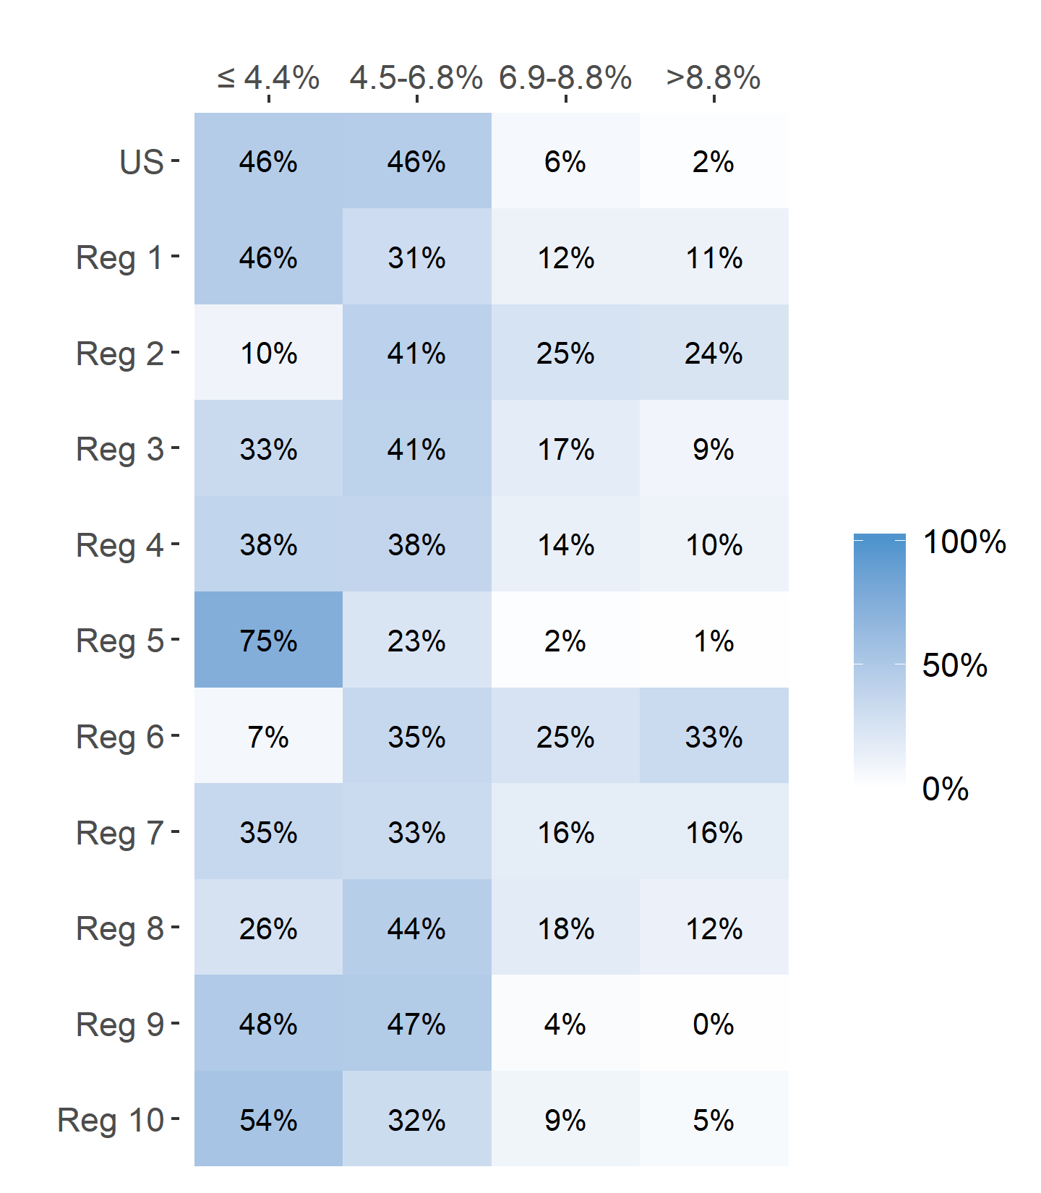
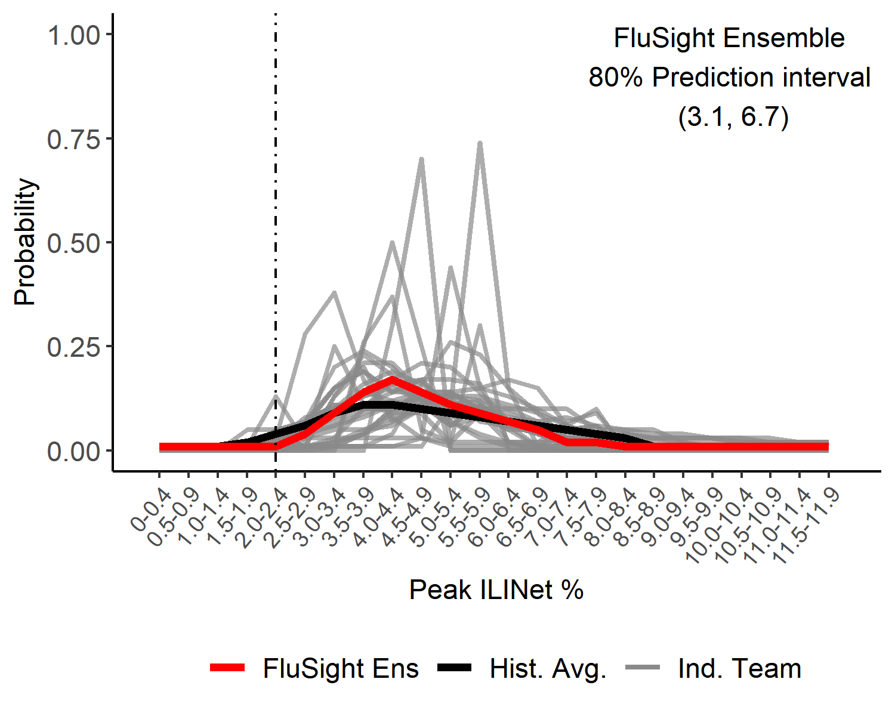
Season Peak ILI %
US Peak ILI % Predicted Probability

Slide 6
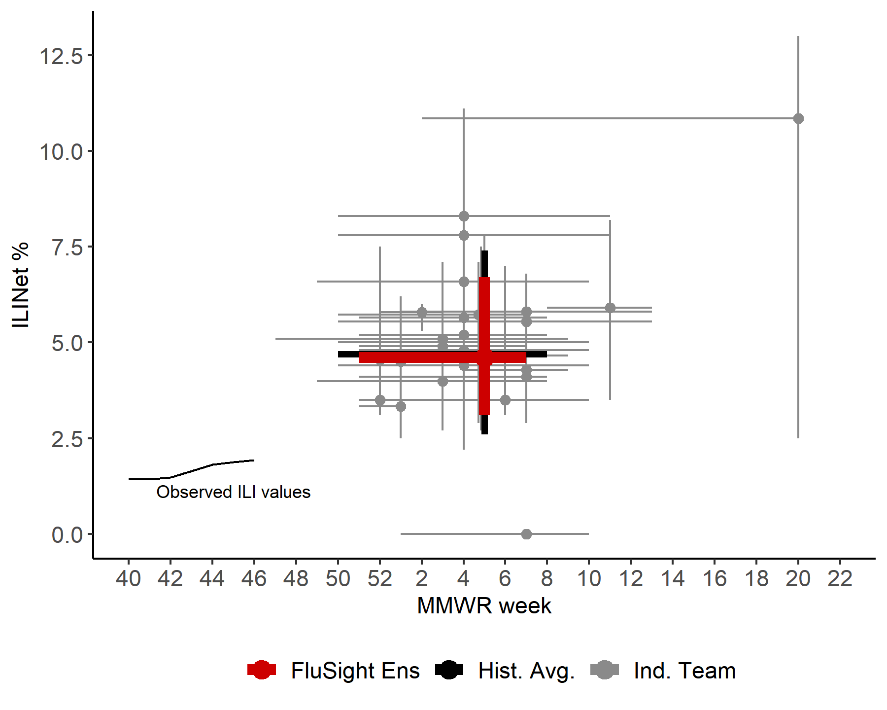
US Season Peak Week and Peak ILI %
Point forecasts with 80% prediction intervals

Slide 7
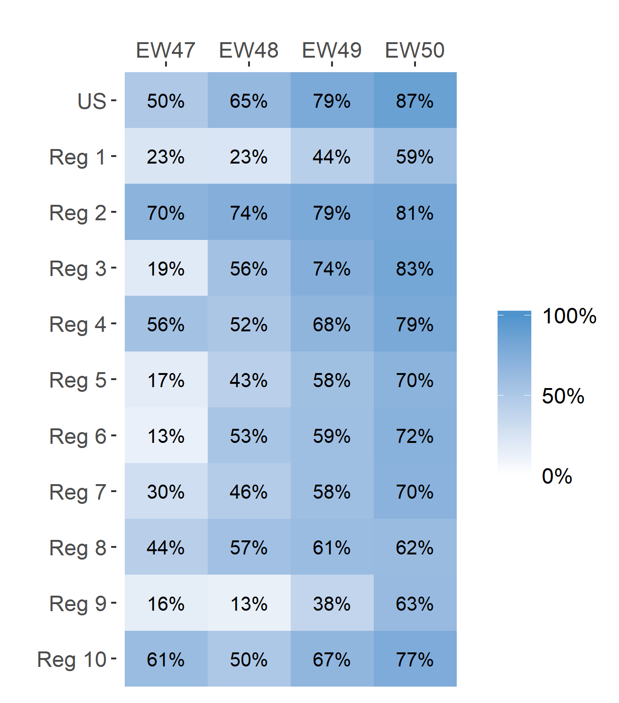
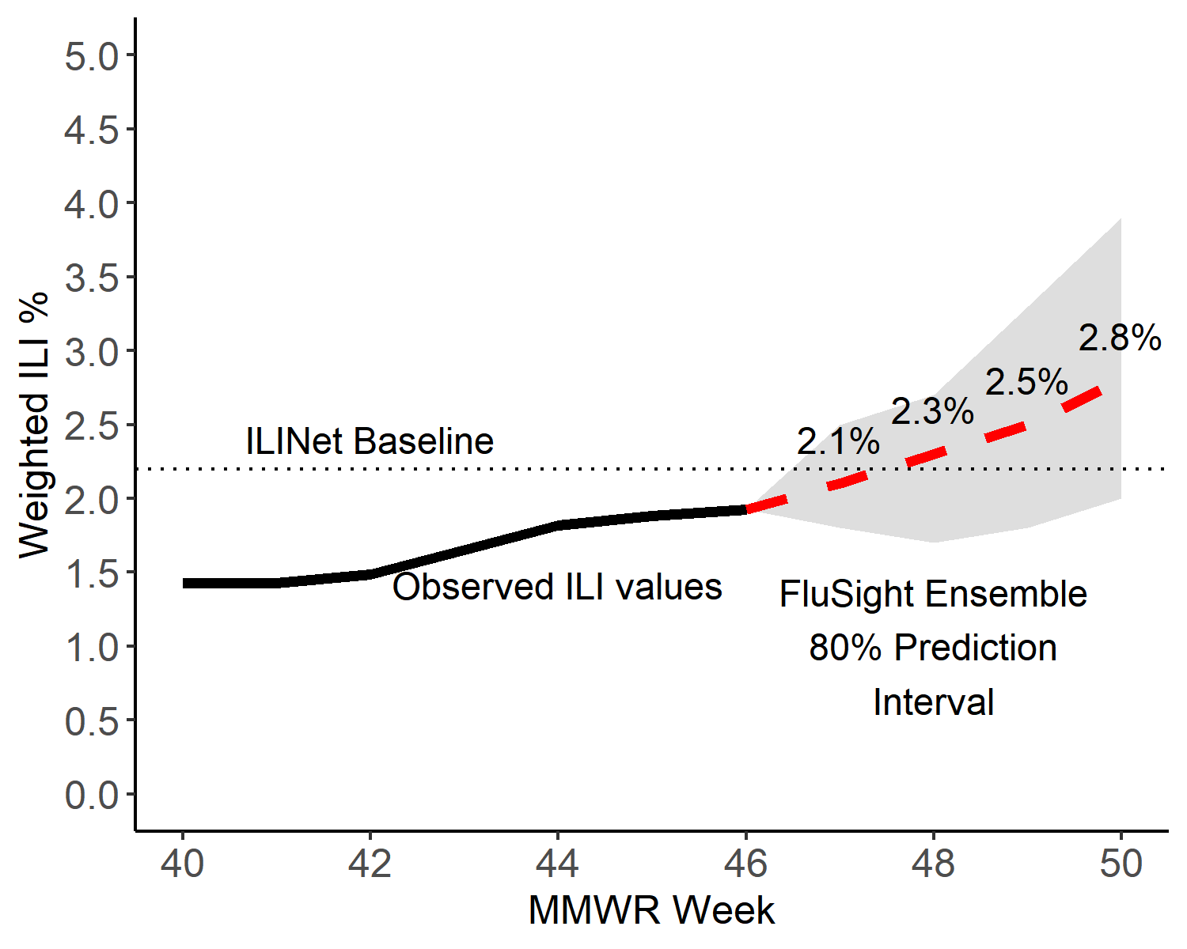
Short-Term ILI Predictions
Prob. ILI will be at or above baseline
US Short-Term Predictions

