Slide 1
Influenza Forecasting Update – week 47
Full forecasts, including individual states, at https://predict.cdc.gov

Slide 2
U.S. Forecasting Summary
Ensemble forecast shows a 74% chance that onset occurred on week 47.
Forecasts for season peak percent ILI and peak week are similar to historical average.
Short-term forecasts show a steady increase in ILI over the next 4 weeks

Slide 3
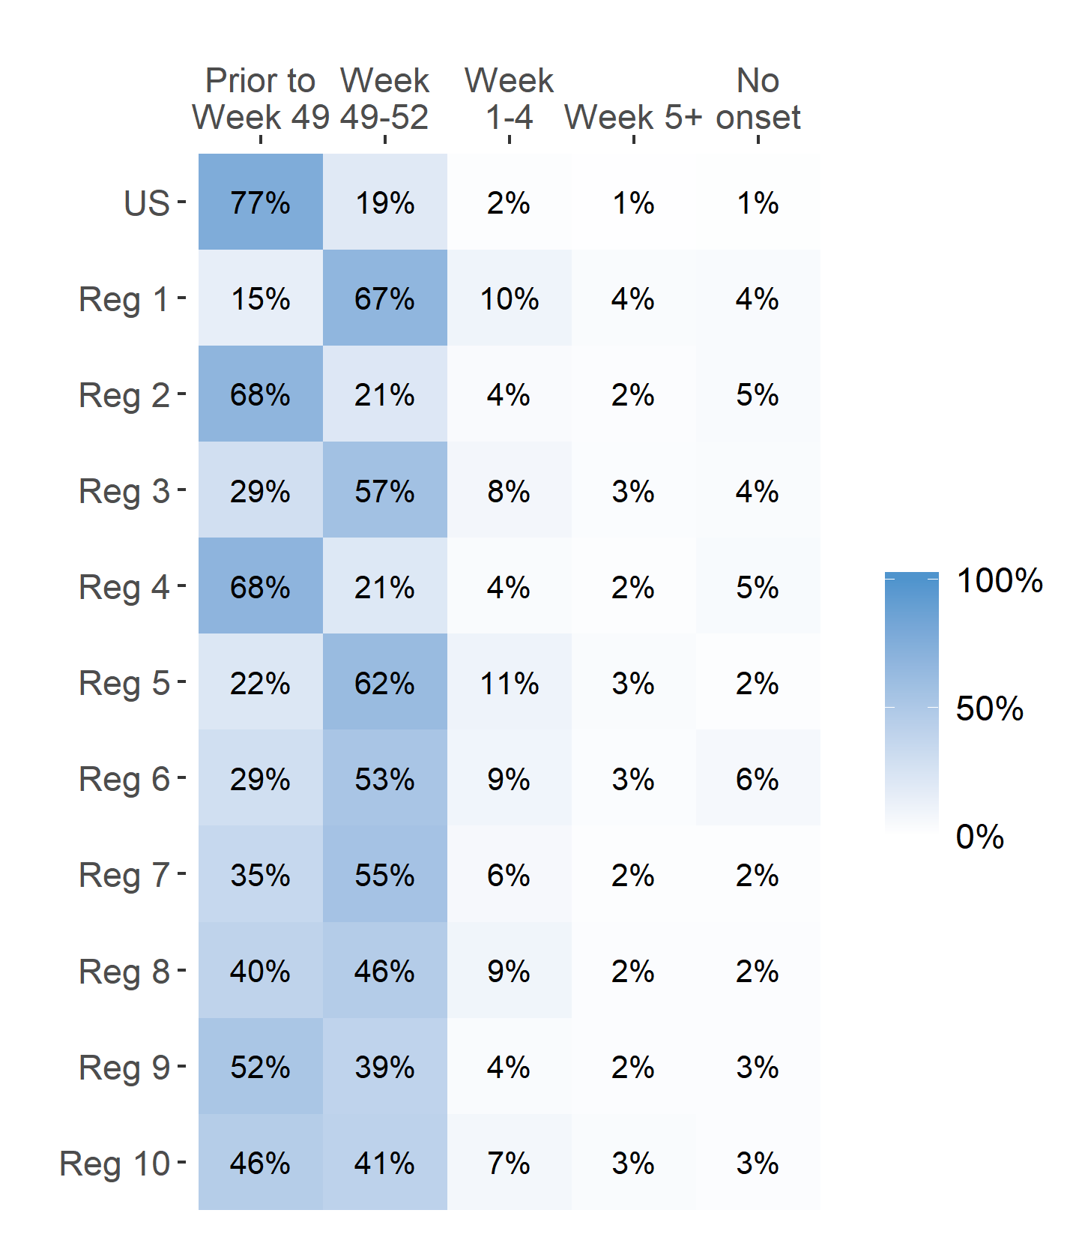
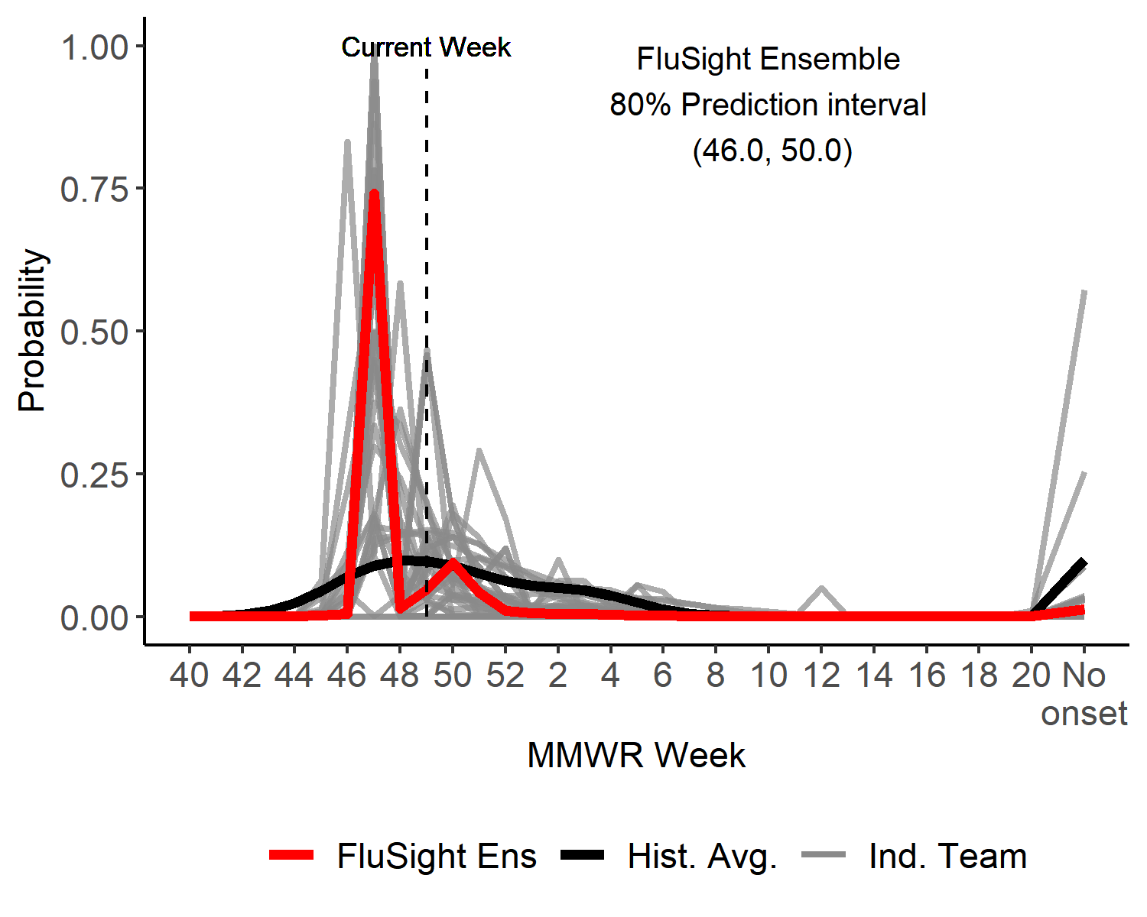
Season onset
US Onset Predicted Probability

Slide 4
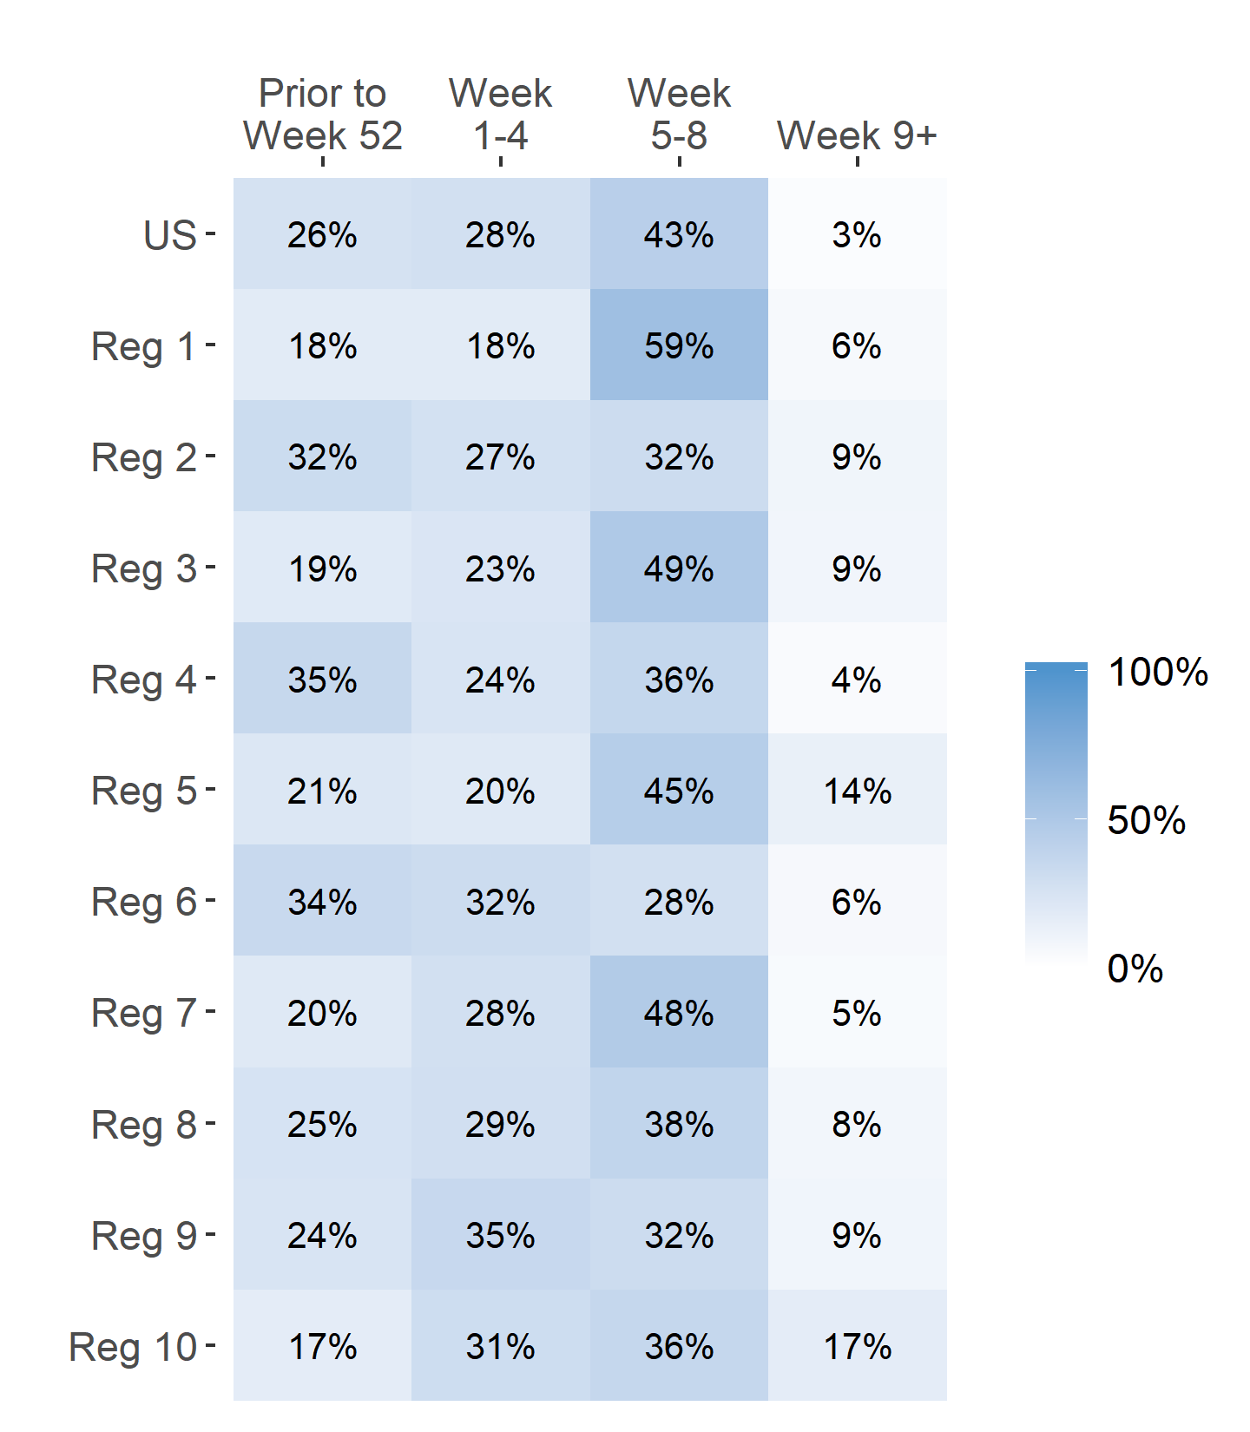
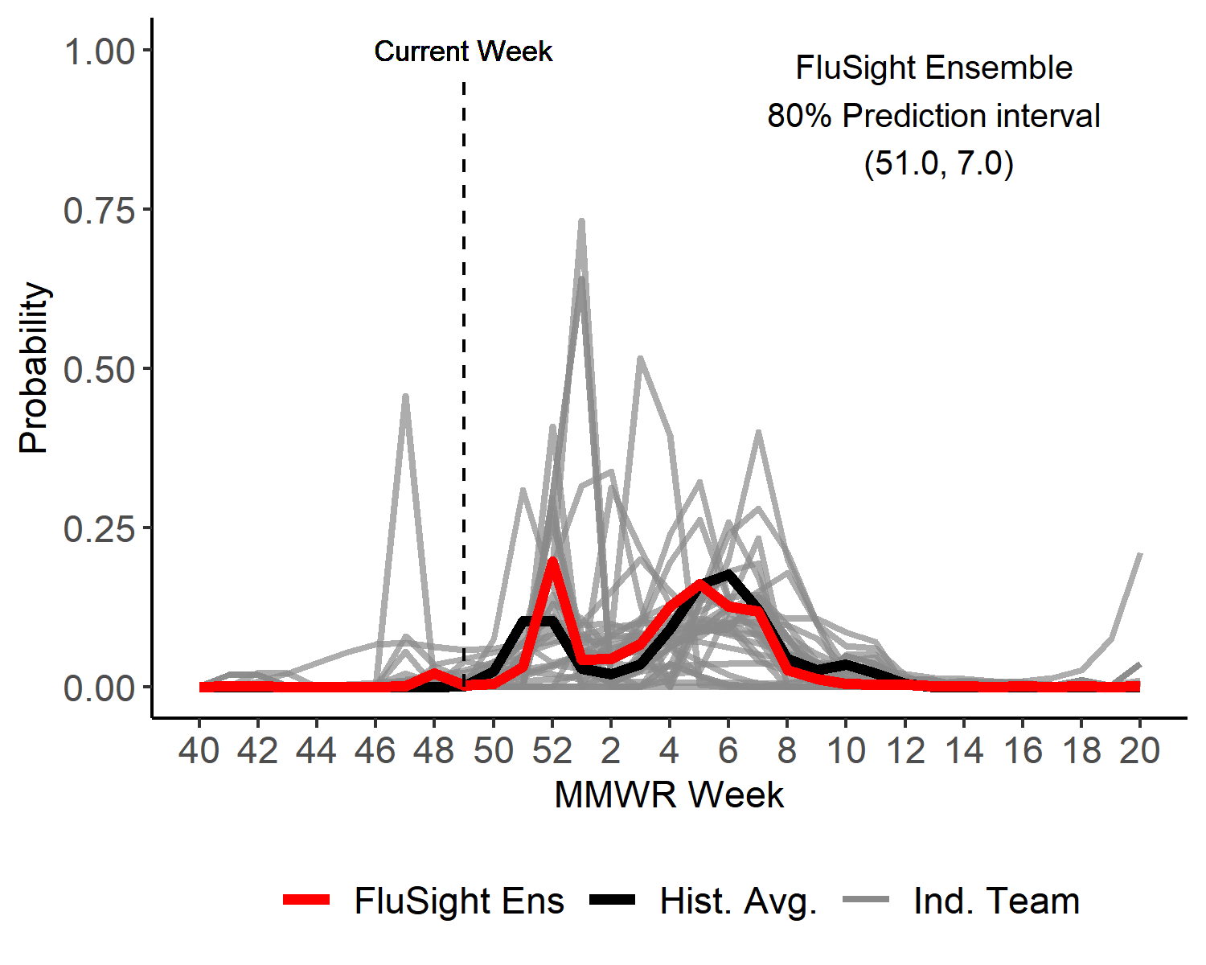
Season peak week
US Peak Week Predicted Probability

Slide 5
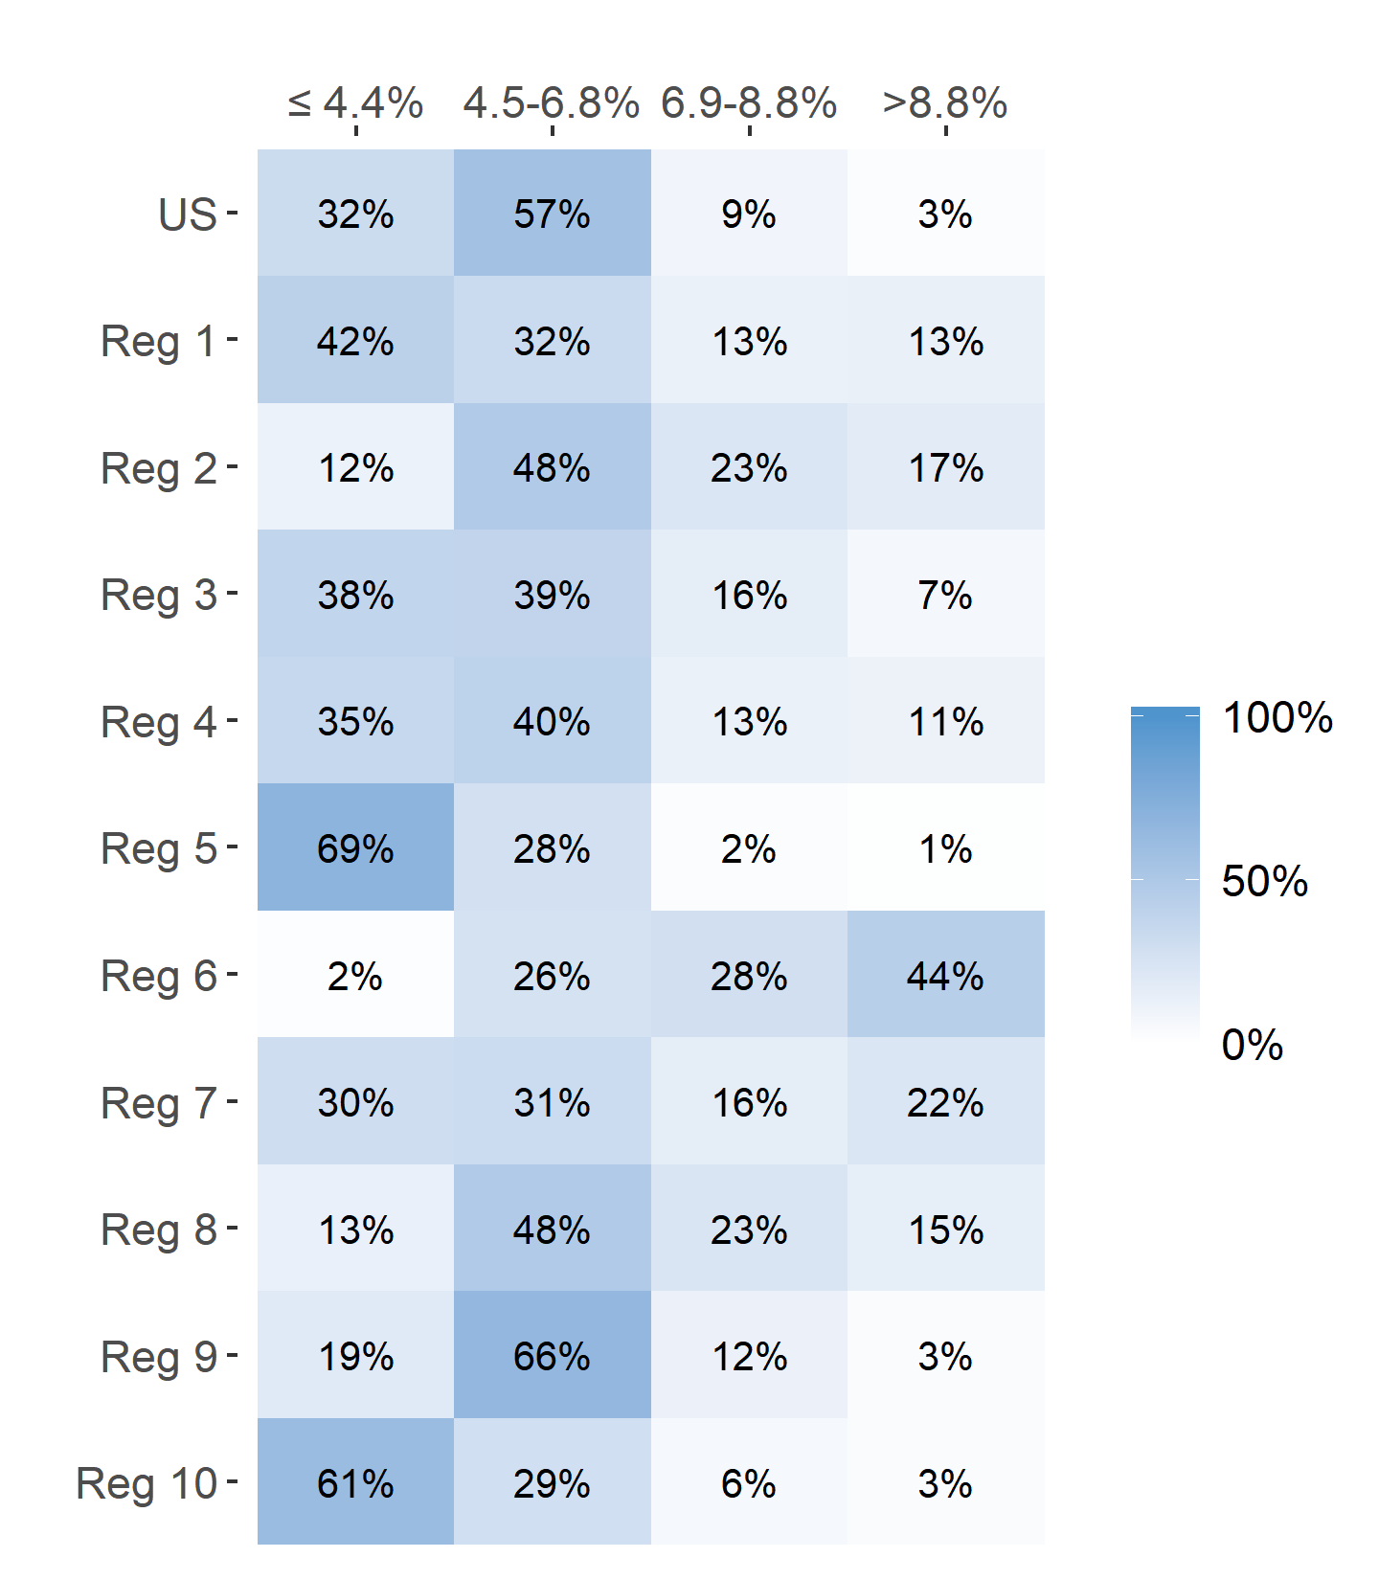
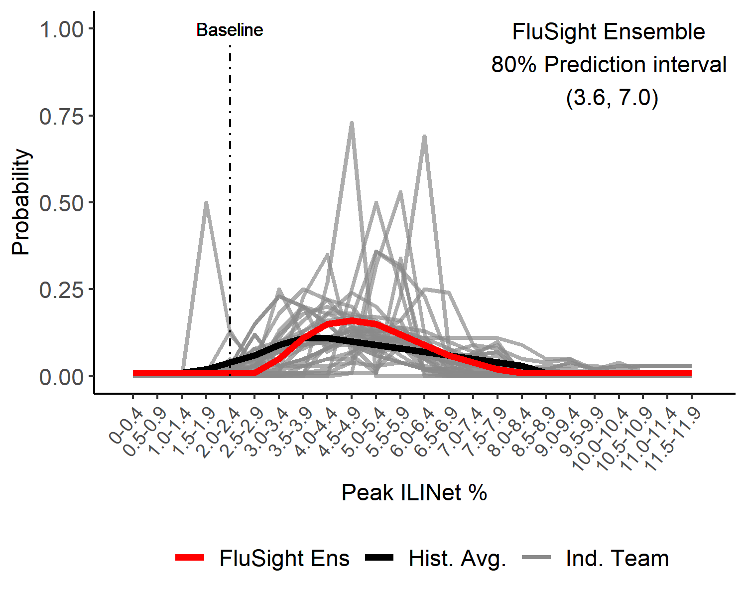
Season Peak ILI %
US Peak ILI % Predicted Probability

Slide 6
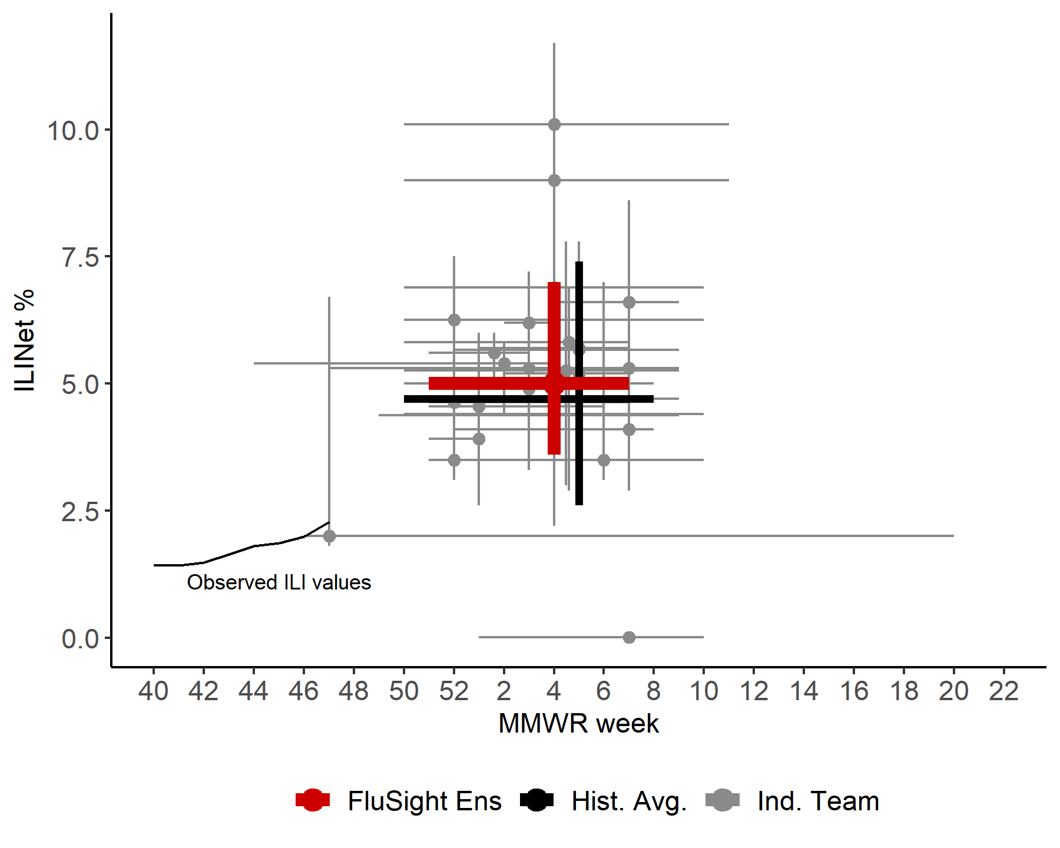
US Season Peak Week and Peak ILI %
Point forecasts with 80% prediction intervals

Slide 7
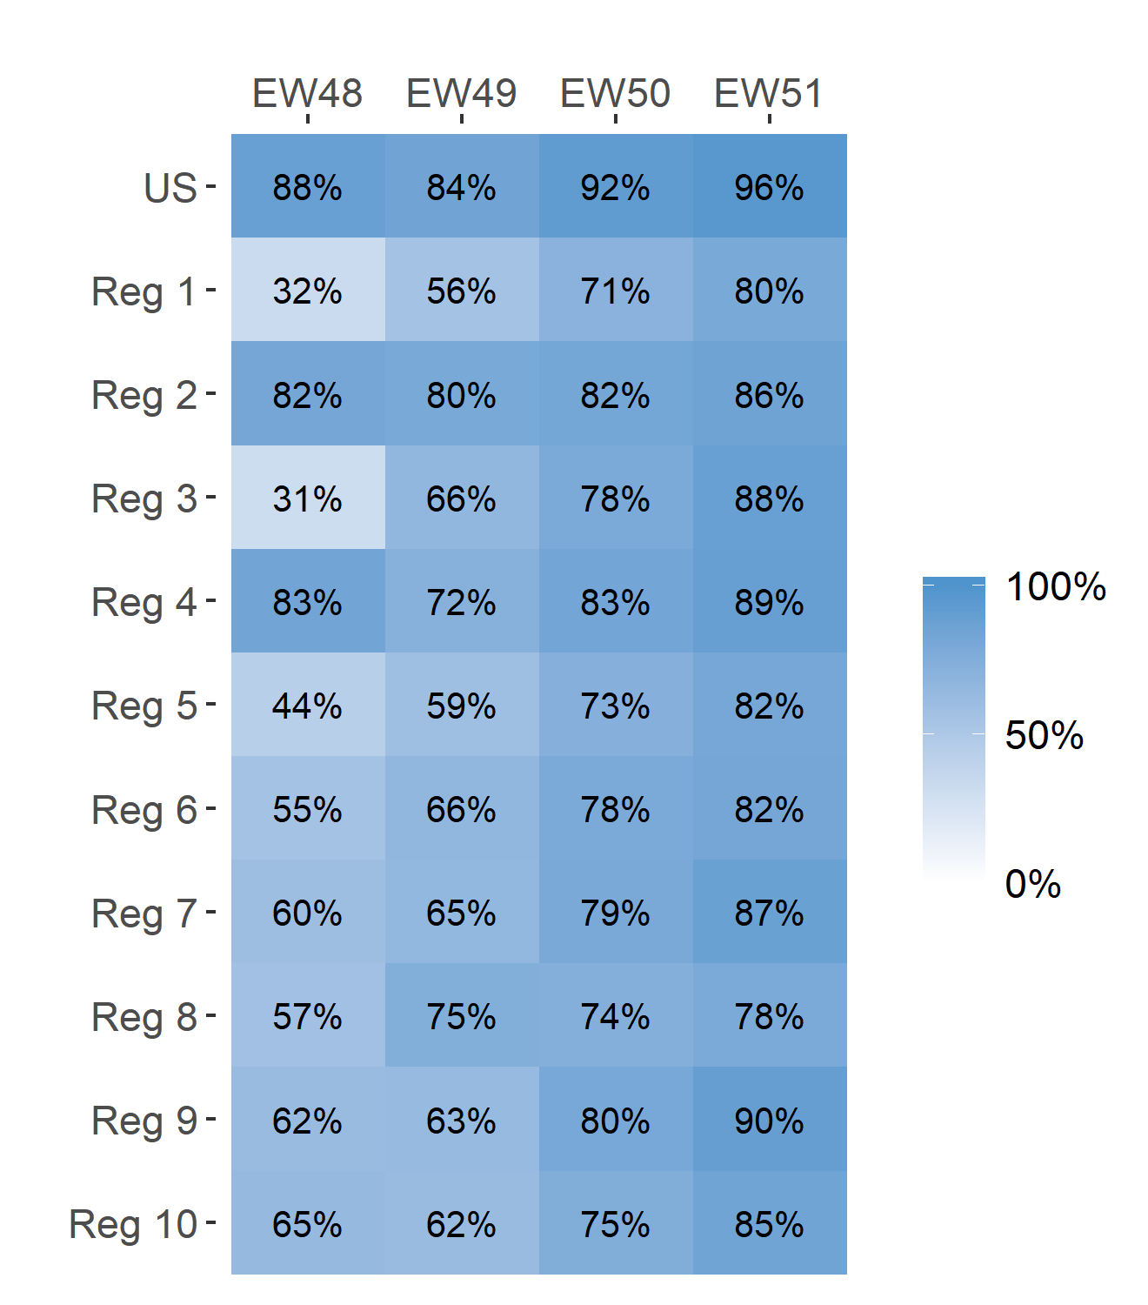
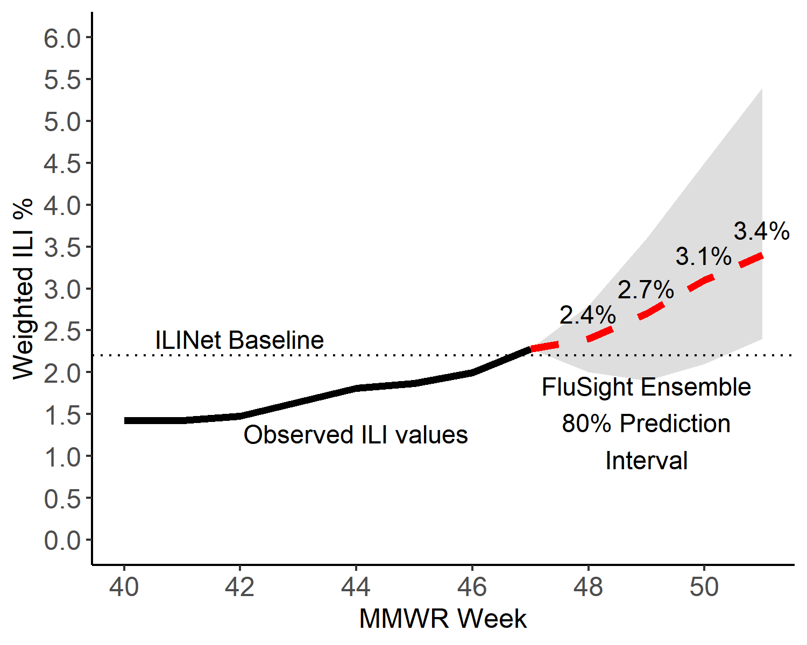
Short-Term ILI Predictions
Prob. ILI will be at or above baseline
US Short-Term Predictions

