Slide 1
Influenza Forecasting Update – week 51
Full forecasts, including individual states, at https://predict.cdc.gov

Slide 2
U.S. Forecasting Summary
There is about a 75% chance that the peak week will occur by the end of January
Forecasts give a similar chance for a high severity season as the historical average
Flu activity is likely to increase over the next four weeks

Slide 3
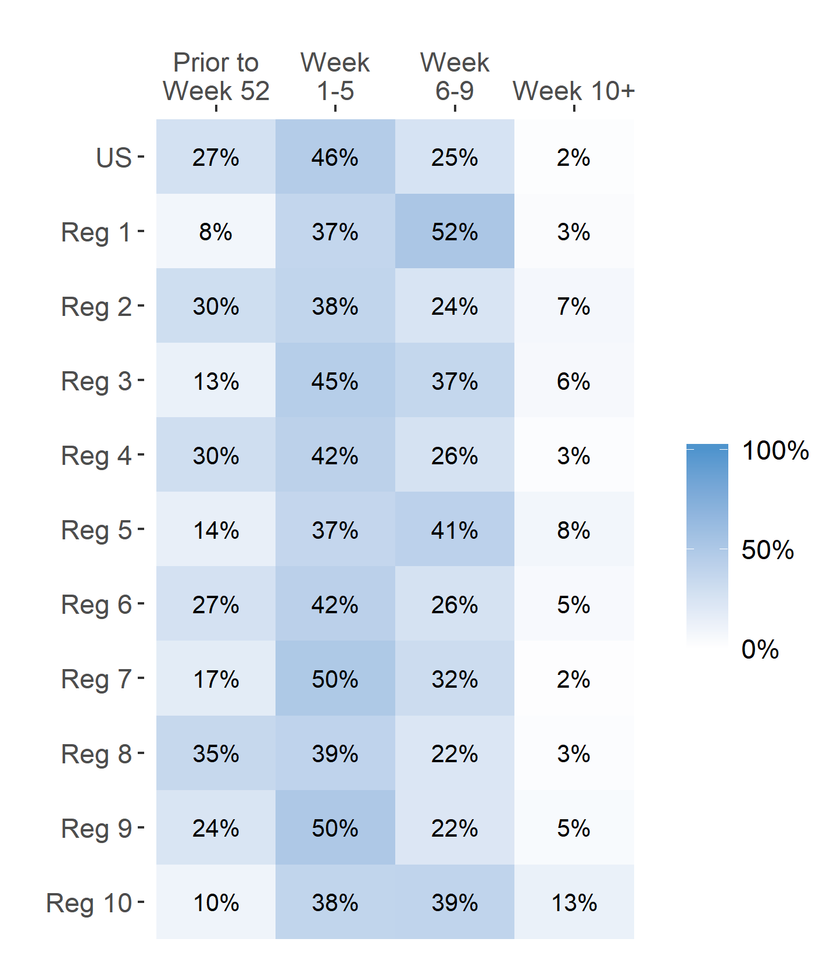
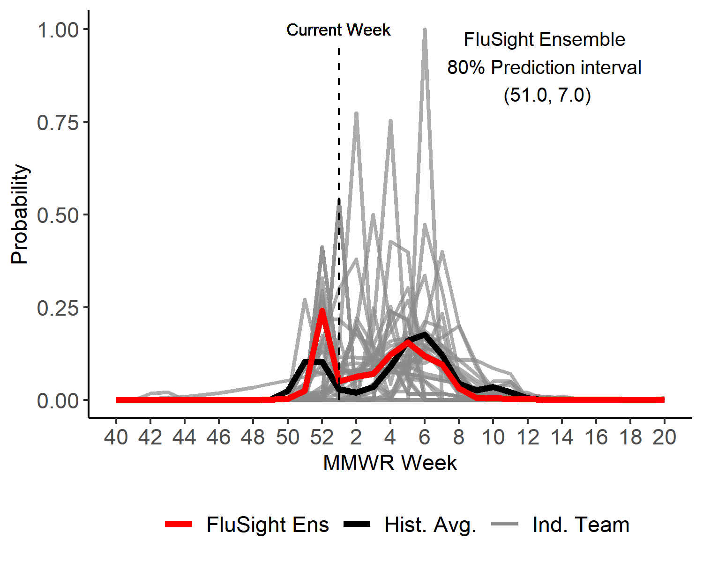
Season peak week
US Peak Week Predicted Probability

Slide 4
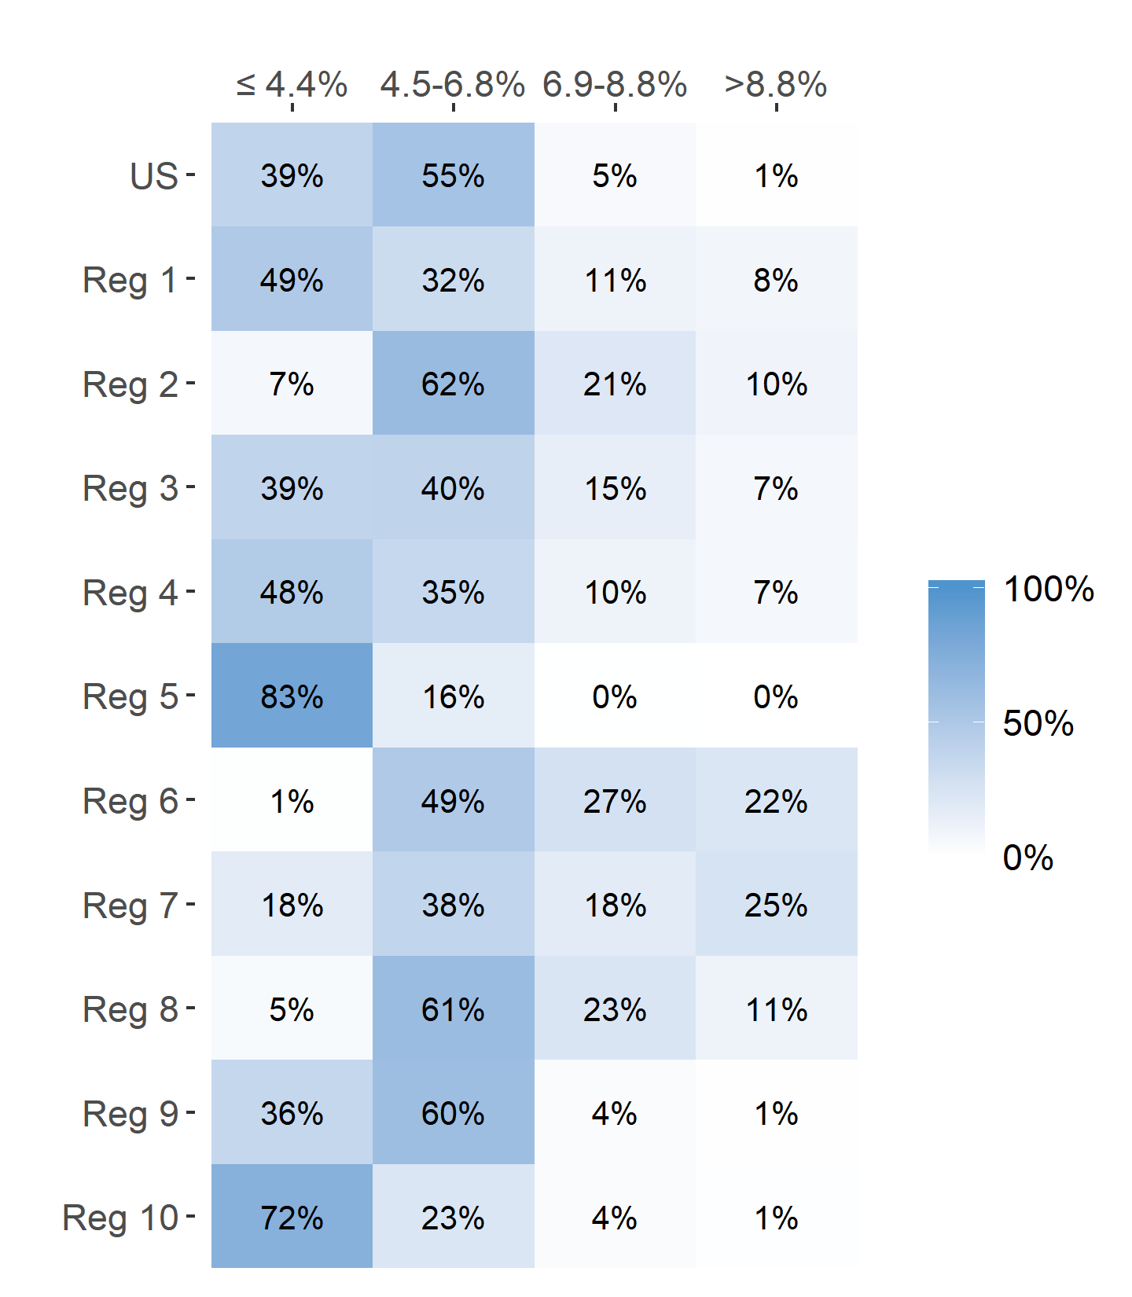
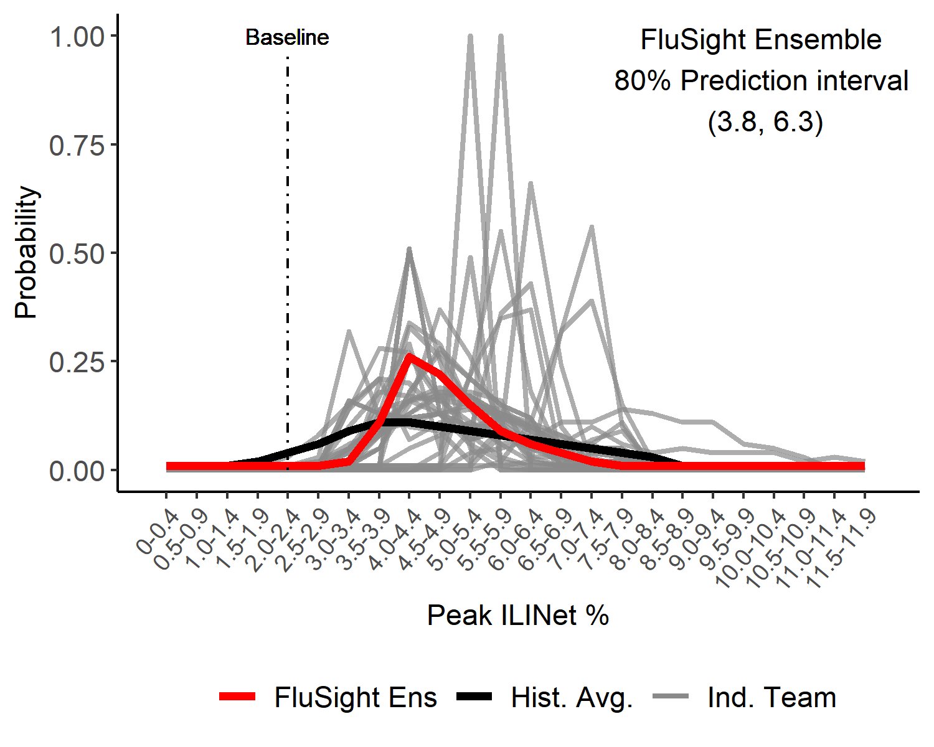
Season Peak ILI %
US Peak ILI % Predicted Probability

Slide 5
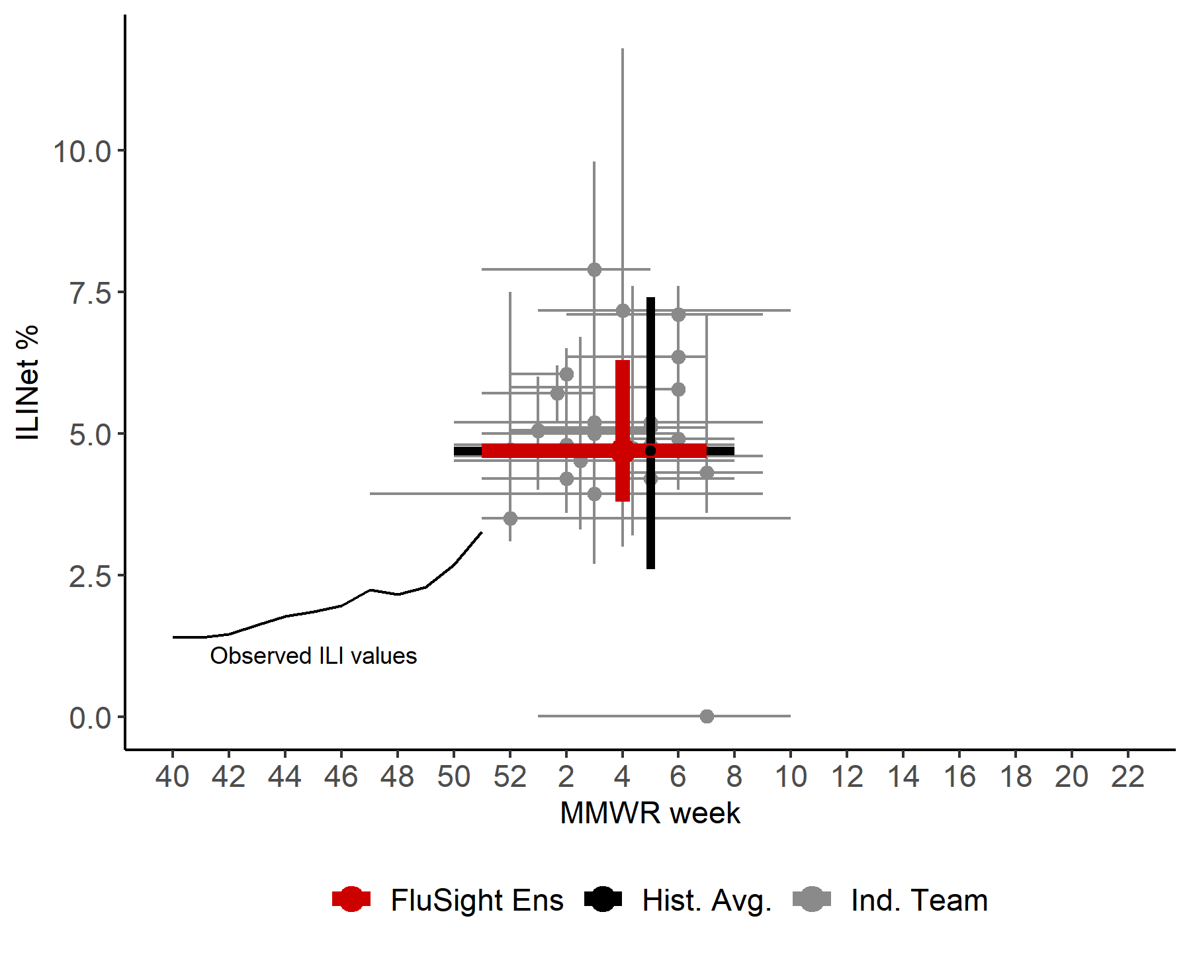
US Season Peak Week and Peak ILI %
Point forecasts with 80% prediction intervals

Slide 6
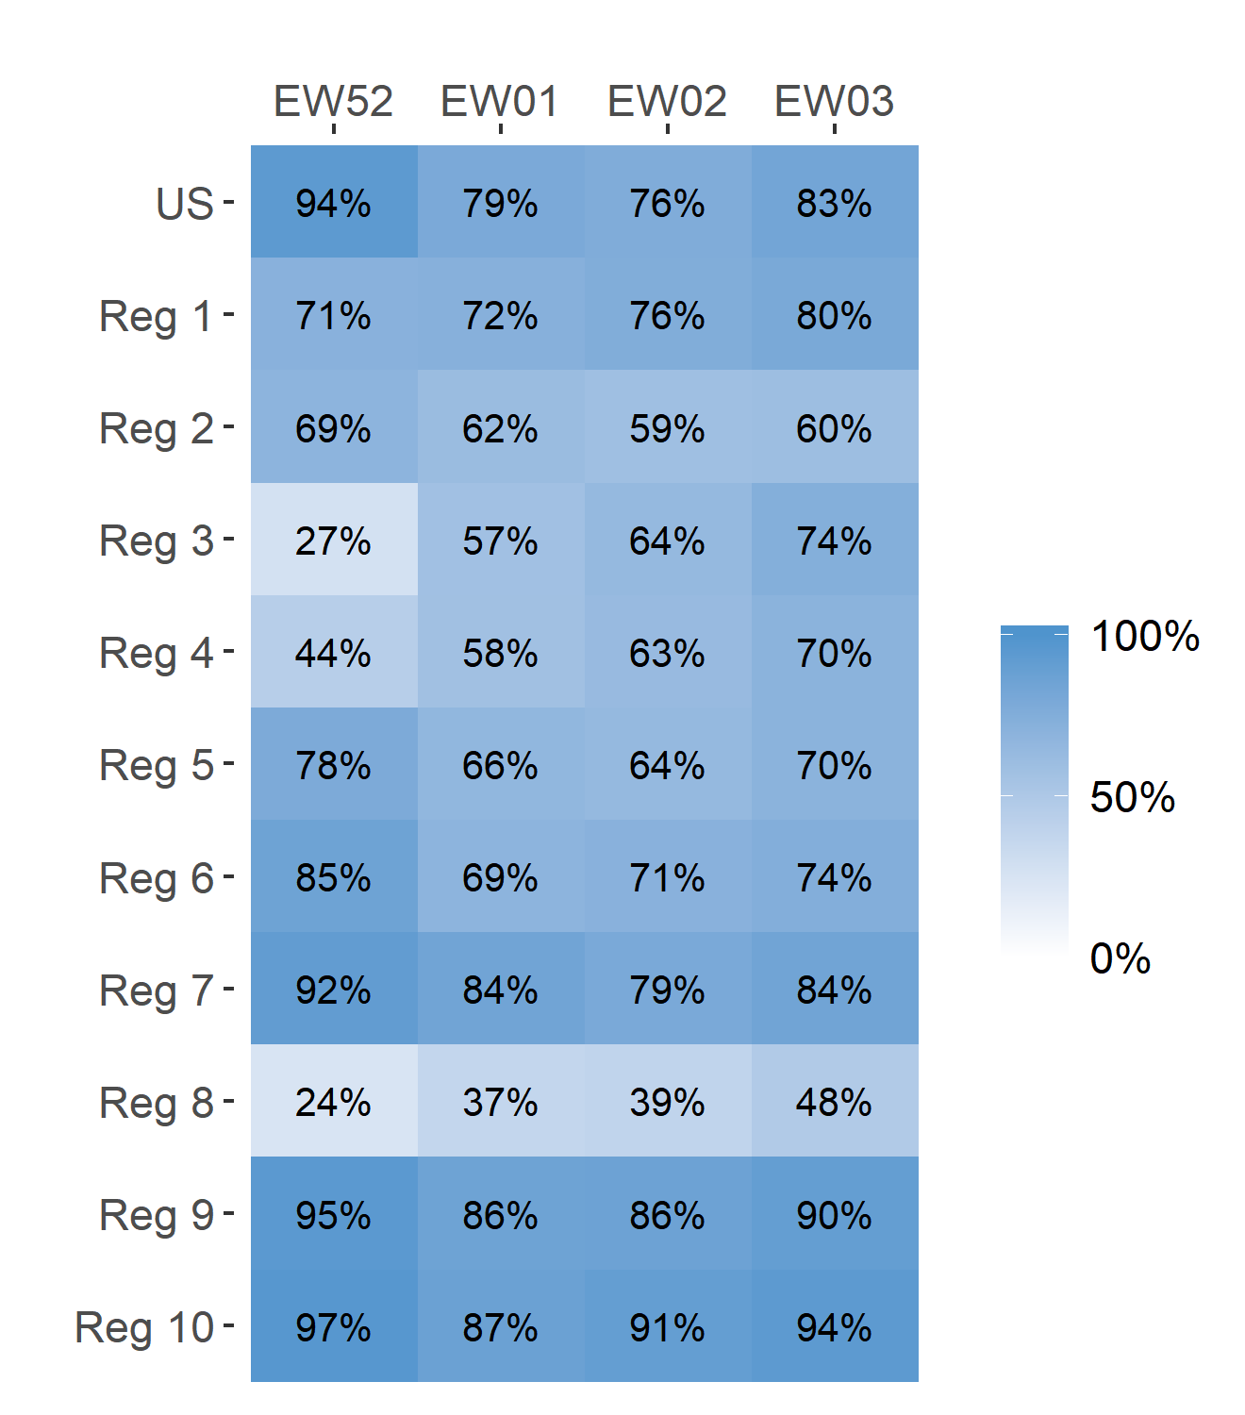
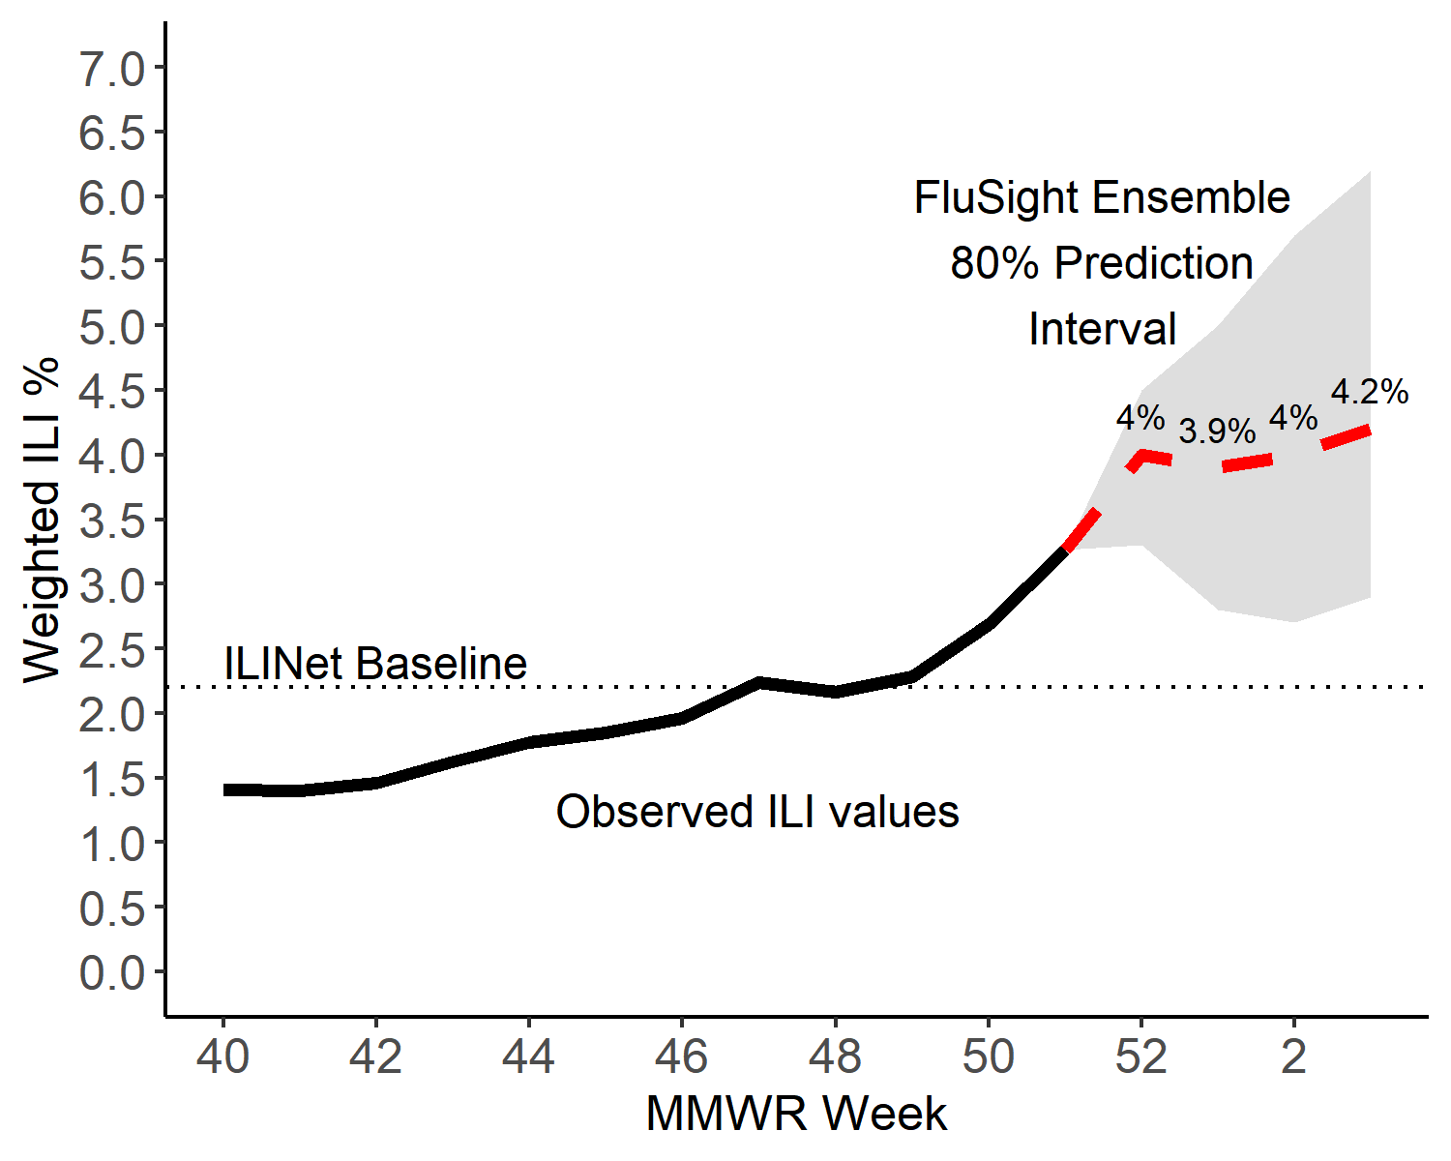
Short-Term ILI Predictions
Prob. ILI will be above last published value
US Short-Term Predictions

Slide 7
Extra Slides

Slide 8
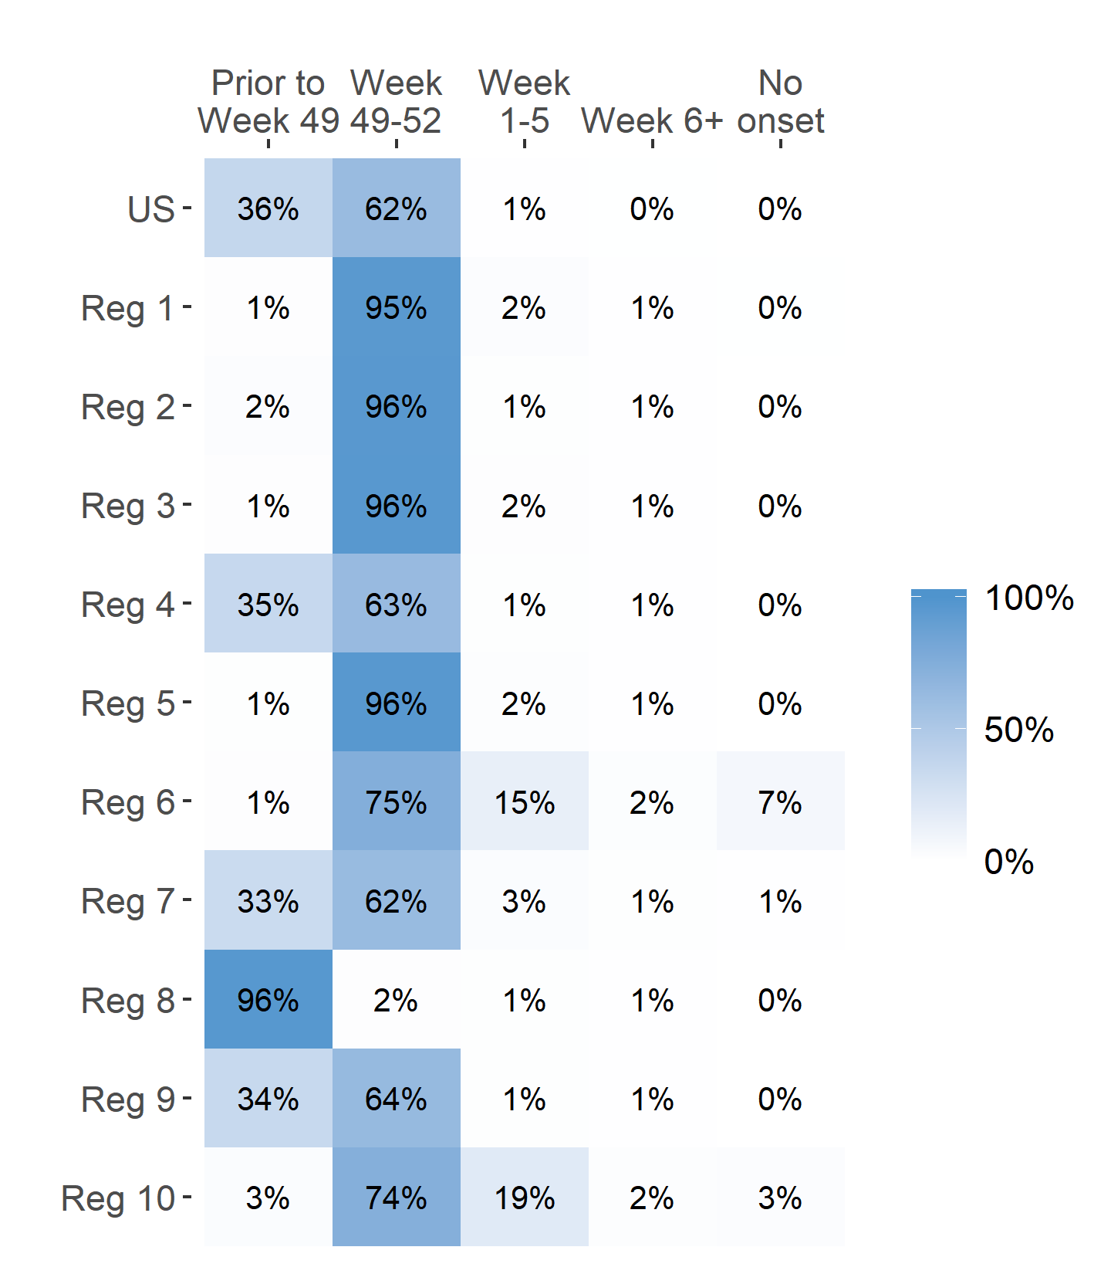
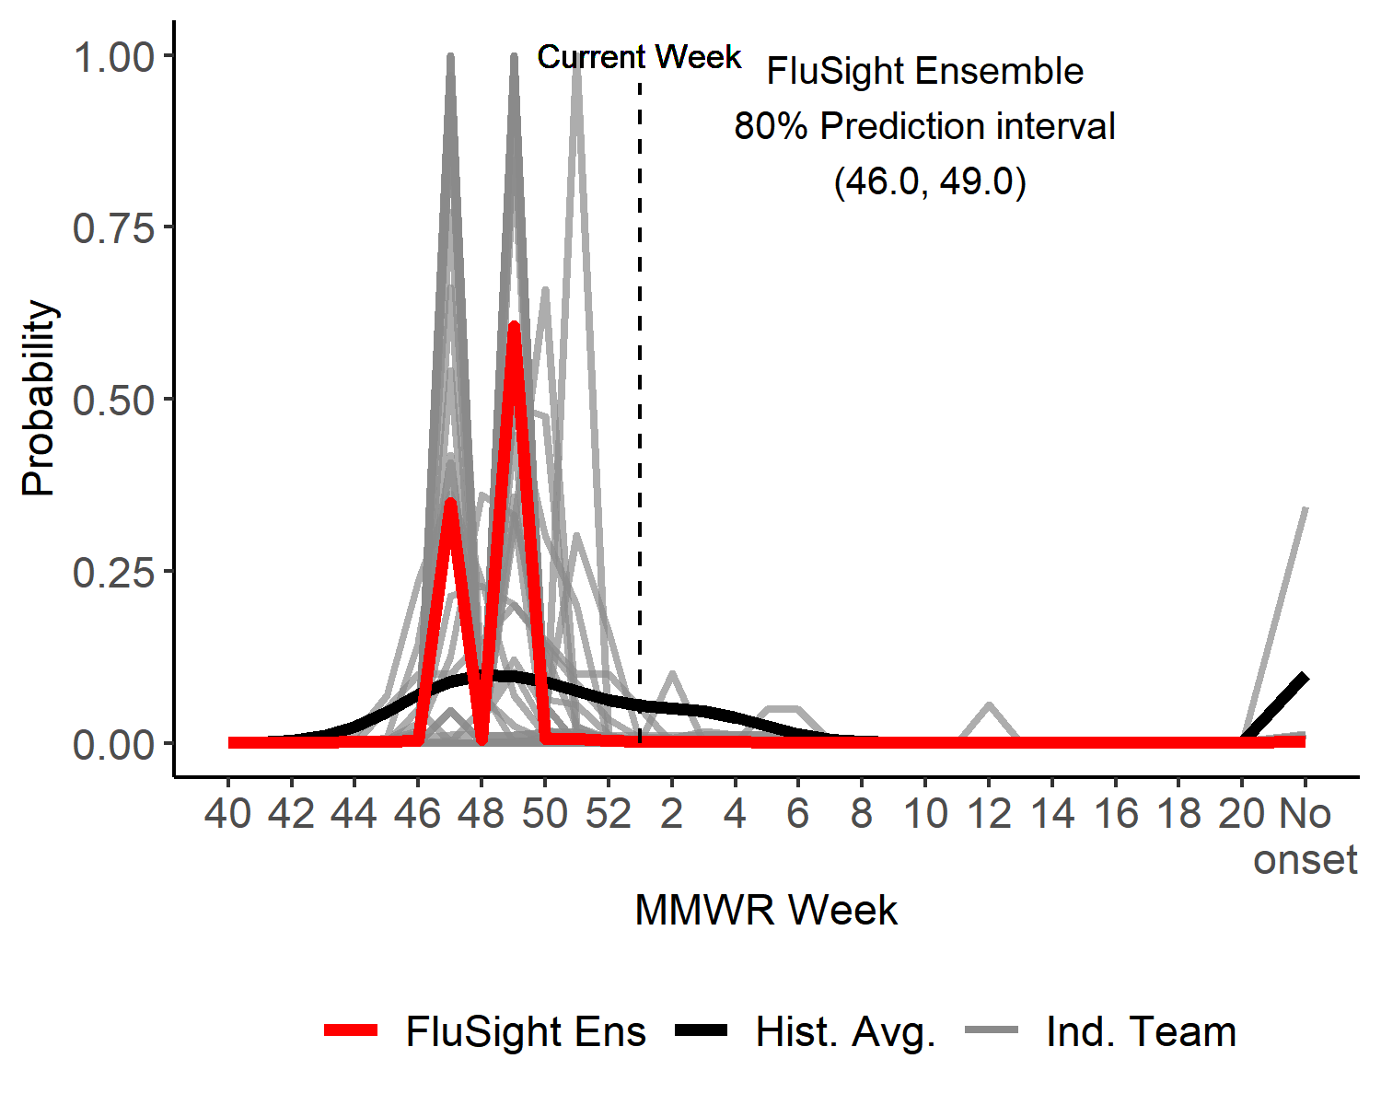
Season onset
US Onset Predicted Probability

