Slide 1
Influenza Forecasting Update – week 52
Full forecasts, including individual states, at https://predict.cdc.gov

Slide 2
U.S. Forecasting Summary
There is about a 70% chance that the peak week will occur by the end of January
Forecasts give a similar chance for a high severity season as the historical average
Flu activity is likely to decrease week 1 but increase weeks 2–4

Slide 3
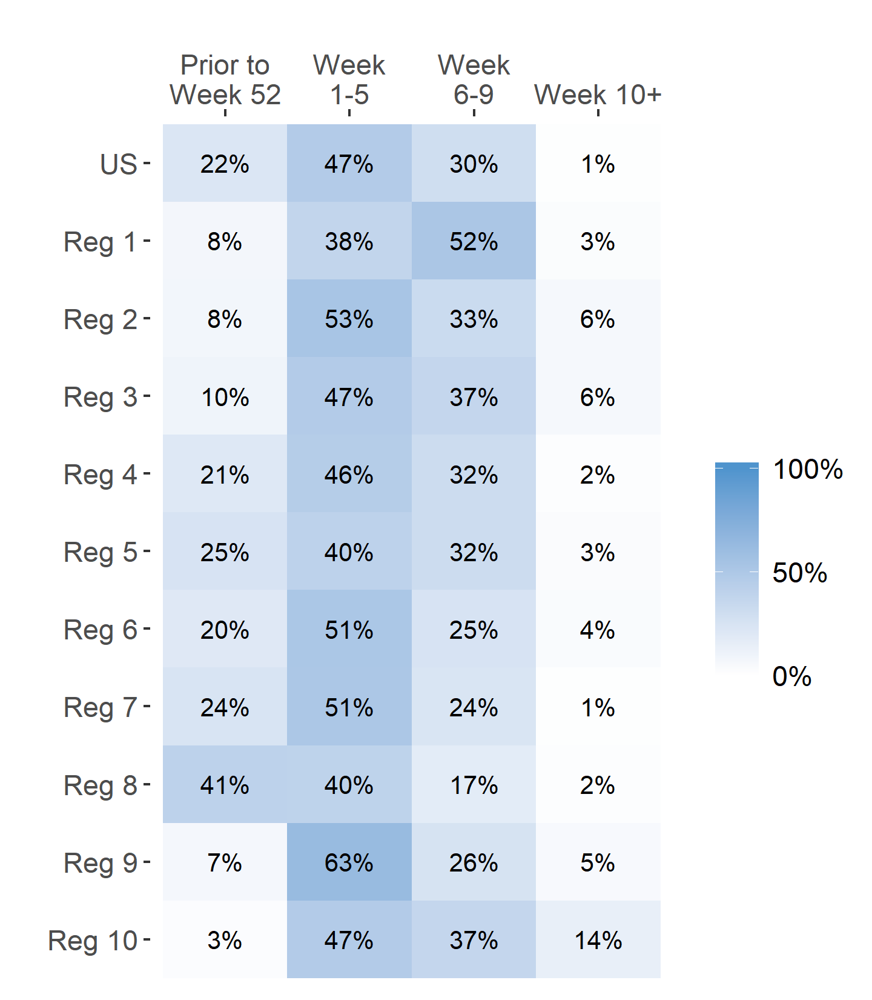
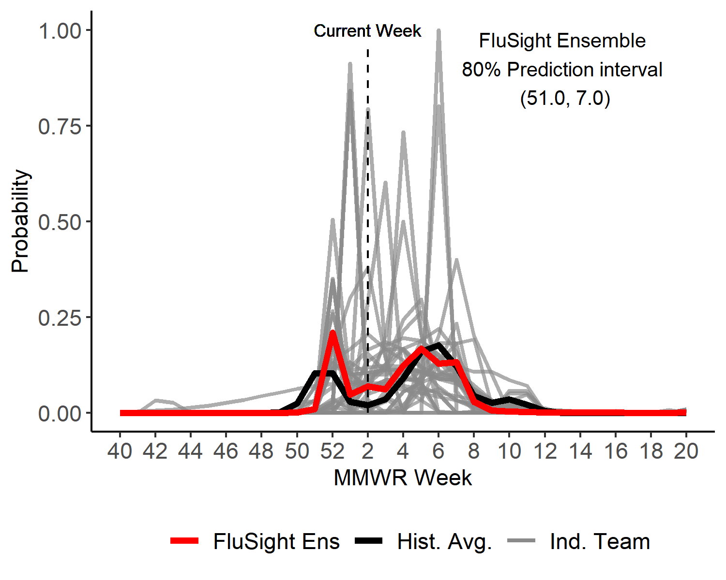
Season peak week
US Peak Week Predicted Probability

Slide 4
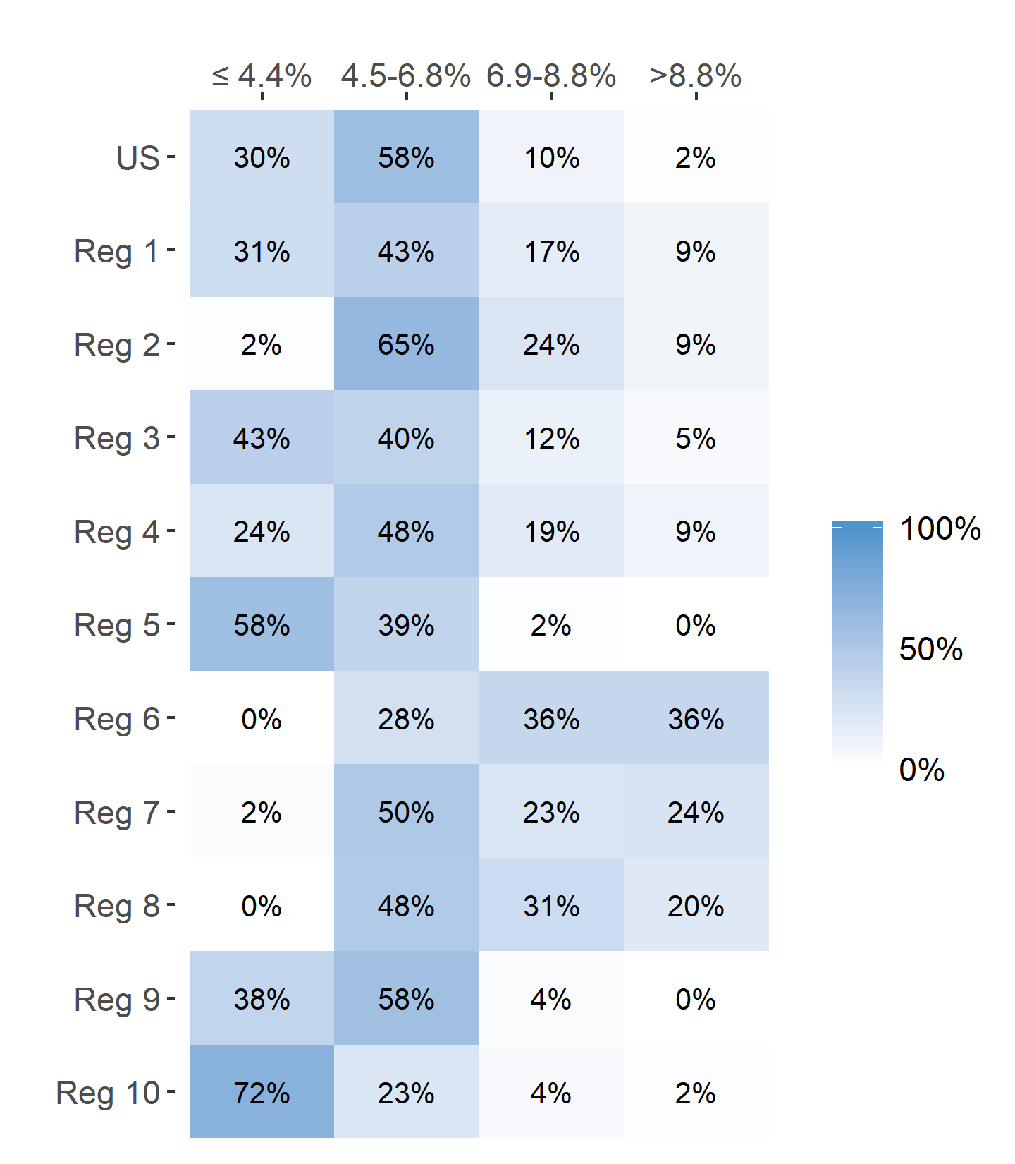
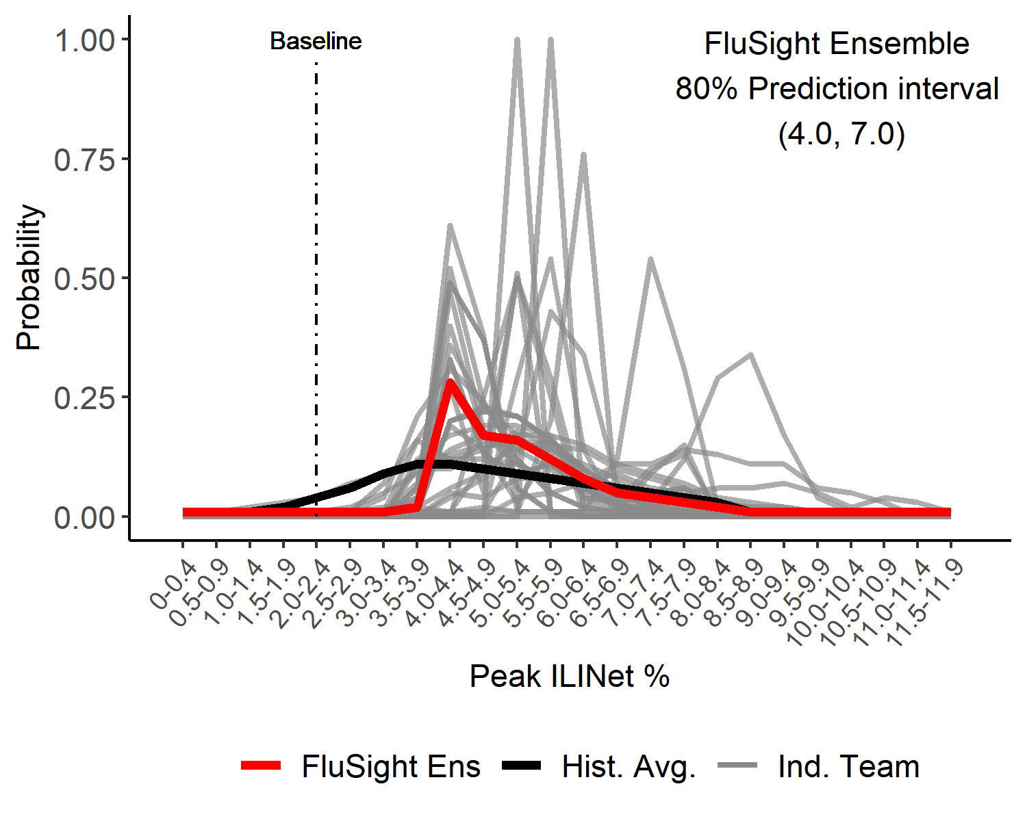
Season Peak ILI %
US Peak ILI % Predicted Probability

Slide 5
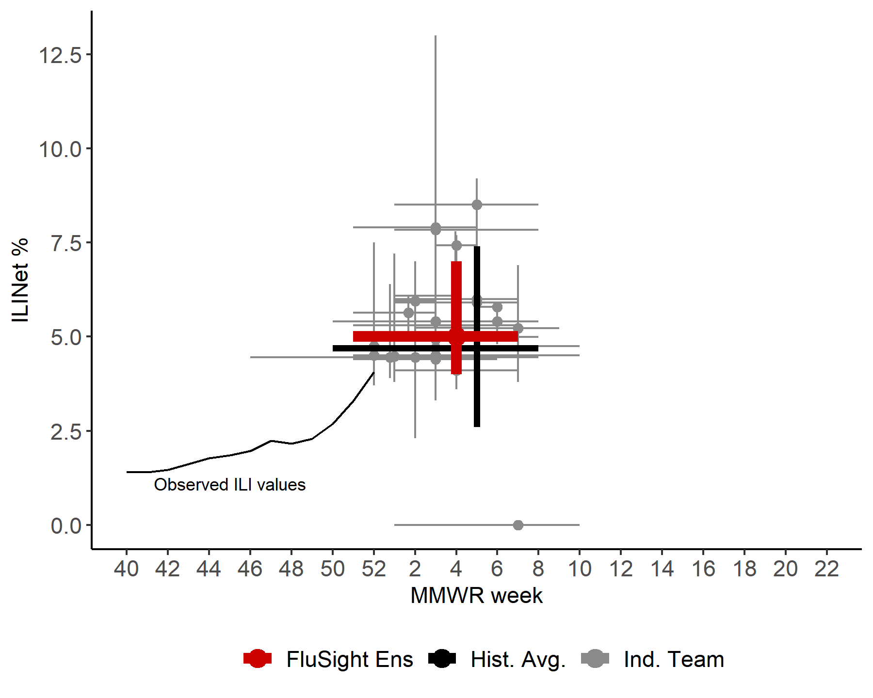
US Season Peak Week and Peak ILI %
Point forecasts with 80% prediction intervals

Slide 6
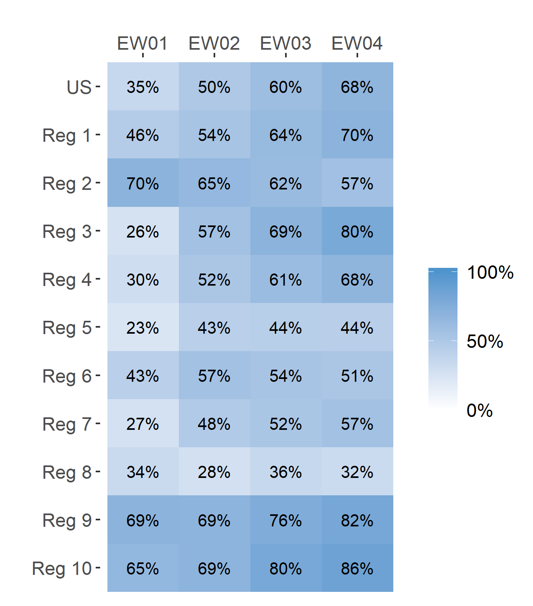
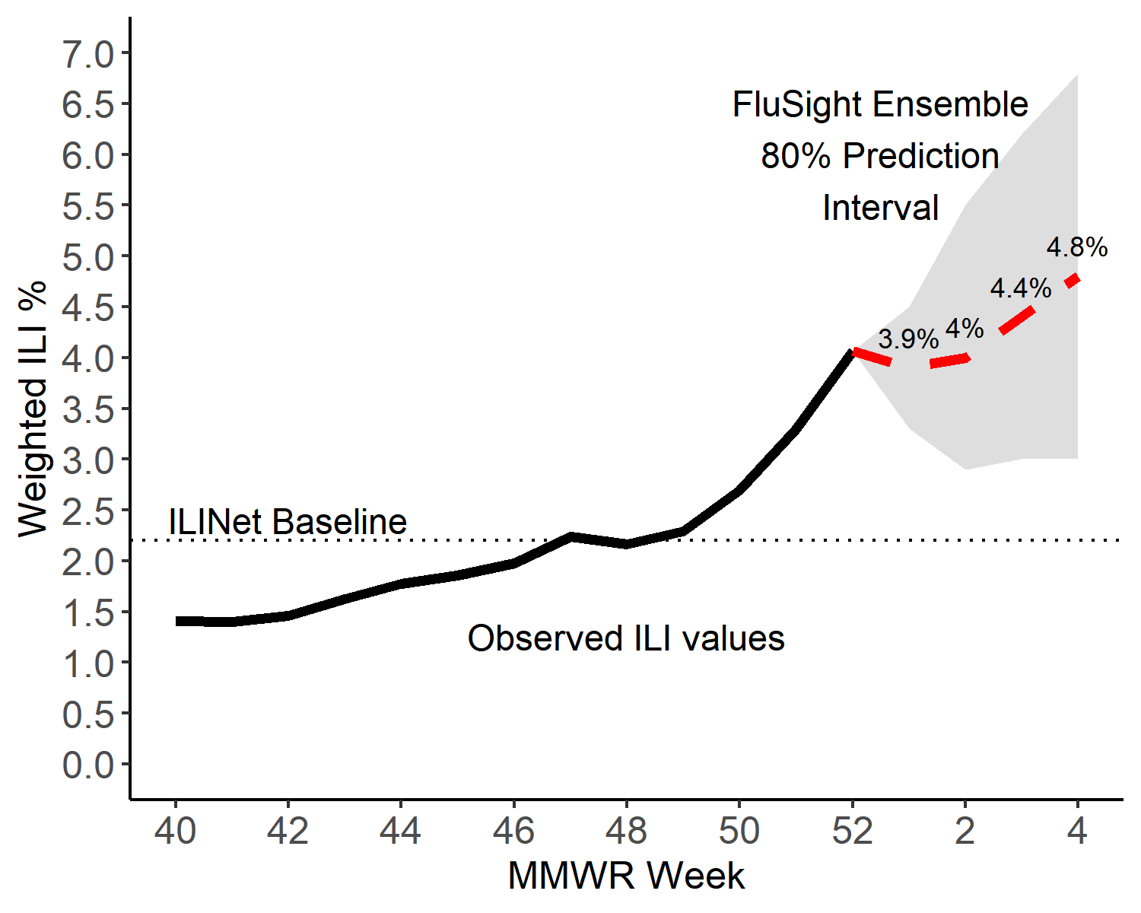
Short-Term ILI Predictions
Prob. ILI will be above last published value
US Short-Term Predictions

