Slide 1
A Look Back at 2017–18 and 2018–19 Surveillance Systems Updates
Lynnette Brammer, MPH
Seasonal Influenza Forecasting (“FluSight”) Workshop
August 30, 2018

Slide 2
Outline
Changes to surveillance
Unusual features of the 2017-18 season

Slide 3
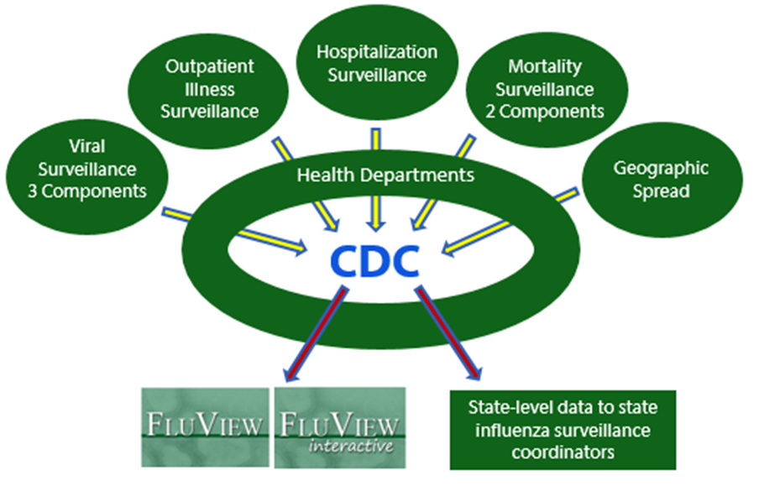
U.S. National Influenza Surveillance System

Slide 4
Surveillance System Improvements
Continuing to increase the amount of electronic data in ILINet
  Most of the new sites are emergency departments
  Much of the data is coming from Essence (directly and indirectly)
  For the 2017-18 season ~250 new sites were added resulting in an average of more than 152,000 additional visits per week
  Currently validating new sites for the 2018-19 season but the increase in data may be larger than last season

Slide 5
Surveillance System Improvements
Optional surveillance enhancements (looking for a catchier name)
Working with state/local health departments to fill critical gaps in our current system
Health departments could apply to provide data for any/all of 3 activities
  Systematic sampling at ILI sites to determine influenza attributable proportion of ILI
  Estimation of population served at selected ILI sites so that rates can be calculated
  Identification of samples from known inpatients and outpatients

Slide 6
2017-18 Influenza Season

Slide 7
2017-18 Influenza Season - General Observations
The season was severe overall and for all age groups
The season was long
More influenza A(H1N1) than we’ve seen in recent H3 predominant seasons
Early nursing home outbreaks of B/Yamagata viruses in addition to H3 viruses

Slide 8
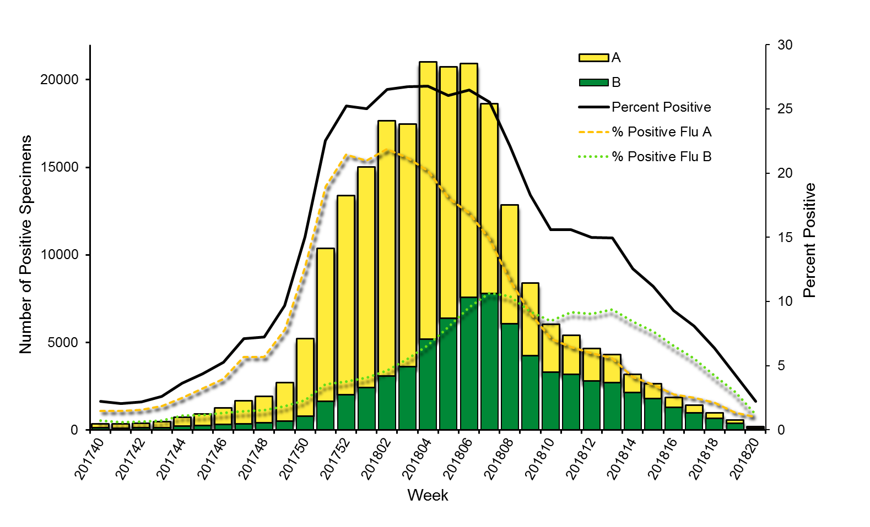
Influenza Positive Tests Reported to CDC by U.S. Clinical Laboratories,
National Summary, 2017-2018 Season

Slide 9
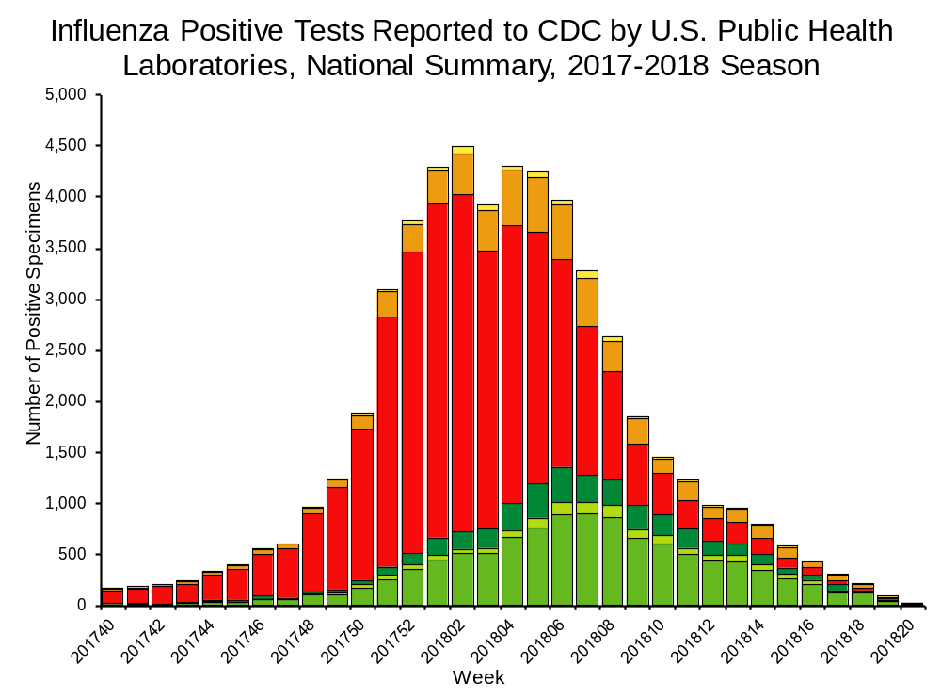
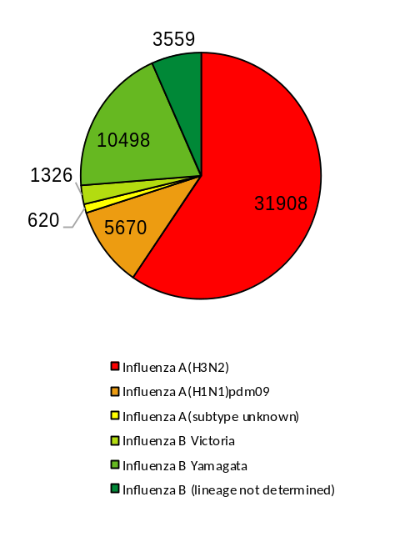
59%
11%

Slide 10
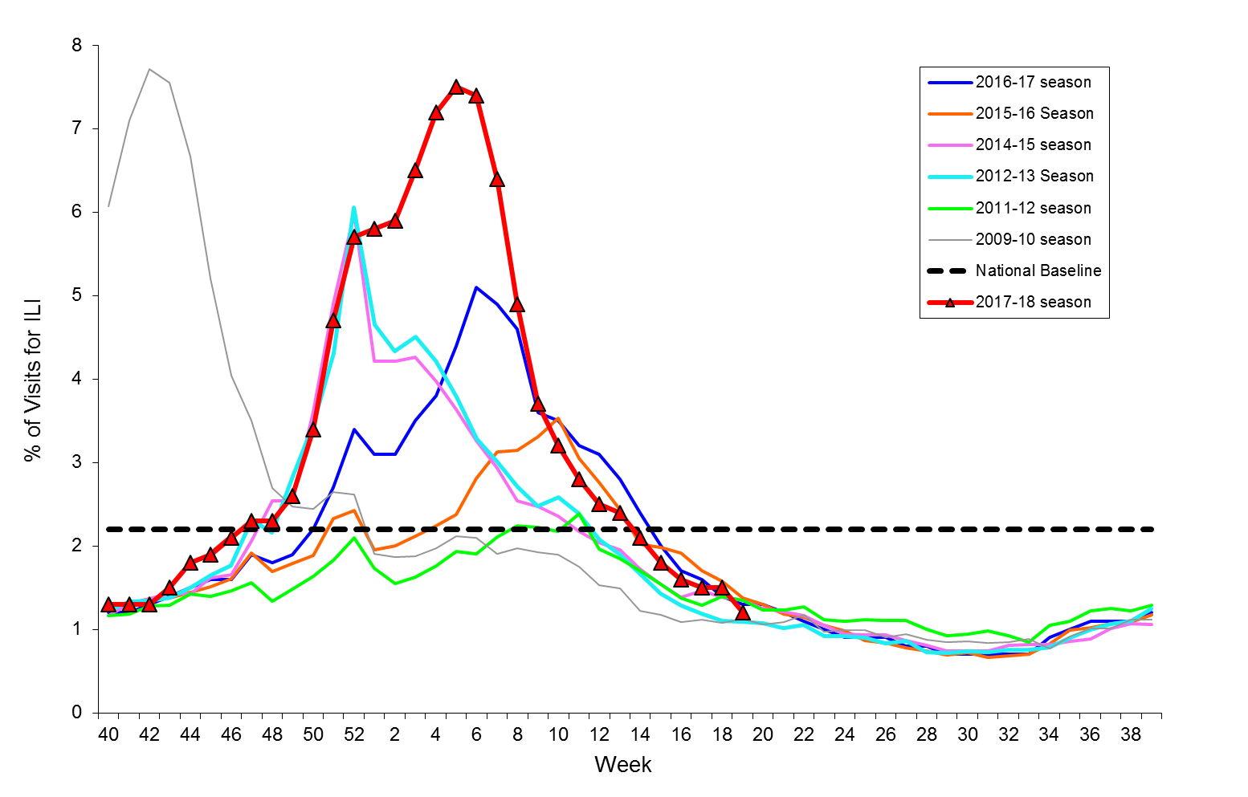
Percentage of Visits for Influenza-like Illness (ILI) Reported by
the U.S. Outpatient Influenza-like Illness Surveillance Network (ILINet),
Weekly National Summary, 2017-2018 and Selected Previous Seasons
Notes:
Nationally, the weekly percentage of outpatient visits for ILI to health care providers participating in the United States Outpatient Influenza-like Illness Surveillance Network (ILINet) was at or above the national baseline§§ level of 2.2% for 19 consecutive weeks (weeks 47–13) during the 2017–18 season (Figure 1). The percentage of outpatient ILI visits exceeded 7.0% for three consecutive weeks, peaking at 7.5% during the week ending February 3, 2018 (week 5). During the 2012–13 through 2016–17 seasons, peak weekly percentages of outpatient ILI visits ranged from 3.6%–6.1% and remained at or above baseline levels for an average of 16 weeks (range = 11–20 weeks).

Slide 11
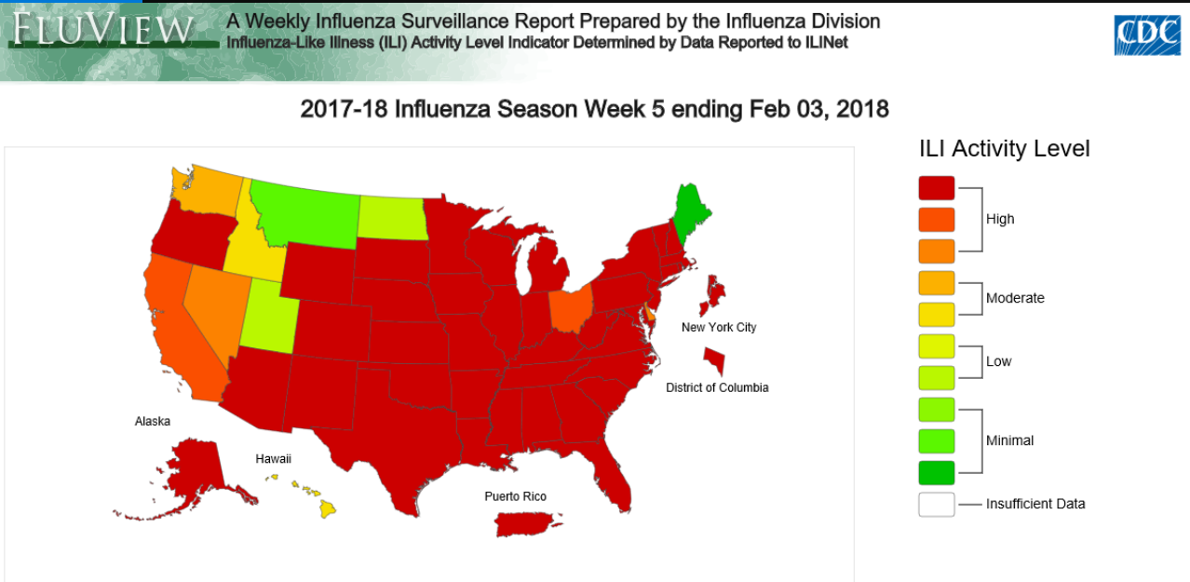
Notes:
For the weeks ending December 30, 2017–February 24, 2018, more than half of the 53 jurisdictions experienced high ILI activity each week, with the highest number (46; 87%) during the weeks ending January 27–February 10, 2018 (weeks 4–6). During the past 5 seasons, the highest number of jurisdictions experiencing high ILI activity in a single week ranged from 16 (30%) during the 2015–16 season to 31 (58%) during the 2012–13 season

Slide 12
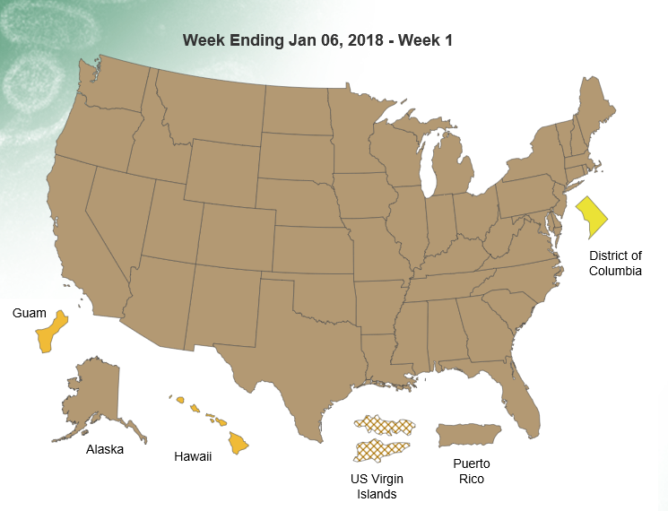
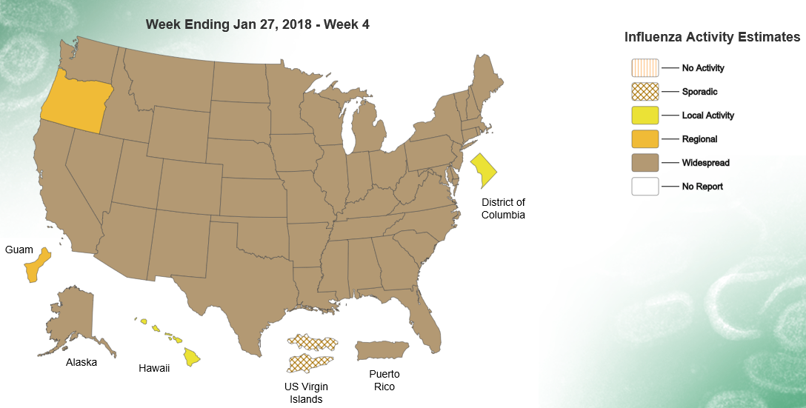
State and Territorial Epidemiologist Reports
Notes:
During the 2017–18 season, the peak number of jurisdictions reporting widespread activity in a single week was 50 (93%); this occurred for 3 consecutive weeks (weeks ending January 6, 13, and 20, 2018). During the previous 5 influenza seasons, the peak number of jurisdictions reporting widespread activity in a single week during each season has ranged from 41 (76%) (2015–16 season) to 48 (89%) (2012–13 season).

Slide 13
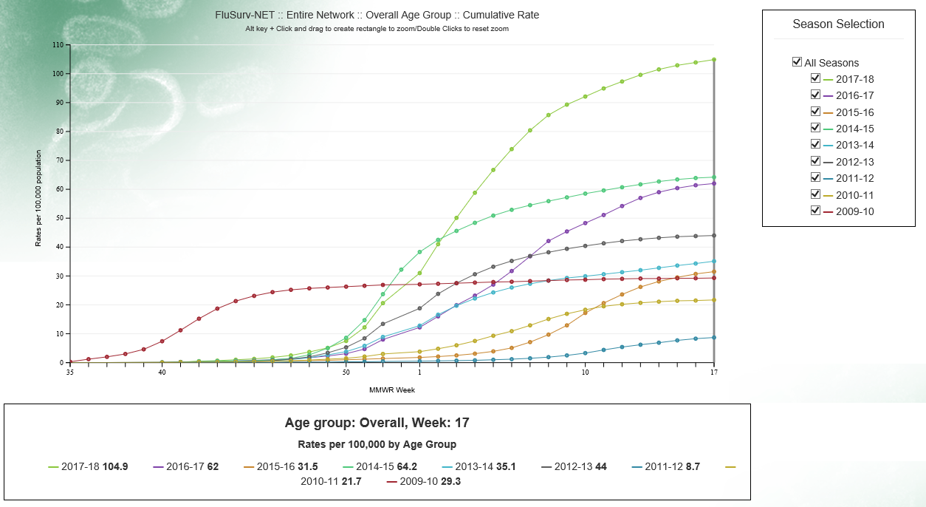

Slide 14
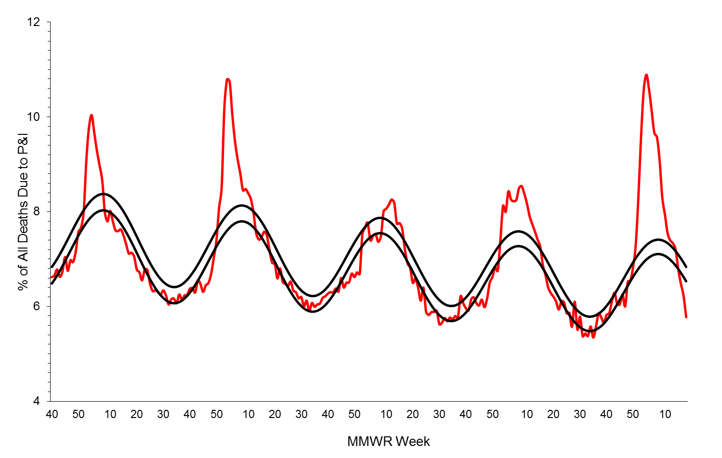
Pneumonia and Influenza Mortality from
the National Center for Health Statistics Mortality Surveillance System
Data through the week ending May 5, 2018, as of May 24, 2018
Epidemic Threshold
Seasonal Baseline
2013
2014
2015
2016
2017
2018

Slide 15
P&I Percentage Points Above Baseline

Slide 16
Influenza-Associated Pediatric Deaths by Week of Death: 2014-15 season to present
 | Influenza A (2009 H1N1) | Influenza A (H3N2) | Influenza A (Subtype not Determined) | Influenza B | Influenza A and B Co-infection | Type not Determined | Total
# Deaths Since October 1, 2017 | 32 | 37 | 37 | 68 | 2 | 3 | 179
2014-15
Number of Deaths Reported = 148
2015-16
Number of Deaths Reported = 93
2016-17
Number of Deaths Reported = 110

Slide 17
Peak Week
 | Week
 | 50 | 51 | 52 | 1 | 2 | 3 | 4 | 5 | 6 | 7 | 8 | 9 | 10
ILINet |  |  |  |  |  |  |  | X | x
Clinical labs |  |  |  |  | x | x | X | x | x
Hospitalization |  |  |  | X
Mortality |  |  |  |  |  | X
X = peak
x = close to peak

Slide 18
Peak Week ILI, Clinical % Positive and Mortality by Region and Hospitalization
 | Week
 | 50 | 51 | 52 | 1 | 2 | 3 | 4 | 5 | 6 | 7 | 8 | 9 | 10
1 |  |  |  |  |  |  |  |  | X
2 |  |  |  |  |  |  |  |  | X
3 |  |  |  |  |  |  |  |  | X
4 |  |  |  |  |  |  | X | X | x
5 |  |  |  |  |  |  |  |  | X
6 |  |  |  |  |  |  | X
7 |  |  |  |  |  | x | X | X | x
8 |  |  |  |  |  |  |  | X
9 |  |  | X
10 |  |  |  | X
X = ILI peak
x = ILI close to peak
Peak % positive
Peak mortality
Peak hospitalization
Near peak % positive

Slide 19
Number of H3 positives by age group 2012-13

Slide 20
Number of H3 positives by age group 2017-18

Slide 21
Peak Week Hospitalizations by Age Group
 | Week
 | 50 | 51 | 52 | 1 | 2 | 3 | 4 | 5 | 6 | 7 | 8 | 9 | 10
0-4 |  |  |  |  |  |  | X
5-17 |  |  |  |  |  |  |  | X
18-49 |  |  |  |  | X
50-64 |  |  |  | X
65+ |  |  |  | X

