Slide 1

Aspen Hammond
Global Influenza Programme (GIP)
Infectious Hazards Management (IHM)

Slide 2
Outline
Context and background
  Global influenza programme activities
  2009 pandemic review
Influenza incidence analytics group activities
  Objectives, status, future plans
How to get involved

Slide 3
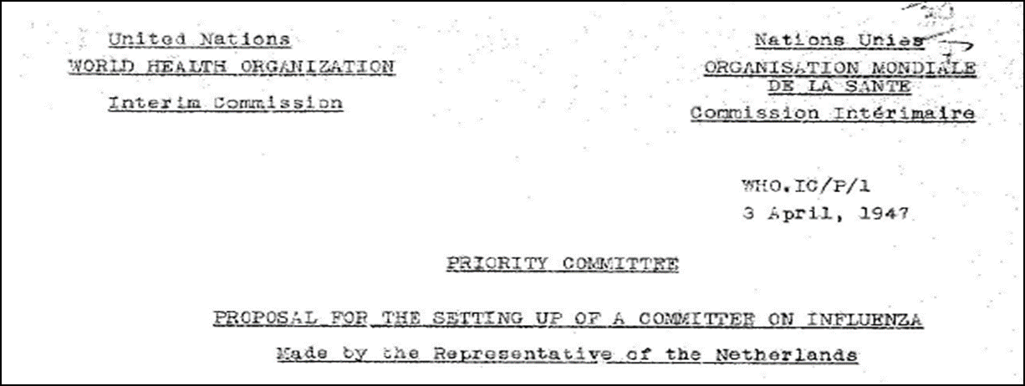


Context
Global Influenza Programme (GIP, 1947):
coordinates the Global Influenza Surveillance and Response System (GISRS, 1952),
conducts surveillance, monitoring and assessment of risks associated with influenza (seasonal, zoonotic and pandemic); and
guides global preparedness for influenza epidemics and pandemics.

Slide 4
Context
Surveillance and monitoring within GIP:
Routine seasonal influenza monitoring and reporting on situation
Burden of influenza disease
Zoonotic influenza monitoring and risk assessment
Severity assessments during epidemics and pandemics
  www.who.int/influenza/surveillance_monitoring/en/
Notes:
I will come back to the last point in a few slides, but first a few points on how our work is guided and why we are interested in how influenza analytics, operationally…

Slide 5
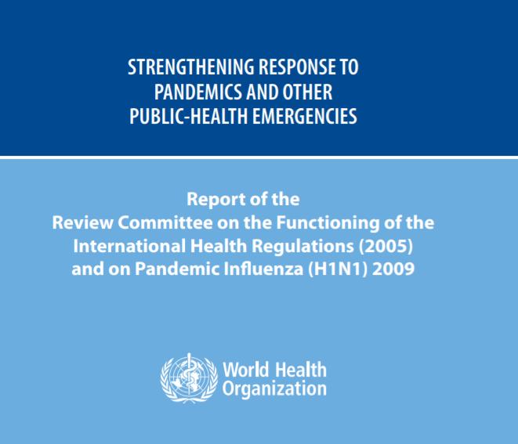
Background
  2009 pandemic review
  A 2011 review of the pandemic response gives 15 recommendations to WHO and its Member States to strengthen preparedness for future pandemics.
  Outlines lead responsibility and timeframe to complete implementation of recommendations
apps.who.int/iris/bitstream/handle/10665/75235/9789241564335_eng.pdf;jsessionid=F719487946BC58CBB212366EAED74371?sequence=1
Notes:
Another part of the background is the review post 2009 pandemic. I will not go into the history of modeling during the 2009 pandemic but some of the lessons learned are incorporated in the following slides as presented in the independent review published on our website.

Slide 6
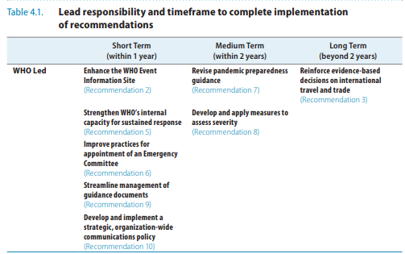
Background
  2009 pandemic review
  Recommendation 8: Develop and apply measures to assess severity. WHO should develop and apply measures that can be used to assess the severity of every influenza epidemic.
  Use quantitative values to define descriptive terms
  Use of a “basket of indicators”
  Express confidence and uncertainty around any estimates
  Apply, evaluate and refine the tools to measure severity every year, to be better prepared in the next pandemic
apps.who.int/iris/bitstream/handle/10665/75235/9789241564335_eng.pdf;jsessionid=F719487946BC58CBB212366EAED74371?sequence=1
Notes:
The first relevant recommendation is on the development of a severity assessment.

Slide 7
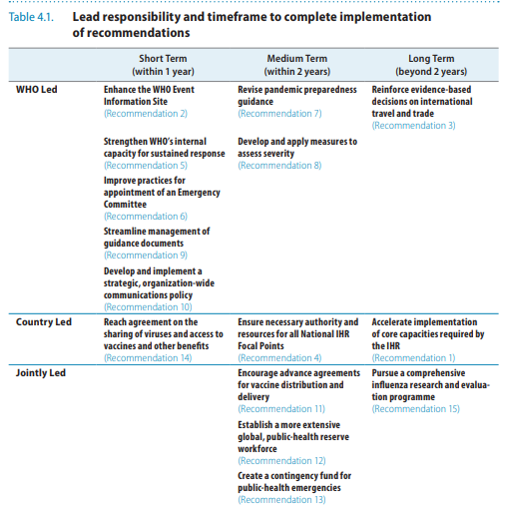
Background
  2009 pandemic review
  Recommendation 15: Pursue a comprehensive influenza research and evaluation programme.
  Key research goals include:
  enhance the accuracy and timeliness of modelling projections
apps.who.int/iris/bitstream/handle/10665/75235/9789241564335_eng.pdf;jsessionid=F719487946BC58CBB212366EAED74371?sequence=1
Notes:
The second relevant recommendation is to work on predictions.

Slide 8
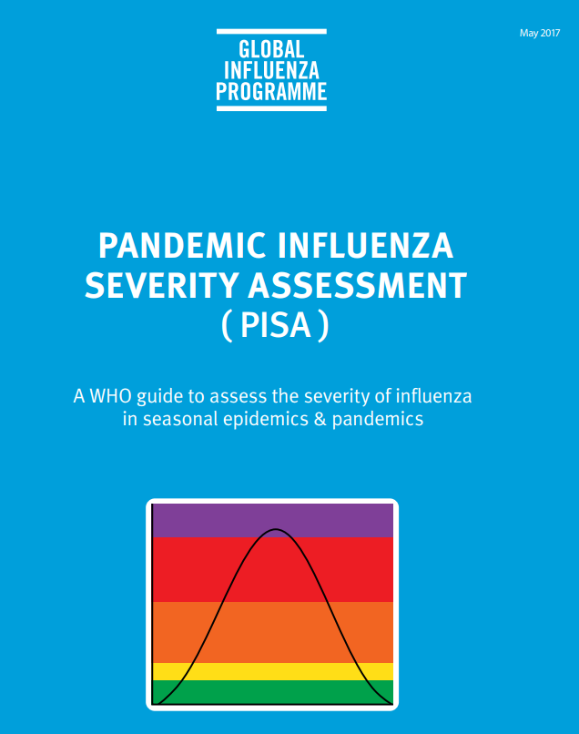
Background
  Pandemic Influenza Severity Assessment
  Severity is assessed using 3 indicators:
    Transmissibility
    Seriousness of disease
    Impact
  Sources of data
    Historical data from existing surveillance systems is used to calculate seasonal and intensity thresholds for various parameters
    Information from modeling and special studies, especially during a pandemic
http://www.who.int/influenza/surveillance_monitoring/pisa/en/
Notes:
Going back to the first recommendation on developing a severity assessment, which has been under development since 2013, and launched in 2017. I will focus on the last bullet point: the modeling and special studies component.

Slide 9
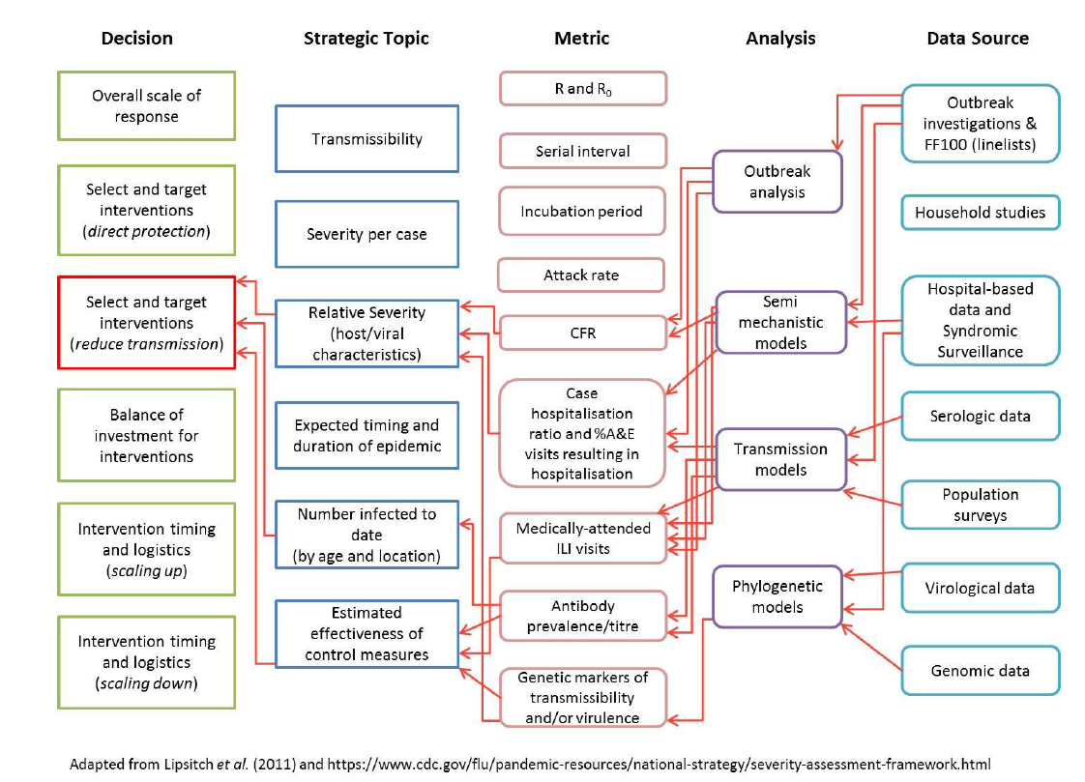
Background
  PISA Analytics component proposal (Imperial College London, WHO CC, 2016)
  Inform key decisions such as:
    Overall scale of the response
    Selecting and targeting interventions
    Timing of interventions (scaling up or scaling down)
Aligned with data coming from special studies
  Line lists
  Outbreak and household studies (FF100, contacts)
  Serosurveys
Notes:
In 2016, a proposal outlined how analytics could feed in to the overall severity assessment, addressing key decisions such as …, among others. The analytics component would have to be closely aligned with the data sources, such as special studies, including information from line lists, and looking at transmission dynamics, risk factors and outcomes in the FF100 studies and household studies. Serology to help us understand the age-specific attack rates and proportions of asymptomatic cases and risk.

Slide 10
Background
  PISA Analytics component proposal (2016)
  Epidemiology analysis:
      Transmission: reproduction number, serial interval, secondary attack rates… and how these change over time
      Seriousness and impact: ideally Infection Fatality Rate (IFR) but CFR and similar are what we must work with; expected number of cases according to severity pyramid
  Transmission modeling:
    Nowcasting and forecasting: timing and size of the epidemic or pandemic (and future waves for a pandemic
  Scenario planning and interventions analyses
Notes:
The proposal details the expected outputs from the analytical component. The epidemiology analysis would give more detailed info on the indicators, especially key parameters associated with transmission and seriousness of disease. Once these parameters are elucidated, key questions on timing, scenario planning, and interventions can be looked at with transmission models and uncertainty in predications can be expressed. In the proposal, data sources were also prioritized and types of collaborative structures were suggested.
Are we looking at modeling spread?

Slide 11
Background
  PISA launch meeting (March 2017)
  Modeling and special studies component:
  Beneficial especially during a pandemic when data from surveillance systems may be unstable or incomplete
  Data needs prioritized and sharing mechanisms proposed
  Reconvene special studies group to define data requirements and identify data sources
  Recommended that potential collaborative structures to be setup during intra-pandemic period
Notes:
In March 2017, the proposal was presented to a large group of PISA pilot countries and public health professionals. The modeling and special studies initiatives as part of PISA were endorsed and the following observations and recommendations were made. The last one being the one most relevant here and different in that this network be established not just during a pandemic, as happened in 2009.

Slide 12
IIAG development
  Influenza INCIDENCE analytics group (since late 2017)
  Key questions and scoping paper
  Call for collaborators
  Objectives:
    move from ad hoc work to an engaged network of modelers who use publicly available flu data from routine surveillance for incidence analytics (not genomics)
    enhance accuracy of incidence analytics;
    build a repository of tools which focus on incidence analytics
  Data sharing platform (which data and how to share)
Notes:
To take the last recommendation forward, an informal, ad hoc group was set up in the following manner. The focus of this group is incidence data as opposed to genomics data. The use of public data is to allow for transparency and reproducibility.
Example of key questions: When will seasons peak? Will the season be severe? What will happen in a certain country given circulation in a neighboring country?

Slide 13
IIAG
Current status:
Why now: collaborative structures to be setup during intra-pandemic period and as part of a comprehensive influenza programme
Who: WHO staff, country epidemiologists, academics (13-ish regulars)
When: teleconferences every 2-3 weeks
Current objectives: building the group and looking at the feasibility of real-time forecasting using available influenza incidence data
Notes:
The description of the group is here. Currently, we are focused on building the group and looking at the feasibility of using the avail data for real-time forecasting. So far, not focused on comparisons across time and space.

Slide 14
IIAG activities
  Highlights from the teleconferences:
  Github repository that contains the reproducible code
  Regular updates on the US CDC’s forecasting challenge (local data)
  Regular updates from Sarah Kramer’s forecasts on FluNet and FluID data (global)
  Recently, a few updates on Australia’s seasonal predictions (local data)
  Presentation on visualization options for modelling outputs
  Presentation on the Ebola synthetic challenge
  Discussion on next steps (building the network and mechanisms)

Slide 15
IIAG activities
Plans for IIAG and flu modeling
Concept/opinion paper
Meeting in November 2018
Make code/tools public
Increase use of public data (FluNet and FluID)
Increase collaboration
Investigate small amounts of funding
Real-time or synthetic challenge?
Tackle other challenges:
  Engage and understand needs of countries? (How is this helpful?)
  Standardization of coding and outputs
  Reach consensus
  Advocate for and increase modeling literacy
  Communicating outputs and uncertainty
  Monitoring and evaluation (measure performance and contributions to policy)
  Keep modelers engaged
Notes:
Some other things we are discussing… Have identified issues and challenges on the horizon. Keep modelers engaged (money, databases, forums, repositories, meetings, standards, workshops, publications…

Slide 16
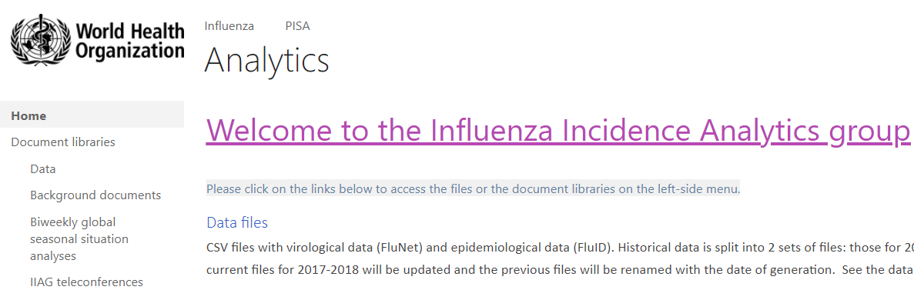
How to get involved
Contact:
Kaat Vandemaele (vandemaelek@who.int),
myself (hammonda@who.int) or
Steven Riley (s.riley@imperial.ac.uk)
Notes:
If you have any questions or suggestions or would like to get involved, please let me know or send us a message.

Slide 17
Acknowledgements
Katelijn Vandemaele, GIP
Julia Fitzner, GIP
Wenqing Zhang, coordinator of the Global Influenza Programme
Steven Riley and Natsuko Imai, Imperial College London, WHO CC
All the participants in the IIAG TCs and discussions in 2017-2018

Slide 18
Thank you

Slide 19
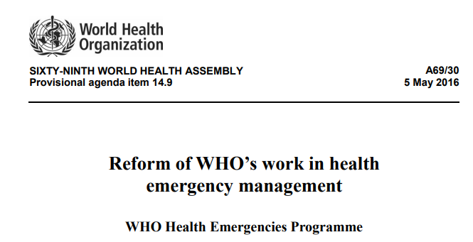
Context
WHO Health Emergencies Programme (2016) mission:
Help countries, and to coordinate international action, to prevent, prepare for, detect, rapidly respond to and recover from outbreaks and emergencies.
www.who.int/about/finances-accountability/budget/PB2018-2019_en_web.pdf?ua=1
apps.who.int/iris/bitstream/handle/10665/252688/A69_30-en.pdf?sequence=1&isAllowed=y
Notes:
Not exhaustive list.

Slide 20
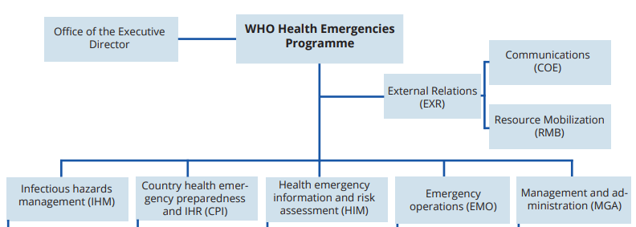
Context
WHO Health Emergencies Programme:
www.who.int/about/finances-accountability/funding/financing-dialogue/whe-update.pdf
Notes:
Not exhaustive list.

Slide 21
Context
The Infectious Hazard Management department provides technical support to countries and communities to prevent and control epidemics.
  Develop and manage expert networks at global level for forecasting and modelling, pathogen identification and virulence assessment...
  Provide technical expertise for risk assessment, event mitigation/control and response to new and evolving high-threat infectious hazards.
  Ensure wide access to adapted technical knowledge on new and evolving high-threat infectious hazards.
www.who.int/about/finances-accountability/budget/PB2018-2019_en_web.pdf?ua=1
Notes:
Not exhaustive list.

Slide 22
IIAG development
Objectives:
  Establish a network of interested scientists and surveillance officers (and policy makers?)
  Use publicly available global influenza incidence data provided in a standardized, machine-readable format conducive to advanced analytics
  Develop a repository of models for real-time prediction which can be shared and adapted
  innovative visualizations with historical comparison;
  incidence forecasting; and
  traditional epidemiological analyses conducted in real time (comparisons of current age distribution of cases to prior years or to current neighboring countries)
  Stimulating the generation of additional open source tools for the analysis of influenza incidence data
Notes:
These are the objectives as informally agreed upon within the group. Thus far, we have not engaged policy makers. Thus far, we have looked only at already existing modeling initiatives that collaborators are working on.

Slide 23
Data
FluNet (1997), is a global web-based tool established with the aim of being an early-alert system to provide international and national authorities, the public and the media with access to real-time virological influenza data.
Number of countries: 58 countries (1997) to 136 countries (2016)
FluID (2009) complements FluNet by providing influenza epidemiological data (ILI cases, ILI outpatients, SARI cases, SARI inpatients, and SARI deaths)
Number of countries: 114 countries (2011) and 108 (2016)
Data is housed in FluMart
http://www.who.int/influenza/surveillance_monitoring/fluid/en/
http://www.who.int/influenza/gisrs_laboratory/flunet/en/
www.who.int/influenza/resources/flumart/en/
Notes:
Not exhaustive list.

