Slide 1
2017–18 season pilots
Matthew Biggerstaff, ScD, MPH (mbiggerstaff@cdc.gov)
FluSight annual meeting
August 31, 2018

Slide 2
State Forecasts Pilot
  Purpose
    Determine accuracy of state-level forecasts of ILINet
    Explore the use of forecasting at the state-level (with CSTE)
    Determine if state-level data impacts regional- and national-level accuracy
  Targets
    Peak week, peak % and % 1–4 weeks ahead
  Shared data
    Historic (back to 2010–11 season) ILINet and virologic data for 36 jurisdictions, plus ongoing access to their data in real time
  Timeline
    Pilot of state-level forecasts for 2017–18 season
    Draft guidance available
    Should we focus on a core set of states for evaluation?

Slide 3
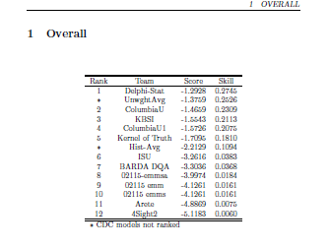
Scores (Overall)

Slide 4
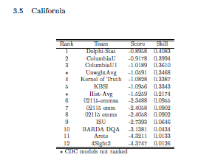
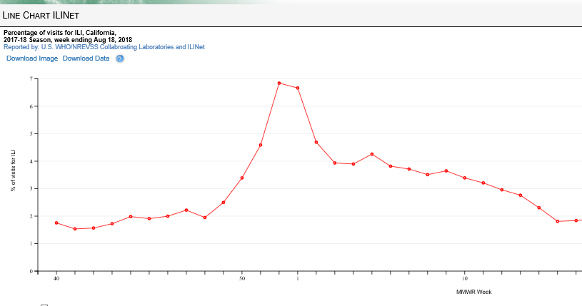
Scores (California)

Slide 5
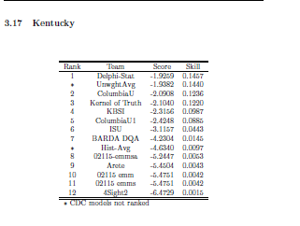
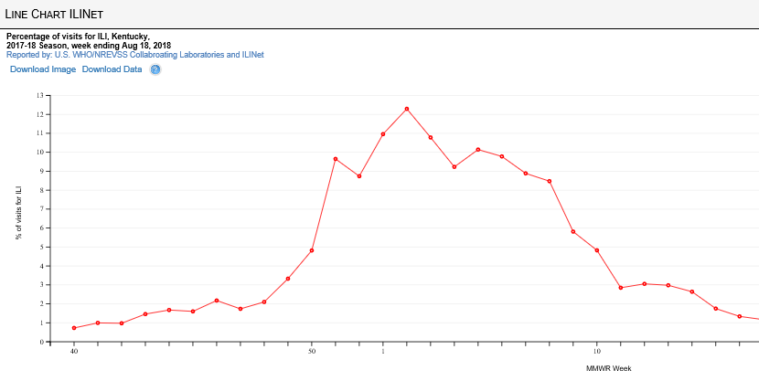
Scores (Kentucky)

Slide 6
Discussion
This represented a lot of work. THANK YOU
What did we learn?
What were barriers of participation?
Should this continue?
What is needed to continue?
What should change?

Slide 7
Hospitalization Forecasting
  Purpose
    Determine accuracy of forecasts of lab-confirmed rates of influenza hospitalizations
    Compare with ILINet (non lab-confirmed)
    Evaluate utility to inform influenza severity/burden estimates
  Targets
    Rates 1–4 weeks ahead of publication, peak week, peak rate (overall and for five age groups)
  Shared data
    Initial AND revised rates and census population estimates for catchment
  Timeline
    Limited pilot of retrospective forecasts; pilot of prospective forecasts for 2017–18 season
    Guidance available for comment

Slide 8
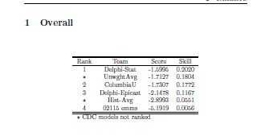
Scores (overall)

Slide 9
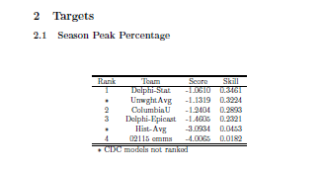
Score (peak intensity)

Slide 10
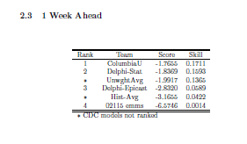
Score (1-week ahead)

Slide 11
Discussion
This represented a lot of work. THANK YOU
What did we learn?
What were barriers of participation?
Should this continue?
What is needed to continue?
What should change?

Slide 12
Setting the research priorities
Matthew Biggerstaff, ScD, MPH (mbiggerstaff@cdc.gov)
FluSight annual meeting
August 31, 2018

Slide 13
Ideas?
Demonstrating causal improvements in forecast accuracy
  “Vintage” models, models with and without certain data
Methods to incorporate additional data or approaches
  Genetic and/or “World” data
Deconstruct 2017-18 season
  Systematically test data sources/approaches to see if we can improve
Studying behavioral responses to forecasts/what people need to use them
Surveying forecast end users (Columbia has a recent paper)

Slide 14
How?
What do we need to move forward on these priorities?
Should we formalize the recommendations?
Who wants to help?

Slide 15
2018-19 FluSight priorities
Matthew Biggerstaff, ScD, MPH (mbiggerstaff@cdc.gov)
FluSight annual meeting
August 31, 2018

Slide 16
Next season priorities
Continue FluSight
Improve visualization
Improve communication
Increase in season collaboration and information sharing among forecasters and public health
Increase state and local partner outreach and awareness
Explore how to “pilot” state forecasting beyond ILINet with states
Think about/refine targets (end week?)
Advocate for resources
What else????

