Slide 1
Epidemic Prediction Initiative
Michael A Johansson

Slide 2
Objectives
Connect forecasting research to decision making needs
Facilitate applied forecasting research
Evaluate forecast skill
Operationalize forecasting

Slide 3
EPI funding
CDC Influenza Division
CDC Division of Vector-Borne Diseases
Department of Health and Human Services Idea Lab
CDC Office of Public Health Preparedness and Response (3 years)
  Web application development
  Stakeholder engagement
    Talks (scientific, data science, open data, training)
    Workshops
    CSTE
Future funding…

Slide 4
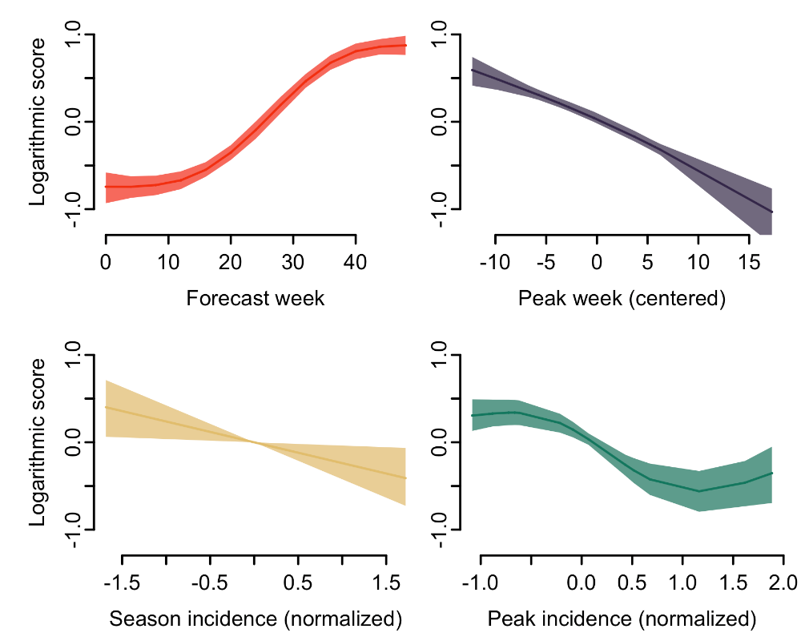
Dengue forecasting challenge
Manuscript
Correlates of accuracy:
  Forecast week
  Early peak
  Low incidence (season & peak)
Model type:
  Statistical
  No climate data
  No vector component
  Ensembles

Slide 5
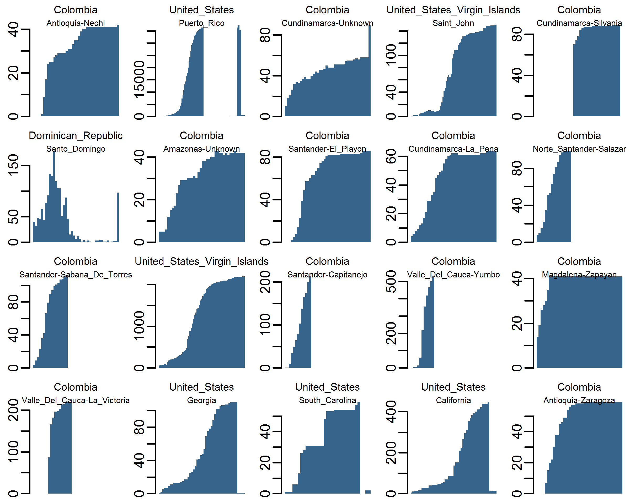





Zika data repository
20 contributors from academia and government
1,000s of clones
150+ stars
100+ forks
10+ citations
900+ reports, 1,500+ locations
Common referring sites:

Slide 6
Council of State and Territorial Epidemiologists
Seminars
  November 2017
  100+ participants each
Working group
  Jennifer Myers, California Department of Health
  Greg Danyluk, Florida Department of Health in Polk County
  50+ participants
  Sub-groups: influenza, vector-borne

Slide 7
Council of State and Territorial Epidemiologists
CSTE/CDC Epidemic Forecasting Workshop:
  June 2018
  ~60 applications
  30+ participants
CSTE/CDC Seasonal Influenza Forecasting (“FluSight”) Workshop
White paper

Slide 8
Web application
predict.phiresearchlab.org → predict.cdc.gov
Advantages:
  Institutional, security, stability
Challenges:
  Not up-to-date, bugs, testing
Future:
  Updated client/server side processing
  API
  JSON
  Visualizations

Slide 9
Improving forecast formats
Excel → csv → JSON
Challenges:
  Upload/transfer speed
  Target flexibility
  Alternative distribution types
  Modeler-side verification and evaluation
Software package?
Notes:
Target example: age groups

Slide 10
csv ↔ nested data.frame ↔ JSON
https://github.com/jennybc/lego-rstats

Slide 11
Challenge guidelines
A guide to setting up new forecasting challenges
Establish objectives and targets
Identify, acquire, or simulate data
Construct models
Evaluate predictions
Forecast
Communicate forecasts

Slide 12
Aedes forecasting
Aedes aegypti and Aedes albopictus
Vectors of chikungunya, dengue, yellow fever, and Zika viruses
Limited surveillance
Need for vector control

Slide 13
“ESTIMATED range”
CDC 2016

Slide 14
“ESTIMATED potential range”
CDC 2017, Johnson et al. 2017
Notes:
What about presence? Seasonality?

Slide 15
Preparing for the next pandemic
“It is difficult to make predictions, especially about the future.”
Tools
  Framework, data and forecast pipelines, evaluation metrics, visualizations, evidence base
Community
  Researchers and public health professionals experienced in developing, producing, and interpreting real-time forecasts

Slide 16
Acknowledgements
The Epidemic Prediction Initiative community
CDC Epidemic Prediction Initiative
Office of Public Health Preparedness and Response
Influenza Division
Division of Vector-Borne Diseases
Matt Biggerstaff
Craig McGowan
Juan Sanchez Montalvo
Luis Mier-y-Teran Romero
Dania Rodriguez Vargas
F. Scott Dahlgren
mjohansson@cdc.gov

