Slide 1
Forecast calibration
Michael A Johansson

Slide 2
“It ain’t what you don’t know that gets you into trouble. It’s what you know for sure that just ain’t so.”
- Mark Twain

Slide 3
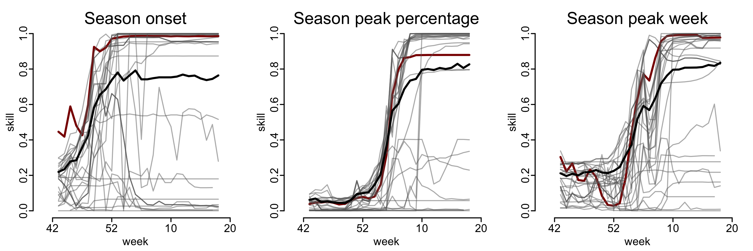
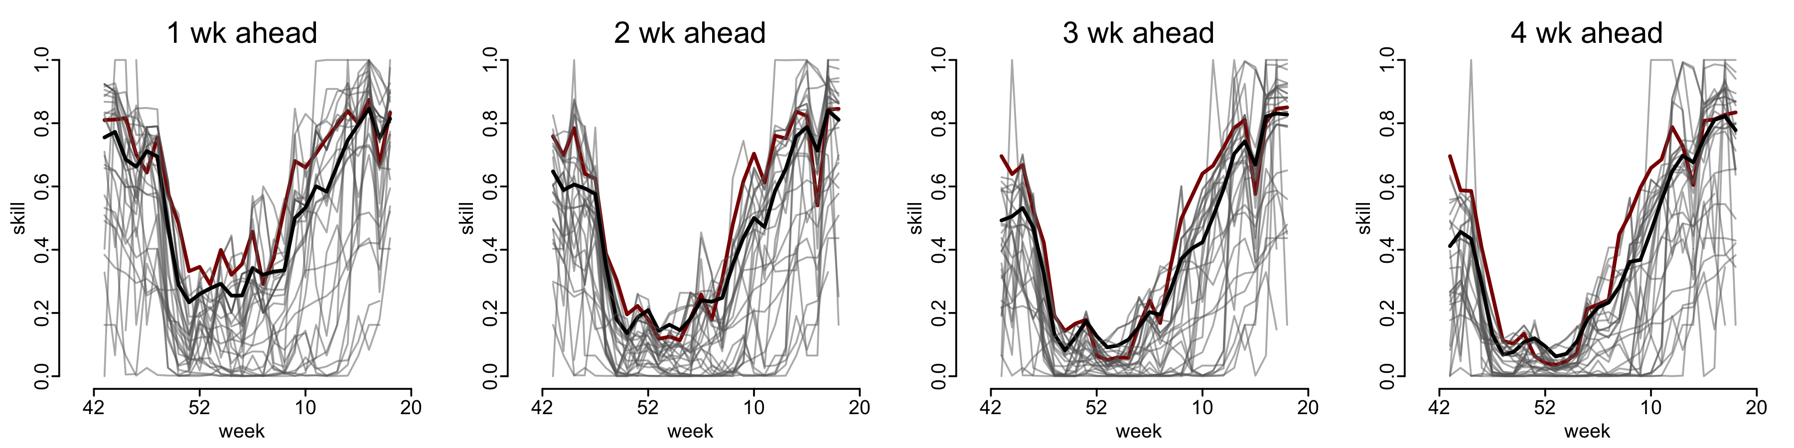
Forecast skill 2017-18
Top team overall
Unweighted ensemble
Notes:
Lower skill not necessarily a worse forecast

Slide 4
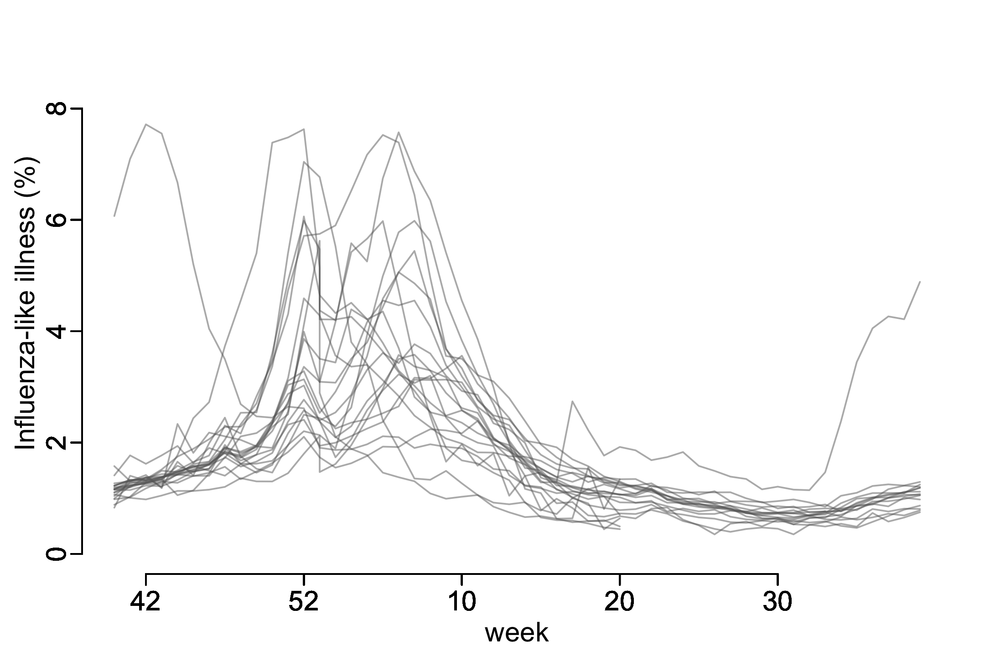
ILINet 1997-2018
2009

Slide 5
ILINet 1997-2018
2009

Slide 6
ILINet 1997-2018
2009
Notes:
Objective: maximize the probability assigned to the outcome AND minimize the probability that we’re wrong.

Slide 7
calibrate \ ˈka-lə-ˌbrāt \
: to standardize (something, such as a measuring instrument) by determining the deviation from a standard so as to ascertain the proper correction factors
www.merriam-webster.com

Slide 8
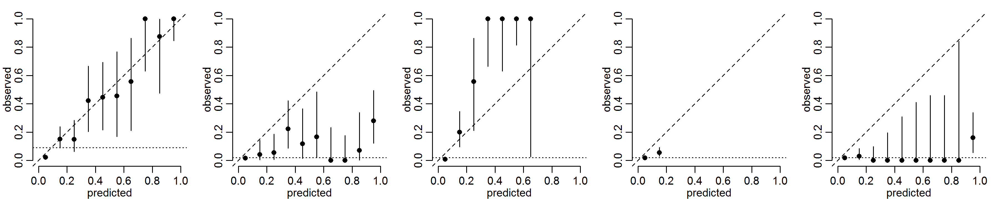
Forecast calibration
Well-calibrated
Over-confident
Under-confident
No confidence
No resolution

Slide 9
Calibration 2014-15 to 2016-17
Notes:
overconfident

Slide 10
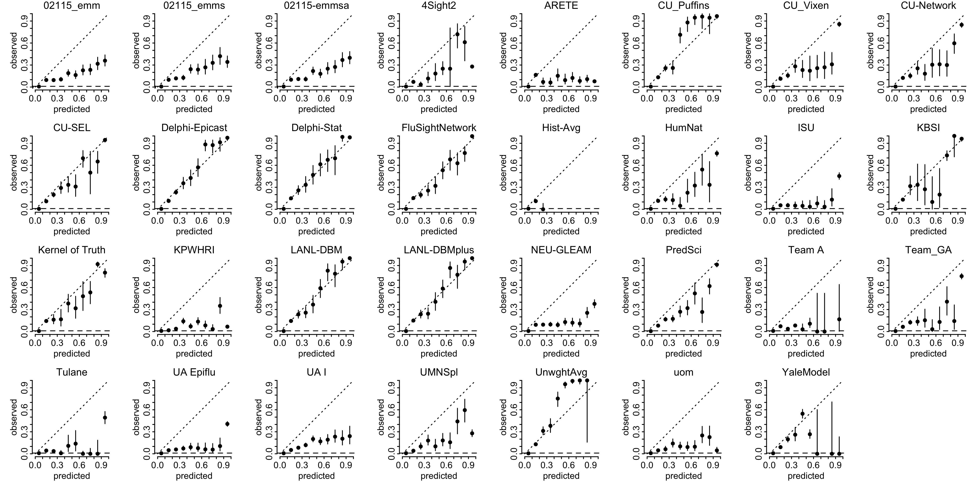
Calibration 2017-18

Slide 11
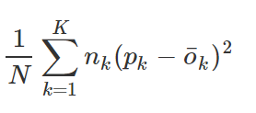
Calibration metric
Single metric to characterize calibration
Squared error metric comparing binned (k) predictions (p) to observations (o)
Sub-component of Brier Score
Closer to 0 is better
All individual bins included → many low-probability predictions → low numbers

Slide 12
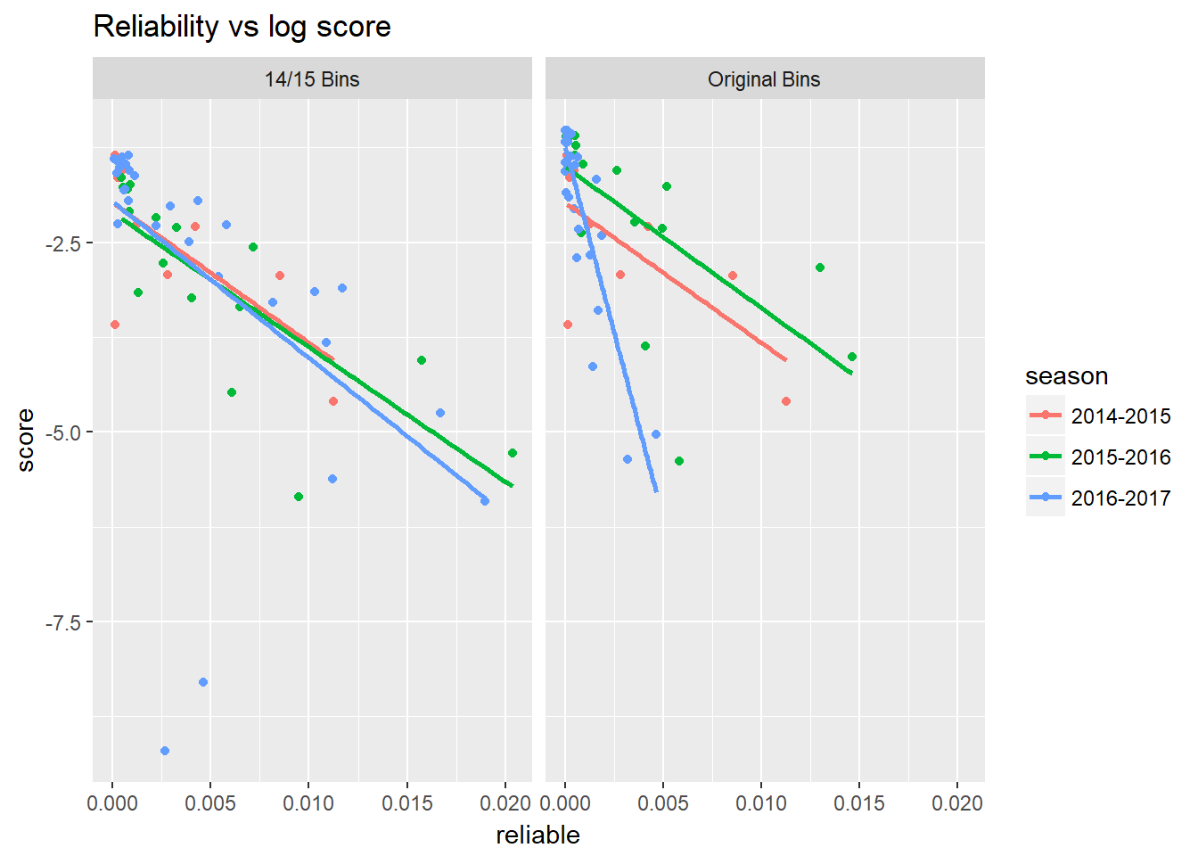
Better calibration = Better Log Scores
Log score
Calibration

Slide 13
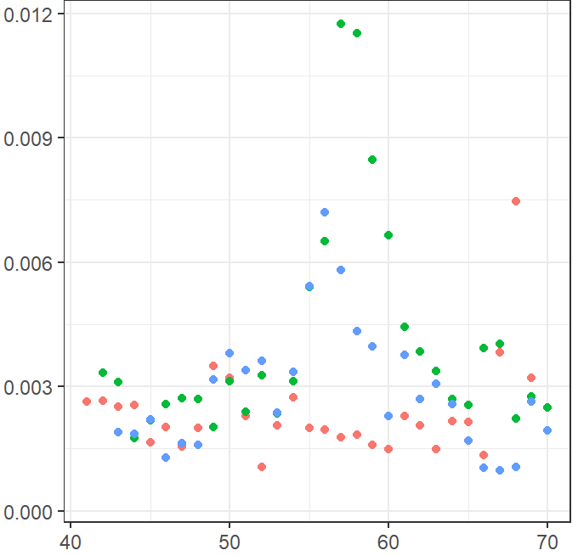
Correlates of reliability
Experienced teams not significantly better than new teams
Ensembles not necessarily better than single models
Calibration worst in mid-season
Calibration
Week of season

Slide 14
Calibration maters to public health
There is an 90% chance that the epidemic will peak between week 1 and week 3.
There is an 20% chance that the epidemic will peak between week 1 and week 3.
Notes:
If better calibrated, the latter is a better forecast

Slide 15
Forecast skill 2017-18
Top team overall
Unweighted ensemble
Notes:
Lower skill not necessarily a worse forecast

Slide 16
Conclusions
Pay attention to calibration
Even models with low accuracy can be well calibrated
Better calibration will improve log scores
Calibration is necessary for reliability and public health utility
BUT calibration alone does not make a forecast useful

Slide 17
“It is remarkable how much long-term advantage people like us have gotten by trying to be consistently not stupid, instead of trying to be very intelligent.”
- Charlie Munger
Notes:
Vice Chairman Berkshire Hathaway

