Slide 1
BARDA-DQA
CDC State-ILI Forecasting challenge
Carlos J. Arguello, Ph.D.
Jason Asher, Ph.D.
Jessica Appler, Ph.D.
August 30, 2018

Slide 2
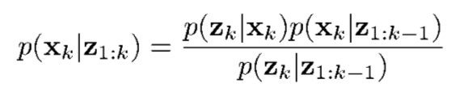


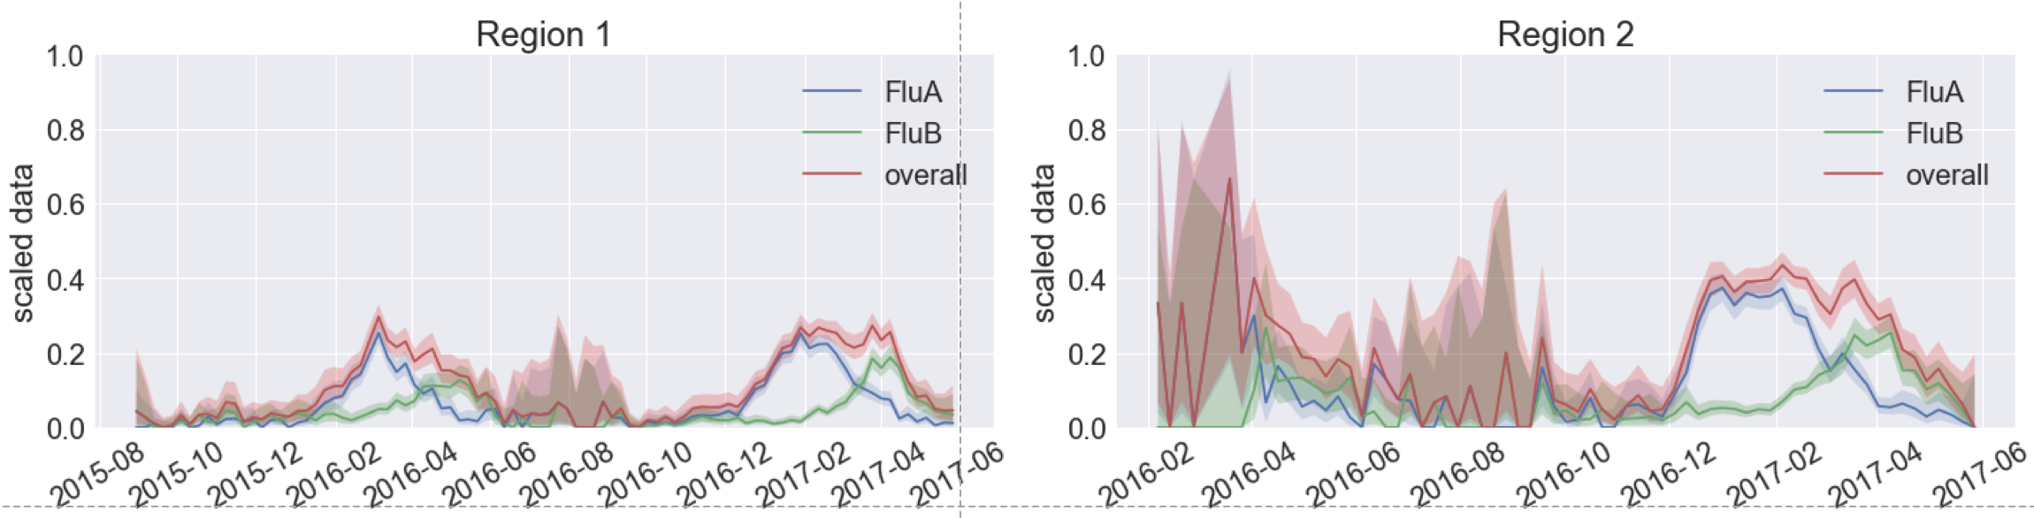
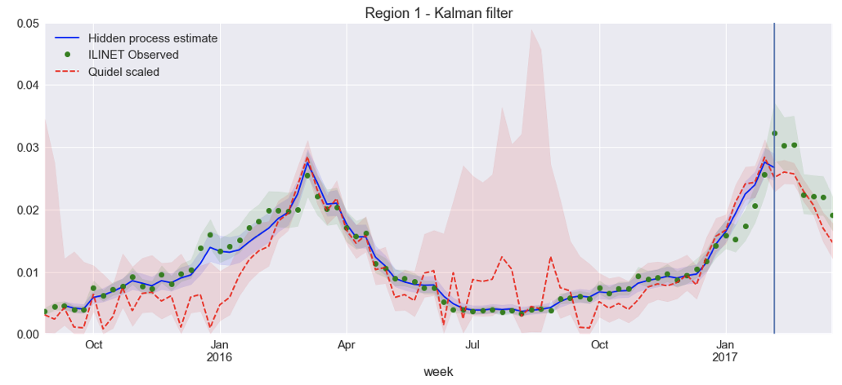
METHODOLOGY
Kalman Filter (Linearization. Gaussian distributions, easy to compute)
Bayesian Optimal Filtering
“Stable ILINet”
(Forecasting target)
Build ARIMA SS model.
Sensors:
ILINet (lagged, backfill) (State level)
Quasi real-time Influenza (A, B) diagnostics tests (Quidel Virena data)
Quidel for ILINet nowcasting…
Pretty cool at HHS regional level!

Slide 3
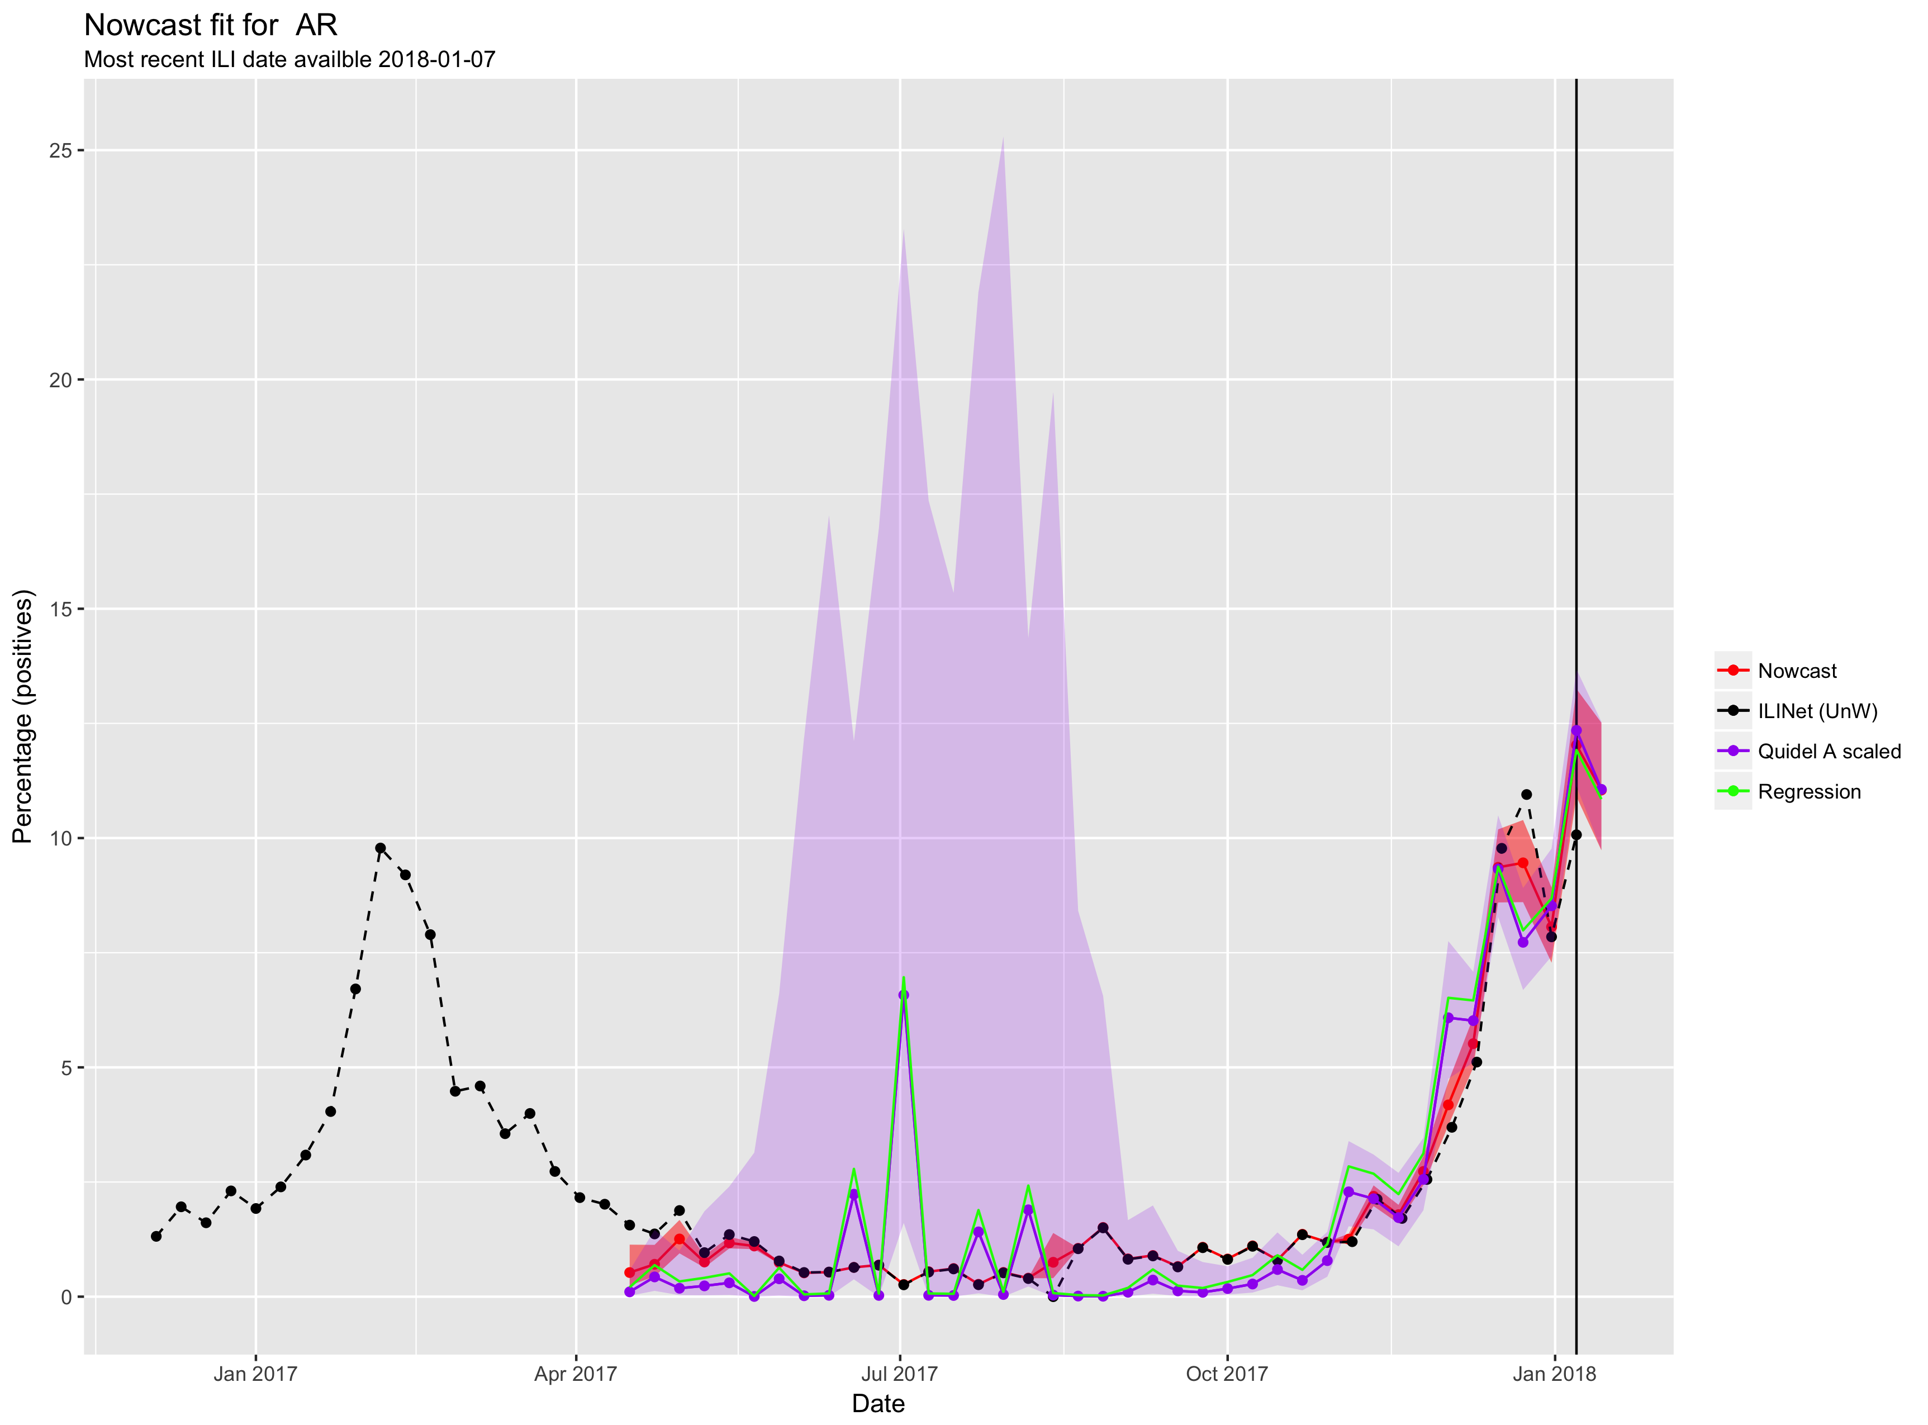
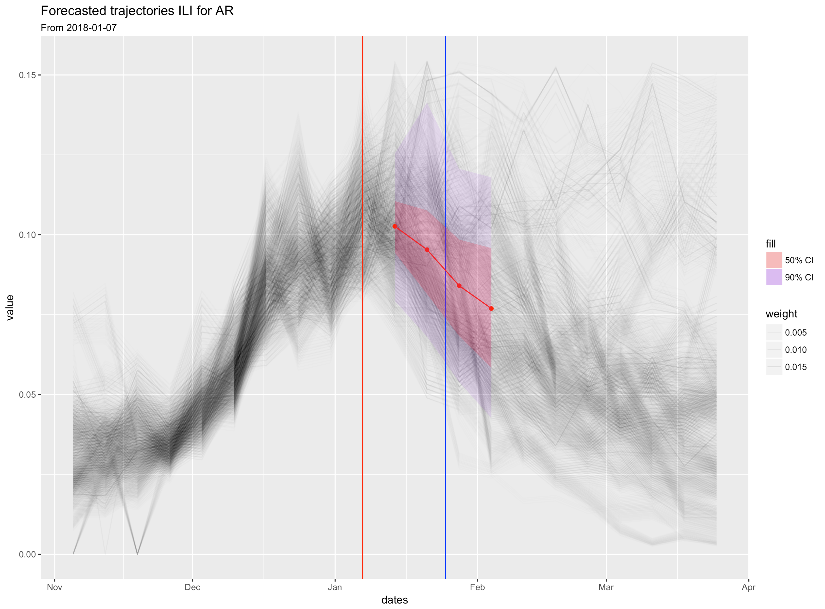
METHODOLOGY:
NOWCASTING AND FORECASTING
Method of Analogues – Use Kalman Smoother posterior distribution to assign likelihood of trajectories!
Nowcasting at State level: Linearize Quidel signal, use ILINet. Run Kalman Filter + Kalman Smoother

Slide 4
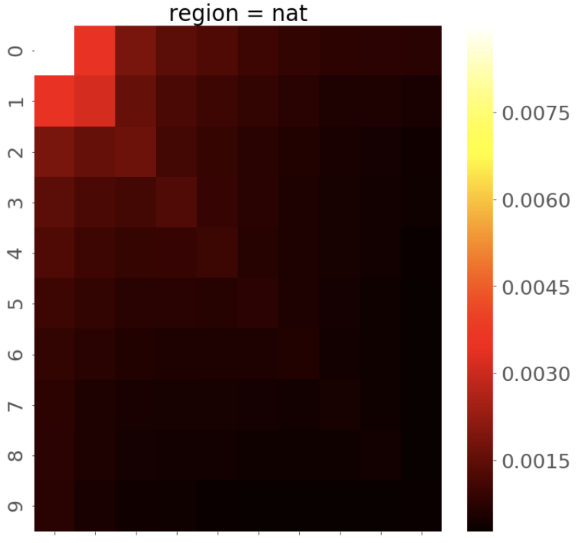
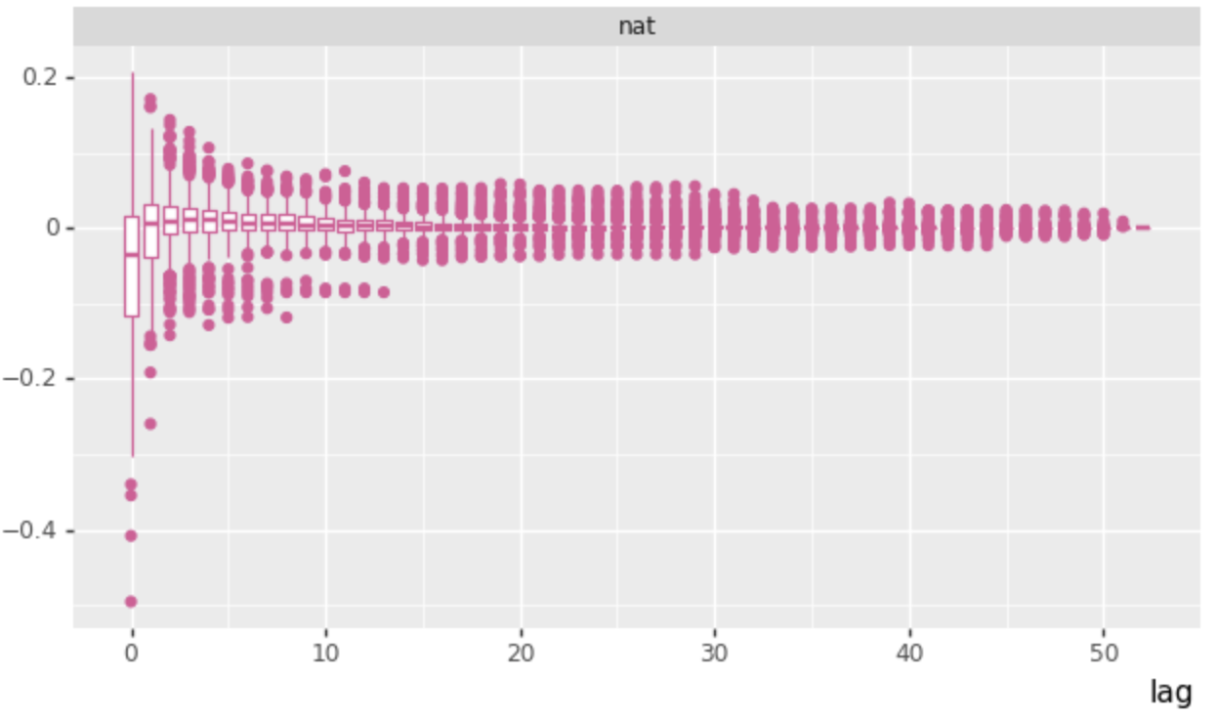
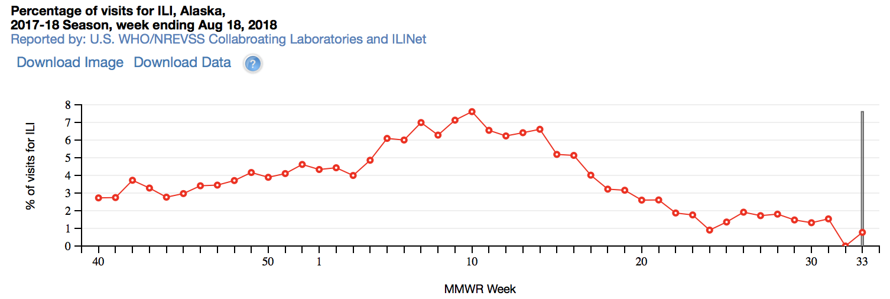
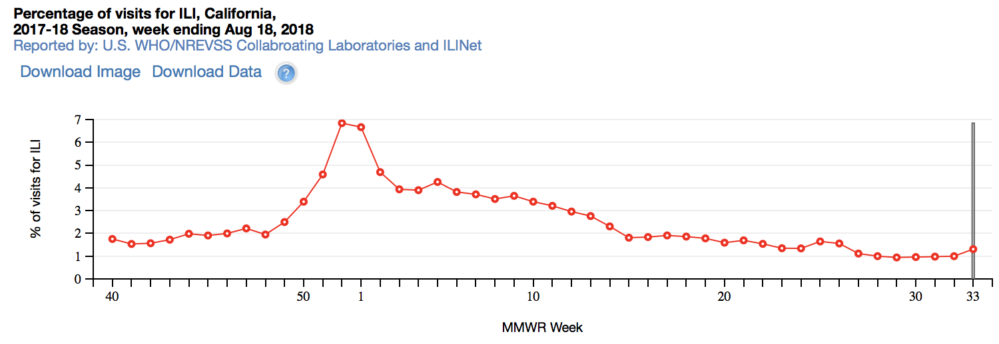
CHALLENGES: ILINET BACKFILL AND STATE-ILI DYNAMICS VARIABILITY!
ILINet – Backfill process
Time persistance
Backfill process – Large covariance
Modeled as “colored” AR(1) Noise in KF
ILINet - AK
ILINet - CA
Is this double peak real?

Slide 5
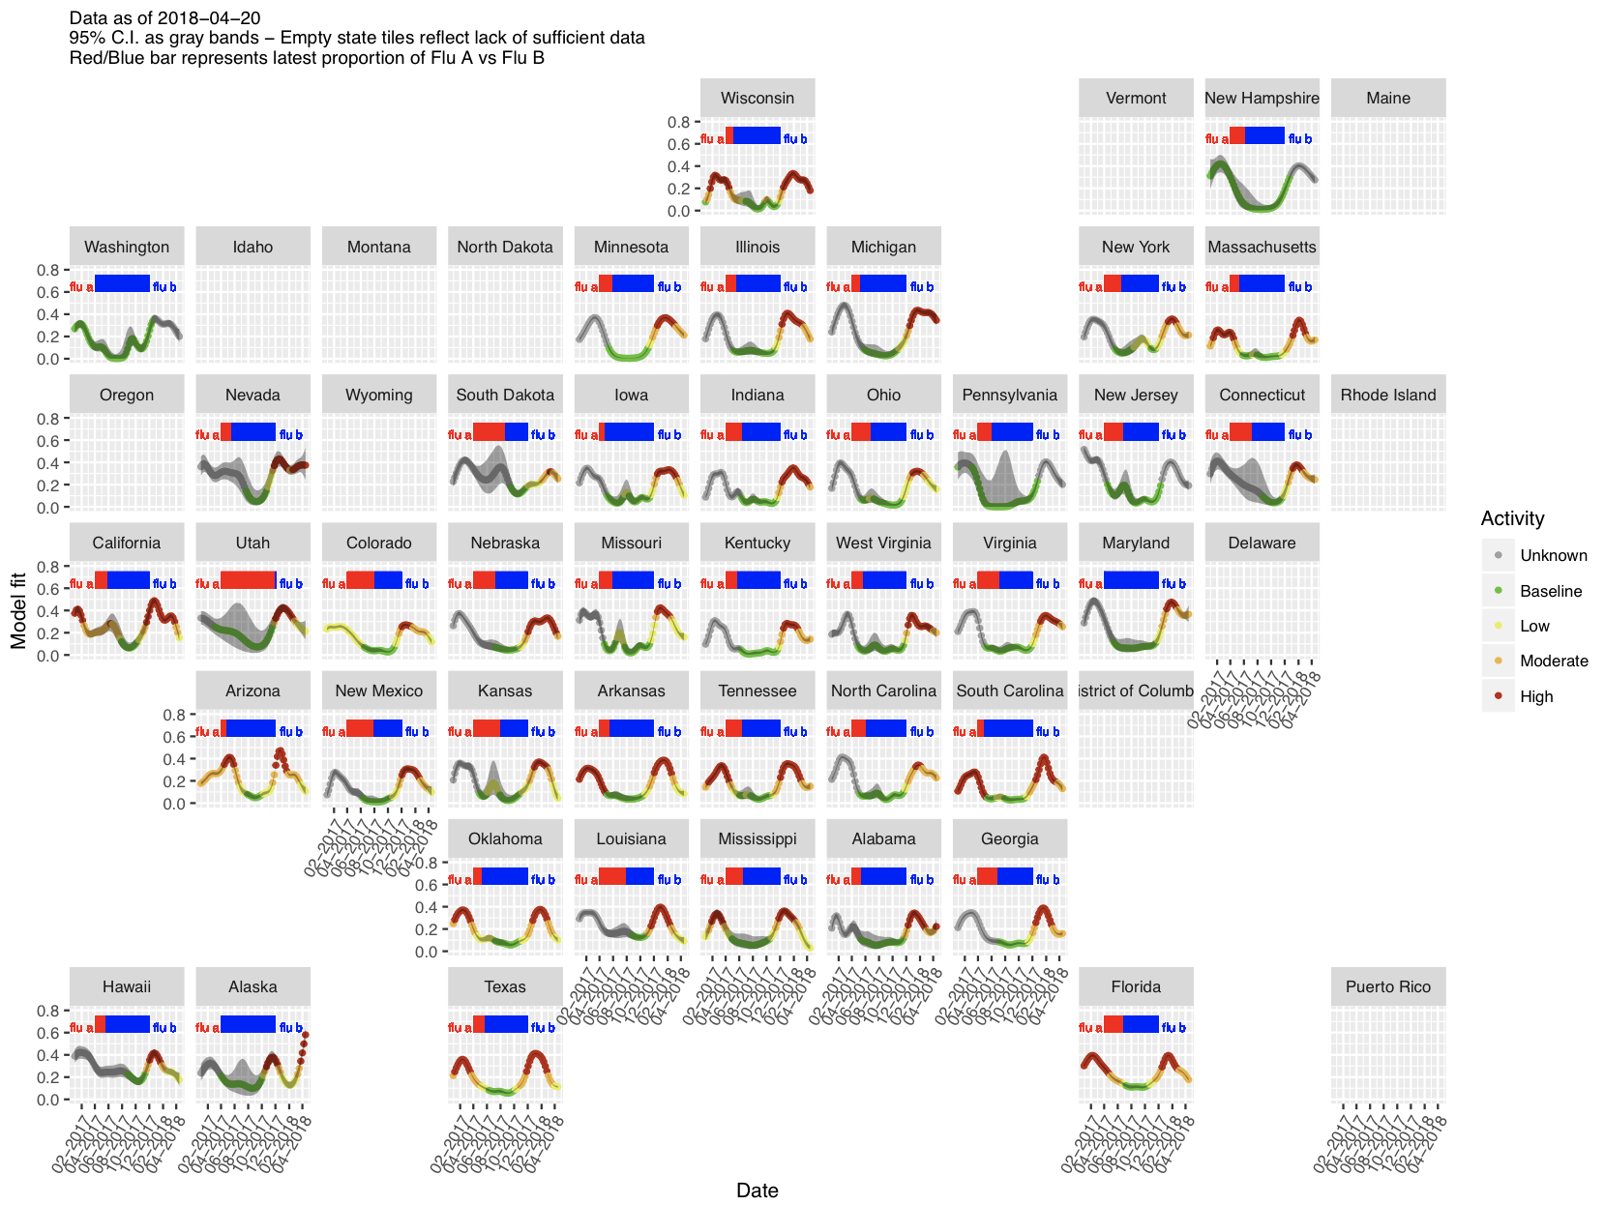
LESSONS LEARNED – Near real time awareness… Great for operational purposes!
Our Job:
Provide leadership and decision makers with current, clean (and defensible!) influenza activity models.
  Moving away from purely symptomatic data (if possible)…
  Or cleverly separate Influenza from RSV, other confounders…
  Or even better, 1+2 + Real time data!
DATA!!! Extra data sources!

Slide 6
THANK YOU!!!

Slide 7
BACK-UP SLIDES

Slide 8
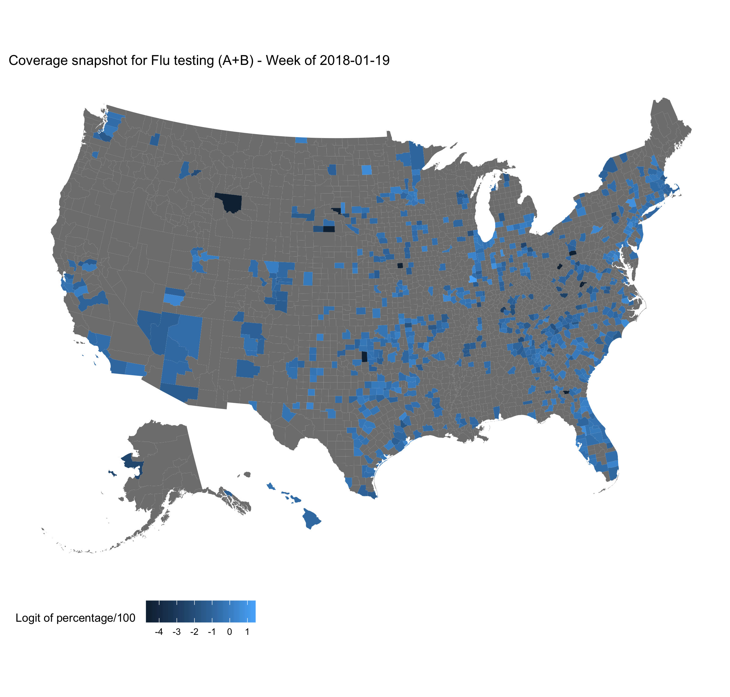
Quidel Dataset
Daily counts, naturally modeled after Binomial or Poisson distributions.
High granularity (zip code level!)
Relatively clean (a bit of duplication ~ 3% of records).
Easy for the most part to identify.

Slide 9
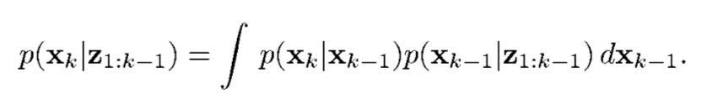

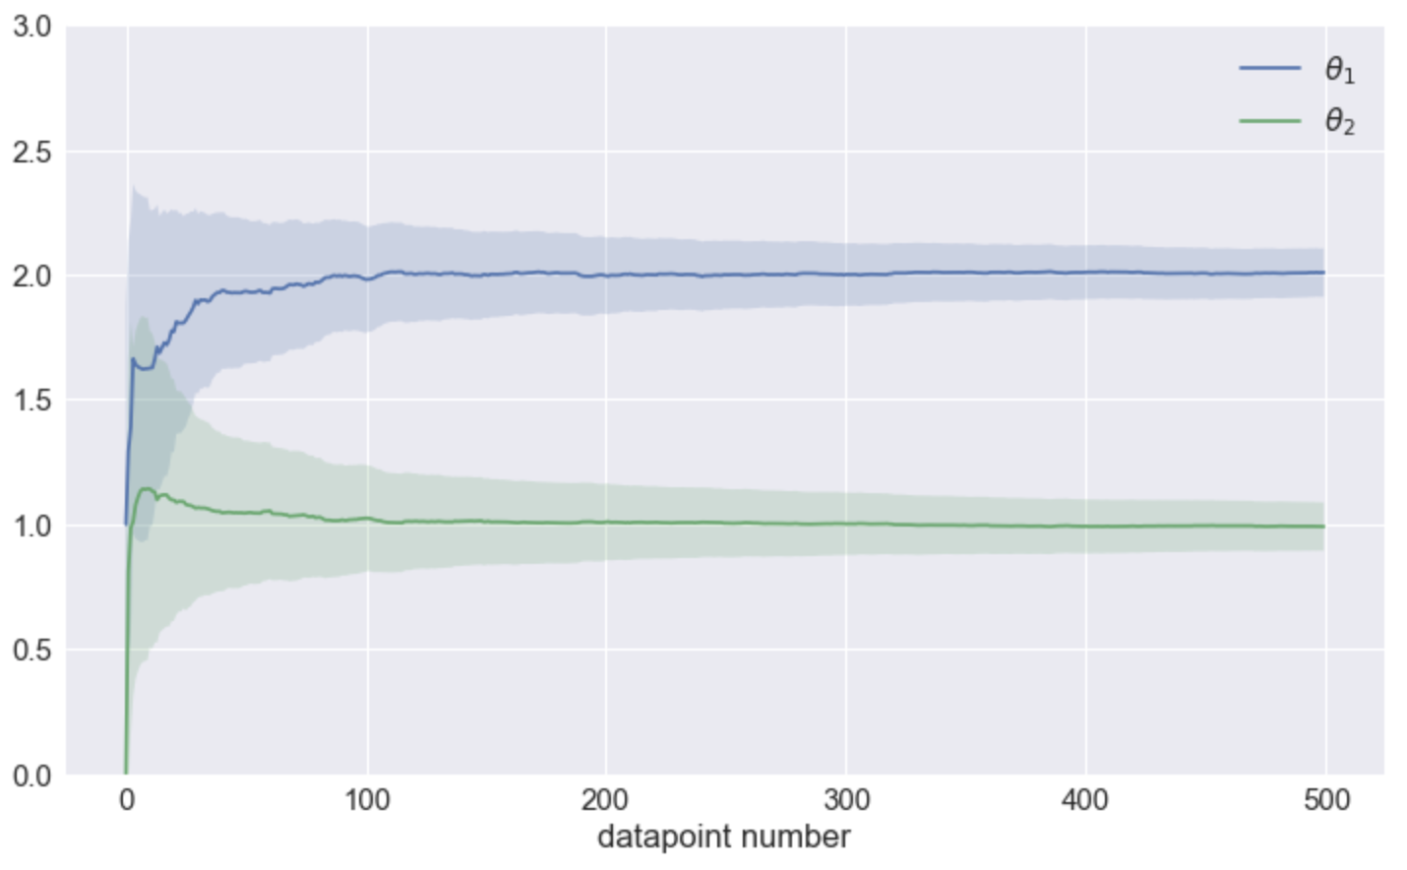
METHODOLOGY
Bayesian Optimal Filtering
“Stable ILINet”
(Forecasting target)
Example: Online Regression:
“Sensors”
Which sensors can we use?

