Slide 1
FluSight Collaborative 2017/18
Columbia University
J. Shaman, T. Yamana, S. Pei, H. Morita, S. Kandula

Slide 2
Overview
Data source
  Use of Google search trends based nowcast
New model for regional forecasts
  Human mobility informed network model
  CU-Network
Comparison of forecast quality – state vs regional
  State level ILINet data for Washington DC

Slide 3
1. Nowcast
Sun
Sat
Mon
Fri
Submitted as 1-week ahead forecast
  Regional, State and Hospitalizations
Used as an ‘observation’ in forecast models
API was unavailable for 2 weeks (EW45, EW46)
Kandula, S., D. J. Hsu and J. Shaman: Sub-regional nowcasts of seasonal influenza using search trends. J Med Internet Res. 2017; 19(11):e370

Slide 4
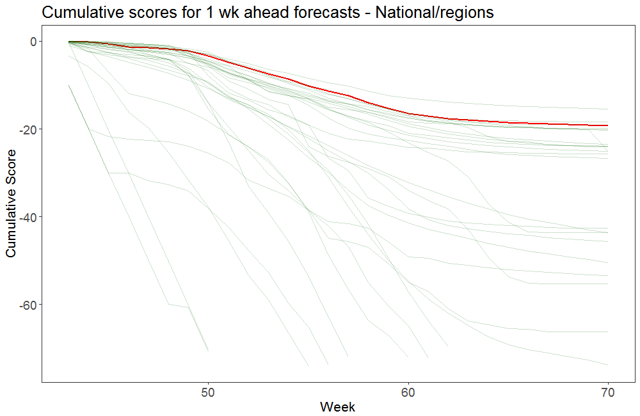

Slide 5
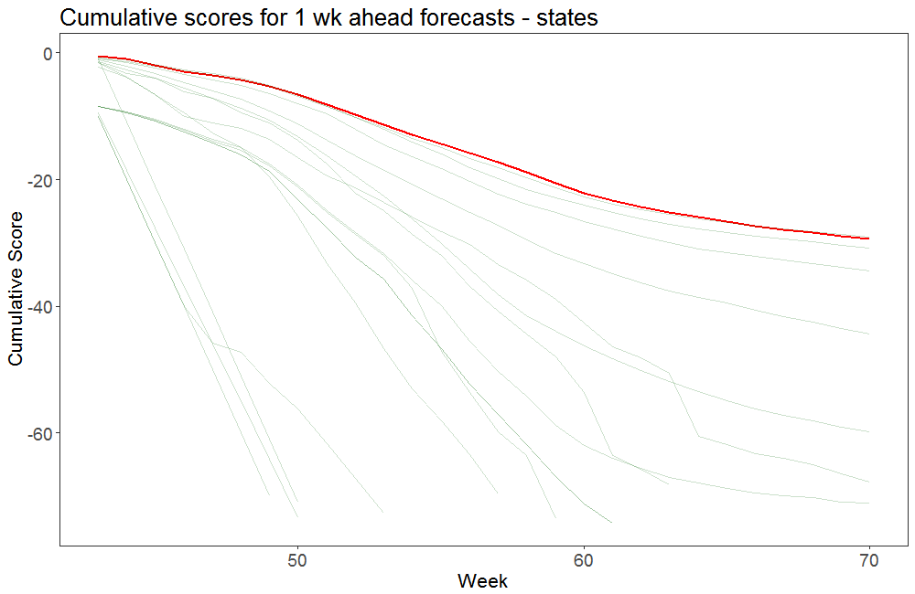

Slide 6
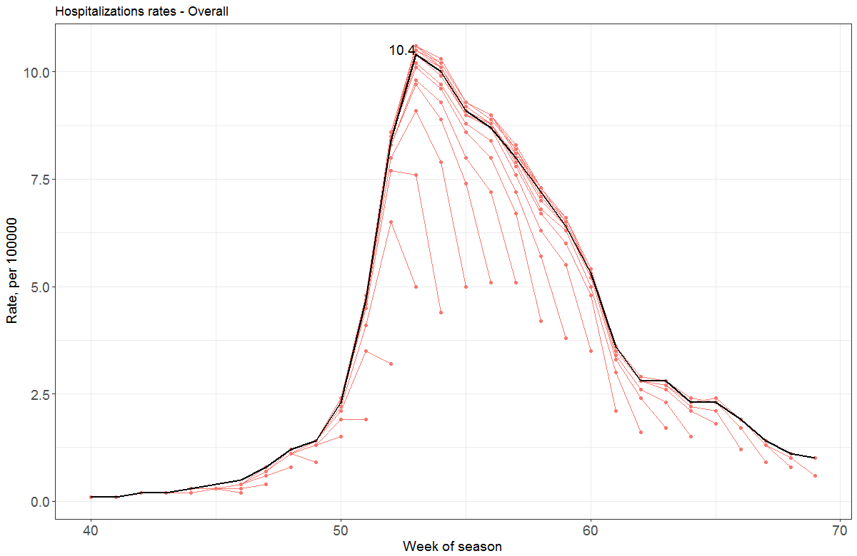

Slide 7
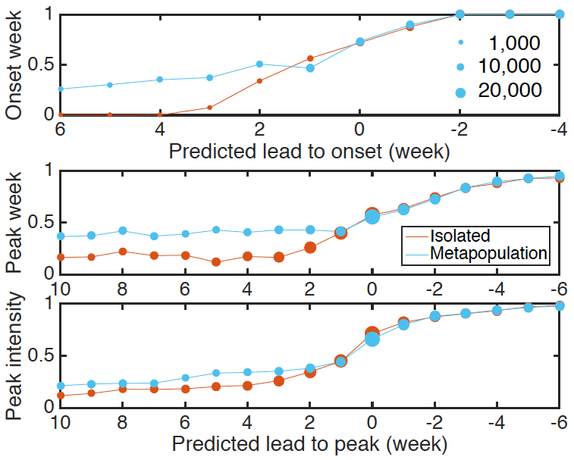
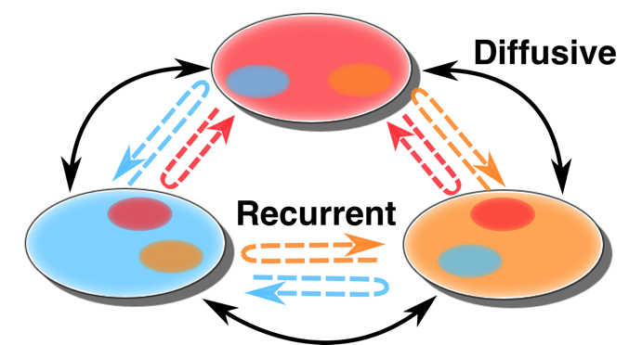


2. Network model for regional forecasts
Metapopulation model
  Human mobility for connectedness
Two types of mobility
  Recurrent work commute
  Diffusive random movement
US Census Bureau data
Pei, S et al. Forecasting the spatial transmission of influenza in the United States. PNAS Feb 2018;Image: Sen Pei

Slide 8
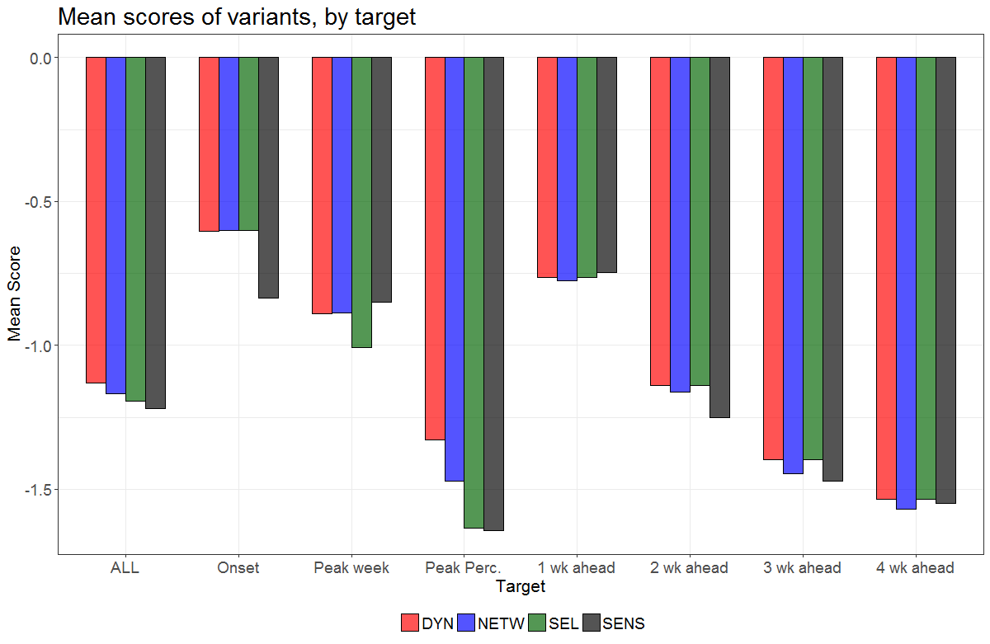

Slide 9
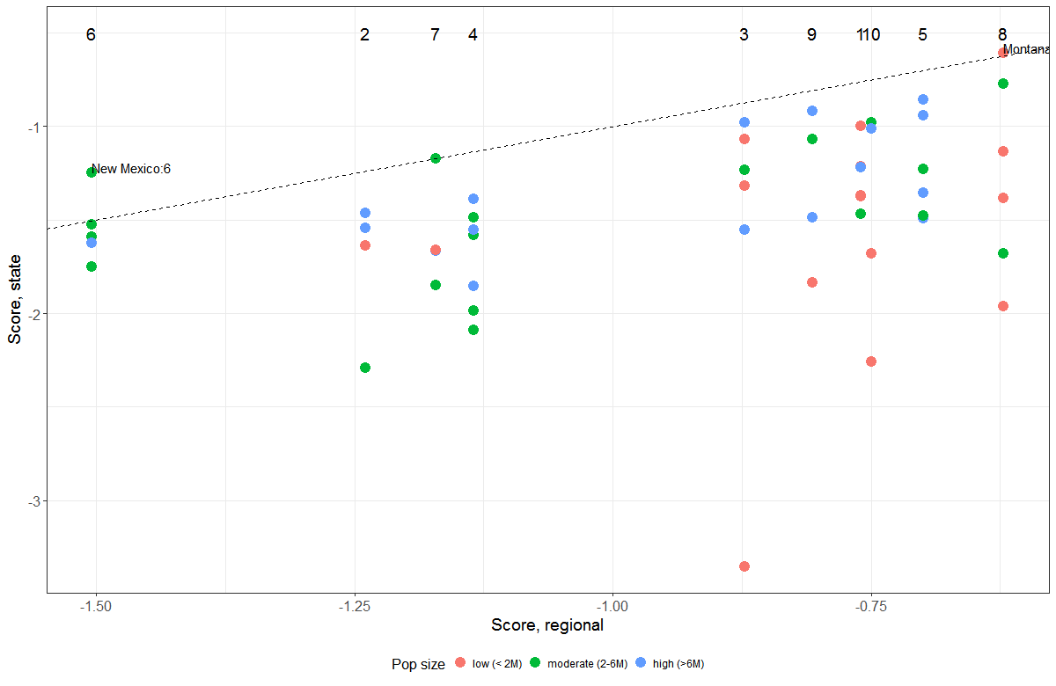
3. Comparison of State & Regional forecasts
District of Columbia

Slide 10
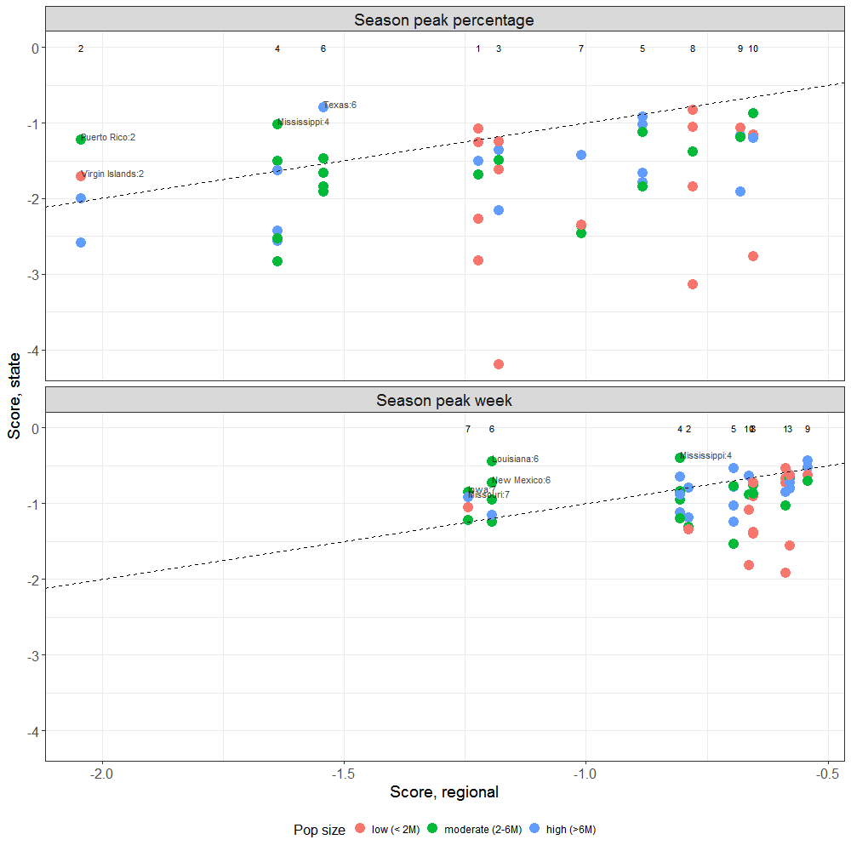
Notes:
Label if score.st –score.reg > 0.25

Slide 11
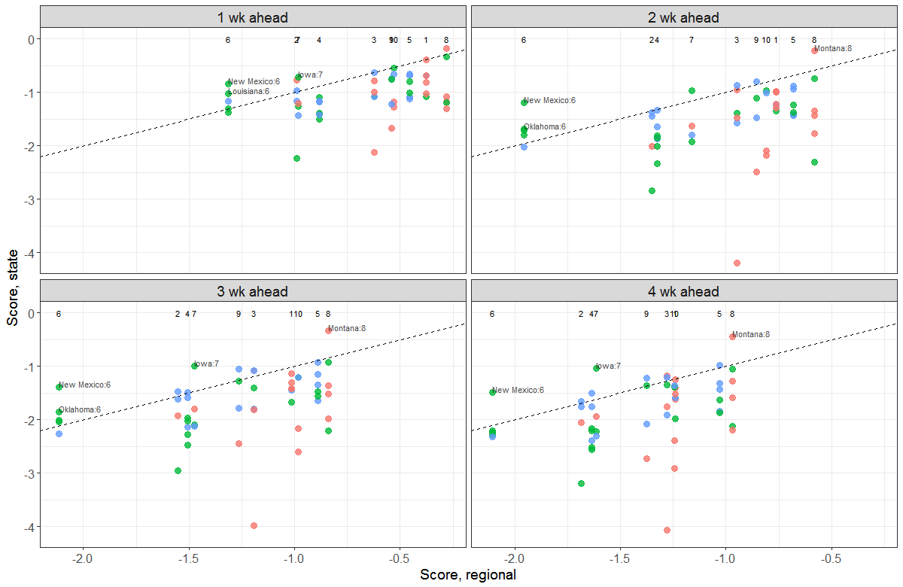
Notes:
Label if score.st –score.reg > 0.25

Slide 12
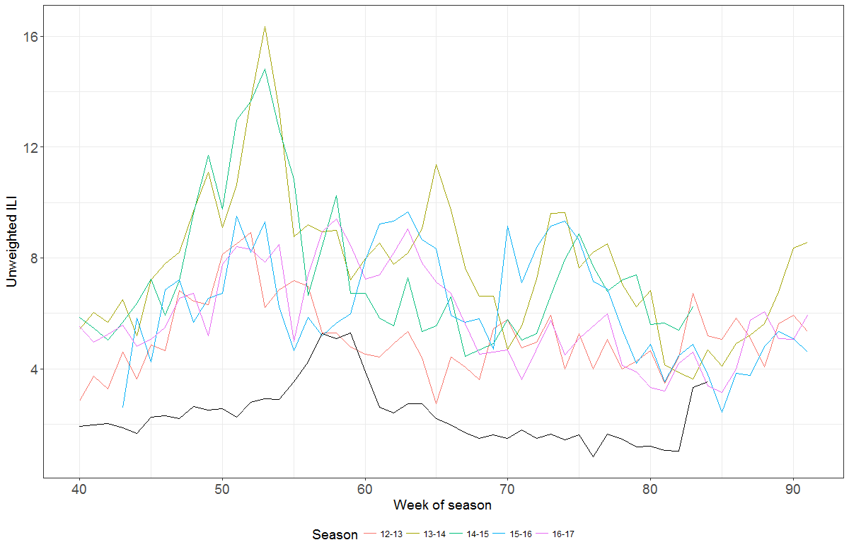

Slide 13
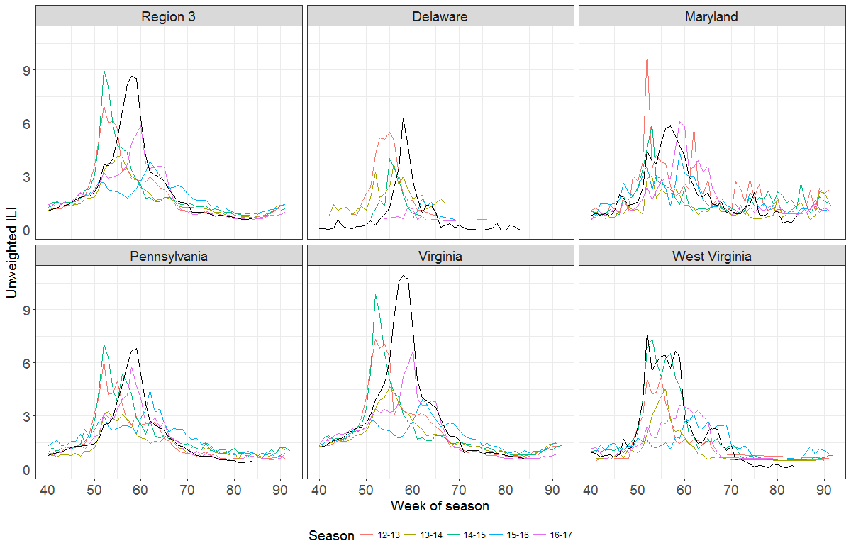

Slide 14
Standings
National/Regional ILI
State ILI
Hospitalizations
Rank | Team | Score | Skill
1 | Delphi-Epicast | -1.0962 | 0.3341
2 | FluSightNetwork | -1.1037 | 0.3316
3 | LANL-DBMplus | -1.1166 | 0.3274
4 | LANL-DBM | -1.1276 | 0.3238
5 | CU-DYN | -1.1301 | 0.323
* | UnwghtAvg | -1.1559 | 0.3148
* | PPFST Crowd | -1.1573 | 0.3143
6 | CU-Network | -1.169 | 0.3107
7 | CU-SEL | -1.1947 | 0.3028
8 | Delphi-Stat | -1.204 | 0.3
9 | CU-SENS | -1.2196 | 0.2953
10 | Kernel of Truth | -1.2422 | 0.2887
…
Rank | Team | Score | Skill
1 | Delphi-Stat | -1.2928 | 0.2745
* | UnwghtAvg | -1.3759 | 0.2526
2 | ColumbiaU | -1.4659 | 0.2309
3 | KBSI | -1.5543 | 0.2113
4 | ColumbiaU1 | -1.5726 | 0.2075
5 | Kernel of Truth | -1.7095 | 0.181
…
Rank | Team | Score | Skill
1 | Delphi-Stat | -1.5995 | 0.202
* | UnwghtAvg | -1.7127 | 0.1804
2 | ColumbiaU | -1.7307 | 0.1772
3 | Delphi-Epicast | -2.1478 | 0.1167
* | Hist-Avg | -2.8993 | 0.0551
4 | 02115_emms | -5.1919 | 0.0056
Notes:
CU_DYN = CU_Vixen
CU_SENS = CU_Puffins

Slide 15
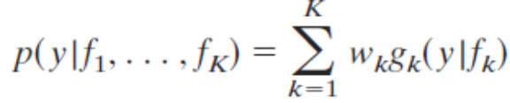
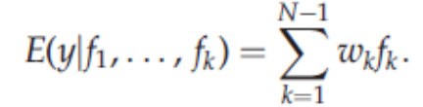
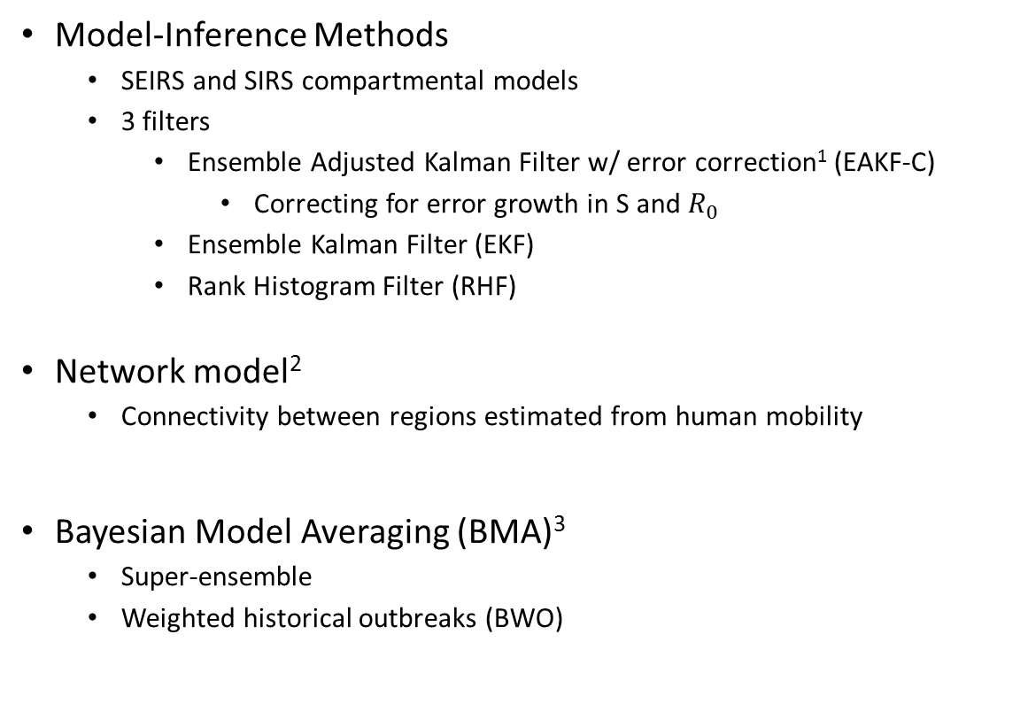
Methods
Model-Inference Methods
  SEIRS and SIRS compartmental models
  3 filters
    Ensemble Adjusted Kalman Filter w/ error correction¹ (EAKF-C)
      Correcting for error growth in S and $R_{0}$
    Ensemble Kalman Filter (EKF)
    Rank Histogram Filter (RHF)
Network model²
  Connectivity between regions estimated from human mobility
Bayesian Model Averaging (BMA)³
  Super-ensemble
  Weighted historical outbreaks (BWO)
Pei S, Shaman J. Counteracting structural errors in ensemble forecast of influenza outbreaks. Nature communications. 2017 Oct 13;8(1):925.
Pei, S et al. Forecasting the spatial transmission of influenza in the United States. PNAS Feb 2018.
Yamana et al. Superensemble forecasts of dengue outbreaks. Journal of The Royal Society Interface. 2016;13(123):20160410.

Slide 16
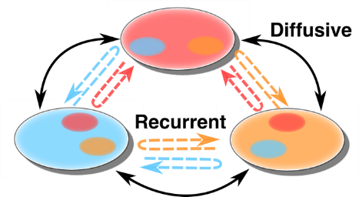
Network
Bayesian Weighted
Outbreaks (BWO)
EKF
SIRS
EKF
SEIRS
RHF
SIRS
BMA
Super-ensemble
Puffins
RHF
SEIRS
Discretionary Selection
SEL
EAKF-C
SIRS
EAKF-C
SEIRS
Vixen

