Slide 1
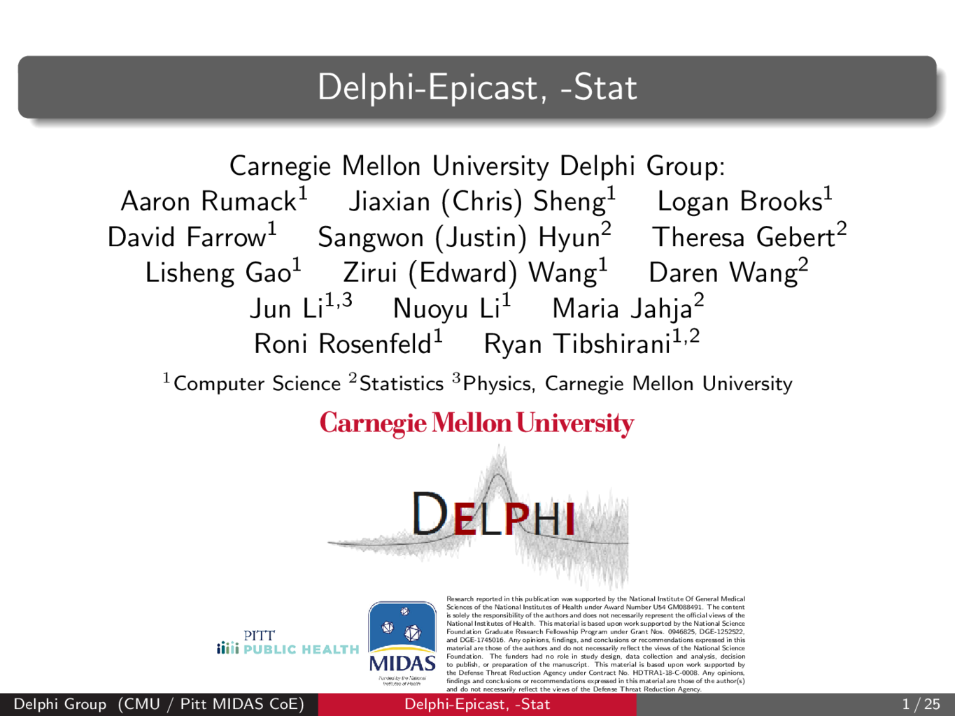

Slide 2
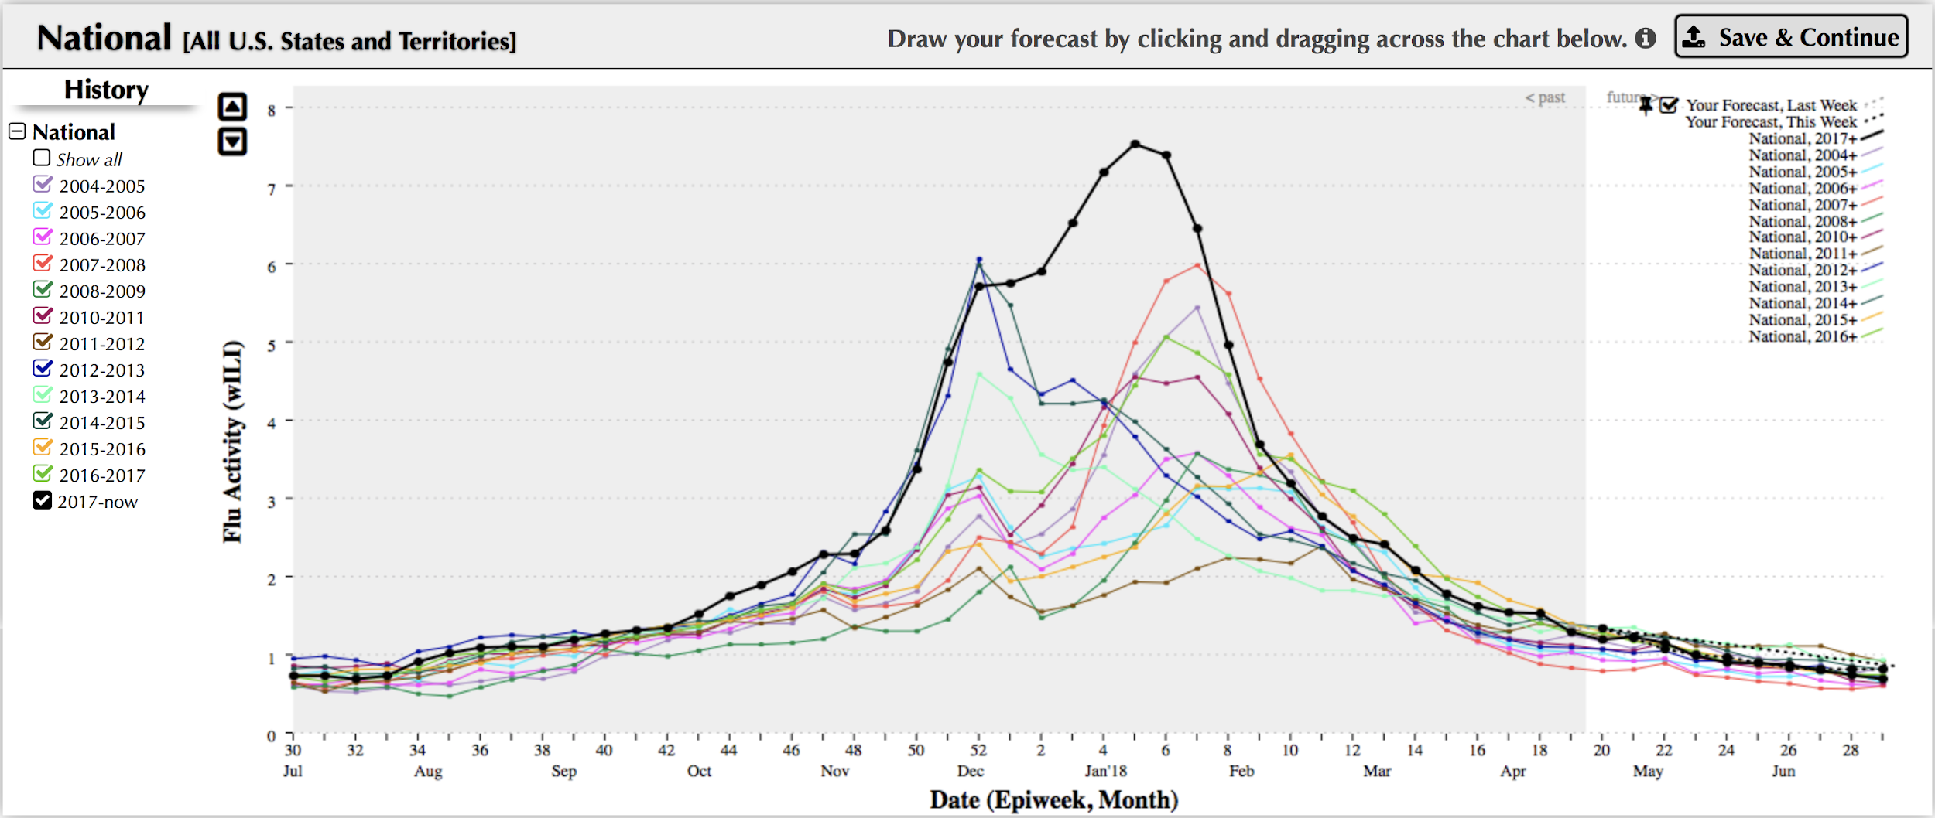
Introduction
Two systems:
  Statistical ML (“Delphi-Stat”)
  Wisdom of Crowds (“Delphi-Epicast”)
This season: challenging to forecast!
Notes:
We submitted two systems: a traditional Stat/ML method (a.k.a. Delphi-Stat) and a wisdom of the crowds method (a.k.a. Delphi-Epicast).
This season was especially challenging to forecast, because it seemed to match previous seasons until EW52, but then diverged from those previous seasons.

Slide 3
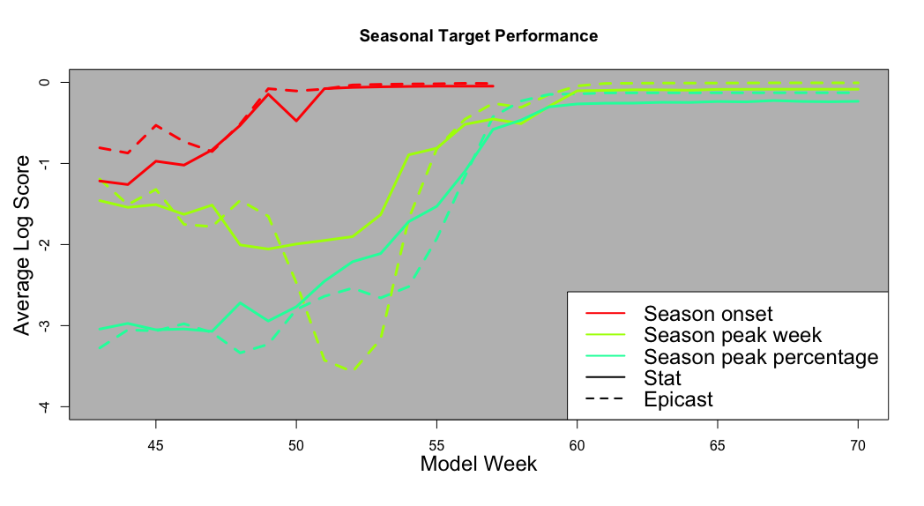
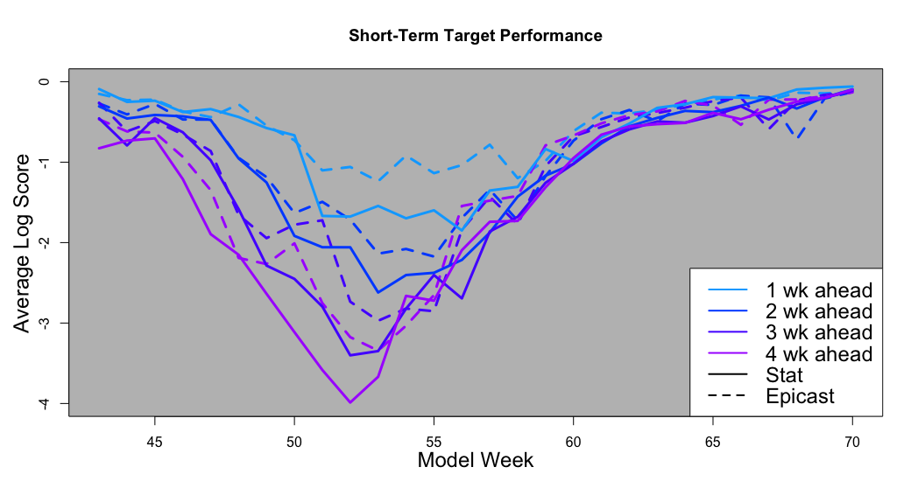
Wisdom of the Crowds vs. Stat/ML
WOC outperformed Stat/ML in short-term forecasts.
Both systems predicted decrease every week starting MW52, even though national peak was not until MW57.
Stat/ML outperformed WOC in the seasonal forecasts.
Tail weight and use of ensemble helped Stat/ML this season.

Slide 4
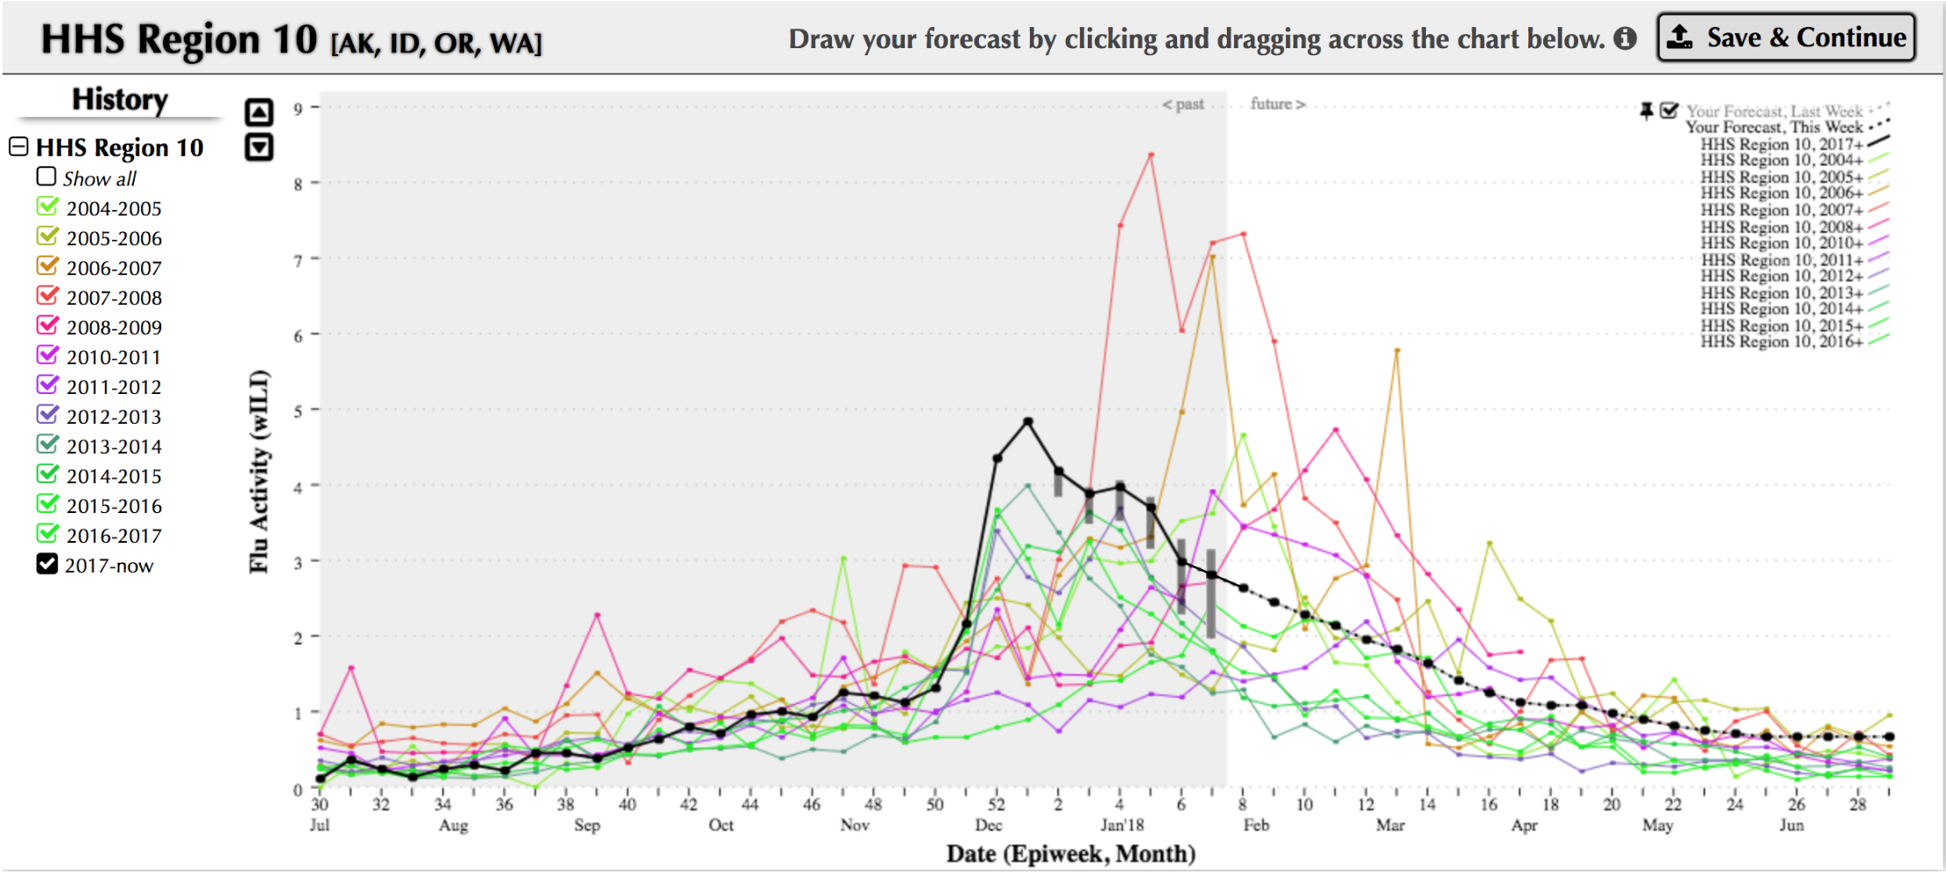
Wisdom of the Crowds (Delphi-Epicast)

Slide 5
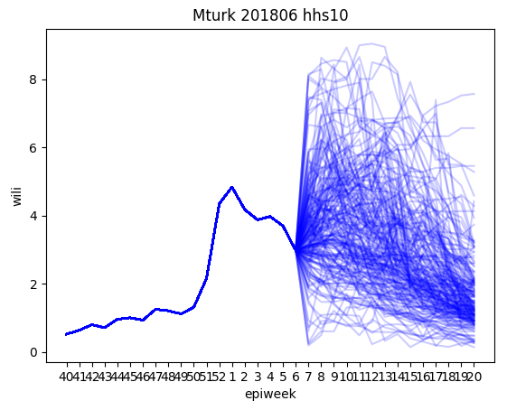
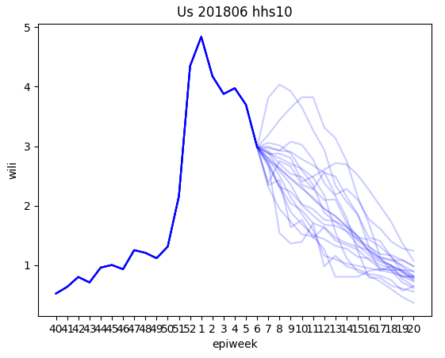
Mechanical Turk vs. Regular Users
Around influenza peak weeks in this season, Mechanical Turk (Mturk) does much worse than we did, even though Mturk has 200+ inputs and we have less than 20. In most of the targets, Mturk’s forecast has much larger variance and error (up to 17) than our forecast.
Mturk users tend to think of the current peak as the peak of the year, rather than expecting it to go up later; this contributes the large error during peak week forecast.
Our next step is to create better incentive for long-term users: users make better forecasts by learning from the errors they made in the past.

Slide 6
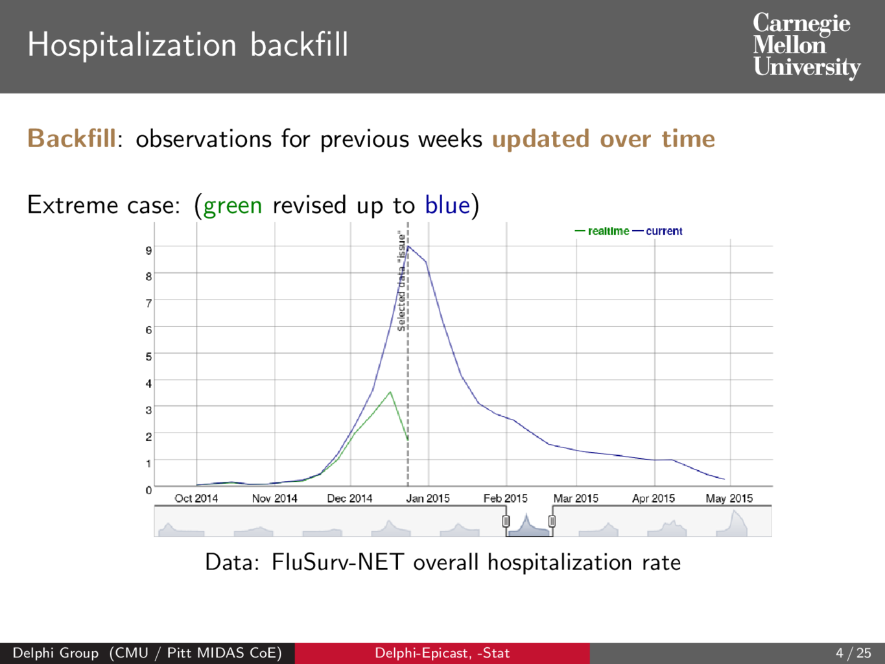

Slide 7
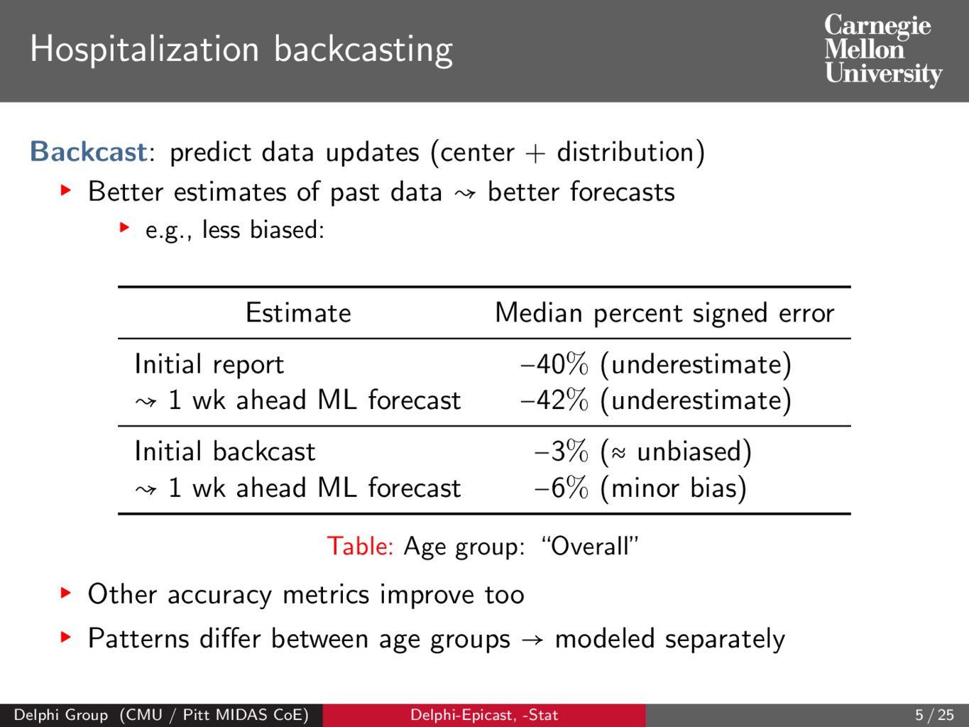

Slide 8


Slide 9
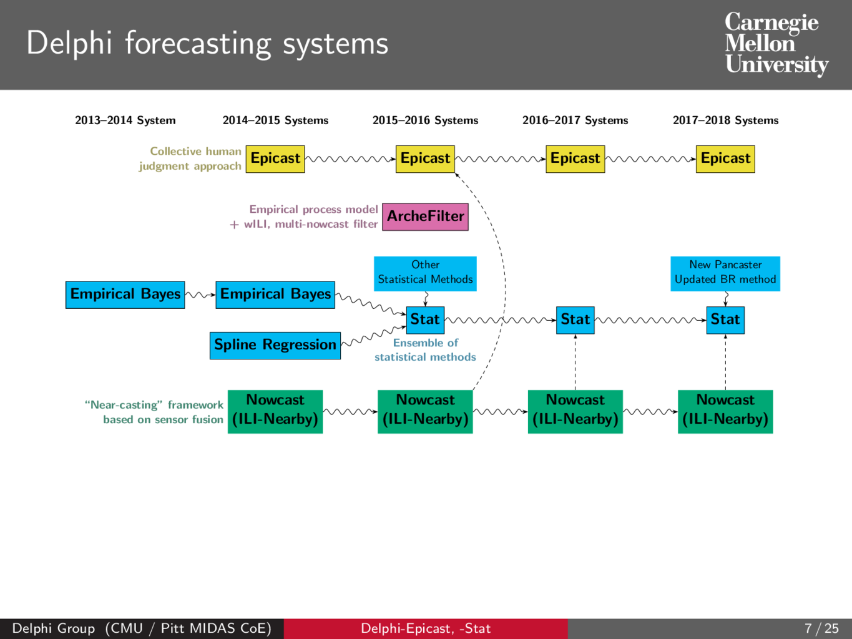

Slide 10
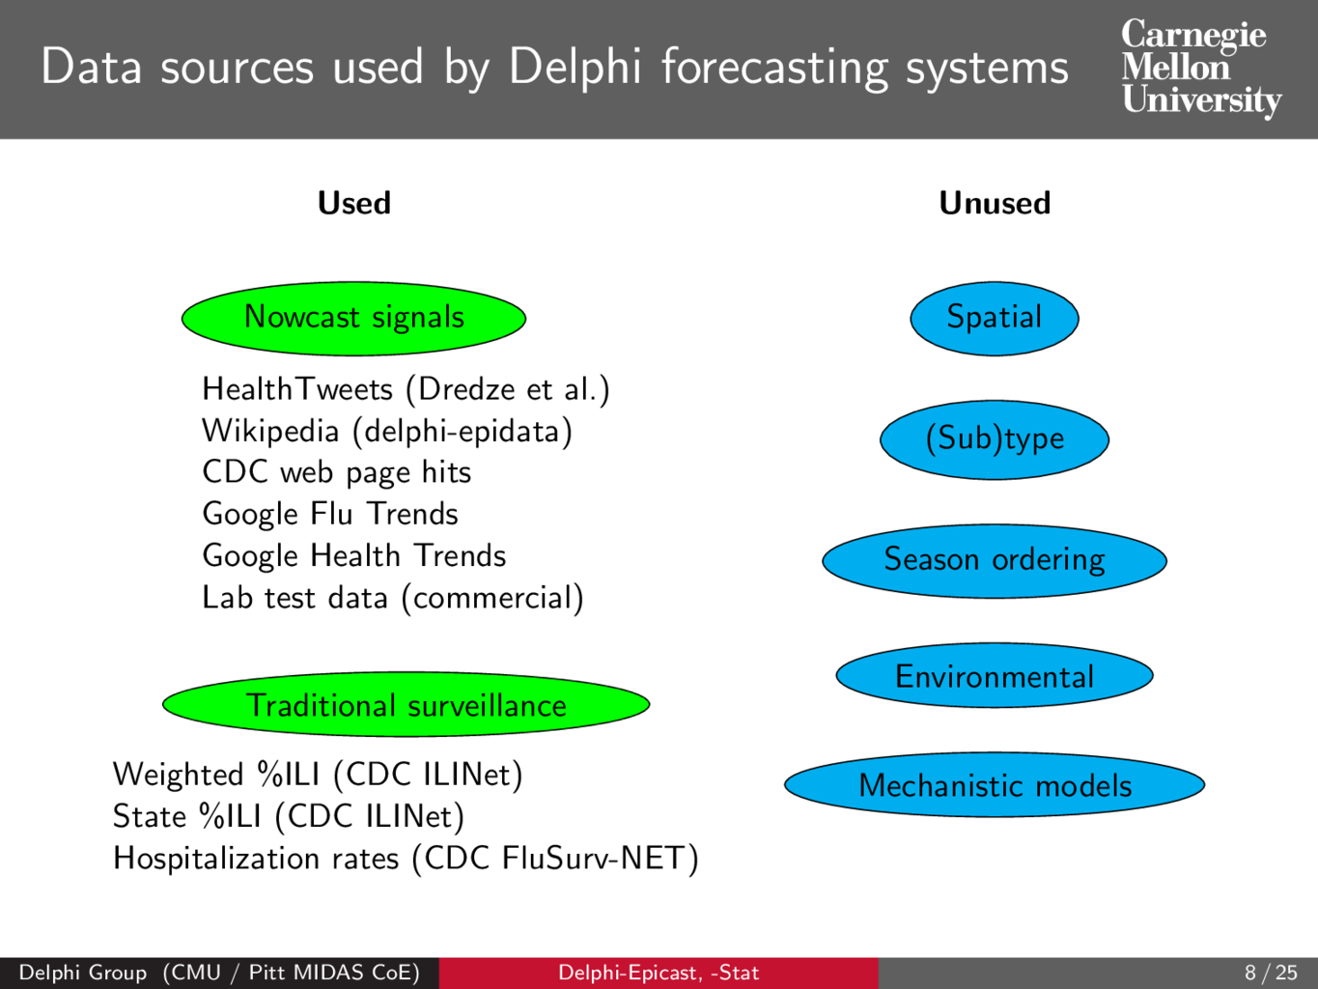

Slide 11
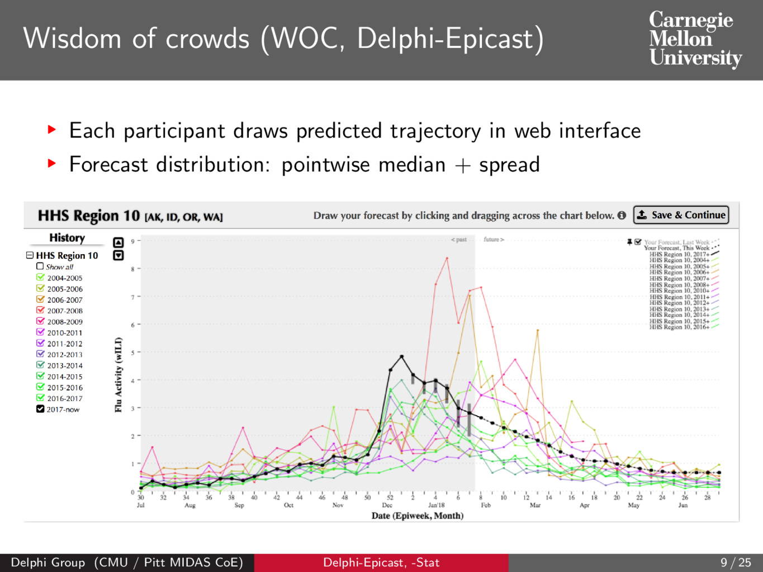

Slide 12
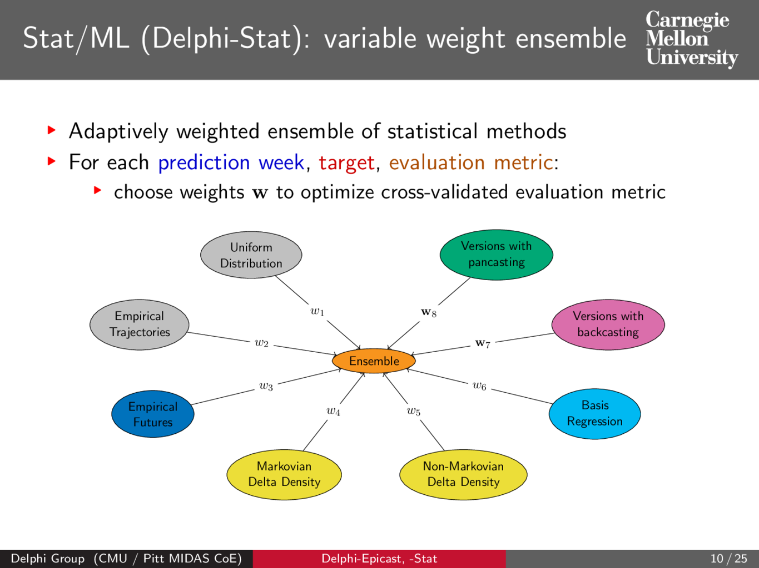

Slide 13
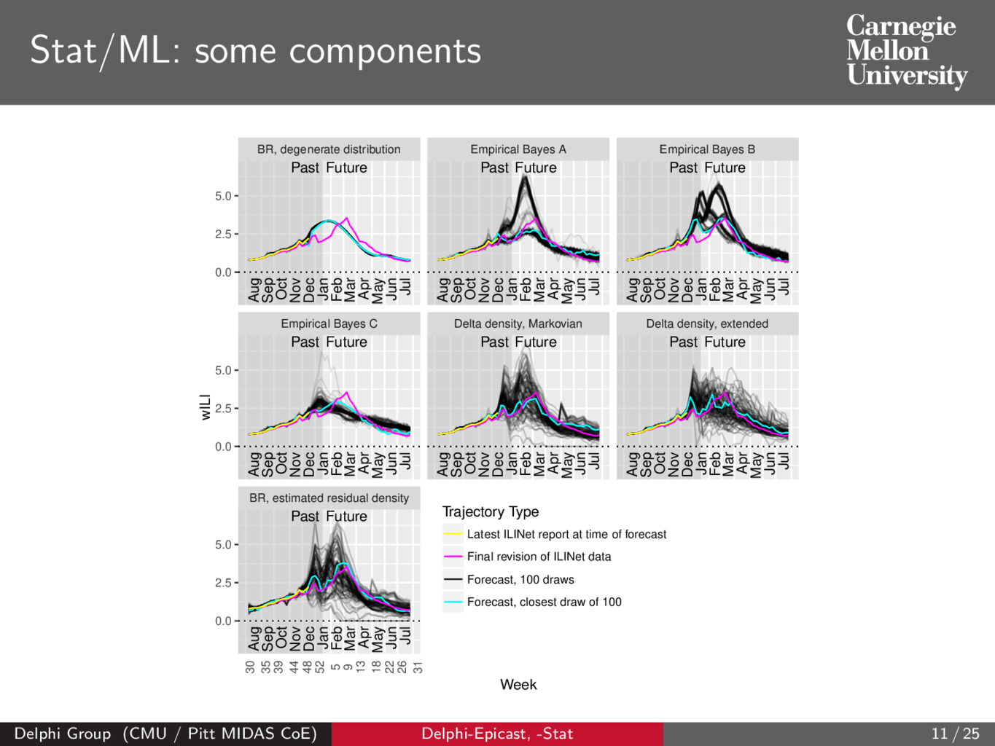

Slide 14
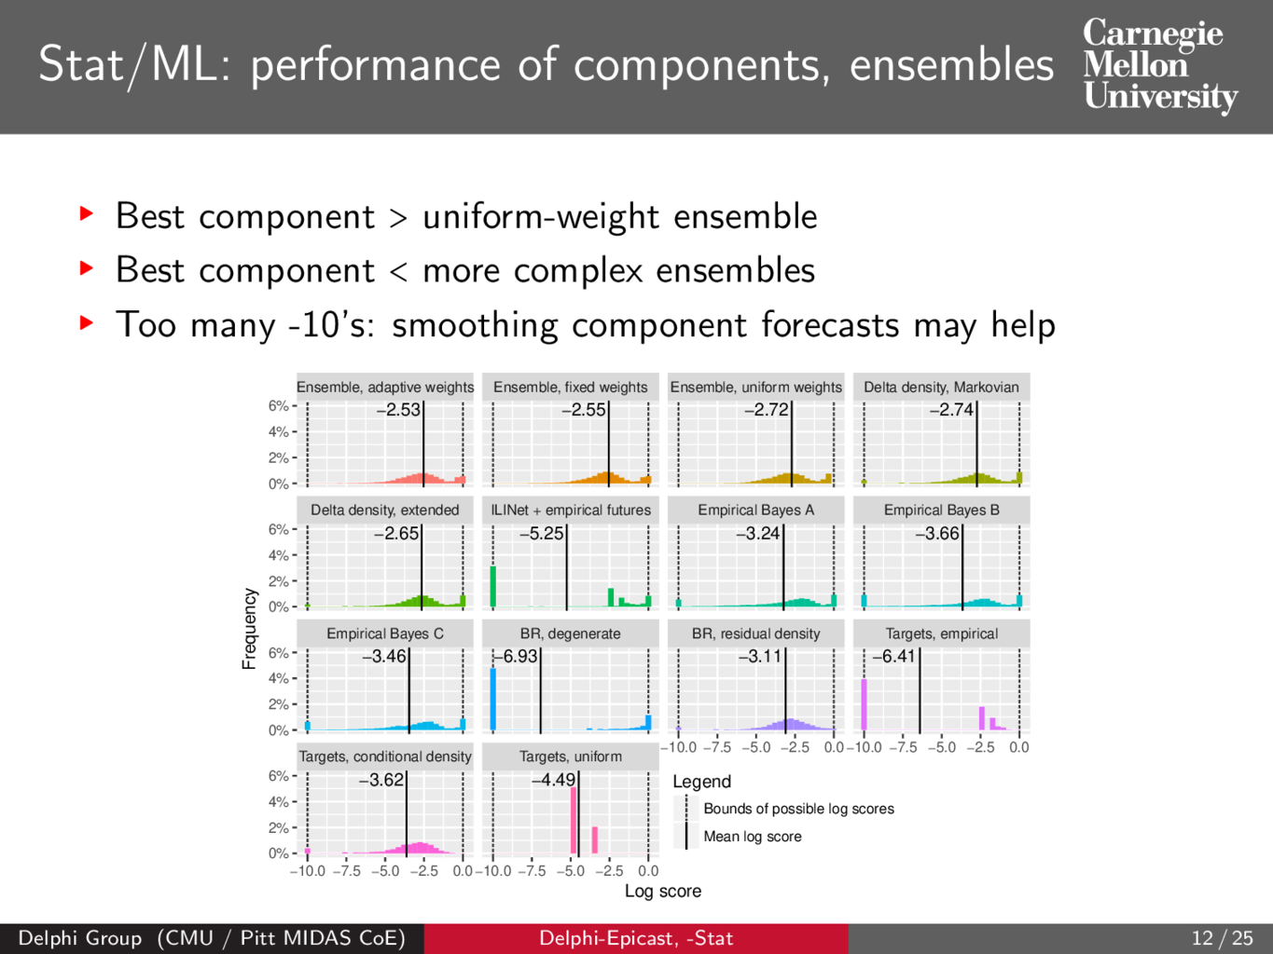

Slide 15
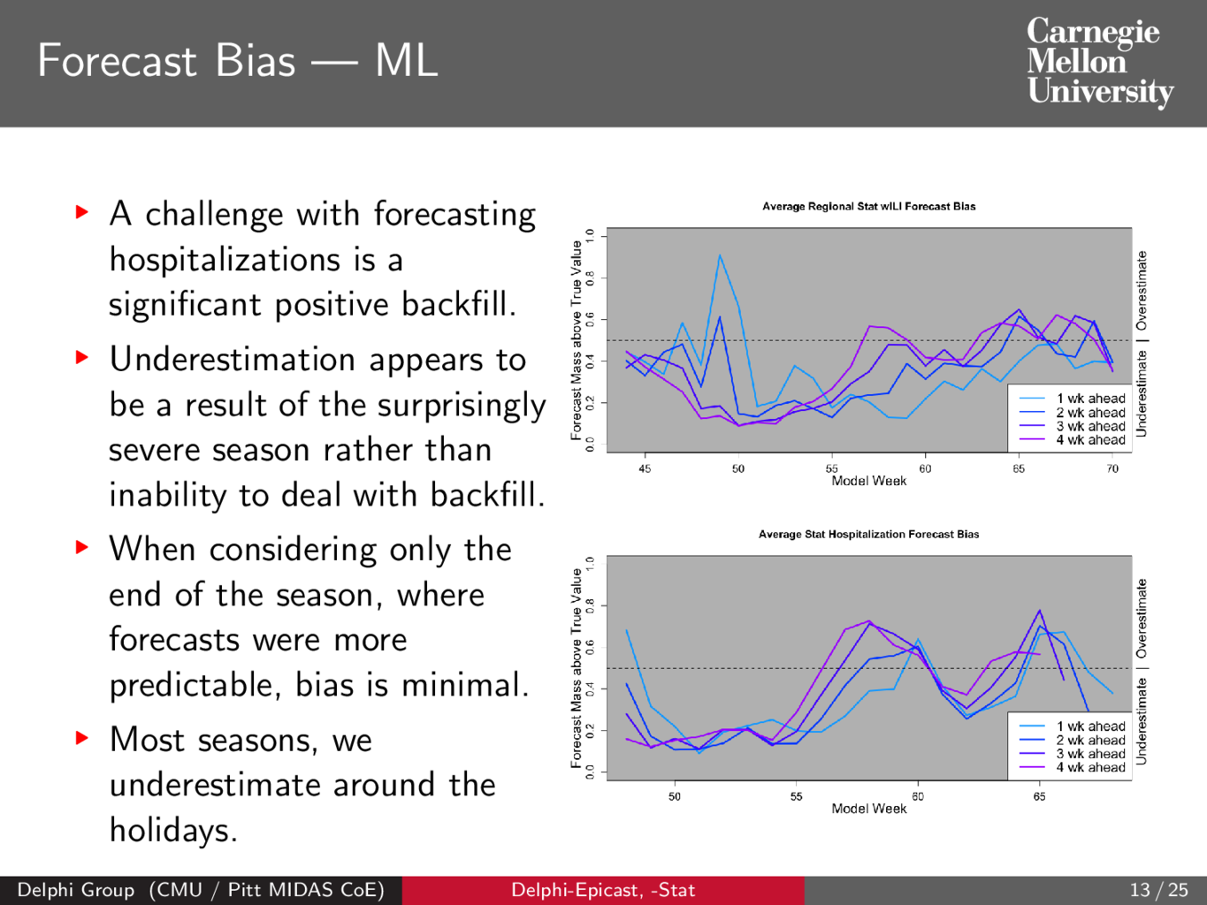

Slide 16
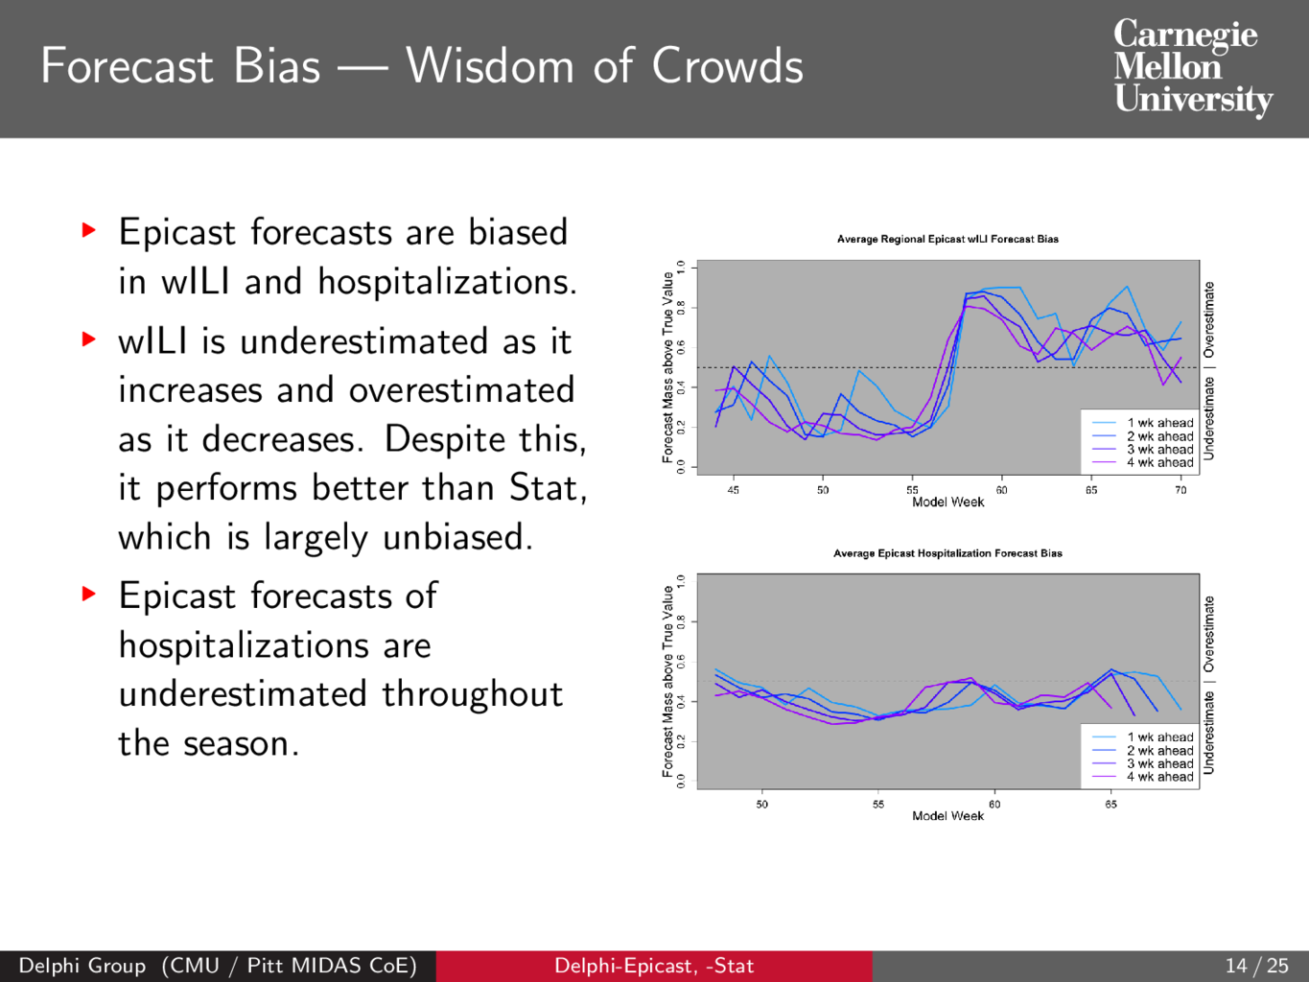

Slide 17
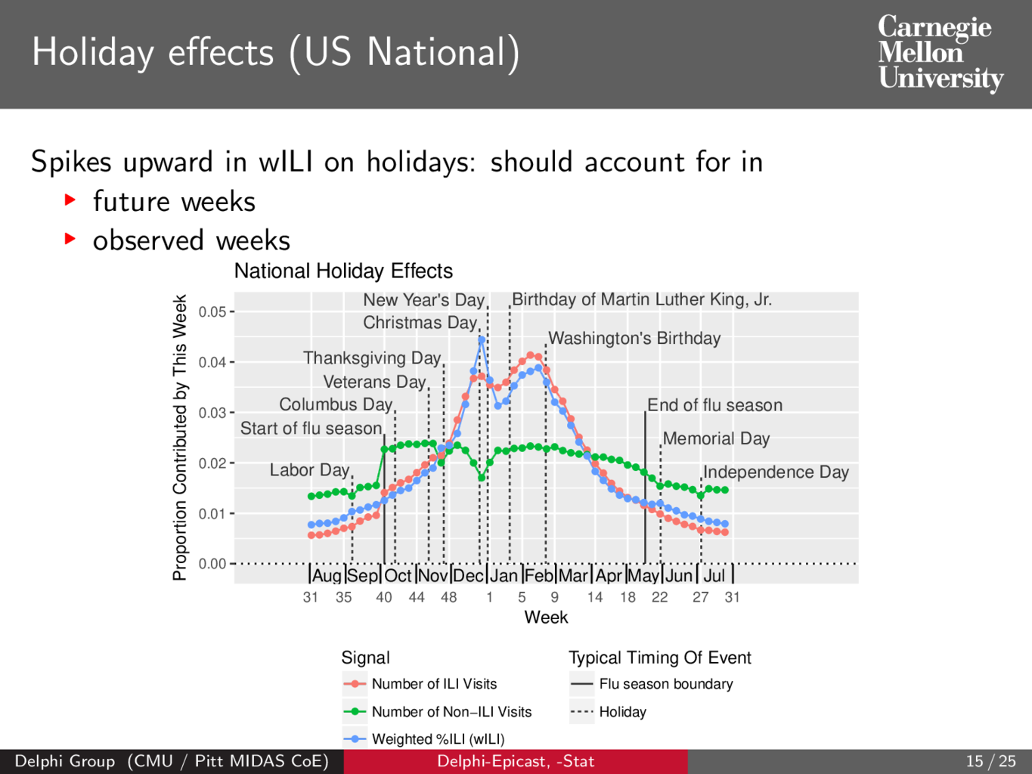

Slide 18
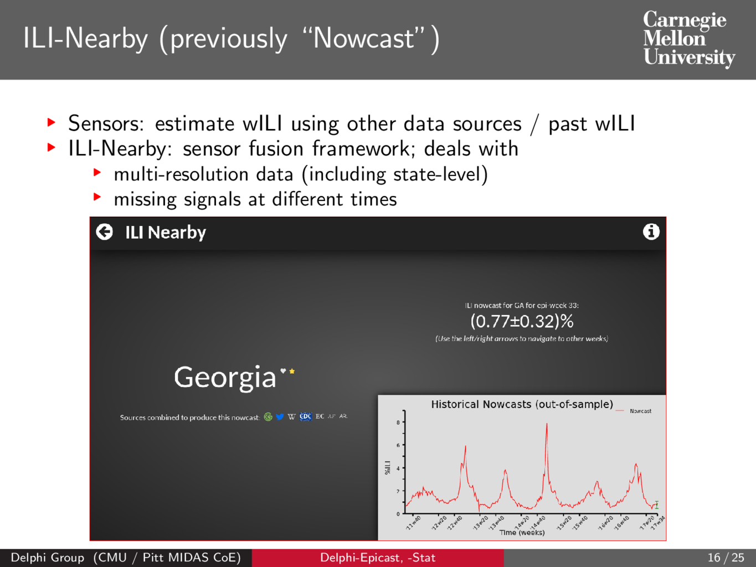

Slide 19
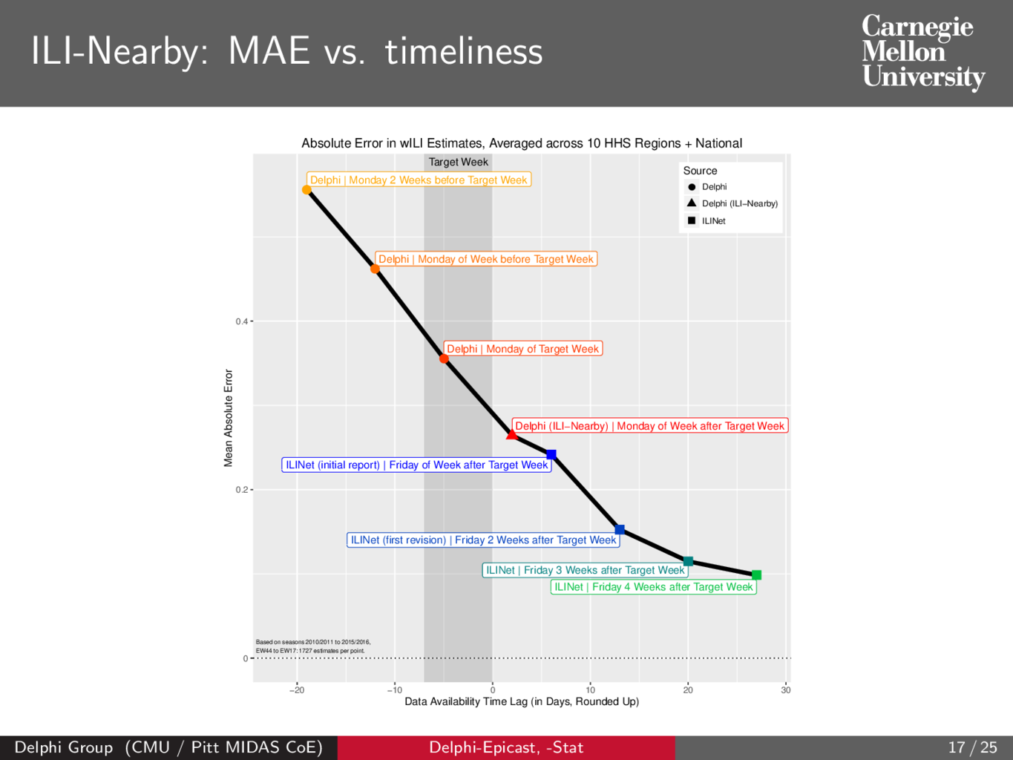

Slide 20
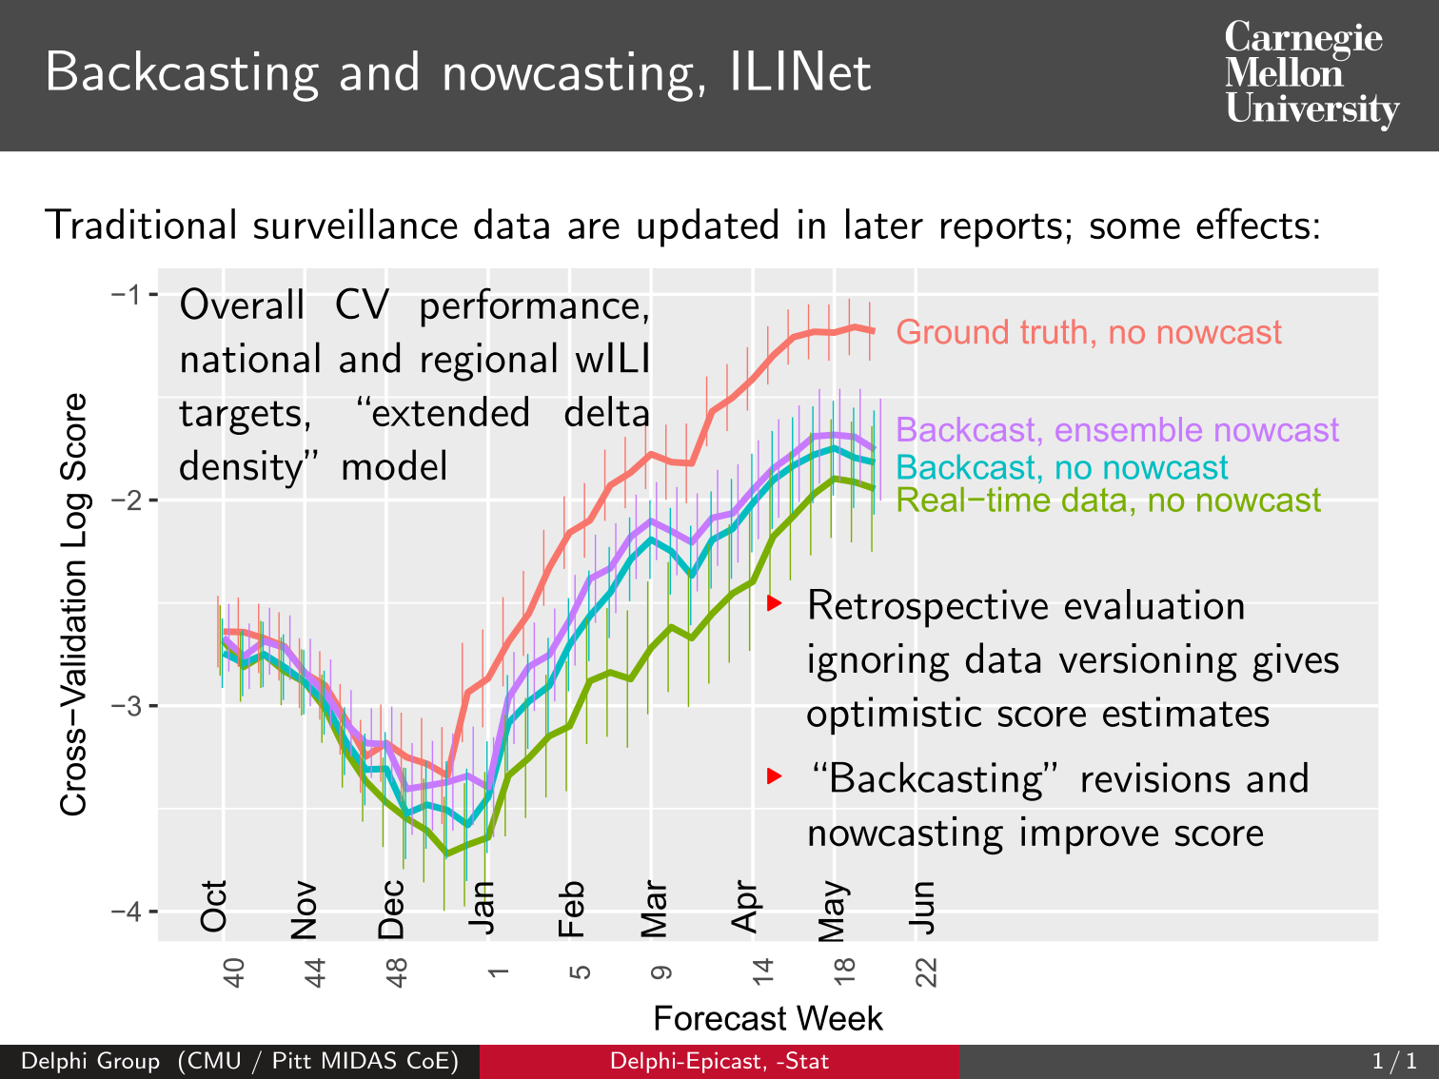

Slide 21
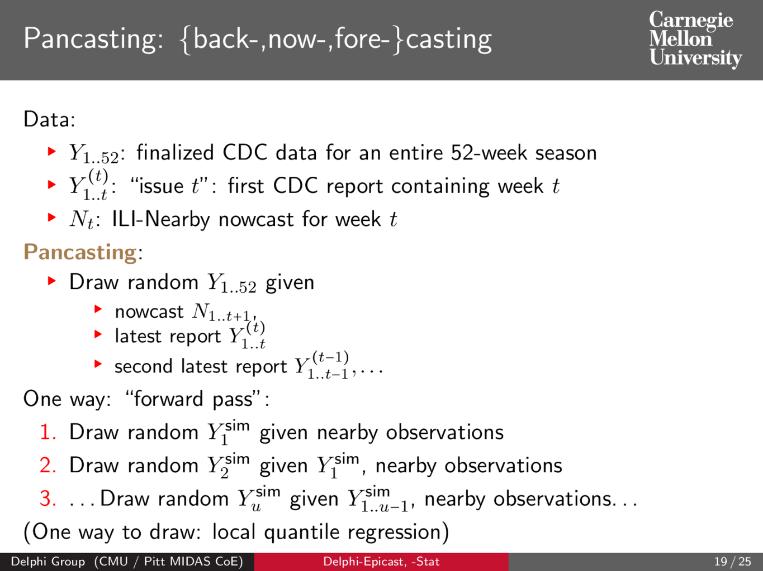

Slide 22
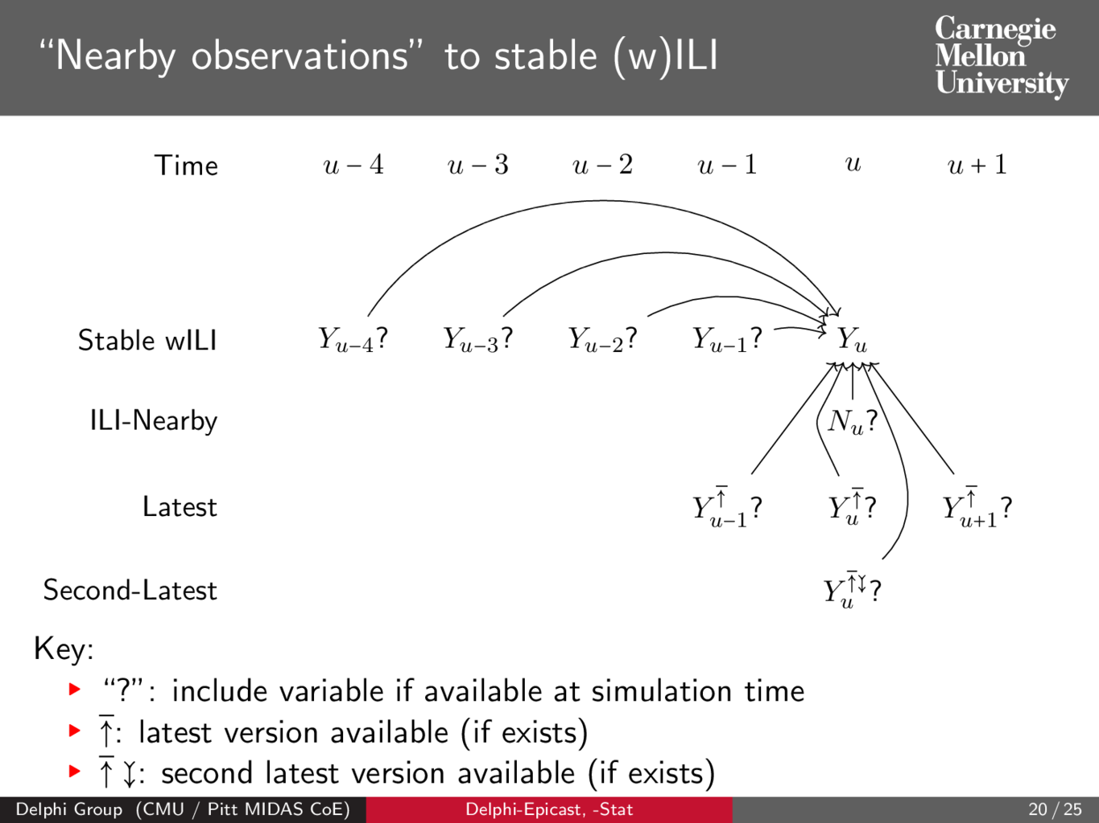

Slide 23
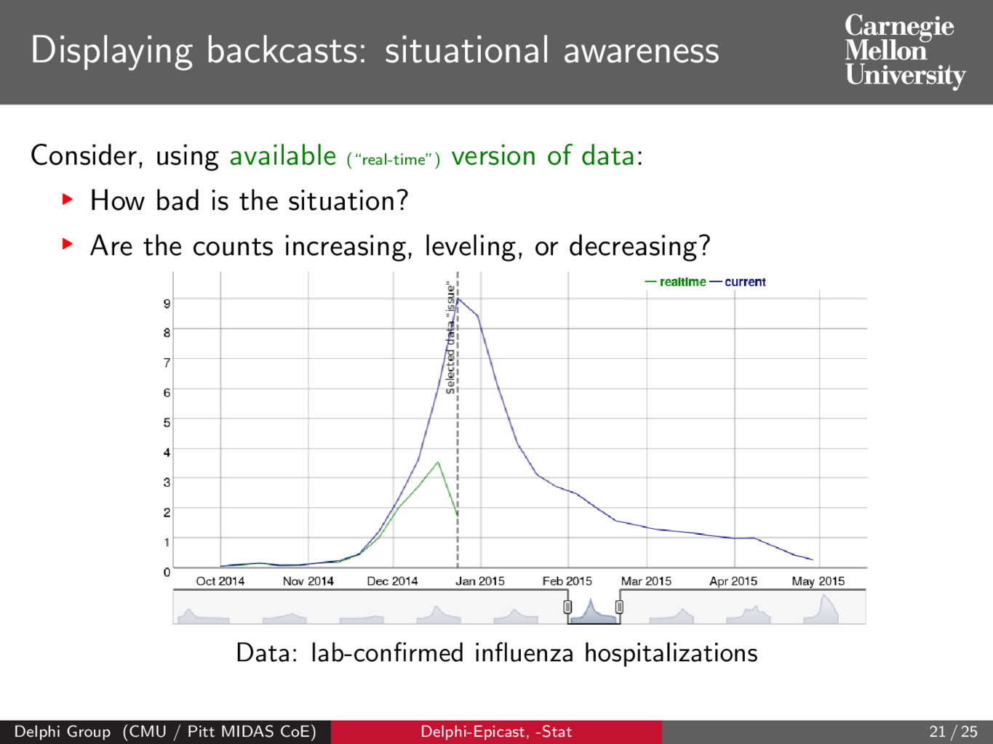

Slide 24
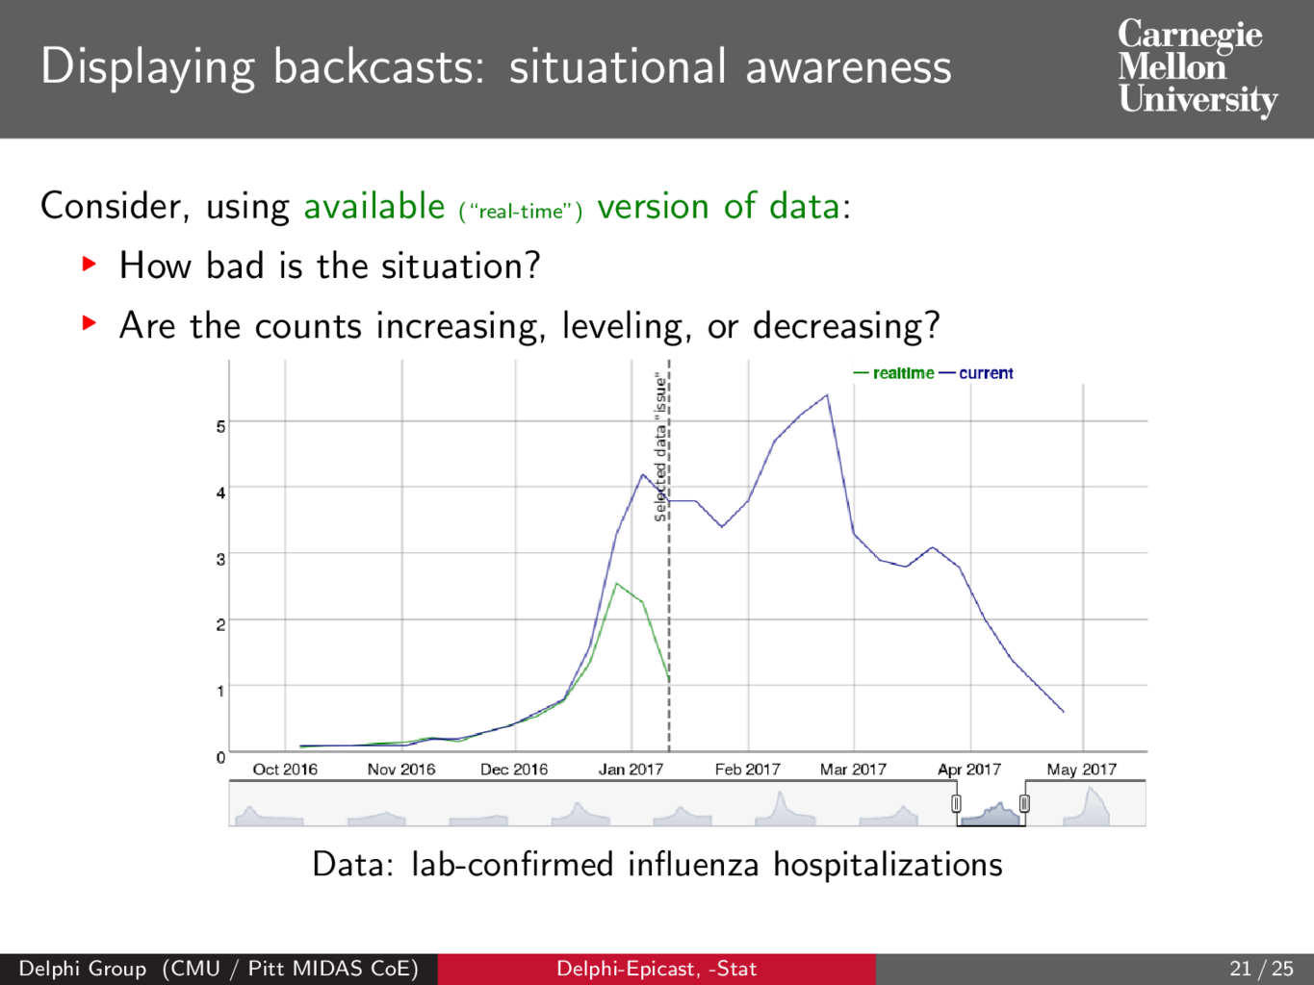

Slide 25
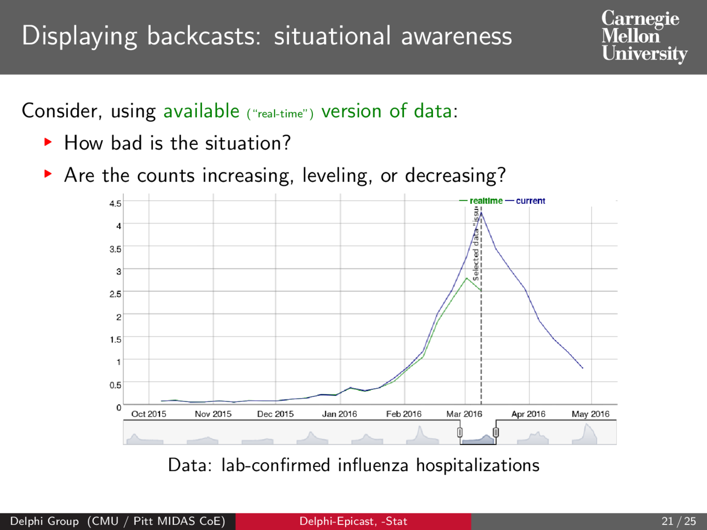

Slide 26
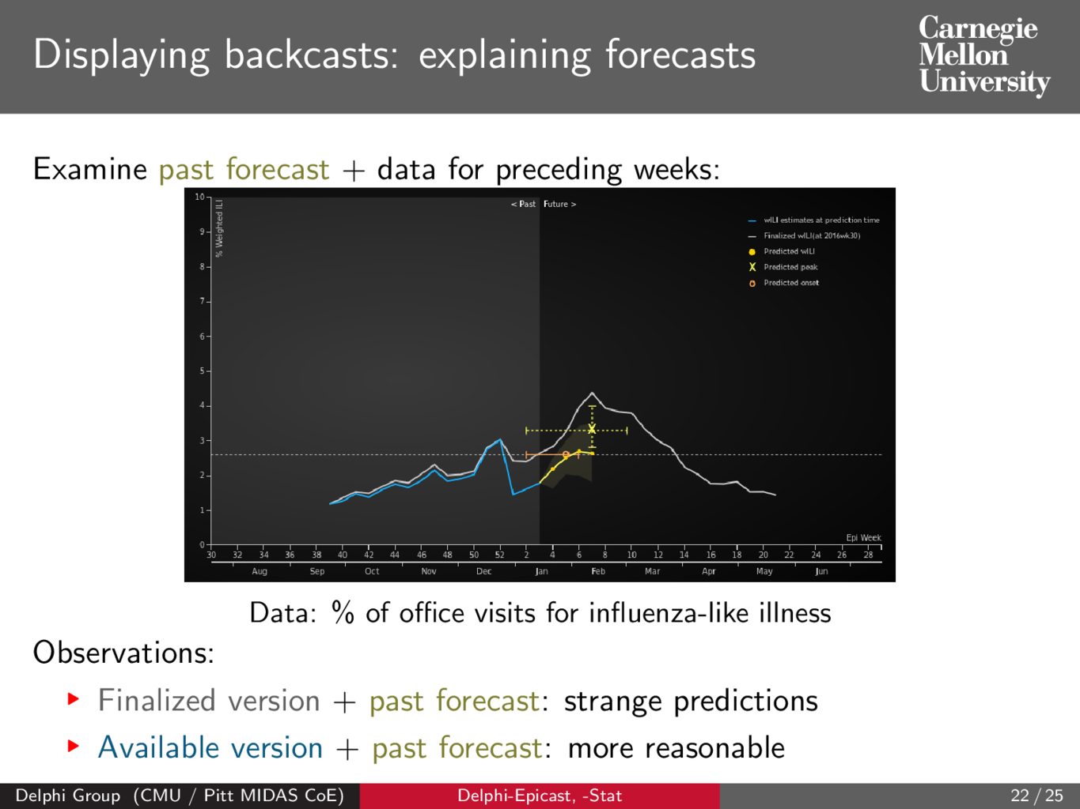

Slide 27
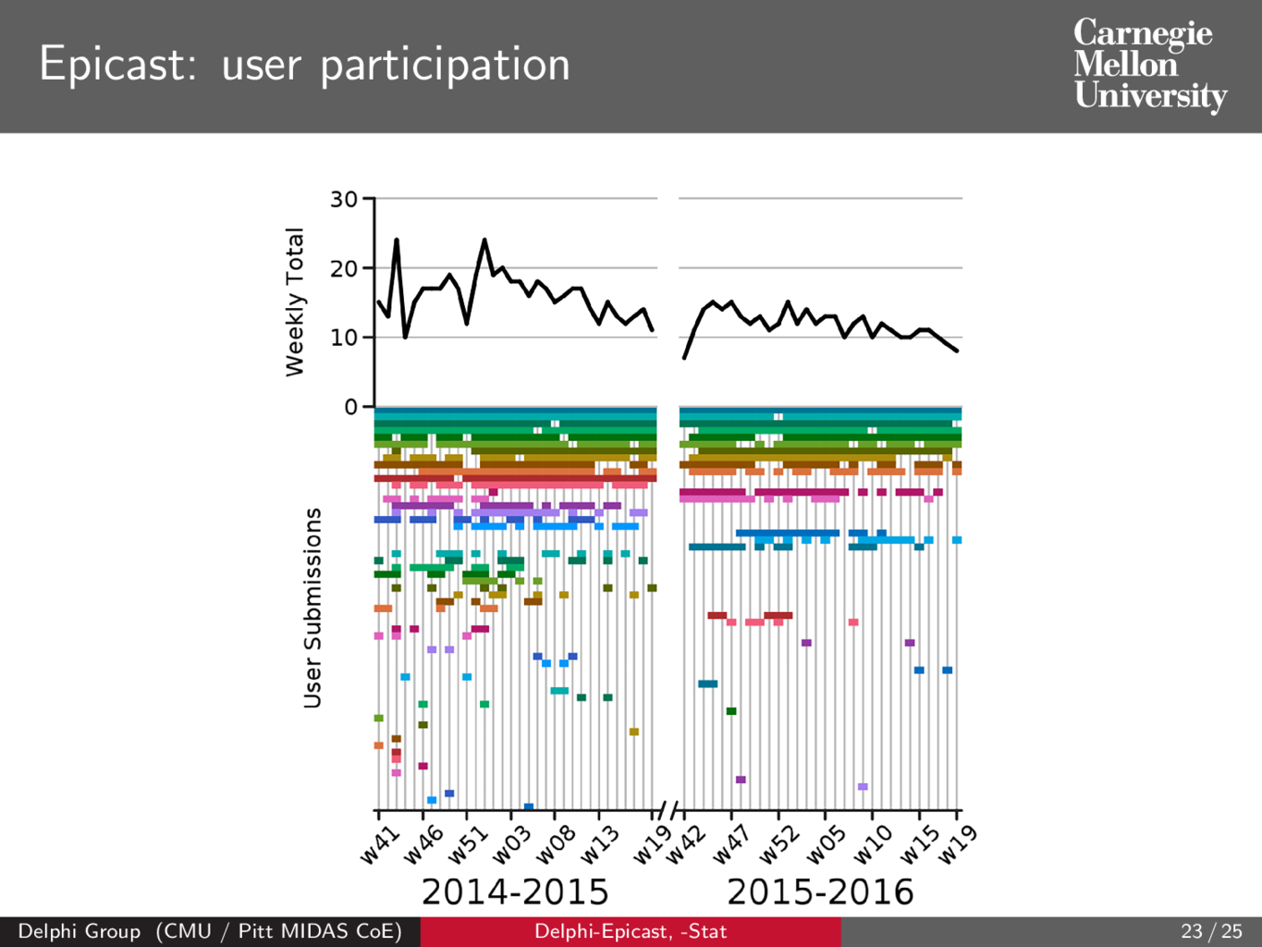

Slide 28
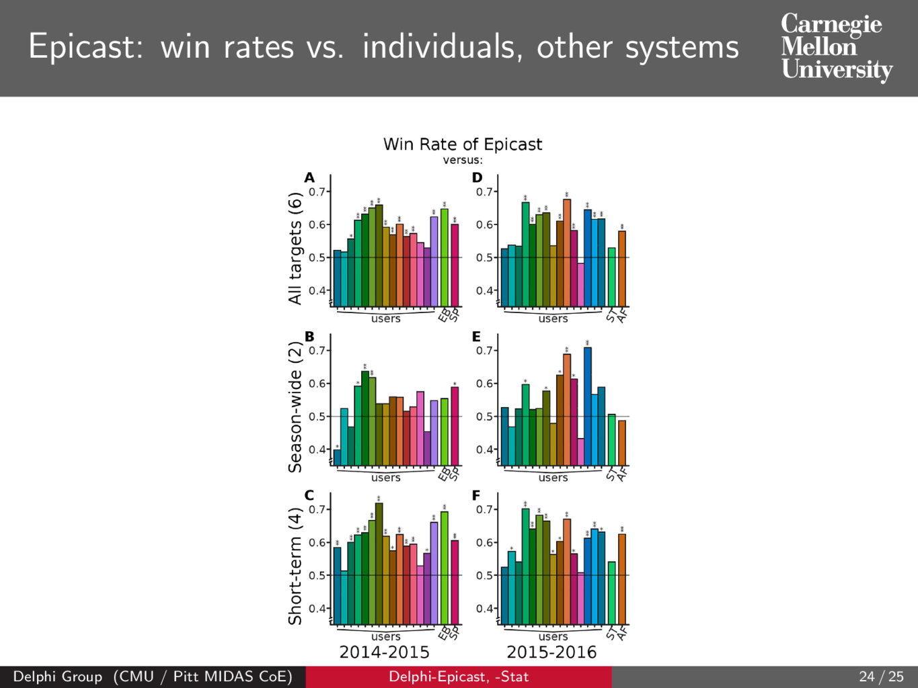

Slide 29
