Slide 1
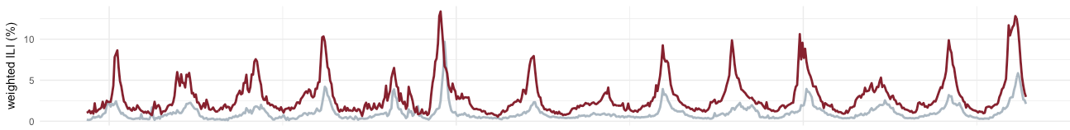
Collaborative Ensemble Forecasting from the FluSight Network
August 2018

Slide 2
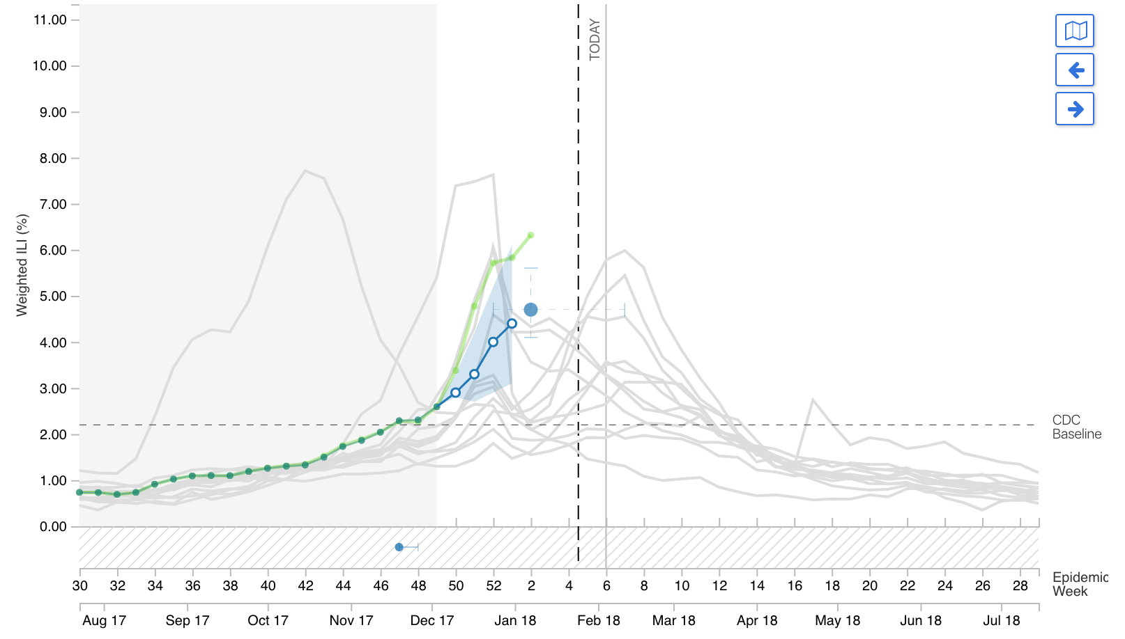
Collaborative, real-time flu forecasts in 2017/2018

Slide 3
Guidelines overview
To participate in the collaborative ensemble, each team provided a “complete set” of forecasts for 2010/2011 - 2016/2017 seasons.
    Essentially, a set of full-season forecast files, as provided to CDC for the real challenge.
    33-34 files/season, total of 233 files (~100MB).
Must only use data available “in real-time”.
Must also provide a metadata file about the model

Slide 4
Inputs, Outputs
Main inputs:
For each of 21 component models:
Once: 233 retrospective forecast .csv’s
Weekly (2017/2018): 1 prospective forecast .csv
Main outputs:
For each of 5 candidate ensemble models:
Once: 233 CV forecast .csv’s
For selected ensemble model:
Weekly (2017/2018): 1prospective forecast .csv

Slide 5




Collaborative Ensemble Forecasting
from the FluSight Network
2017/2018
Logan Brooks
Roni Rosenfeld
Carnegie Mellon
Teresa Yamana
Sasikiran Kandula
Jeff Shaman
Shaman Group
Evan Ray
Abhinav Tushar
Nicholas Reich
Dave Osthus

Slide 6
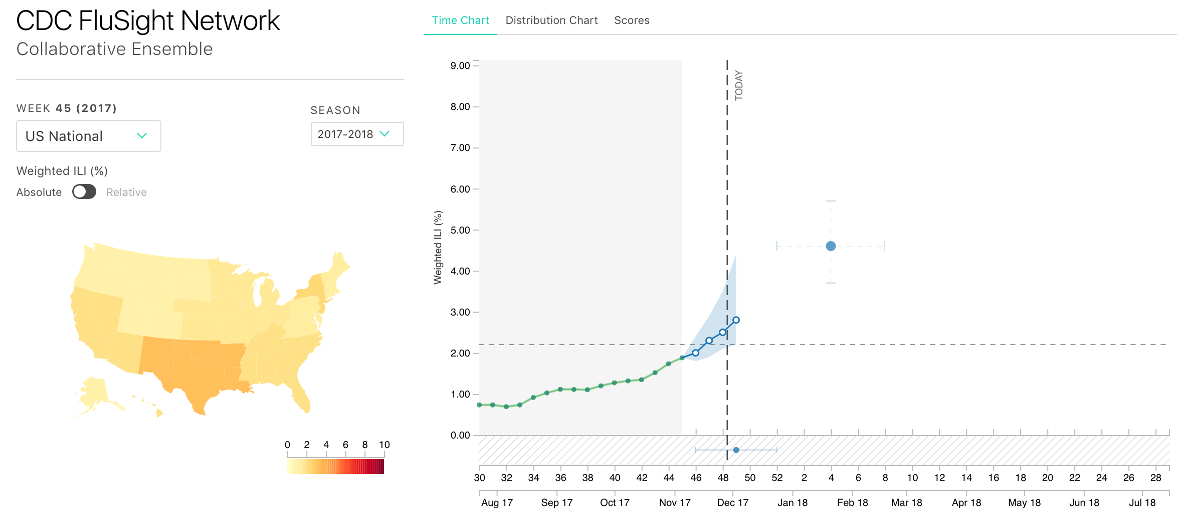
flusightnetwork.io
FluSight Network Website

Slide 7
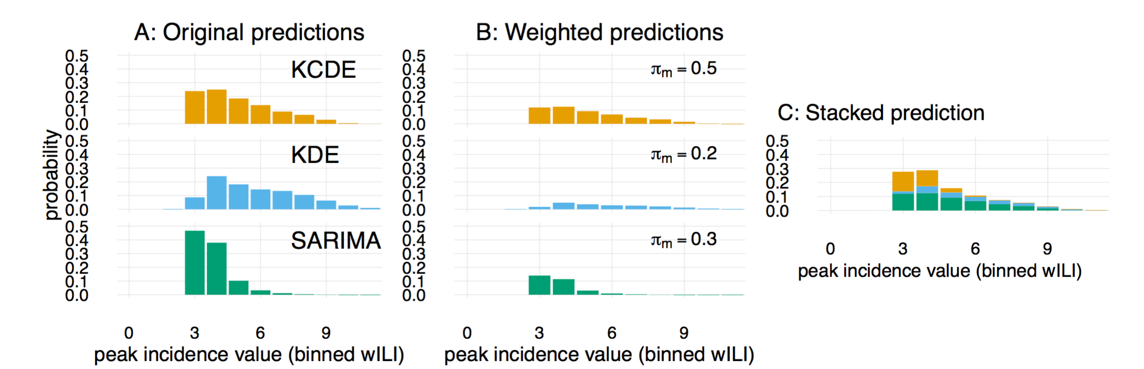
Weighted Density Ensembles

Slide 8
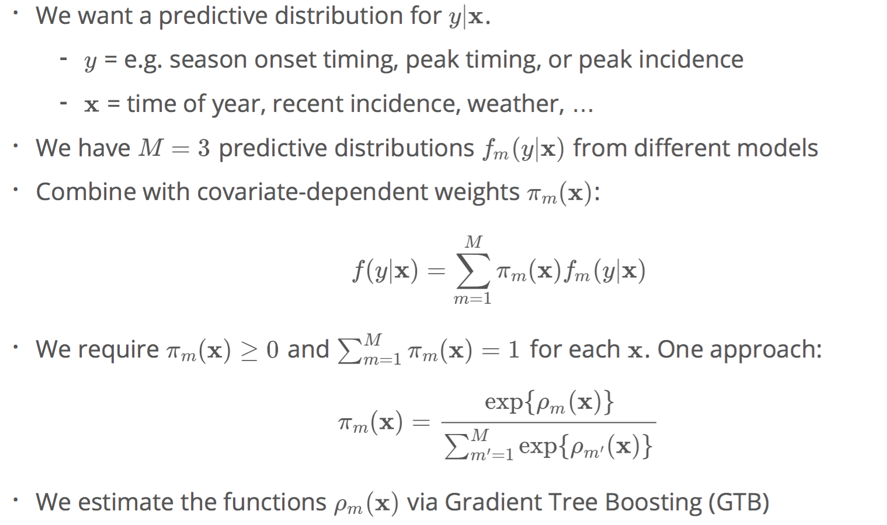
Ensemble Component Models
In general, a component model could be anything, from a statistical time-series model to an expert-opinion survey.

Slide 9
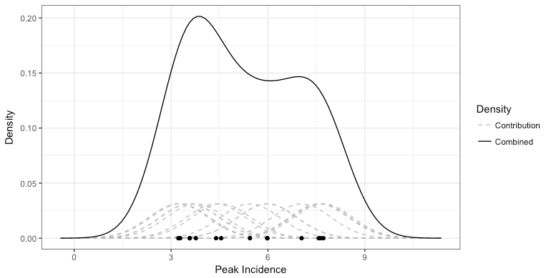
Example Component Model 1
Kernel Density Estimation (KDE)
Estimated distribution, based on historical observations, of season peak incidence, peak week and onset week.
Distributions are not updated over the course of the season!

Slide 10
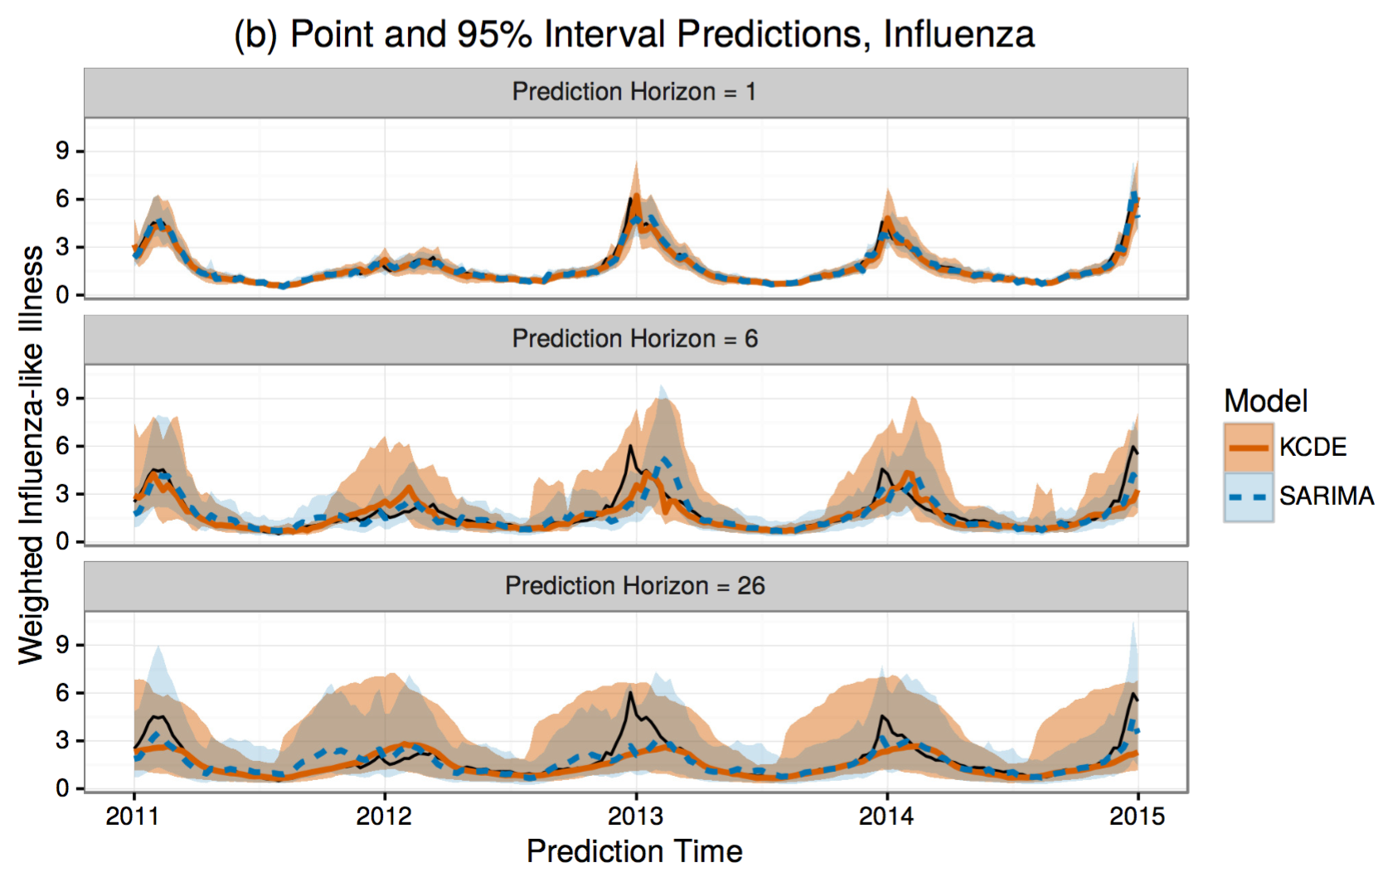
Example Component Model 2
Seasonal Auto-Regressive Integrated Moving Average (SARIMA)
Equation for a SARIMA (1,0,0)(2,1,0)_{s} model
A classical statistical model for time-series.
Uses similar info as KCDE but makes more parametric assumptions.
Figure from Ray et al., Statistics in Medicine, 2017.

Slide 11
Model Stacking
a method for creating weighted ensembles of predictive distributions
In practice, weights estimated by gradient tree boosting or degenerate EM algorithm.
Figure from Ray and Reich, PLOS Computational Biology (2018).

Slide 12
The math of stacking

Slide 13




Simple stacking weights
Weights estimated by degenerate EM algorithm.
Equal weights for each model.
Weights estimated per model.
Weights estimated per model and target.
Weights estimated per model, target, and region.

Slide 14
Component model overview
Team | # models | model type & external data
Delphi @ CMU | 9 | mostly statistical + 1 ensemble, internet search and social media data
Shaman Group @ CU | 7 | mechanistic compartmental models w/climate & search data, 1 statistical model
Reich Lab @ UMass | 4 | statistical time-series models, parametric and non-parametric
Osthus @ LANL | 1 | Bayesian SIR state-space model

Slide 15
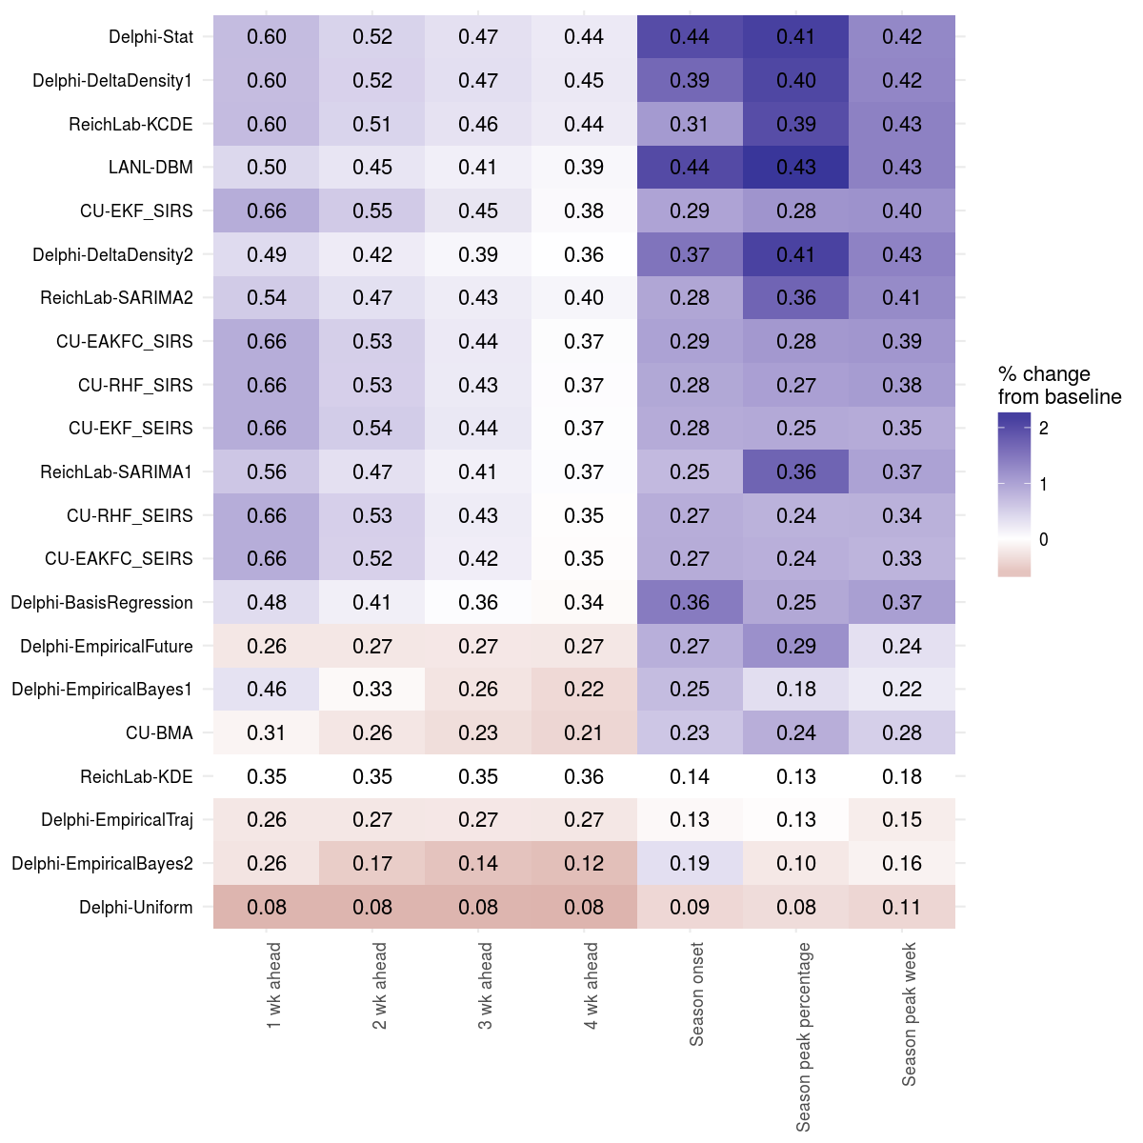
Average model accuracy by target across 7 seasons
Notes:
Forecast skill represents the average probability assigned to the eventually observed outcome across all regions, seasons, and relevant weeks.
Models are sorted with best models at the top, worst at bottom
"ReichLab-KDE" is a naive model based on historical data, represents a baseline that models should be able to beat.
In this setting, baseline model has harder time predicting seasonal targets, in particular season onset.
Nearly half the models (9/21) assign at least 50% probability on average to the right value for next week's incidence.

Slide 16
Pre-specified ensemble list
Governing principle: start simple!
number of component models = 21
(total number of estimated parameters in parentheses.)
"EW" = Equal weights for each model. (0)
"CW" = Constant wts estimated per model. (21)
"TTW" = Wts est'd per model, target-type. (42)
"TW" = Wts est'd per model and target. (147)
"TRW" = Wts est'd per model, target, and region. (1,617)

Slide 17
Cross-validation to choose "best" ensemble
Retrospective cross-validation and ensemble model training
left-out seasson
2010/2011 season
…
2016/2017 season
Ensemble models compared based on cross-validated log-scores.
Best model chosen to submit to CDC during 2017/2018 season.
Prospective validation
current season
2017/2018 season

Slide 18
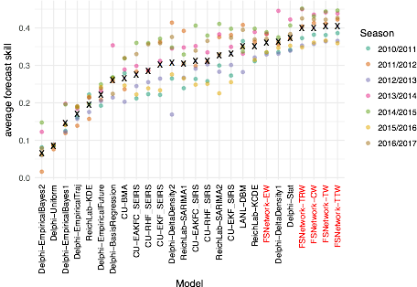
Ensembles have best scores
Models with “FSNetwork” prefix are different versions of the ensemble models.
Models are sorted so that models with the highest average forecast skill are on the right.
more accurate
less accurate
Four ensemble models have
best scores
Notes:
Cross-validated (“leave-one-out”).

Slide 19
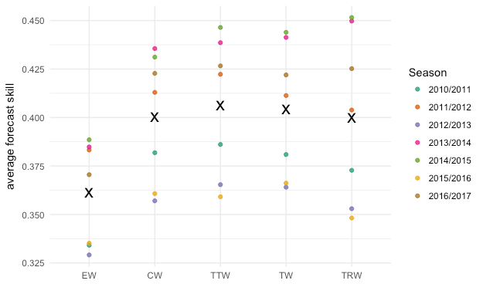
Close-up ensemble comparison
Models now sorted by complexity/number of parameters.
Simple models on the left, with increasing complexity to the right.
0
21
42
147
1617
# of weights
more accurate
less accurate

Slide 20
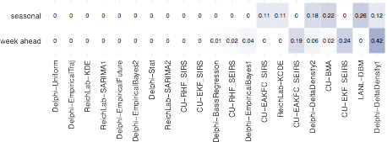
2017/2018 model weights
Each model is assigned a weight that is used to combine its forecasts with the others.
all groups represented
in top 7 models
Weights don't necessarily represent model "rank".

Slide 21
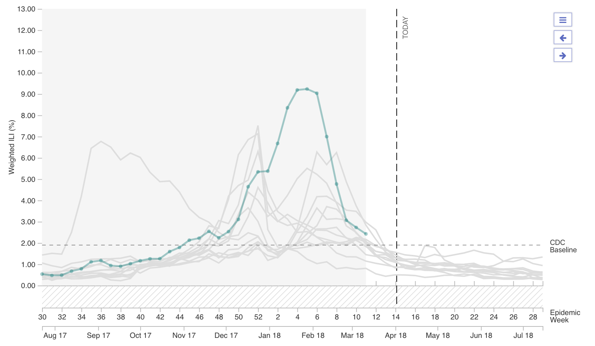
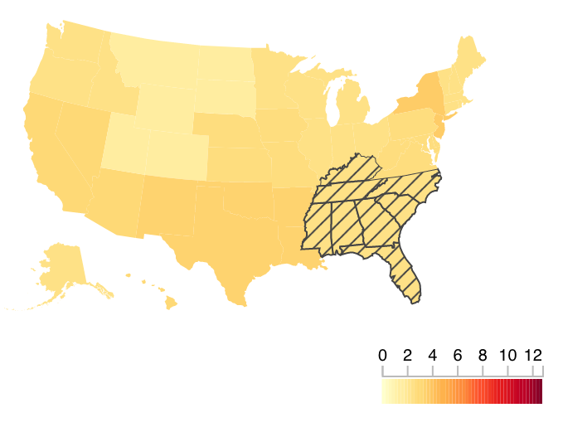
2017/2018 had dynamics unlike any of past 15 flu seasons
e.g. HHS Region 4
2017/2018
2009/2010

Slide 22
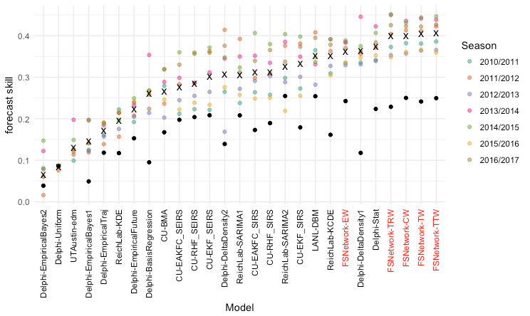
2017/2018 performance was lower
more accurate
less accurate
2017/2018 performance

Slide 23
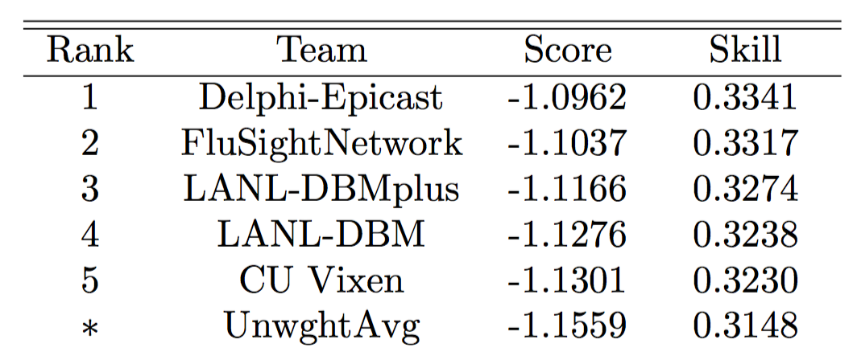
2017/2018 forecast accuracy

Slide 24
Conclusions
Ensembles for infectious disease forecasting provide more consistent and reliable performance than any single model, though differences are often small.
Ensembles effectively fuse diverse forecasts, including mechanistic and statistical models.
There may be diminishing returns for complex combination schemes.
We have a long way to go in terms of improving overall model accuracy.

Slide 25
Future directions
Methods to update ensemble weights "online", i.e. in season
Tools for standardization, replication of process for building a collaborative ensemble
  Formal workflow development, R package for model building, online API access to forecast data, standard code for building ensembles
Incorporating new data sources and models
- hierarchical spatiotemporal model
- strain-specific model
- expert opinion model
- …

