Slide 1
PPFST
Wisdom Of Crowds Approach for
Combining Models
Jeff Morgan
19morgan@cua.edu
jmorgan@jrad.us
(M) 540-845-7249

Slide 2
Three Big Things
1) Express Appreciation
2) Explain Approach
3) Discuss plans and welcome input for 2018-2019

Slide 3
Appreciation (Background)
Government customer (Robert Huffman) became Executive Secretary for Office of Science and Technology Policy (OSTP) Pandemic Prediction Science and Technology (PPFST) Working Group (Jean Paul Chretien, Michael Johansson, and Paul Lewis)
Defense Health Program SBIR on “Predictive Capability for Infectious Disease”
  KBSI (Madhav Erraguntla)
Also pursuing PhD in Biomedical Engineering from Catholic Univ (Otto Wilson)
Attended this meeting last two years and discussed influenza modeling with Roni Rosenfeld, Matt Biggerstaff, Craig McGowan, Nicholas Reich, and others
  Seek to improve upon the average model
  The Wisdom of Crowds by James Surowiecki
  Superforecasting The Art and Science of Prediction by Philip Tetlock and Dan Gardner

Slide 4
Appreciation (Background)
Forecasting Teams
Participants
Influenza Challenge Administrators
Tutor
Delphi Epicast | CU-SEL | LANL DBM
Delphi STAT | CU-Network | 4 Sight
Kernel of Truth | KBSI | 4 Sight 2
Emily Briskin | Paul Lewis | Jonathan Phillips
Jessica Fung Deerin | Jeff Morgan | Srini Venkatramanan
Bryan Lewis | Steve Morgan | Cécile Viboud
Craig McGowan | F. Scott Dahlgren
Prahlad Menon

Slide 5
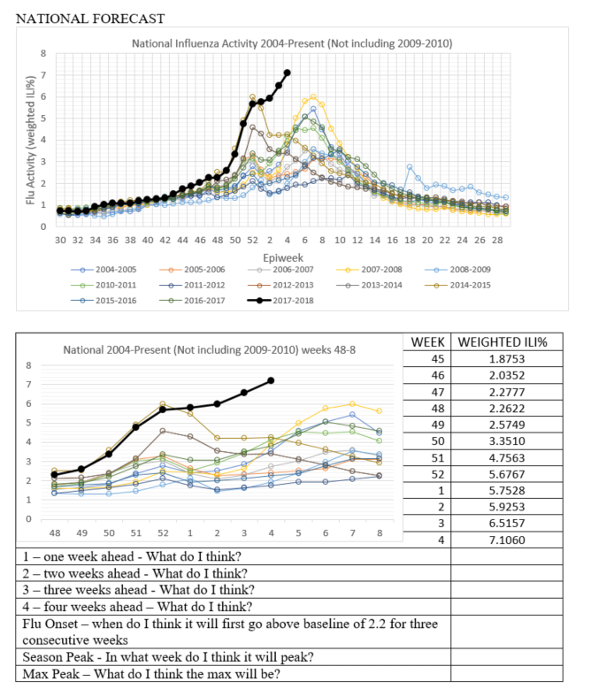
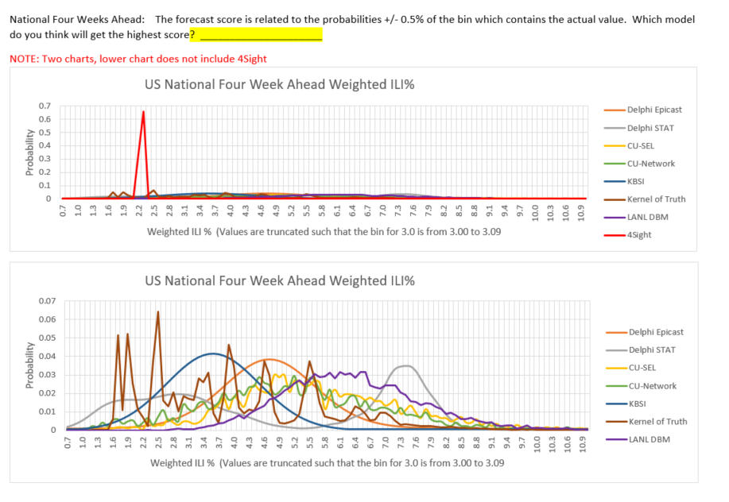
Approach
Worksheet
Ballot

Slide 6
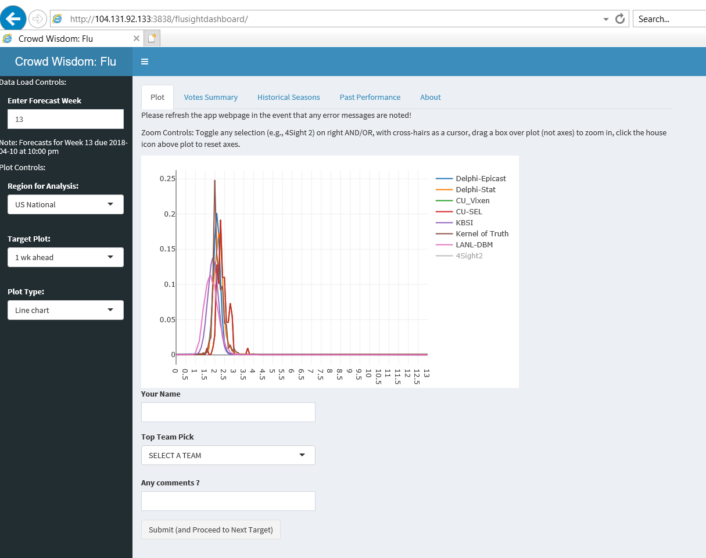
Screenshot of R/Shiny app

Slide 7
Approach
Crowd-members would select “best model” for 7 targets for National, Region 3, and Region 4
Weights for weighted average were determined by crowd voting
(Value Bin n)PPFST Crowd = Votes A (Value Bin n)Model A +…+Votes M(Value Bin n)Model M
Votes A +…+Votes M
Weights for Regions 1, 2, and 5-10 were determined by average of weights from Region 3 and 4

Slide 8
Approach
What I wanted to do
What I did
Learn GitHub
Learn R
Create Fun, User-Friendly Website that was persistent and easy to refresh on a weekly basis
Collect Votes from a lot of people
Compile votes automatically
Score automatically
Created forms in Excel and Word to be used, distributed via email, until website was running
Hired Tutor
  Got help with GitHub, R, and Rstudio
  Created website that was somewhat cumbersome
Collected Votes from a few participants (usually n = 4)
Used Excel to compile results and score
Provided tentative scores for models and participants throughout contest

Slide 9
2018-2019 Plans
Continue creating documents in Excel and Word and distribute via email
Make previous website created in R Shiny better/faster (retain tutor)
Also create new website that is easier to use (new tutor, Suchada Foster)
Attract more participants
  Incentivize/Reward participants
  Publicize website better
  Help in recruiting college students from advisor and tutors
  Capture input from those who are less familiar with probability distribution functions
  Compare results of SMEs and lay people

