Slide 1
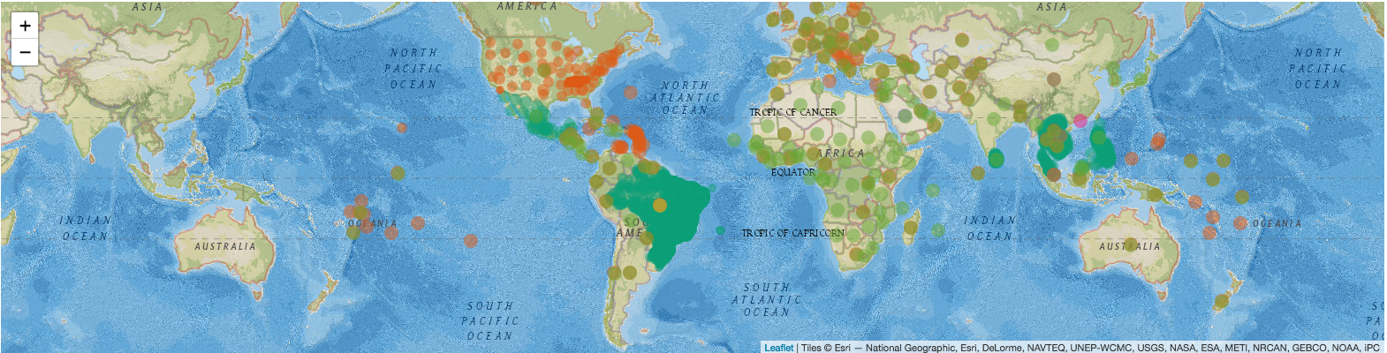
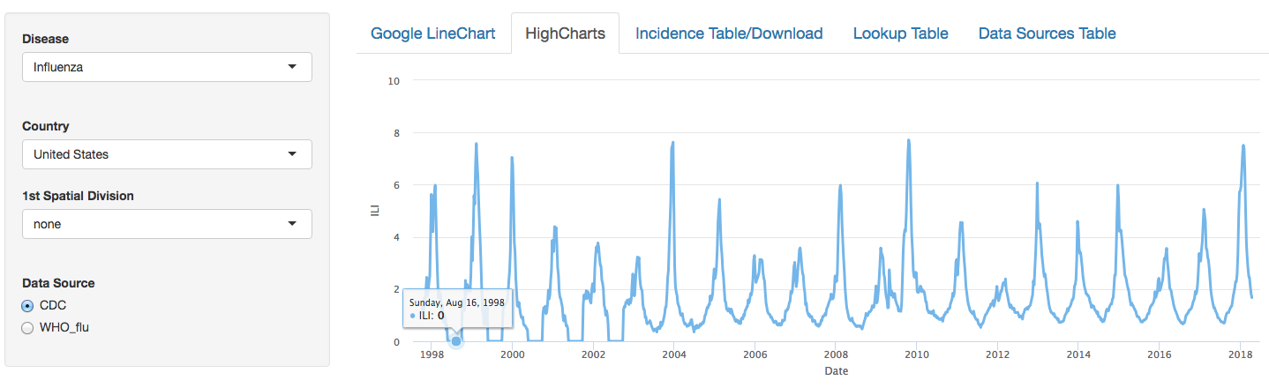
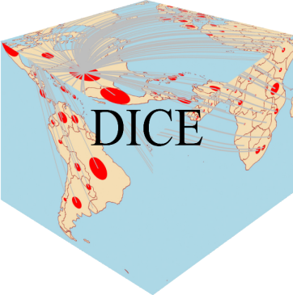


Forecasting the 2017/2018 Influenza Season: The CDC Flu Challenge
Michal Ben-Nun, James Turtle, Pete Riley Predictive Science Inc., San Diego
Steven Riley
Imperial College, London
Donald Ellis, David Bacon
Center for Atmospheric Physics, Leidos

Slide 2
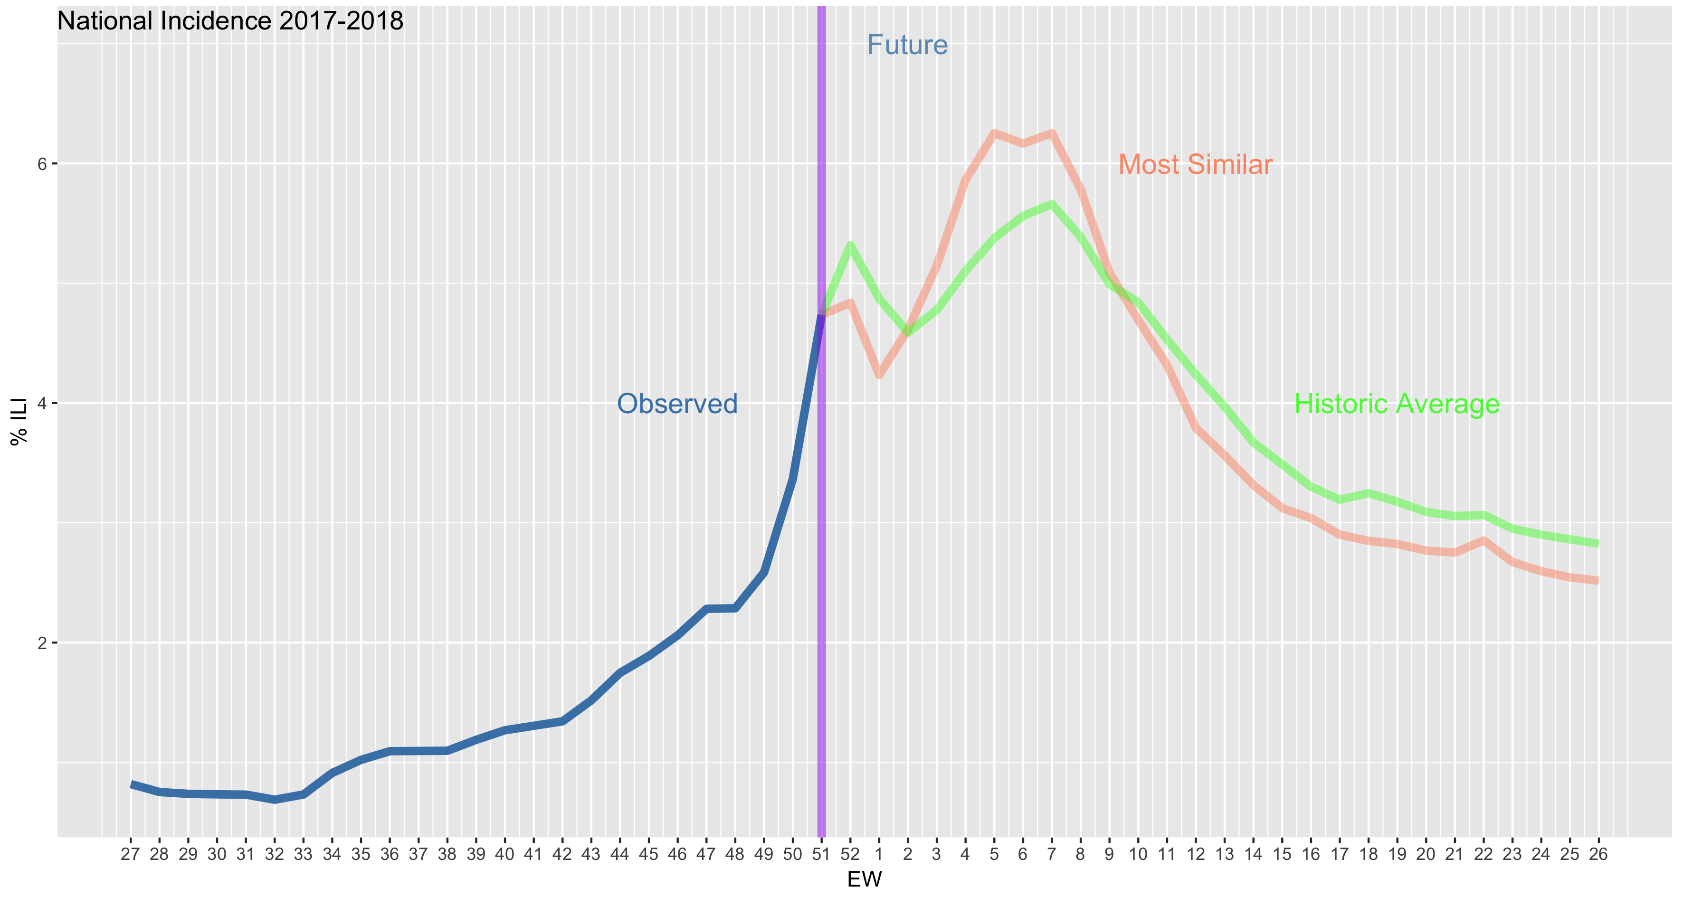
DICE – Dynamics of Interacting Community Epidemics
Global, arbitrary spatial scale, mechanistic compartmental models
Directly transmitted & vector-borne diseases
Spatial regions can be coupled or not
Uncoupled
  Sequential optimization of each HHS region -> regional incidence
  National profile is the weighted sum of these ten profiles
  National profile also fitted directly (no regional information)
Coupled
  All ten regions are coupled and optimized simultaneously to fit the national incidence
Force of Infection Models:
  Four different models: specific humidity, school vacation schedule, both SH and school, and a fixed value
MCMC fitting procedure
  Optimize the likelihood that sentinel incidence is generated from underlying model values
  Returns a posterior distribution for model parameters
Auxiliary Information
  Informed Priors
  Data augmentation
Human supervised model/prior/coupled selection
Observed
Most Similar
Historic Average
Future (unknown)
Notes:
DICE – a global mechanistic model with an arbitrary spatial scale.
Can be used to model both vector borne and directly transmitted diseases with and without coupling between the regions

Slide 3
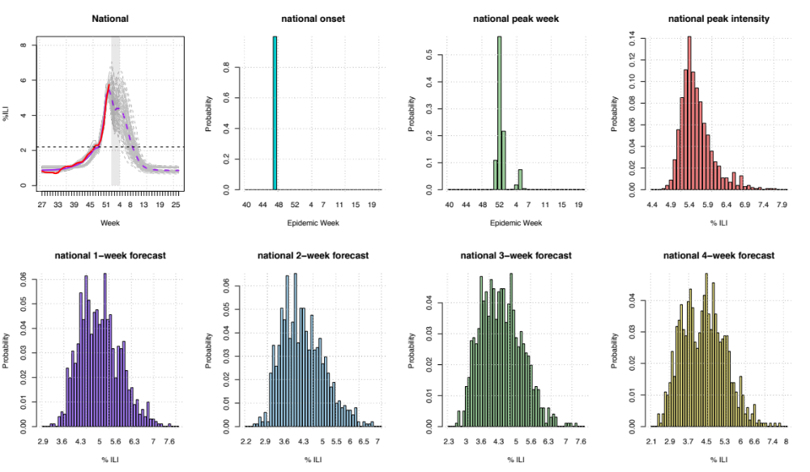
National – Weekly Submission
Notes:
Example from EW 52 – last week of 2017. Top left is the national ILI profile with the observation (at EW 52) in red and our fit and forecast in grey with dashed purple being the mean.
Grey line – 1,000 random realizations from the second half of the MCMC chain.
The peak onset, peak week and peak intensity are calculated from the forecast distribution as are the 1-4 weeks forward.

Slide 4
Comparing 2017/18 to 2016/17
Score By Target
Score by Location
Target | PSI 2016-17 | PSI-2017-18
Onset Week | -0.76 | -0.18 (2)
Peak Week | -1.04 | -0.69 (3)
Peak % | -1.34 | -1.72 (16)
1-week | -0.73 | -0.70 (6)
2-week | -1.08 | -1.07 (9)
3-week | -1.34 | -1.51 (11)
4-week | -1.57 | -1.75 (12)
Overall | -1.12 (13) | -1.09(11)
Region | PSI 2016-17 | PSI 2017-18
1 | -0.62 | -0.82 (7)
2 | -1.71 | -1.55 (16)
3 | -1.13 | -1.15 (14)
4 | -1.57 | -1.48 (15)
5 | -1.00 | -0.92 (11)
6 | -1.51 | -1.16 (3)
7 | -1.47 | -1.22 (8)
8 | -0.62 | -0.62 (7)
9 | -0.94 | -0.90 (13)
10 | -0.90 | -0.93 (12)
Nation | -0.88 (13) | -1.11 (11)
Overall | -1.12 (13) | -1.09 (11)
Both seasons a total of 29 models
Scores calculated using all weeks
Parenthesis our ranking this season
Large variations in ranking

Slide 5
Discussion
Target | Rank
Season Onset | 2
Peak Week | 3
Peak Intensity | 16
1-week ahead | 6
2-week ahead | 9
3-week ahead | 11
4-week ahead | 12
OVERALL | 11
Large number (32) of coupled/uncoupled models
Weekly selection is subjective
Like all other teams we did poorly on peak intensity
Improve data augmentation procedure
Improve our 3-4 week ahead forecast

Slide 6
The End..

Slide 7
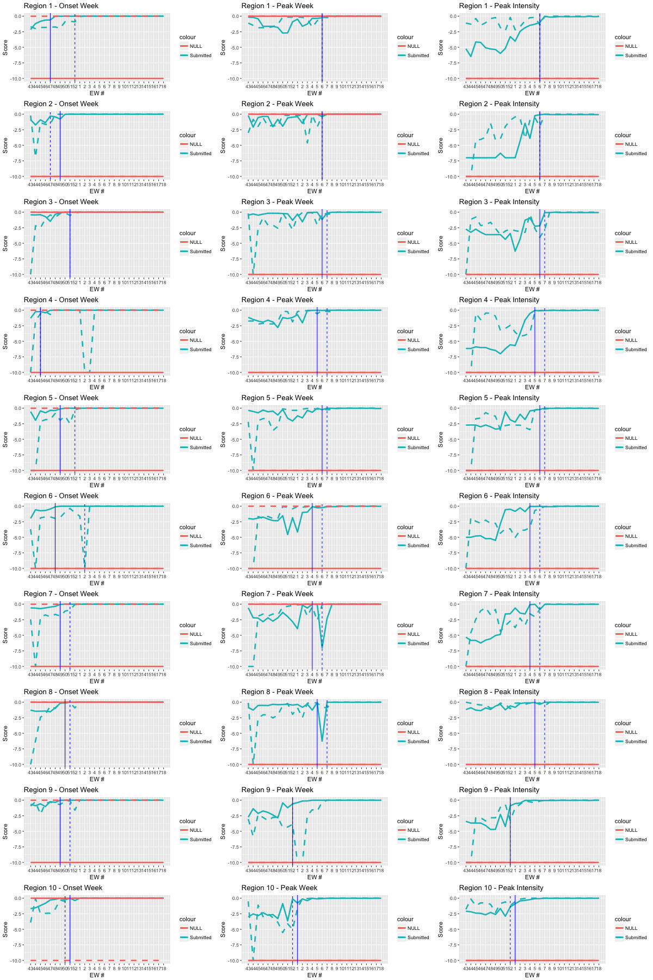
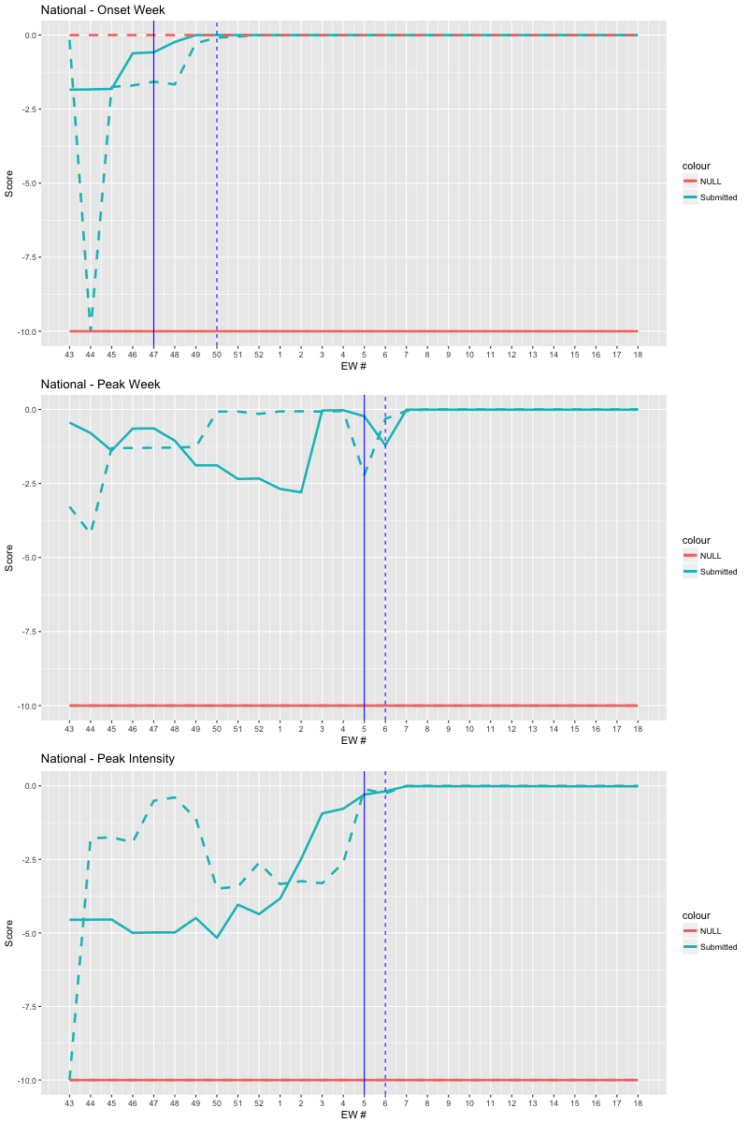
Comparing Season Target By Week
DICE , Historic average
Left – regions 1-5 , right - Nation
Current year full line past year dashed line
Vertical lines: onset or peak week

Slide 8
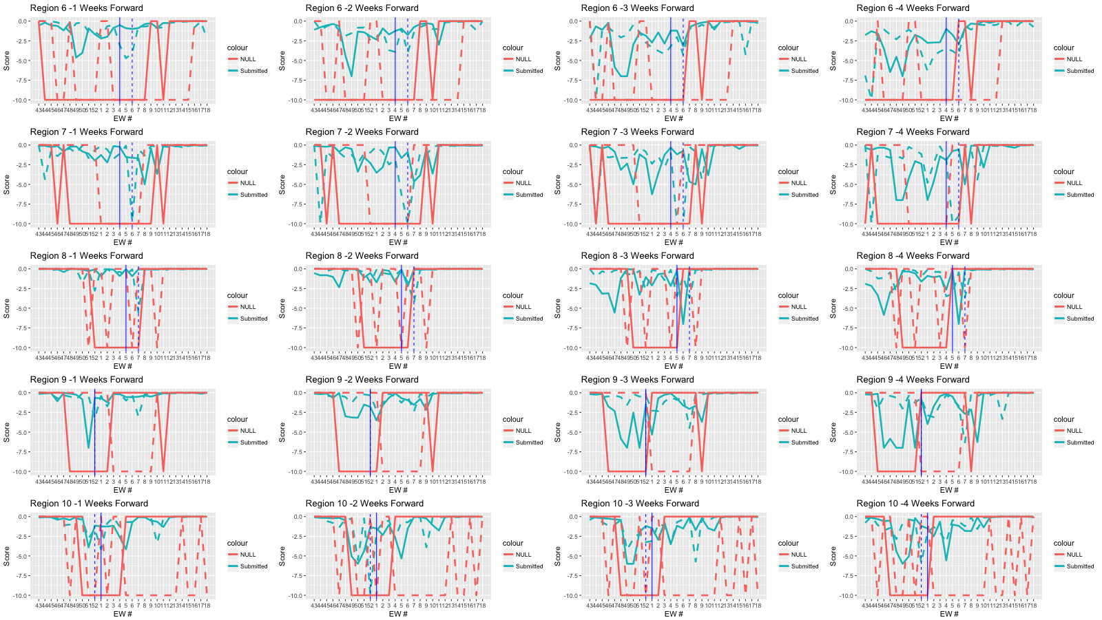
Region- Comparing Forecast Score by Week
Regions 6-10 (by row). Full/dashed lines current/past season
DICE, Historic Average, peak week

Slide 9
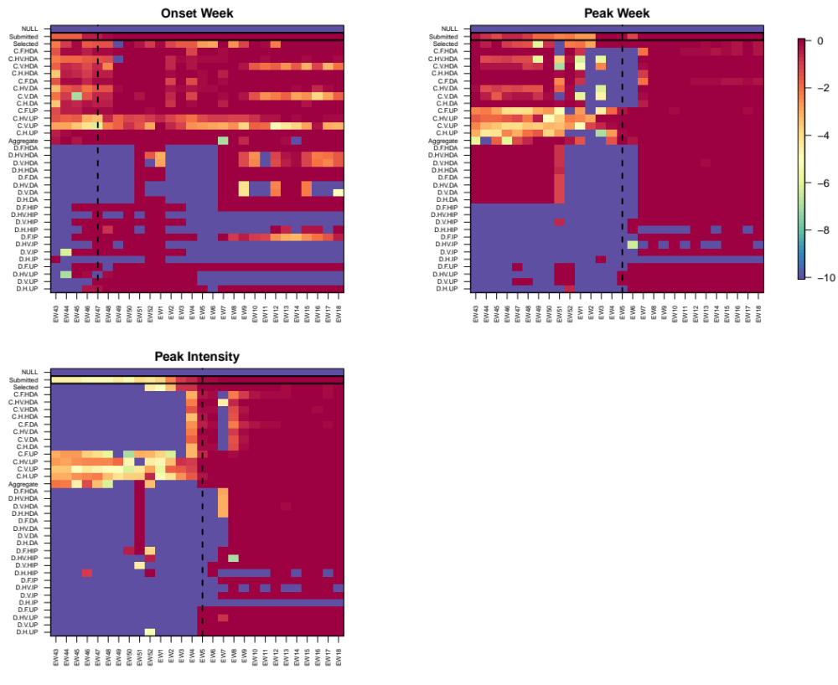
National Season Targets Scores
CDC Score for each model/method during the challenge
Submitted includes a ‘fail safe’ baseline
The NULL model: simple historic average
Dashed vertical line: onset/peak week
Models scores are clustered: uncoupled (UP,IP), uncoupled (DA/HAD) , coupled, coupled (DA/HDA)
Better for onset and peak week
Peak intensity was hardest season target for us
Notes:
Submitted has rectangle around it.
We do better with onset (ranked 2) and peak week (ranked 3) as compared to peak intensity (ranked 16!).
This is also reflected in our score compared to other groups participating in the challenge.
Most likely because DA could not really help with properly guiding us to the correct peak intensity.
Also we maximize the likelihood which does not emphasize getting the peak right

Slide 10
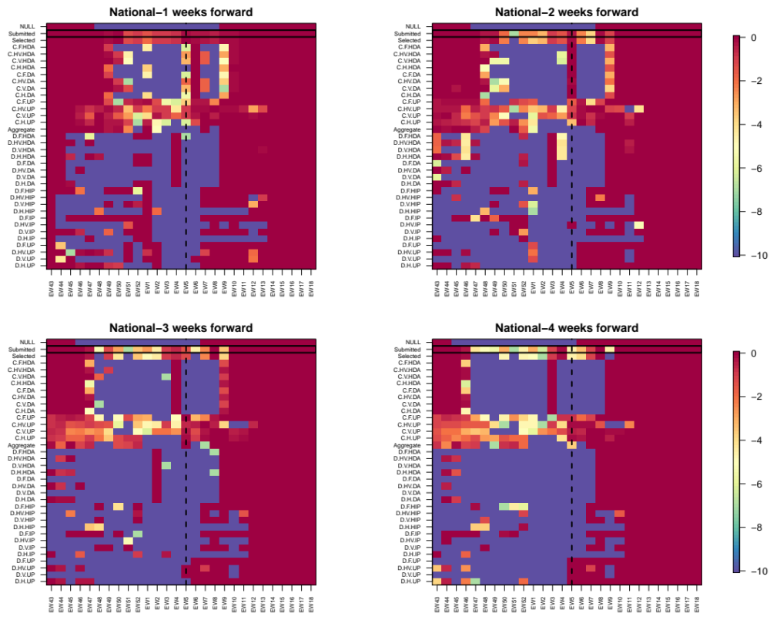
National 1-4 Weeks Forecast Scores
Clustering of scores
Errors goes up with prediction horizon
Null model does well early/late in the season
Notes:
Ranking for weeks 1-4 is: 6, 9, 11 and 12

Slide 11
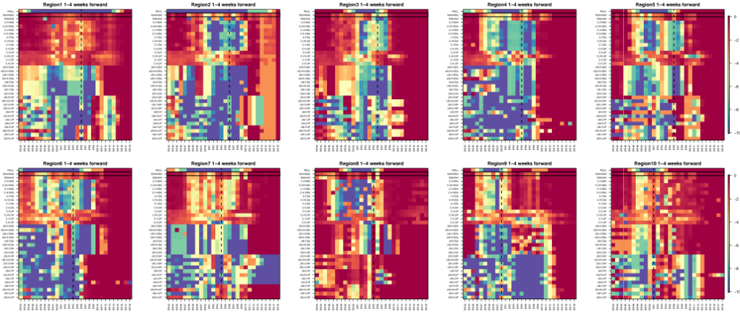
Regional 1-4 Weeks Forecast Scores
Black dashed vertical line is peak week in each region
Average score for 1-4 weeks forward
Score in some regions better than others (e.g. 1, 8).
Notes:
Our ranking for the regions varies a lot – with the most extreme values being ranked 3 on region 6 and rank 16 for region 2.

Slide 12
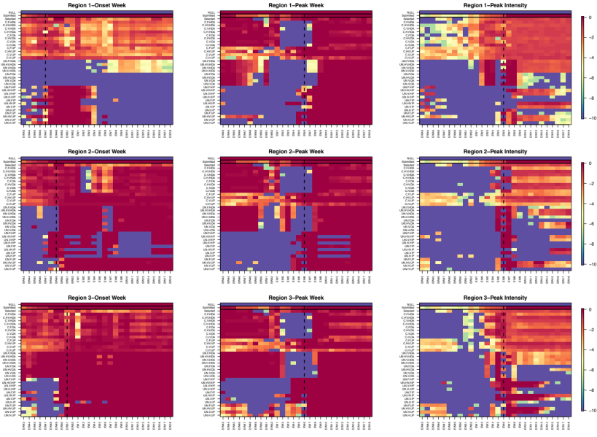
Regional Season Target Scores
Notes:
Showing three out of the ten regions.
Clustering of results. Our scores vary dramatically between the regions
Different regions we score quiet differently
Peak intensity is the hardest target for us.

