Slide 1
Forecasting the 2017-18 Influenza Season
Presented by Desiree Mustaquim on behalf of Team GA
Influenza Forecasting Workshop,
CDC, Atlanta, GA
8/30/2018

Slide 2


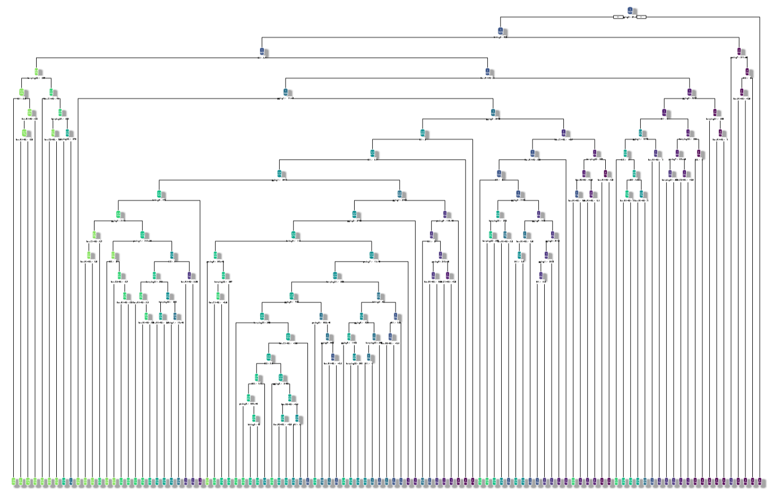

Team GA: Overview of model
Notes:
GA State University: Our inaugural year
Bagged Tree regression model
Predicting weekly weighted ILI percentage (wILI%)
Predictor variables: wILI, influenza lab positives, Google searches, climate data (min temperature, max precipitation)
Performed OK, but underpredicted the season

Slide 3
Results

Slide 4
Onset Week

Slide 5
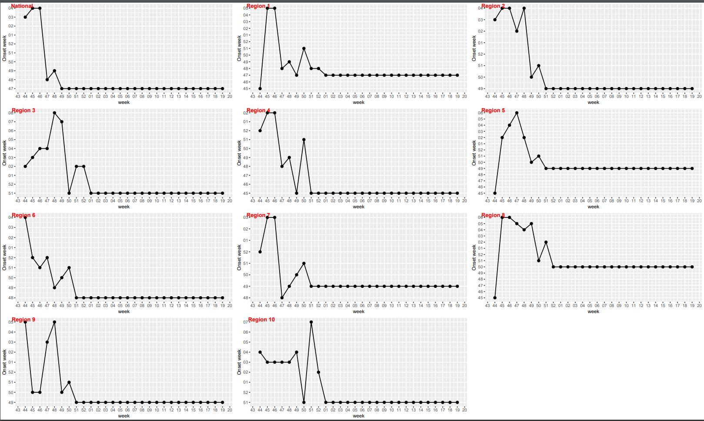
Notes:
Predicted usually high initially – stabilized a week or two after actual onset week; national predictions were generally better than the regional predictions

Slide 6
Peak week

Slide 7
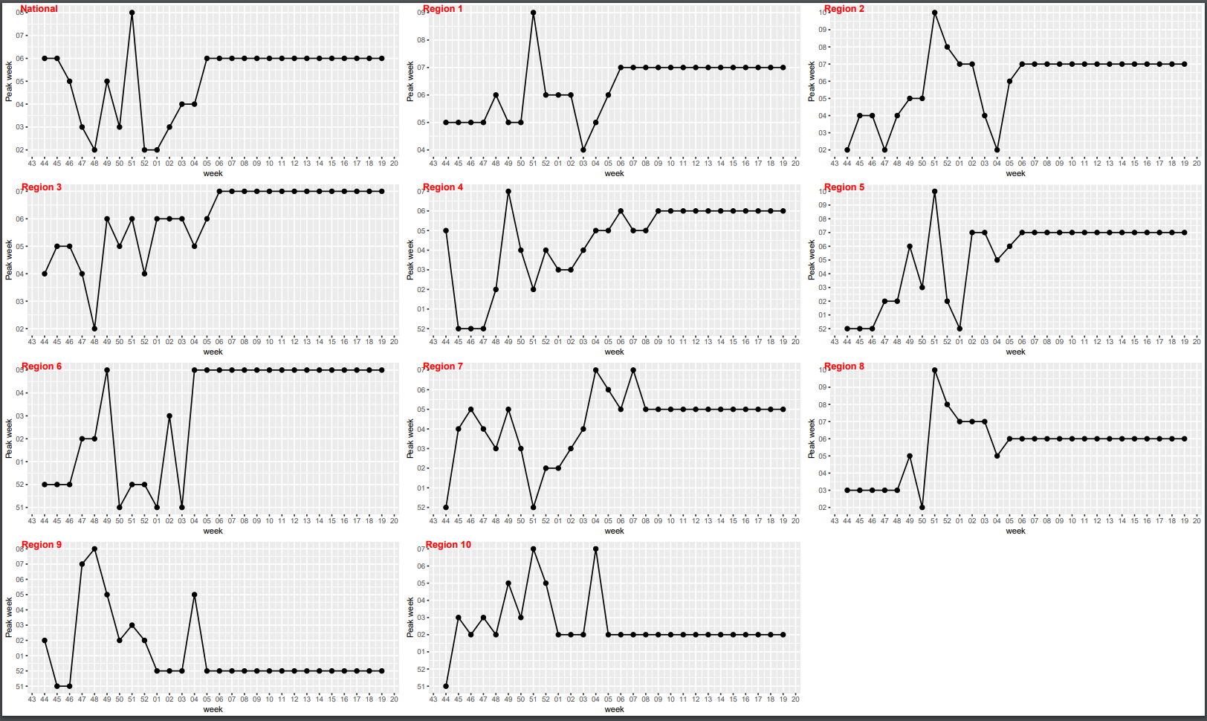
Notes:
Nationally, correctly predicted peak timing a week before the actual peak occurred. Similarly, we were able to predict slightly in advance for several regions as well

Slide 8
Peak Intensity

Slide 9
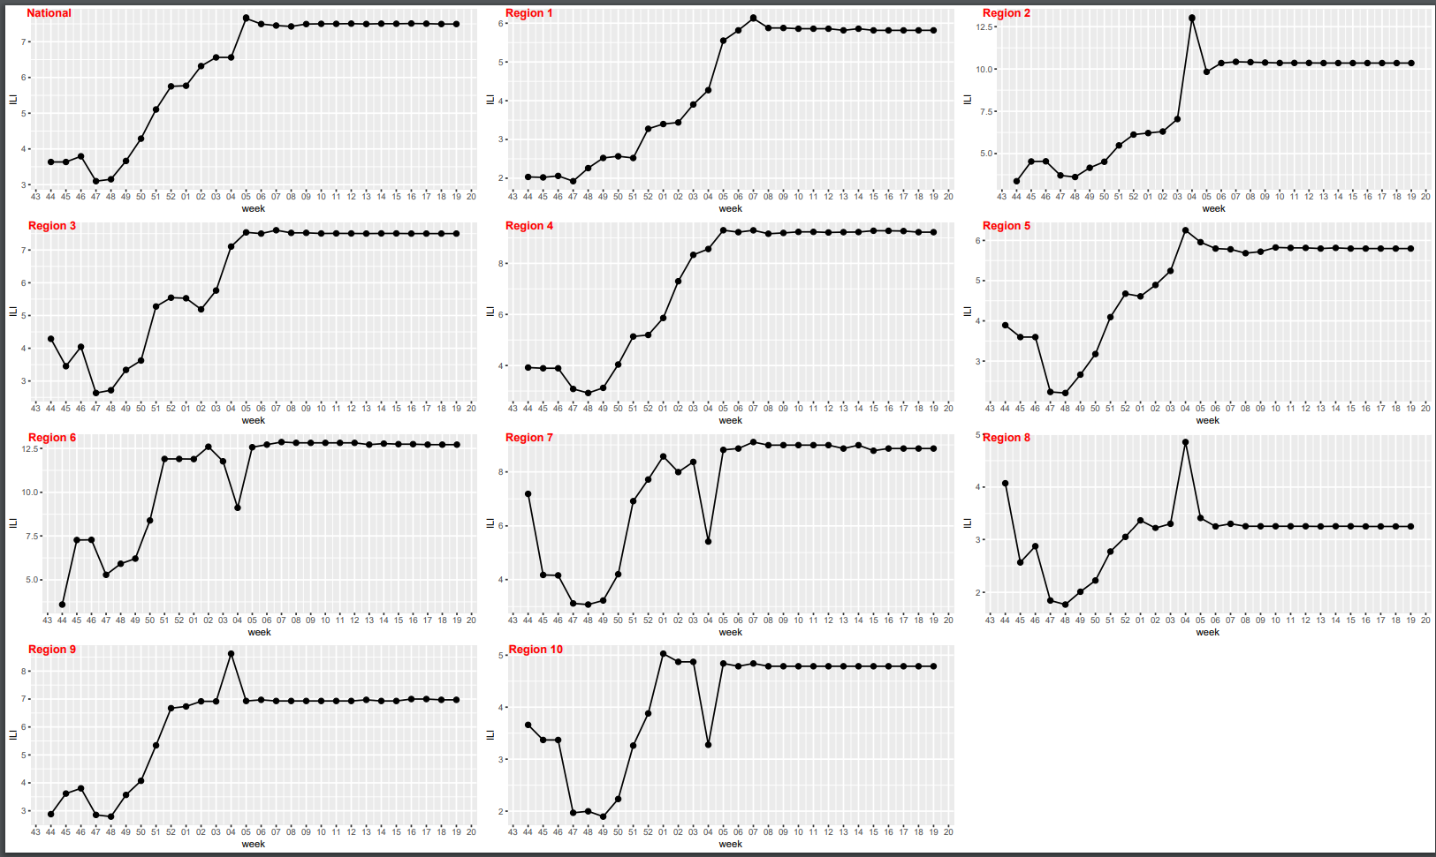
Notes:
Generally, underpredicted the peak values across the board, but surprisingly severe season

Slide 10
1 week ahead

Slide 11
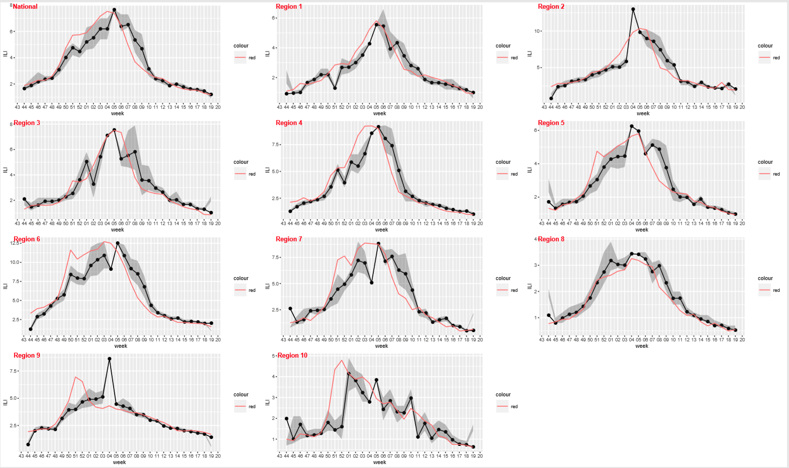

Slide 12
2 weeks ahead

Slide 13
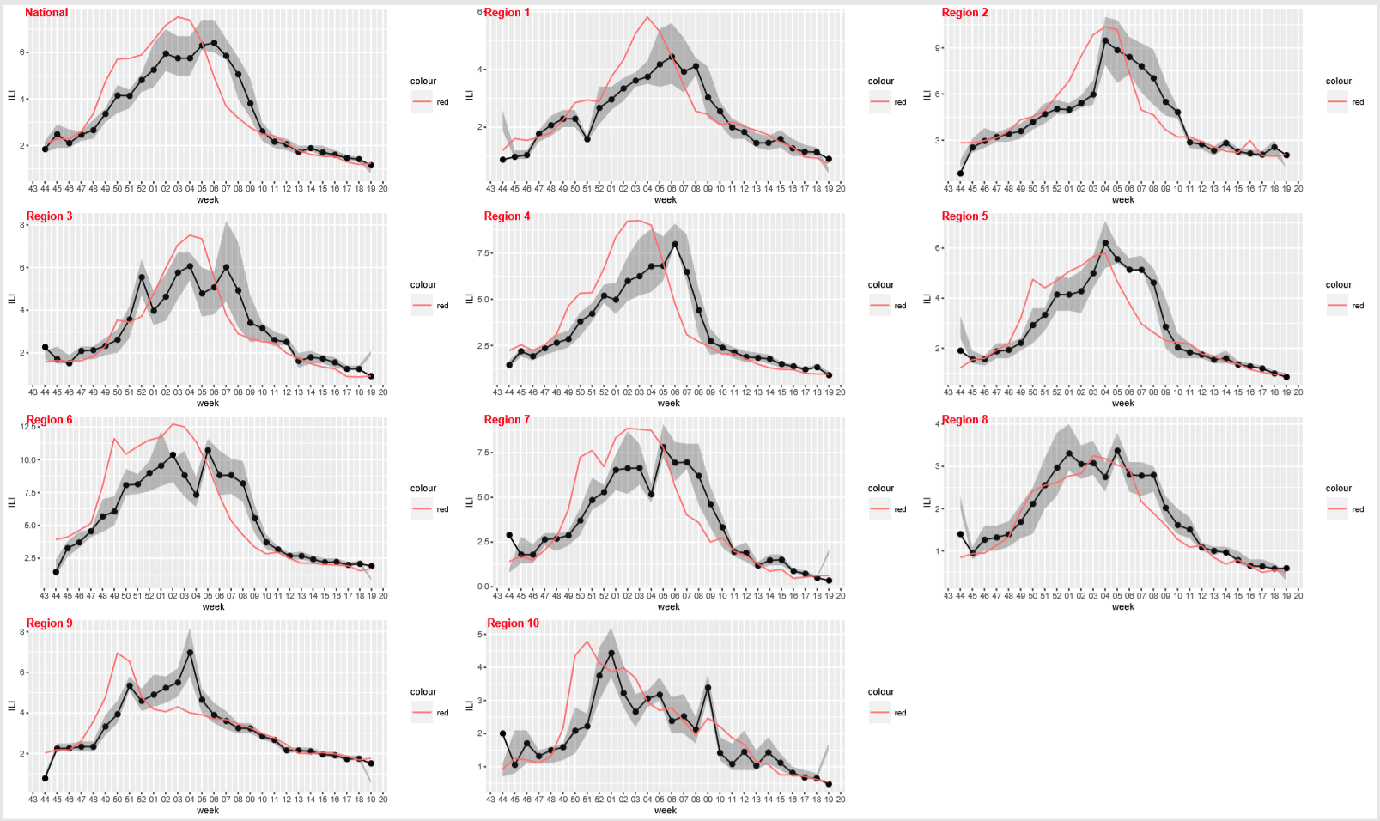

Slide 14
3 weeks ahead

Slide 15
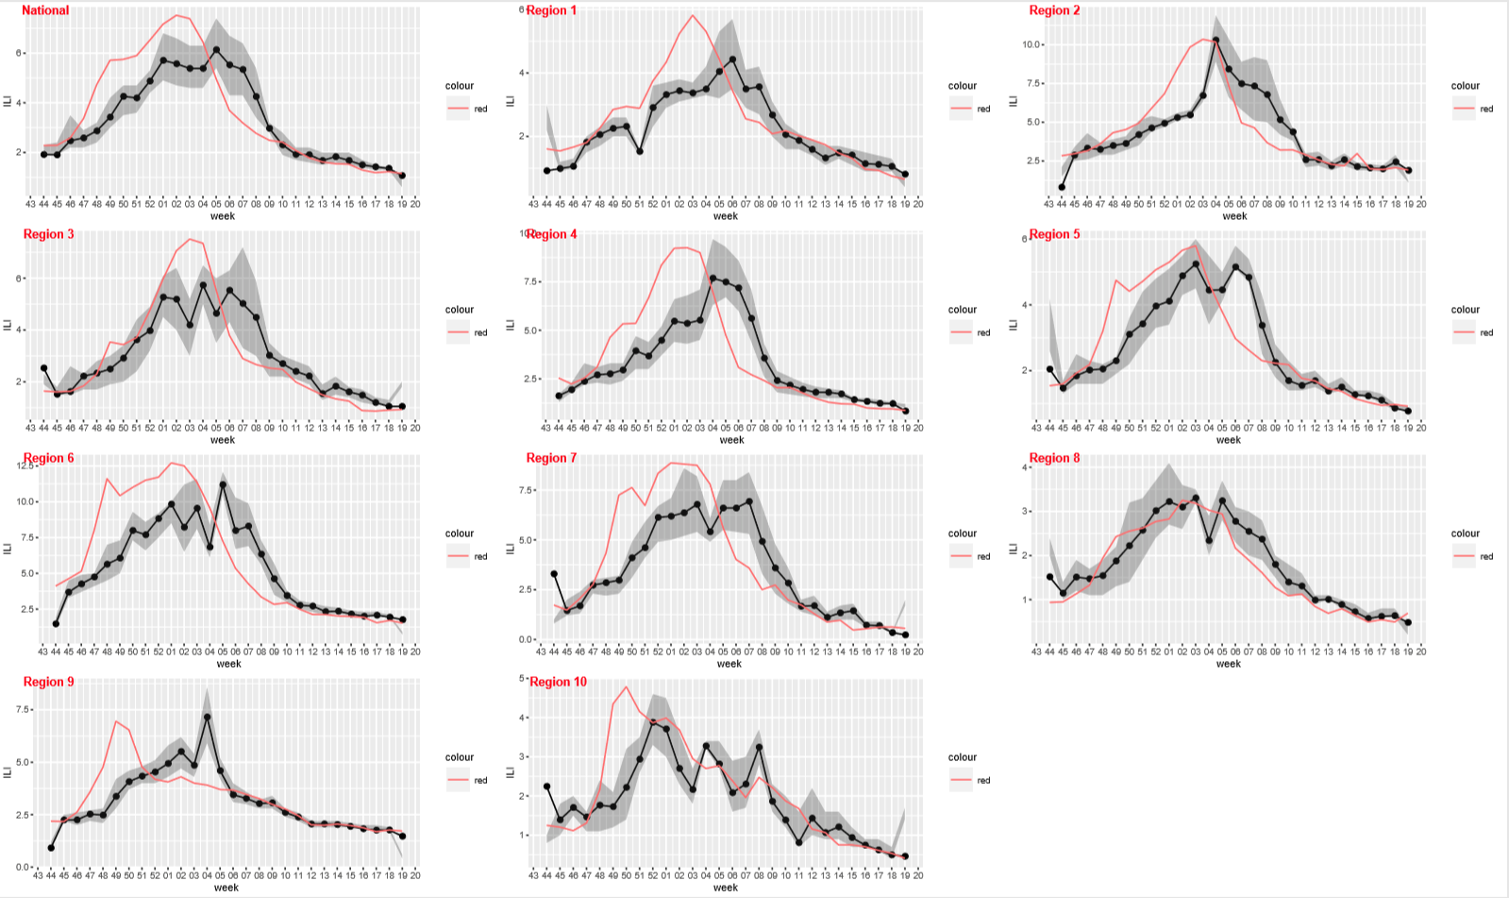

Slide 16
4 weeks ahead

Slide 17
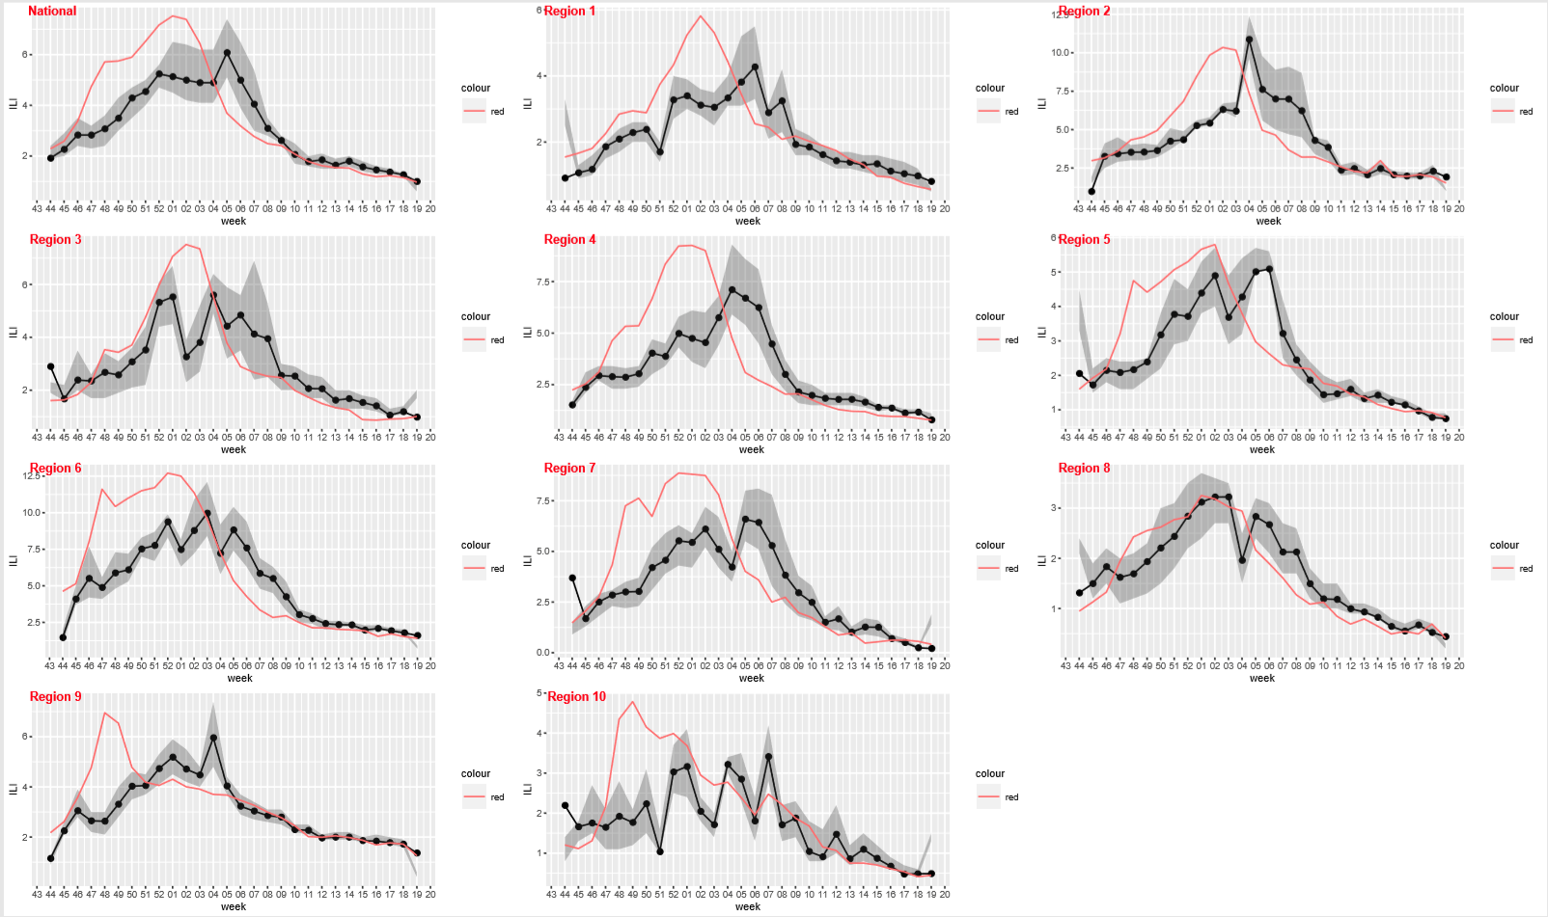

Slide 18
conclusions

Slide 19
Conclusions
Season was exceptionally severe- our model under-predicted the intensity – and also timing (predicted later)
Though there is a lot of room for improvement, it performed better than expected for first attempt
Some limitations
  Model largely depends on historical average and incorporated limited variables
  Does not account for mechanism of virus transmission
Notes:
Anything else?

Slide 20


Suggestions for future forecasting models
Incorporate variance in climate data
Adjust for spatial correlations
Explore additional predictors:
  Unplanned school closures
  Twitter
  Others?
Notes:
Anything else?

Slide 21
Questions?
Thank you for a great season!
Additional 2017-18 GSU Team Members:
Dr. Gerardo Chowell-Puente
Linh Dinh, MPH, PhD student
Dr. Suranga Edirisinghe
Dr. Kenji Mizumoto

Slide 22
supplemental

Slide 23
Independent variables

Slide 24
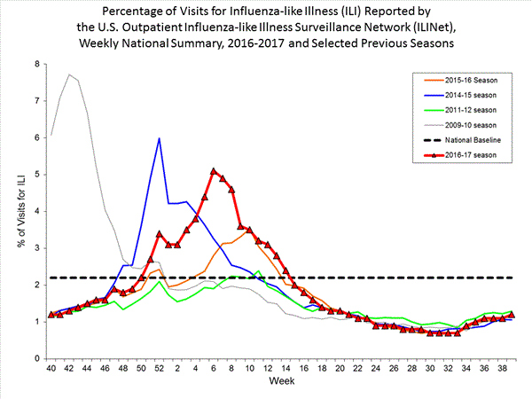
Surveillance Data -ILI
Used weighted ILI (Influenza-like Illness)
Also target of forecasting challenge
Extracted with cdcfluview package in R
Source: https://www.cdc.gov/flu/weekly

Slide 25
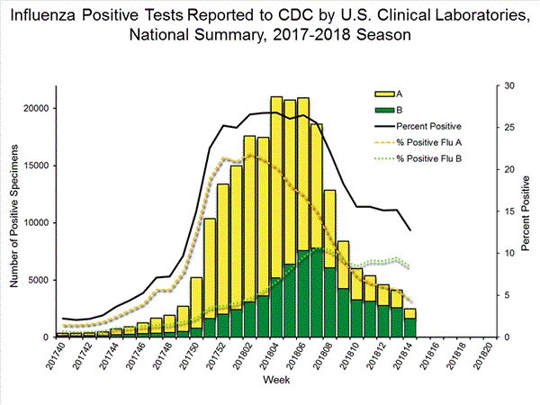
Surveillance Data - Lab
Laboratory data: from CDC FluView
Total influenza positives by week
Post 15-16 season, used clinical lab data counts only
Extracted with cdcfluview package in R
Source: https://www.cdc.gov/flu/weekly
Notes:
Looked at using A/B proportions but could not make it work in time for the start of the challenge – may revisit it in the future.

Slide 26

Google Search Data
Google Health API: Google search volume (keywords: flu, tamilfu, influenza) was retrieved for each state and then weighted by population size:
  G_{r} = $\frac{\sum_{i=1}^{s}{Gi∗Pi}}{\sum_{i=1}^{s}{Pi}}$
  G_{r}: weekly google search of region r
  G_{i}: weekly google search of state i
  P_{i}: population size of state i
  s: the number of state within the region r
Average of weekly Google search was computed from previous years (week 40/2010 – present)
Source: https://developers.google.com/discovery/v1/getting_started

Slide 27

Climate
Climate data: MERRA-2
  Minimum weekly temperature/region and nationally
  Maximum weekly precipitation/region and nationally
To extract and prepare the data:
  Ex:
  T_{r} = $\frac{\sum_{i=1}^{n}{Ti}}{n}$
  T_{r}: min temperature of region r
  T_{i}: min temperature measured in a pixel i
  n: the number of pixels within region
Calculations done similarly for max. precipitation
Source: https://disc.sci.gsfc.nasa.gov/datasets/M2I3NPASM_V5.12.4/summary?keywords=MERRA-2
Notes:
Based on others’ work – believed these to be the best climatological indicators

Slide 28
Model

Slide 29
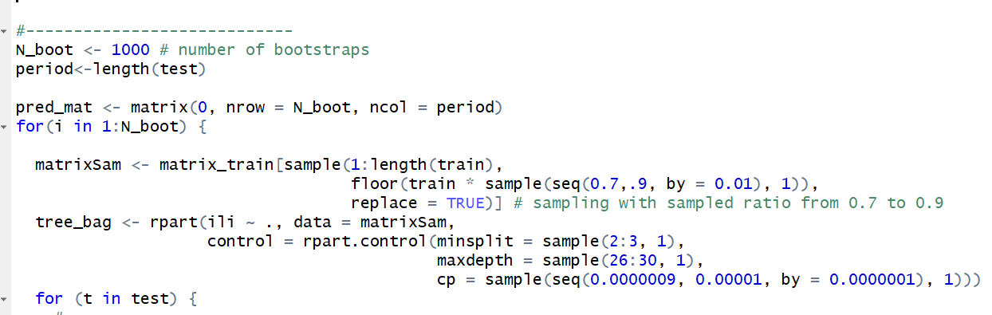
Model
Tree Regression
Bagging: 1000 bootstrapping simulations
Sliding window - Predicted wILI one week at a time and fed that value back into the model as part of the wILI predictor value set
Autocorrelation
Used R extensively
Notes:
Decision tree regression analysis - ensembled 1000 bootstrap simulations
Used sliding window method for predicting each future week – supervised machine learning
Used lagged predictors because of autocorrelation
Mainly used R (rpart, randomforest)for this forecasting model

Slide 30
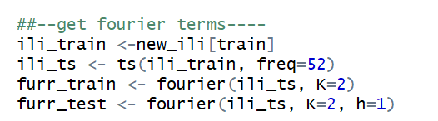
Seasonality

Slide 31
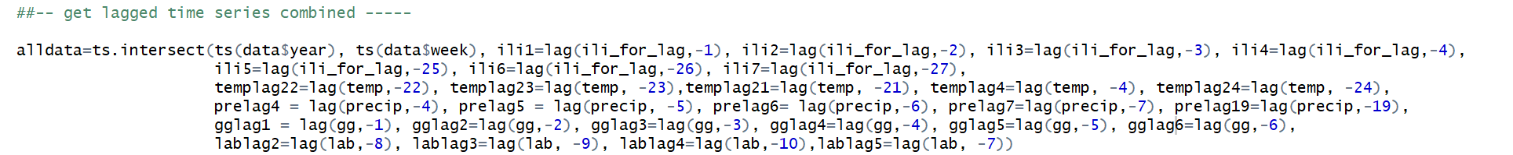
Autocorrelation and Cross Correlation
Notes:
Ex. wILI as a predictor exhibited autocorrelation
Examined ACF
Most recent week had the greatest correlation with the following week
Used lagged predictors
Also accounted for cross correlation with other predictors similarly – ex. ILI and lab counts)

Slide 32
Most Influential predictors

