Slide 1
Influenza Forecasting Update – week 8
Full forecasts, including individual states, at https://predict.cdc.gov

Slide 2
U.S. Forecasting Summary
ILI activity is likely to remain above baseline for the next 4 weeks
Forecasts predict ILI to decrease weeks 9–12
There is about an 90% chance that the flu season has peaked (likely peak weeks 7–9)
Forecasts give a lower chance for a high severity season than the historical average (<1% from forecasts vs. 8% historically)

Slide 3
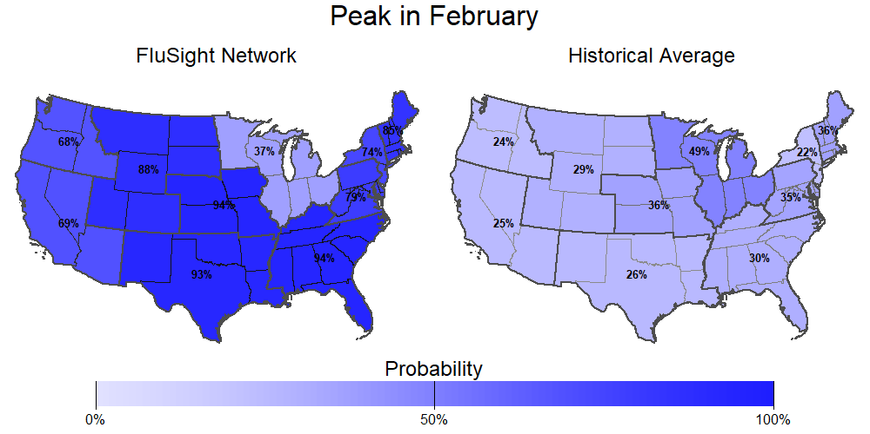
Season peak
~90% chance of U.S. peak in February (historically is 37%).

Slide 4
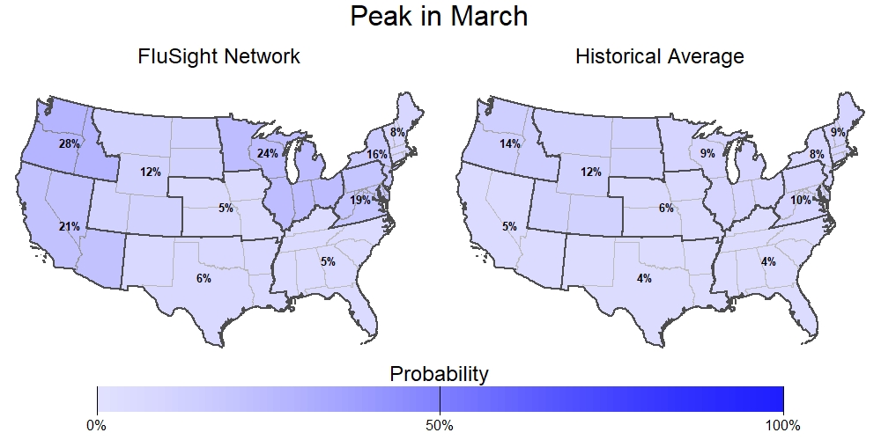
Season peak
10% chance of U.S. peak in March (historically is 6%).

Slide 5
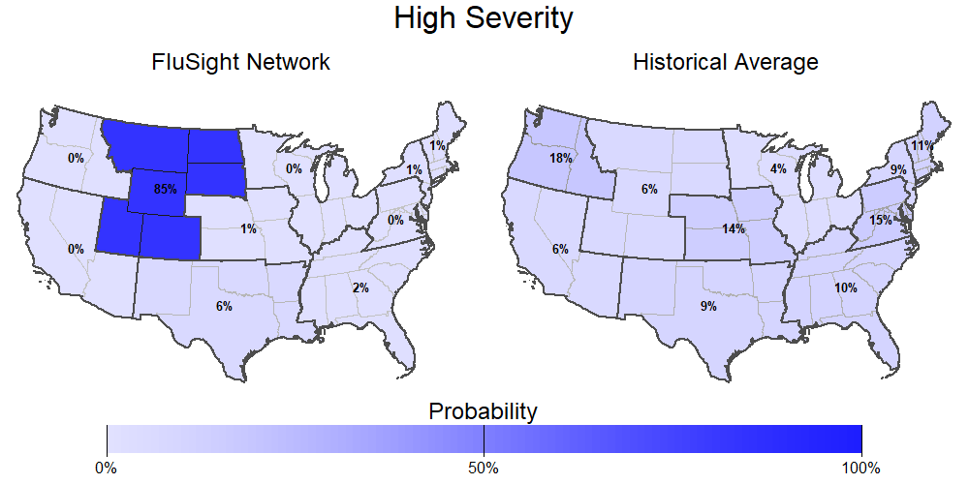
Season intensity
<1% chance U.S. has a high severity season (historically is 8%).

Slide 6
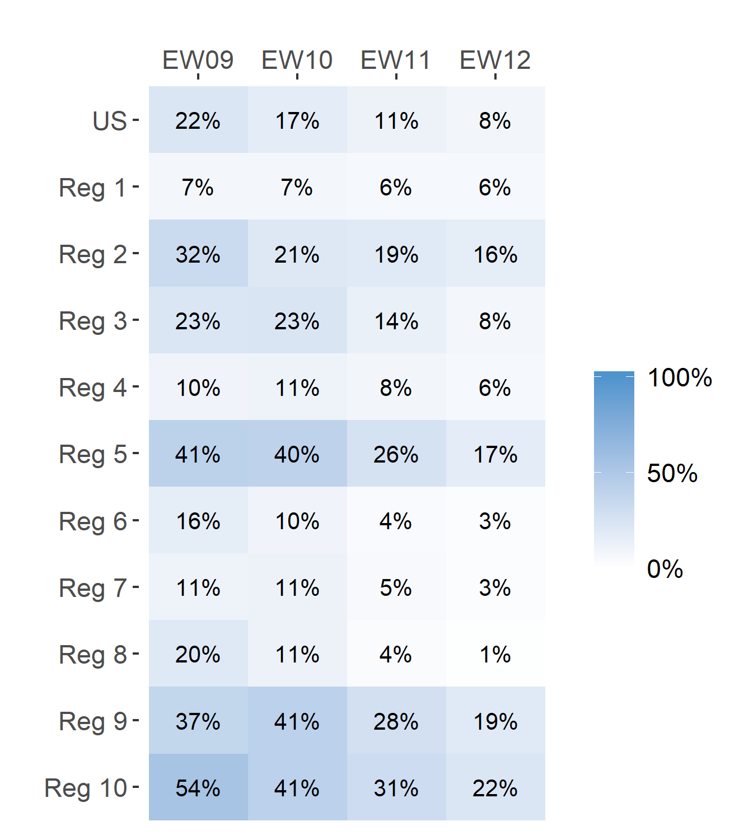
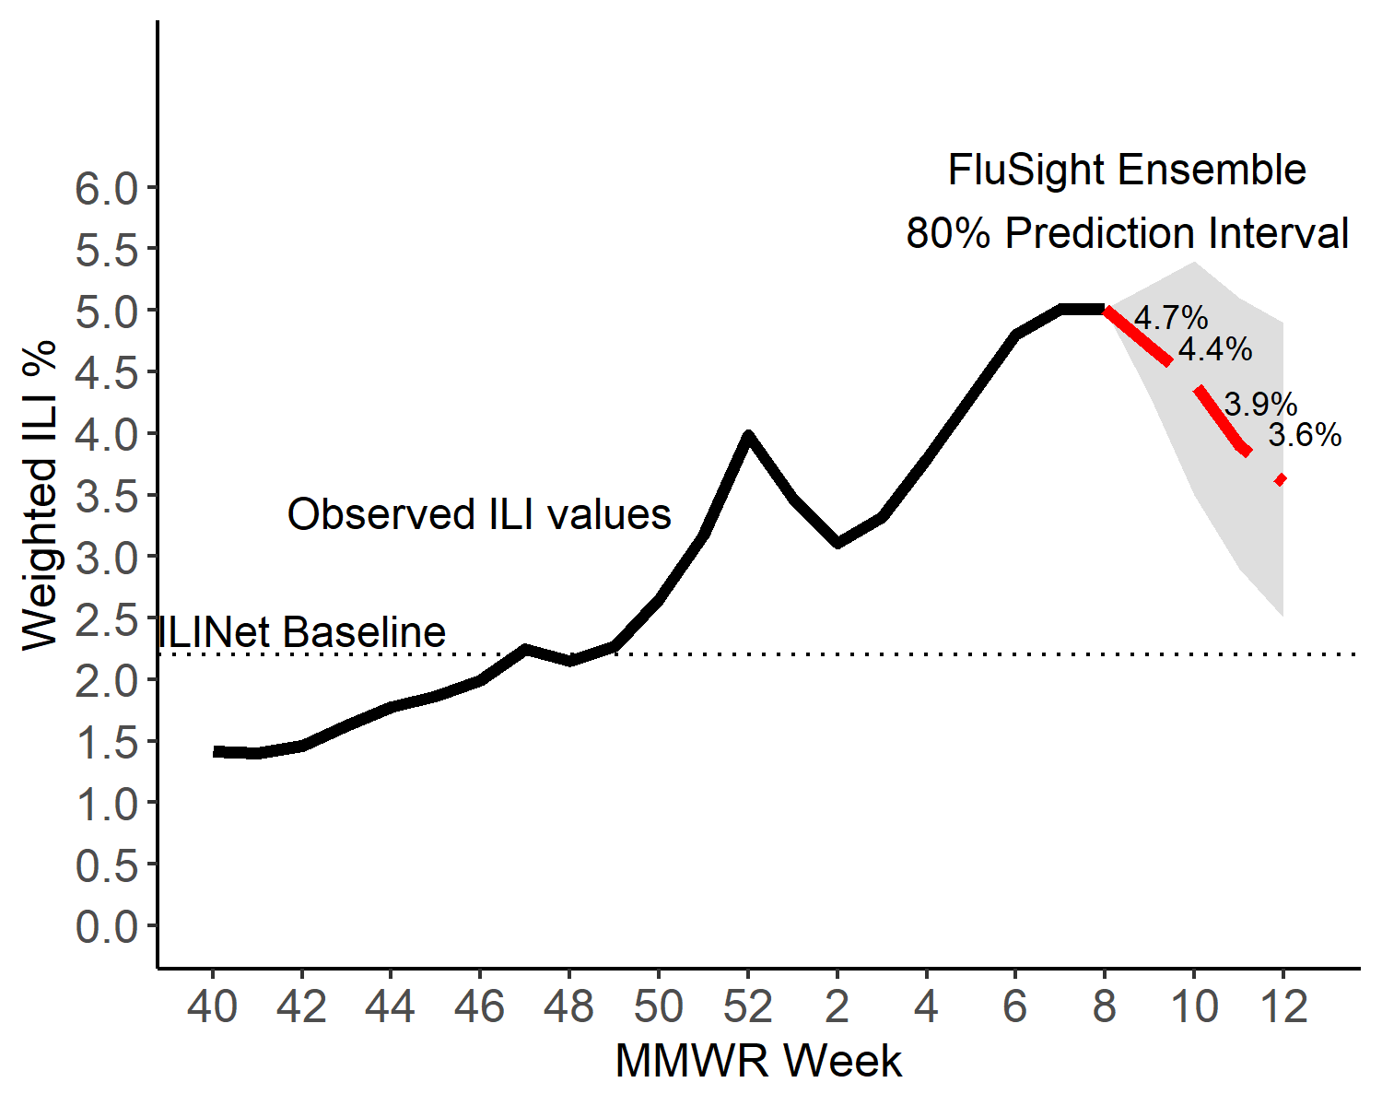
Short-Term ILI Predictions
Prob. ILI will be above last published value
US Short-Term Predictions

Slide 7
Extra Slides

Slide 8
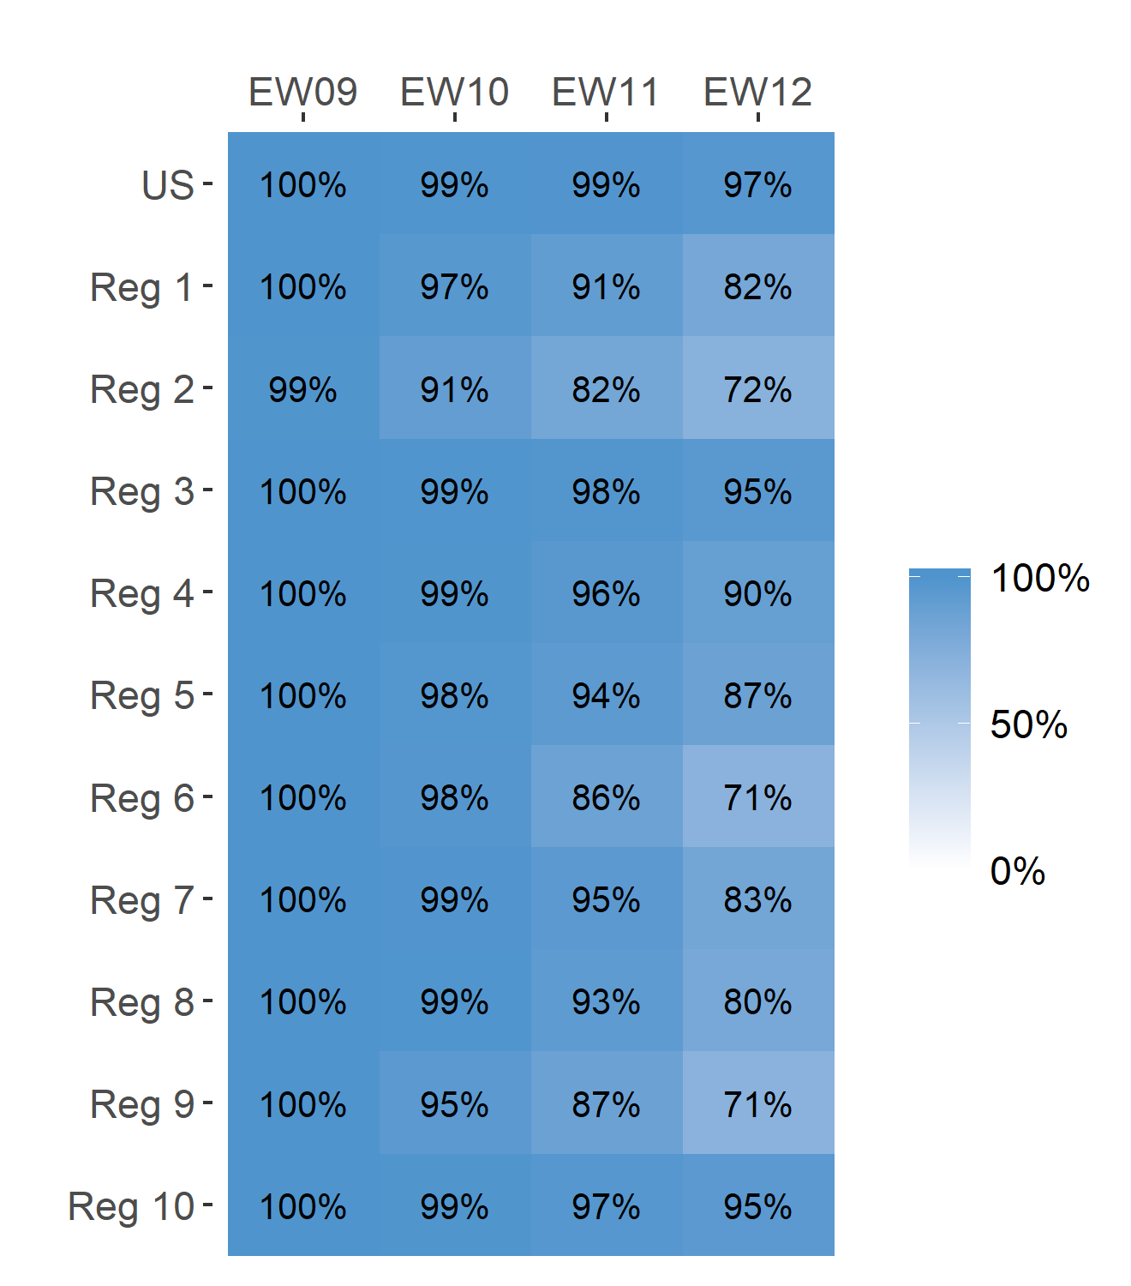
Short-Term ILI Predictions
Prob. ILI will be at or above baseline
US Short-Term Predictions

