Slide 1
Influenza Forecasting Update – week 12
Full forecasts, including individual states, at https://predict.cdc.gov

Slide 2
U.S. Forecasting Summary
ILI activity is likely to remain above baseline nationally through week 15
Forecasts predict ILI to decrease weeks 13–16
There is a 99% chance that the flu season has peaked nationally (likely peak week 7), but Regions 5, 7, & 10 are forecasted to have peaked in mid-March
Forecasts give a lower chance for a high severity season than the historical average (<1% from forecasts vs. 8% historically)

Slide 3
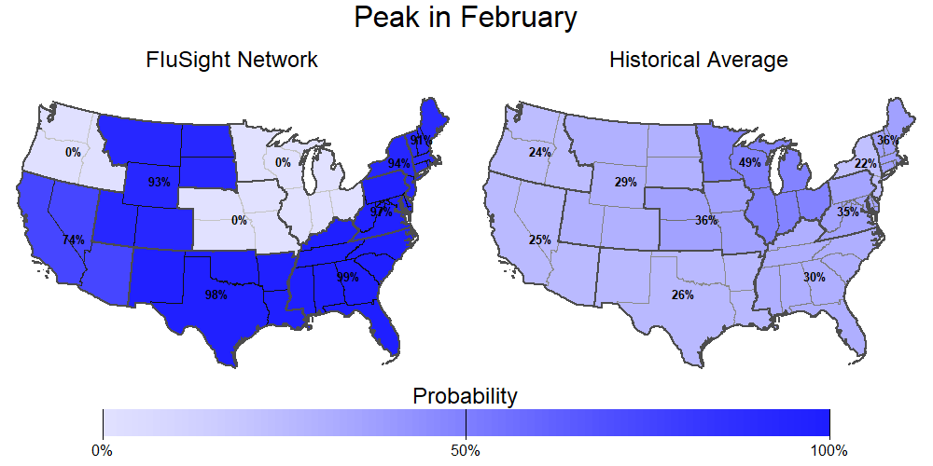
Season peak
99% chance of U.S. peak in February (historically is 37%).

Slide 4
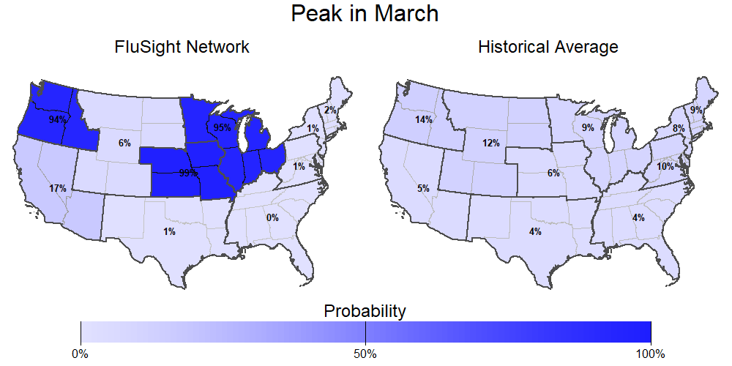
Season peak
<1% chance of U.S. peak in March (historically is 6%).

Slide 5
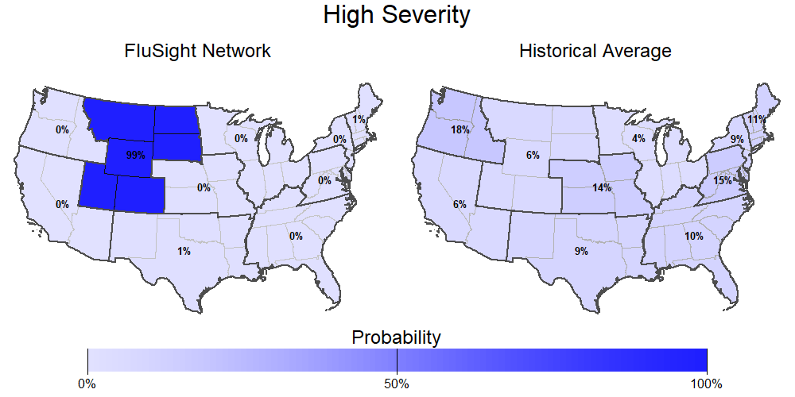
Season intensity
<1% chance U.S. has a high severity season (historically is 8%).

Slide 6
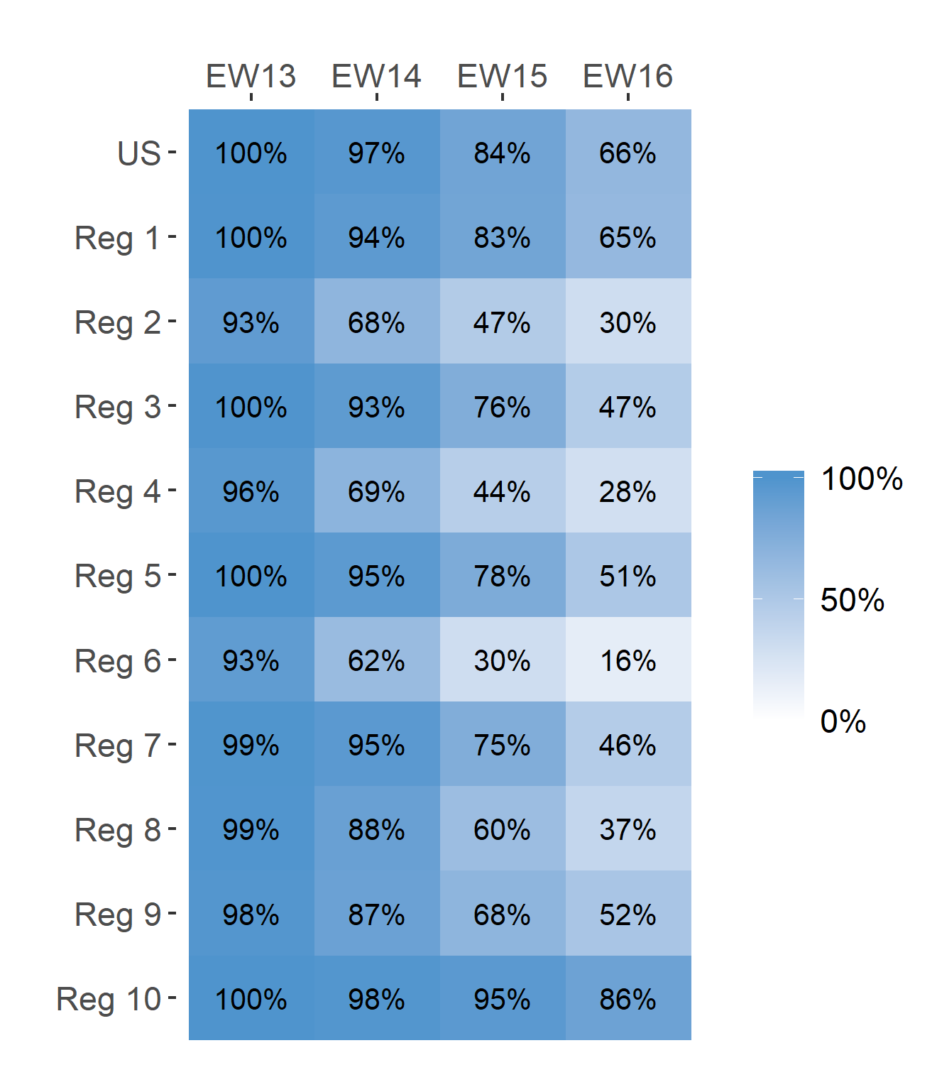
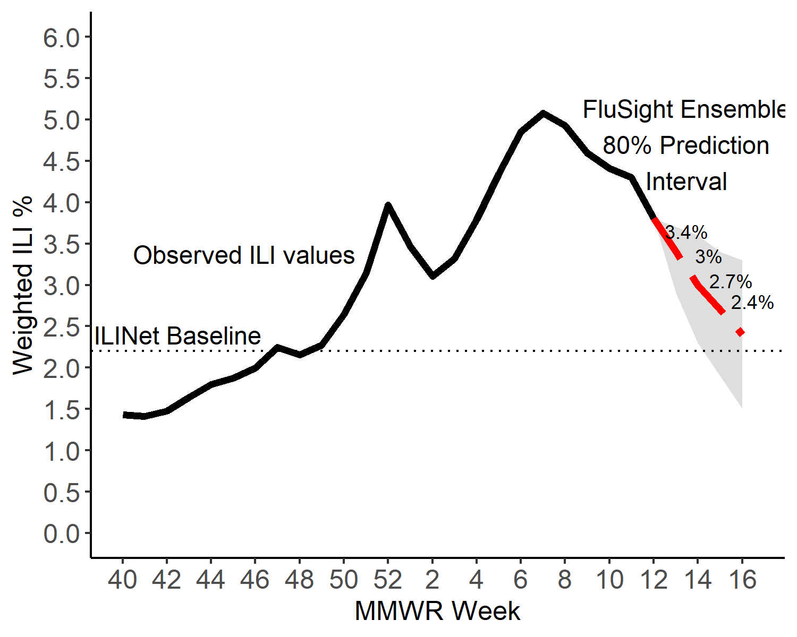
Short-Term ILI Predictions
Prob. ILI will be at or above baseline
US Short-Term Predictions

Slide 7
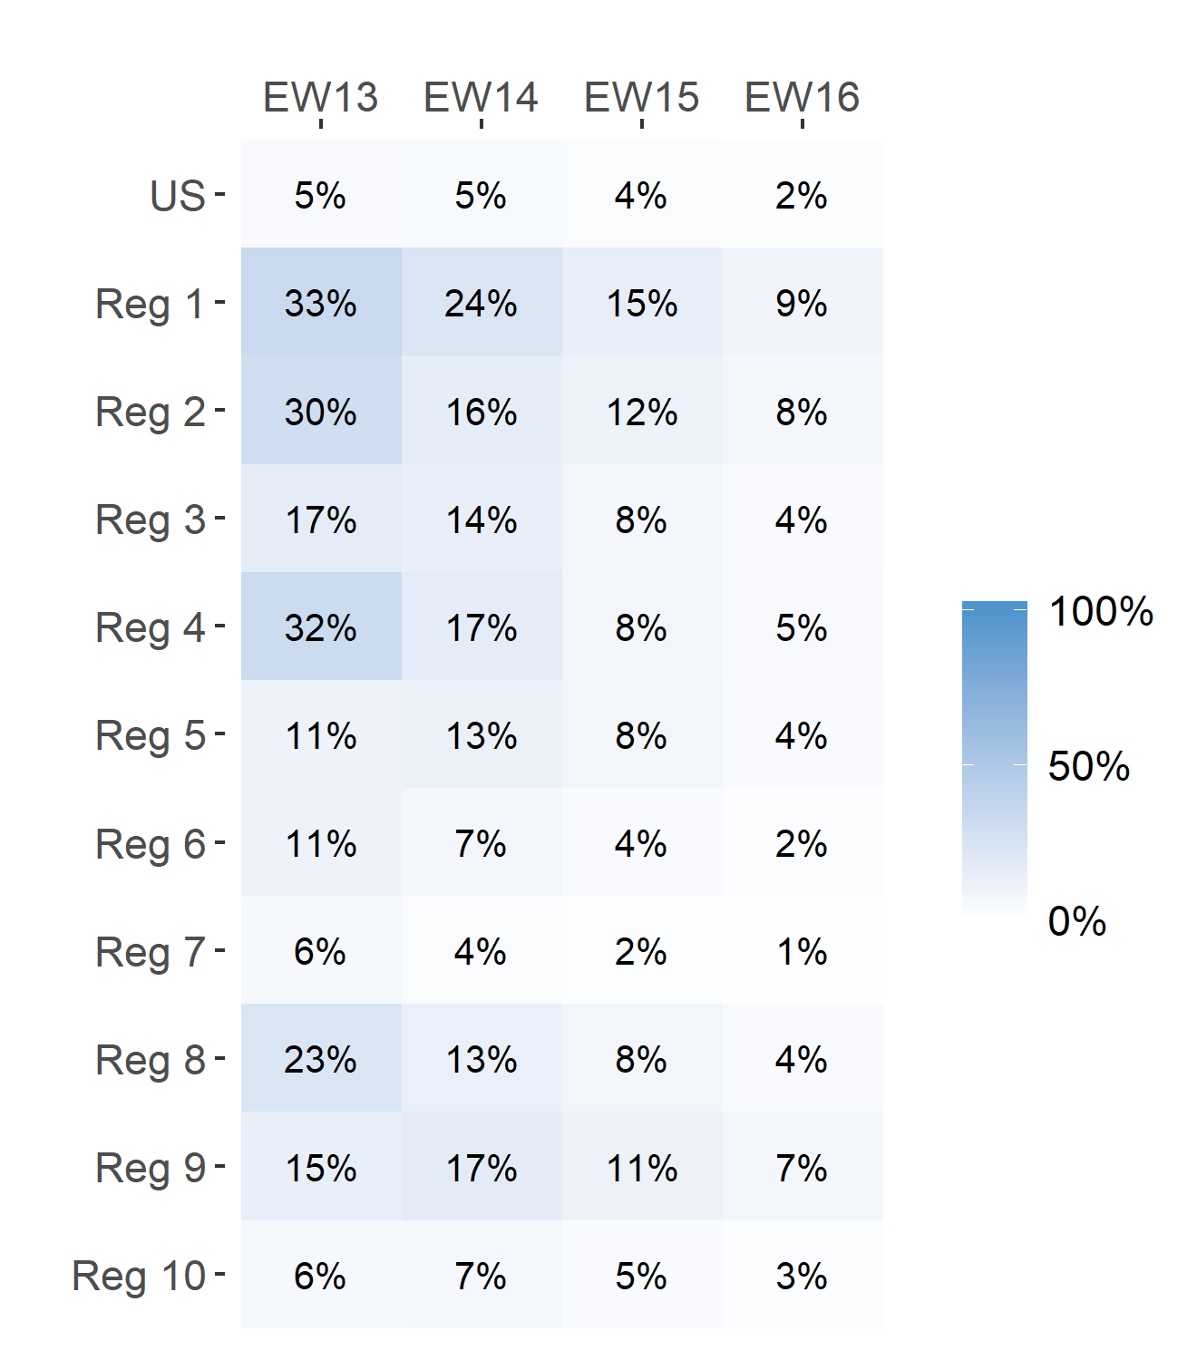
Short-Term ILI Predictions
Prob. ILI will be above last published value
US Short-Term Predictions

