Slide 1
Influenza Forecasting Update – week 17
Full forecasts, including individual states, at https://predict.cdc.gov

Slide 2
U.S. Forecasting Summary
Forecasts predict ILI to decrease weeks 18–21
ILI likely (≥98% chance) to remain below baseline nationally weeks 18–21

Slide 3
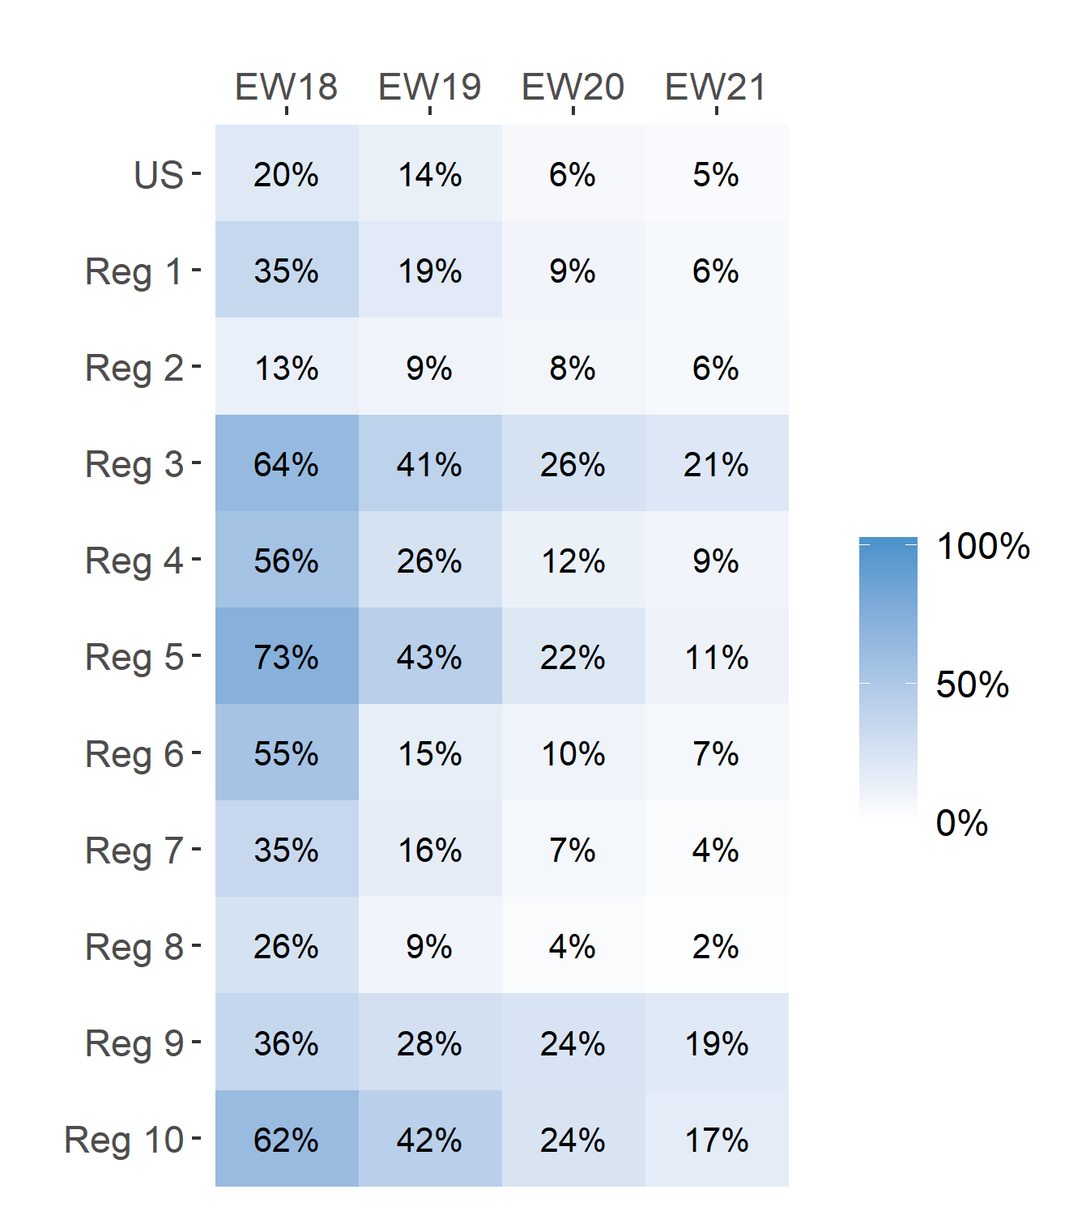
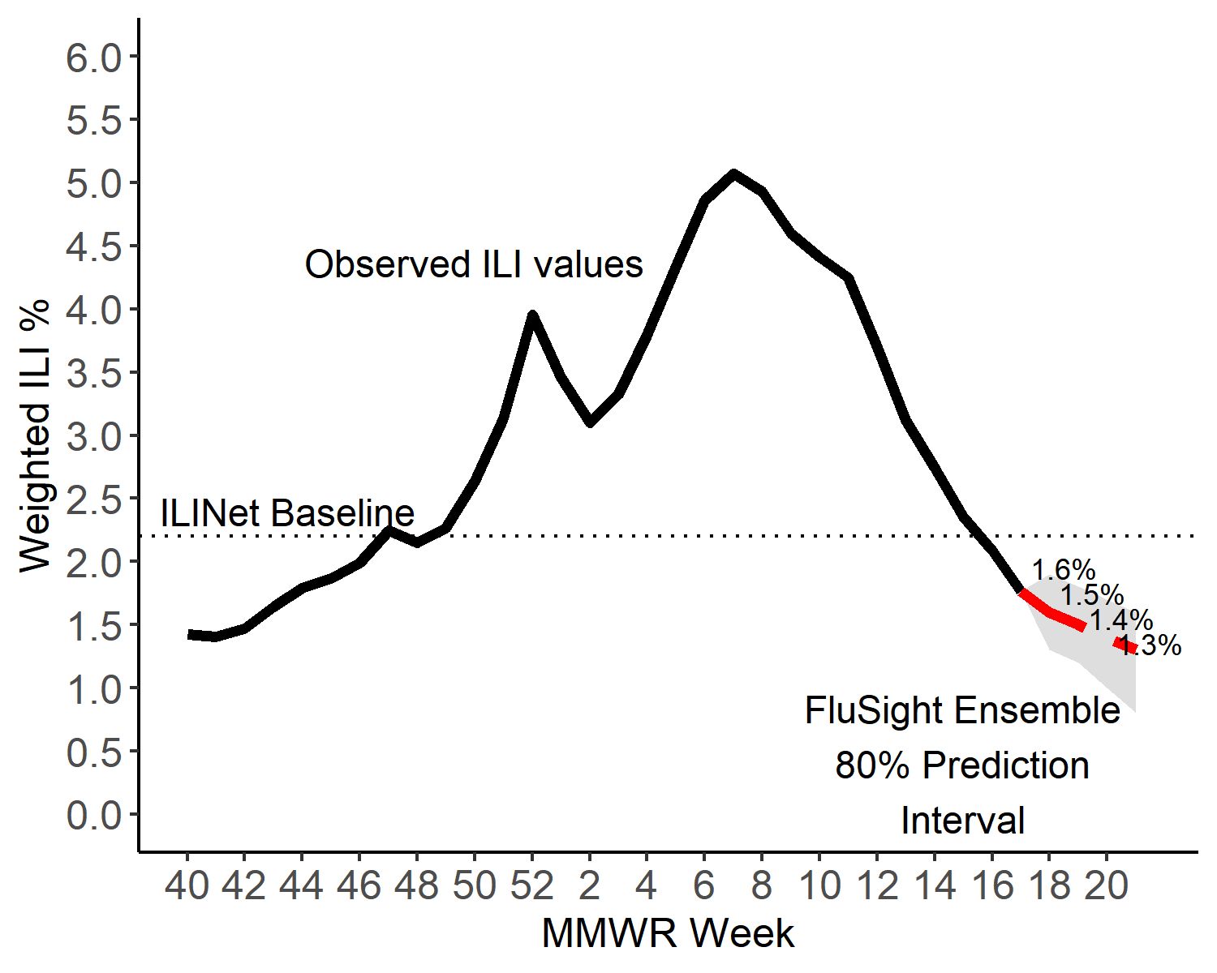
Short-Term ILI Predictions
Prob. ILI will be above last published value
US Short-Term Predictions

Slide 4
Back-up Slides

Slide 5
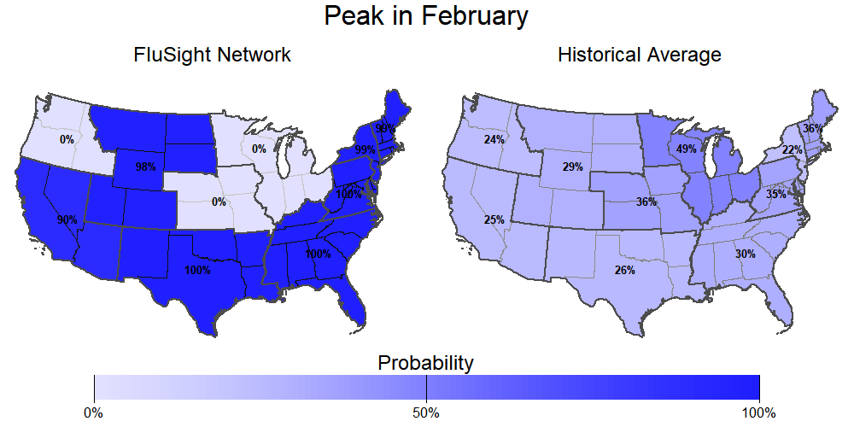
Season peak
100% chance of U.S. peak in February (historically is 37%).

Slide 6
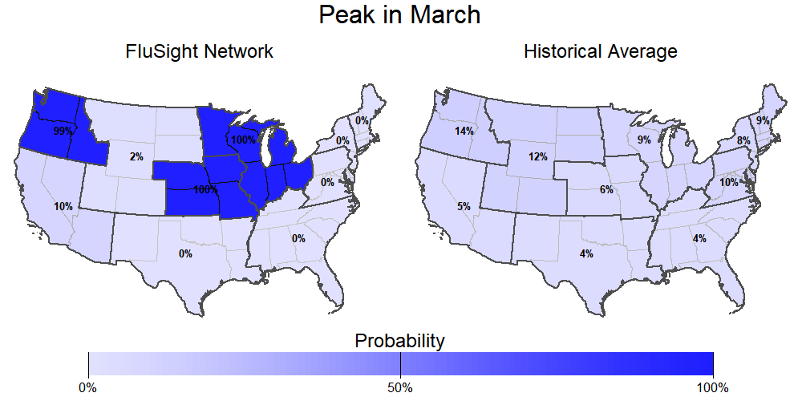
Season peak
0% chance of U.S. peak in March (historically is 6%).

Slide 7
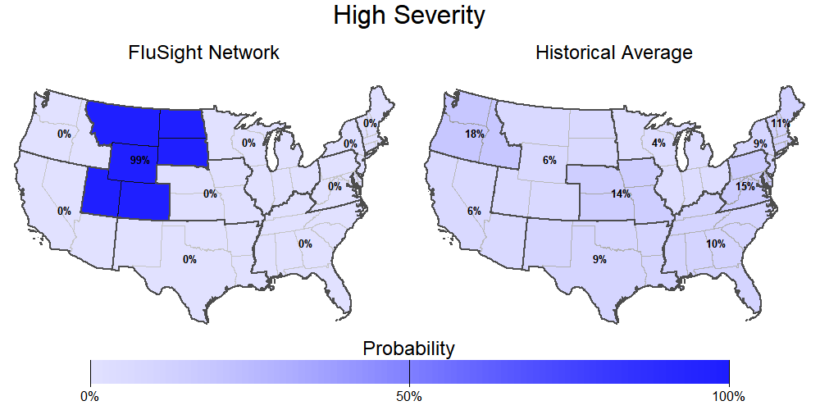
Season intensity
0% chance U.S. has a high severity season (historically is 8%).

Slide 8
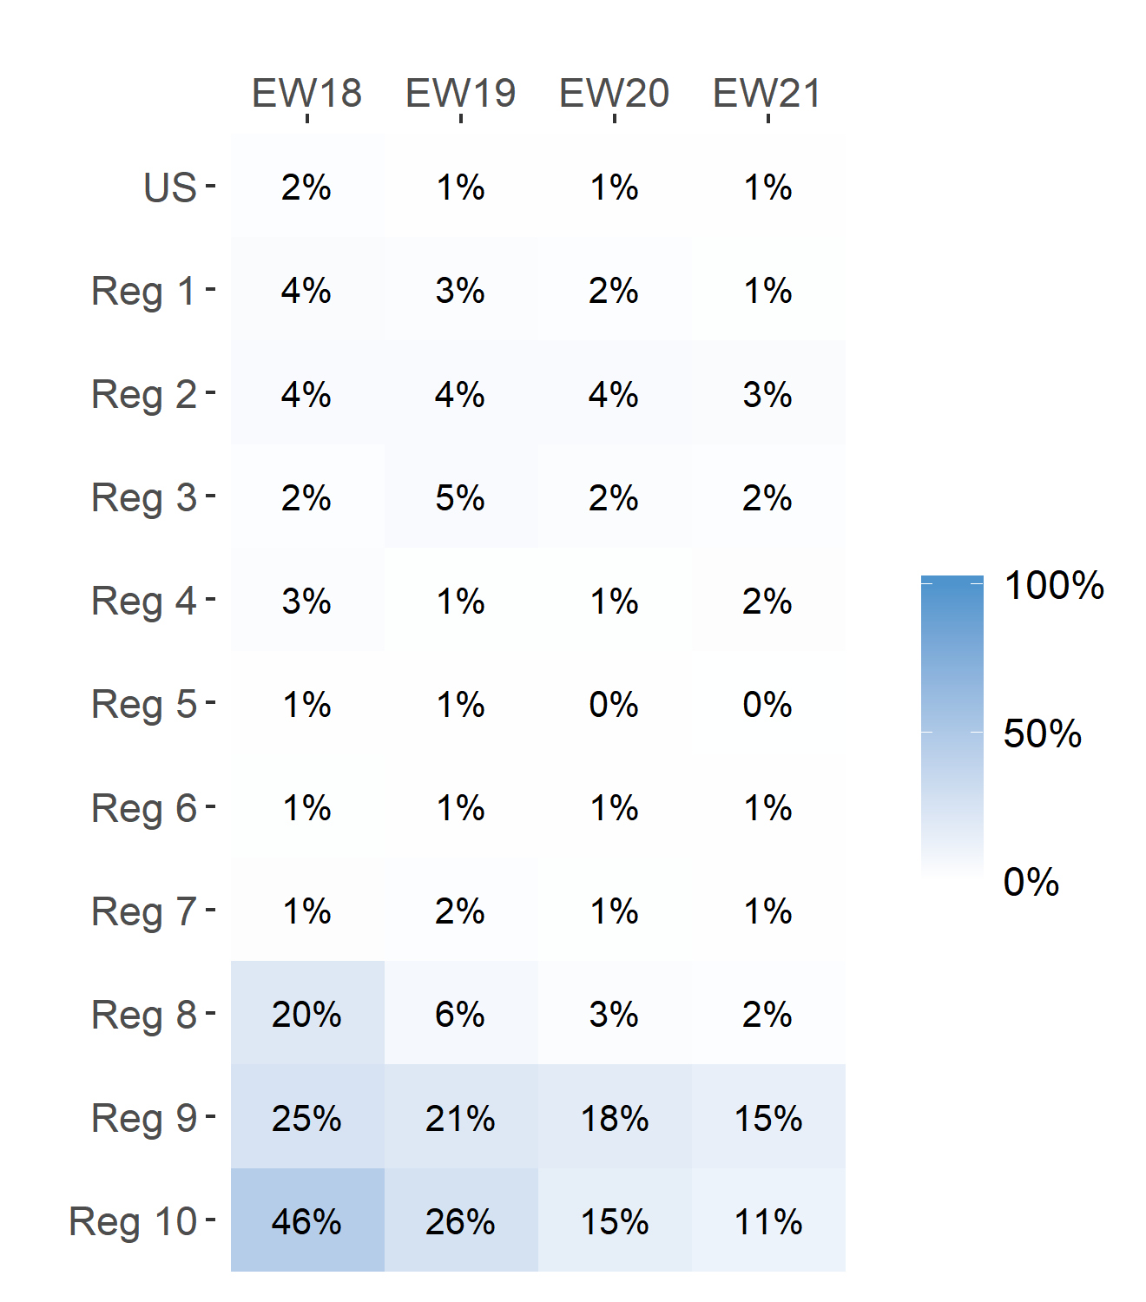
Short-Term ILI Predictions
Prob. ILI will be at or above baseline
US Short-Term Predictions

