Slide 1

Successes and Challenges for Extreme Heat Public Health Interventions
August 24, 2020
Presenting To
Council of State & Territorial Epidemiologists | Webinar
Matthew Roach, MPH | Epidemiology Program Manager
Laura Fox, MPH, CPH | EPHT Senior Epidemiologist

Slide 2
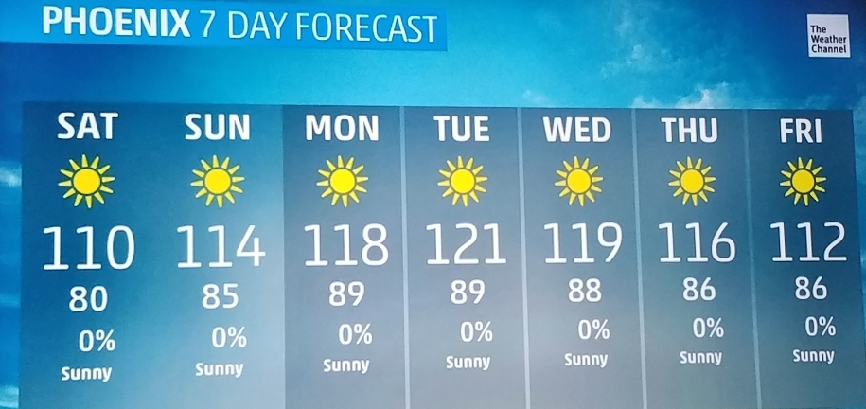
Notes:
I think all of us are pretty familiar with this weather forecast in AZ during the summer. Consistent 110+ degree days are pretty miserable for being outside and put people at risk for daily activities.

Slide 3
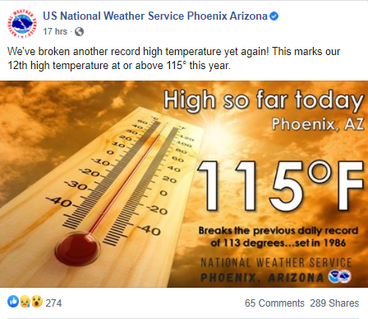
Notes:
https://news.yahoo.com/record-challenging-heat-shows-no-232305096.html
As of 8/15/2020

Slide 4
Temperature Records As of 8/19/20
Number of Days with a Low of 90 + F (Phoenix, AZ)
Top 10
1. | 26 (2020)
2. | 15 (2013)
3. | 15 (2003)
4. | 14 (2018)
5. | 14 (2007)
6. | 13 (2011)
7. | 13 (2010)
8. | 13 (2009)
9. | 12 (2019)
10. | 11 (2012)
Number of Days with a High of 110 + F (Phoenix, AZ)
Top 10
1. | 44 (2020)
2. | 33 (2011)
3. | 32 (2007)
4. | 30 (2016)
5. | 29 (2019)
6. | 28 (2002)
7. | 28 (1979)
8. | 27 ( 2009)
9. | 27 (1989)
10. | 27 (1985)

Slide 5
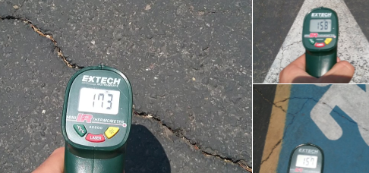
Notes:
These are images of different paved surfaces around Tempe, AZ in June 2017. Imagine a child or even yourself touching these surfaces. I have also seen playground equipment with similar temperatures. Hot temperatures such as these contribute heavily to the urban heat island, exacerbating already hot temperature across the valley and impacting residents’ health.

Slide 6
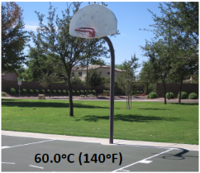
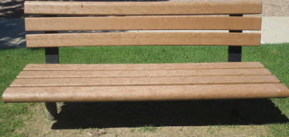
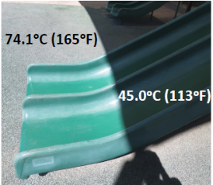
Arizona Summer Park Temperatures
Bench – 64° C
(147°F)
Vanos et al, 2015

Slide 7
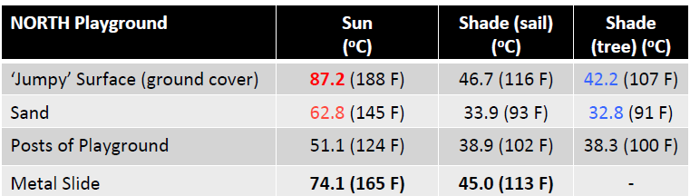
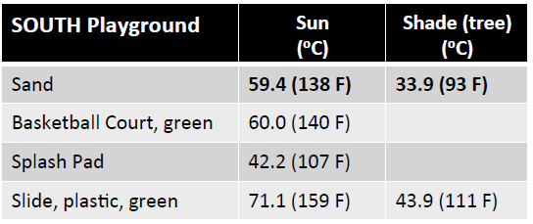
Vanos et al, 2015

Slide 8
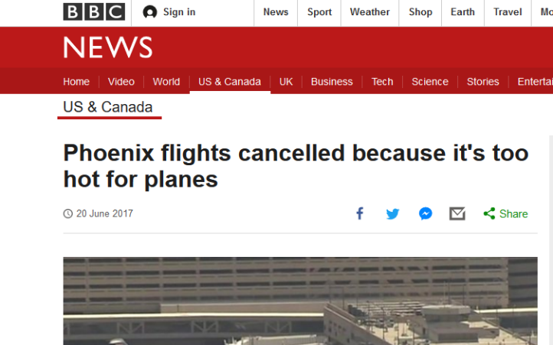
Notes:
You may remember seeing this on the news, that it was too hot for planes to leave Phoenix. So we could not escape the 120 degree heat. The impact of heat expands farther than human health in Phoenix—e.g. airplanes, infrastructure maintenance
Additional issues=human and pet health, work schedules, built environment etc.

Slide 9
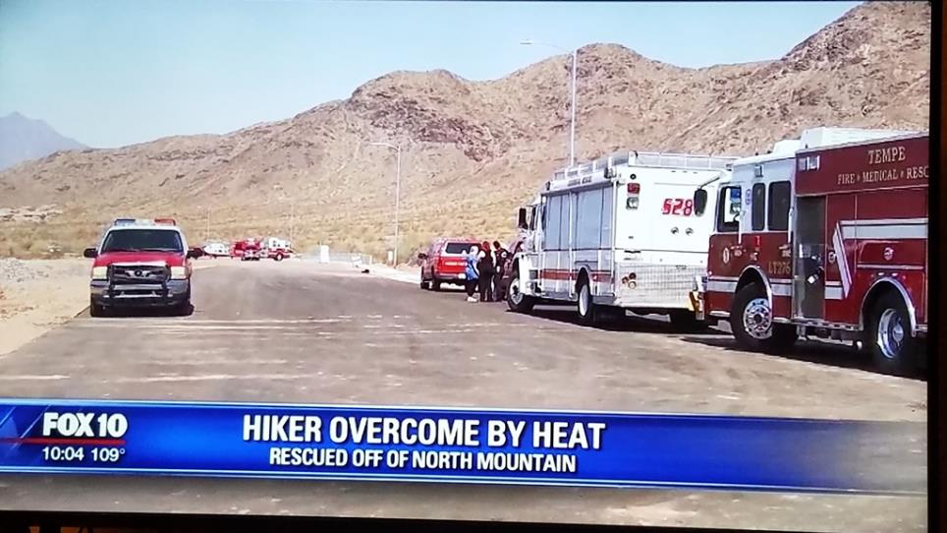
Notes:
Numerous reports of Arizona residents and visitors hiking in the summer and needing to be rescued are common. These incidents contribute to heat illness and deaths found each year. Roughly 2000 + emergency room visits each year and 100+ deaths.

Slide 10
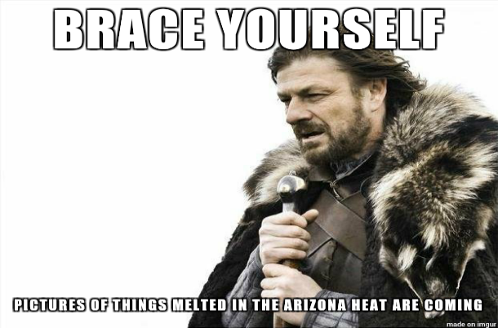

Slide 11
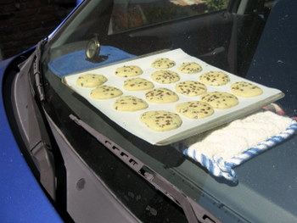


Slide 12
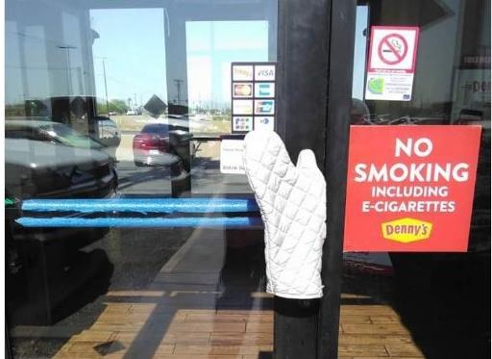
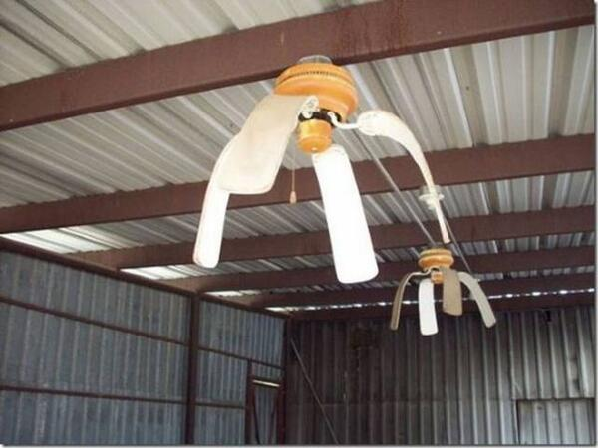

Slide 13
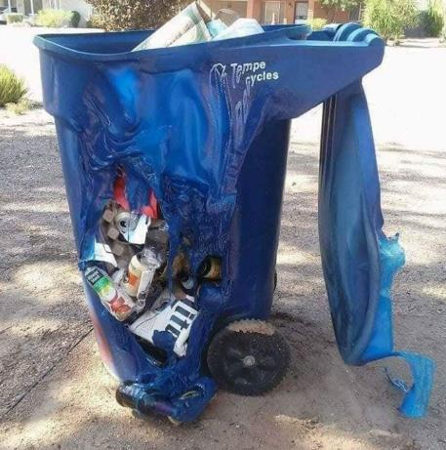

Slide 14

Heat-Related Illness and Mortality Data Sources
Hospital Discharge Data
Death Records
Syndromic Surveillance

Slide 16
Heat-Related Illness ED Visits Summary, 2015-2019
Average 2870 visits per year
28% were Middle-Aged Adults 45-64 years
67% were Male
61% White non-Hispanic and 26% Hispanic
89% were AZ Residents
92% of cases occurred from May-September
Preceding activity: recreational or occupational
Place of injury: private residence, street/highway, & industrial site

Slide 18
Heat-Related Illness Hospitalizations Summary, 2015-2019
Average 685 visits per year
38% were Middle-Aged Adults 45-64 years
77% were Male
88% were AZ Residents
95% of cases occurred from May-September
3 Days Median Length of Stay
Preceding activity: recreational or occupational
Place of injury: private residence or street/highway

Slide 20
Heat-Related Deaths Summary, 2015-2019
Average 229 deaths per year, and exceeded 250 deaths the last 3 years
75% were Male
72% were Adults 45+ years
77% were Arizona residents
Most deaths occurred in Southern Arizona Counties
96% of cases occurred from May-September

Slide 21
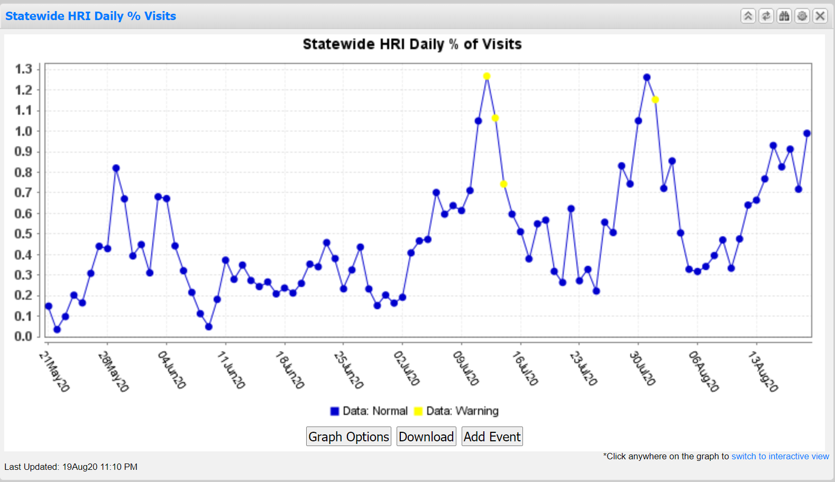
NSSP BioSense Platform

Slide 22
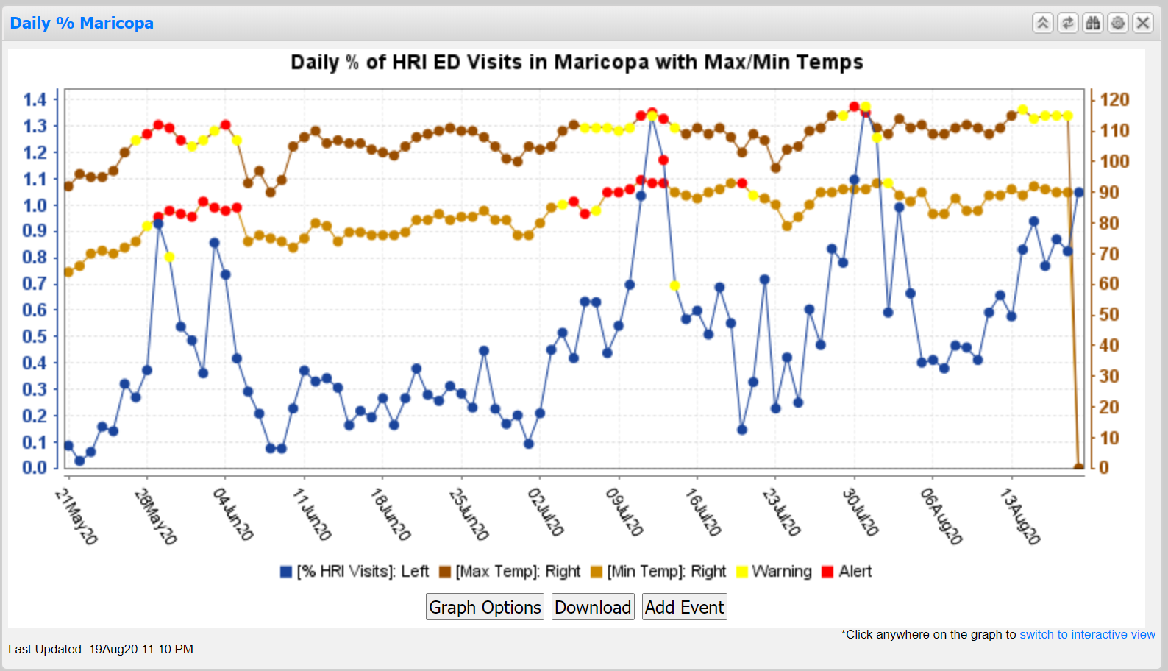
NSSP BioSense Platform

Slide 23
Economic Burden of Heat-Illness
Total Charges for Heat-Related Illness in Arizona, 2008-2018
ED Visit Charges*
$136 Million
Hospitalization Charges*
$308 Million
Overall Costs for Heat-Related Mortality in Arizona, 2008-2018
Deaths
$17.8 Billion
Notes:
Our preliminary analysis determined heat-related illness ED visit charges totaled $136 million, hospitalization charges totaled $308 Million, and heat related deaths cost $17.8 billion from 2008 through 2018.
Adjusted for inflation ($2019) using Bureau of Labor statistics calculator
$40 million in charges per year for heat-related morbidity
$1.6 billion in costs per year for heat-related mortality

Slide 24
Economic Burden of Heat Illness
Notes:
Our preliminary analysis determined heat-related illness ED visit charges totaled $136 million, hospitalization charges totaled $308 Million, and heat related deaths cost $17.8 billion from 2008 through 2018.
Adjusted for inflation ($2019) using Bureau of Labor statistics calculator
$40 million in charges per year for heat-related morbidity
$1.6 billion in costs per year for heat-related mortality
*Values adjusted for inflation using BLS inflation calculator
**Death costs using EPA Value of Statistical Life
Fox, L. & Roach M. (2020). Monitoring the Health Costs of Heat-Related Illnesses and Deaths in Arizona, 11th Conference on Environment and Health. Boston, MA. https://ams.confex.com/ams/2020Annual/meetingapp.cgi/Paper/368261

Slide 25
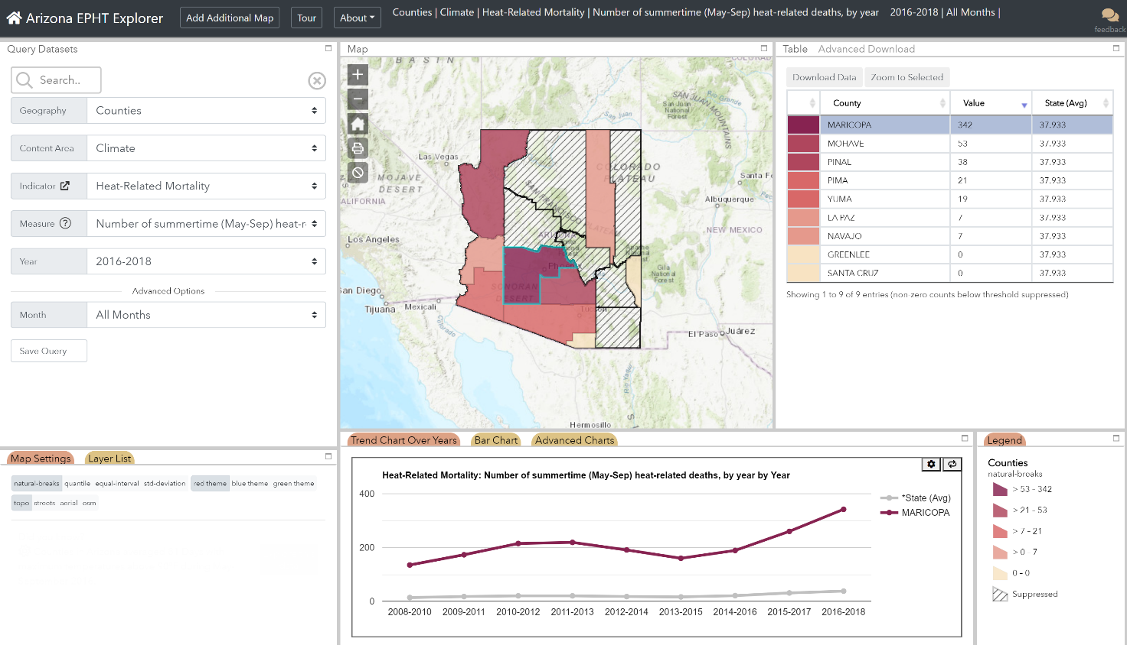
Notes:
Data explorer displaying heat related mortality with Maricopa County highlighed

Slide 26
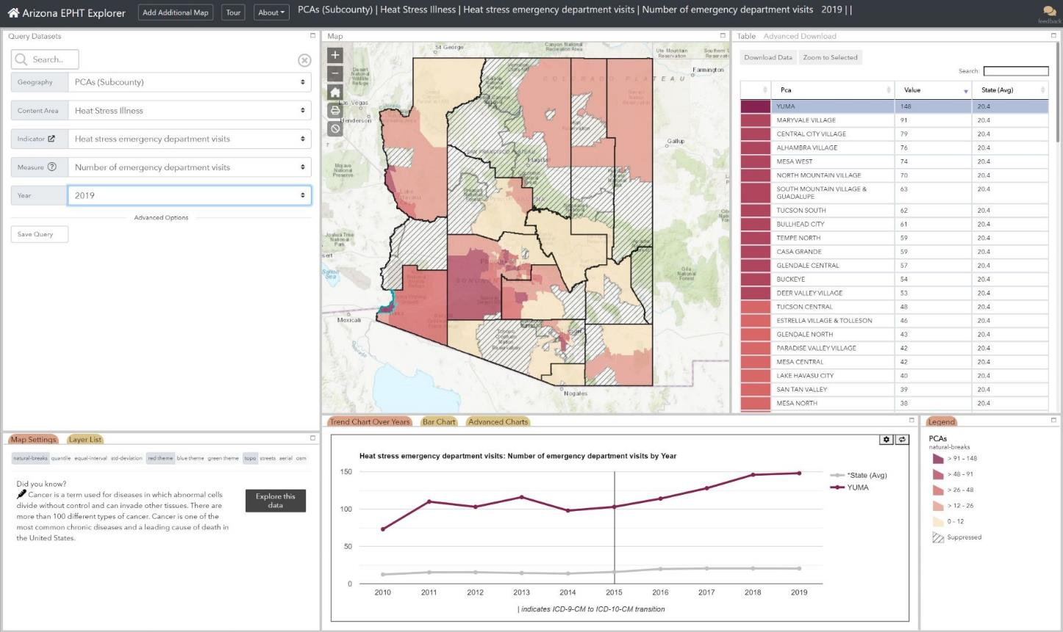

Slide 27
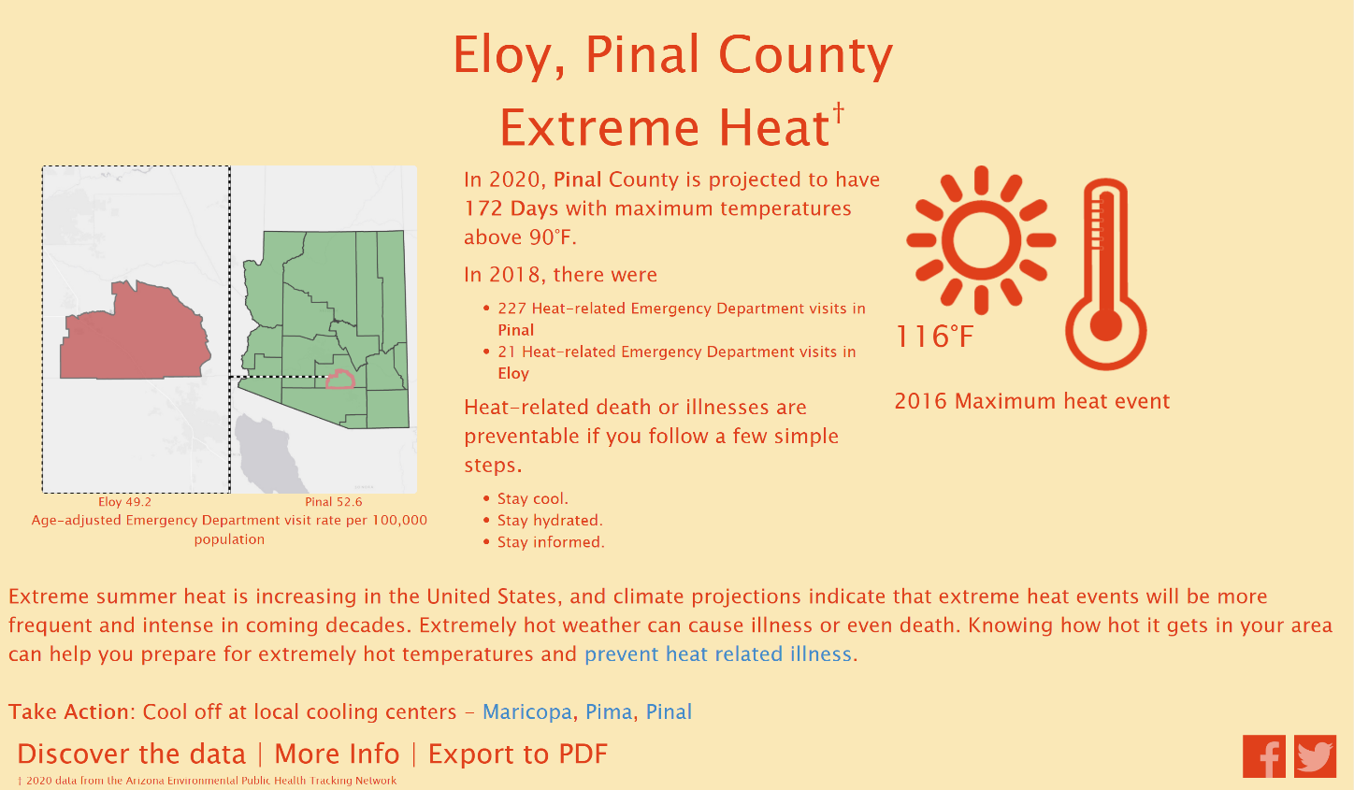
Notes:
Azdhs.gov/epht

Slide 28
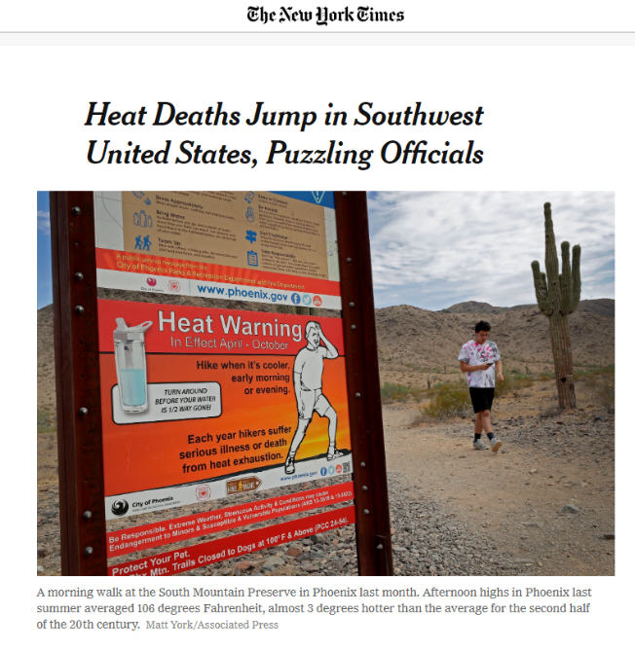
Current Intervention Activities
Tracking Program monitors heat-related illness and death
Publishing Heat Advisories
Annual State Heat Meeting
Work with partners to establish cooling centers and public health messaging
Emergency Response Plans
Notes:
To understand the burden of heat-related illness and death, the Arizona Environmental Public Health Tracking program, or Tracking Program for short, monitors heat-related illness and death.
We display this information on our Data Explorer in charts, graphs, and maps, publish heat advisories, hold annual state heat meetings to engage stakeholders of the heat community, and work with county health departments to establish cooling centers and public health messaging.

Slide 29
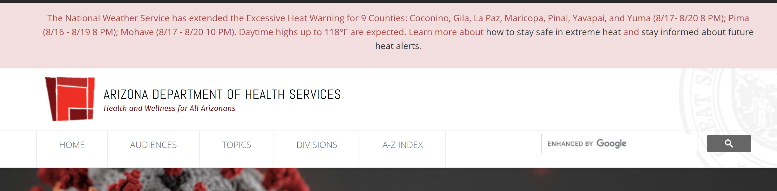
Heat Warning Alert Banner on State Health Department Website

Slide 30
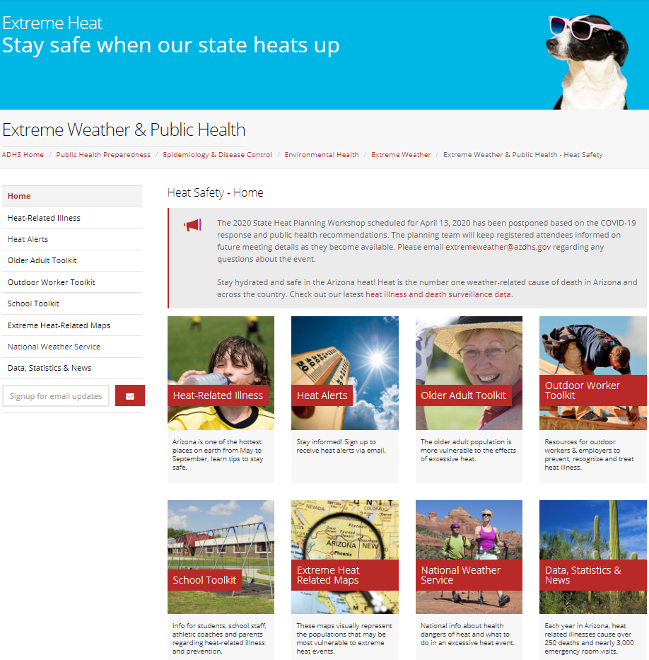
Azhealth.gov/heat

Slide 31
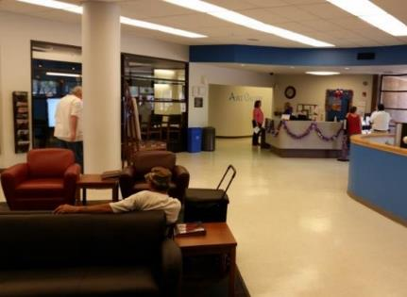
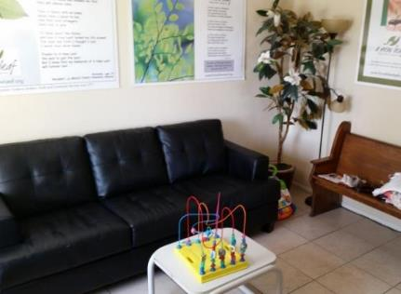
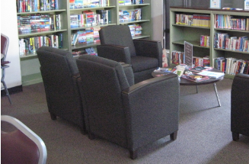
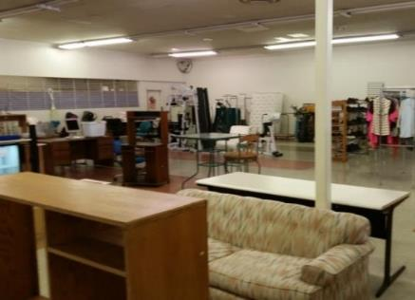
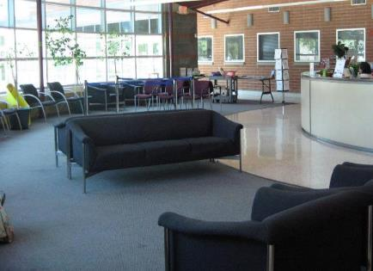
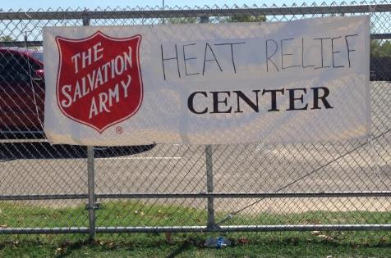
What is a cooling center?
Notes:
Defined by the CDC as…
A “cooling center” or “cooling shelter” is a public location, typically with air-conditioning that has been designated to provide free respite from the heat.
Examples: libraries, community centers, shopping malls

Slide 32
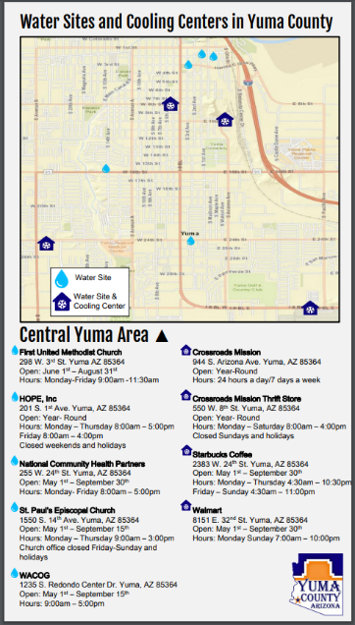
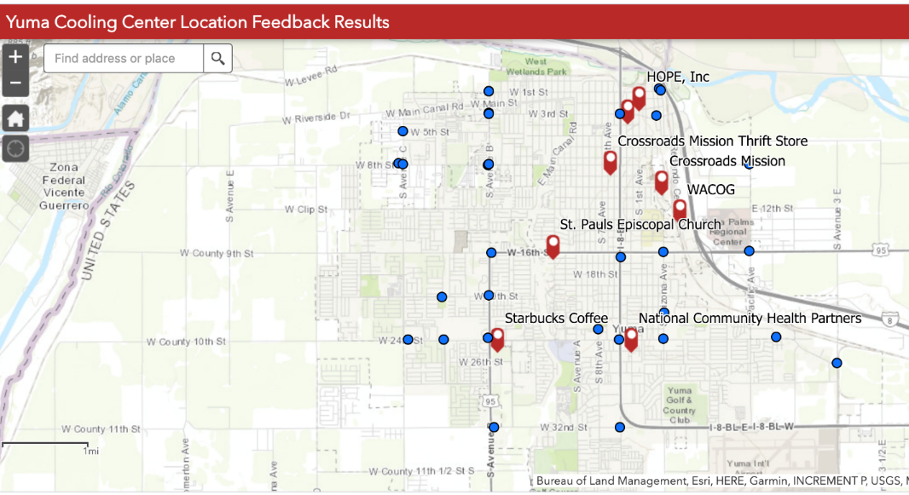
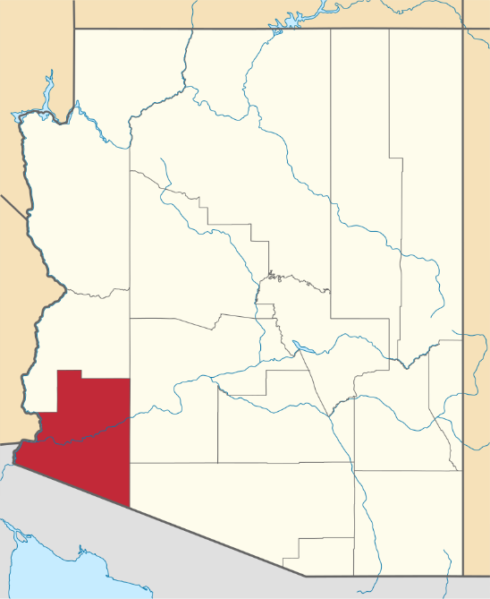
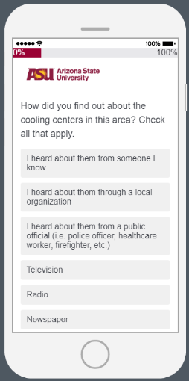
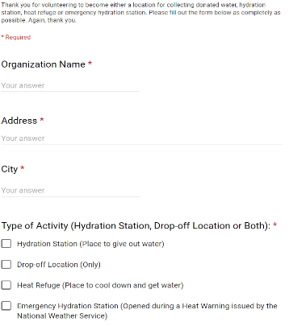
Evaluating Cooling Centers in Yuma, Arizona
Notes:
Intake Form and New Map and Centers Organized by the County Health Department

Slide 33
Question
Are cooling centers helpful for protecting vulnerable populations from the heat?
Methods
3 evaluation tools
  Intercept (Homeless) survey, cooling center manager interview, and older adult survey
Notes:
Briefly review history of cooling center efforts in Yuma, desire to expand network from local partners, opportunity to influence future network growth/improvements.
Briefly discuss methods here, including survey training, planning for bilingual resources, field deployment, etc. Make it clear that there are three instruments, with different modes of administration.

Slide 34

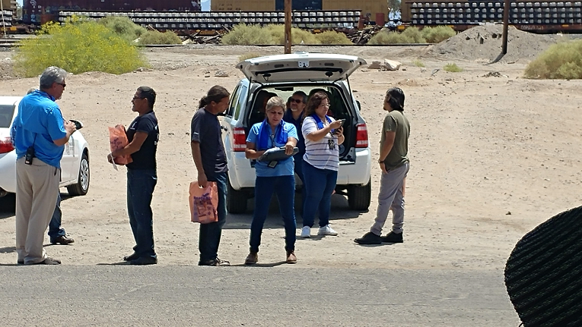
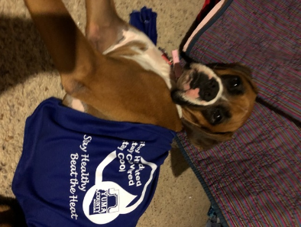
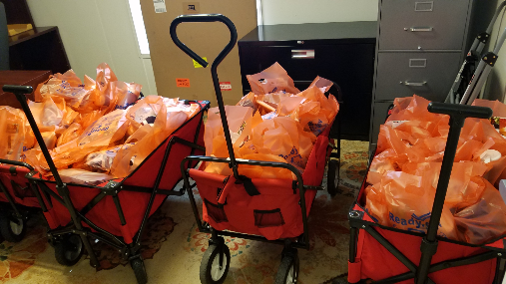
Surveying Strategies (In-Person & Online)
Notes:
Describe approach to both surveys relatively quickly – on the ground vs online, heat support materials, partnerships for recruitment (both in person and for online surveys - knowing where to go in the city, which facebook channels to advertise with, etc.) Homeless survey in 2018, older adult survey in 2019.
Focused on particular populations that are known to be, on average, at higher risk for adverse heat-health outcomes.
Describe survey methods and outreach materials in more detail, including types of questions asked:
Do you know what a cooling center is?
Do you know where cooling centers are located in your area?
How did you find out about them?
Have you visited a cooling center?
How do you usually get to a cooling center?
We had a great team comprised primarily of staff from Yuma County Health Services District, along with staff from the state health department and researchers from ASU. A particularly helpful part of this partnership was having access to local information about places in the county where individuals experiencing homelessness tend to spend time during the day. We were able to concentrate our efforts on a handful of commonly-visited places, making the most effective use of the time we had that was volunteered from staff from many departments.

Slide 35
Homeless Surveys N = 76
40% of respondents knew where cooling centers are located
20% of Spanish-speaking respondents knew where cooling centers are located
60% of respondents experienced medical symptoms related to heat in the last year

Slide 36
Survey Results – Homeless Survey
Learning about cooling centers:
word of mouth and local organizations
Accessing cooling centers:
walking and biking
Notes:
We also learned that accessing cooling centers poses challenges for these individuals – of those individuals who use cooling centers, more than 80% either walked or biked to get there. Another key finding was that the most common way individuals found out about cooling centers was through someone they knew. This was more common than traditional media modes.

Slide 37
Survey Results – Homeless Survey
Notes:
Sample was largely male, roughly evenly split between those 18-44 and 45-64, with a few respondents in older age groups.
About half of respondents identified as White, half as Hispanic
90% of survey administered in English
Ultimately we collected responses from 76 individuals. We were successful in our efforts to primarily engage with individuals experiencing homelessness; 71% of respondents said that they do not have a regular home.
This survey was administered AT cooling centers for some respondents, so we don’t have reliable information about cooling center use. Some people told us they were not aware of cooling centers despite the fact that we were at a cooling center. Does the cooling center term mean anything to this population?
We found that the majority of respondents did not know where cooling centers were located – only 40% said that they did.

Slide 38
Survey Results – Older Adult Survey
Notes:
(Switch to older adult survey)
Summary of demographic characteristics of respondents to the older adult survey:
Mostly 5+ year resident home owners, single-family homes, 45-64 years old, predominantly White, largely female, work full-time was most common, but also many retirees, homemakers, and part-time workers
144 completed surveys – English/Spanish
Were more familiar with the term cooling center, but a much lower percentage in this sample knew where cooling centers were located. About 10% of the older adults that completed this survey had visited a cooling center.

Slide 39
Facility Manager Interview Results (n=5)
Successes
Challenges
Notes:
Five Yuma cooling/water site managers were interviewed in November 2018 of the seven total facilities that operated that year. There was a mixture of faith-based and not faith-based organizations.
We heard some successes and some challenges from the facility managers.
In terms of successes:
-Most facilities reported having bilingual staff present
-Very few identified any hard or soft costs associated with operating as a cooling center; one facility noted electrical costs for running fans, chargers
-Facility managers reported that their facilities were used; the amount of time visitors spent in facilities varied from about 15 minutes to a few hours
In terms of challenges:
-As has been reported in other cooling center evaluations, open hours were largely restricted to business hours. Most facilities said they were open appx MF 8-4pm. Interestingly, many facilities reported that they were busiest in the morning.
-Signage was reported as a weakness, requests for network coordinator to help with large signs and other publicity
-Also heard challenges related to water. Facilities reported handing out anywhere between a few bottles to a few cases per day. 3 of 5 managers recalled running out of water in the past, and all said that they were extremely reliant on donations for their water supply. Interest in a more centralized/coordinated water distribution system.

Slide 40
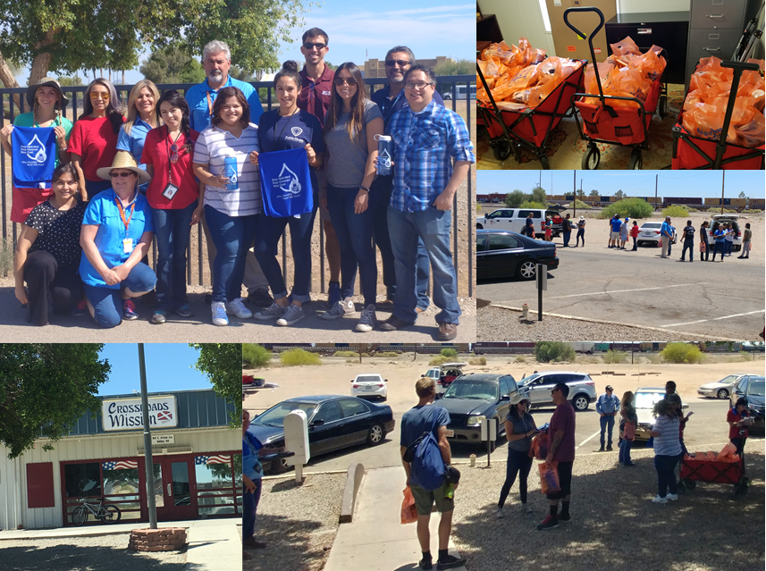
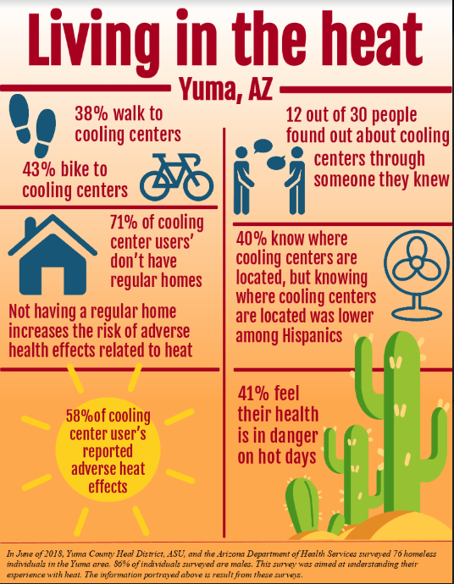
Evaluating Cooling Centers in Yuma, Arizona
Notes:
(cooling towels, water bottles, educational materials)

Slide 41
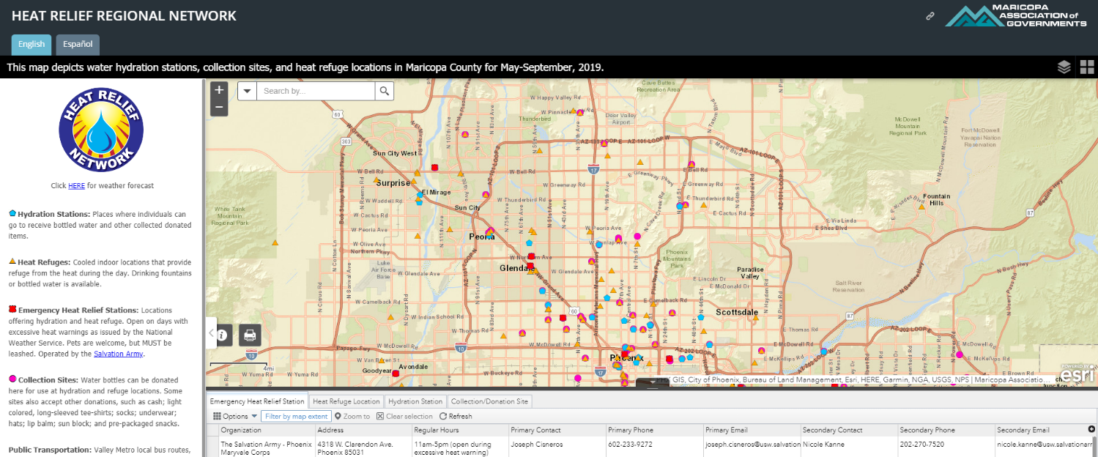
Maricopa County Cooling Center Evaluation
Notes:
Berisha, V., Hondula, D., Roach, M., White, J. R., Mckinney, B., Bentz, D., … Goodin, K. (2017). Assessing Adaptation Strategies for Extreme Heat: A Public Health Evaluation of Cooling Centers in Maricopa County, Arizona. Weather, Climate, and Society, 9(1), 71–80. doi: 10.1175/wcas-d-16-0033.1

Slide 42
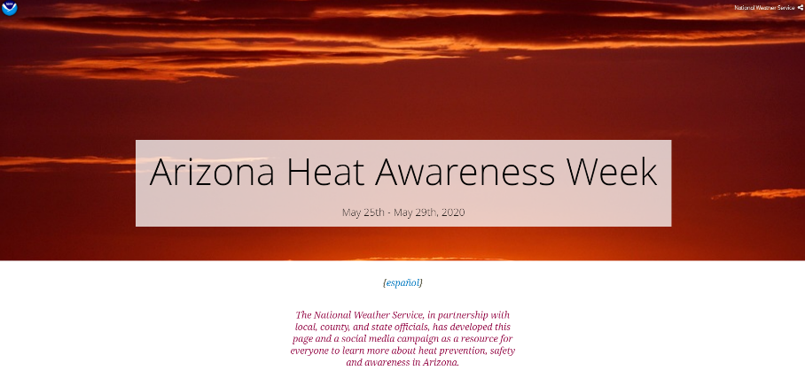
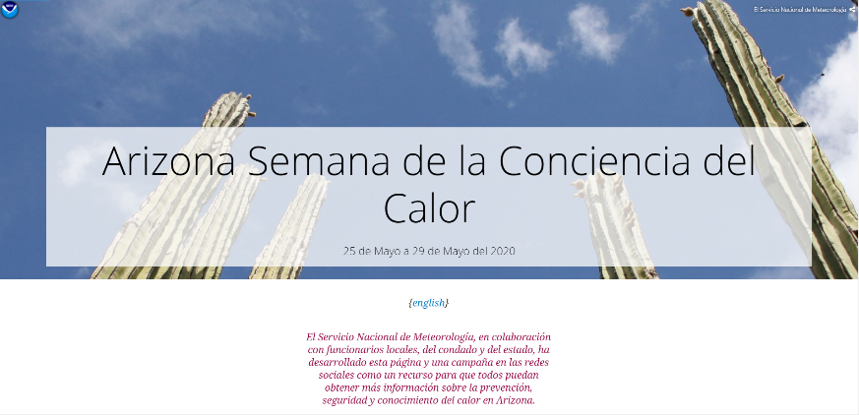
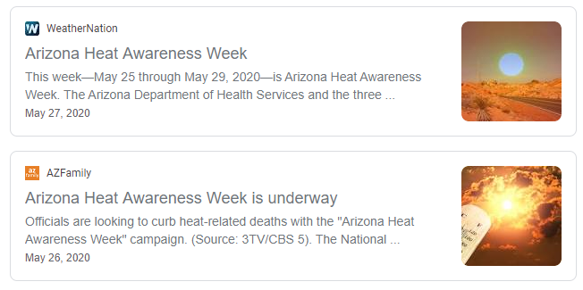
Arizona Heat Awareness Week with NWS
Notes:
Used funds to do a social media campaign for heat awareness in the end of May (May 28–June 1). 400,000 views on social media in a week.
NWS has media partners. Health departments can leverage their connection with TV meteorologists to broadcast heat safety messages.
https://noaa.maps.arcgis.com/apps/Cascade/index.html?appid=ef58590accb84b539b77e5676ca742c0&utm_medium=email&utm_source=govdelivery
https://noaa.maps.arcgis.com/apps/Cascade/index.html?appid=c5ba41d4e61f4d3ea10fc22aa3ec1d9f

Slide 43
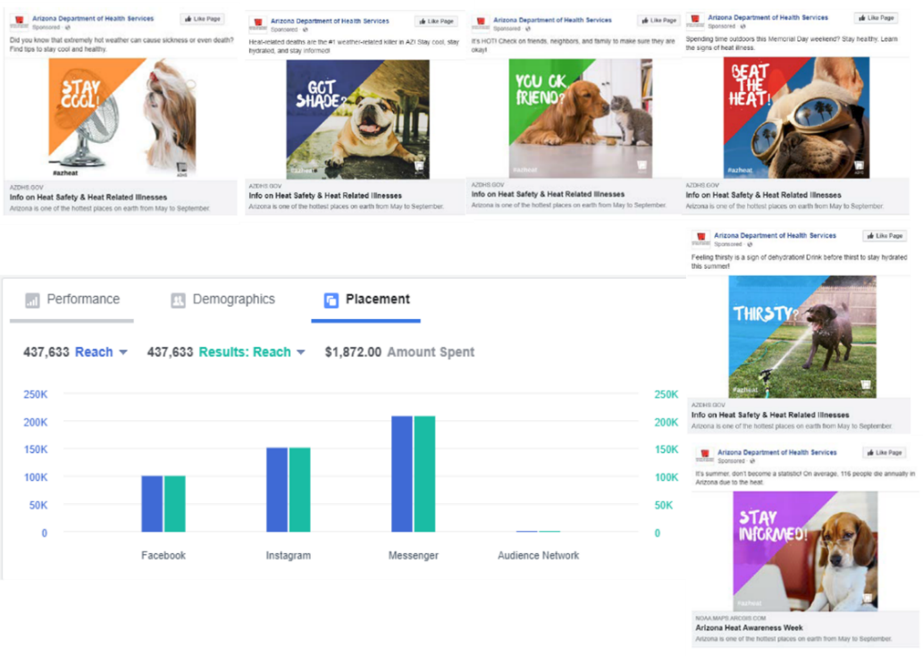
Heat Awareness Week Results
Notes:
Used funds to do a social media campaign for heat awareness in the end of May (May 28–June 1). 400,000 views on social media in a week.

Slide 44
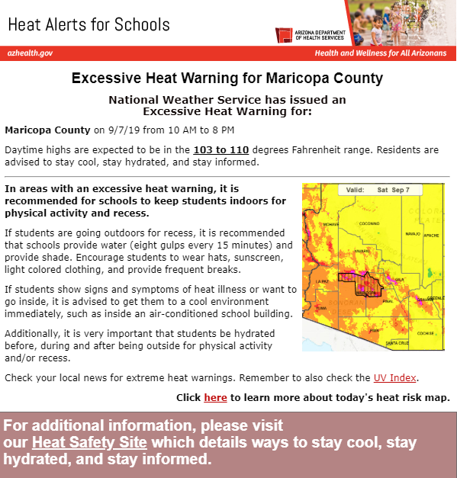
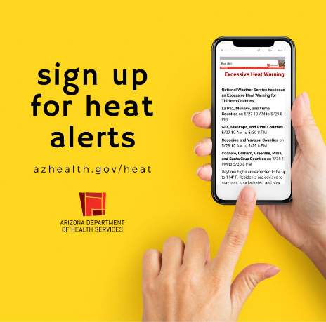
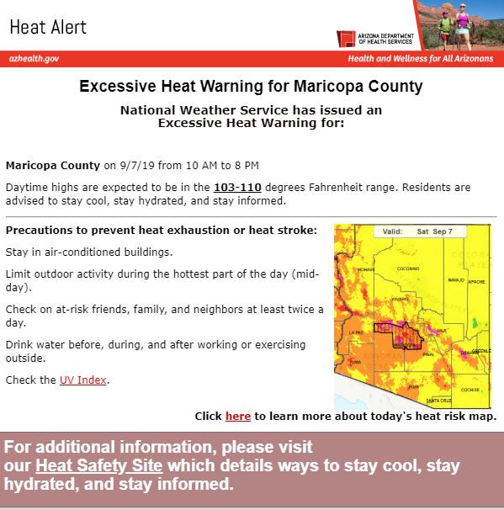
Heat Alerts
4,226 Subscribers
14,272 Subscribers
Notes:
3145 for schools
9012 for general public

Slide 45
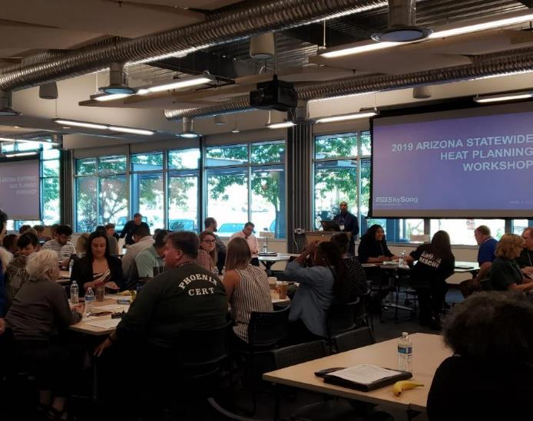
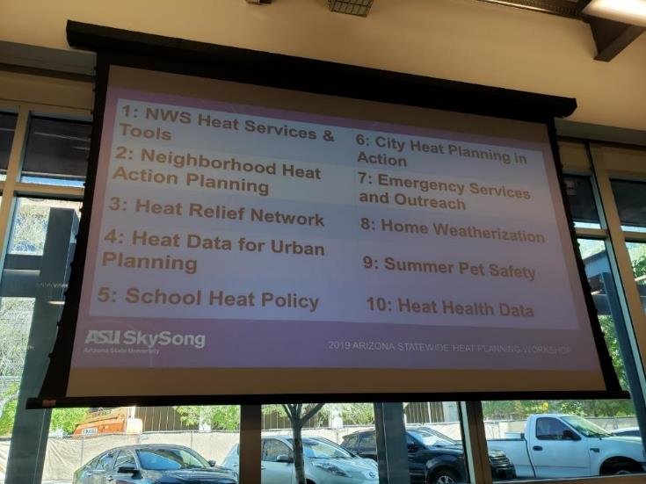
Annual State Heat Planning Workshop
(2019) 108 Attendees
Notes:
Guyer, H. E., Putnam, H. F., Roach, M., Iñiguez, P., & Hondula, D. M. (2019). Cross-Sector Management of Extreme Heat Risks in Arizona. Bulletin of the American Meteorological Society, 100(3). doi: 10.1175/bams-d-18-0183.1

Slide 46
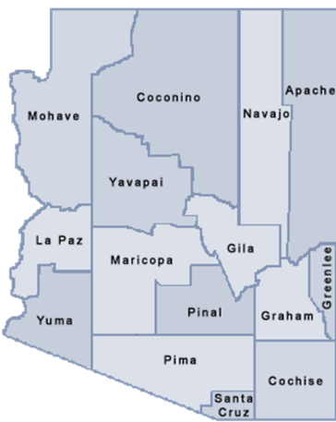
Pinal County – Enhanced Surveillance of Heat-Related Illness Using Syndromic Surveillance
Using Syndromic Surveillance to Identify Risk Factors and Take Action
Notes:
Kent, D. C., Garcia, R. Z., Packard, S., Briggs, G., Hill, C., Griffin, S., Bedrick, E., Collier, K., & Roach, M. (2018). Enhanced Surveillance of Heat-Related Illness in Pinal County. Online Journal of Public Health Informatics, 10(1), e111. https://doi.org/10.5210/ojphi.v10i1.8829
http://www.cec.org/sites/default/files/documents/agenda/lun-11-f%C3%A9vr.-2019/dametreea-carr.pdf

Slide 47


Emergency Preparedness Plans
Notes:
Heat Illness thresholds were based on Arizona morbidity and mortality data associated with heat. Petitti, D. B., Hondula, D. M., Yang, S., Harlan, S. L., & Chowell, G. (2015). Multiple Trigger Points for Quantifying Heat-Health Impacts: New Evidence from a Hot Climate. Environmental Health Perspectives, 124(2). doi:10.1289/ehp.1409119

Slide 48


COVID-19 & Heat Combined Safety Messaging
Notes:
Social Media on Heat and COVID messaging combined

Slide 49


Distributing Heat Safety Materials to Outdoor & Drive Up Testing Sites
Notes:
Surveyed 100+ outdoor testing sites and developed form to request and distribute Heat Safety Brochures in English and Spanish to Testing Sites
Other questions from local governments on Cooling Center Safety. Passed messaging on cooling center and COVID safety from CDC’s website https://www.cdc.gov/coronavirus/2019-ncov/php/cooling-center.html

Slide 50



THANK YOU
Matthew Roach, MPH | Epidemiology Program Manager
Matthew.Roach@azdhs.gov | 602-364-3673
azhealth.gov
@azdhs
facebook.com/azdhs
Funding: These projects were supported by the CDC’s Climate Ready States & Cities Initiative & Environmental Public Health Tracking Network

