Slide 1
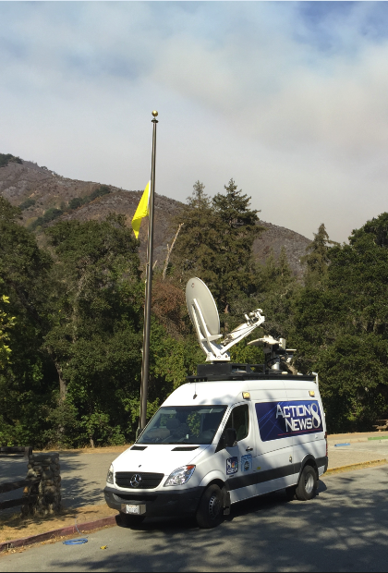
Integrating Data from Sensors with Regulatory Monitors during Wildfire Smoke Events
Susan Lyon Stone, Senior Environmental Health Scientist
U.S. EPA Office of Air Quality Planning and Standards
Narasimhan K. Larkin and Peter Lahm USFS, Phillip Dickerson, Kristen Benedict, and Gayle Hagler USEPA
3
June 22, 2020

Slide 2
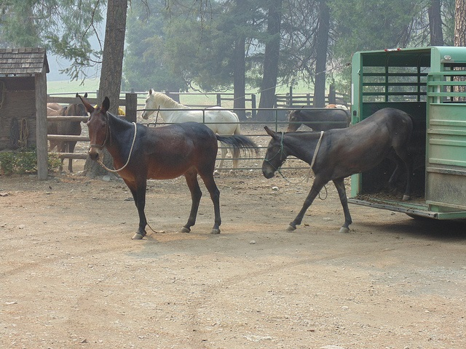
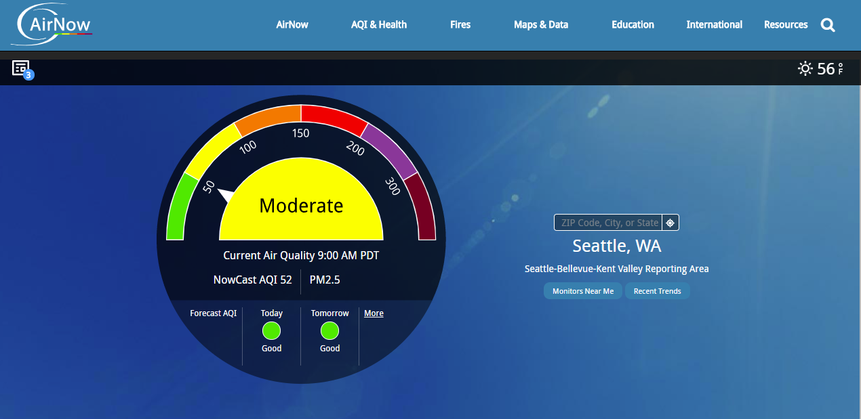
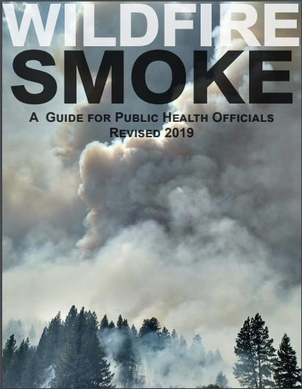
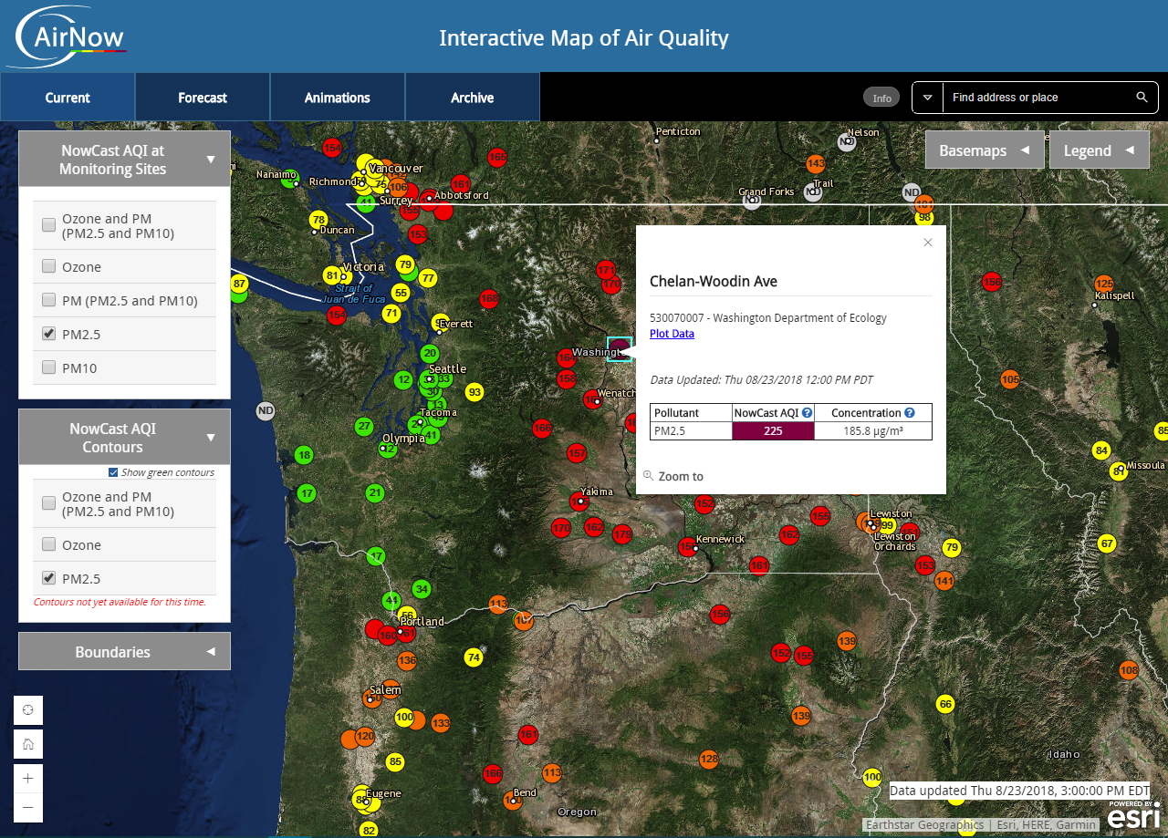
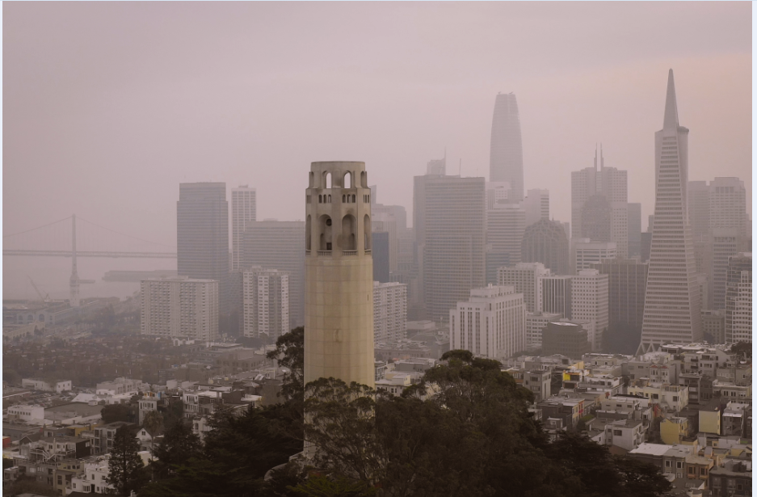
Issue
Wildfire episodes create highly dynamic air quality conditions with fine particulate matter (PM_{2.5}) concentrations having significant variation over small geographic areas, modulated by local meteorology and fire activity.
Sensor data could supplement the data from regulatory and special purpose monitors by enhancing spatial coverage and temporal resolution of observations
There are issues with integrating these data streams
  Different spatial and temporal scales
  Data shown on separate web applications

Slide 3
Pilot Project to Test a New Approach
U.S. EPA and the U.S. Forest Service (USFS) have been working on an approach to present PM_{2.5} data from FEM monitors, special purpose (near-FEM) monitors, and sensors
Sensor data layer on the new “Fire and Smoke Map” on the AirNow website
  During the pilot, data will be behind a firewall
    Accessible to USFS and state, local and tribal air agencies and Air Resource Advisors
  Extensive outreach to AirNow partners during pilot phase
Provide the public with clear, consistent and up-to-date information to help reduce smoke exposure

Slide 4
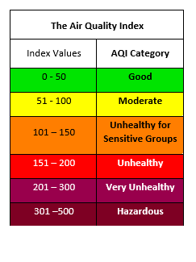
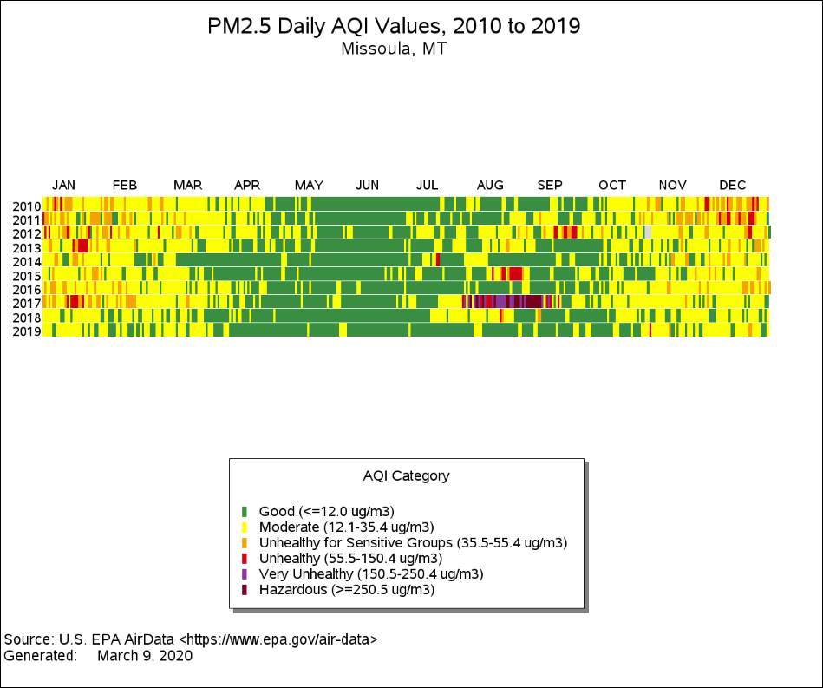
Air Quality Index - Linking Air Quality and Health
EPA’s color-coded tool for communicating air quality and health information to the public
  Nationally uniform – used by federal/state/tribal/local agencies
  Used for all FRM/FEM monitors
  Updated to reflect the latest standards and science
The daily Air Quality Index (AQI) for fine particle pollution is a 24-hour index
AQI is used for
  Next-day forecasting
  Current air quality (NowCast)
Daily AQI reports for particle pollution show previous day’s air quality
PM2.5 Daily AQI Values 2010-2019, Missoula Co, MT
Data Viz (www.airnow.gov)
Notes:
.

Slide 5
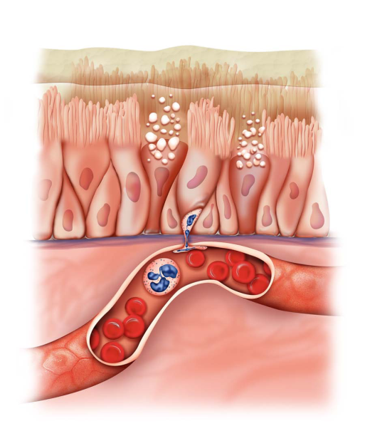
Air Quality Index
Pollutant-specific health effects and cautionary statements address question “who will be affected”
Based on health information supporting the standards – uses health relevant averaging periods
  Controlled human exposure, epidemiological studies exposure/risk assessments used to set breakpoints
  Epidemiological studies useful for identifying risk factors and more serious effects
  Controlled human exposure studies useful for identifying proportion of healthy population affected, symptoms, mechanisms of effects, genetic variability
  How to use the AQI to lower the dose of inhaled pollution when air quality is unhealthy:
Dose = Concentration x Ventilation rate x Time
  C - be active outdoors when air quality is better
  V - take it easier when active outdoors
  T - spend less time being active outdoors
Since people respond differently - PAY ATTENTION TO SYMPTOMS!

Slide 6
AirNow Sensor Data Pilot Map
PM_{2.5} NowCast AQI from AirNow monitors
PM_{2.5} NowCast AQI from USFS portable monitors
Fire and Smoke data
Satellite fire detects and smoke plumes from NOAA Hazard Mapping System (HMS)
Smoke Outlooks from USFS
New layer adding PM_{2.5} AQI hourly data from Purple Air sensors
  EPA U.S. correction and NowCast formula applied
  Displayed in AQI colors with a different symbol than AirNow monitoring data
Information included to help the public understand the sensor data layer

Slide 7
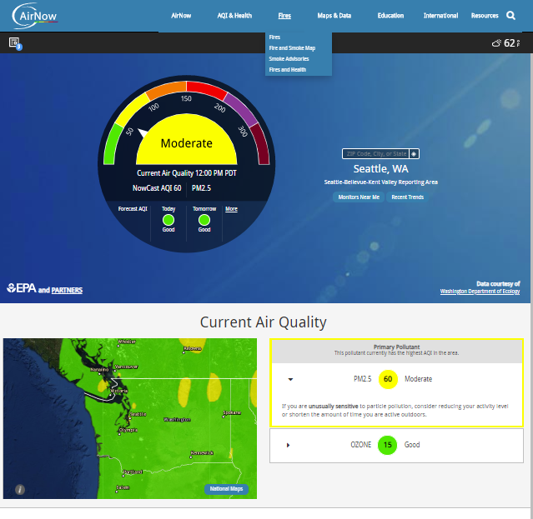
AirNow Homepage www.airnow.gov

Slide 8
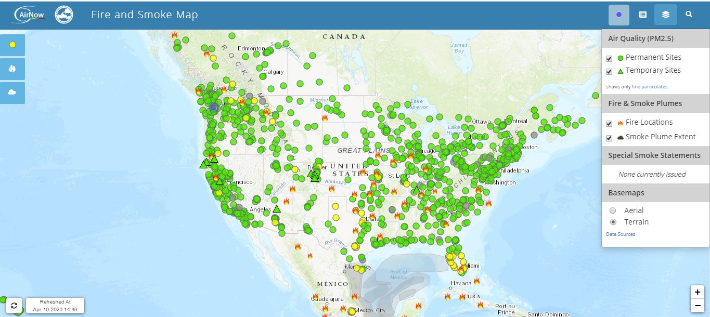
Fire and Smoke Map – Data Layers

Slide 9
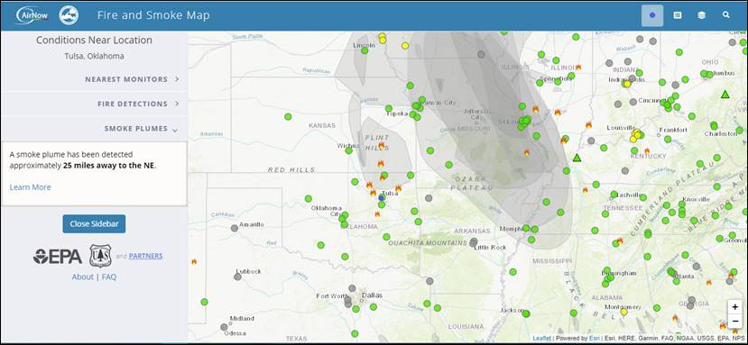
Fire and Smoke Map – Conditions Near Location

Slide 10
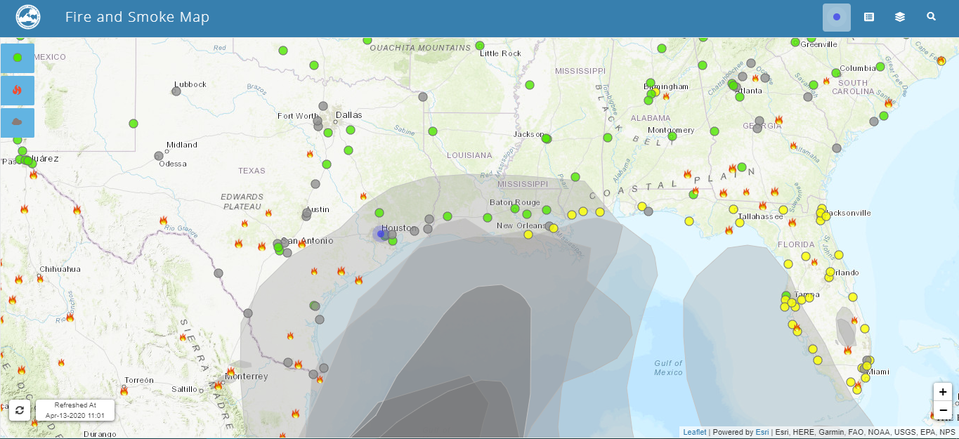
Fire and Smoke Map without Sensor Layer
April 13, 2020

Slide 11
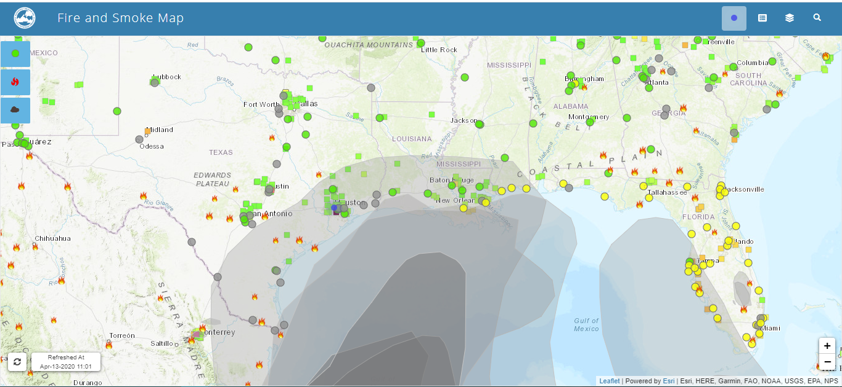
Fire and Smoke Map with Prototype Sensor Layer
April 13, 2020

Slide 12
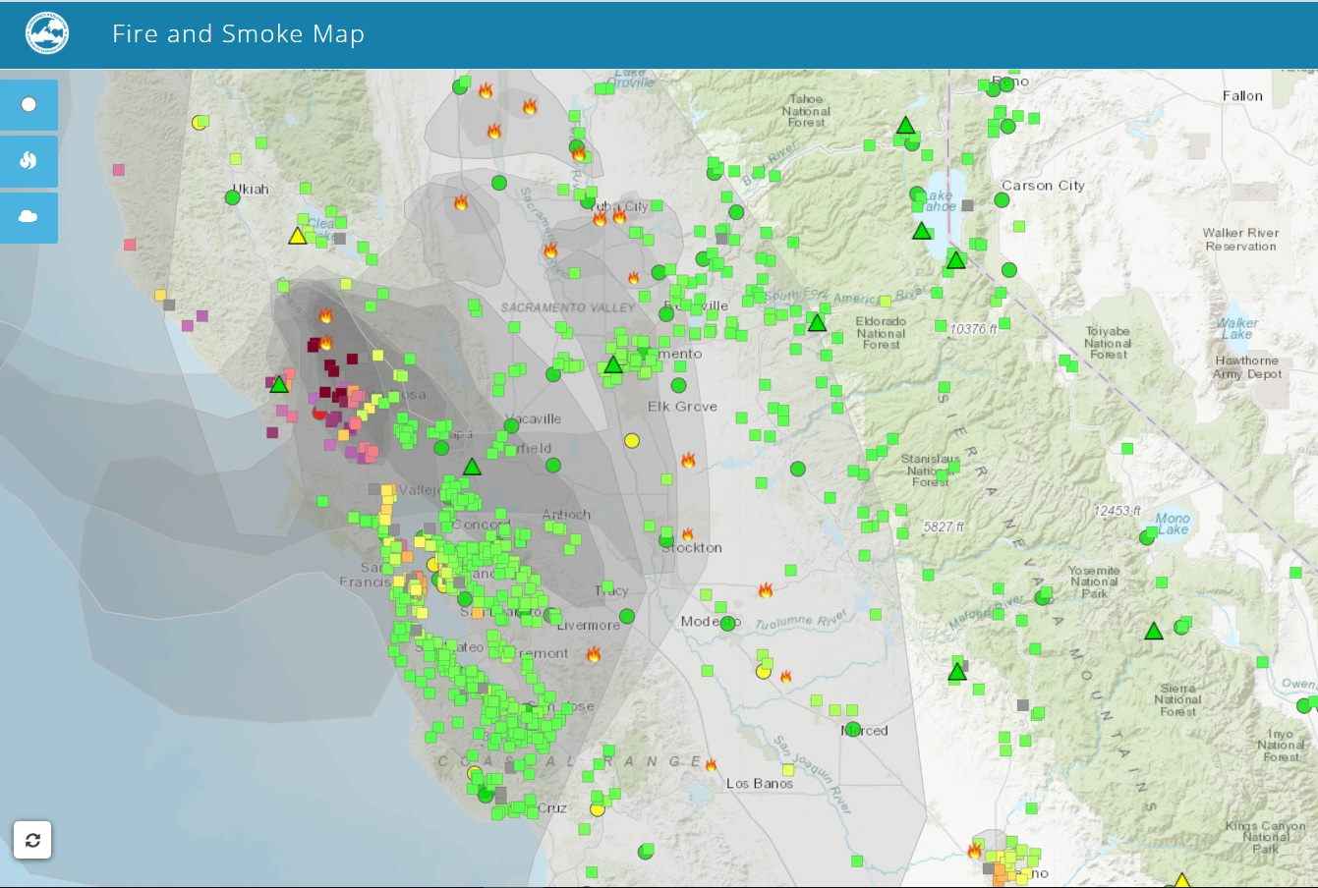
Fire and Smoke Page with Prototype Sensor Layer
Kincaid Fire October 25, 2019
Slide provided by John White

Slide 13
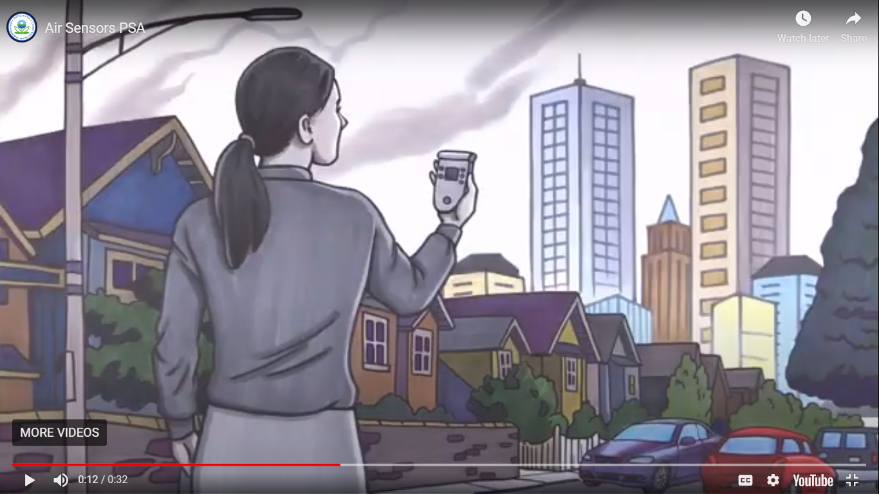
New Video Tools
EPA has developed three short videos to help people understand the nature of low cost sensors and how air quality measurements relate to public health, as well as a public service announcement to introduce the videos.
The videos cover how EPA collects and uses regulatory data, how EPA communicates health messaging, and questions that the public can ask themselves as they consider how to use sensors.
Links to videos:
Air Sensor PSA
Air Sensor PSA (Spanish)
Air Sensors: Regulatory Data and Sensor Data Quality
Calidad de los Datos Regulatorios y de los Datos del Sensor
Air Sensors: Measurements and Your Health
Medidas y Su Salud
Air Sensors: Sources of Air Quality Information
Fuentes de Información sobre la Calidad del Aire

Slide 14
Team
Forest Service: Sim Larkin, Pete Lahm, Stuart Illson
EPA Office of Air Quality Planning and Standards: Kristen Benedict, Alison Davis, Phil Dickerson, Lourdes Morales, Susan Stone, Lori Tussey, Miki Wayland, John White, Rob Wildermann
EPA Office of Research and Development: Karoline Barkjohn, Amara Holder, Samuel Frederick, Andrea Clements, Gayle Hagler

