Slide 1
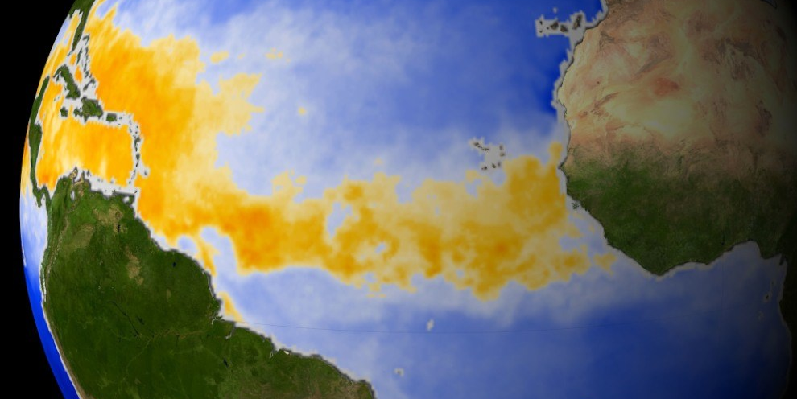
Impact of climate on vector-borne & zoonotic disease
Liz Dykstra, PhD, BCE
Public Health Entomologist
WA State Dept of Health
Notes:
PRESENTATION TITLE SLIDE ADD PHOTO
Quick Help Tips
Photo Box:
click on the icon in the middle of the box to insert photo
photo will automatically size to fit the designated area
photo size can also be adjusted
to obtain good quality imagery, visit the DOH Photo Library (SharePoint, Center for Public Affairs, under Strategic Communications)
Presentation Title Box:
just add text
Washington State Department of Health Box:
just add program/office name or use as is
If titles/text are lengthy, boxes can be adjusted by dragging/stretching them for best visual appeal

Slide 2
Agenda
Why are zoonotic and vector-borne diseases important?
Vector biology and environmental drivers
Climate change Impacts

Slide 3
Why be concerned?
Many VBDs are zoonoses maintained by wildlife.
VBD risk intrinsically sensitive to changes in weather and climate.
Where, when, and how many arthropod vectors are found directly dependent on multiple impacts of weather and climate including:
  Direct effects of low and high temperatures on vector mortality rates.
  Effects of temperature and humidity on vector activity and successful host detection.
  Effects of temperature on vector development rates from one life stage to the next.
  Effects of rainfall on availability of breeding habitat for insect vectors like mosquitoes.
Rosenberg et al. MMWR, May 2018
Notes:
Many VBDs are zoonoses maintained by wildlife – occurrence is intrinsically less determined by human’s control efforts.

Slide 4
Why be concerned?
From 2004-2016:
Reported tick-borne bacterial and protozoan diseases increased from >22,000 to >48,000
  Lyme disease accounted for 82% of all TBDs
Mosquito-borne disease marked by virus epidemics
  Dengue, Chikungunya, and Zika virus
  West Nile virus endemic and periodically epidemic
Rosenberg et al. MMWR, May 2018

Slide 5
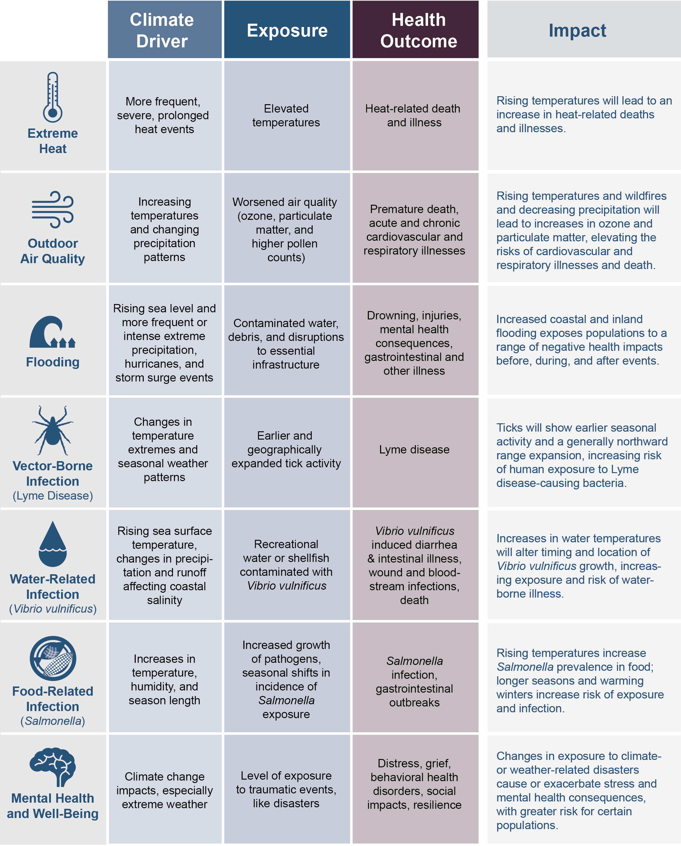
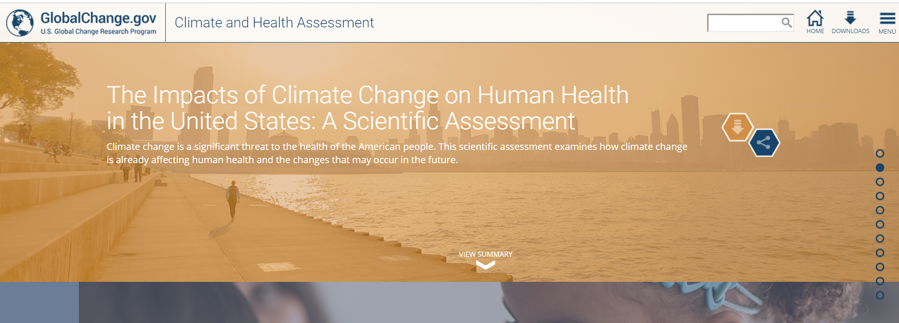
Why?
Health2016.globalchange.gov

Slide 6

^{VECTOR-BORNE DISEASES}
5
Changing Distributions of Vectors and Vector- Borne Diseases
^{Key Finding 1:}
Climate change is expected to alter the geographic and seasonal distributions of existing vectors and vector-borne diseases [Likely, High Confidence].
Health2016.globalchange.gov

Slide 7
^{VECTOR-BORNE DISEASES}
5
Earlier Tick Activity and Northward Range Expansion
^{Key Finding 2:}
Ticks capable of carrying the bacteria that cause Lyme disease and other pathogens will show earlier seasonal activity and a generally northward expansion in response to increasing temperatures associated with climate change [Likely, High Confidence].
Longer seasonal activity and expanding geographic range of these ticks will increase the risk of human exposure to ticks [Likely, Medium Confidence].
Health2016.globalchange.gov

Slide 8
^{VECTOR-BORNE DISEASES}
5
Changing Mosquito-Borne Disease Dynamics
^{Key Finding 3:}
Rising temperatures, changing precipitation patterns, and a higher frequency of some extreme weather events associated with climate change will influence the distribution, abundance, and prevalence of infection in the mosquitoes that transmit West Nile virus and other pathogens by altering habitat availability and mosquito and viral reproduction rates [Very Likely, High Confidence].
Alterations in the distribution, abundance, and infection rate of mosquitoes will influence human exposure to bites from infected mosquitoes, which is expected to alter risk for human disease [Very Likely, Medium Confidence].
Health2016.globalchange.gov

Slide 9
^{VECTOR-BORNE DISEASES}
5
Emergence of New Vector-Borne Pathogens
^{Key Finding 4:}
Vector-borne pathogens are expected to emerge or reemerge due to the interactions of climate factors with many other drivers, such as changing land-use patterns [Likely, High Confidence].
The impacts to human disease, however, will be limited by the adaptive capacity of human populations, such as vector control practices or personal protective measures [Likely, High Confidence].
Health2016.globalchange.gov

Slide 10
Zoonosis (pl: Zoonoses)
A disease that can be transmitted from
animals to humans under natural conditions
Vector
An organism that does not cause disease itself, but which spreads infection by conveying pathogens from one host to another.
Notes:
Zoonotic diseases (zoonoses) arise from infections transmitted from vertebrate animals to people.
Enzootic- means the pathogen is present in a given population of humans or animals…and for us dealing with animals- we need to consider that they all have something we need to use caution with handling/dealing with them!! Always treat them as though they are infected- so it goes better with you

Slide 11
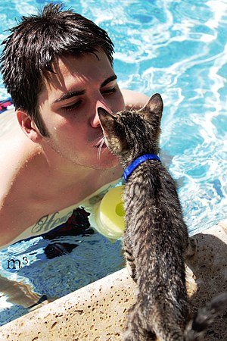

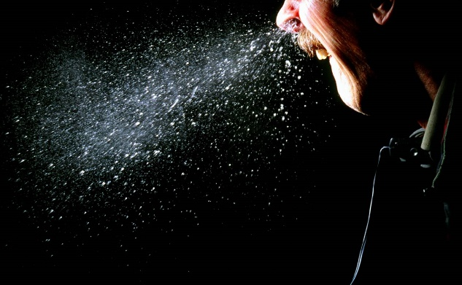
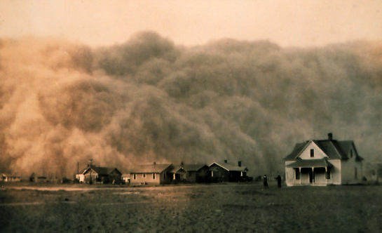
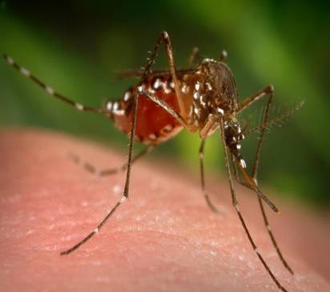
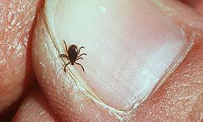
Zoonotic Disease Transmission
Direct Contact
Aerosol
Indirect
Vector
Notes:
ZOONOTIC DISEASE TRANSMISSION
Transmission of infection requires three elements:
(How you can get “it”)

Slide 12
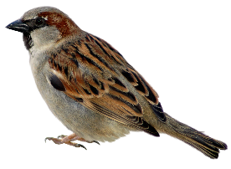
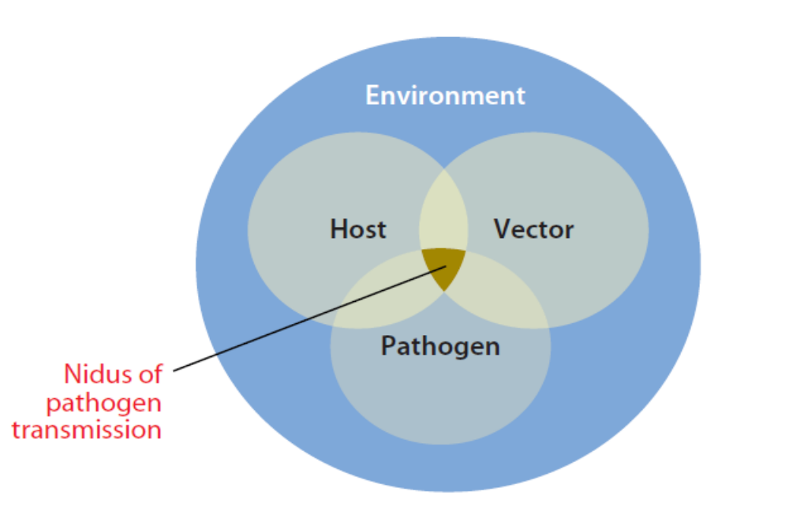
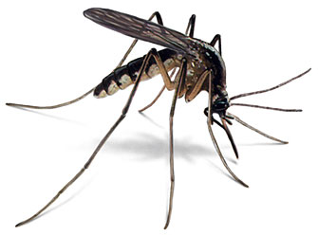

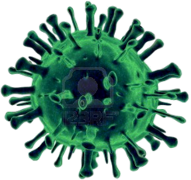
Vector-borne Disease System
Reservoir Host
Dead End Host
Modified from Reisen 2010

Slide 13

Impact of Climate on Zoonotic and Vector-Borne Diseases
CLIMATE CHANGE
(natural & human-caused)
Moderating
Influences
Vector Longevity
Vector
Development
Pathogen
Development
Natural vertebrate
host distribution
and abundance
Vector and
Host Habitat
Altered length of transmission season
Altered intensity of transmission
Altered distribution of diseases
Increased or decreased disease risk (disease-specific)
Disease
Transmission
Dynamics
Regional
weather
changes
Temperature
Precipitation
Humidity
Adaptation
Measures
Notes:
Pathways by which climate change affects human health
Potential vector- and rodent-borne diseases.
Moderating influences include non-climate factors that affect climate-related health outcomes, such as standards of living, access to health care, international travel, and public health infrastructure.
Adaptation measures include actions to reduce risks of adverse health outcomes, such as medical technology (e.g., vaccine development) or use of climate forecasts for early warning of favorable conditions for disease transmission.
So now that you’ve got a background on historical climate change, let’s examine how climate change can impact human health.
Climatic influences on health are often modulated by interactions with other ecological processes, social conditions, and adaptive policies. These help determine how severe the impact of climate change will be on the various health effects that will occur.

Slide 14
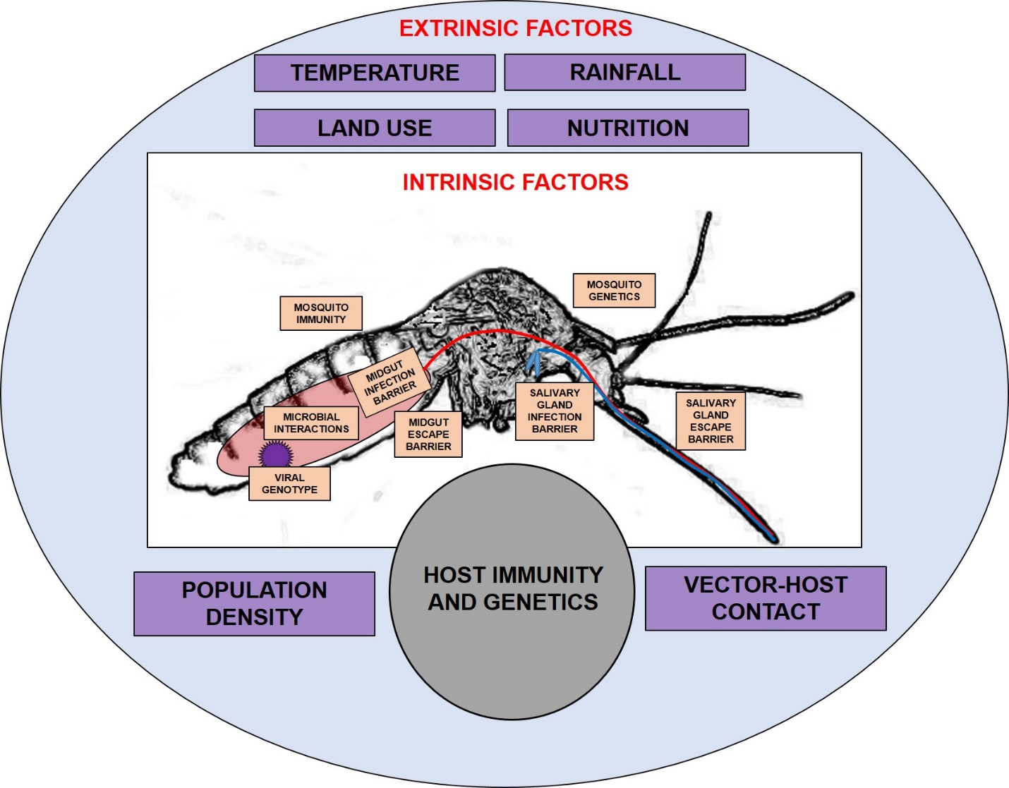
A Ciota and LD Kramer
Curr Opin Virol. 2015
Notes:
Important Aspects of Vector Biology
Vectorial capacity - VC=ma²(I*T)p^{n}/-ln p

Slide 15
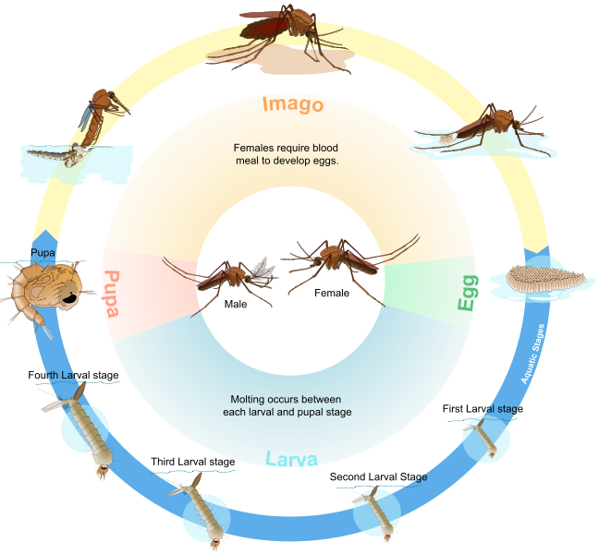

Slide 16
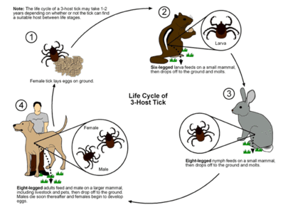
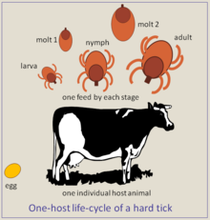

Slide 17
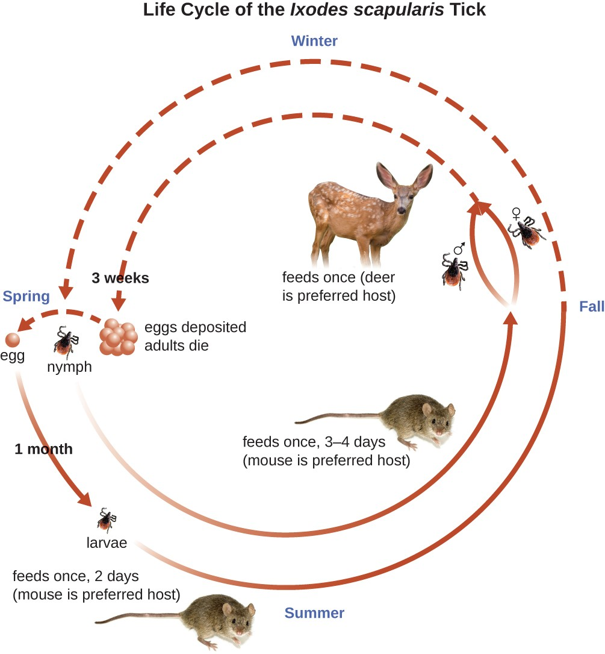
Notes:
Figure 3: Figure depicts the life cycle of blacklegged ticks, including the phases in which humans can be exposed to Lyme disease, and some of the changes in seasonality expected with climate change. (Figure source: adapted from CDC 2015)

Slide 18
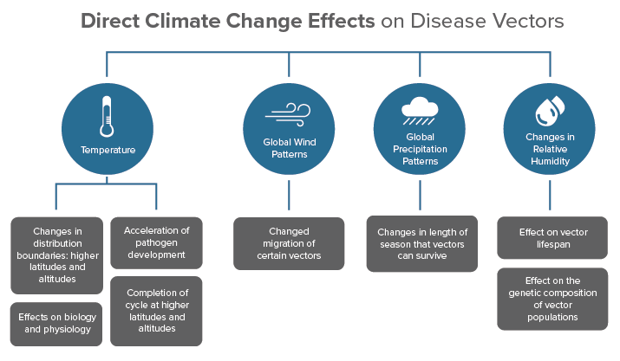
Notes:
Increasing temperatures
Changes to geographic patterns of rainfall
Increasing climate variability
Increasing frequency and severity of extreme weather events

Slide 19
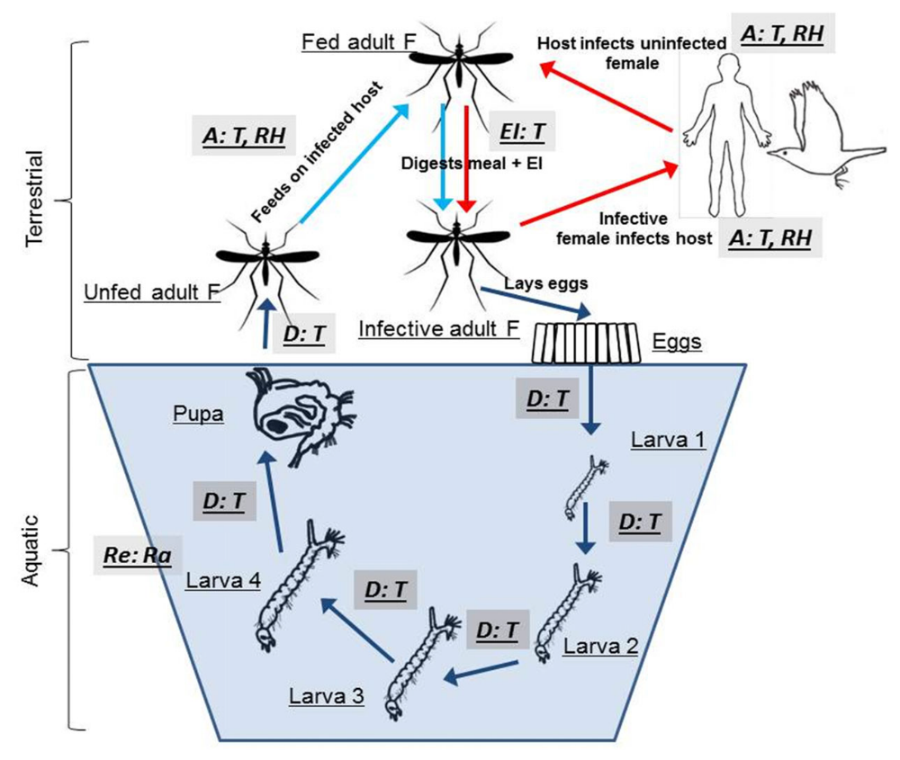
      .
A = effects on activity
D = effects on inter-stadial development rates
EI = effects on extrinsic incubation period
Re = effects on Reproduction
T = effects of temperature
Ra = effects of rainfall
RH = effects of humidity
Ogden 2017
Notes:
Figure 1. Direct effects of climate and weather on vector populations and vector-borne pathogen transmission illustrated by potential effects on West Nile virus
transmission (from Ogden and Lindsay 2016). Dark and pale blue arrows indicate, respectively, development and host finding, while red arrows indicate pathogen
transmission. Points at which weather and climate (and potentially climate change) may impact the vector’s lifecycle and pathogen transmission cycle are indicated
by the grey-filled boxes in which A = effects on activity, D = effects on inter-stadial development rates, EI = effects on the extrinsic incubation period, Re = effects on
reproduction, and T = effects of temperature, Ra = effects of rainfall and RH = effects of humidity.

Slide 20
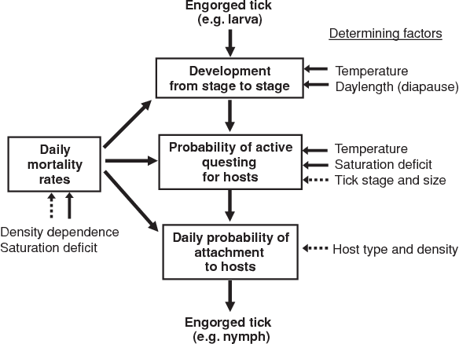
Bowman and Nuttall, 2008
Notes:
The structure of a population model for the tick Ixodes ricinus. Factors which determine the rates of the processes described within each box may be abiotic (solid arrow) or biotic (dotted arrow).

Slide 21
Climate Condition | Influence on Vectors
Increasing temperatures
Higher transmission potential | Decreasing vector generation time Increasing vector population growth rate Decreasing pathogen extrinsic incubation period Increasing length of transmission period
Lower transmission potential | Decreasing vector longevity Decreasing life expectancy
Increasing abundance of water
Higher transmission potential | Increase in vector larval habitats Increase in vector population sizes Increase in animal host populations over time
Lower transmission potential | Decrease vector host interactions with increase in water sources and dispersion of animal hosts Some vector-borne disease cycles require periods of drought for pathogen amplification
Both water and temperature will influence host and vector distribution in unknown complex ways
Tabachnick, 2010

Slide 22
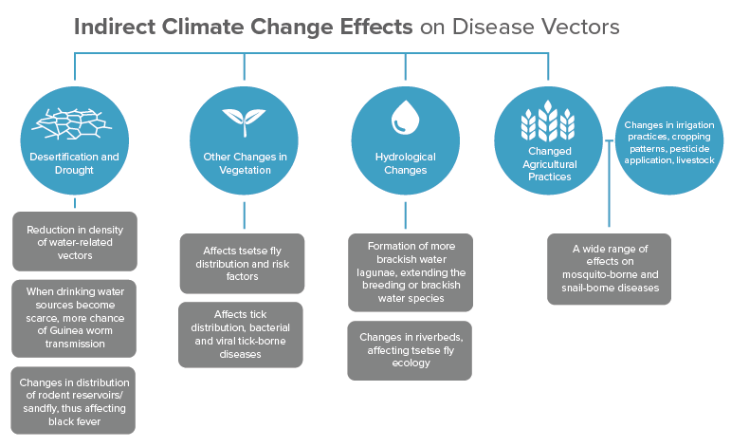
https://climatenexus.org/climate-issues/health/climate-change-and-vector-borne-diseases/

Slide 23
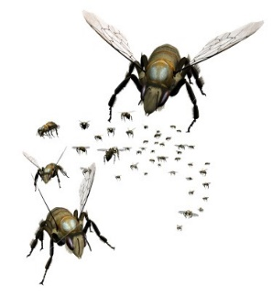

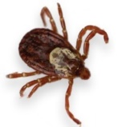
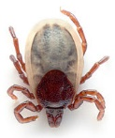

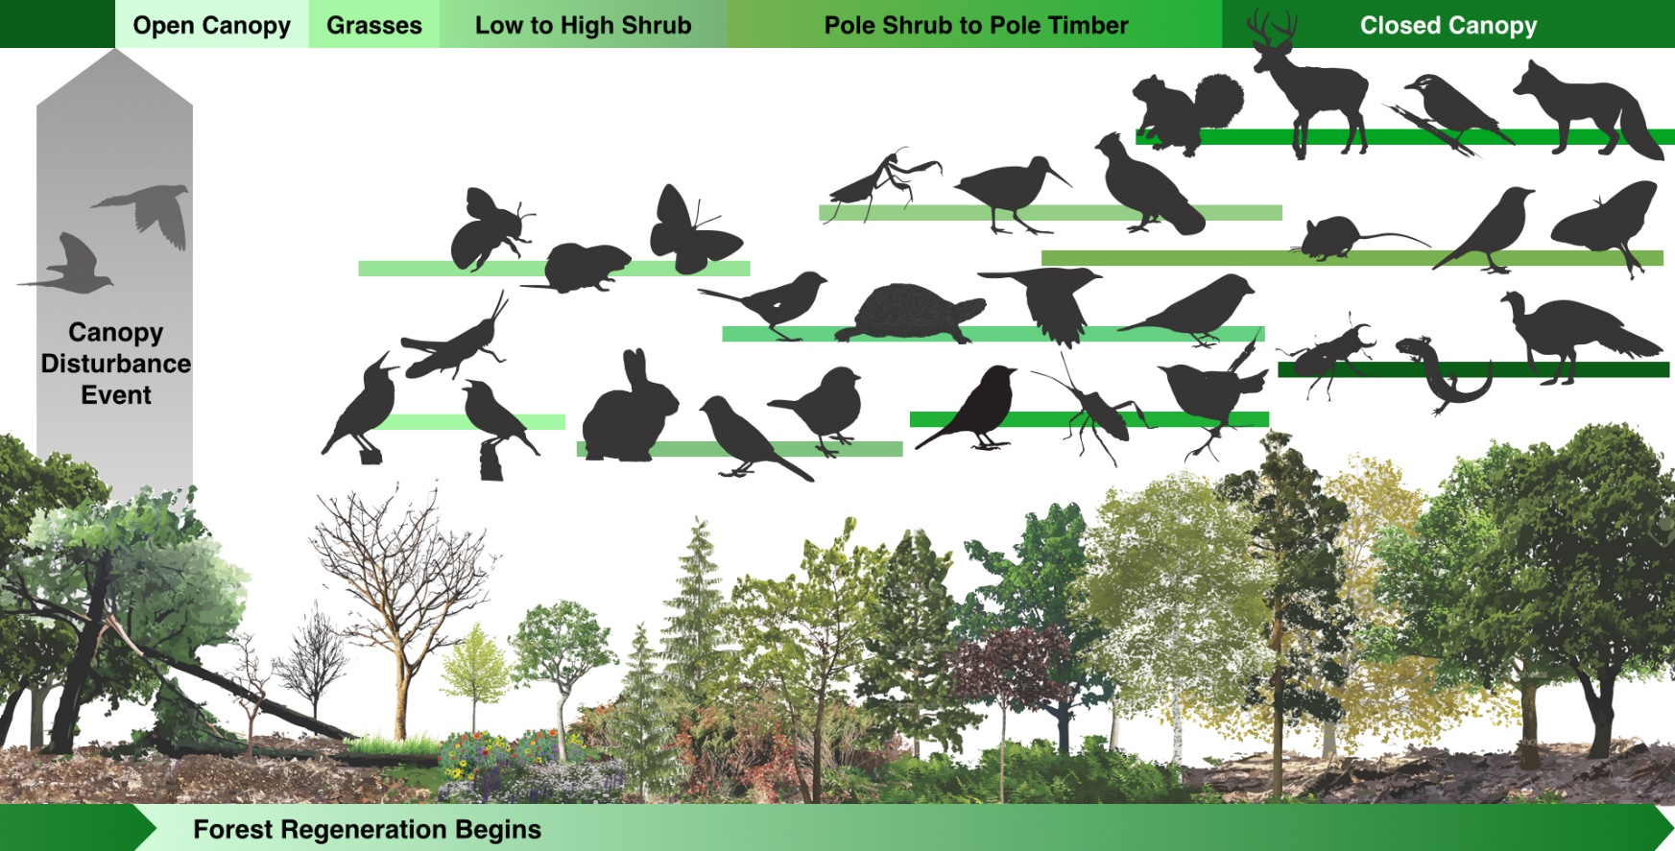
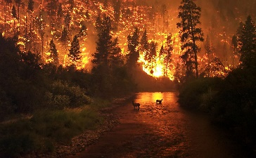
Time
Notes:
Expected that many VBD transmitted by flies would be able to respond quickly to changes in weather and climate, because of the short (several weeks long) lifecycles of many dipteran vectors, resulting in increasingly epidemic behavior of these diseases. Tick-borne diseases, whose vectors have lifecycles often several years long, would be expected to respond with slower progressive, rather than epidemic changes in occurrence.
Occurrence and levels of risk from VBDs are also determined by factors that are frequently considered independent of climate and insensitive to climate change. These include efforts to control VBDs, socioeconomic factors that determine how frequently people are bitten by vectors (e.g. how residences are constructed and air conditioned) or diagnosed and treated after infection and how vectors and vector-borne pathogens are disperse internationally to permit new niches to be filled.

Slide 24
Factors Involved in the Emergence [& Spread] of Infectious Disease
Microbial adaptation and change
Human susceptibility to infection
Climate and weather
Changing ecosystems
Human demographics and behavior
Economic development and land use
International travel and commerce
Technology and industry
Breakdown of public health measures
Poverty and social inequality
War and famine
Lack of political will
Intent to harm
Morens et al. 2004

Slide 25
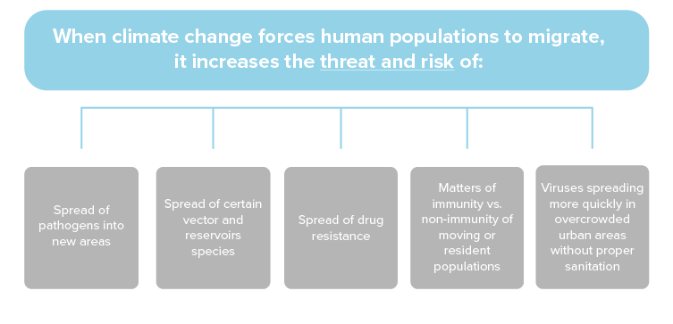

Slide 26
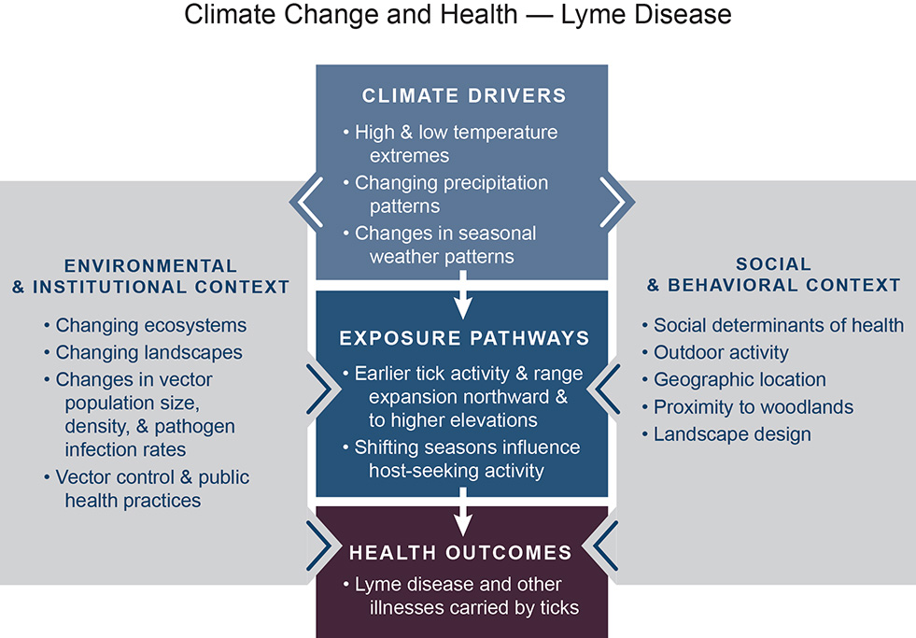
^{VECTOR-BORNE}
^{DISEASES}
5
Notes:
Figure 1: This conceptual diagram illustrates the key pathways by which climate change influences human exposure to Lyme disease and the potential resulting health outcomes (center boxes). These exposure pathways exist within the context of other factors that positively or negatively influence health outcomes (gray side boxes). Key factors that influence vulnerability for individuals are shown in the right box, and include social determinants of health and behavioral choices. Key factors that influence vulnerability at larger scales, such as natural and built environments, governance and management, and institutions, are shown in the left box. All of these influencing factors can affect an individual’s or a community’s vulnerability through changes in exposure, sensitivity, and adaptive capacity and may also be affected by climate change. See Ch. 1: Introduction for more information.

Slide 27
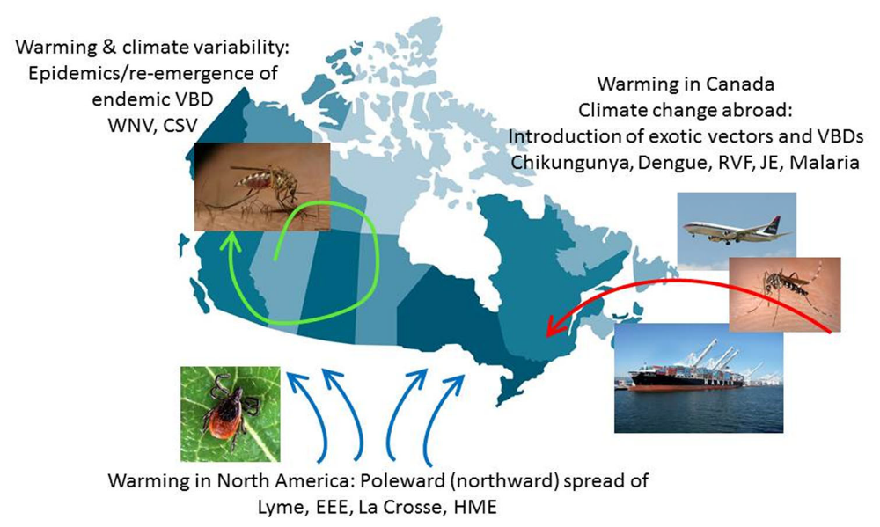
Expected Threats as Climate Changes
Ogden, 2017
Notes:
Possible impacts of climate change on changing risks from vector-borne diseases illustrated using possible impacts on Canada as an example. VBD = vectorborne
disease, WNV = West Nile virus, CSV = California serogroup viruses, RVF = Rift valley fever, JE = Japanese encephalitis, EEE = eastern equine encephalitis, La
Crosse = La Crosse encephalitis, HME = human monocytic ehrlichiosis.
Risk from endemic VBDs may increase due to long-term changes in temperature and rainfall patterns, and mosquito-borne diseases may become more epidemic as the vectors and pathogen transmission cycles respond to increasing climate variability and extreme weather events.
VBDs may shift their geographic ranges poleward (or to higher altitudes in mountains) into regions where they are currently not present.
Climate change may increase the threat of establishment of “exotic” tropical/subtropical vector-borne diseases (i.e. those endemic to regions far away) by directly increasing the climatic suitability of currently non=endemic countries, by increasing abundance of vectors and pathogens in regions where they are currently endemic and by increased frequency of introduction via increased international or within nation migration.

Slide 28
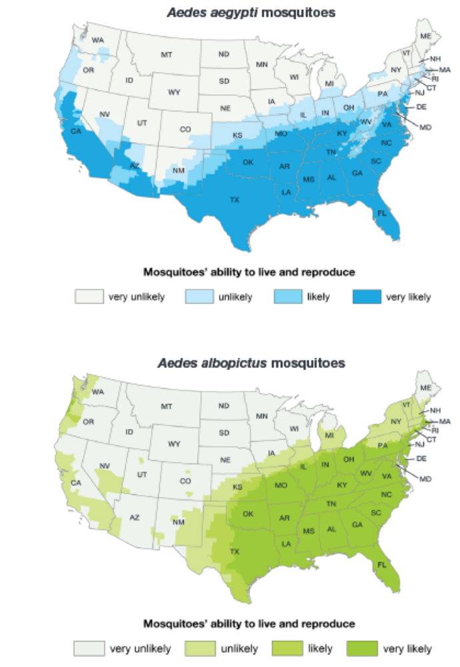
ESTIMATED potential range of Aedes aegypti and Aedes albopictus in the United States, 2017

Slide 29
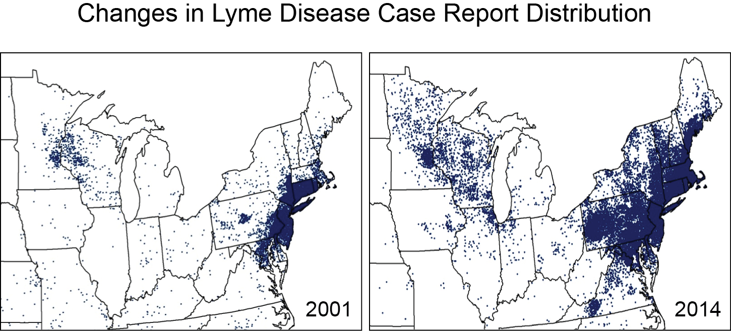
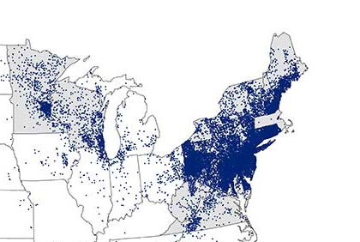
5
^{VECTOR-BORNE DISEASES}
2018
Notes:
Maps show the reported cases of Lyme disease in 2001 and 2014 for the areas of the country where Lyme disease is most common (the Northeast and Upper Midwest). Both the distribution and the numbers of cases have increased (see Ch. 5: Vector-Borne Diseases). (Figure source: adapted from CDC 2015)

Slide 30
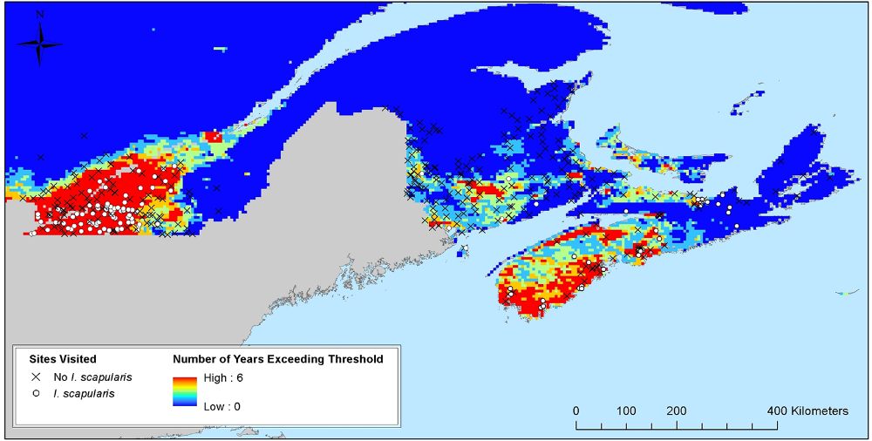
Relation of temperature conditions and results of field surveillance for I. scapularis in eastern Canada.
Gabriele-Rivet et al. 2015
Notes:
Relation of temperature conditions and results of field surveillance for I. scapularis in eastern
Canada. The map shows the number of years from 2009–2014 in which DD > 0°C was greater than the
model-based threshold for I. scapularis population survival obtained for southeastern Quebec and the
Maritime provinces (New Brunswick, Prince Edward Island and Nova Scotia) from MODIS satellite data at a
spatial resolution of 250 m. Sites where field surveillance for I. scapularis has occurred are indicated by
circles (for locations where I. scapularis were found) and crosses (for locations where I. scapularis were not
found). The map was created in ArcMap 10.2.2 (ESRI. Redlands, CA)

Slide 31
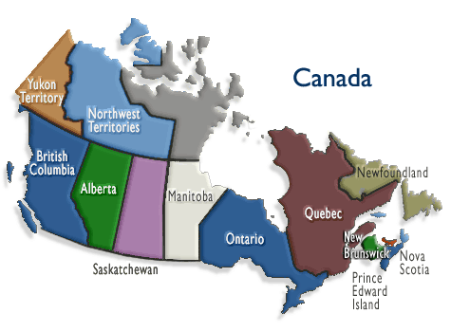
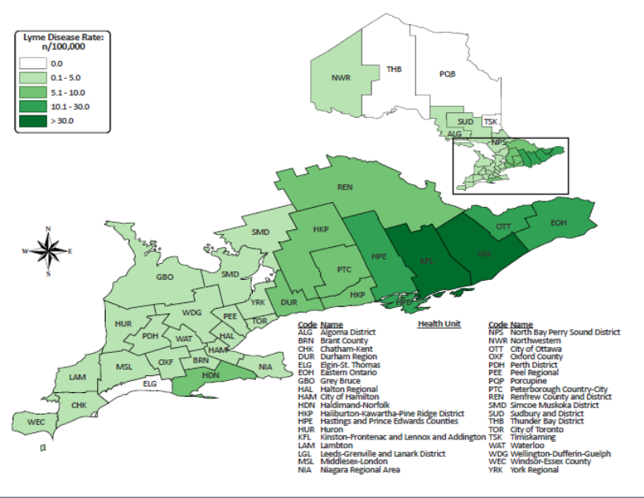
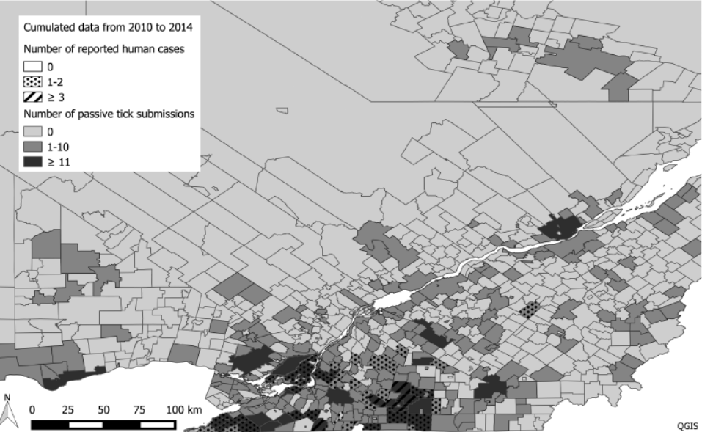
Lyme Disease in Canada
Southern Ontario
Southern Quebec
Nelder et al. 2018
Ripoche et al. 2018
Notes:
Spatial distribution of total passive tick submissions and total number of human cases per municipality (CSDs) of southwestern Quebec cumulated from
2010 to 2014. Dark-shaded polygons show municipalities with more than 11 tick submissions over 5 yr, and polygons with hatched lines show the presence of
more than three human cases over the same period. Dotted polygons are municipalities with emerging risk (1–2 human cases).
Incidence rate of Lyme disease (per 100,000 population) by public health unit: Ontario, Canada (2017)

Slide 32
Public Tick Submissions to WA DOH, 2011-2018
N = 1,689
Average tick submissions/year: 211
Notes:
Total all years: 1,689
Average per year: 211 ticks
2013 - Below average temperatures in January and again from October to December served to balance out a very warm interim period. The unusually clear and inactive weather pattern that persisted during much of 2013 translated into relatively warm conditions for much of the year. An early May heat wave sent temperatures soaring into the 90s across eastern Washington, while cool and wet weather later in the month kept high temperatures at some of the same locations below 50 degrees on May 22nd.
2018 - Average temperatures in 2018 were slightly above normal in the Pacific Northwest, cooler than normal in the inland Northwest, Cooler than normal temperatures dominated along the northern tier of the region in the first few months of 2018 and again in the autumn season, resulting in below normal annual temperatures. Mid-April-May: North-central Washington also experienced snowmelt flooding in May, notably along the Okanogan River. On May 10, the Washington governor declared a State of Emergency for 20 central and eastern Washington counties.

Slide 33
Public Tick Submissions to WA DOH by Month, 2011-2018

Slide 34
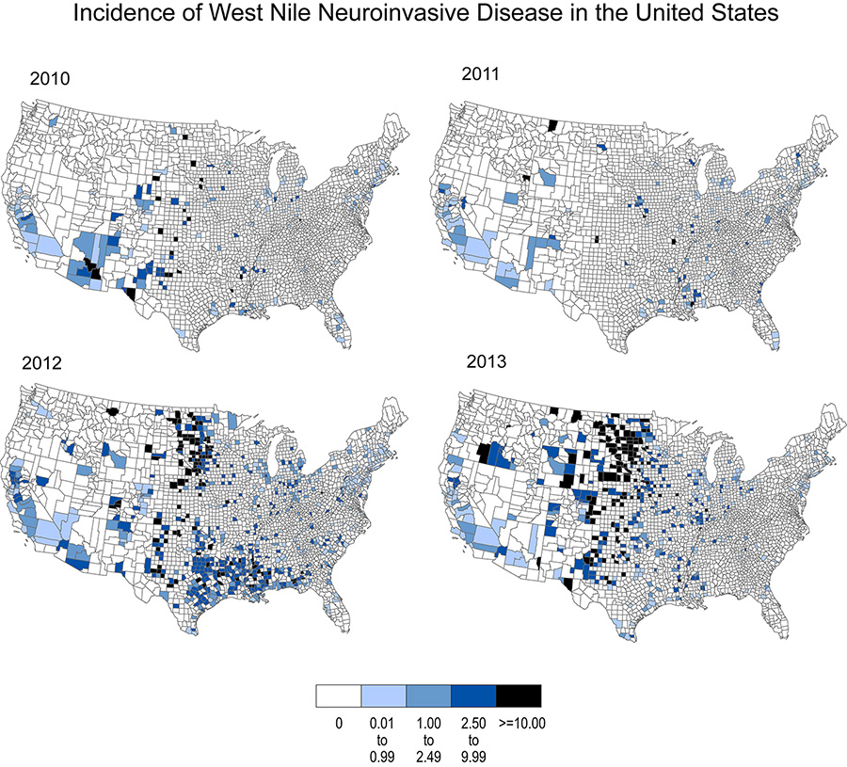
^{VECTOR-BORNE DISEASES}
5
Notes:
Figure 5: Maps show the incidence of West Nile neuroinvasive disease in the United States for 2010 through 2013. Shown as cases per 100,000 people. (Data source: CDC 2014)

Slide 35
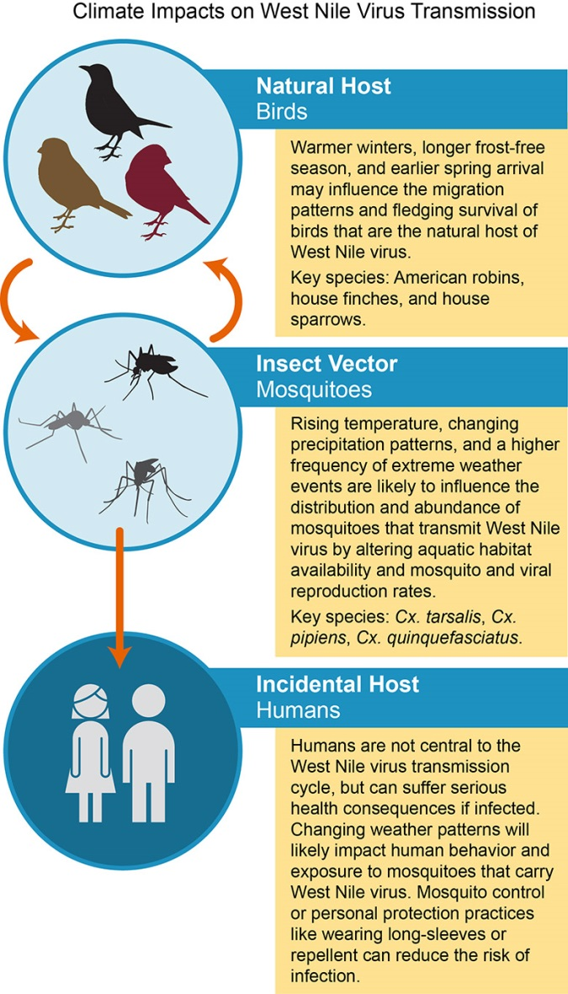
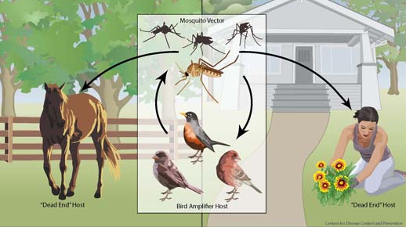
Climate Impacts on West Nile Virus Transmission

Slide 36
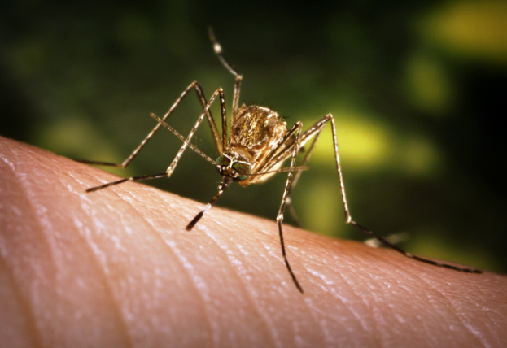
Culex tarsalis
Encephalitis mosquito
WNV, WEE and SLE vector
Habitats include irrigation tailings, seeps, ditches.
Increased temp – increased warmth of aquatic environment = increased Culex tarsalis abundance and development speed
Temperatures >30°C = shift in seasonal distribution?
Notes:
Culex tarsalis is considered one of the two primary vectors of West Nile Virus in WA and two of the most common mosquitoes in Washington.

Slide 37
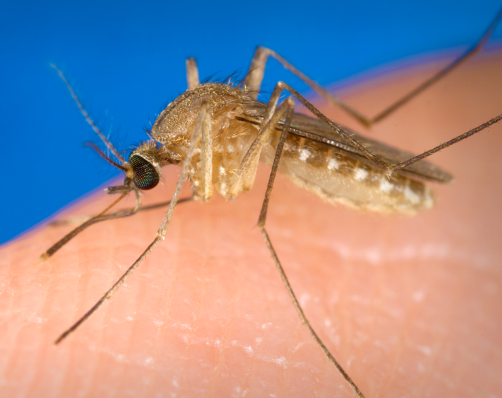
Culex pipiens
Northern House Mosquito
WNV and SLE vector
Habitats include artificial containers, storm water retention ponds and drains, and water with high organic content.
Increased & prolonged water in storm retention ponds and drains = increased habitat for Culex pipiens mosquitoes
High rainfall – can flush out storm drains & retention ponds
Notes:
Culex pipiens is considered one of the primary vectors of West Nile Virus and one of the most common mosquitoes in Washington.

Slide 38
Impacts of Climate Change – Western U.S.
Wetter winters
  Reduced snowpack
Decreased spring and summer snow cover
  Loss of cold-water dependent ecosystems (high alpine areas, mountain aquatic systems)
Earlier stream flow peaks from snow-melt
Warmer summers
Notes:
Most climate models project wetter winters and warmer summers for the western United States
These impacts imply that both the availability of water and prevalence of wildfire will be affected by the changing climate. Ecosystems and wildlife species of western mountains and forests are deeply dependent on snow and ice melt.
Spring and summer snow cover has decreased in the western mountains by 15–30% since 1950, and stream flow peaks from snow-melt occurred 1–4 weeks earlier in 2002 than 1948.
Reduced availability of summer water will likely result in a loss of cold-water dependent ecosystems such as high alpine areas and cold, mountain aquatic systems.
While the high alpine areas may experience a decline in growth, wetter winters may mean increased woody growth across the West.
Variations in amount and timing of snow and rain also have important effects on fire frequencies.
Drier years make the mountain forests more prone to fires and wetter years increase fire frequencies in arid, low elevations due to increased amounts of burnable materials.7
Due to variations in the effects that climate change will have on each ecosystem within the western forests ecoregion, there will be differences in the ways plant and animal species respond to the changing climate.

Slide 39
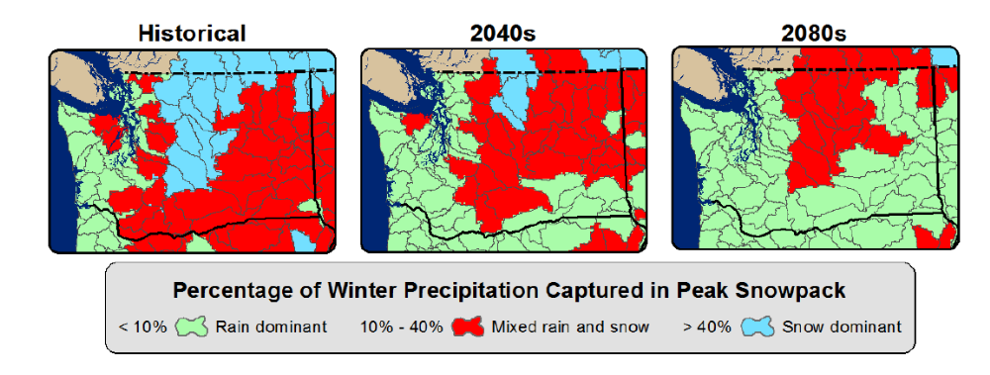
Rising temperatures will lead to earlier melting of the snowpack, which plays a critical role in spring and summer water supplies.
Along with more precipitation falling as rain instead of snow, this may also lead to an increase in springtime flooding.
Notes:
Figure 6-1. Changing hydrology with warming. Maps above indicate current and future watershed
classifications, based on the proportion of winter precipitation stored in peak annual snowpack. Graphs
below indicate current and future average monthly streamflow for these watershed types. Both compare
average historical conditions (1916-2006) and projected future conditions for two time periods, the 2040s
(2030-2059) and the 2080s (2070-2099), under a medium greenhouse gas scenario (A1B). Green shading
in the maps indicates warm (“rain-dominant”) watersheds, which receive little winter precipitation in the
form of snow. In these basins, streamflow peaks during during winter months and warming is projected to
have little effect (below, left). Blue indicates cold (“snow-dominant”) watersheds, that is, cold basins that
receive more than 40% of their winter precipitation as snow. Depending on elevation, these basins are
likely to experience increasing winter precipitation as rain and increased winter flows (below, right). The
most sensitive basins to warming are the watersheds that are near the current snowline (“mixed rain and
snow”), shown in red. These are middle elevation basins that receive a mixture of rain and snow in the
winter, and are projected to experience significant increases in winter flows and decreases in spring flows
as a result of warming (below, center). Source: Hamlet et al., 2013.[3]
Figure

Slide 40
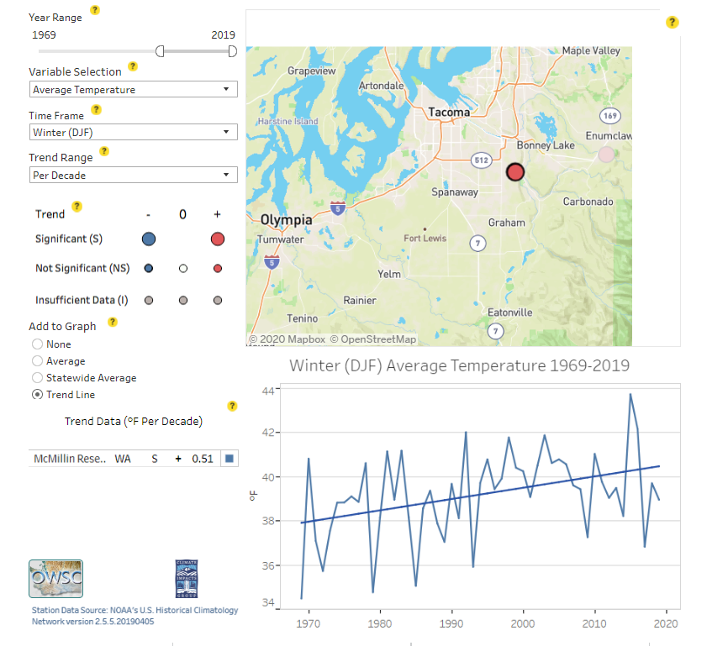

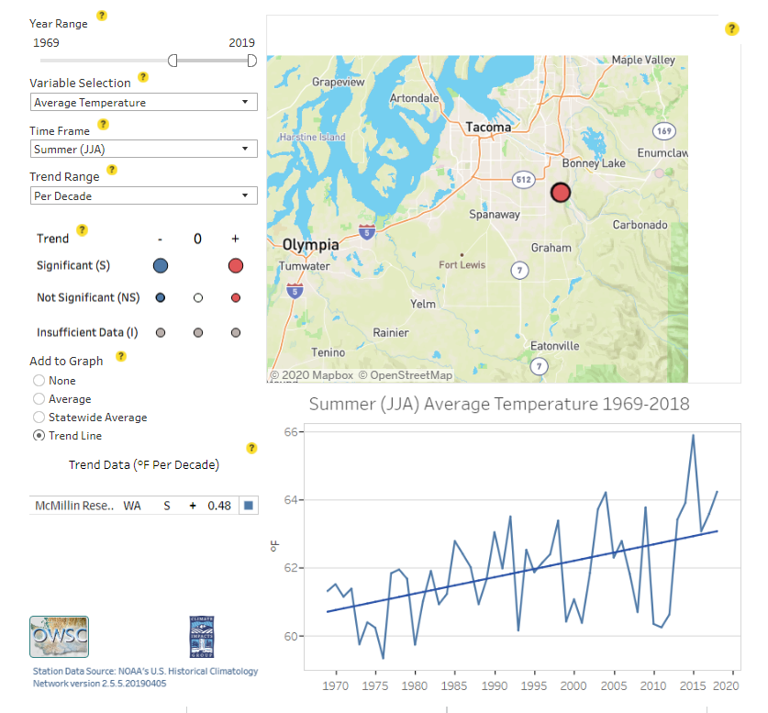
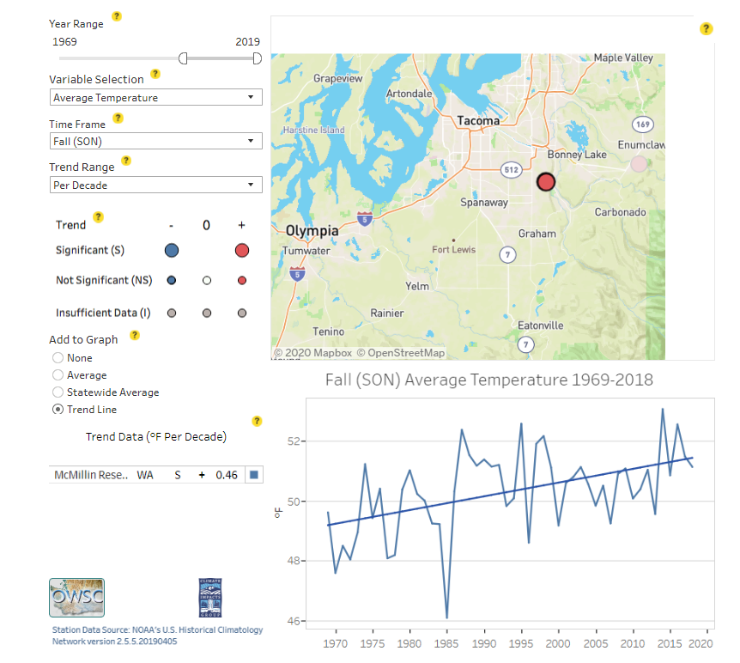
Average Temperature, South Puget Sound - 1969-2019
https://climate.washington.edu/climate-data/trendanalysisapp/

Slide 41
Total Mosquito Collections, NNWR 2007-2019
N = 76,902
Average Number Collected/Year: 5,916
Saltwater estuary restoration
Notes:
Total all years: 1,689
Average per year: 211 ticks
2013 - Below average temperatures in January and again from October to December served to balance out a very warm interim period. The unusually clear and inactive weather pattern that persisted during much of 2013 translated into relatively warm conditions for much of the year. An early May heat wave sent temperatures soaring into the 90s across eastern Washington, while cool and wet weather later in the month kept high temperatures at some of the same locations below 50 degrees on May 22nd.
2018 - Average temperatures in 2018 were slightly above normal in the Pacific Northwest, cooler than normal in the inland Northwest, Cooler than normal temperatures dominated along the northern tier of the region in the first few months of 2018 and again in the autumn season, resulting in below normal annual temperatures. Mid-April-May: North-central Washington also experienced snowmelt flooding in May, notably along the Okanogan River. On May 10, the Washington governor declared a State of Emergency for 20 central and eastern Washington counties.

Slide 42
WNV Vector Mosquito Collections, NNWR 2007-2019
N = 12,746 (12,131 / 615)
Saltwater estuary restoration
Notes:
Total all years: 1,689
Average per year: 211 ticks
2013 - Below average temperatures in January and again from October to December served to balance out a very warm interim period. The unusually clear and inactive weather pattern that persisted during much of 2013 translated into relatively warm conditions for much of the year. An early May heat wave sent temperatures soaring into the 90s across eastern Washington, while cool and wet weather later in the month kept high temperatures at some of the same locations below 50 degrees on May 22nd.
2018 - Average temperatures in 2018 were slightly above normal in the Pacific Northwest, cooler than normal in the inland Northwest, Cooler than normal temperatures dominated along the northern tier of the region in the first few months of 2018 and again in the autumn season, resulting in below normal annual temperatures. Mid-April-May: North-central Washington also experienced snowmelt flooding in May, notably along the Okanogan River. On May 10, the Washington governor declared a State of Emergency for 20 central and eastern Washington counties.

Slide 43
Total Mosquito Collections by Month, NNWR 2007-2019

Slide 44
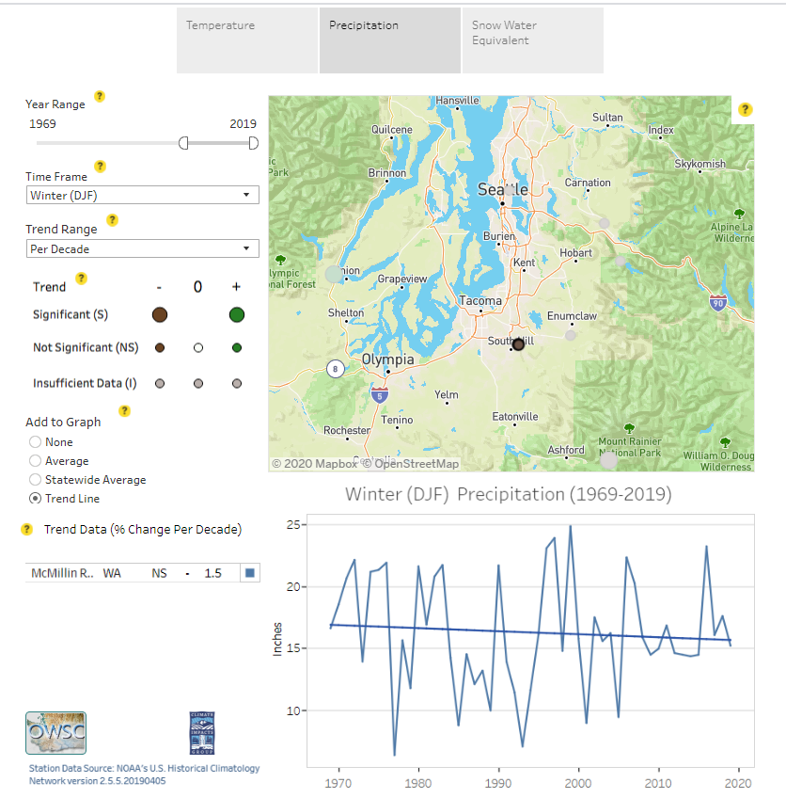
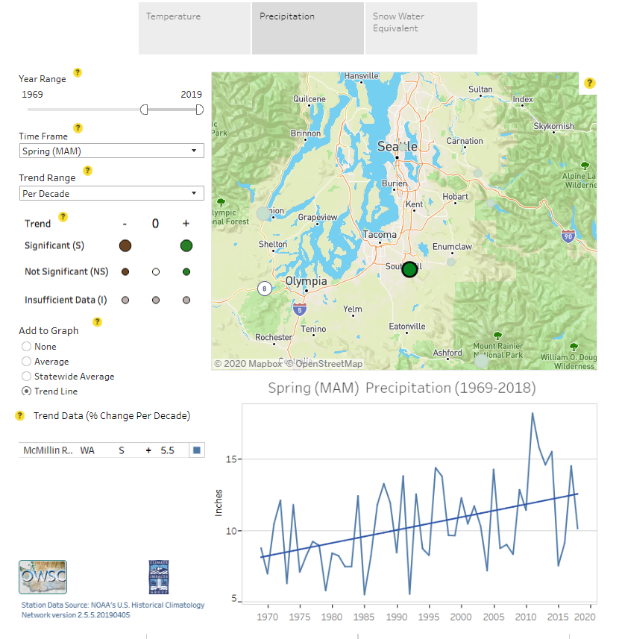


Precipitation, South Puget Sound - 1969-2019
https://climate.washington.edu/climate-data/trendanalysisapp/

Slide 45
WNV Vector Collections by Month, NNWR 2007-2019

Slide 46
Summary
We are already seeing changes in vector ecology and species distribution.
Some of that will be because of climate change.
We have a better chance of preventing and reducing VBDs if we factor climate change into our vector surveillance efforts and how we do business.
Understanding those relationships requires more robust, coordinated, and strategic surveillance and data sharing.
Notes:
That means understanding and monitoring how not only variability in weather, but variability in landscapes in the PNW and shifting stream flow timing, snow pack reduction, soil moisture how that influences vector ecology and species distribution and disease risk.

Slide 47

Questions
Liz Dykstra, PhD, BCE
elizabeth.dykstra@doh.wa.gov
360-236-3388
Notes:
BLANK SLIDE
Quick Help Tips
Blank Slide Box:
just add text
You can input text boxes or images as needed if none of the other provided template formats does not fit your needs.
If you have a suggestion about a common format that we might have missed, please send your suggestion to simana.dimitrova@doh.wa.gov for consideration to add to this templates slide deck.
Thank you.

