Slide 1

The impact of changes in coal-fired power plant emissions on asthma-related healthcare utilization and symptoms in Louisville, KY
July 27, 2020
jac2250@cumc.columbia.edu
Joan A. Casey, Jason G. Su, Lucas Henneman, Corwin Zigler, Andreas M. Neophytou, Ralph Catalano, Rahul Gondalia, Yu-Ting Chen, Sarah S. Moyer, Veronica Combs, Grace Simrall, Ted Smith, James Sublett, Meredith A. Barrett
Source:
Nounproject.com

Slide 2
Coal-fired power plant events improve air quality
Notes:
Including retirements or installation of sulfur dioxide controls

Slide 3
Coal-fired power plant events improve air quality
which, in Louisville, KY, translated into fewer asthma-related healthcare visits and fewer rescue inhaler uses

Slide 4
Quasi-experimental designs
Our KY study
Background on coal-fired power plants and health
Where we are headed

Slide 5
Why all the hype about
“natural” experiments and
quasi-experimental designs?

Slide 6

What we observe
Group 1 (exposed)
Group 2 (unexposed)
1 preterm birth
0 preterm births
Notes:
If this doesn’t exist, we have confounding

Slide 7
What we’d like to observe
Group 2 (had they been exposed)
Group 2 (unexposed)
? preterm births
0 preterm births

Slide 8
Then we could compare...
Group 2 (had they been exposed)
Group 2 (unexposed)
2 preterm births
0 preterm births

Slide 9
Then we could compare...
Group 2 (had they been exposed)
Group 2 (unexposed)
2 preterm births
0 preterm births
“The coal plant caused 2 preterm births.”

Slide 10

Natural experiments
1950s
1998
Dutch famine
Huai River Policy
Quebec ice storm
Olympics
Ebenstein A, Fan M, Greenstone M, He G, Zhou M. 2017. New evidence on the impact of sustained exposure to air pollution on life expectancy from China's Huai River Policy. Proc Natl Acad Sci U S A 114(39):10384-10389; http://www.meteo.mcgill.ca/extreme/Extreme_Photos.htm
Notes:
Here we are breaking the link between differences in populations by exposure by having psuedo randomization of exposure in certain places at certain times

Slide 11
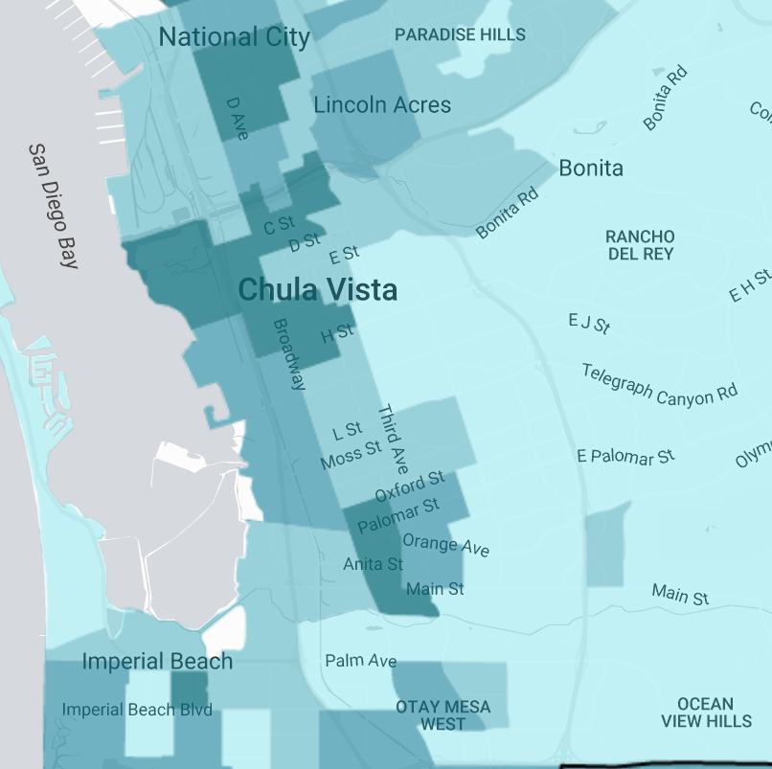
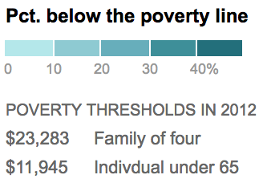
Natural experiments:
An opportunity for Epidemiology
Source: http://www.nytimes.com/newsgraphics/2014/01/05/poverty-map/
Notes:
Pseudo-randomization of participants to exposures
Policy changes
Industrial plant closures
We see the the plant is located in an area of relatively high poverty, so are the poor health outcomes located nearby due to poverty or air pollution.

Slide 12
Natural experiments:
An opportunity for Epidemiology
Source: http://www.nytimes.com/newsgraphics/2014/01/05/poverty-map/
Notes:
Pseudo-randomization of participants to exposures
Policy changes
Industrial plant closures
We see the the plant is located in an area of relatively high poverty, so are the poor health outcomes located nearby due to poverty or air pollution.

Slide 13
A challenge for environmental epidemiology
Individuals and populations who experience more environmental hazards may have other systematic differences
Notes:
Other pollutants, behaviors, psychosocial stressors

Slide 14
1. Environmental justice
Socioeconomic disadvantage and
disproportionate environmental exposures
Morello-Frosch R, Jesdale BM. Separate and unequal: residential segregation and estimated cancer risks associated with ambient air toxics in U.S. metropolitan areas. Environ Health Perspect 2006;114(3):386-93.
Cushing L, Morello-Frosch R, Wander M, Pastor M. 2015. The haves, the have-nots, and the health of everyone: the relationship between social inequality and environmental quality. Annu Rev Public Health 36:193-209.
Notes:
Poorer individuals may select into lower environmental quality neighborhoods for a range of reasons
Industrial plants may be differentially sited in low socioeconomic status communities

Slide 15
2. Avoidance behavior
Sicker individuals may avoid pollution

Slide 16
Structure of the relationships
Socioeconomic status
Asthma exacerbations
Air pollution

Slide 17
Socioeconomic status
Asthma exacerbations
⚙️
Air pollution
Notes:
So, often the causal effect, what we really care about, does not equal the estimated association
Quasi-experimental designs can help us estimate the causal effect by creating exchangeable groups and helping us better estimate the counterfactual.
Natural experiments used in the past include the dutch famine and the Beijing olympics
We break the link between confounding factors and the exposure of interest

Slide 18
Socioeconomic status
Asthma exacerbations
Air pollution
Notes:
We break the link between confounding factors and the exposure of interest

Slide 19

Quasi-experimental designs
Our KY study
Background on coal-fired power plants and health
Where we are headed

Slide 20

Coal-fired power plants emit particulate matter (PM), NO_{x}, SO₂, benzene, mercury, lead, PAHs, other pollutants
Source: American Lung Association. Toxic Air: the Case for Cleaning Up Coal-Fired Power Plants. 2011:1-12
Notes:
In fact, coal-fired power plants emitted 63% of sulfur dioxide in the US in 2014 and 6% of PM2.5

Slide 21
Studies find associations between SO₂ and respiratory symptoms
Barbone F, Catelan D, Pistelli R, Accetta G, Grechi D, Rusconi F, et al. 2019. Int J Environ Res Public Health 16(6). 10.3390/ijerph16061057.
Charpin D, Kleisbauer JP, Fondarai J, Graland B, Viala A, Gouezo F. 1988. Arch Environ Health 43(1):22-27. 10.1080/00039896.1988.9934369.
Cohen AA, Bromberg S, Buechley RW, Heiderscheit LT, Shy CM. 1972. Am J Public Health 62(9):1181-1188. 10.2105/ajph.62.9.1181.
Deger L, Plante C, Jacques L, Goudreau S, Perron S, Hicks J, et al. 2012. Can Respir J 19(2):97-102. 10.1155/2012/218957.
Dubnov J, Barchana M, Rishpon S, Leventhal A, Segal I, Carel R, et al. 2007.. Environ Res 103(1):87-98. 10.1016/j.envres.2006.02.009.
Ramadour M, Burel C, Lanteaume A, Vervloet D, Charpin D, Brisse F, et al. 2000. Allergy 55(12):1163-1169.
Schenker MB, Speizer FE, Samet JM, Gruhl J, Batterman S. 1983. Arch Environ Health 38(6):325-330.
Smargiassi A, Kosatsky T, Hicks J, Plante C, Armstrong B, Villeneuve PJ, et al. 2009. Environ Health Perspect 117(4):653.
Notes:
uncontrolled asthma, respiratory symptoms and pulmonary function, and respiratory-related hospitalizations among populations living near coal-fired power plants
uncontrolled asthma,¹¹ respiratory symptoms and pulmonary function,¹²⁻¹⁶ and respiratory-related hospitalizations¹⁷

Slide 22
Prior studies were limited
Primarily cross-sectional
Associational studies
Considered single air pollutants alone

Slide 23
Quasi-experimental designs
Our KY study
Background on coal-fired power plants and health
Where we are headed

Slide 24

Source: U.S. EIA

Slide 25
MILL CREEK POWER PLANT
Source: The Nature Conservancy
Notes:
Years: 2012-2017
4 coal-fired power plants had energy transitions
900-2600 MW plants
KY in the top ¼ of asthma prevalence nationwide

Slide 26
HyADS
Jefferson County
Henneman LRF, Choirat, C., Ivey, C. E., Cummiskey, K., & Zigler, C. M. 2019. Characterizing population exposure to coal emissions sources in the United States using the HyADS model. Atmos Environ 2020.
Notes:
Uses HYSPLIT average dispersion model to quantify the extent to which any power plant influences air quality across U.S. ZIP codes
The four highest-ranked facilities by HyADS impact in 2012 that installed SO₂ emission controls or shuttered by 2017 included: Cane Run, a 943 MW plant located 14 kilometers southwest of downtown Louisville; Clifty Creek, a 1303 MW plant located about 75 kilometers northeast of Louisville that had the greatest impact of any coal-fired power plant in the country on east Jefferson County; Mill Creek, a 1717 MW plant located 25 kilometers southwest of downtown Louisville that had the greatest impact of any coal-fired power plant in the country on west Jefferson County in 2012; and Rockport, a 2600 MW plant located about 100 kilometers west of Louisville.

Slide 27
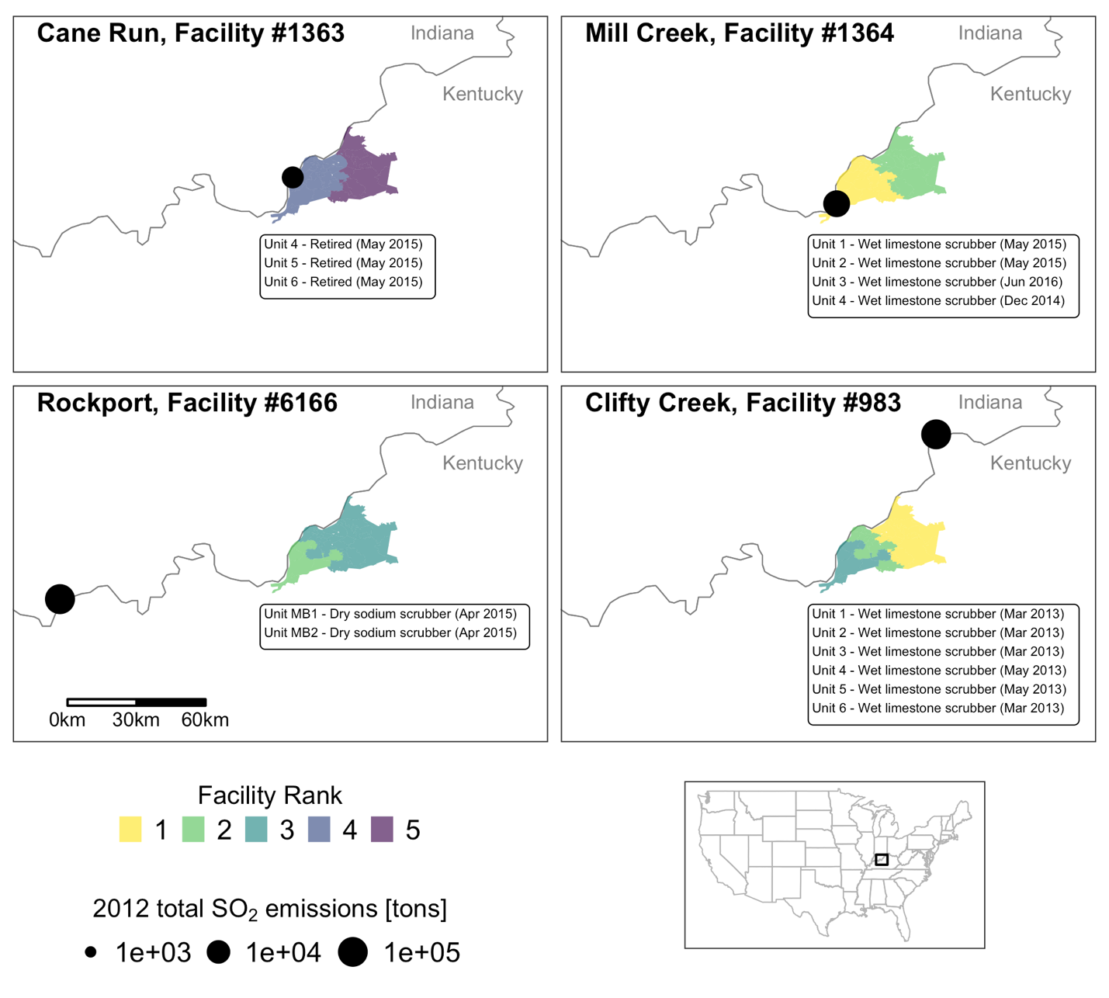
HyADS
Jefferson County
Henneman LRF, Choirat, C., Ivey, C. E., Cummiskey, K., & Zigler, C. M. 2019. Characterizing population exposure to coal emissions sources in the United States using the HyADS model. Atmos Environ 2020.
Notes:
Uses HYSPLIT average dispersion model to quantify the extent to which any power plant influences air quality across U.S. ZIP codes
The four highest-ranked facilities by HyADS impact in 2012 that installed SO₂ emission controls or shuttered by 2017 included: Cane Run, a 943 MW plant located 14 kilometers southwest of downtown Louisville; Clifty Creek, a 1303 MW plant located about 75 kilometers northeast of Louisville that had the greatest impact of any coal-fired power plant in the country on east Jefferson County; Mill Creek, a 1717 MW plant located 25 kilometers southwest of downtown Louisville that had the greatest impact of any coal-fired power plant in the country on west Jefferson County in 2012; and Rockport, a 2600 MW plant located about 100 kilometers west of Louisville.

Slide 28
HyADS
Louisville
Henneman LRF, Choirat, C., Ivey, C. E., Cummiskey, K., & Zigler, C. M. 2019. Characterizing population exposure to coal emissions sources in the United States using the HyADS model. Accepted. Atmos Environ.
Notes:
Uses HYSPLIT average dispersion model to quantify the extent to which any power plant influences air quality across U.S. ZIP codes
The four highest-ranked facilities by HyADS impact in 2012 that installed SO₂ emission controls or shuttered by 2017 included: Cane Run, a 943 MW plant located 14 kilometers southwest of downtown Louisville; Clifty Creek, a 1303 MW plant located about 75 kilometers northeast of Louisville that had the greatest impact of any coal-fired power plant in the country on east Jefferson County; Mill Creek, a 1717 MW plant located 25 kilometers southwest of downtown Louisville that had the greatest impact of any coal-fired power plant in the country on west Jefferson County in 2012; and Rockport, a 2600 MW plant located about 100 kilometers west of Louisville.

Slide 29
Use HyADS to characterize changes in air quality
Look for changes in asthma outcomes
  Quarterly ZIP code-level asthma hospitalizations/ED visits
  Daily individual-level rescue inhaler use

Slide 30
Use HyADS to characterize changes in air quality

Slide 31
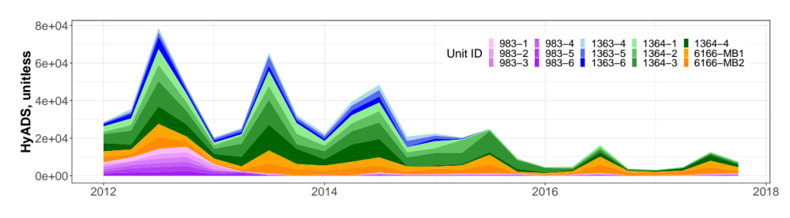
Big drop in hyads in spring 2015
Rockport scrubbers on all units, Mill Creek scrubbers on 2/4 units, Cane Run retired 3/3 units

Slide 32
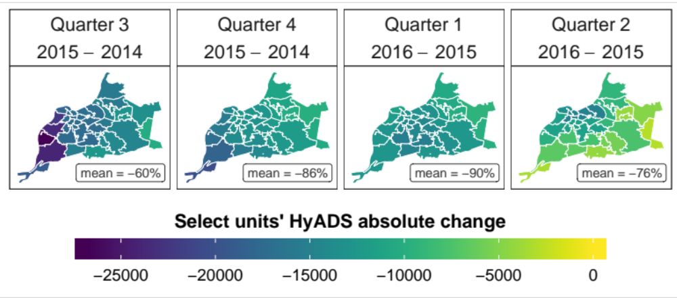
large drop in hyads shown spatially

Slide 33
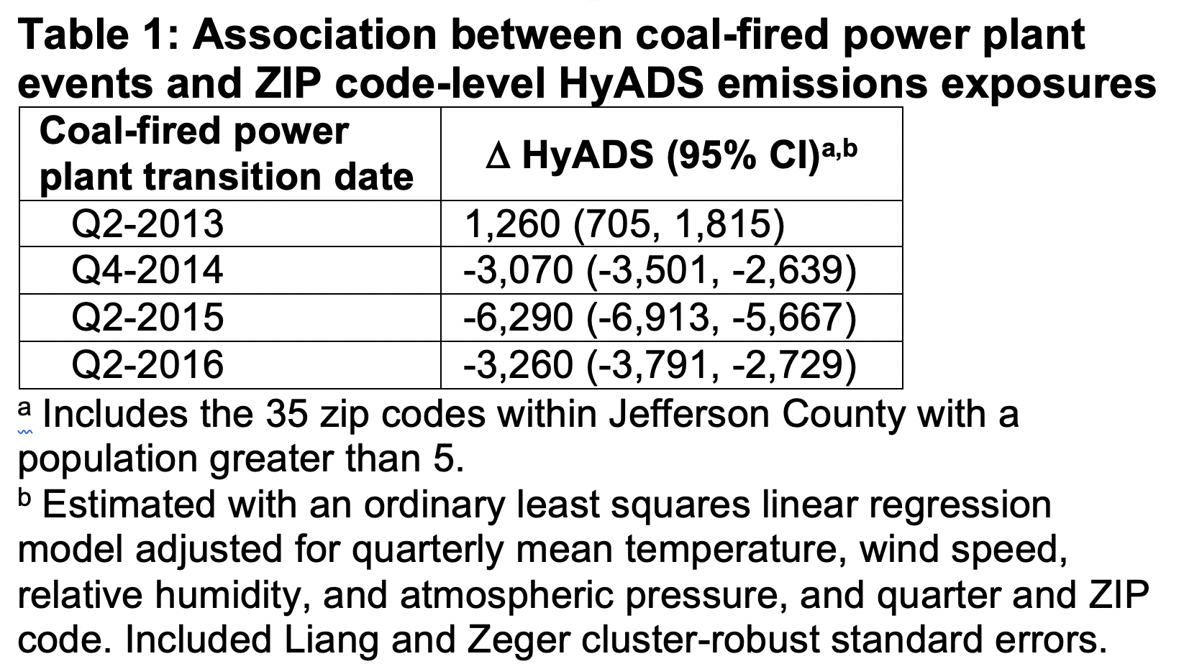
Power plant events associated with reduced hyads levels

Slide 34
Use HyADS to characterize changes in air quality
Look for changes in asthma outcomes

Slide 35
Use HyADS to characterize changes in air quality
Look for changes in asthma outcomes
  Quarterly ZIP code-level asthma hospitalizations/ED visits
  Daily individual-level rescue inhaler use

Slide 36
Confounding variables
Demographics: total population, percent non-Hispanic Black individuals, percent individuals living in poverty, and percent unemployed individuals
Meteorology: temperature, wind speed, relative humidity and atmospheric pressure
Individual-level models included mold counts, ambient pollen concentrations (i.e., weed, tree, grass), social vulnerability index

Slide 37
Zip code-level analysis

Slide 38
Asthma counts spatially and temporally
Quarterly median asthma hospitalizations/ED visits =
16 (IQR: 9, 31)

Slide 39
Difference-in-differences
Difference from the pre to post period in the exposed relative to the unexposed group

Slide 40
Difference-in-differences
Difference from the pre to post period in the exposed relative to the unexposed group
Unexposed
Quantity of interest:
(B2-B1) – (A2-A1)
Exposed
Source: incidentaleconomist.com

Slide 41
Difference-in-differences
Energy transition
Parallel trends?

Slide 42
Zip code level results
 | Count (95% CI)
DiD estimate | -2.8 (-5.4, -0.2)
Adjusted for annual total population, percent non-Hispanic Black individuals, unemployed individuals, and individuals living below the federal poverty threshold, quarterly mean temperature, wind speed, relative humidity, and atmospheric pressure, and year, quarter, and ZIP code.
Notes:
We estimated that a high level of change induced by the Q2-2015 energy transition reduced asthma hospitalizations/ERVs by 2.8 visits per ZIP code per quarter relative to areas where the transition induced a low level of change.

Slide 43
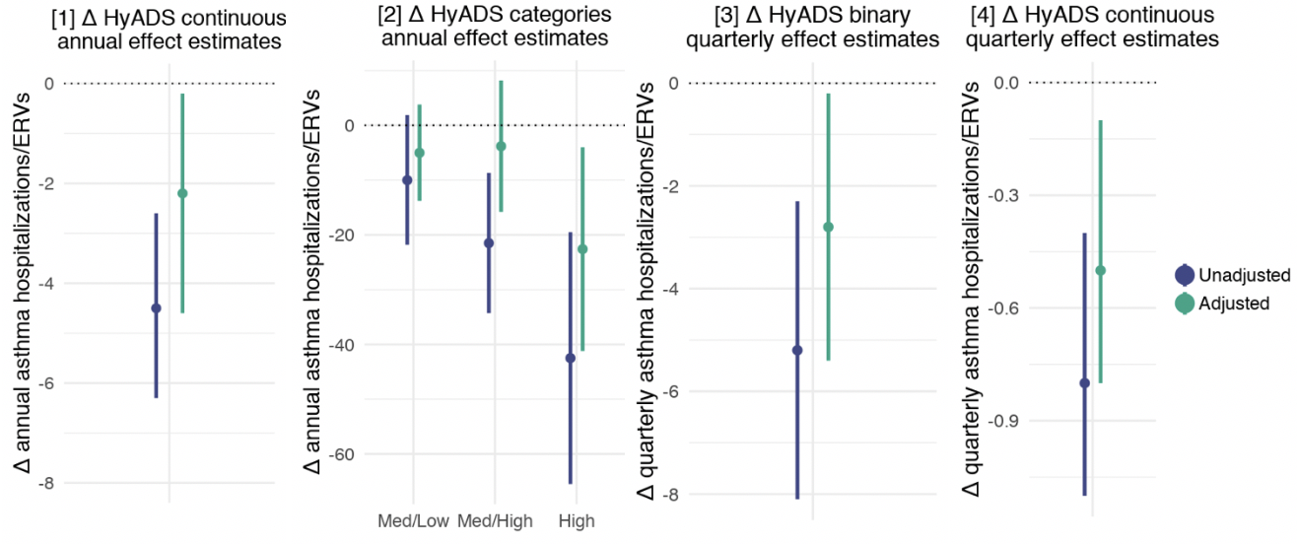
Zip code level results – alternative specifications
Notes:
We estimated that a high level of change induced by the Q2-2015 energy transition reduced asthma hospitalizations/ERVs by 2.8 visits per ZIP code per quarter relative to areas where the transition induced a low level of change.

Slide 44
Individual-level analyses

Slide 45
Propeller health
Source: Propeller Health

Slide 46
Mill creek scrubber event

Slide 47
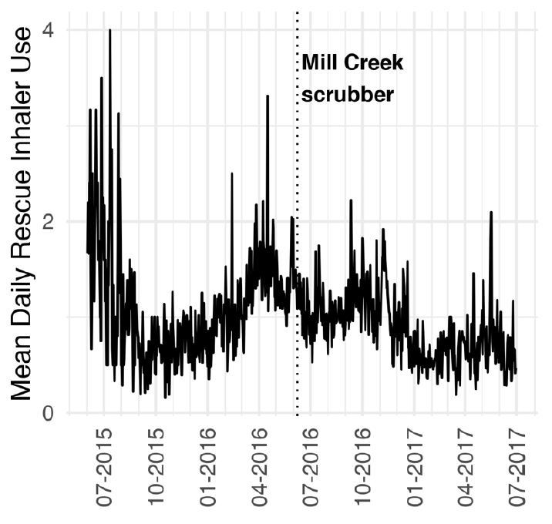
Rescue inhaler use over time

Slide 48
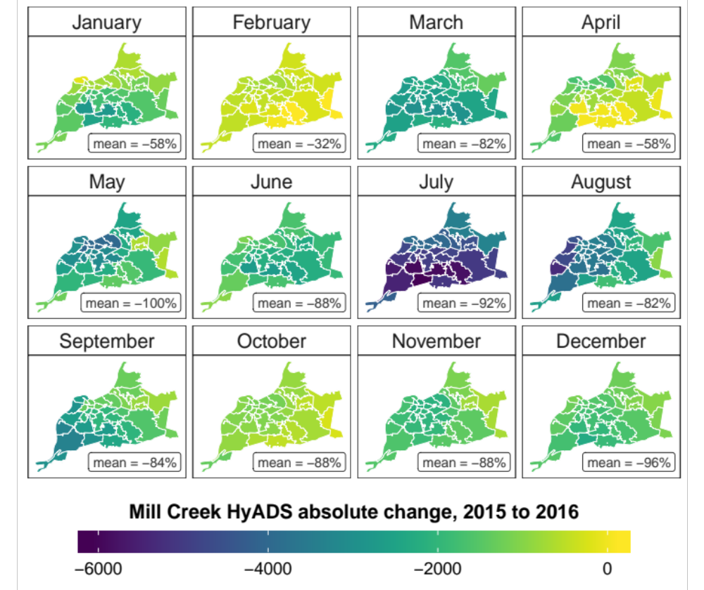
Similar reduction county-wide

Slide 49

Inhaler use $={exp(β}_{0}+β_{1}T+$
$$β_{2}control+β_{3}T∗control)$$
T
control
T * control
Notes:
Interrupted time series design
People serve as their own controls

Slide 50
RR = 0.83,
95% CI: 0.69, 1.00
RR = 0.98,
95% CI: 0.95, 1.01
Notes:
Monthly average daily rescue inhaler use before and after the June 2016 Mill Creek SO₂ scrubber installation. Orange represents the period prior to the scrubber installation and navy blue after. Points are average monthly daily predicted SABA use from the adjusted model with a LOESS line.

Slide 51
Quasi-experimental designs
Our KY study
Background on coal-fired power plants and health
Where we are headed

Slide 52
Policy implications
Coal plants as of 2017
Notes:
Coal produced about 30% of U.S. electricity in 2017
Health benefits of replacing oil and coal electricity generation with other fuel types
The U.S. EIA has identified nearly 7000 MW of coal and oil capacity in 8 states slated for retirement in 2018 alone. Future retirements will provide opportunity for additional health studies.

Slide 53
Thank you
Jason G. Su, Ralph Catalano – UC Berkeley
Lucas Henneman – Harvard University
Corwin Zigler – UT Austin
Andreas M. Neophytou – Colorado State University
Yu-Ting Chen, Sarah S. Moyer –
Louisville Metro Department of Public Health
Veronica Combs, Ted Smith – University of Louisville
Grace Simrall –
Louisville Metro Office of Civic Innovation
Rahul Gondalia, James Sublett, Meredith A. Barrett
– Propeller Health
Funding sources
Robert Wood Johnson Foundation
AIR Louisville
The National Institute of Environmental Health Sciences grant K99ES027023

Slide 54
Coal-fired power plant changes result in fewer asthma events.
Do these changes reduce health disparities?

