Slide 1
Using NAB Data to Understand the Allergic Pollen Season
Fiona Lo
fionalo@uw.edu
Dept. of Atmospheric Sciences, University of Washington
CSTE Climate and Respiratory Health Webinar
Aug 7, 2018

Slide 2
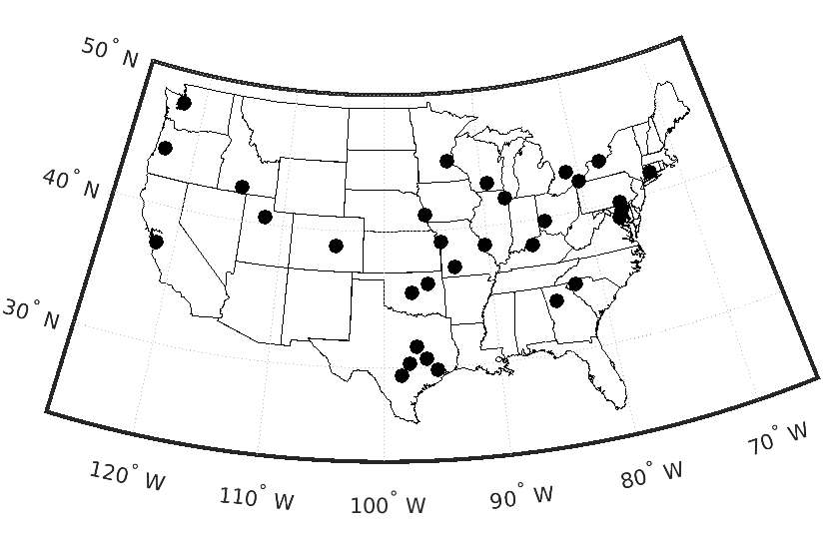
NAB Pollen Station Observations
National Allergy Bureau (NAB)
  2003-2017
  Daily pollen concentration (grain/m3) of allergenic pollens.
  38 different pollen types (genus, family)
Data Challenges:
  difficulty in obtaining data
  non-daily, irregular data collection
  start collecting after pollen season has already begun
32 stations (out of 51): average more than 3 days/week between Mar 1 – Oct 1; more than 2 years.
Notes:
Pollen stations are sparsely located in the west.
AAAAI: American Academy of Allergy, Asthma and Immunology
2

Slide 3
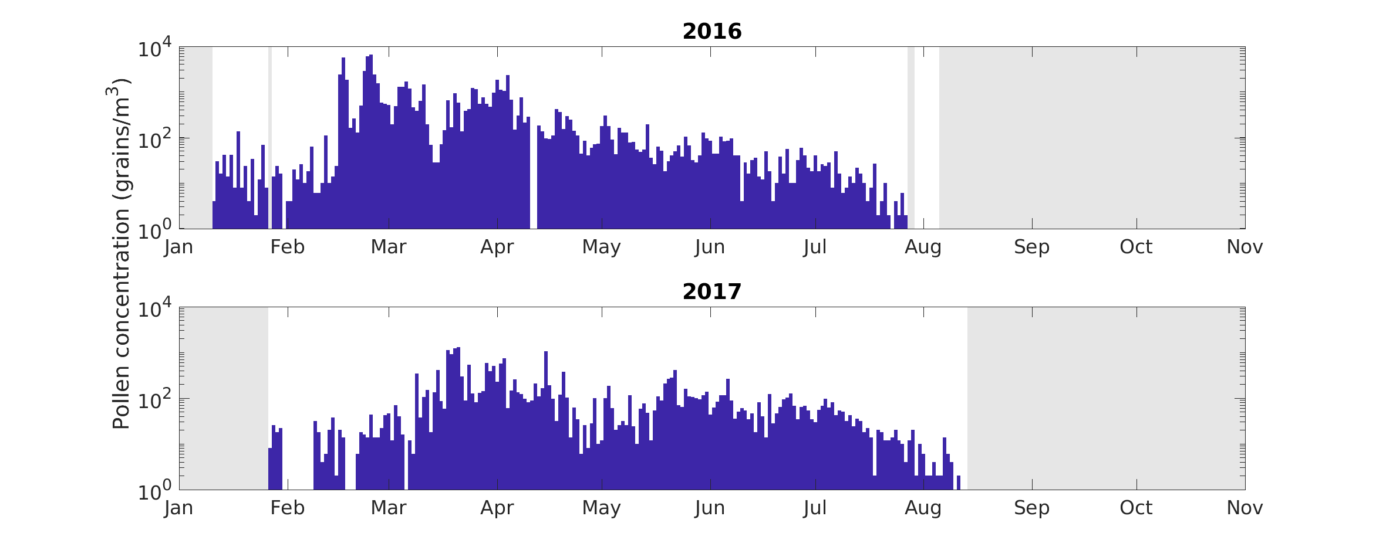
Pollen concentration: Seattle
Notes:
Pollen conc is log scale
Grayed out area = no data collection: start in Jan. end in late summer
Noisy.
2016: When start counting, already in the 10s. Ramps up mid-lat Feb.
Not quite as high in 2017, and ramps up later in mid-Mar

Slide 4
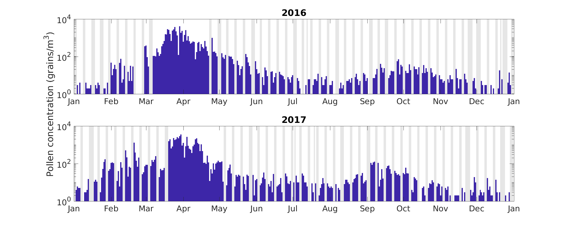
Pollen concentration: Atlanta
Notes:
Don’t collect data on weekends, except in the middle of the season.
Year around detectable levels of pollen
Major peak – tree. Minor peak in fall - weeds

Slide 5
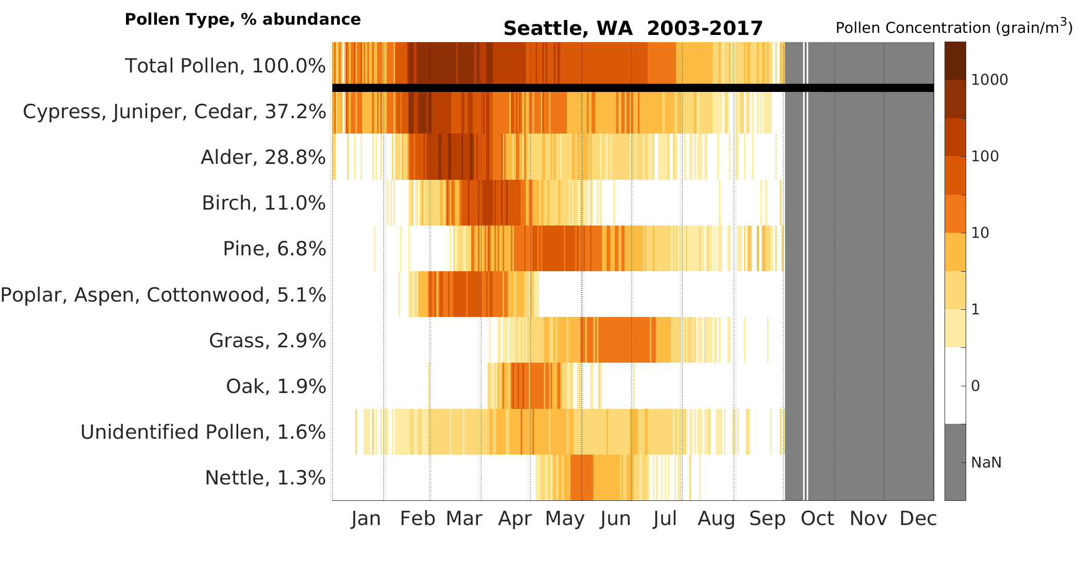
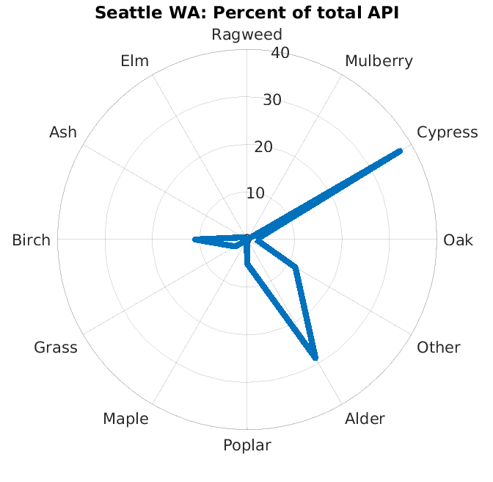
Pollen Calendar: Seattle
Notes:
Daily mean climatology. Log scale
I’ve ordered the pollen type by abundance
Each pollen type has it’s season. Ramp up and dormant period
Cypress Family – earliest pollen
Spider plot – identified 11 most important allergenic pollens in US. This shows % of each at each location
Transition: Pollen calendar for every location is different
5

Slide 6
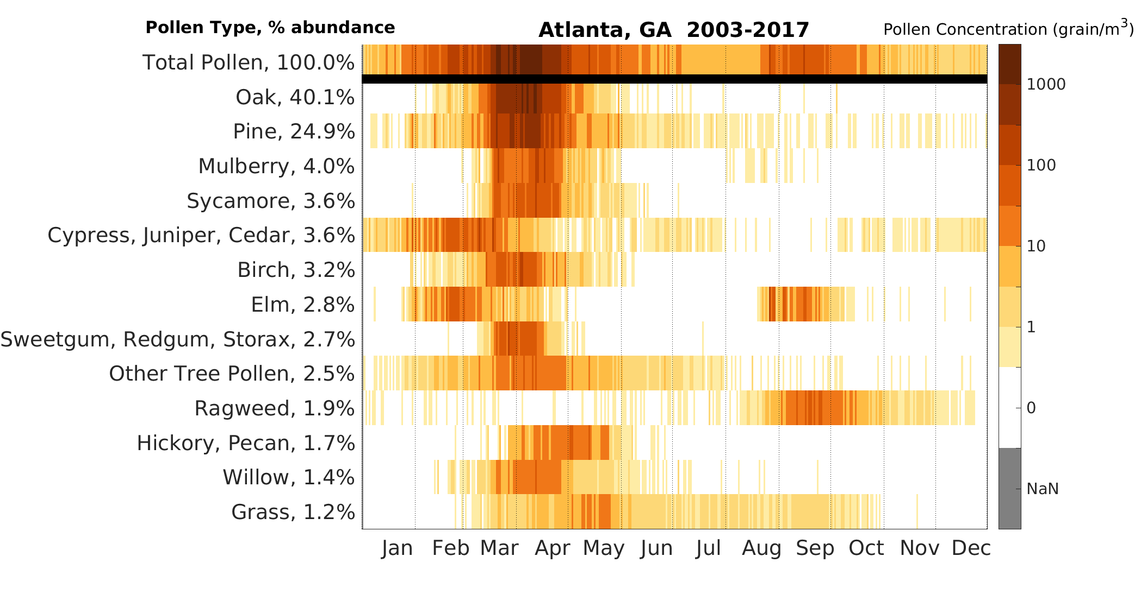
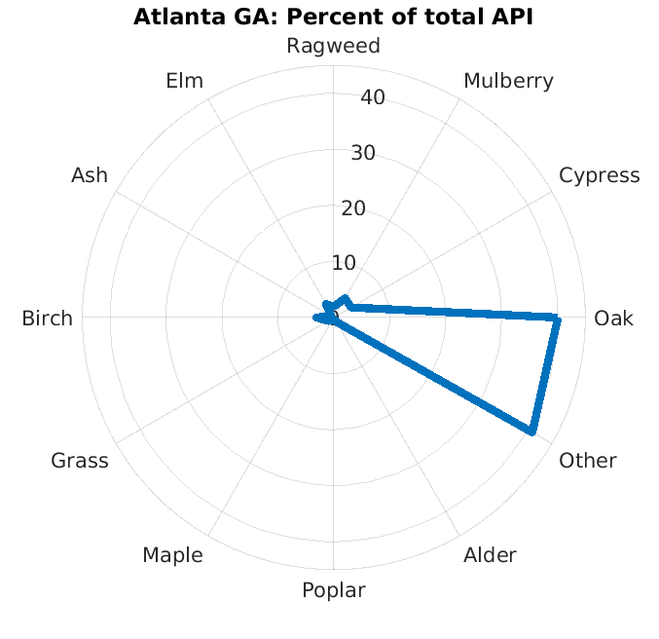
Pollen Calendar: Atlanta
Notes:
Pollen calendar looks different in Atlanta. Different pollen types are abundant
Pine = not very allergenic, but are an irritant so can exacerbate symptoms. big and yellow
Ragweed – fall
Cypress Family – earliest pollen
Elm – later……

Slide 7
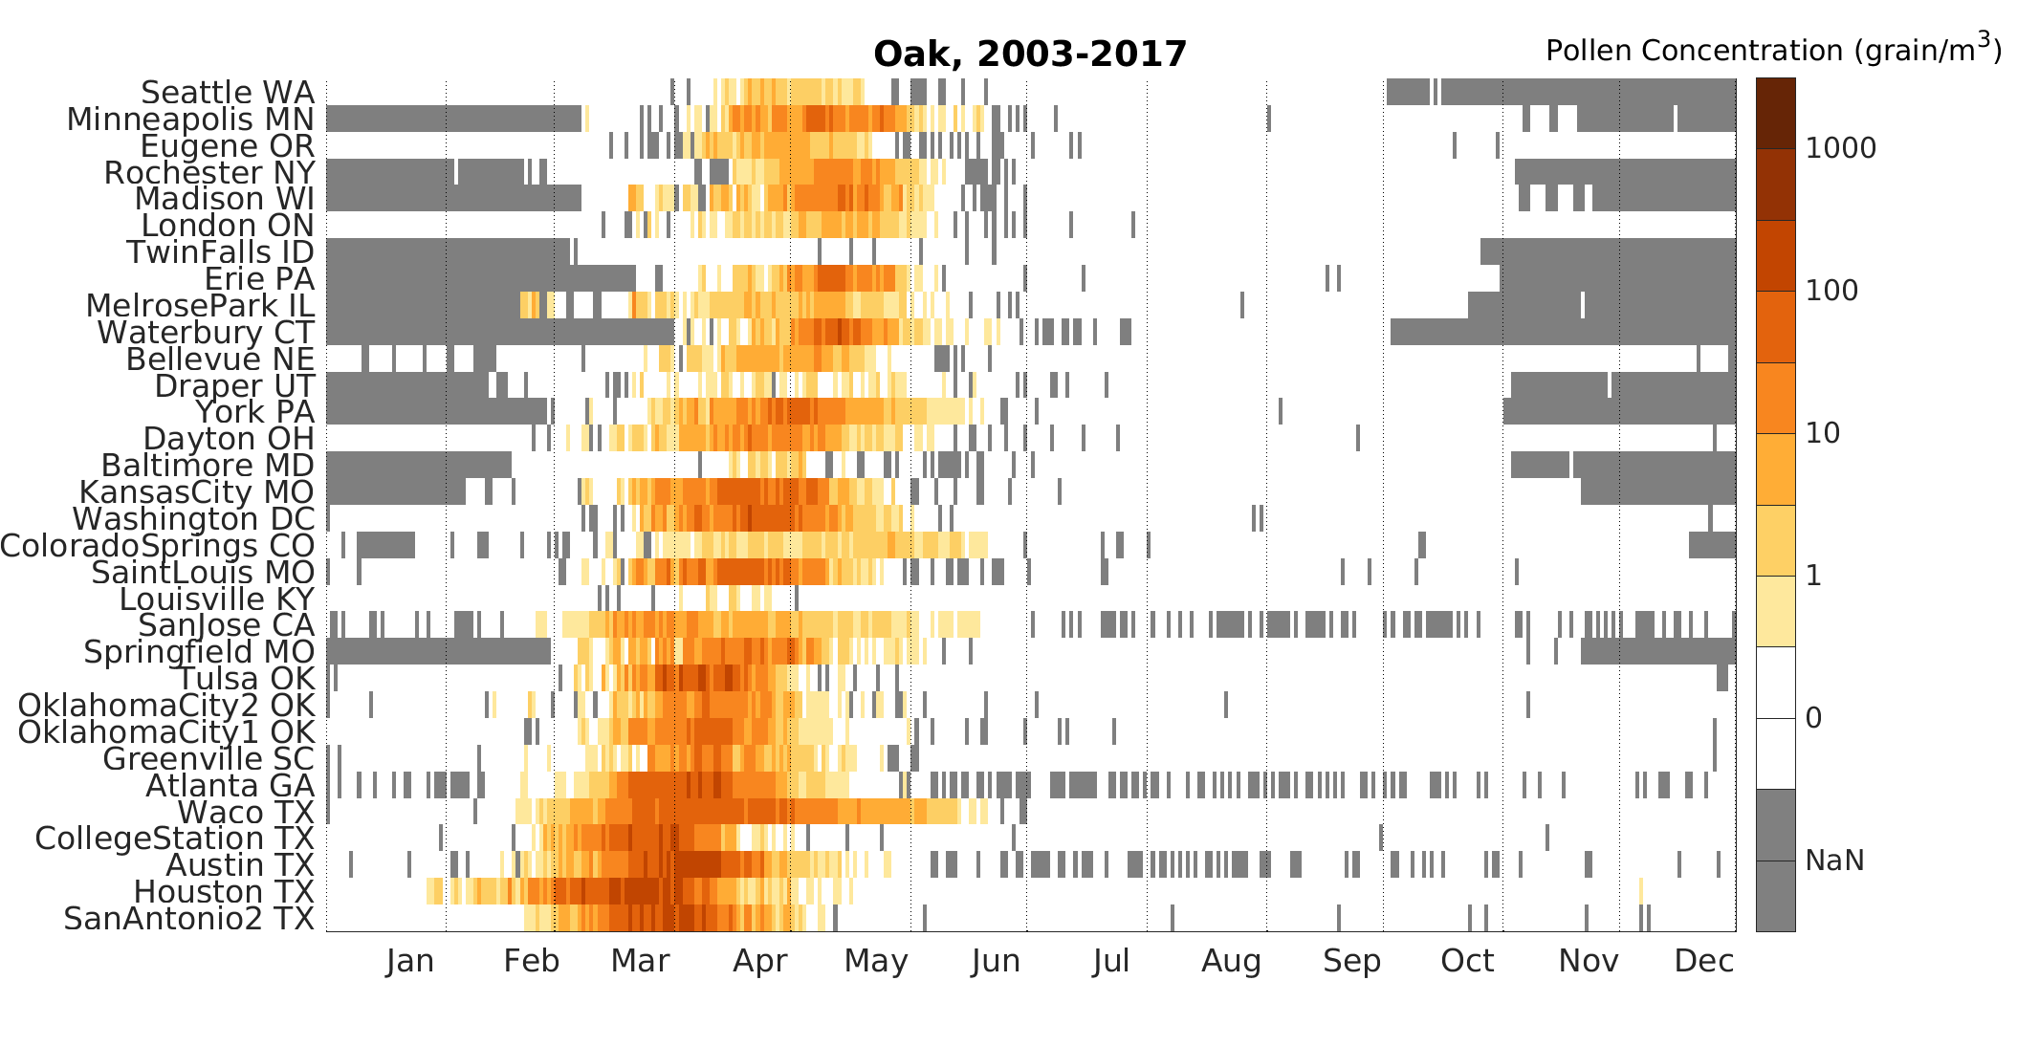
Pollen Calendar: Oak
North
South
Pollen season is later at higher latitudes
Higher concentrations at lower latitudes
Notes:
Another way of looking at this is for a specific pollen type for various locations
Oak – most abundant allergenic pollen in US
Latitude dependence is representative of a lot of tree pollens
7

Slide 8
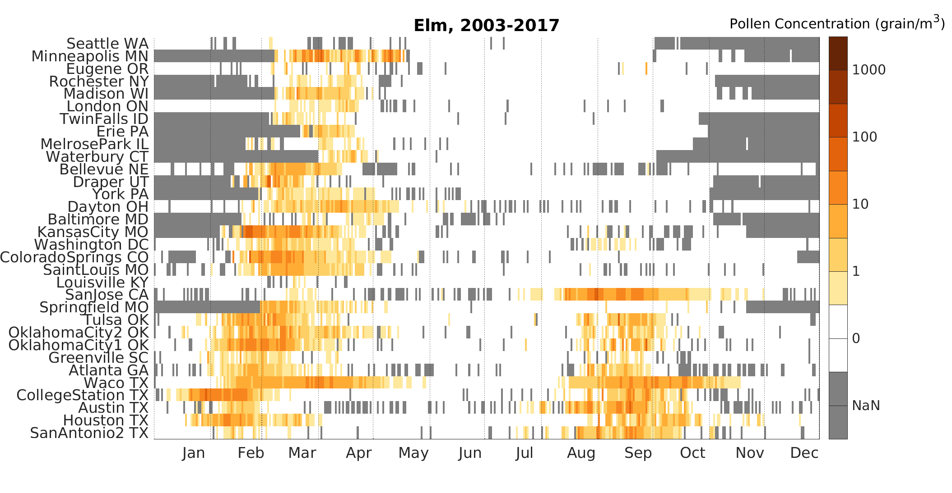
Pollen Calendar: Elm
North
South
Spring and Fall pollinating species
Notes:
Different signature than other tree pollens.
Fall pollinating – Chinese elm in lower latitudes
One allergist had no idea that elms pollinated in the fall as well.
8

Slide 9
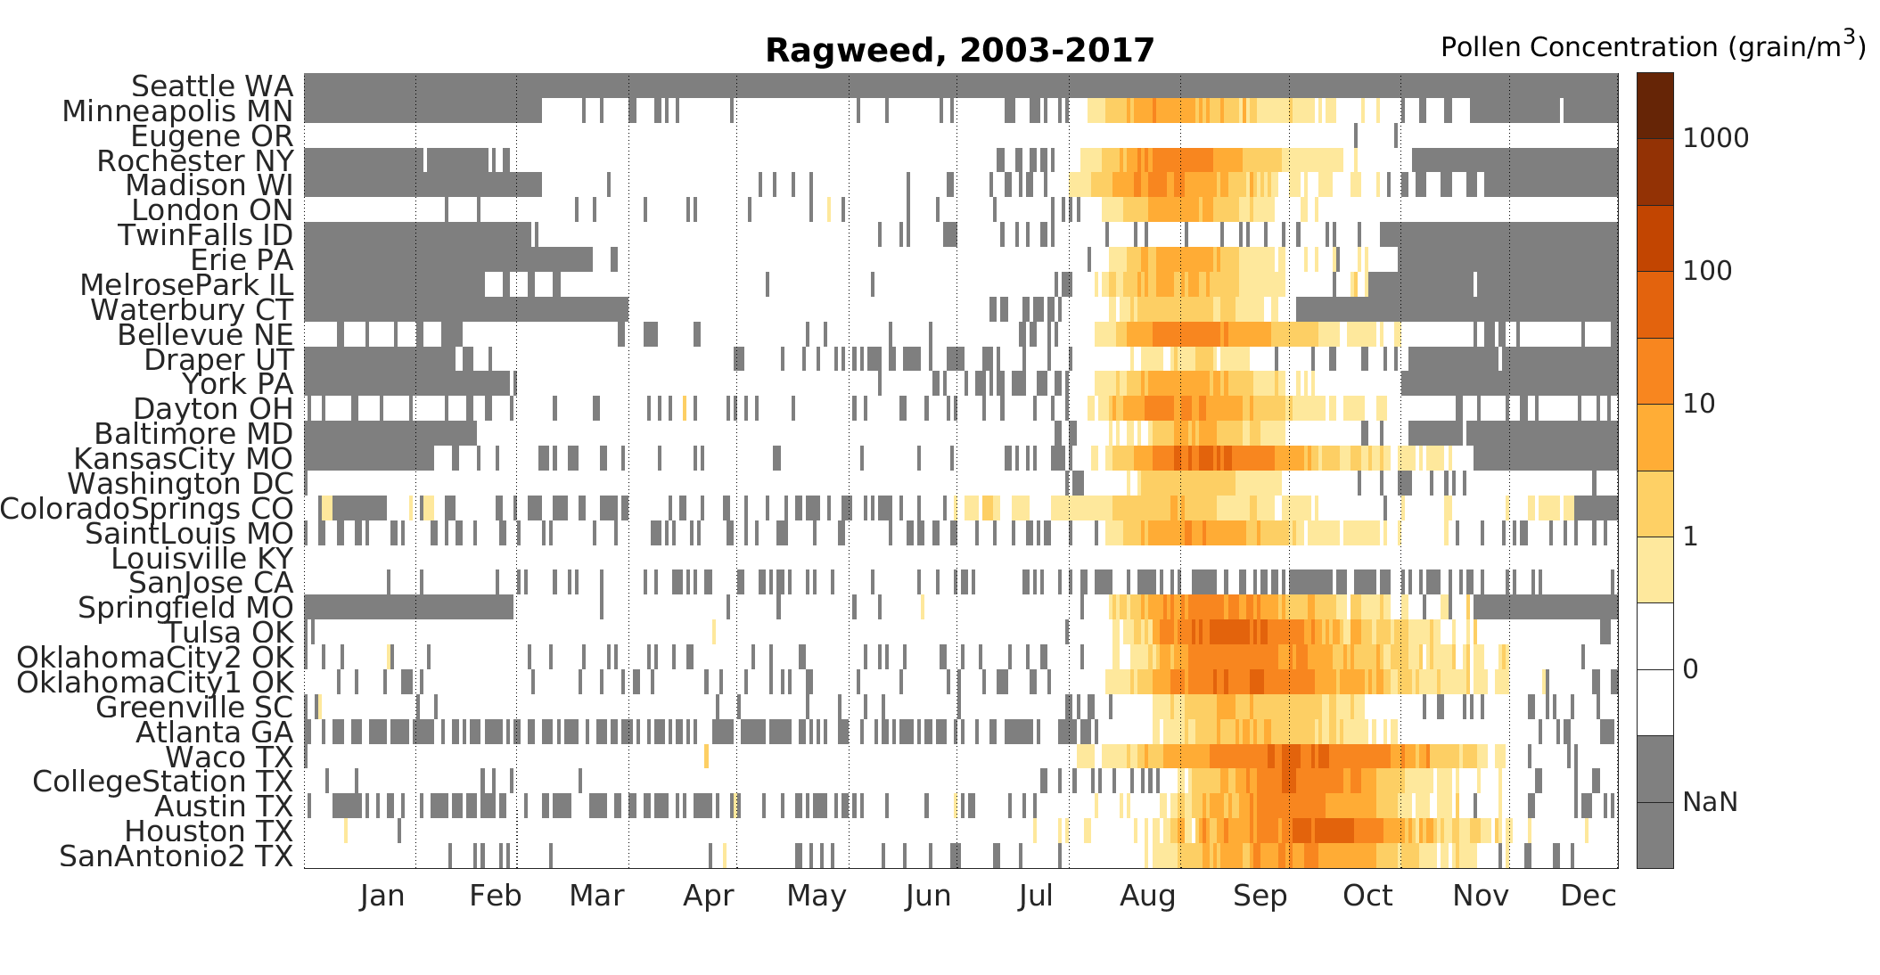
Pollen Calendar: Ragweed
North
South
End date of ragweed season dependent on first frost
Season is longer at lower latitudes
Notes:
Ragweed- very allergenic.
Short day plant – flowering when days get shorter
Transition: now that we know what the pollen data looks like – define some meaningful, quantitative indices

Slide 10
Start Date of Pollen Season: Definition
Start Date was defined with allergic symptoms in mind.
the sum of daily pollen concentration from Jan 1* reaches 50 grain-days/m³
* usually Jan 1, but earlier for early pollinating types (e.g. Cypress)
If total annual pollen concentration <2000grain/m3 then use date at which the sum of pollen concentration from Jan 1 reaches 2.5% of the historical mean.
Notes:
Jan 1 is used because it’s during the dormant period for most pollen types.
10

Slide 11
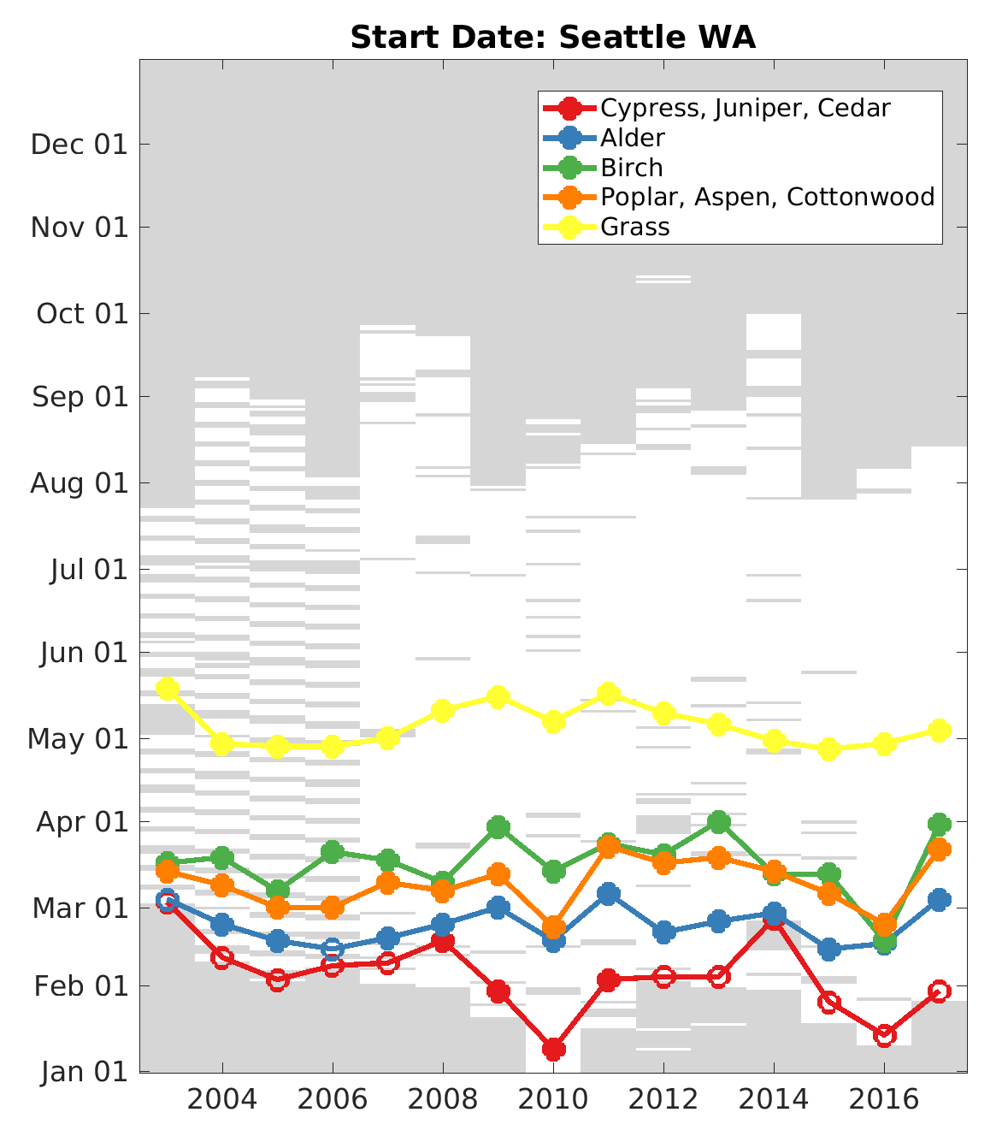
Start Date: Seattle
Open circle = less than 7 days of measurements between the first day of data collection and the pollen start date.
Missing data is a problem.
Notes:
Start date on y- axis
5 most abundant pollen types in Seattle
11

Slide 12
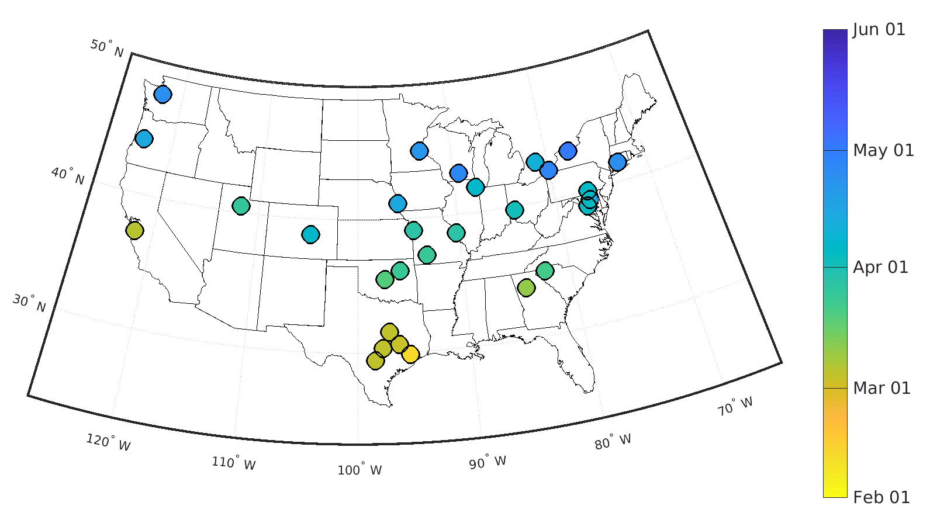
Pollen Map: Mean Start Date of Oak
2003 -2017
Notes:
Another way of looking at this
1. Clear signal of start date
2. Note 3 west coast stations that have earlier start date than stations with same latitude
Hint: Give an idea that it’s not just latitude determining start date – temperature with continental and marine climate
12

Slide 13
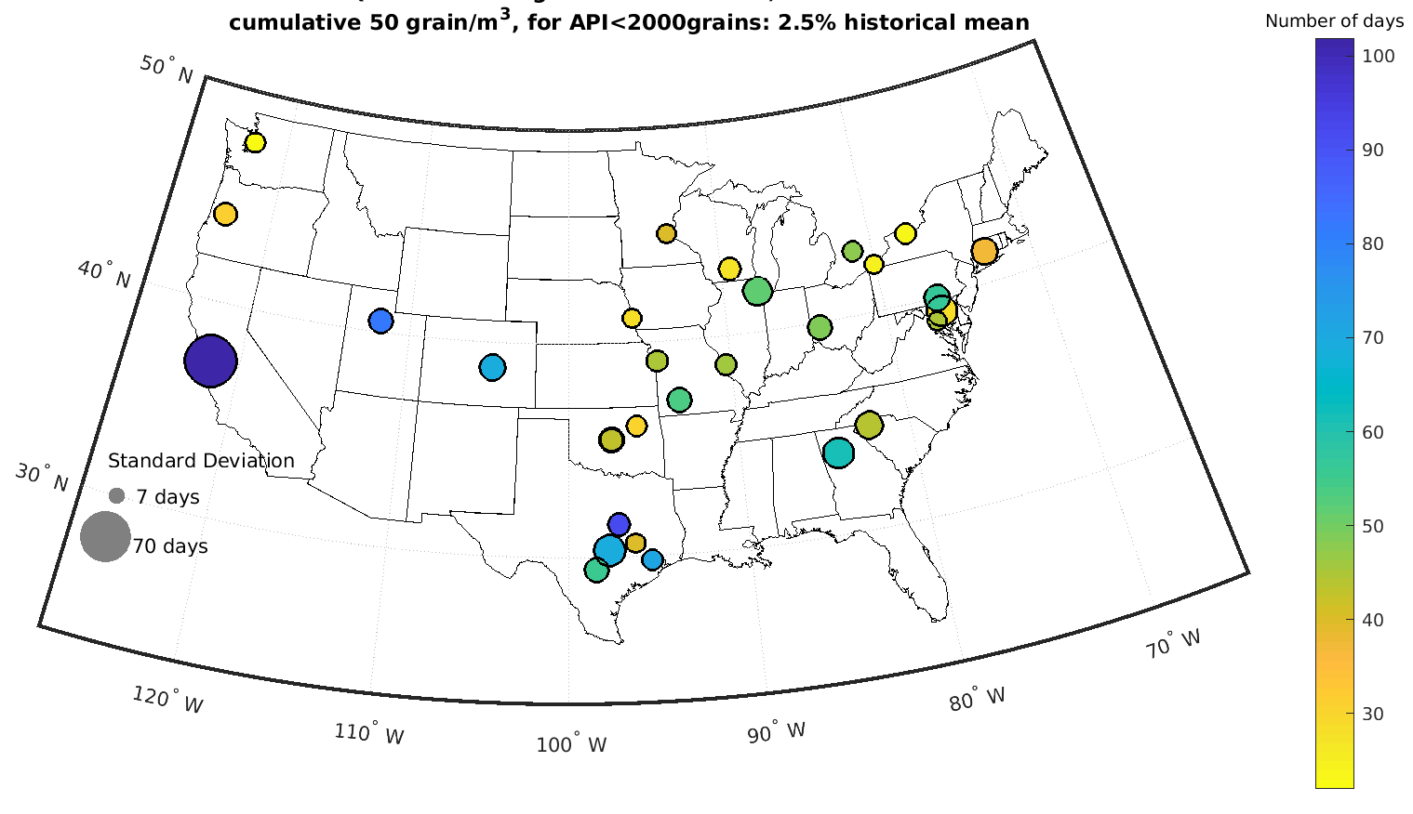
Pollen Map: Mean Season Duration of Oak
2003 -2017
Notes:
Duration = end date – start date
Surprising that it doesn’t depend on latitude.
I thought that warmer temps = longer pollen season
13

Slide 14
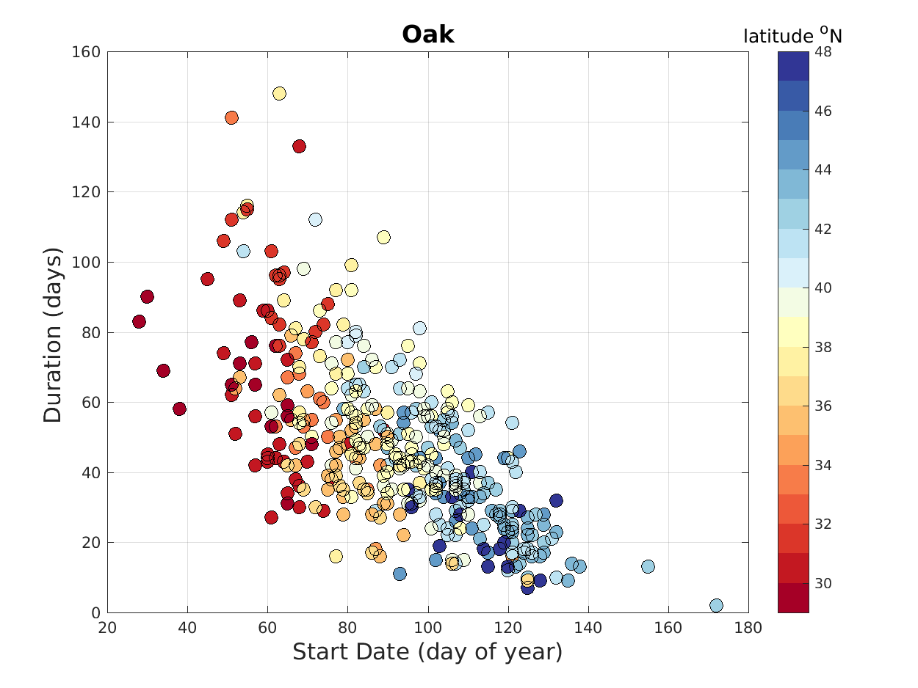
Oak : Mean Start Date vs Mean Duration
32 NAB stations, 2003 -2017

Slide 15
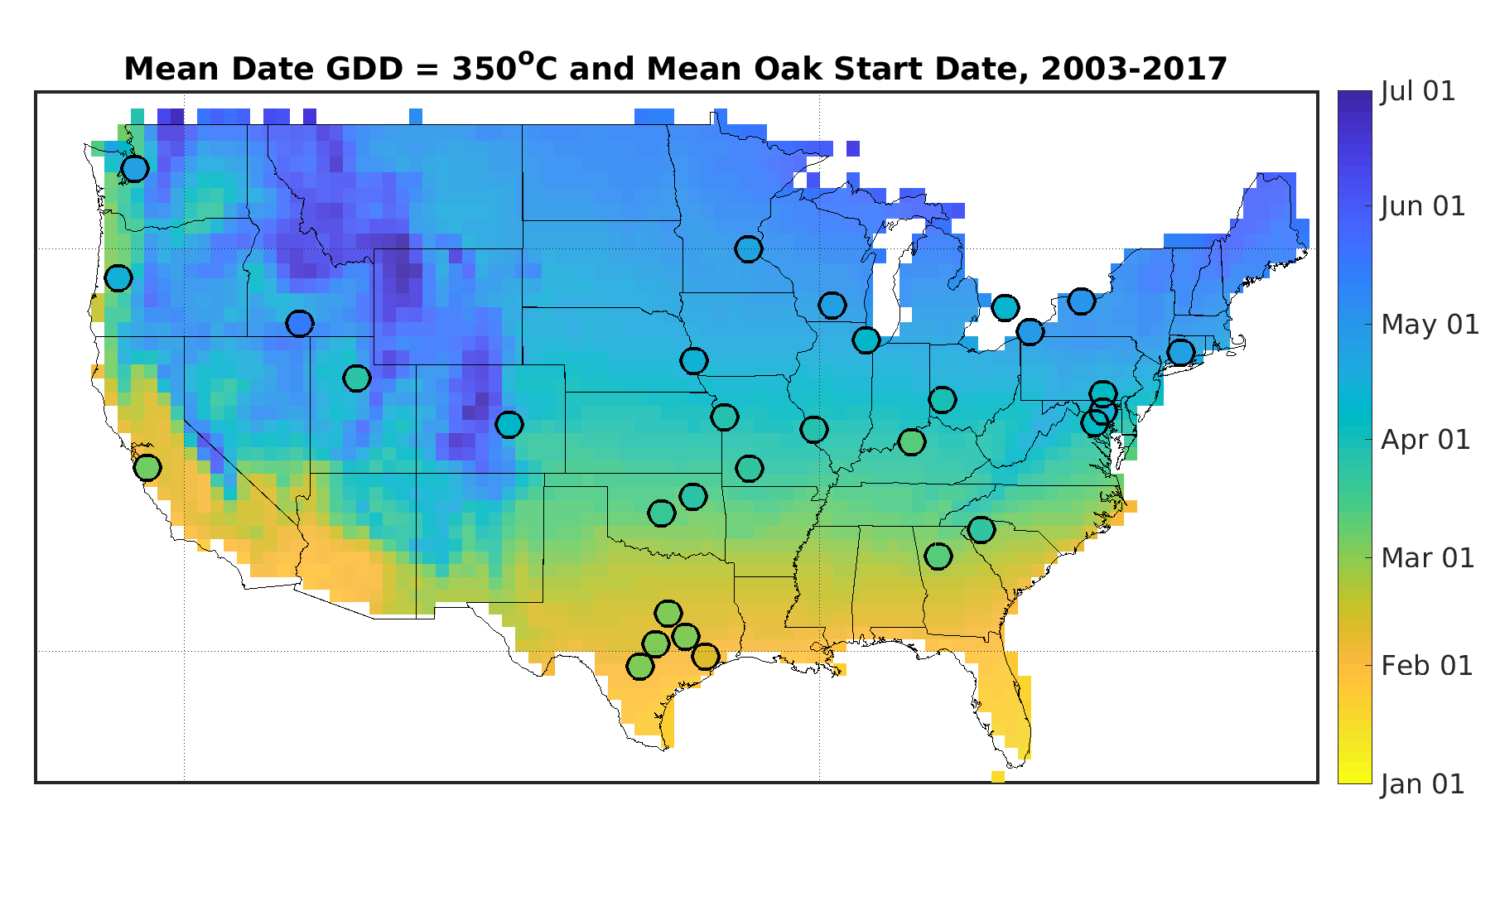
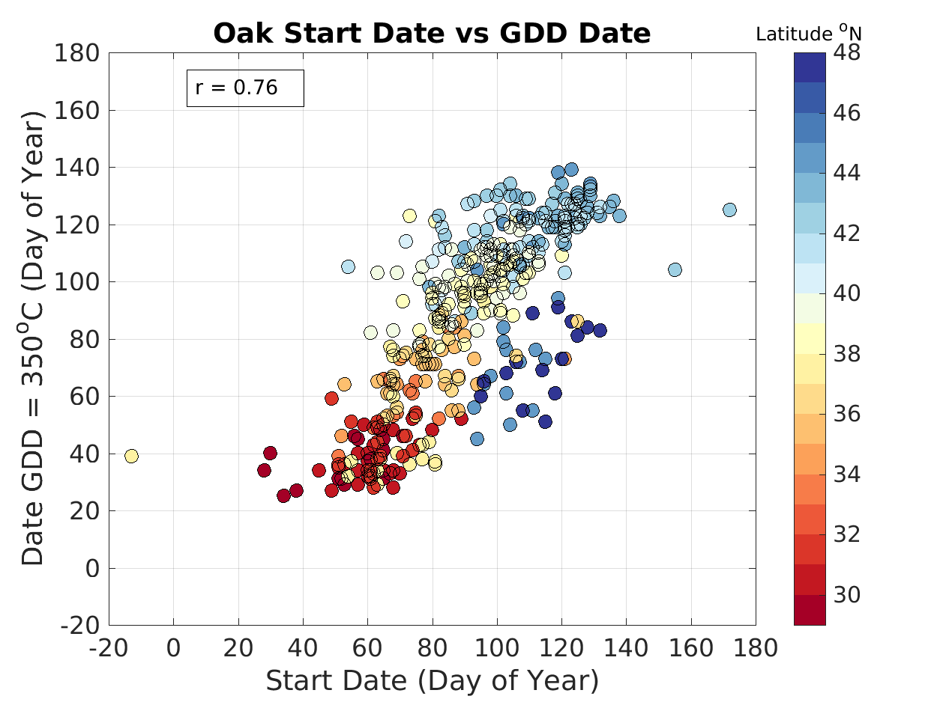
Growing Degree Days and Oak Start Date
Growing degree days and oak start date are significantly correlated over all stations
Notes:
GGD is a heat index used by agriculture, horticulturist, gardeners to predict plant development.
For every GGD threshold temperature is an corresponding date.
Pick 350C because other research on oak have found budburst between 100-400 GGD
Warmer in the south, GDD date earlier in the south
Good correlation between start date and GDD.
Look at every station every year (15 yrs) sig 99%
15

