Slide 1
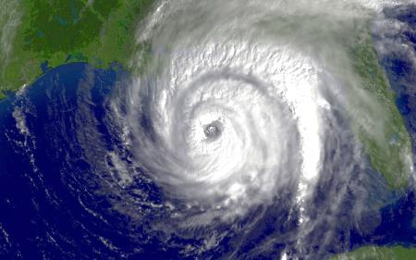
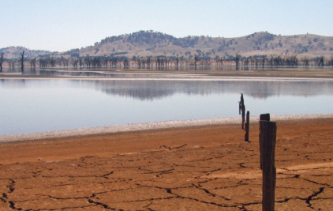
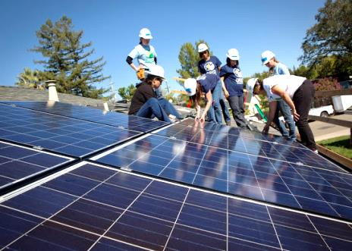
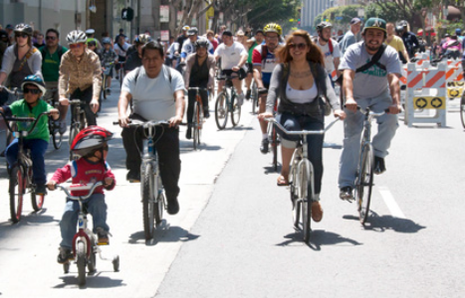
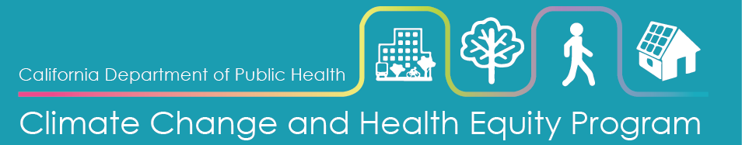
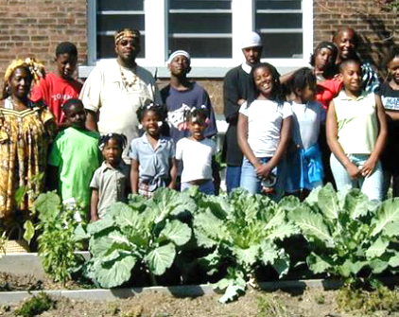

California’s Wildfire Hazard & Vulnerable Populations
Image: NOAA.gov
Image: drought.ca.gov
August 7, 2018
Council of State and Territorial Epidemiologists
Climate & Respiratory Health Working Group Webinar
Image: CA Energy Commission
Jason Vargo, PhD, MPH, MCRP
Lead Research Scientist
Climate Change & Health Equity Program
Jason.Vargo@cdph.ca.gov
Notes:
Climate change, including wildfires, is expected to bring with it a number of direct and indirect health impacts. Effective planning and preparedness requires that the most vulnerable – the most likely to be hurt first and worst when wildfires do occur, be identified, understood, and that planned responses be designed to adequately protect them.

Slide 2

California Department of Public Health
Climate Change and Health Equity Program
CalBRACE
Climate Change and Health Vulnerability Indicators
https://www.cdph.ca.gov/Programs/OHE/Pages/CCHEP.aspx
https://www.cdph.ca.gov/Programs/OHE/Pages/CalBRACE.aspx
https://discovery.cdph.ca.gov/ohe/CCHVIz/
Notes:
The Climate Change and Health Equity Program sits in the Office of Health Equity within the California Department of Public Health.
CCHEP’s mission is to embed climate change and equity within the practice of public health, and to embed health and equity in the many activities and policies around climate change in California.
The CDC-funded, CalBRACE program provides resources and technical assistance for the state and local public health departments to build climate adaptation capacity and enhance resilience at the local and regional levels.
CalBRACE has curated a list of indicators for the entire state that help us identify vulnerable populations across the state to assist in local adaptation planning to protect human health.

Slide 3
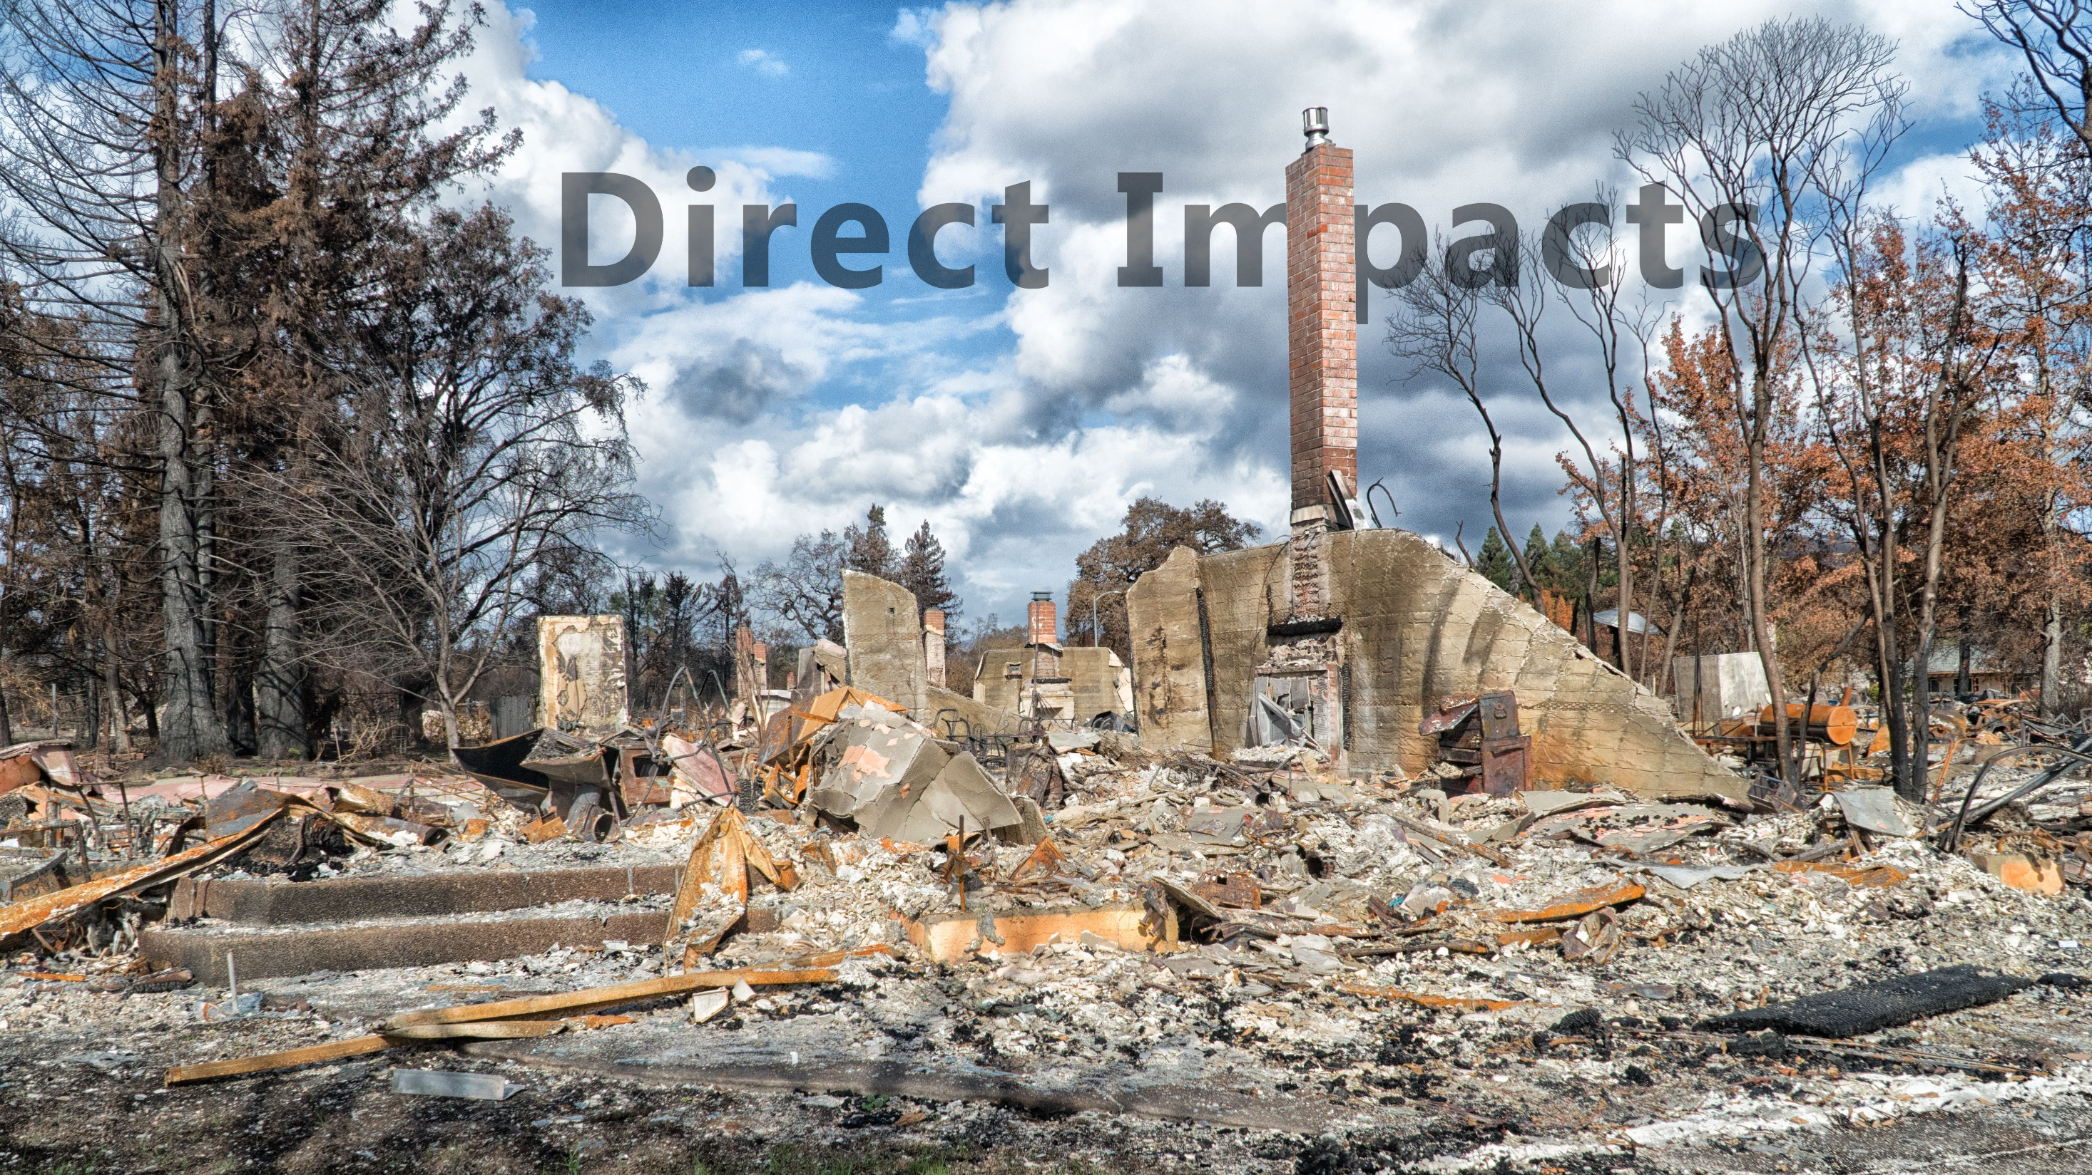
Burns (injury and death)
Health care system (increased pressure)
Displacement & Traumatic stress
Notes:
There are many health impacts associated with wildfires, some are more direct, immediate and local.
Residents in close proximity to fires face risks of burn injuries, heavy smoke inhalation, and in the most severe cases death.
The timing and magnitude of these impacts can place considerable burden on the important critical infrastructure of the healthcare system.
Also, loss and displacement are real for many households and with it traumatic stress that can last for a lifetime.
The occupational hazards of fighting wildfires may be many times greater than for others given the length and intensity of exposures.

Slide 4
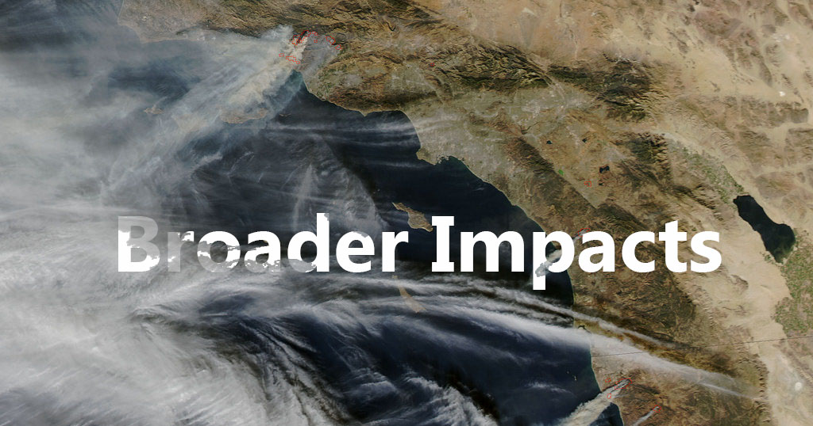
Smoke (Asthma & cardiovascular disease)
Erosion and landslides
Toxic cleanup
Notes:
The impacts of wildfires can be felt far from the actual sites and burn scars. Exposure to air pollution from fires - fine particulate matter – can occur hundreds of miles downwind.
Other indirect and lingering effects of wildfires include landslides and the impacts of erosion and sediment loading into waterways once rains hit burned areas.
Toxic occupational hazards also exist for workers involved in cleanup efforts.

Slide 5
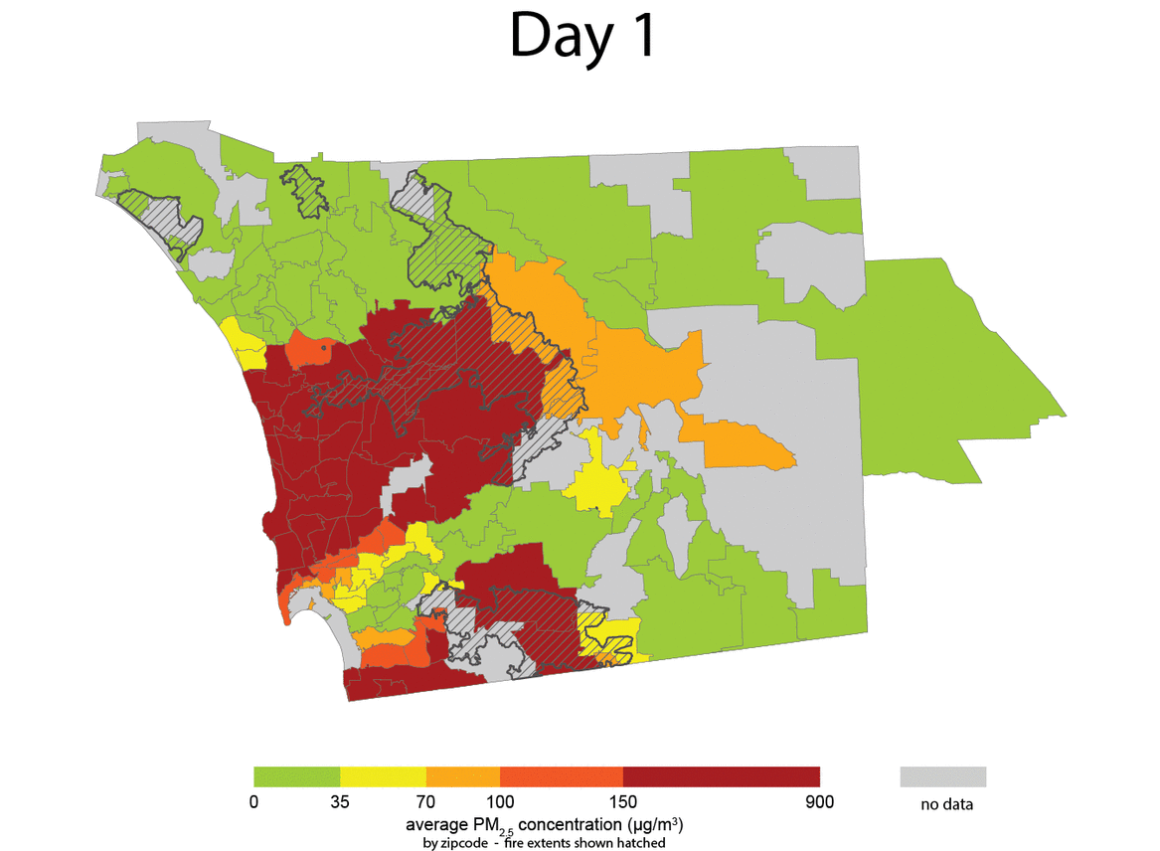
Wildfire Smoke Concentrations
2007 San Diego Firestorm
Hutchinson, Justine A., Jason Vargo, Meredith Milet, Nancy HF French, Michael Billmire, Jeffrey Johnson, and Sumi Hoshiko. "The San Diego 2007 wildfires and Medi-Cal emergency department presentations, inpatient hospitalizations, and outpatient visits: An observational study of smoke exposure periods and a bidirectional case-crossover analysis." PLoS medicine 15, no. 7 (2018): e1002601.
Notes:
This animation show the concentrations and movement of wildfire-related fine Particulate matter over the 5 days of the 2007 San Diego Firestorm. This work was part of a recent analysis CDPH conducted with researchers from Michigan Tech University.
In this study we found a 136% increase in ED visits among children (Medi-Cal recipients) aged 0-4 and a 243% for children under the age of 1.

Slide 6
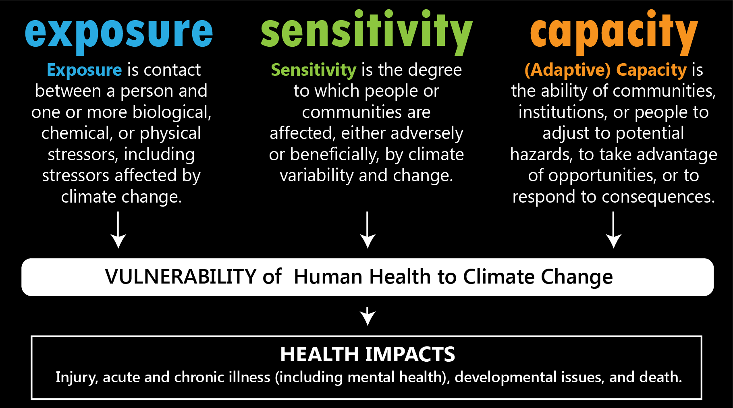
Notes:
To identify and understand vulnerability we use a common framework involving 3 facets. Considering these factors together is important to adaption work as it attempts to understand vulnerability and the flip side of the same coin, resilience.
Exposure describes the proximity and timing between populations and climate stressors. For example where we see people living in or near locations where we expect more frequent or intense wildfires.
Sensitivity factors help identify populations that succumb to adverse health effects more quickly, perhaps related to physiological characteristics. For example the elderly, the very young or pregnant women.
Finally the ability of a population to cope with potential hazards describes their adaptive capacity. These can be as simple as a household’s access to resources, connectivity to receive protective information, or ability to escape climate threats.
All three of these factors are socially determined by the person or community’s degree of privilege, power, history, and access to protective goods or risks.
The combination of these multiple factors can explain why some communities face much greater risks from climate change than others.

Slide 7
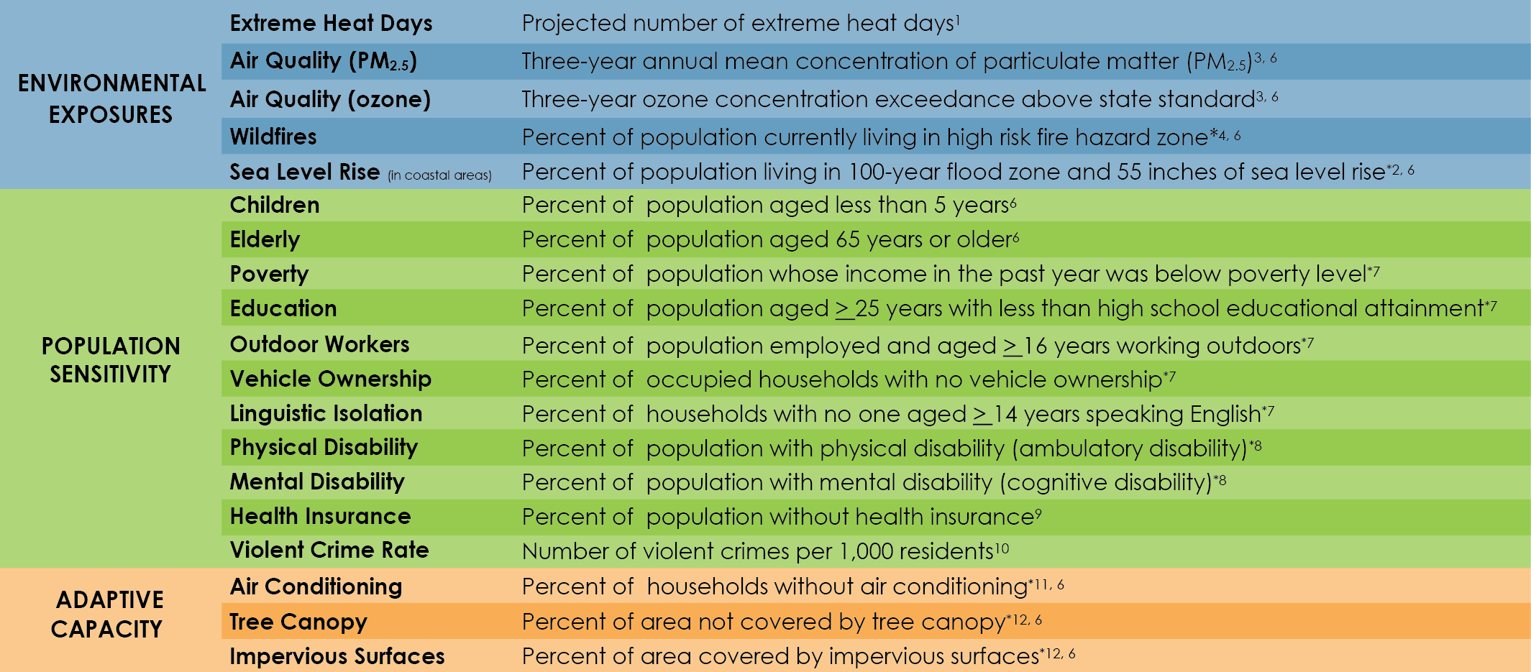
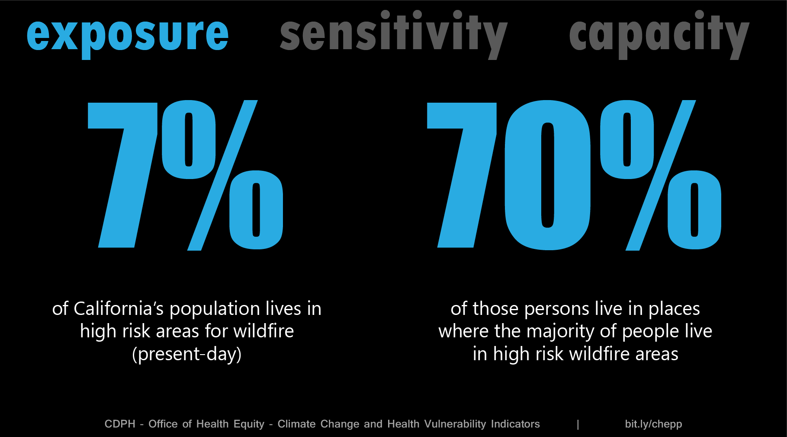
Notes:
Our Climate Change and Health Vulnerability Indicators are organized along these lines. You can find all of the data at various geographies for the state and descriptions of these indicators at our website.

Slide 8
Notes:
With regard to exposure, we examine the percent of the population in all of California’s census tracts that live in high risk WF zones (according to CalFIRE’s designations).
About 7% of CA’s nearly 40M people live in high risk WF zones. (2.7M people)
Wildfire exposed populations are not evenly distributed throughout the state. They are fairly concentrated. Looking at just the census tracts where 50% or more of the people live in High Risk WF zones, we find this is also just about 7% of the state’s more than 8000 tracts. BUT, those places house more than account for over 70% of California’s high risk exposed population.
This is good news for targeting interventions to protect those communities and may offer opportunities for focusing communities on collective actions.

Slide 9
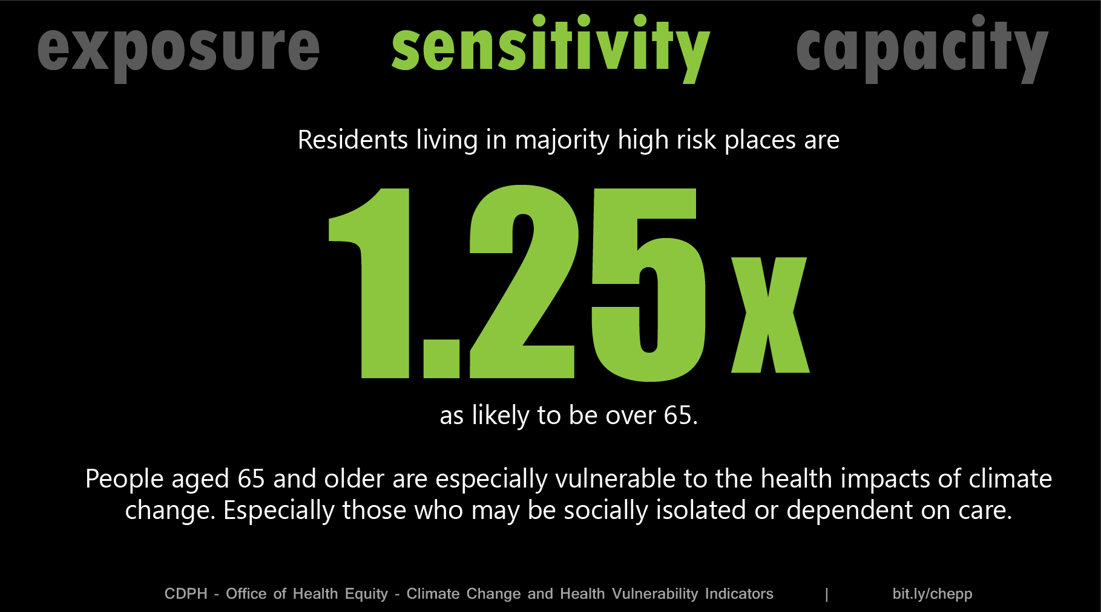
Notes:
The elderly, very young, and those with existing conditions like asthma tend to be most sensitive to the impacts of WF.
From the maps of WF risk for the state, we know Wildland Urban Interfaces and forested areas are more at risk. When we examine the populations living there we also see concentrations of elderly.
A person living in those tracts mentioned on the previous slide (where more than half of the people live in high risk WF zones) are 1.25 times as likely to be aged over 65 than in the rest of CA.
The elderly may suffer from chronic conditions that reduce lung function, are more likely to live alone, and to require assistance with evacuation. A study of the 2015 fire season in California found those over 65 to be most affected by dense smoke, with a 22% increase in coronary heart disease and a 42% increase in heart attacks 1 day after exposure.

Slide 10
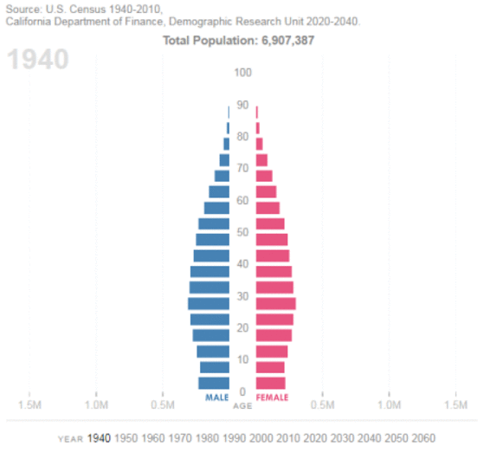
Notes:
This is especially important as California’s population ages, with the Baby Boom generation growing substantially by 2030.

Slide 11
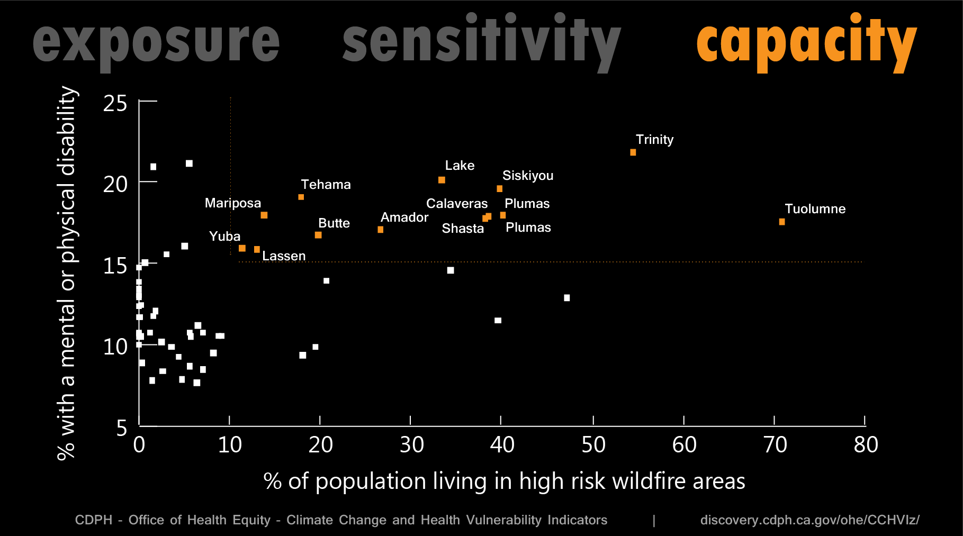
Notes:
Lastly, many factors can impact someone’s ability to cope when faced with a disaster.
While some of these factors may not be more likely in high-WF-risk generally, there are still areas of the state where we see the confluence of exposure and lack of adaptive capacity.
This plot displays county-level WF exposure in relation to prevalence of a mental or physical disability. Counties in the top third of all California counties for both indicators are the orange points. Similar examinations could be done for children and wildfire, or combined with additional data to look at sensitivity variables, like asthma prevalence, and WF hazard.
Those with disabilities face disadvantages if they have limited resources and capacity during the phases of evacuation, response, and recovery.

Slide 12
California Department of Public Health
Climate Change and Health Equity Program
CalBRACE
Climate Change and Health Vulnerability Indicators
https://www.cdph.ca.gov/Programs/OHE/Pages/CCHEP.aspx
https://www.cdph.ca.gov/Programs/OHE/Pages/CalBRACE.aspx
https://discovery.cdph.ca.gov/ohe/CCHVIz/
Notes:
Within CDPH’s Office of Health Equity the
CCHEP embeds health and equity in California climate change planning, and embeds climate change and equity in public health planning.
The CDC-funded, CalBRACE program provides resources and technical assistance for the state and local public health departments to build climate adaptation capacity and enhance resilience at the local and regional levels.
CalBRACE has curated a list of indicators for the entire state that help us identify vulnerable populations across the state to assist in local adaptation planning to protect human health.

Slide 13
California’s Wildfire Hazard & Vulnerable Populations
Image: NOAA.gov
Image: drought.ca.gov
IEPR Workshop August 2, 2018
Jason Vargo, PhD, MPH, MCRP
Lead Research Scientist
Climate Change & Health Equity Program
Jason.Vargo@cdph.ca.gov
Image: CA Energy Commission
Notes:
Surely planning efforst should be taken to protect households from wildfires. More effective measures and plans will consider the specifics of exposure, sensitivity, and capacity to provide for the most vulnerable among us.
And THE MOST EFFECTIVE measures will work to rethink and change the ways that systems that create and foster inequities in society. (these include several that support our survival including food, energy, water, and transport)

