Slide 1
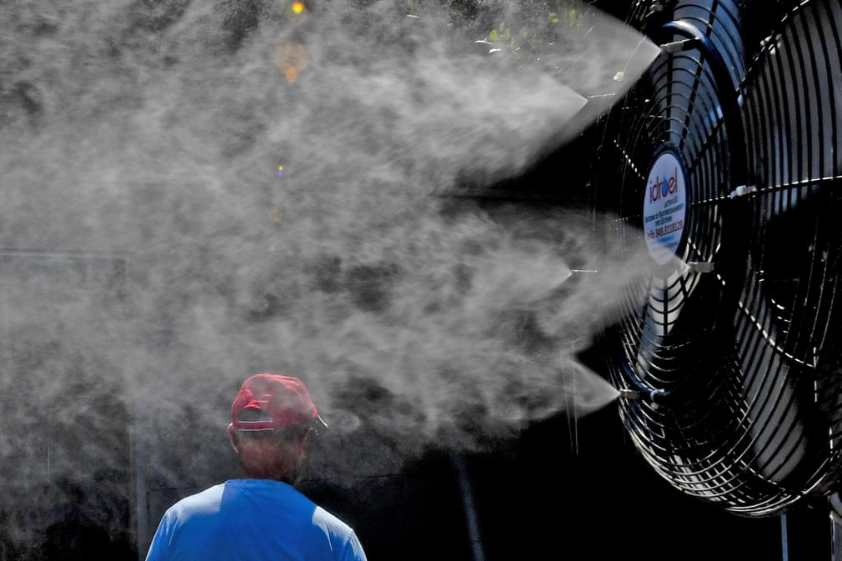
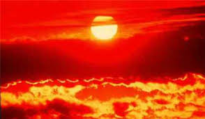
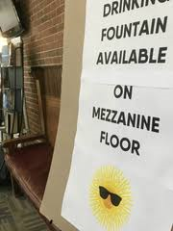
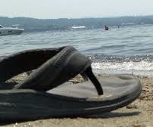

CSTE Climate, Health & Equity Subcommittee
Discussion: Summer 2018 Heat-Related Health Impacts
CSTE Climate, Health & Equity Subcommittee
November 26, 2018

Slide 2
Summer 2018 Heat-Related Health Impacts
Some Heat-Related Health Impacts Questions:
Is the heat wave data gathered timely and actionable?
Is or can data gathered be used to help identify/target immediate interventions to those at greatest risk (during heat wave)?
If extreme heat plans, policies and/or mitigation resources were deployed during Summer of 2018 heat waves, was this reflected in heat wave data collected?
New ideas/strategies for heat wave response?
  New outcomes selected/data sources used
  New partners
  New programs, policies, resources, etc.

Slide 3
Summer 2018 Heat-Related Health Impacts
Discussion Approach:
Discuss 1: Data collected, major observations/conclusions throughout Summer 2018 heat waves
  Major Findings, interesting observations
Discuss 2: What actions were taken, and were the impacts of these actions observed in outcome observations
  Health messaging
  Changes in activity
  Partners involved
  Resources used
  Targeted interventions
Discuss 3: Identify heat-related health impact best practices that can be universalized and employed by most
  Observed successes
  Timing of actions
  Public health guidance to targeted populations
  Hard to reach individuals
  Vulnerable populations
  Challenges encountered
  Development of community/county/region/state-wide Heat-Related Health Emergency Plans

Slide 4
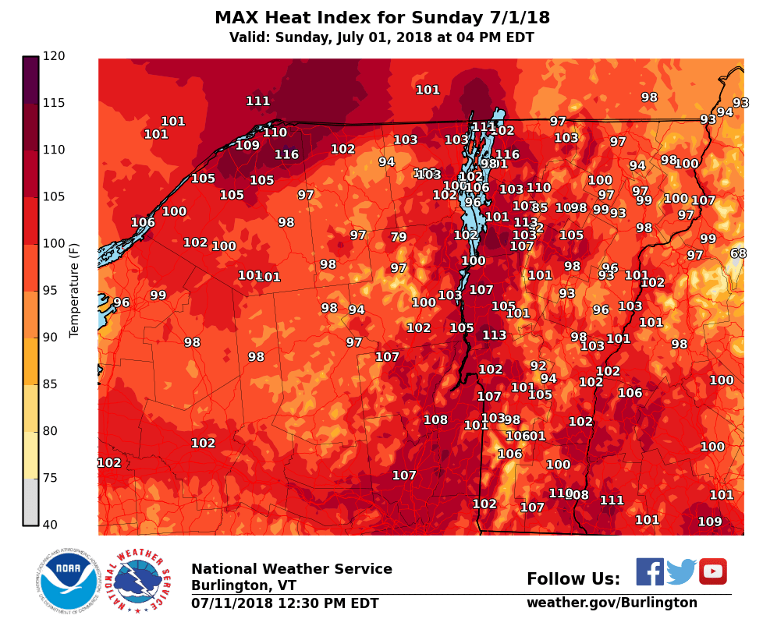
2018
Heat
Wave
Recap
and
Health
Impacts
Jared Ulmer, MPH, AICP
Climate & Health Program Manager
November 26, 2018

Slide 5
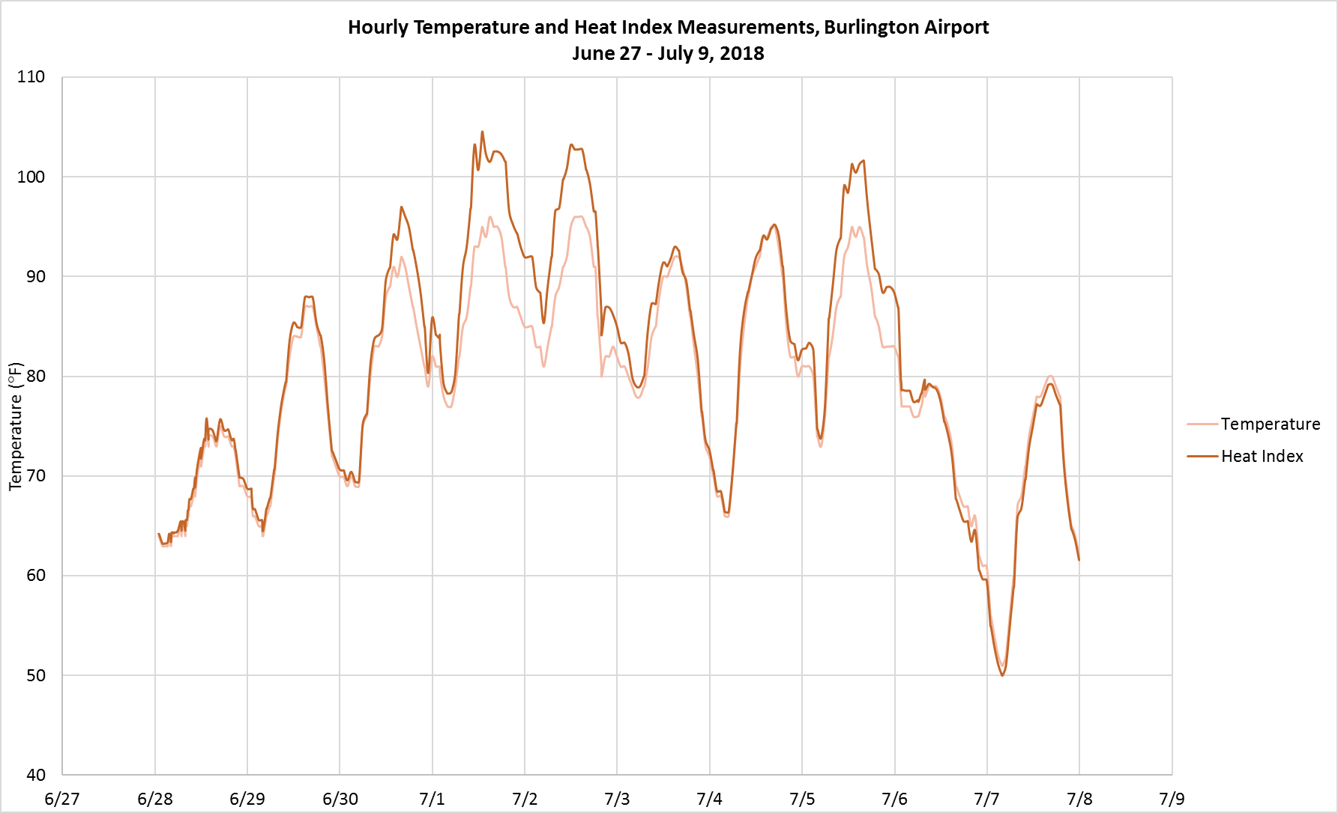
Heat Wave: NWS Burlington Station
105
103
102
96
97
80
76
78
Extreme Heat
Warning
Heat
Advisory
Heat Advisory
Data source: National Weather Service, 2018.
Notes:
High temperature reached 93F°-97°F for 6 consecutive days (second longest heat wave on record)
Heat index exceeded 100°F for 3 of 6 days
All time highest minimum temp set on the morning of 7/2, when overnight temp never dropped below 80°F

Slide 6
Estimated heat-related health impacts
4
Deaths
97*
ED/Urgent Care Visits
140*
EMS Calls
* Estimate based on preliminary surveillance data.
Data sources: The Statewide Incident Reporting Network (SIREN), 2018. The Electronic Surveillance System for the Early Notification of Community-Based Epidemics (ESSENCE), 2018.
Vermont Vital Statistics, 2018 (preliminary).
Notes:
This is to show an order of magnitude comparison, it is not necessarily a full accounting of all health impacts

Slide 7
Heat-related ED and Urgent Care Visits
Data sources: The Electronic Surveillance System for the Early Notification of Community-Based Epidemics (ESSENCE), 2016-2018. The National Weather Service, 2018.
Notes:
Similar pattern to what we saw with SIREN

Slide 8
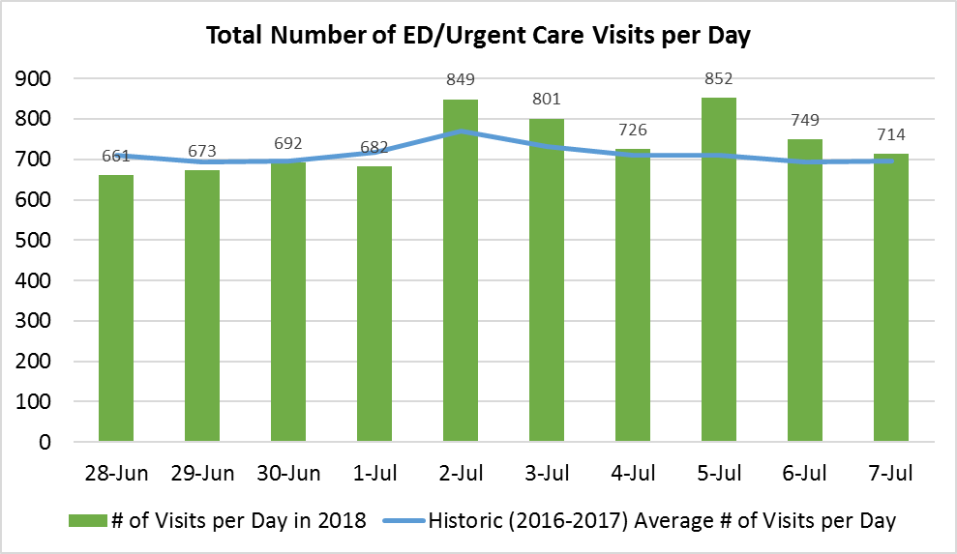
Total ED and Urgent Care Visits
Data source: The Electronic Surveillance System for the Early Notification of Community-Based Epidemics (ESSENCE), 2016-2018.
Notes:
Historic average calculated based on 2016 and 2017 data (big change in # of visits from 2015 to 2016…went from 11 reporting EDs to 14), adjusted for day of week, based on utilization in prior 30 days
+300 ED visits (+6%)
+300 EMS calls (+19%)

Slide 9
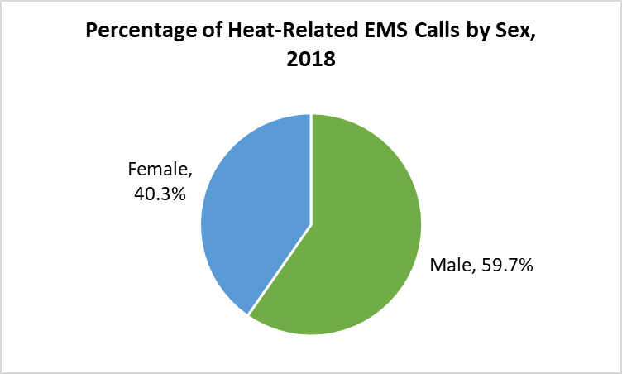
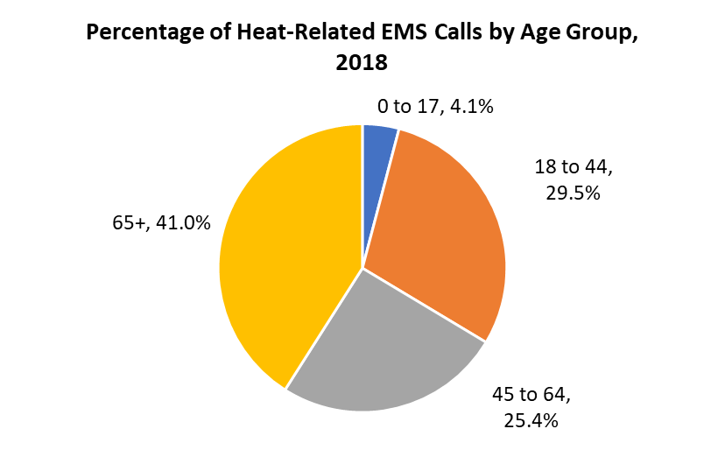
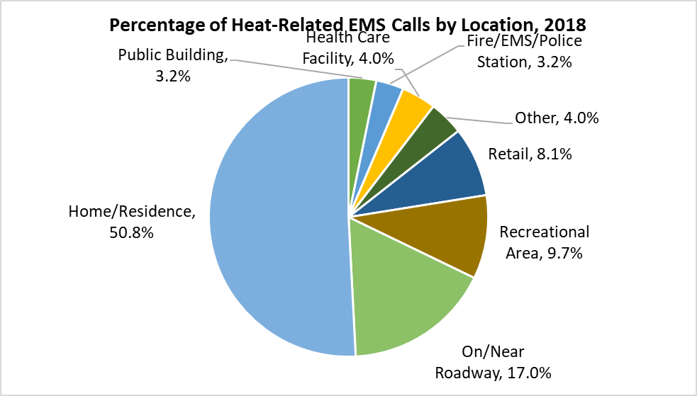
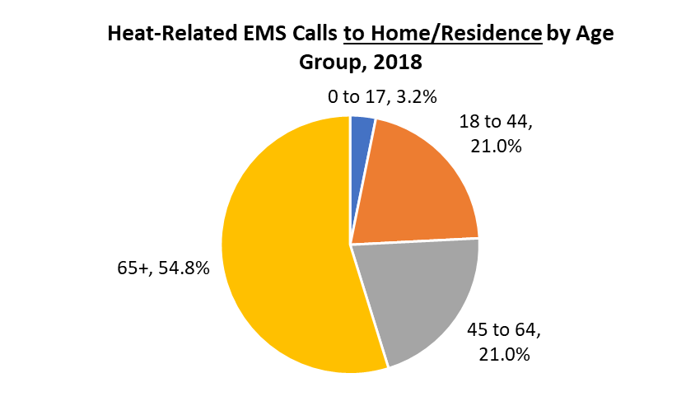
Who was Affected? (EMS calls)
Notes:
Vermont population: 19% 65+
Talk about impact on EMS crews: incident in which CPR was stopped “due to heat, exhaustion of the crew”

Slide 10
Heat-Related Deaths Over Time
Year | # of Heat-Related Deaths
2009 | 1
2010 | 2
2011 | 0
2012 | 0
2013 | 2
2014 | 0
2015 | 2
2016 | 0
2017 | 1
2018 | 5
Data source: Vermont Vital Statistics, 2009-2018(preliminary).
Notes:
All heat-related deaths in VT (resident and non-resident)
Differences between the narrower definition of death due directly to heat exposure (what’s captured here) vs. a more indirect heat-related death (can’t assess until data come back coded from National Center for Health Statistics)
All 4 deaths in 2018 occurred in the decedent’s home
2 males, 2 females
Ages ranged from 57 to 79
3 in Chittenden county, one in Washington

Slide 11
Challenges (heat wave and ongoing)
Challenges during heat wave
  Roles/coordination between key partners
  Informal communications protocols
  Demand for cooling centers/shelters, home cooling assistance
  Assisting hard to reach individuals living alone
Future needs
  System for checking in on high-risk individuals
  Guidance for schools / child care
  Develop more formal emergency response plan
What else can the Health Department offer???
Notes:
Cooling centers
– what more can state agencies or other partners do?
- Adverse weather exception?
- other guidance for communities?
Need for formal plan to clarity roles/responsibilities, communications channels.

Slide 12
Contact Information
Jared Ulmer, MPH, AICP
Vermont Department of Health
Climate & Health Program
802-865-7762
Jared.Ulmer@vermont.gov or ClimateHealth@vermont.gov
healthvermont.gov/climate

Slide 13
Summer 2018 Heat-Related Health Impacts
In Your Jurisdiction…
Discuss 1: What data did you collect?
  Major Findings, interesting observations
Discuss 2: How did you respond to heat waves this past summer?
  Health messaging
  Targeted interventions
  Partners involved
Discuss 3: What worked? What didn’t? What do you want to do next time?
  Successes
  Timing
  Public health guidance
  Hard to reach individuals
  Vulnerable populations
  Future planning

Slide 14
Summer 2018 Heat-Related Health Impacts
Other Comments?

Slide 15
Summer 2018 Heat-Related Health Impacts
Discussion Approach:
Discuss 1: Data collected, major observations/conclusions throughout Summer 2018 heat waves
  Major Findings, interesting observations
Discuss 2: What actions were taken, and were the impacts of these actions observed in outcome observations
  Health messaging
  Changes in activity
  Partners involved
  Resources used
  Targeted interventions
Discuss 3: Identify heat-related health impact best practices that can be universalized and employed by most
  Observed successes
  Timing of actions
  Public health guidance to targeted populations
  Hard to reach individuals
  Vulnerable populations
  Challenges encountered
  Development of community/county/region/state-wide Heat-Related Health Emergency Plans

