Slide 1

Climate Change, Public Health, and Equitable Community Planning
CSTE Climate, Health & Equity
April 25, 2022
Aaron Ferguson
Climate and Tracking Unit
Division of Environmental Health
FergusonA1@michigan.gov

Slide 2
Michigan Climate & Health Adaptation Program (MICHAP)
MICHAP supports a climate resilient public health system by investigating climate-driven health risks, identifying needs for climate and health adaptation across sectors, and collaboratively implementing equitable climate adaptation strategies.
Strategic Adaptation Planning and Implementation
2009 - 2013
Building Resilience Against Climate Effects (BRACE)
2013 - 2016
Climate & Health Adaptation and Monitoring Program
2016 - 2021
New strategic plan, implementing Guidebook
2022
www.Michigan.gov/climateandhealth
Notes:
The Climate and Health program has been funded for a decade by the CDC’s Climate Ready States and Cities Initiative to build public health capacity to prepare for and respond to climate change impacts. The map shows some of the other jurisdictions that are currently being funded which include 16 states and 2 cities.

Slide 3

Connecting Health to Climate
How does that impact us?
Notes:
Here are some other tools and resources that you may find helpful as you incorporate climate health adaptation into your own community’s planning process.

Slide 4
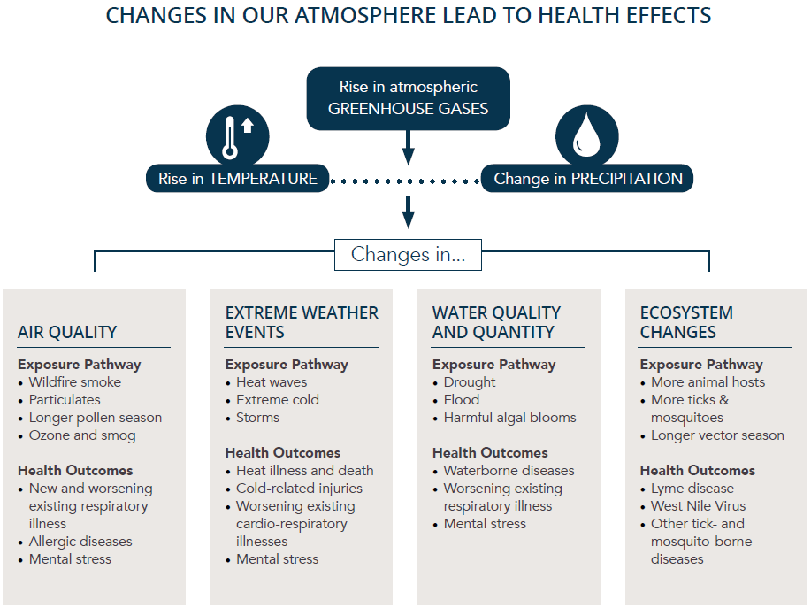
Michigan 1960 -2012
2.9°F
Michigan 1960-2012
4.5%
Source: Climate and Health Adaptation Planning Guide

Slide 5

Building Resilience
How is public health responding?
Notes:
Here are some other tools and resources that you may find helpful as you incorporate climate health adaptation into your own community’s planning process.

Slide 6
Climate and Health Adaptation Strategies
Technical Assistance to State and Local Partners
Surveillance & Assessments - focus on vulnerability and inequity
Emergency Response & Preparedness
Climate & Health in All Policies
Evaluate to Improve Interventions
Notes:
MDHHS utilizes several strategies with partners across sectors at the State and local levels to prepare communities for climate change. Here are a few examples:
Technical Assistance to State and Local Partners
High Water Action Team and SE MI Aging Infrastructure Workgroups
Local health department (LHDs) Community Health Needs Assessments
Surveillance & Assessments
Surveillance and vulnerability reports to identify exposures, health impact disparities, and underserved communities
Monitor MI Syndromic Surveillance System and National Weather Service
Model West Nile Virus risk with MDHHS EZID, MDHHS MiTracking, and University of Oklahoma
Emergency Response & Preparedness – Climate-related Events
Develop health education materials for heat, cold, and flood events
Establish and review protocols with MDHHS Chemical Preparedness and Response Section, Bureau of EMS, Trauma & Preparedness (BTEP), and MI State Police
Health in All Policies Approach to Implement Adaptations
EGLE Catalyst Communities & MI Green Communities
Climate and health planning in Detroit, Marquette, Kalamazoo, etc.
Evaluate Interventions
Identifying health benefits of MDHHS Weatherization Program
Tick and mosquito surveillance training for LHDs with MDHHS Emerging, Zoonotic and Infectious Disease Section (EZID)

Slide 7
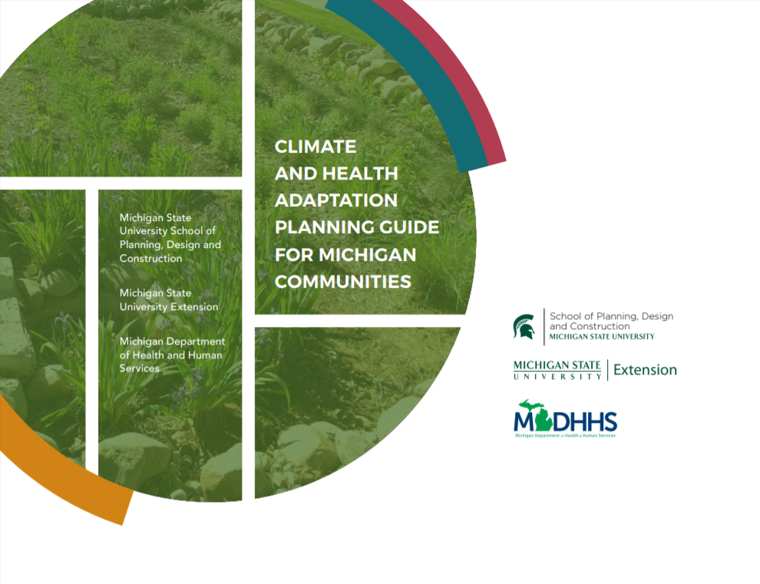
What is a Climate and Health Adaptation Plan?
A strategy document that fosters collaboration across disciplines and interest groups to:
Instigate a series of activities toward the common objectives.
Reduce the anticipated impacts of climate change.
www.michigan.gov/documents/mdhhs/ClimateHealthPlanningGuide_2020_10_2_accessible_704110_7.pdf
Notes:
Another major initiative that compiles best practices and resources compiled from a decade of working in communities across Michigan is the Climate and Health Adaptation Planning Guide for Michigan Communities. This was released in September as part of the Governor’s MI Healthy Climate Plan.
Co-developed with MSU School of Planning, Design, and Construction and MSU Extension
The Guide uses a health in all policies approach to walk communities through a process to integrate climate, health, and equity into community planning, built environment design, and decision making.
MDHHS and MSU piloted the process in Marquette, MI in partnership with the Marquette County Health Department (MCHD).
MDHHS and MSU will expand the approach across the state through their existing networks and by partnering with other local and state initiatives (e.g. EGLE’s forthcoming Catalyst Communities initiative)

Slide 8
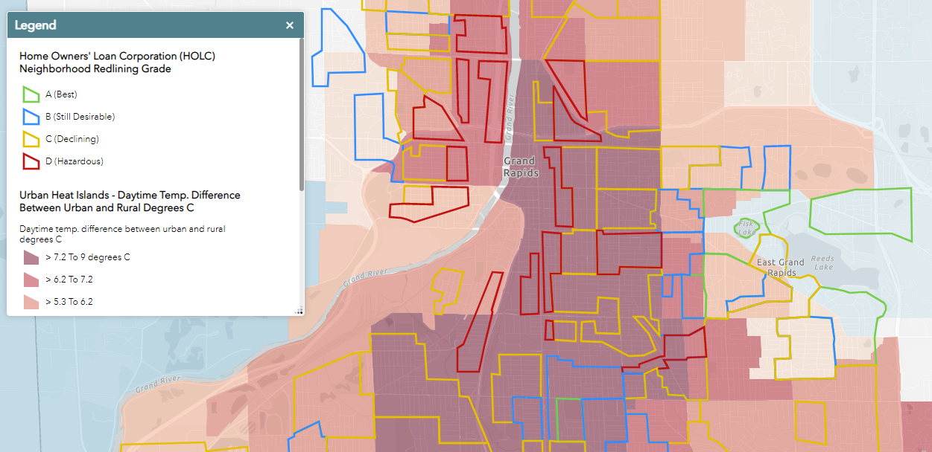
Historic Inequity Influences Current Resilience
Data Source: https://www.mdpi.com/2225-1154/8/1/12/htm#app1-climate-08-00012
Image Source: https://www.npr.org/2020/01/14/795961381/racist-housing-practices-from-the-1930s-linked-to-hotter-neighborhoods-today
HOLC Redlining Data: University of Richmond, https://dsl.richmond.edu/panorama/redlining/
MI EJScreen: https://www.michigan.gov/environmentaljustice/0,9615,7-400-104480---,00.html
Notes:
Through a spatial analysis of 108 urban areas in the United States, we ask two questions: (1) how do historically redlined neighborhoods relate to current patterns of intra-urban heat? and (2) do these patterns vary by US Census Bureau region? Results reveal that 94% of studied areas display consistent city-scale patterns of elevated land surface temperatures in formerly redlined areas relative to their non-redlined neighbors by as much as 7 °C.
The red, yellow, blue and green polygons on the map delineate how loan officers, appraisers and real estate professionals evaluated mortgage lending risk during the mid-1900s. Neighborhoods considered high risk or “Hazardous” were often “redlined” by lending institutions, denying them access to capital investment which could improve the housing and economic opportunity of residents. These neighborhoods were largely considered “hazardous” because of who lived there: they were predominantly immigrant or African American neighborhoods.
While this policy became illegal with the passage of the Fair Housing Act of 1968, the effects of disinvestment continue today. The map layer you see beneath the redlining data depicts the area covered by tree canopy (if tree map) or the calculated heat island temperature difference compared to surrounding areas. Pay attention the darker red areas– representative of warmer ground-level temperatures– in the red polygons (the areas deemed “hazardous”) compared to the green and blue polygons (considered “best” or “still desirable” neighborhoods). The policy from the 40s and 50s continues to impact the environment today. Walking around or waiting for a bus in an area that is 7.2 to 9 degrees warmer than an area in light blue can have an impact on your health. (etc.)

Slide 9
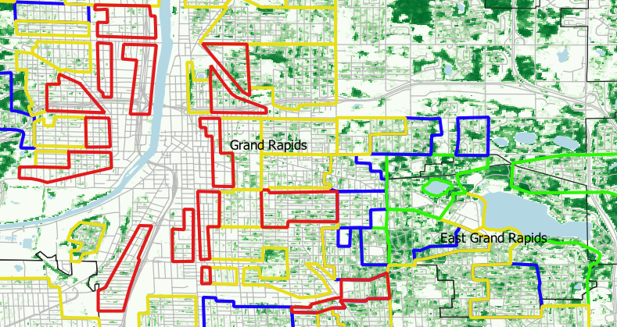
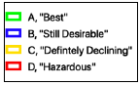
Historic Inequity Influences Current Resilience
HOLC Redlining Data: University of Richmond, https://dsl.richmond.edu/panorama/redlining/
Tree canopy data: National Land Cover Database, https://www.mrlc.gov/data
Notes:
Through a spatial analysis of 108 urban areas in the United States, we ask two questions: (1) how do historically redlined neighborhoods relate to current patterns of intra-urban heat? and (2) do these patterns vary by US Census Bureau region? Our results reveal that 94% of studied areas display consistent city-scale patterns of elevated land surface temperatures in formerly redlined areas relative to their non-redlined neighbors by as much as 7 °C.
The red, yellow, blue and green polygons on the map delineate how loan officers, appraisers and real estate professionals evaluated mortgage lending risk during the mid-1900s. Neighborhoods considered high risk or “Hazardous” were often “redlined” by lending institutions, denying them access to capital investment which could improve the housing and economic opportunity of residents. These neighborhoods were largely considered “hazardous” because of who lived there: they were predominantly immigrant or African American neighborhoods.
While this policy became illegal with the passage of the Fair Housing Act of 1968, the effects of disinvestment continue today. The map layer you see beneath the redlining data depicts the area covered by tree canopy (if tree map) or the calculated heat island temperature difference compared to surrounding areas (if EJ Screen). Pay attention to how much dark green you see – representative of the tree canopy in that geographic area – in the red polygons (the areas deemed “hazardous”) compared to the green and blue polygons (considered “best” or “still desirable” neighborhoods). The policy from the 40s and 50s continues to impact the environment today. Tree coverage is essential for clean air, cooler ground-level temperatures, and all the mental and physical health benefits trees bring and the lack of trees in the redlined neighborhoods impact people who live there.

Slide 10

GUIDING PRINCIPLES OF A CLIMATE AND HEALTH ADAPTATION PLAN
Four guiding principles to develop a climate and health adaptation plan (Adapted from Alameda County, California Office of Sustainability):
Keep health and equity at the forefront of all action
Engage decision makers and representative community members throughout the process
Use locally relevant climate data and vulnerability assessments
Leverage visualizations tools to establish shared vision

Slide 11
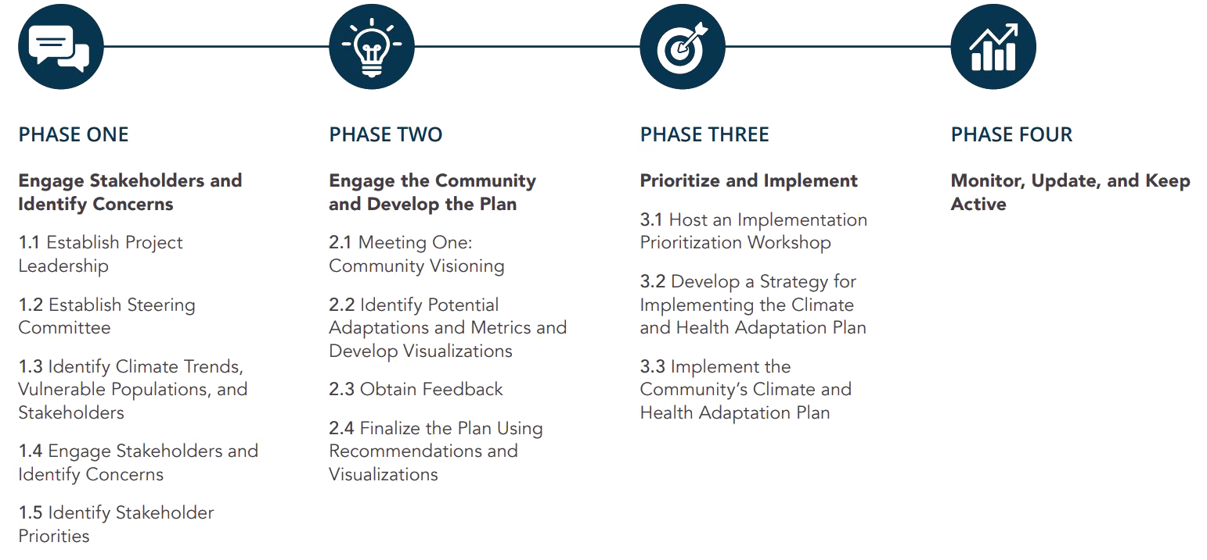
Steps for Creating a Climate and Health Adaptation Plan

Slide 12
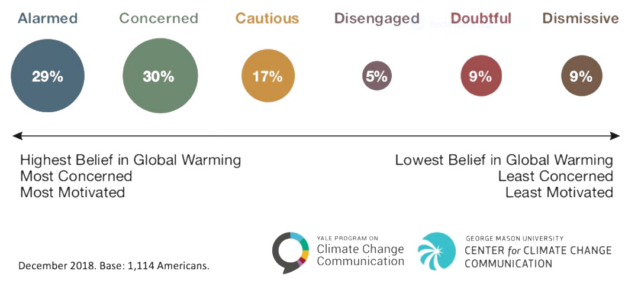
Pre-Planning Checklist:
Create an initial list of key disciplines and functional areas of the community to engage.
Assess community capacity and readiness for climate and health adaptation planning
While the “Six Americas” is a general overview, gathering local data on attitudes of residents and community leaders is useful to individual communities.

Slide 13

Phase 1: Engage Stakeholders and Identify Concerns

Slide 14
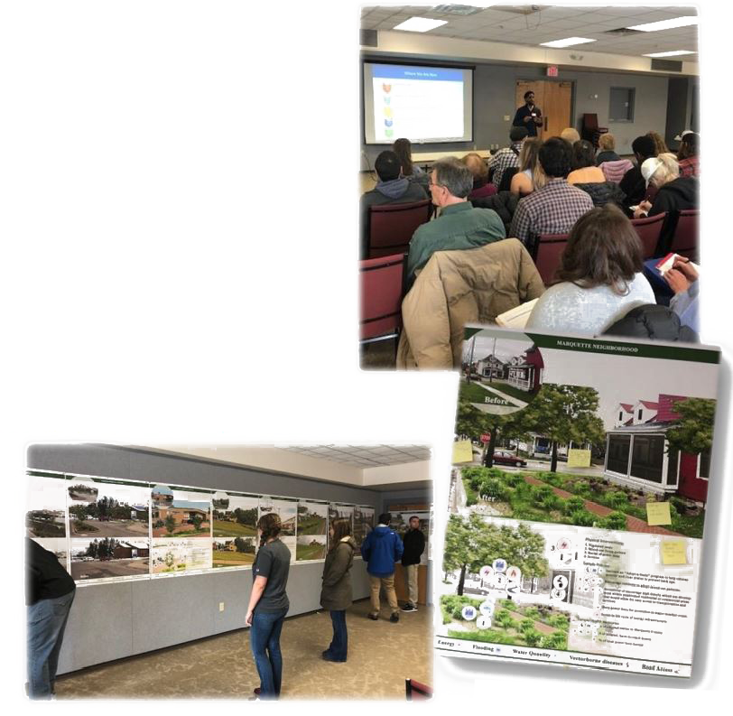
Phase 1: Engage Stakeholders and Identify Concerns
The first phase is about :
Building relationships,
Beginning to educate stakeholders about climate and health issues, and
Gathering concerns or solutions from their perspective.
Phase 1 Goals
• Establish plan leadership and steering committee • Identify climate trends, key stakeholders, vulnerable population and community partners. • Engage key stakeholders and identify priority climate and health concerns

Slide 15
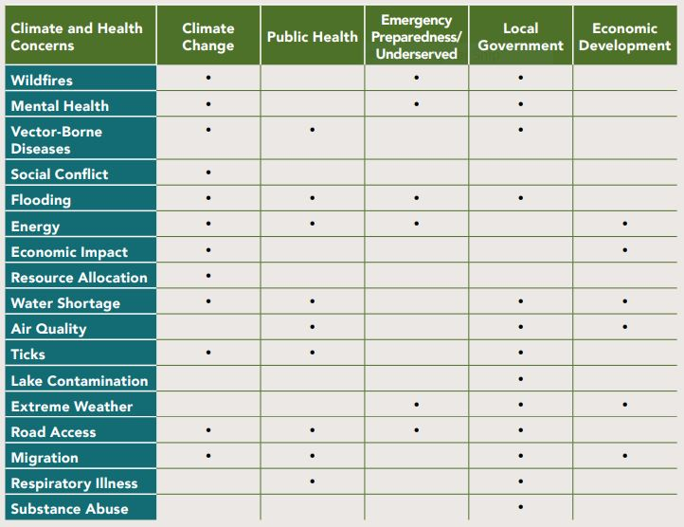
Case study in Marquette County
Primary Concerns
Flooding
Water quality (and groundwater shortages)
Lake contamination
Access to roads and other infrastructure
Wildfires
Vector borne disease
Ticks and air quality were seen as important secondary priorities.

Slide 16
Phase 2: Engage the Community and Develop the Plan

Slide 17
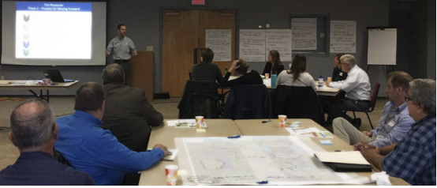
Phase 2: Engage the Community and Develop the Plan
Engage broader community
Educate about issues and the climate and health adaptation planning process
Identify adaptation strategies which the community support
Phase 2 Goals
• Engage the community in a climate-adapted community vision • Educate the community on climate, health, and adaptation • Develop climate and health interventions and the final climate and health adaptation plan

Slide 18
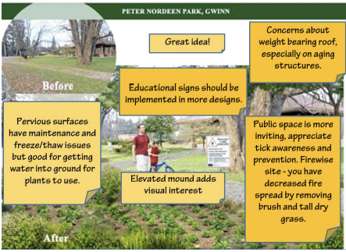
Case study in Marquette County
Participants were asked:
What do you like about the design interventions?
What is missing from the design interventions?
What suggestions do you have to improve the designs, policies, and metrics presented today?

Slide 19
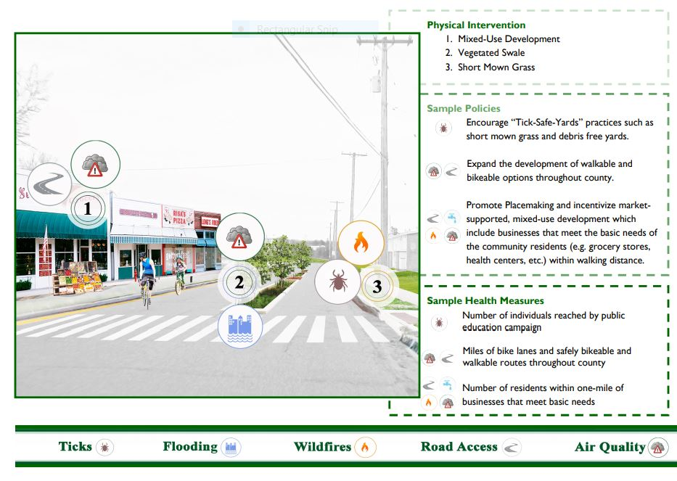
Visualizations to align climate adaptation design and public health benefits

Slide 20
Phase 3: Prioritize and Implement

Slide 21
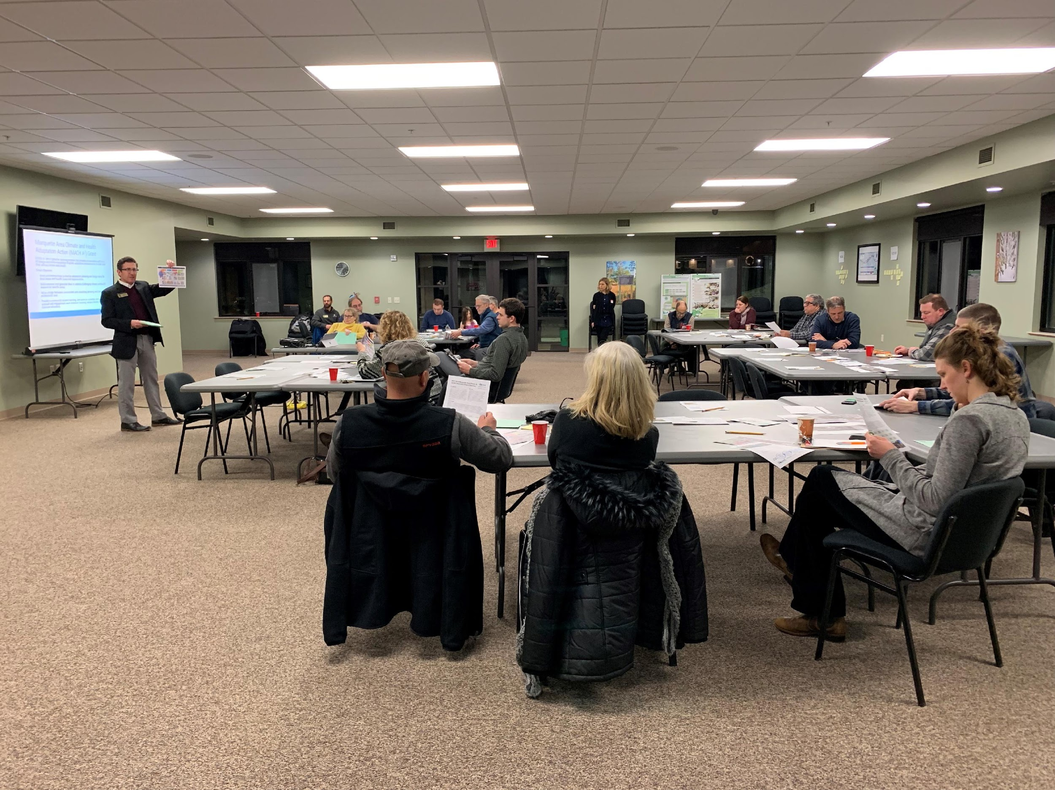
Phase 3: Prioritize and Implement
The third phase is about:
Prioritizing and implementing actions recommended in document
Recommendation in plan are grounded in local input and existing opportunities, still represent a variety of options
Phase 3 Goals
Prioritize the menu of recommended climate and health adaptations Develop a plan for implementing priority objectives Implement priority objectives and actions of the climate and health adaptation plan

Slide 22
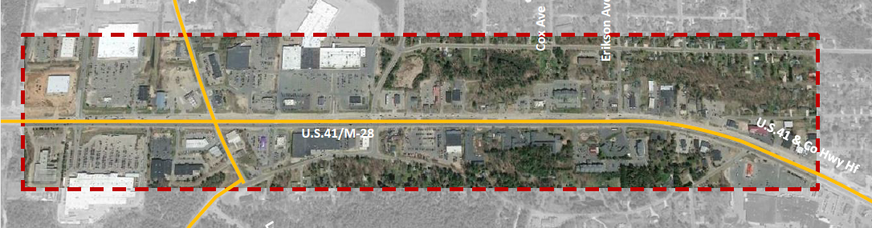
Marquette Township Climate Adaptation Project
Reimagine the U.S. Hwy 41/M-28 Corridor, integrating planning and design elements within a climate and health adaptation framework.

Slide 23




Themes and Design Considerations
Connectivity
Aesthetics
Revitalization
Placemaking
Trail/US-41 connection
Trail design and amenities
Active transportation and mass transit along corridor
Landscaping/tree linings/flower baskets/rain garden/vegetated buffers
Local vegetation/plants
Unique lighting
Mixed use development
Sustainable infill and redevelopment
Renewable, efficient, and resilient energy
Plazas and open spaces
Ground floor appeal to support pedestrian activity
Active inclusive design

Slide 24
Phase 4: Monitor, Update, and Keep Active

Slide 25
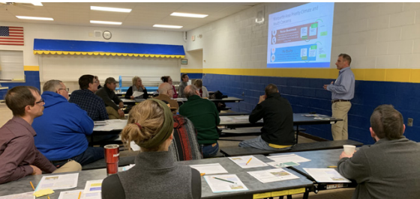
Phase 4: Monitor, Update, and Keep Active
Update plan and ensure adaptation strategies are still adequate to protect community's health and prosperity
Actions implemented should be evaluated based on evaluation plan and metrics previously developed to determine effectiveness
Phase 4 Goals
• Plan is incorporated into community policies and plans • Plan remains active and relevant • Plan is regularly revisited and revised to keep consistent with objectives and overall goals of the community

Slide 26
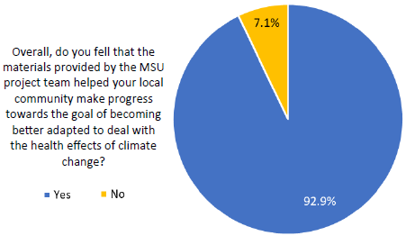
Survey of 31 participants who participated in the full county level process
“This was a sector of planning that was underserved in my community. It has become much more approachable when talking to developers in the community now that I have been a part of this process.”
“Twenty buildings owned by my local township have changed 100% of their lighting systems to environmentally friendly lighting due to this project. These lighting improvements are going to last for years and years and cost little down the road,

Slide 27
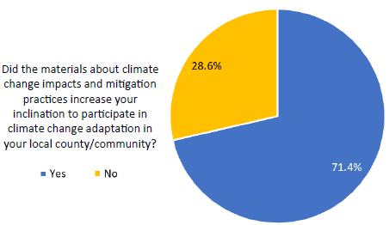
Survey of 31 participants who participated in the full county level process
“This made me want to participate more because I am a very visual person, and when you can walk around a room and see your community in many different phases with potential possibilities for change, it was incredibly eye-opening.”
“This project and the deliverable materials have made it much easier to learn how to compile materials and deliver them to our local planning commissions.”

Slide 28
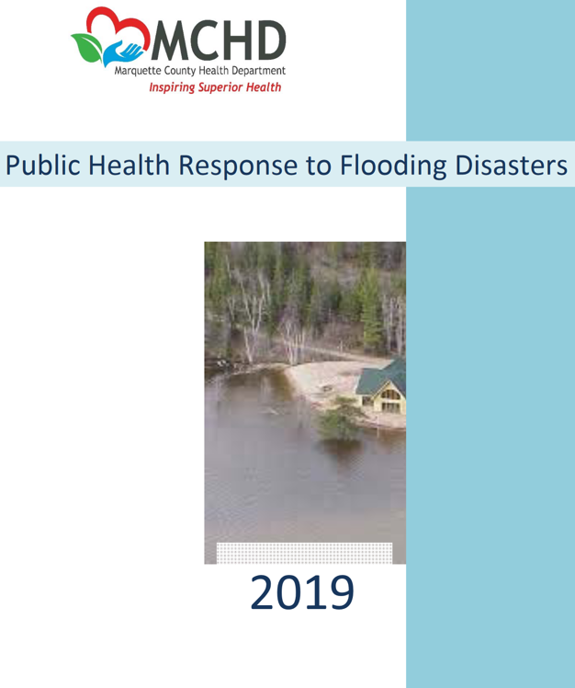
Examples of Implementation
County Water Coalition established
Public Health Response Plan to Flooding – Health Department
Ongoing dialog with MDHHS zoonotic disease epidemiologists regarding tick prevalence
Notes:
Water Coalition is ‘staffed’ by the County Planning Staff:
Surveyed all municipalities on drinking and wastewater infrastructure, and a second about contaminants of concern.
Ongoing mapping of municipal drinking water/wastewater systems involving the digitizing of hard copy records in partnership with the NMU Geography Department.

Slide 29
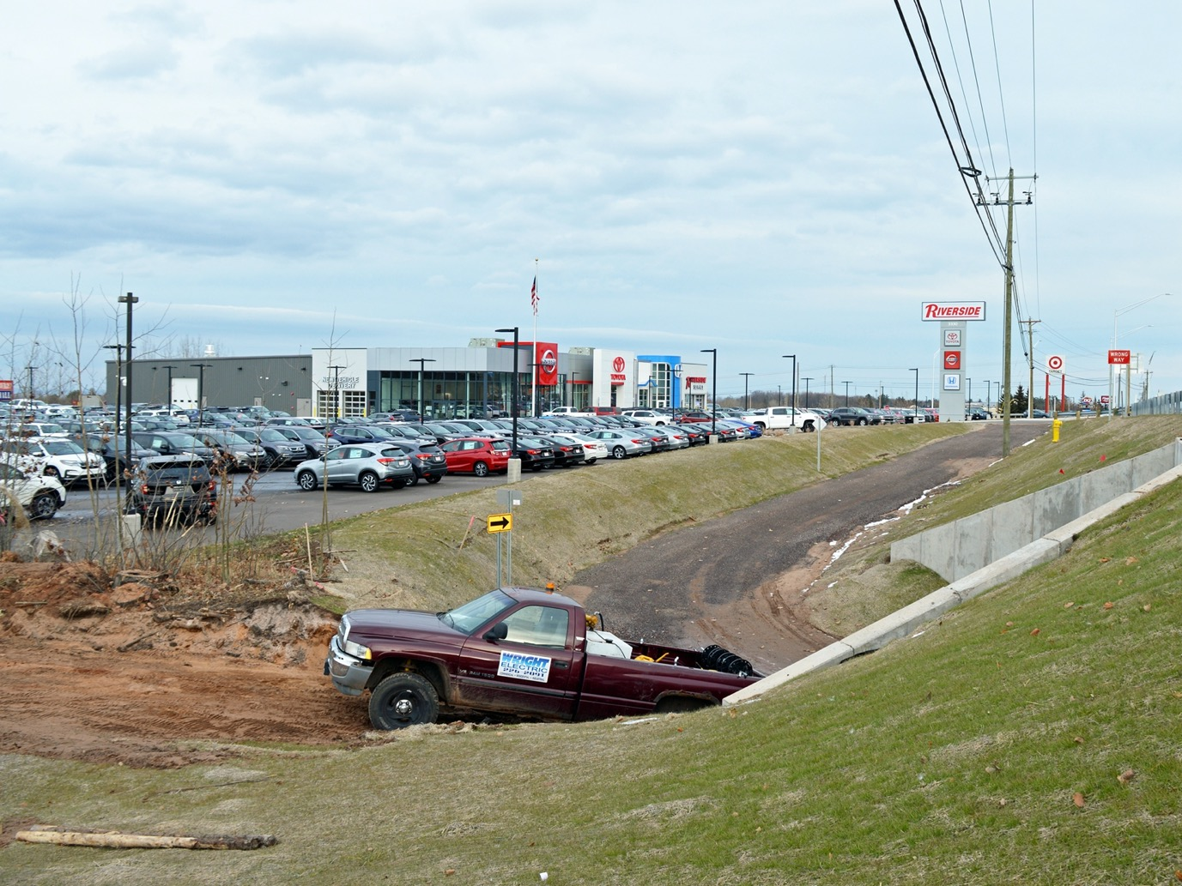
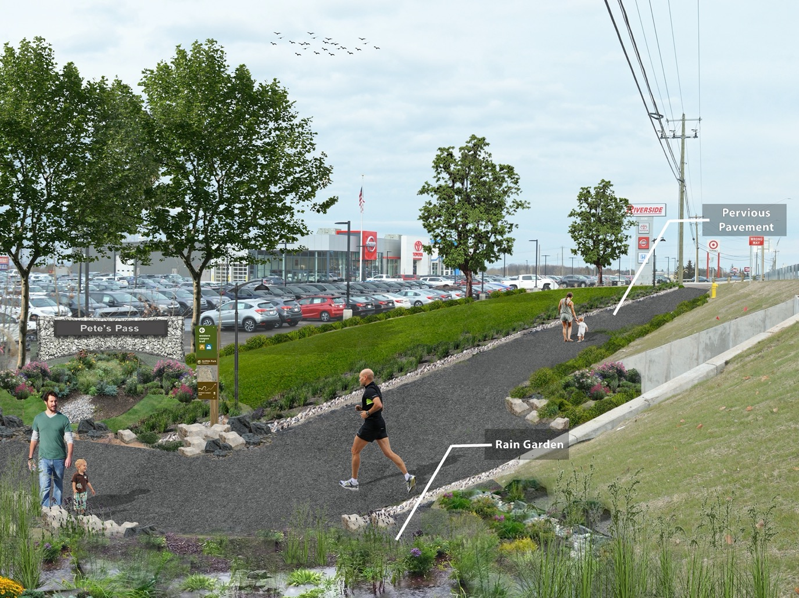
Early Implementation
Rain garden construction – City of Marquette
Expanded non-motorized network: Signage to implement on-street bike routes – City of Marquette
Climate and health content and strategies added to City of Ishpeming master plan (ongoing) and City of Negaunee master plan (forthcoming)

Slide 30
Questions?
Aaron Ferguson
Manager, Climate and Tracking Unit
MDHHS
FergusonA1@Michigan.gov

