Slide 1






Towards a National Urban Heat and Public Health Campaign
Vivek Shandas
Professor of Climate Adaptation
Portland State University
Principal, CAPA Strategies LLC
Jeremy Hoffman
Climate and Earth Scientist
Science Museum of Virginia
Acknowledgments
Jackson Voelkel, Geospatial Researcher
CAPA Strategies LLC

Slide 2
Overview
Background
  Temperatures across the globe and in the US
  Thermal Equity and Environmental Justice
  Pathways of urban heat and public health
  Urban heat primer
Field campaign, including logistics
  Case studies – Portland (OR) and Richmond (VA)
Discussion & Questions
  Opportunities for public health
  Engage with us
Notes:
As a way to from our discussion today, we begin with background on urban heat, then a couple of case studies of Portland’s field campaign, and the same for Richmond, though a focus on the post-campaign analysis, and implications. We end with a description about how this may be important for public health practitioners, and ways to engage us in the Summer of 2019.

Slide 3
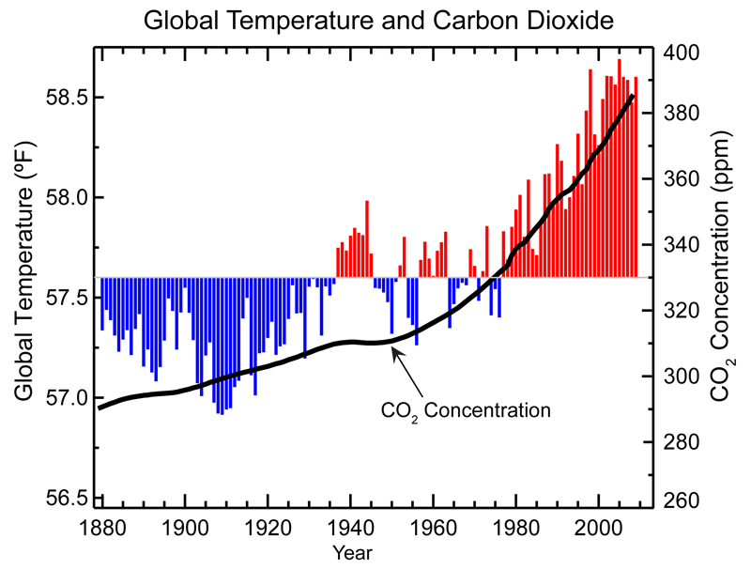
CO₂ and Global Temperatures
Notes:
To begin our background, we draw on the fundamental dynamics that are now attributed to a warming plant.
The relationship between CO2 and temperatures have been well-established for over 120 years now, and this graph provides a recent description of the relationship between CO2 concentrations and global temperatures.
In summary, the more GHGs, the warmer the planet, and as far as we can tell, the long-lived nature of GHGs, we don’t expect the planet to cool anytime soon.

Slide 4
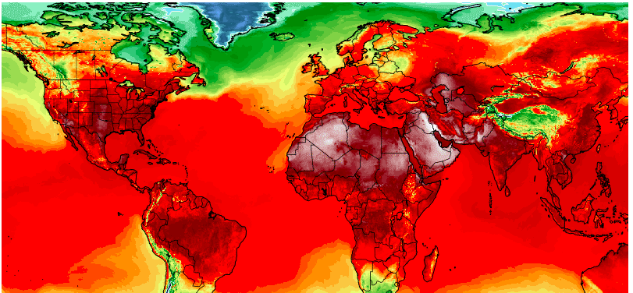
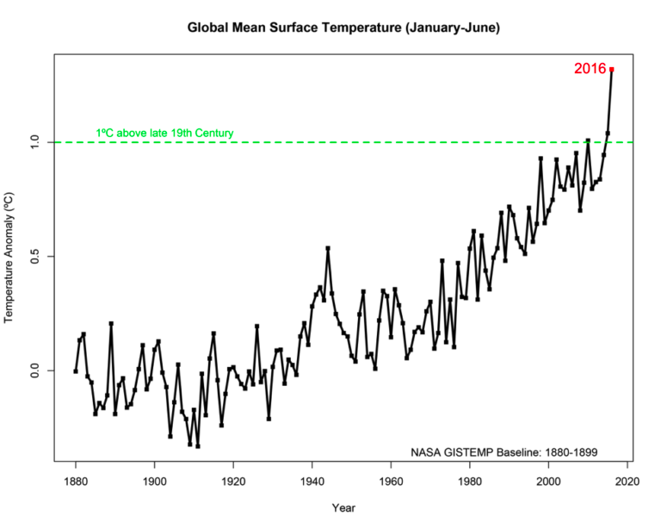
Record Breaking Temperatures
Heat Records for the US (2018)
The University of California Los Angeles set an all time record temp (111F) on July 6, along with several other locations in Southern California.
Denver tied its all-time high-temperature record of 105 degrees on June 28.
Mount Washington, N.H., tied its all-time warmest low temperature of 60 degrees on July 2.
Burlington, Vt., set an all time warmest low temperature ever recorded of 80 degrees on July 2.
Latest Climate Assessment Report confirms the human role in floods and heat waves.
Notes:
The US has seen record breaking temperatures in cities throughout the continent. Here are a few example from 2018 (not exhaustive).
We expect a lot more of the same in the coming summers.

Slide 5
Environmental Justice Framework
Ground the effort in the principle that all individuals have the right to be protected from environmental degradation.
  Which communities are going to be the most impacted from the harms of climate change?
Shift the burden of proof to polluters and dischargers who do harm, who discriminate, and/or who do not give equal protection to all racial and ethnic groups.
  What (or who) is amplifying harms from climate change?
Adopt a public health model of prevention as the preferred strategy to eliminate a threat before it occurs.
  What can be done to reduce the effects of climate change on the public’s health?
Notes:
We frame our work within environmental justice, in large part because we know the many of the most acute climate stressors affect those communities who have the least access to and control over resources – financial, public health, and other wise.
We offer three questions that help to frame our work.
Go through each of the points on the slide.

Slide 6
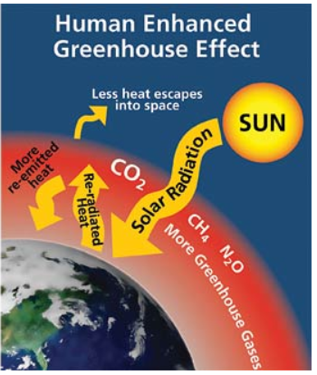
Climate Change and Health
HEALTH EFFECTS
Heat-related illness & death
Flood and storm-related health effects
Air pollution effects
Water- and food borne diseases
Vector-borne and rodent-borne disease
Moderating influences
REGIONAL WEATHER CHANGES:
- extreme
weather
- temperature
- precipitation
Exposure levels
Contamination pathways
Transmission dynamics
Adaptation measures
Notes:
We know the climate warming will have several mechanisms through which it will affect public health.
A commonly used description is the relationship between global trapping of GHGs, and the weather we expect in our cities and neighborhoods.
Those extreme weather events, and changes in temperature and precipitation translate through exposure levels, contamination pathways, and transmission dynamics to have varying public health effects on communities. These might be called the climate-induced determinants of health.
As I’ve mentioned, we’ll focus on heat related illness and death, since that is central to our area of expertise and experience.

Slide 7
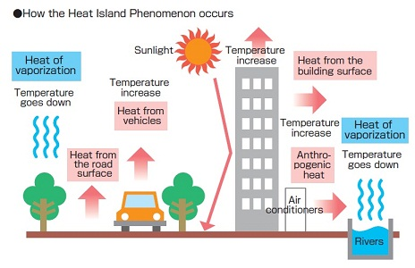
Urban Heat Primer
Notes:
The main mechanism is the sun’s short wave radiation which contains a lot of energy, and heads up all the earth’s surfaces.
Built environment is particularly susceptible because it absorbs the radiation.
The absorbed radiation is remitted as long-wave radiation (infrared waves).
Trees and other vegetation absorb the radiation and evapotranspire.

Slide 8
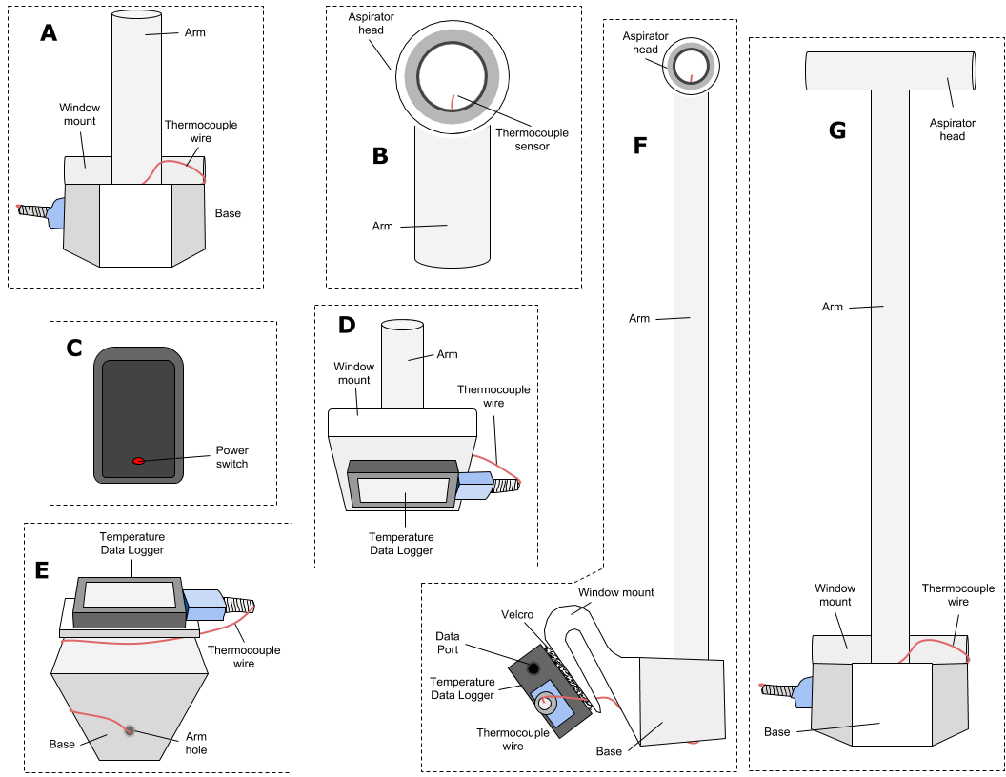

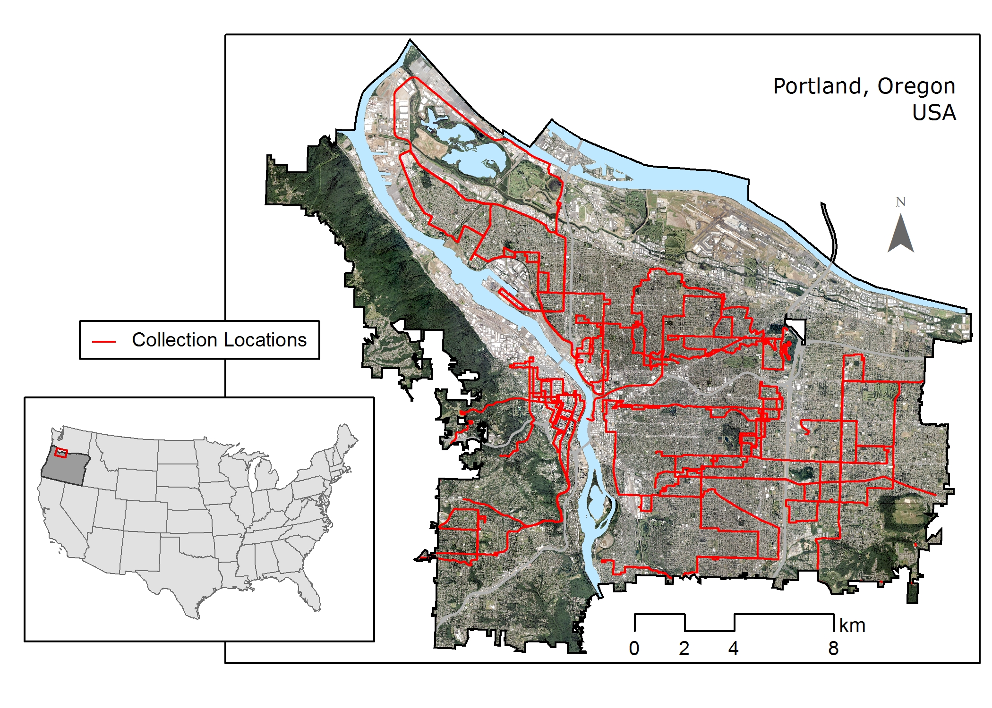
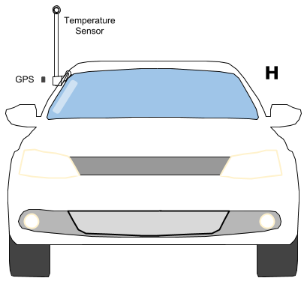
Temperature Traverses
Notes:
Our approach uses vehicles and these thermocouple sensors, which we’ve developed over the past 10 years.
The system mounts on a car, and we work with a local champion to develop partnerships with organizations in a metro region.
Those partnerships translate to drivers, who can drive in specific areas of a region during three one hour periods of the day: 6am, 3pm, and 7pm.
We use the data collected by the volunteer drivers, we use a series of machine learning algorithms to identify the major landscape factors that help to predict temperature across a region. Our results are generally at the 10m resolution, and describe ambient temperatures throughout the day.
Coming up is are the factors for this campaign in Portland, OR, where found six factors to help explain about 96% of the variation in temperatures during a hot day. This particular campaign used LiDAR data and we could describe differences at 1-meter resolution.

Slide 9
Predicting Temperatures
Six built environment factors helped to predict temperatures (one-meter resolution)
  Percent Canopy: vegetation 3m or taller
  Percent Vegetation: 3m or below
  Biomass Density
  Mean Building Height
  Total Building Volume
  Building Height Standard Deviation
Notes:
In the Portland, OR field campaign, we found six landscape features that help to explain temperatures.
Read the six factors from the slide.

Slide 10
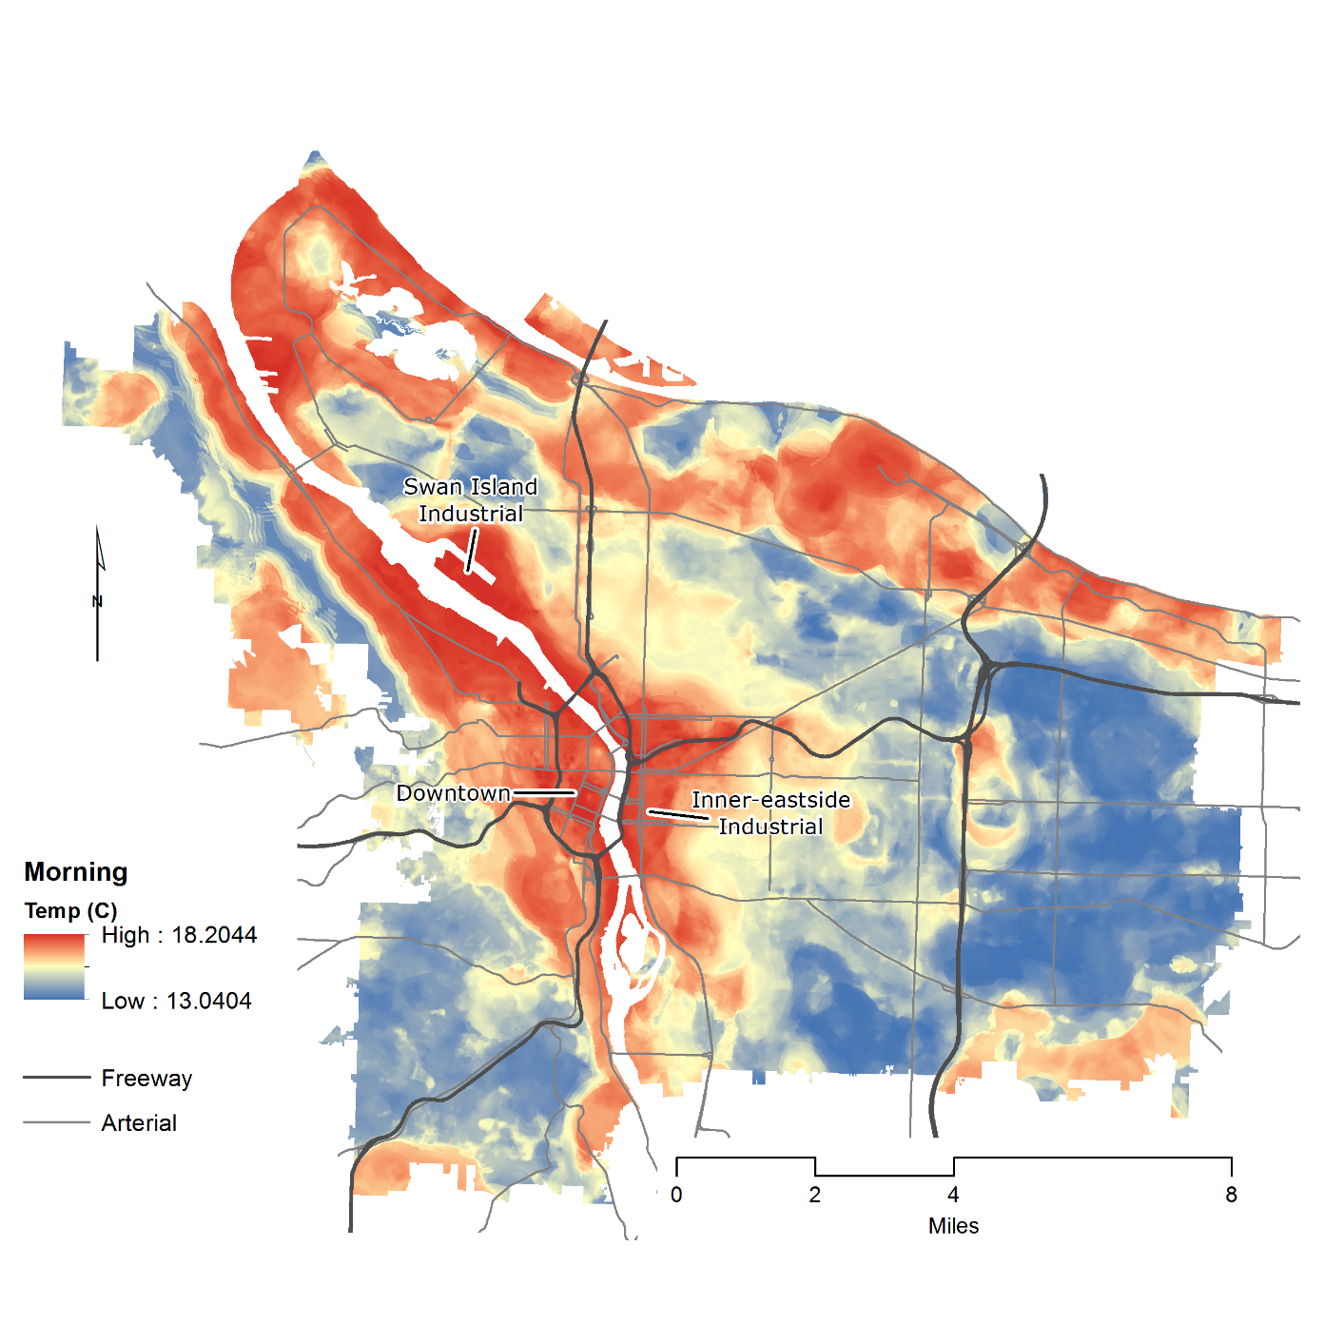
Heat in Portland – Morning (6am)
Notes:
Morning results illustrate how the east side of town is much cooler, almost by 5-dgrees Celsius in the morning.

Slide 11
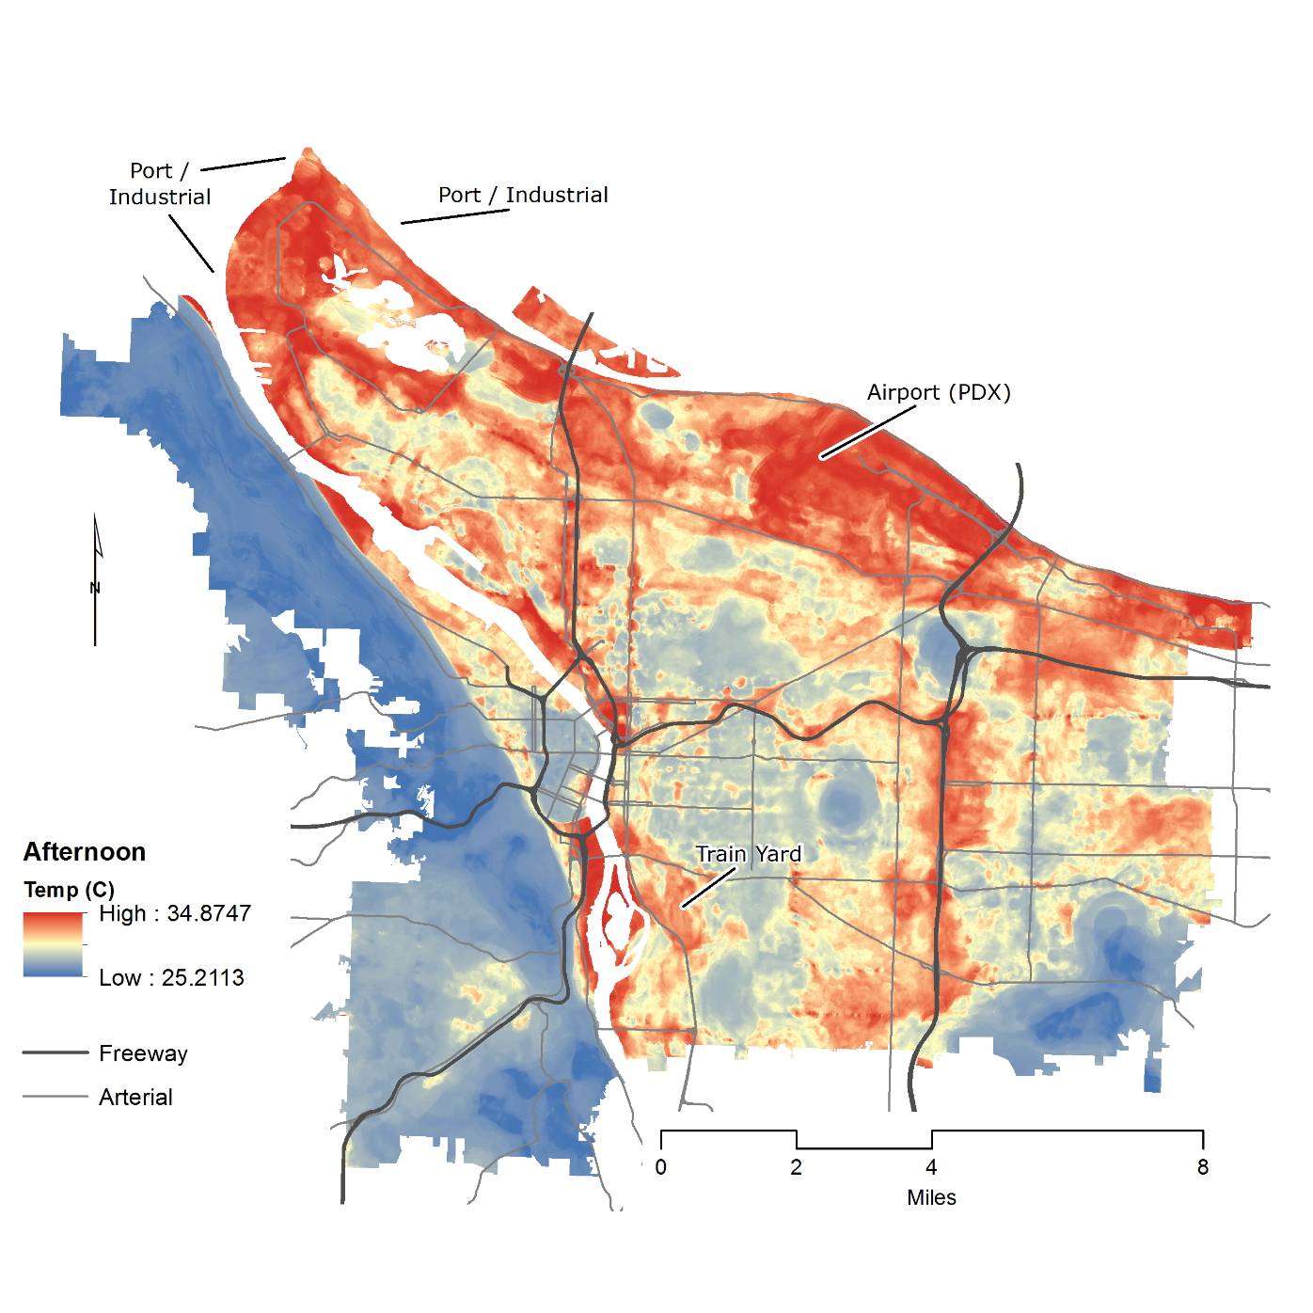
Heat in Portland –Afternoon (3pm)
Notes:
These campaigns help us understand that urban heat is not a static phenomenon, affecting only one area throughout a region.
In the Portland case, the afternoon temperatures are upwards of 35-degrees Celsius (95 Fahrenheit), and 10-degree Celsius (or 18 degrees Fahrenheit) cooler.
Specific areas of the city are beginning to show clear signs of thermal inequities.

Slide 12
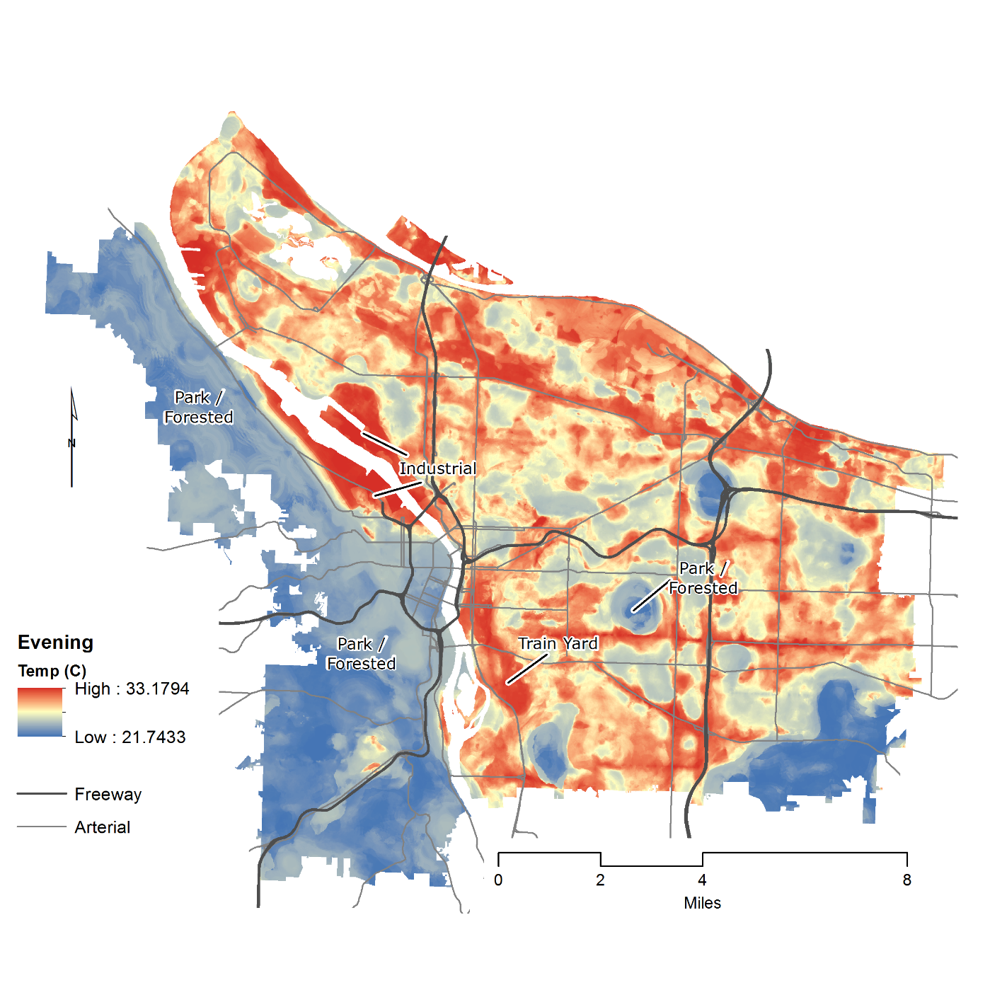
Heat in Portland – Evening (7pm)
Notes:
IN the evening we are now able to identify highly specific city-blocks that are the hottest in the region.

Slide 13
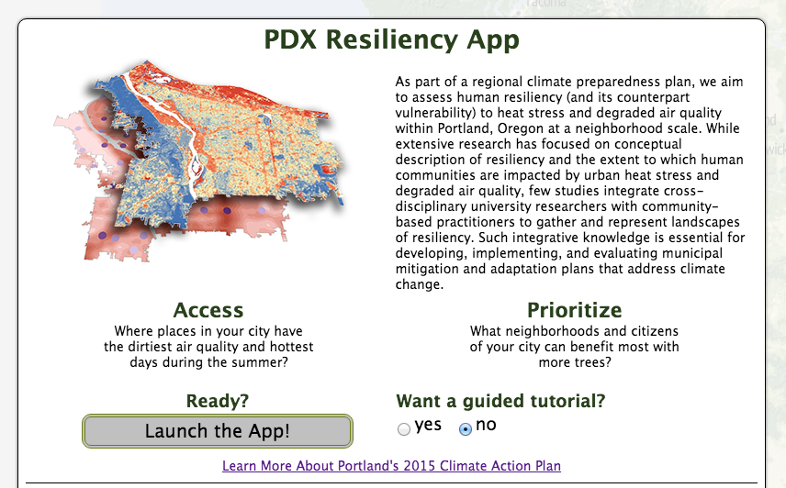
Web-based Platform
Integrating Geographic Equity & Urban Heat
Notes:
We’ve taken all the urban heat island data, and overlaid socio-demographics to identify those areas where the hottest areas align with communities who may be isolated and/or unable to cope.
This information has helped local public health staff and land use planners identify locations for advancing interventions.
We will now look more closely at the Richmond example to identify specific public health impacts emerging from these urban heat events.

Slide 14
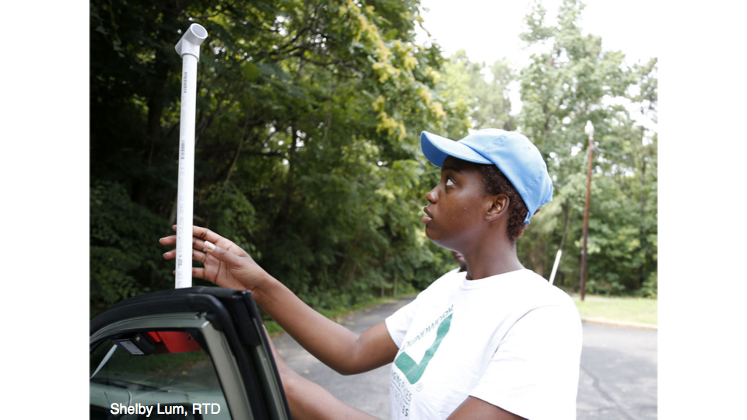
Richmond’s Applications
Notes:
Jeremy describes the approach taken in Richmond.

Slide 15
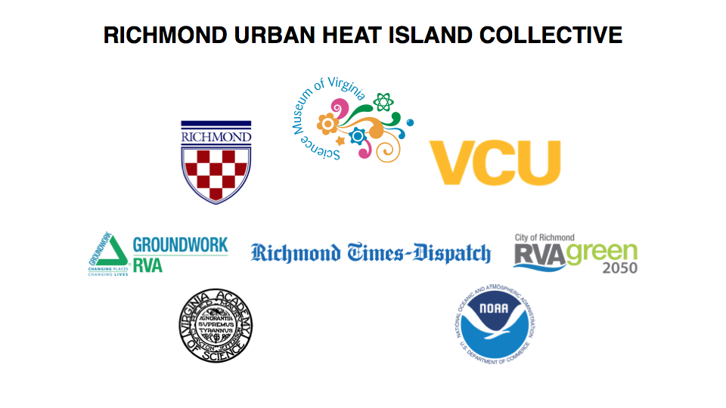

Slide 16
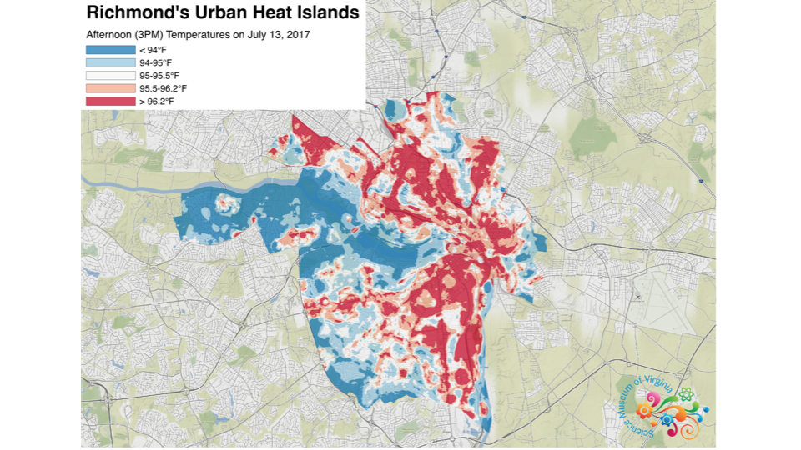
Richmond’s Applications
Notes:
These areas also experience disproportionate negative health out comes

Slide 17
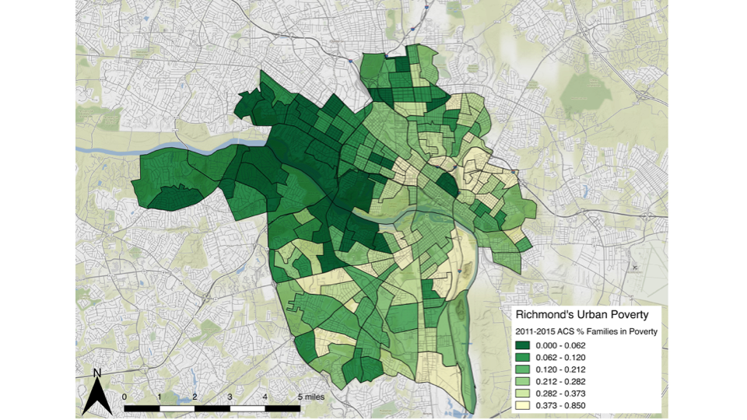
Richmond’s Applications

Slide 18
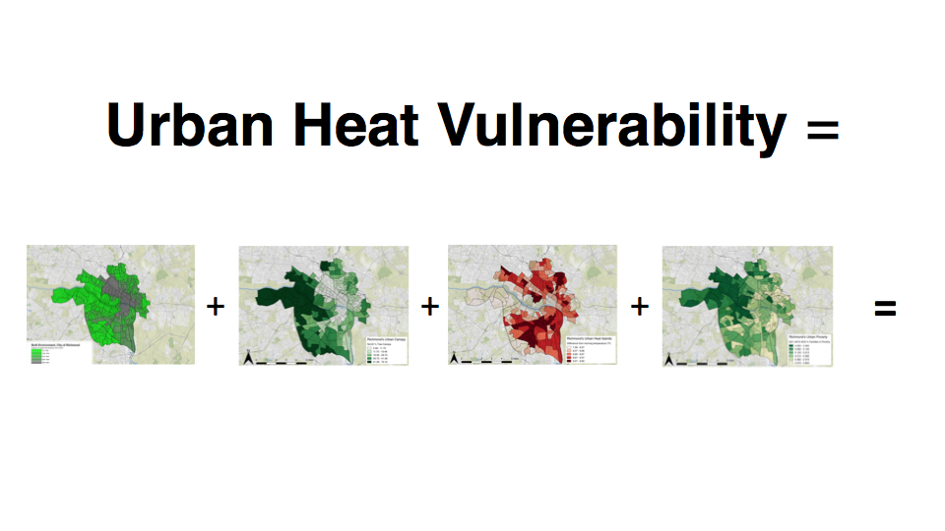
Richmond’s Applications

Slide 19
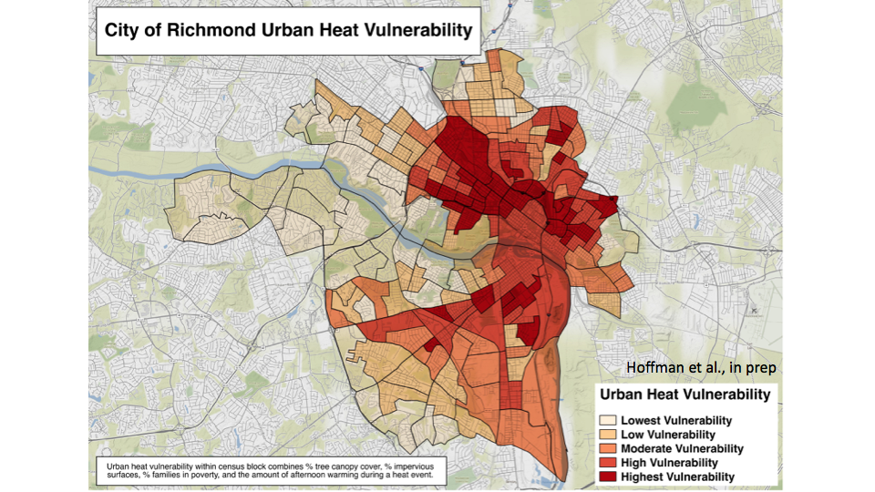
Richmond’s Applications

Slide 20
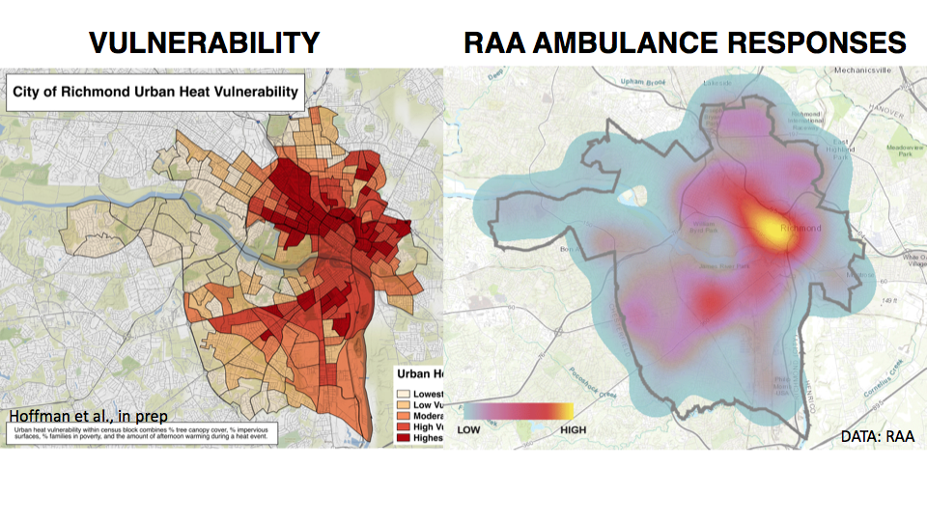
Richmond’s Applications

Slide 21
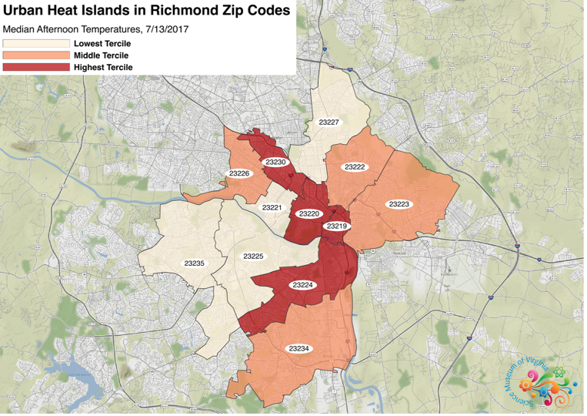
Richmond’s Applications

Slide 22
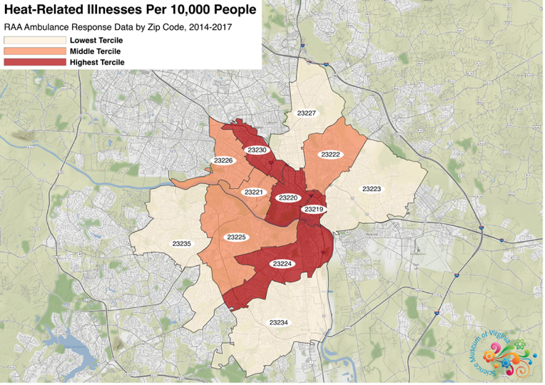
Richmond’s Applications

Slide 23
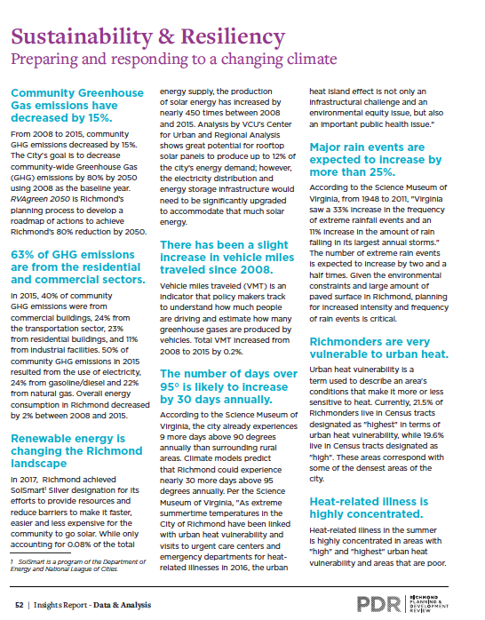
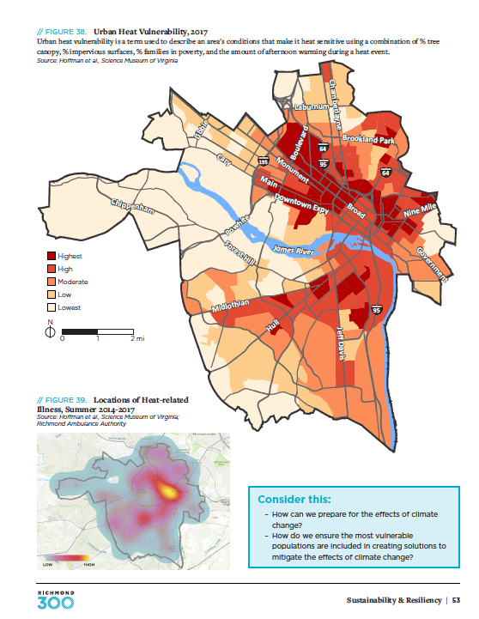
Richmond’s Applications

Slide 24
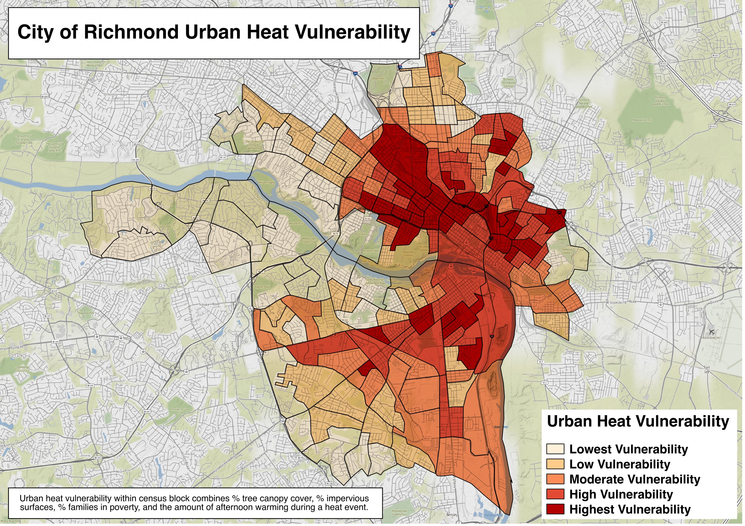
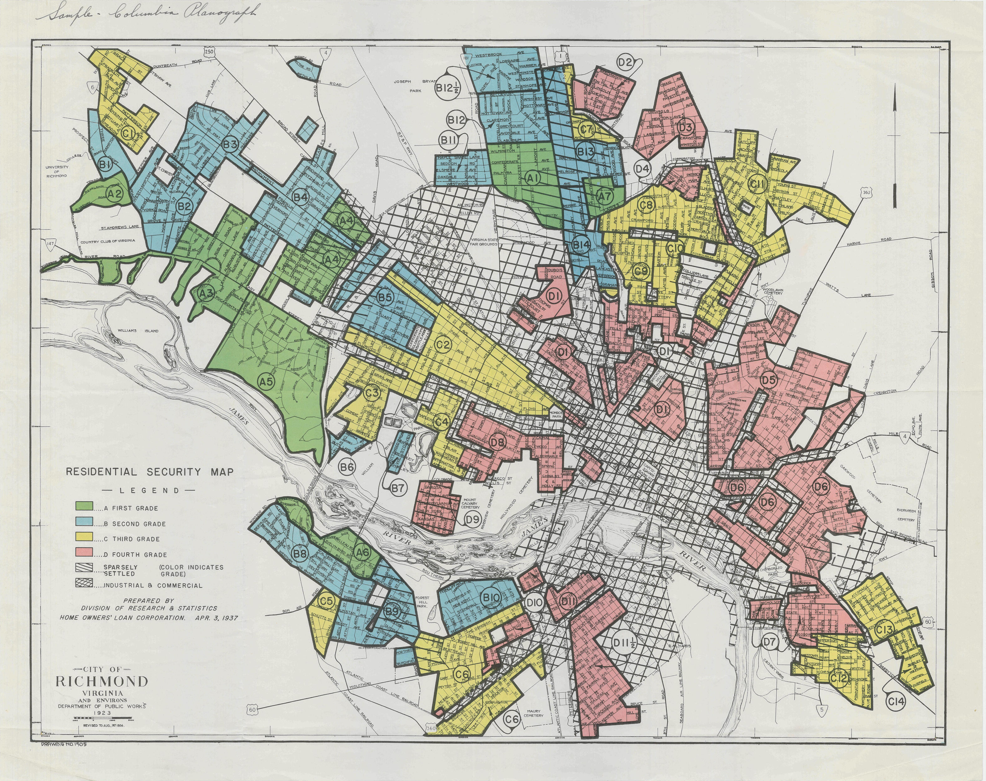

VULNERABILITY
REDLINING MAP (1937)
Hoffman et al., in prep
DATA: RAA

Slide 25
VULNERABILITY
REDLINING MAP (1937)
Hoffman et al., in prep
A B C D
DATA: RAA

Slide 26
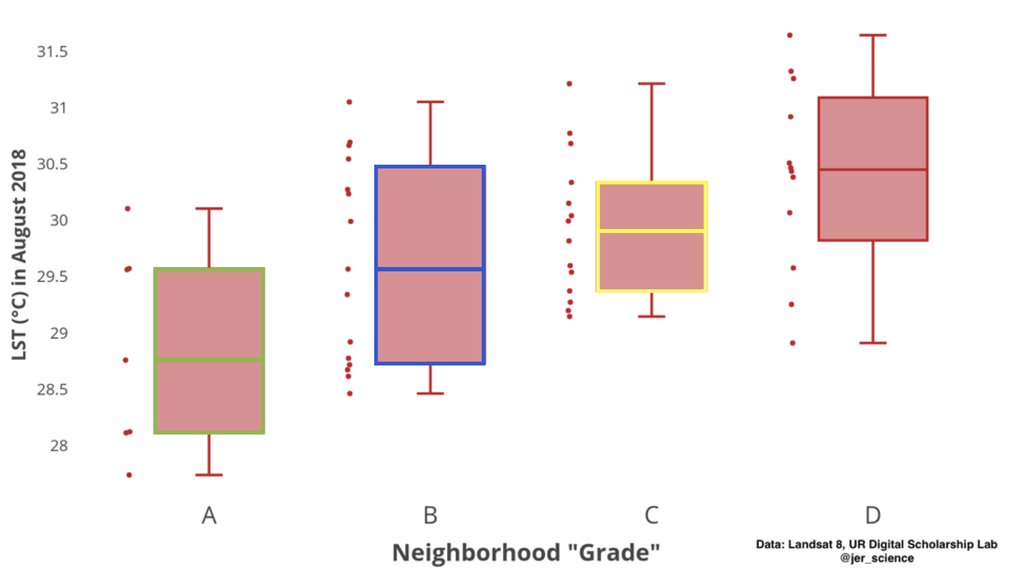

Slide 27
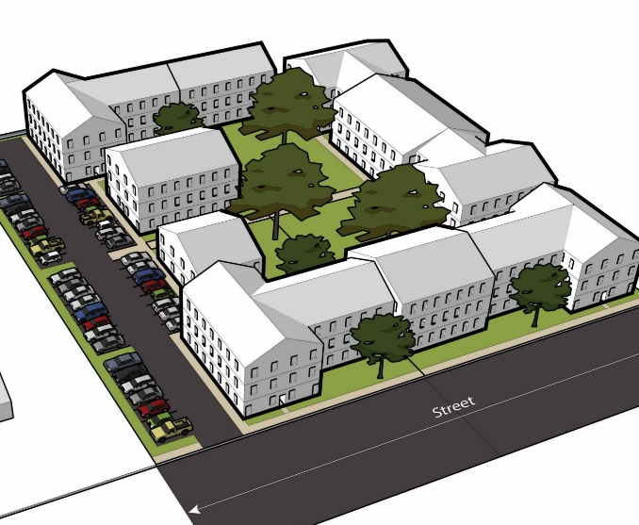
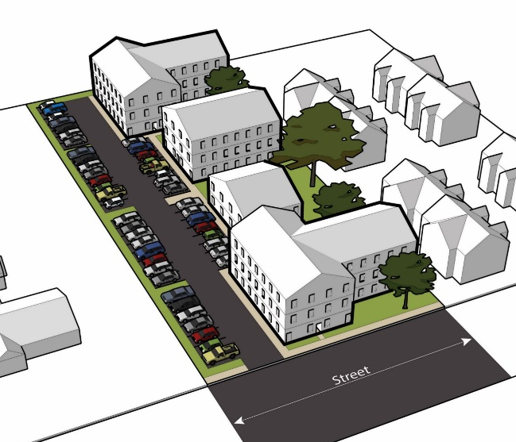
Next Steps
  Prepare dose-response relationships among development proposals, greening scenarios, environmental stressors
  Explore policy options for ‘no net increase’ in temperature and air pollution
  Exploring options for applying mitigation models and web-based engagement to other regions: Midwest, South, Inner-Mountain, Northeast
Notes:
Next steps are to: look at specific land use characteristics to thermal conditions
Identify thresholds
Develop dose-response relationships and link to ‘no net increase in temp’ policy
Expand to other regions in the US, including the Midwest, south, inner-mountain, and northeast.

Slide 28

Would you like to participate?
Notes:
If you would like to engage with us in conducting an urban heat field campaign, where you’ll have the highest resolution heat maps for a whole city and with temperatures across the day. Consider working with us in summer 2019 to conduct a field campaign. Contact us at info@capastrategies.com to explore your options.

Slide 29

Contact
Contact: Vivek Shandas or Jeremy Hoffman
Email: vs@capastrategies.com or jhoffman@smv.org
Website: www.capastrategies.com
Richmond, Baltimore, DC data: https://osf.io/f9nhg/
Notes:
Please feel free to contact us with questions. We would love to engage you in the coming year.

Slide 30
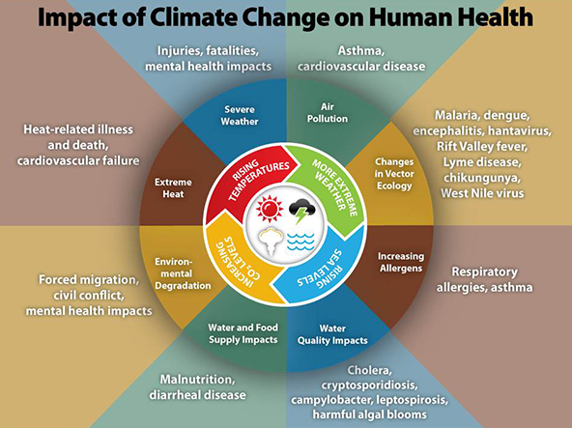
Climate Change and You
In what ways can climate change impact your work – long and short term?
Notes:
Consistent record breaking and anomalous temperatures.
Climate impact models, including those from UW’s Climate Impacts Group, suggests greater intensity, duration, and frequency of heat waves in the future.

Slide 31
Major Concepts of Equity
Procedural Equity: extent to which governing rules, regulations, evaluation criteria, and enforcement of health and safety laws are applied uniformly.
Geographical Equity: location and spatial configuration of communities and their proximity to locations of exposure to extreme climate hazards.
Social Equity: role of sociological factors in environmental decision-making that amplify exposure climate hazards.

Slide 32
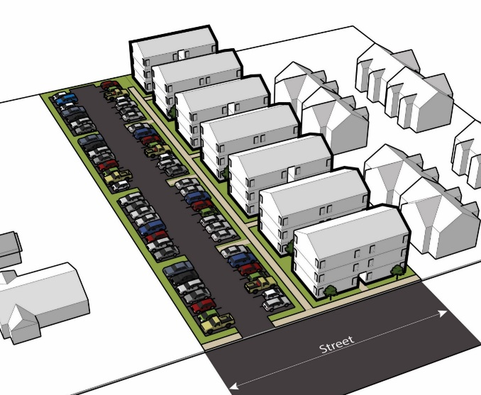
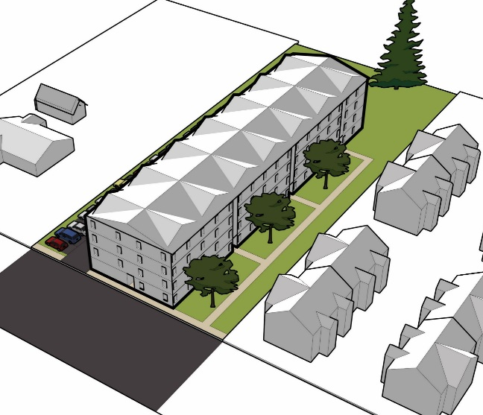
Questions
How does the spatial distribution of urban heat and air quality differ within and across Richmond (VA)?
What factors help to explain the distribution of heat?
Which communities are disproportionately impacted environmental degradation?
Notes:
This provides sharper focus to where we grow. The 2040 Plan does not contemplate uncontrolled growth inside the UGB. Portland has hundreds of miles of transit corridors. We have an opportunity to use growth as a tool to achieve more complete healthy connected neighborhoods. Access to transit is important, but not the only
ingredient that goes into creating distinctive high preforming places.
The Urban Design Framework also establishes a common language for different types of places related to their scale –
• Town Centers
• Civic Corridors
• Neighborhood Centers
and Corridors

