Slide 1
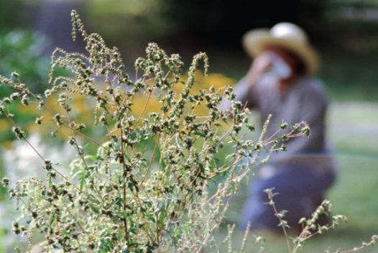
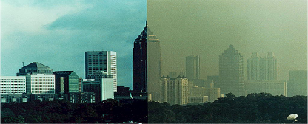
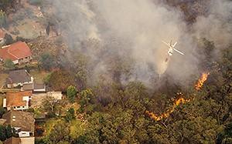
CDC Division of Environmental Health Science and Practice
Climate and Respiratory Health Initiatives
Claudia Brown, MDP
Karna, LLC for Climate and Health Program
Rish Vaidyanathan, PhD
Climate and Health Program
Patrick Wall
Environmental Public Health Tracking Program
Division of Environmental Health Science and Practice
National Center for Environmental Health
Centers for Disease Control and Prevention (CDC)
National Center for Environmental Health
Division of Environmental Hazards and Health Effects

Slide 2
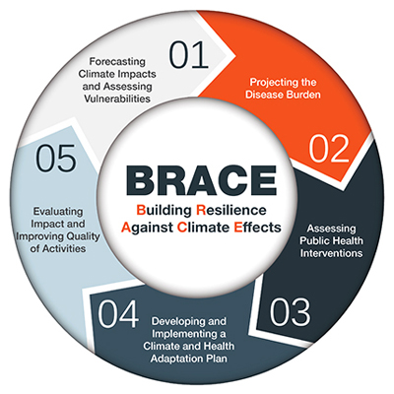


Division of Environmental Health Science and Practice
Programs working on Climate and Respiratory Health
Climate and Health Program
  Funds the cooperative agreement with CSTE to support Climate and Respiratory Health Activities
Asthma Control Program
Environmental Public Health Tracking Program

Slide 3
How we work together
Building the Knowledge
Translating the Data
Guiding Adaptations

Slide 4
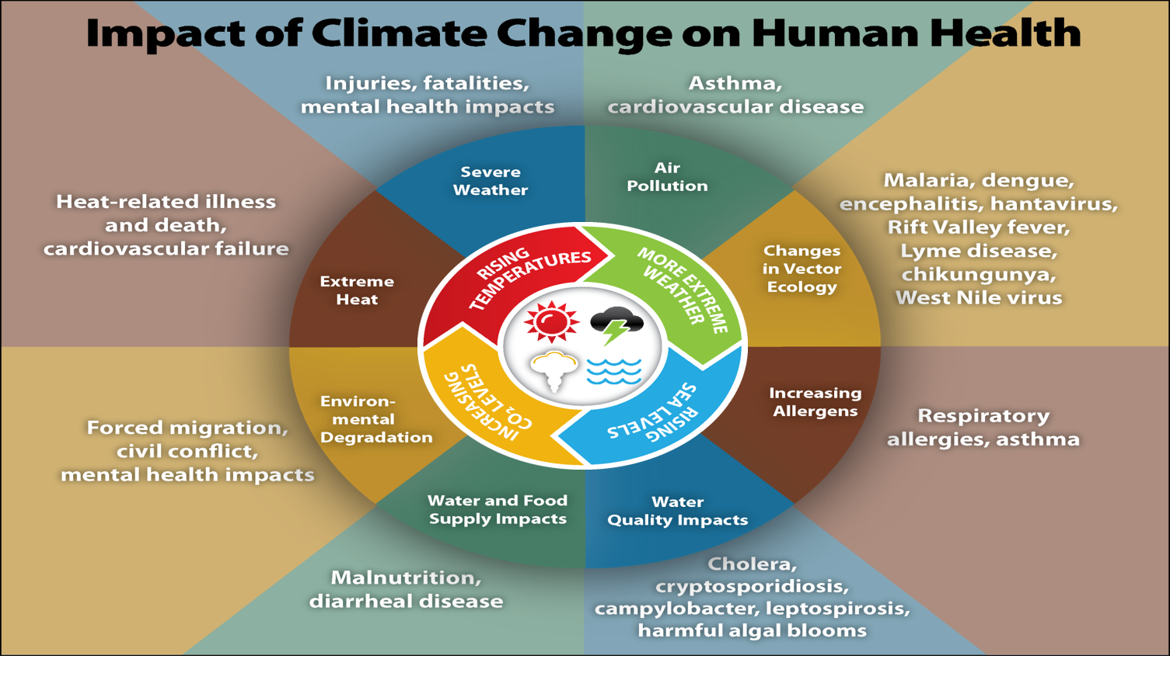
Notes:
Cleared Slide

Slide 5
Building the Knowledge
Translating the Data
Guiding Adaptations
Climate Drivers
Increased temperatures
Changes in precipitation
Exposure Pathways
Longer growing season and increased pollen production
Poorer air quality related to urban heat island effect
Health Outcomes
Asthma
COPD
Decreased soil moisture and increased wildfire risk
Allergic rhinitis
Influences
Age & Race
Housing & Infrastructure
Geography & Land Use
Healthcare access
Preexisting health conditions

Slide 6
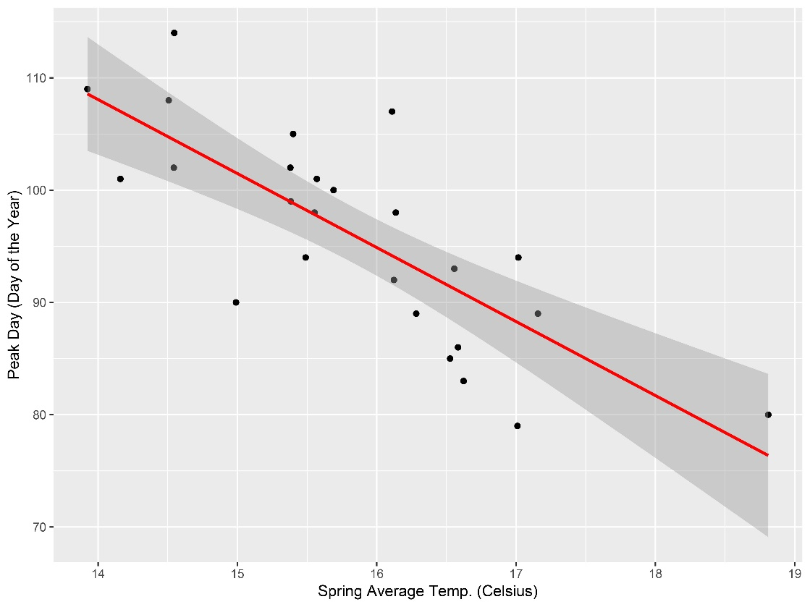
Climate Impacts on Pollen Production in Atlanta
Building the Knowledge
Translating the Data
Guiding Adaptations
Years with warmer Spring temperatures have earlier peak pollen days, signaling an earlier shift in the pollen season
Peak Pollen Day (Day of Year)
Spring Average Temp (Celsius)
Manangan, et al. Forthcoming.

Slide 7
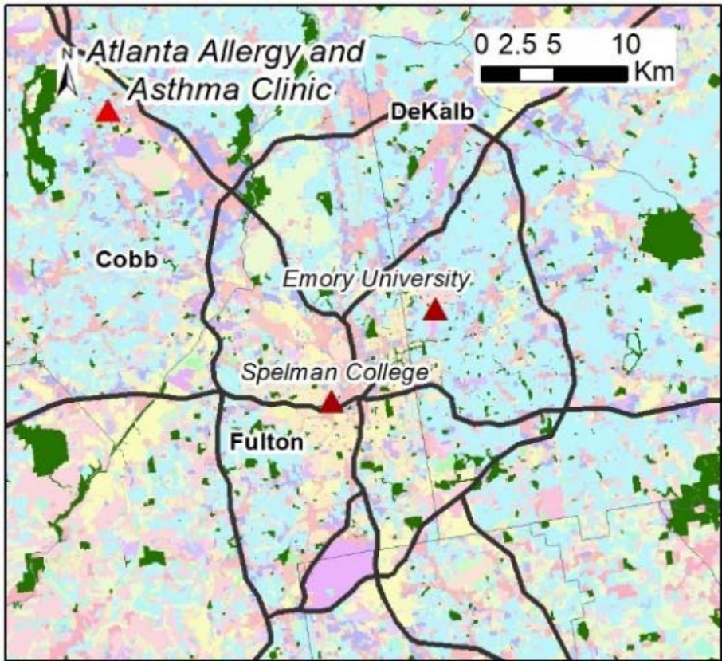
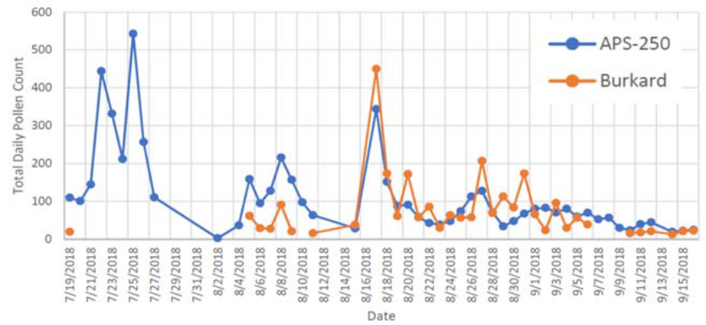
Intra-urban pollen variability and automated counting devices
Building the Knowledge
Translating the Data
Guiding Adaptations
Research collaboration with Emory University aimed at:
Comparing automated pollen sensor with NAB-certified station results
Assessing variation in pollen production across Atlanta
Comparison of pollen counts from National Allergy Bureau certified station and an automated pollen sensor
Proposed study domain. Land Use and green space map overlayed by potential sensor locations.
Notes:
Content cleared as part of research collaboration proposal

Slide 8
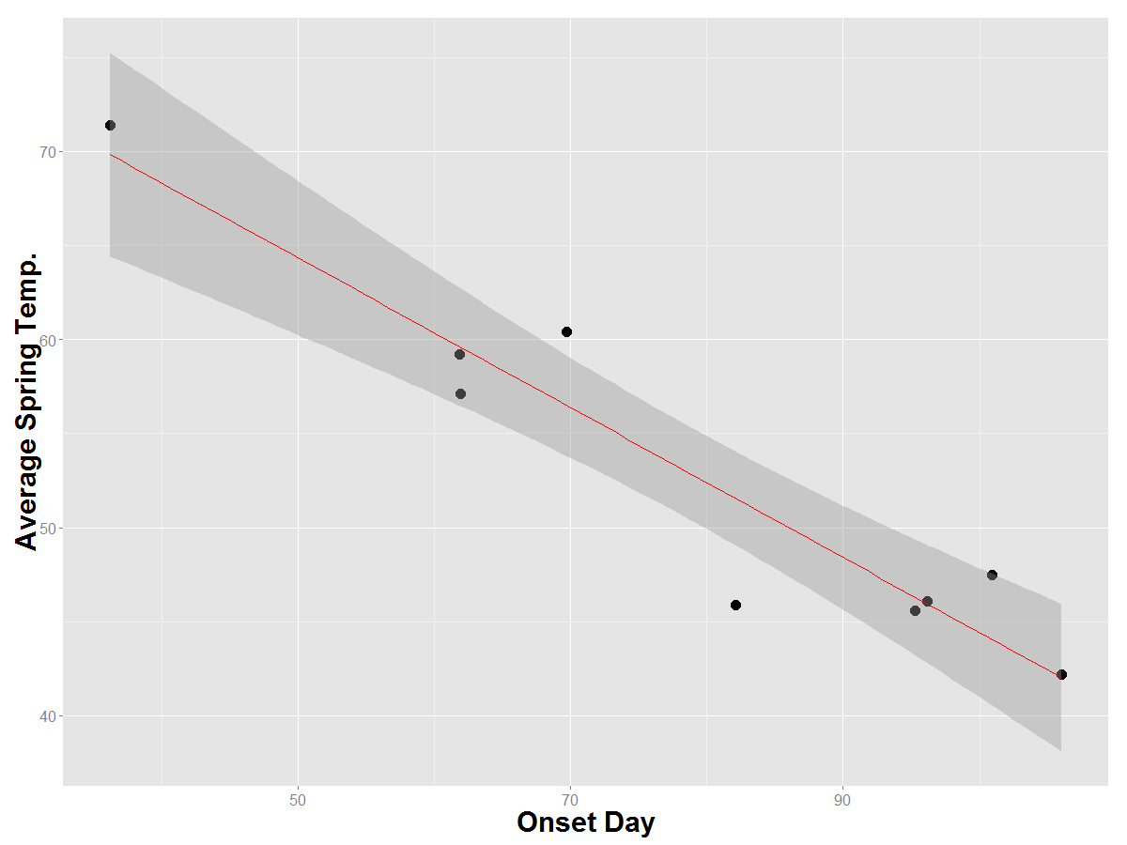
Tree Pollen Season Onset vs Spring Temp
Building the Knowledge
Translating the Data
Guiding Adaptations
Linear relationship between season onset (Spring) and temperature
  Locations with warmer Spring temperatures have earlier pollen season (R²= 0.91, p-value<0.001, df=7)
Sarasota, FL
Atlanta, GA
Raleigh, NC
Albuquerque, NM
Minneapolis, MN
Madison, WI
Baltimore, MD
Detroit, MI
Bangor,
ME
Manangan, et al. Forthcoming.
Notes:
Cleared content

Slide 9
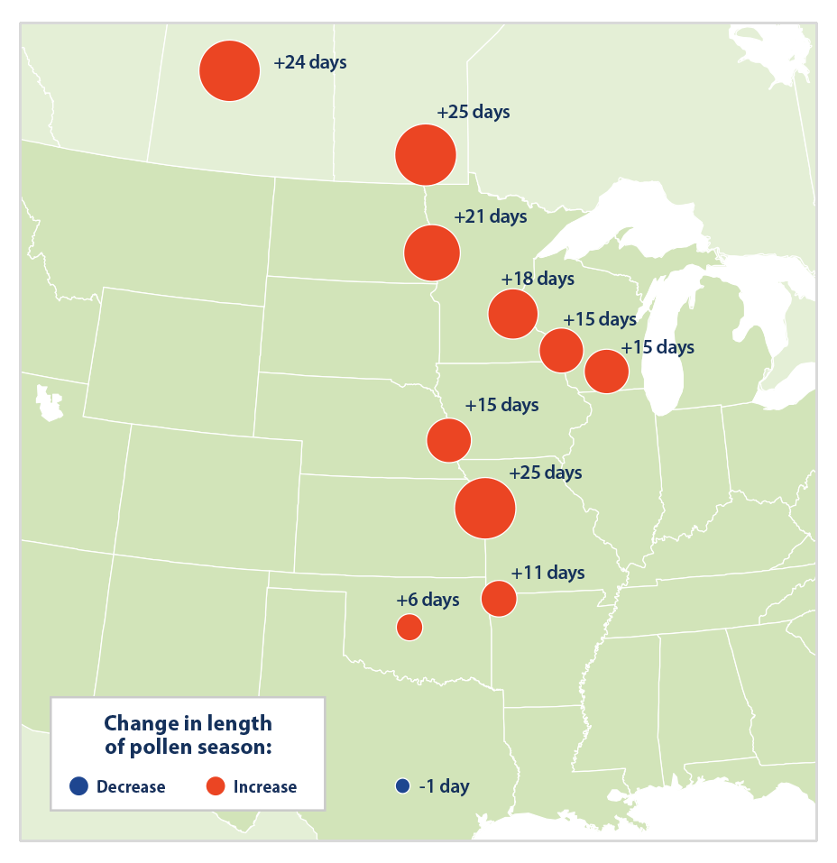
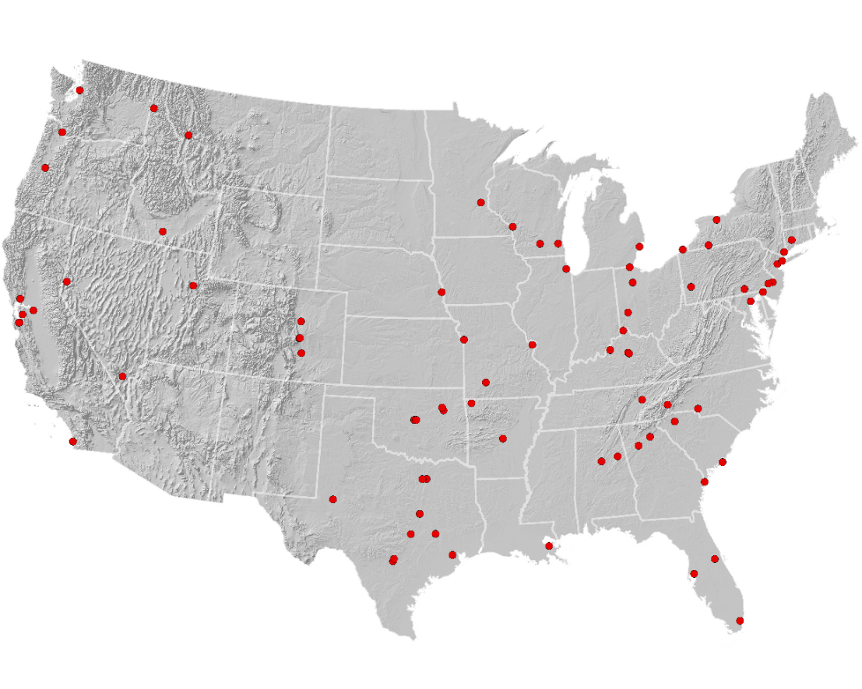
Update of EPA Climate Indicator - Pollen
Building the Knowledge
Translating the Data
Guiding Adaptations
National Allergy Bureau Pollen Stations
Change in ragweed pollen season (1995-2015)
Notes:
Cleared content

Slide 10
Shifts in Global Pollen Season Timing
Building the Knowledge
Translating the Data
Guiding Adaptations
Literature review of global pollen trends
  Results of hundreds of analyses across 62 peer-reviewed studies
Schramm, P, Brown, CL, Saha, S, Conlon, K, Bell, J, and J Hess. Effects of temperature and precipitation on global pollen trends and implications for human health: A systematic review. Forthcoming.
Notes:
Cleared slide

Slide 11
Shifts in Global Pollen Season Amounts
Building the Knowledge
Translating the Data
Guiding Adaptations
Schramm, P, Brown, CL, Saha, S, Conlon, K, Bell, J, and J Hess. Effects of temperature and precipitation on global pollen trends and implications for human health: A systematic review. Forthcoming.
Notes:
Cleared slide

Slide 12
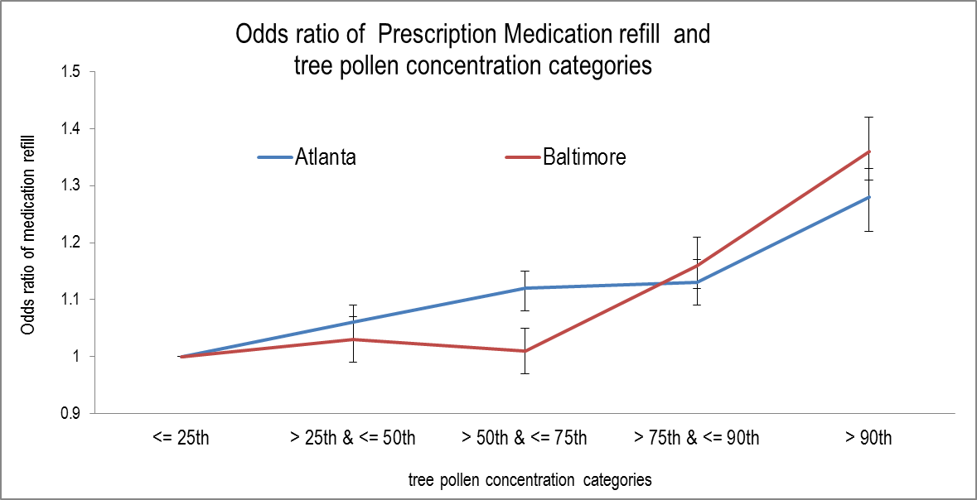
Building the Knowledge
Translating the Data
Guiding Adaptations
Health impacts from pollen exposure
Saha et al. Forthcoming.

Slide 13
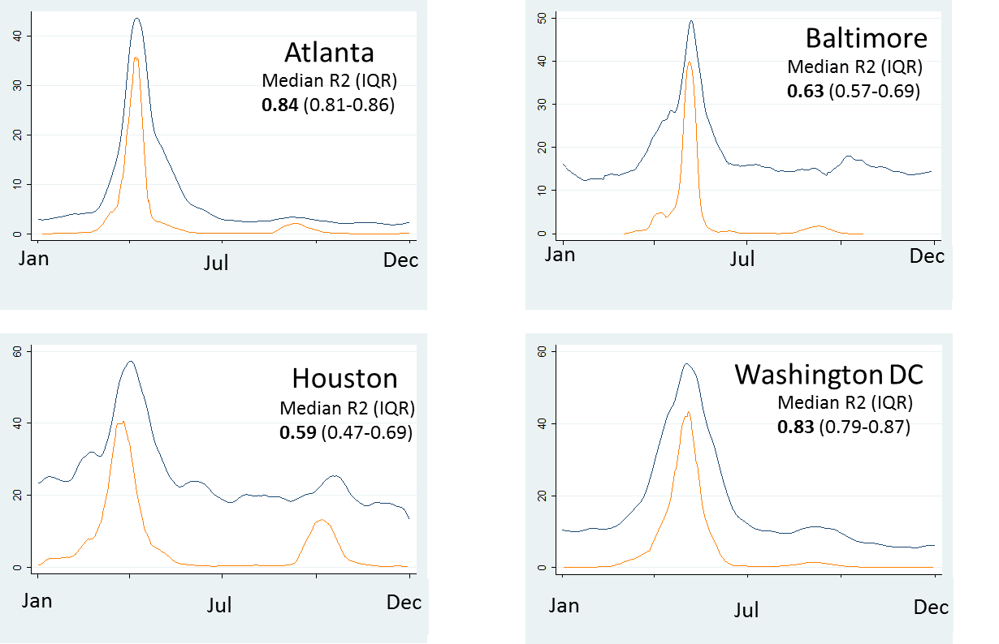
Modelling Pollen using Proxy Measures
Google Trends Data and Pollen
Building the Knowledge
Translating the Data
Guiding Adaptations
Blue: GT searches for “pollen”
Orange: NAB pollen data
2015 data used for Atlanta and Baltimore2014 data used for Houston and Washington DC
Hall, J et al. Forthcoming.

Slide 14
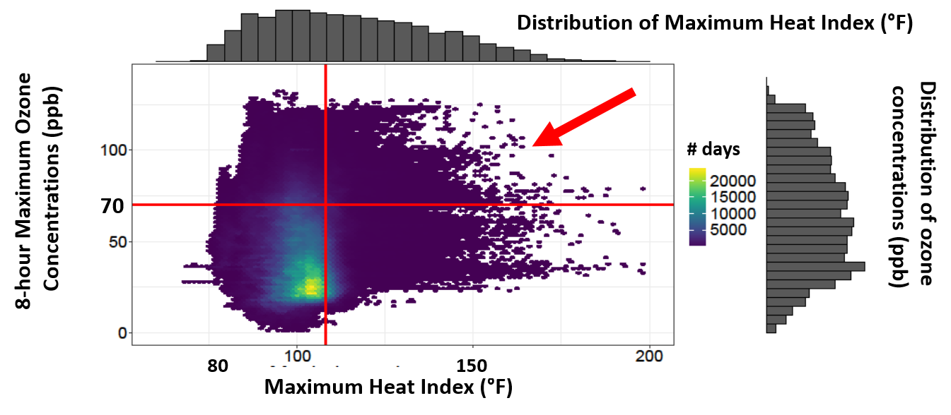
Building the Knowledge
Translating the Data
Guiding Adaptations
Impacts of urban air pollution and extreme heat on health
Coincidence of days of high temperature and high ozone pose significant health risks
Census tract data from 2000-2015 in Houston, TX.
O'Lenick et al. , 2019, In Review

Slide 15
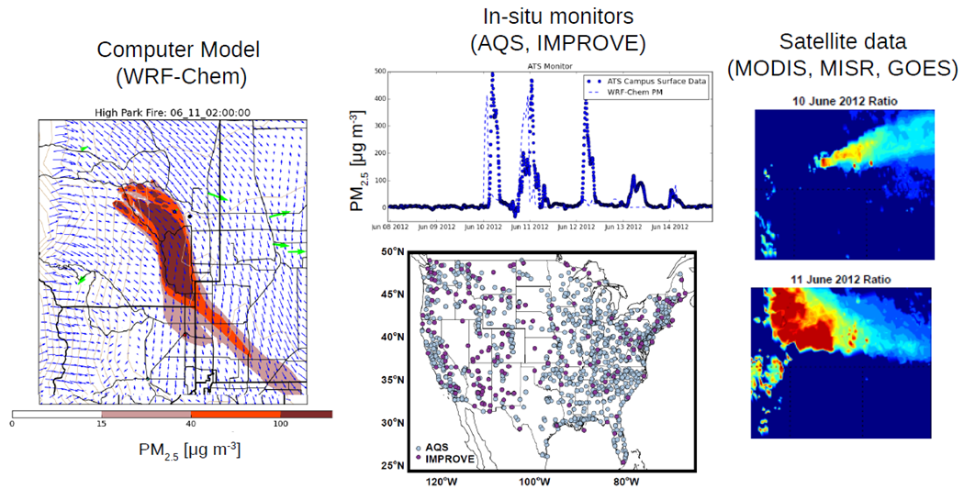
Building the Knowledge
Translating the Data
Guiding Adaptations
Wildfire Smoke – Health Activities:
Exposure Modeling
Notes:
Cleared content

Slide 16
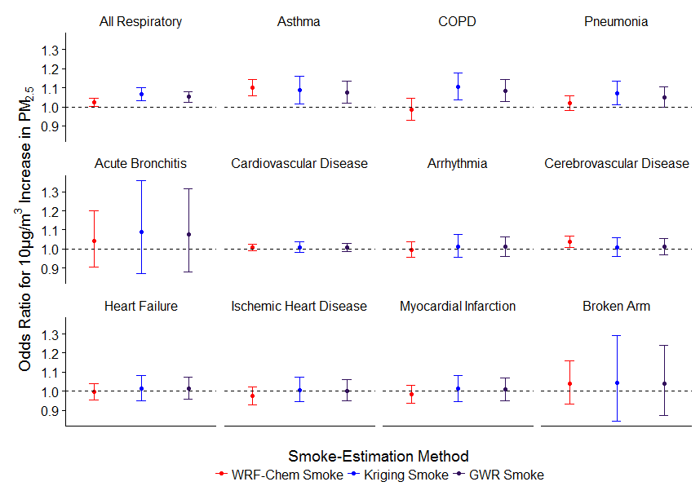
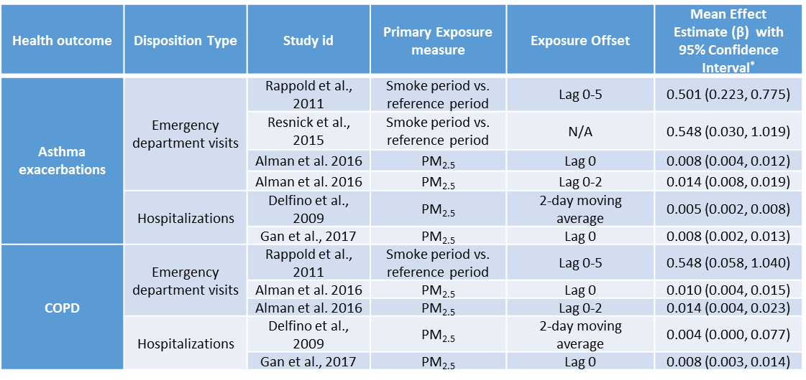
Building the Knowledge
Translating the Data
Guiding Adaptations
Wildfire Smoke – Health Activities:
Estimating Health Risks
Expand to include other wildfire episodes and compile a library of concentration –response (C-R) functions for various locations in the Western United States
Gan RW, Ford BH, Lassman W, Pfister G, Vaidyanathan V, Fischer E, Volckens J, Pierce JR, and Magzamen S. 2017. A comparison of smoke estimation methods and their association with wildfire smoke and cardiopulmonary-related hospital admissions during the 2012 Washington wildfires. GeoHealth, 1(3), pp. 122-136.
Notes:
Cleared content

Slide 17
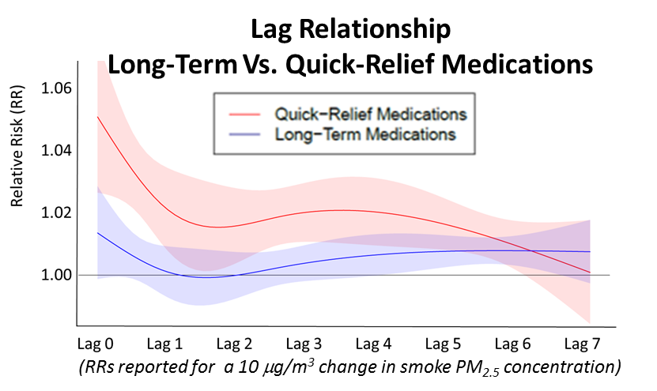
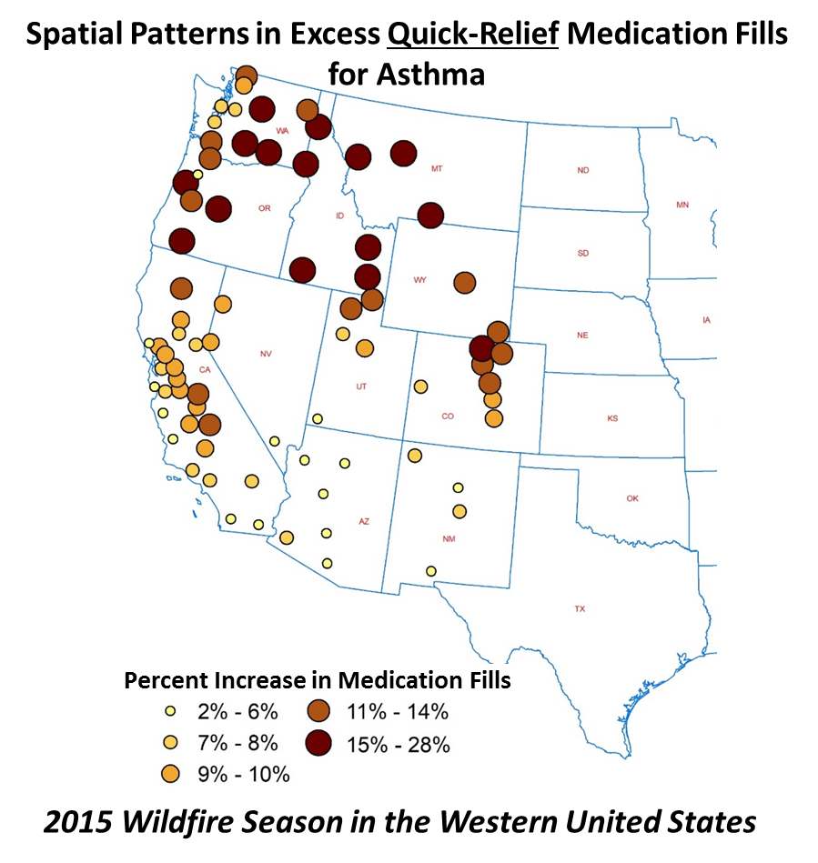
Building the Knowledge
Translating the Data
Guiding Adaptations
Wildfire Smoke – Health Activities:
Estimating Health Risks
Notes:
Cleared content

Slide 18
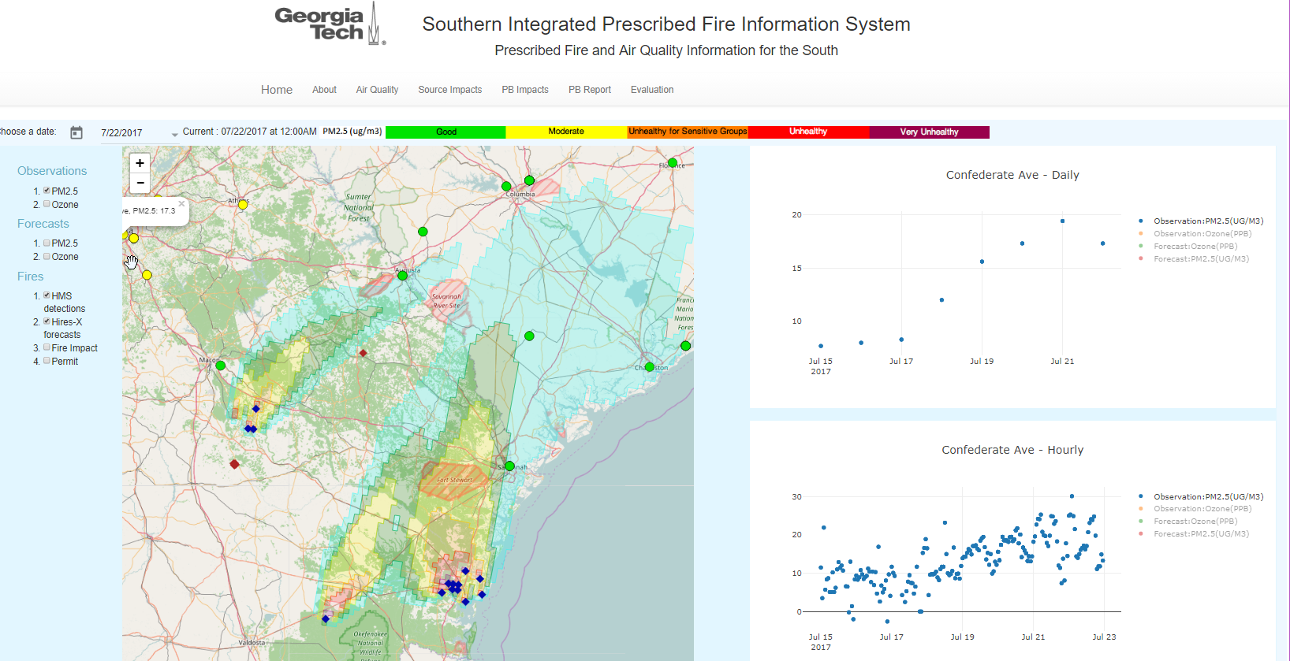
Building the Knowledge
Translating the Data
Guiding Adaptations
Wildfire Smoke – Tool Development:
Prescribed Burn Impacts
Hu Y, Ai H, Odman MT, Vaidyanathan A, and Russell AG. Development of a WebGIS-based Analysis Tool for Human Health Protection from Smoke Impacts of Prescribed Burns in Southeastern USA. International Journal of Environmental Research and Public Health (Under Review)
Notes:
Generated from previously cleared information

Slide 19
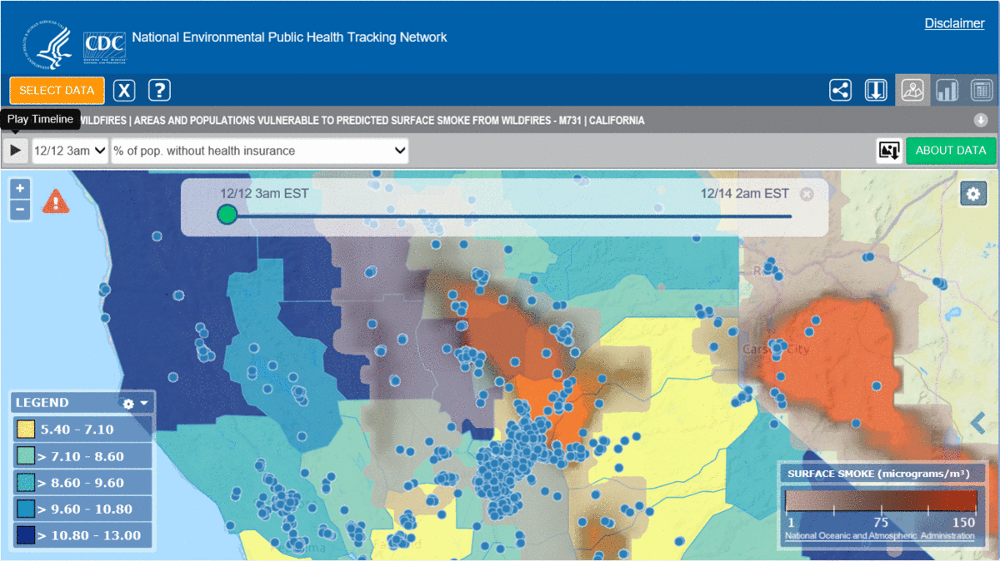
Building the Knowledge
Translating the Data
Guiding Adaptations
Wildfire Smoke – Tool Development:
Real-Time Smoke Vulnerability Assessment
Vaidyanathan A, Yip F, Garbe P. 2018. Developing an online tool for identifying at-risk populations to wildfire smoke hazards. Science of the Total Environment, 619, pp.376-383.
Notes:
Generated from previously cleared information

Slide 20
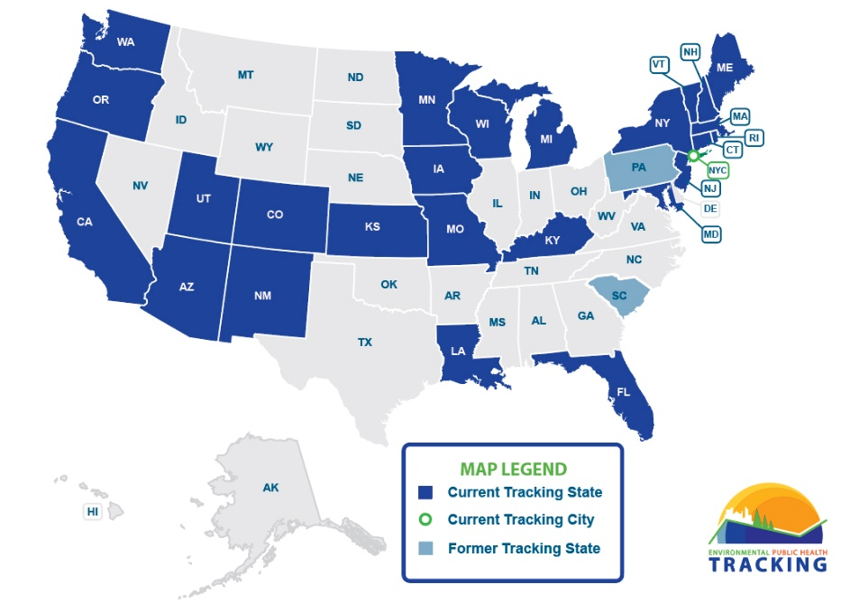
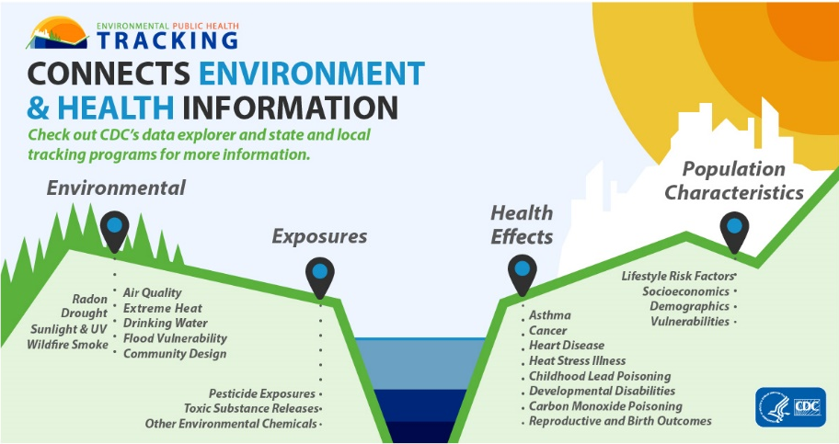
Environmental Public Health Tracking Program
Building the Knowledge
Translating the Data
Guiding Adaptations
Infrastructure + Data + People
Notes:
Generated from previously cleared information

Slide 21
Environmental Public Health Tracking Program
Building the Knowledge
Translating the Data
Guiding Adaptations
Define surveillance question
Evaluate data
Programs, interventions, or polices informed
Individuals or communities take action
Standardized, actionable EH data are accessible
Integrate data
Analyze or translate data
Disseminate information
Notes:
Generated from previously cleared information

Slide 22
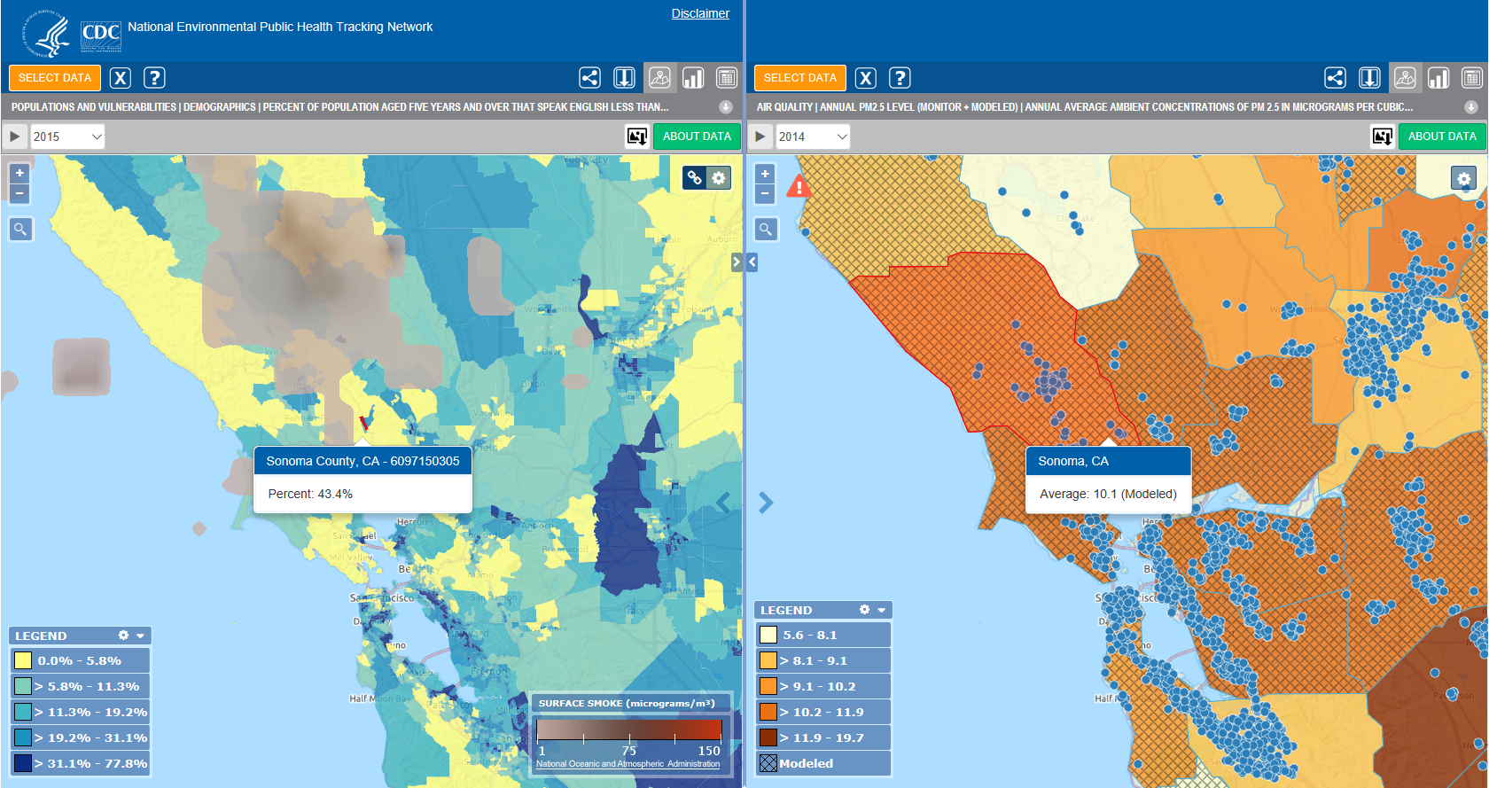
Environmental Public Health Tracking Program
Building the Knowledge
Translating the Data
Guiding Adaptations
Notes:
Generated from previously cleared information

Slide 23
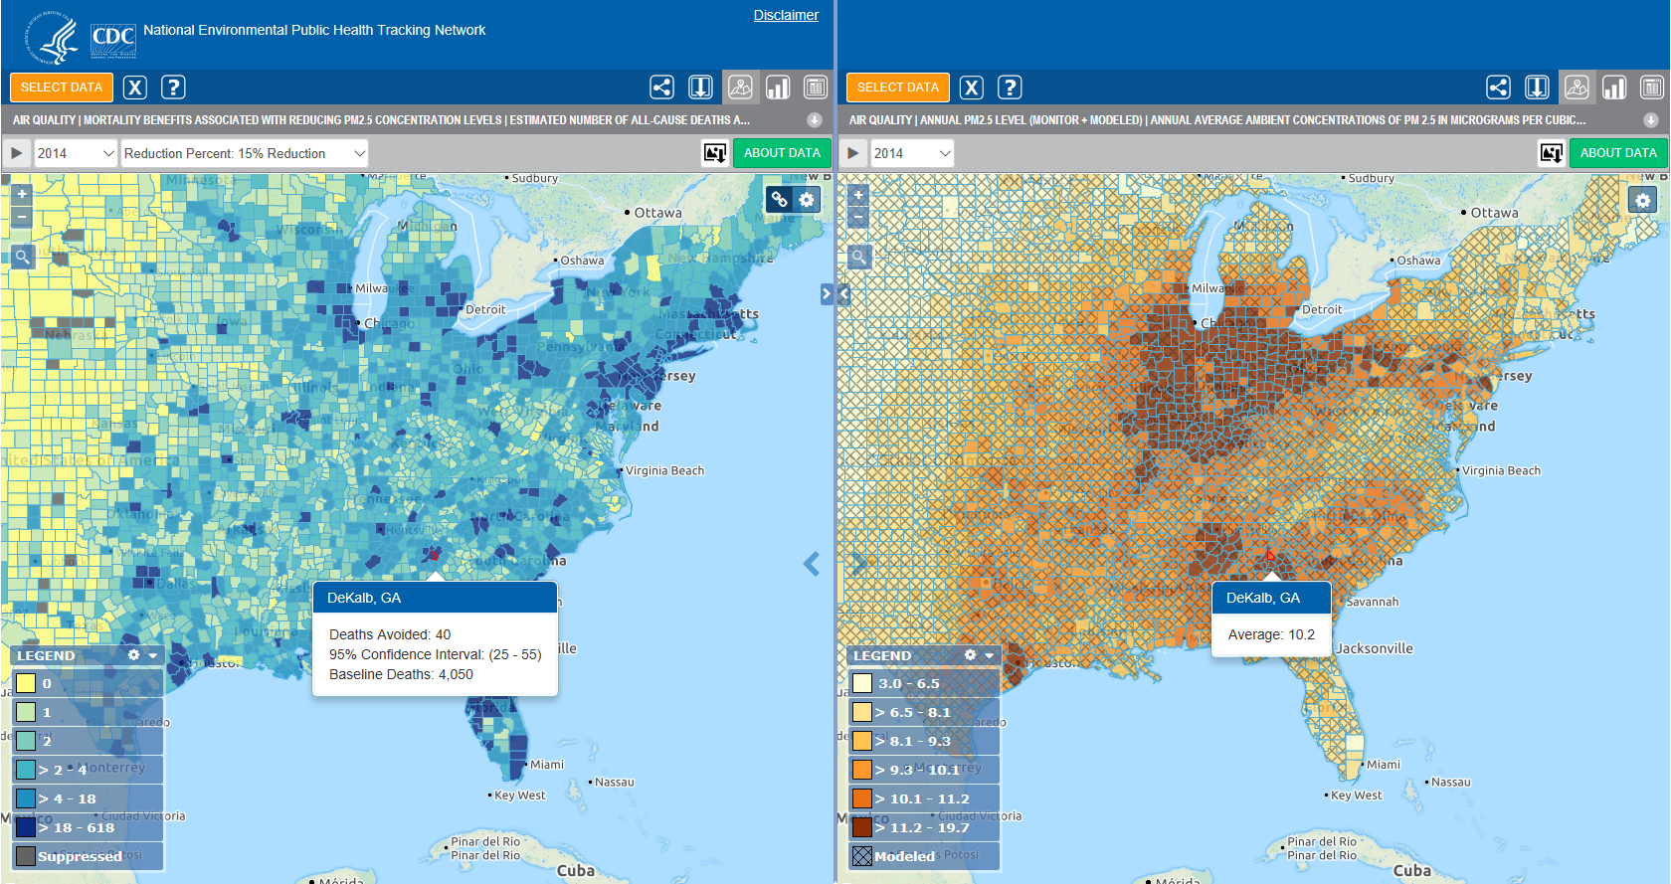
Environmental Public Health Tracking Program
Building the Knowledge
Translating the Data
Guiding Adaptations
Notes:
Generated from previously cleared information

Slide 24
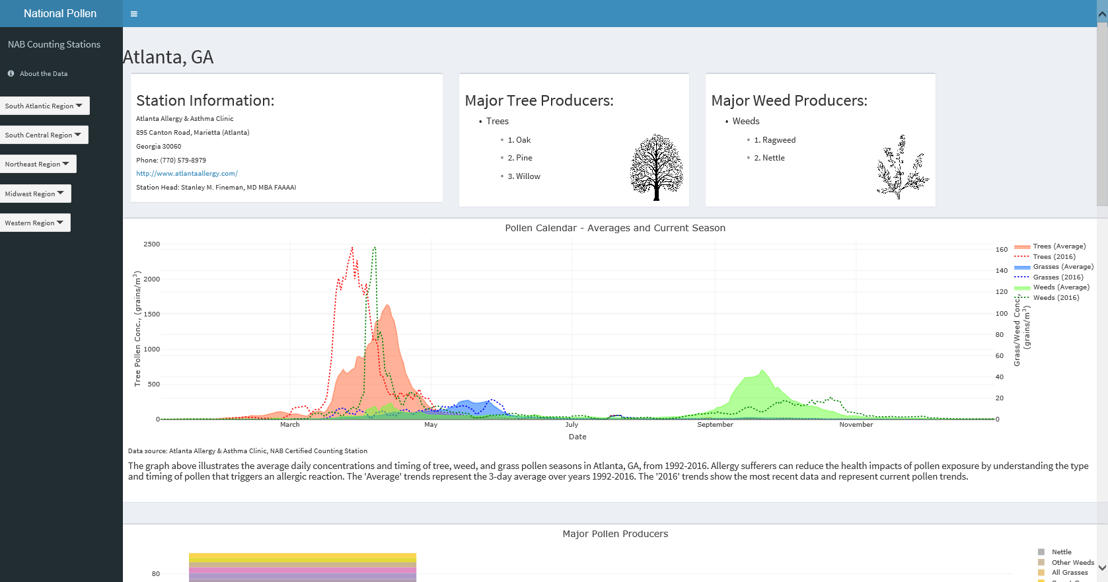
CDC/NAB Pollen Data Proposal and Collaboration
Building the Knowledge
Translating the Data
Guiding Adaptations
Station information
Major producers
Average pollen concentrations in calendar year by trees, weeds and grasses
Real-time pollen concentrations for current year
Prototype of counting station page: Atlanta, GA
Red indicates trees, Green is weeds, Blue is Grasses
Notes:
Cleared slide

Slide 25
Building the Knowledge
Translating the Data
Guiding Adaptations
Notes:
Cleared Content

Slide 26
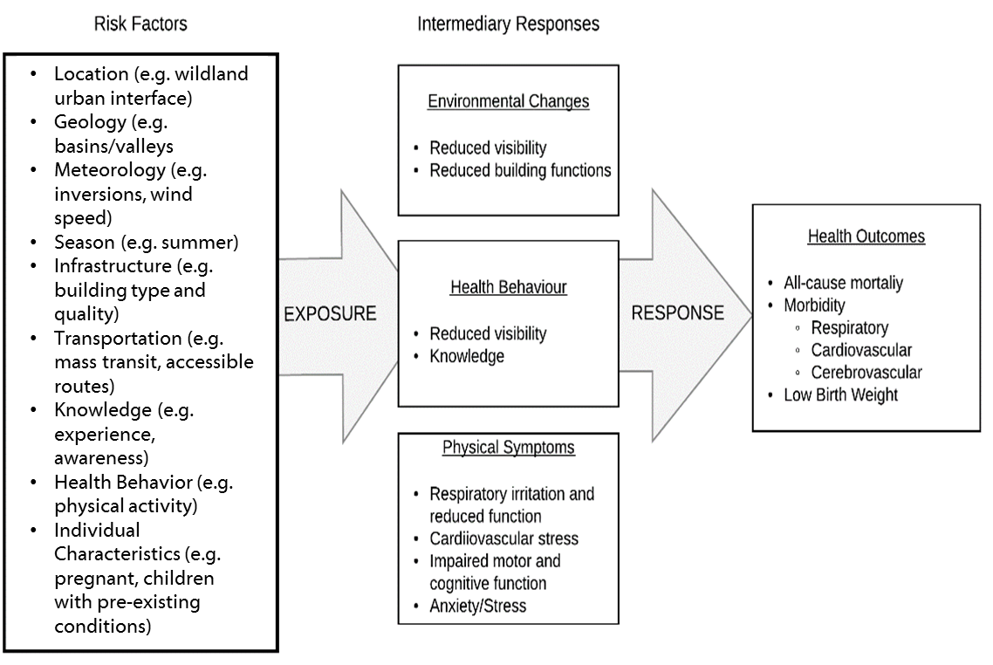
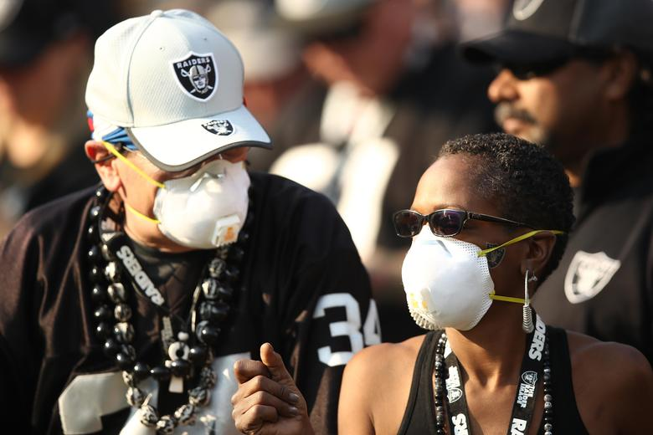
Wildland Fire Intervention Assessment
Building the Knowledge
Translating the Data
Guiding Adaptations
Analytic framework for characterizing interventions for reducing health outcomes to wildland fire smoke exposure.
Michael, R., Widerynski, S., Conlon, K., and C. Austin. Assessment of Wildfire Interventions: CDC Technical Guidance Document. Forthcoming.

Slide 27
CDC’s Controlling Childhood Asthma, Reducing Emergencies (CCARE) initiative will prevent half a million hospitalizations and emergency department visits among children with asthma in five years.
Building the Knowledge
Translating the Data
Guiding Adaptations
Notes:
Cleared Slide

Slide 28


Asthma Evidence-based Strategies
Building the Knowledge
Translating the Data
Guiding Adaptations
Education on asthma self-management
X-tinguishing smoking and secondhand smoke
Home visits for trigger reduction and asthma self-management education
Achievement of guidelines-based medical management
Linkages and coordination of care across settings
Environmental policies or best practices to reduce asthma triggers from indoor, outdoor, and occupational sources
Notes:
Cleared slide

Slide 29
Thank You
The findings and conclusions in this presentation are those of the author and do not necessarily
represent the official position of the Centers for Disease Control and Prevention.
National Center for Environmental Health
Division of Environmental Hazards and Health Effects
Notes:
Thank you.

