Slide 1
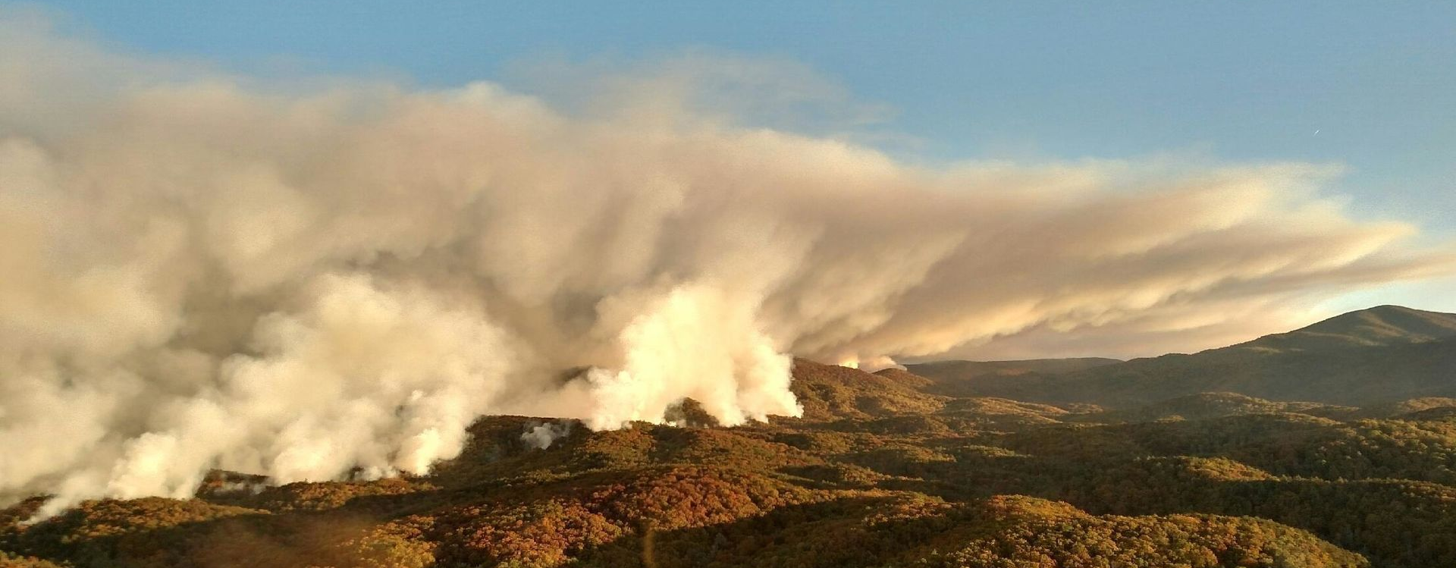
wildfires
Ken Arney,
Regional Forester, Southern Region
USDA Forest Service
Notes:
Thank you for the introduction.
It’s a pleasure to be here today to talk about wildfire and smoke as it relates to respiratory health and our changing climate.
I would like to start off by talking about the 2016 wildfires we experienced in the Southeast.

Slide 2
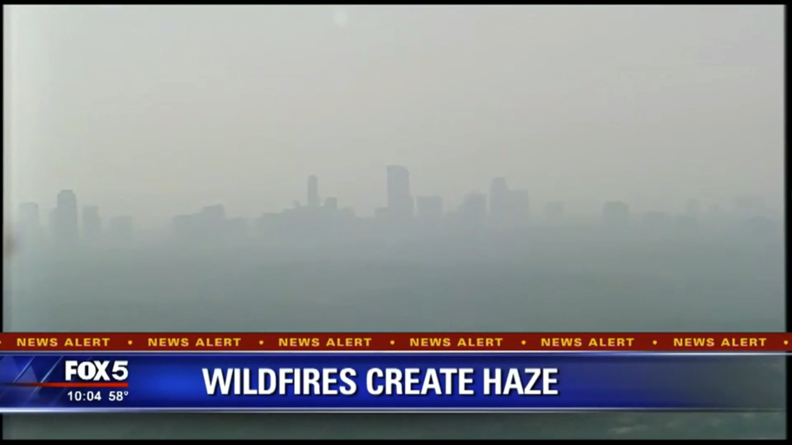
Notes:
The Fall 2016 Fire Season was very active in the Southern Region.
From early October through early December,
we had roughly 12-THOUSAND fires that consumed nearly 400-THOUSAND acres.
Here’s a news clip from Atlanta’s Fox FIVE news that aired on November 6th.

Slide 3
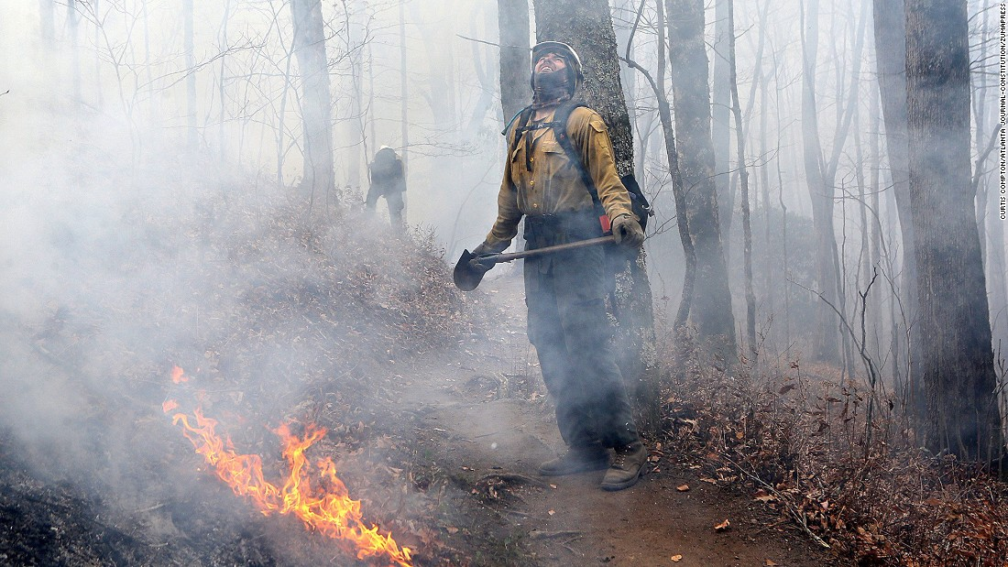
Forest Service deploys
~90 crews
~80 aviation assets
Photo by Curtis Compton, Atlanta Journal Constitution
Notes:
Over a span of 39 days,
nearly 5,000 ground and aviation resources
were activated and assigned
through the federal dispatch system
to fire incidents in the Southern Region.

Slide 4
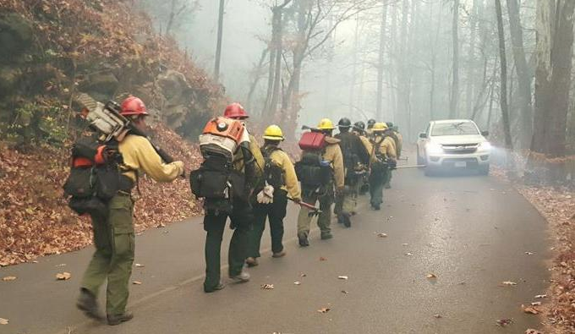
Interagency firefighter crew in the Great Smoky Mountains National Park. November 30, 2016.
AP Photo
Notes:
We worked hard – together – to fight those fires.
Even with all that response,
that fire season was very costly.

Slide 5
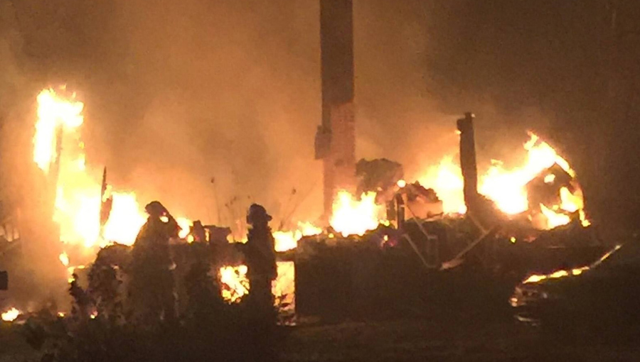
Firefighters stand by a destroyed home after a wildfire forced the mandatory evacuation of Gatlinburg, Tennessee on November 30, 2016.
Photo by Tennessee Highway Patrol
Notes:
In Tennessee, the Great Smoky Mountains wildfires
claimed the lives of 14 people.
More than 130 people were injured,
and more than 24-hundred structures were destroyed.

Slide 6
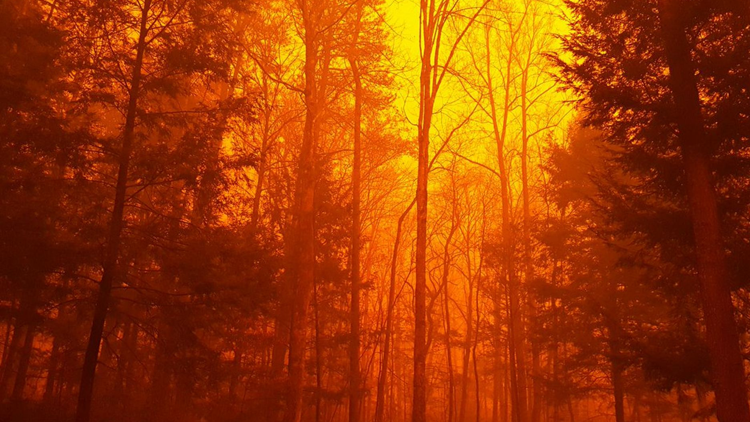
Federal Firefighting Suppression Costs
Notes:
Wildfires cost so much.
Lives.
Property.
And resources to control the wildfires:
Firefighters, time, and money.
With the changing climate
and increase in people in and around the forests,
the threat for an increase in the number
and the size of wildfires is very real.
This graph reflects fire suppression costs for all federal agencies – including the USFS.
In 2018, we spent 57% of a $5 Billion dollar budget on fire suppression – at the cost of other programs.
(Fire Funding Fix)

Slide 7
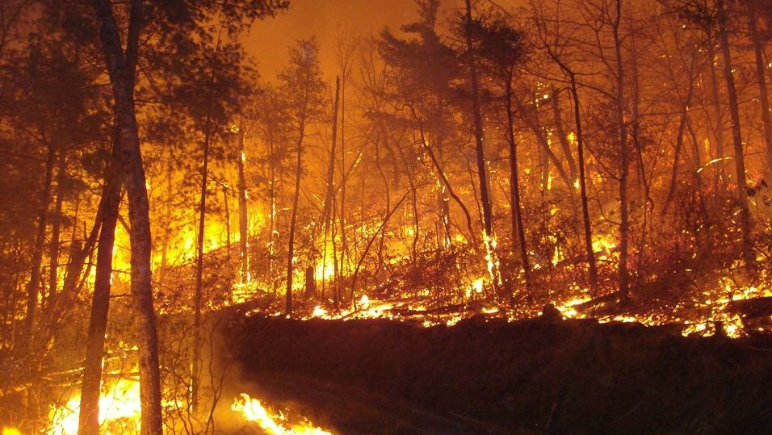
Burnout fire set to combat 2016 wildfire in Chattahoochee National Forest.
Photo by USFS
Notes:
However,
We can work
to mitigate that risk,
to reduce the potential size of wildfires,
and reduce the devastating effects of wildfires.
It’s a focus area for the USDA Forest Service nationally,
regionally
and within our science branch.

Slide 8
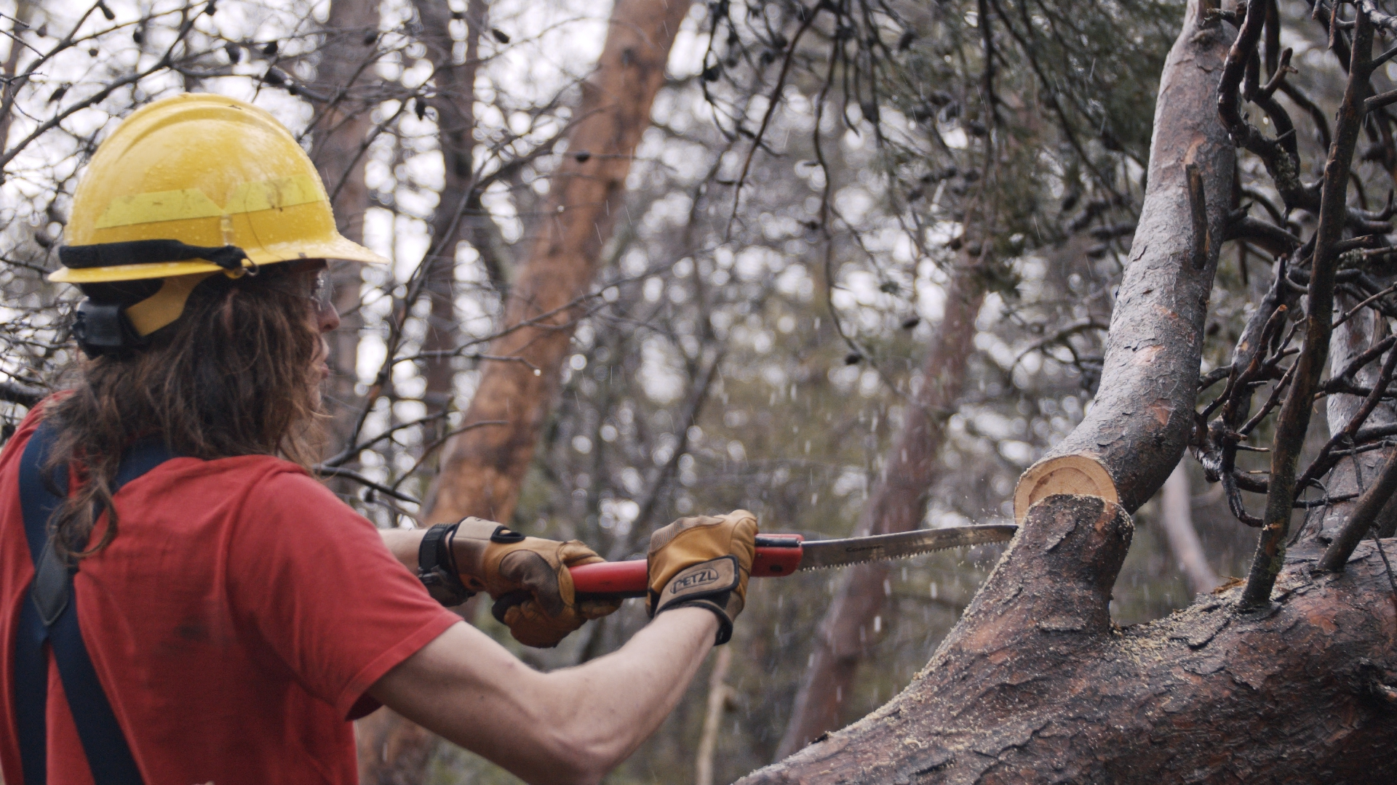
Active Management
Thin forests
to ensure right mix, age, and density of trees
Treat forest lands
to remove or reduce invasive insects and plants
Conduct prescribed fires
to reduce hazardous fuels, help the ecosystem
Notes:
We can mitigate the harmful
effects of wildfire through
active management.
Active management means:
We thin forest lands to
ensure the right mix, right age, and right density of trees
across a landscape.
This promotes forest resiliency and reduces hazardous fuels.
We treat forest lands to
remove or reduce invasive insect and plant species
that kill or weaken trees and create hazardous fuels.
And we also conduct prescribed fires to
reduce biomass fuels,
reduce risks of wildfire,
and protect resources.

Slide 9
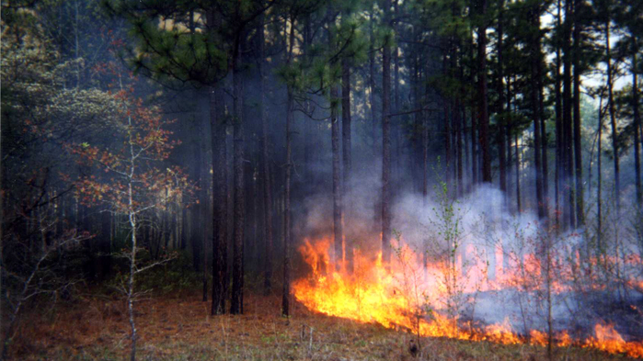
Wildfire and Prescribed Fire at Ft. Benning, Georgia
Number of Wildfires
Prescribed Fires (HA)
Notes:
The National Climate Assessment for 2018
highlights the Department of Defense’s efforts to control wildfires
by using prescribed fire.
The report highlights how the increased use of prescribed fire at Ft. Benning, Georgia,
led to a decrease in wildfire occurrence from 1982 to 2012.
The Forest Service has seen similar results.
Areas that have been treated previously by prescribed fire
tend to have less fuel
and, in many cases, have established fire lines that help control
where and how wildfires burn.

Slide 10
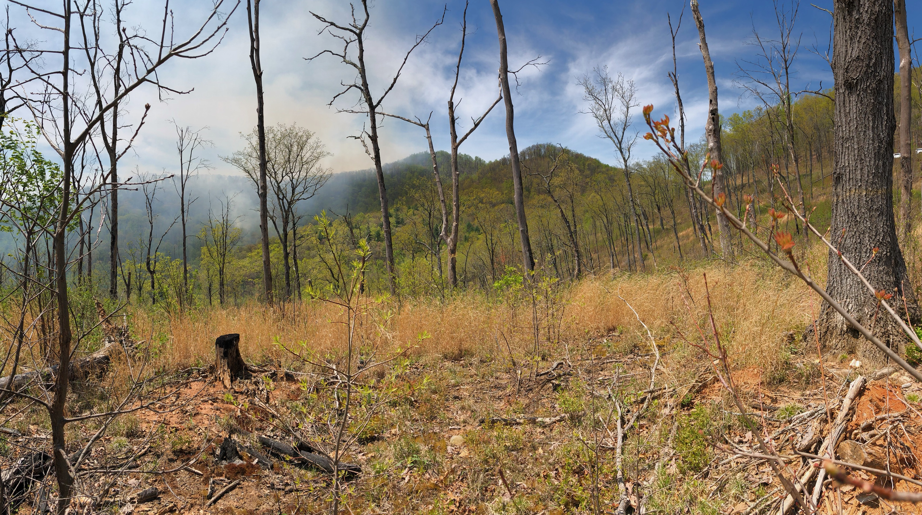
Prescribed fire helps ecosystems
be more resilient to wildfire
and be more resilient to climate change
Chattahoochee National Forest,
Photo by Ginelle Heller, USFS
Notes:
In addition to the direct benefits prescribed fire can have
in preventing and fighting wildfire,
there are some longer-term benefits prescribed fire brings to an ecosystem
that can make it more resilient to wildfire and climate change.

Slide 11
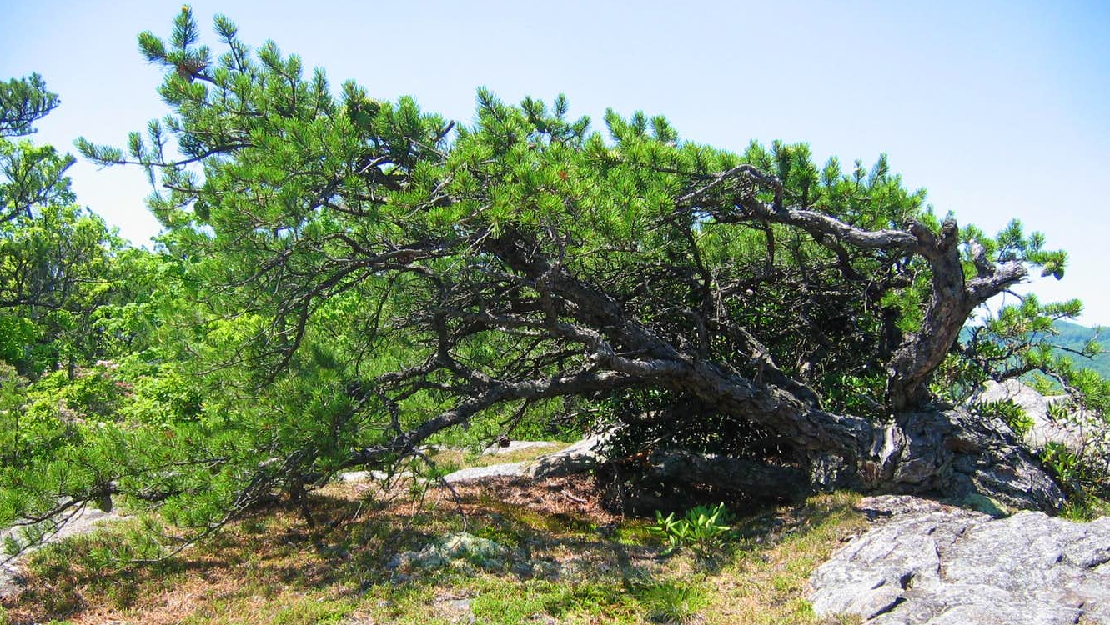
Table Mountain Pine, Little Lost Cove, NC
Photo by Bob Smith/ www.summitpost.org
Notes:
Fire is a natural and essential part of many ecosystems in the Southeast.
The pine cones of the Table Mountain pine
--- a small pine native to the Appalachian Mountains –
will wait years and years for fire at the right temperature
before opening up to disperse their seeds.

Slide 12
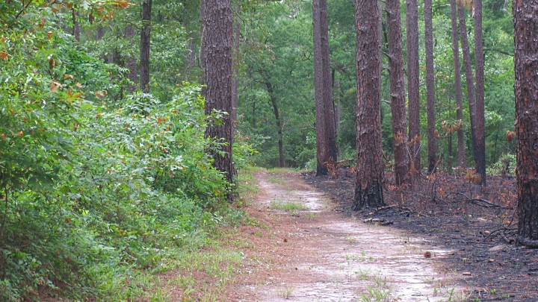
Unburned and burned Longleaf Pine
forest in South Carolina.
Photo by SC Department of Natural Resources
Notes:
Walk down any forest road in the Southeast
where one side was recently burned during a prescribed fire
and the other side hasn’t been treated years
and you’ll experience something quite amazing.
The wildlife is abundant.
Birds are chirping in the trees
and animal tracks can be found all over.
Sprouts from new trees and grasses pop up all over.
Periodic fire tends to favor understory species that require a more open habitat.
A mixture of burned and unburned areas tends to promote a large and varied wildlife population.
Deer, dove, quail, many song birds, and turkey are some of the species that benefit from fire.

Slide 13
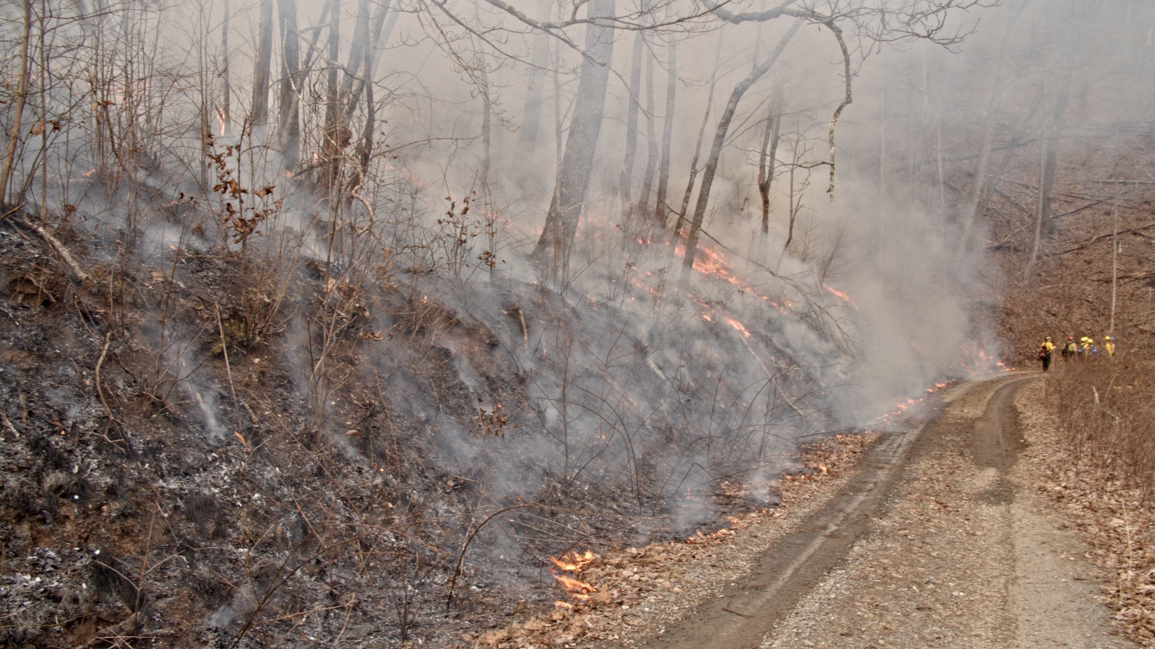
Prescribed fire in the
Chattahoochee National Forest.
Photo by Alex Cantatore / @quickactcasusal
Notes:
Fire can be good.
And prescribed fires can produce similar positive ecological effects of wildfires,
while decreasing the severity and frequency of future wildfires.
Because of all these benefits, prescribed fire is the dominant fuels treatment used in the South.

Slide 14
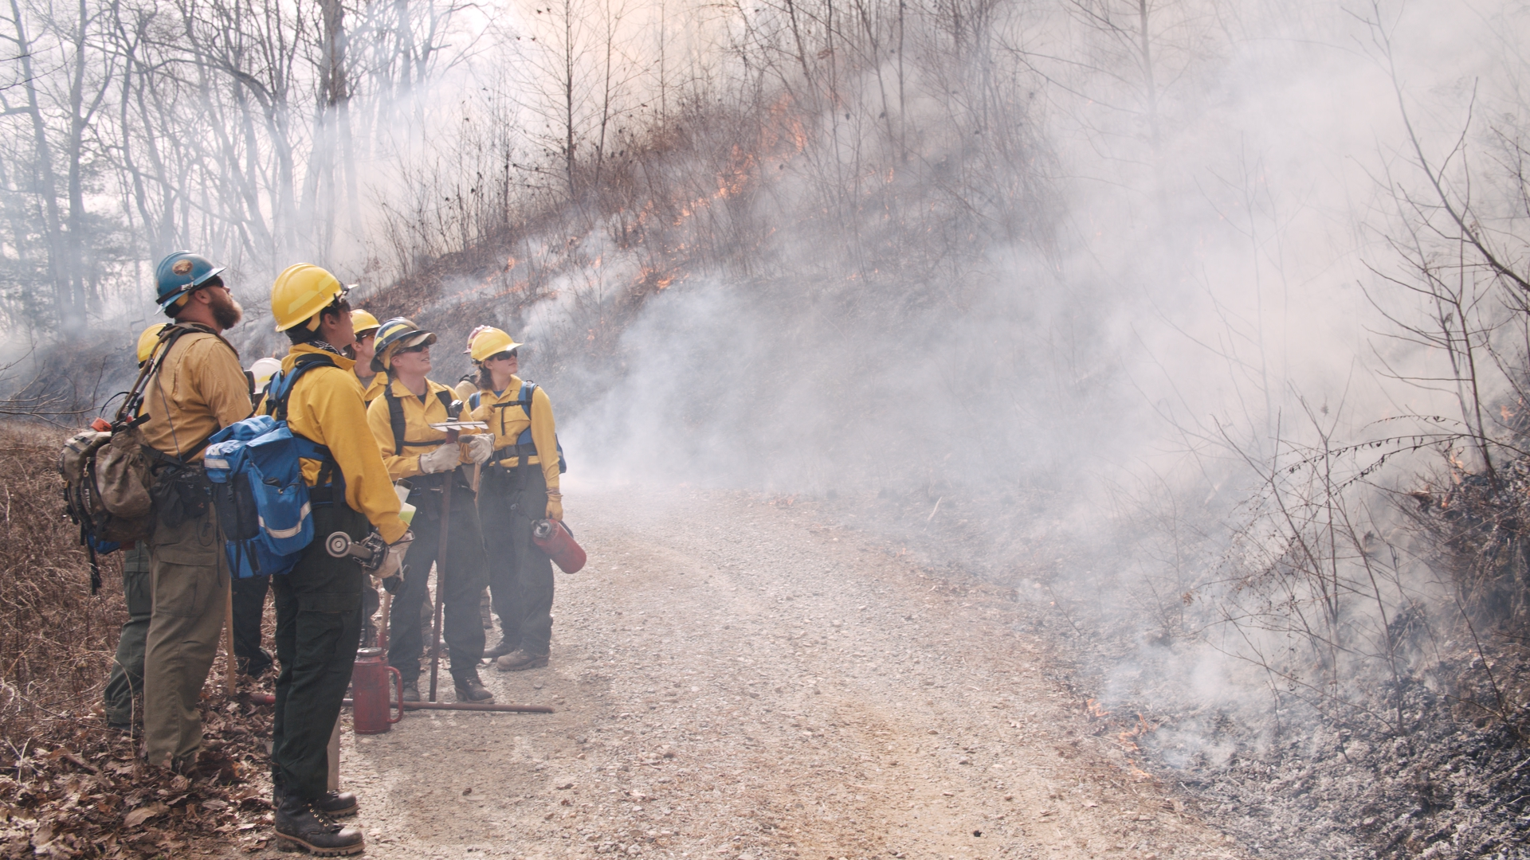
Prescribed fire in the
Chattahoochee National Forest.
Photo by Alex Cantatore / @quickactcasusal
Notes:
This puts us in a position where we are literally fighting fire with fire.
And with fire comes smoke.
Smoke is a major concern for us whenever there’s wildfire
or whenever we conduct a prescribed burn.
Large fires consuming above average fuel loads of vegetation
can far surpass regulatory agency standards for air quality.
Studies have shown that even limited exposure to wood smoke
can reduce resistance against infections
and that an association exists between wildfires and increased emergency room visits
for upper and lower respiratory illnesses and decreased lung function.

Slide 15
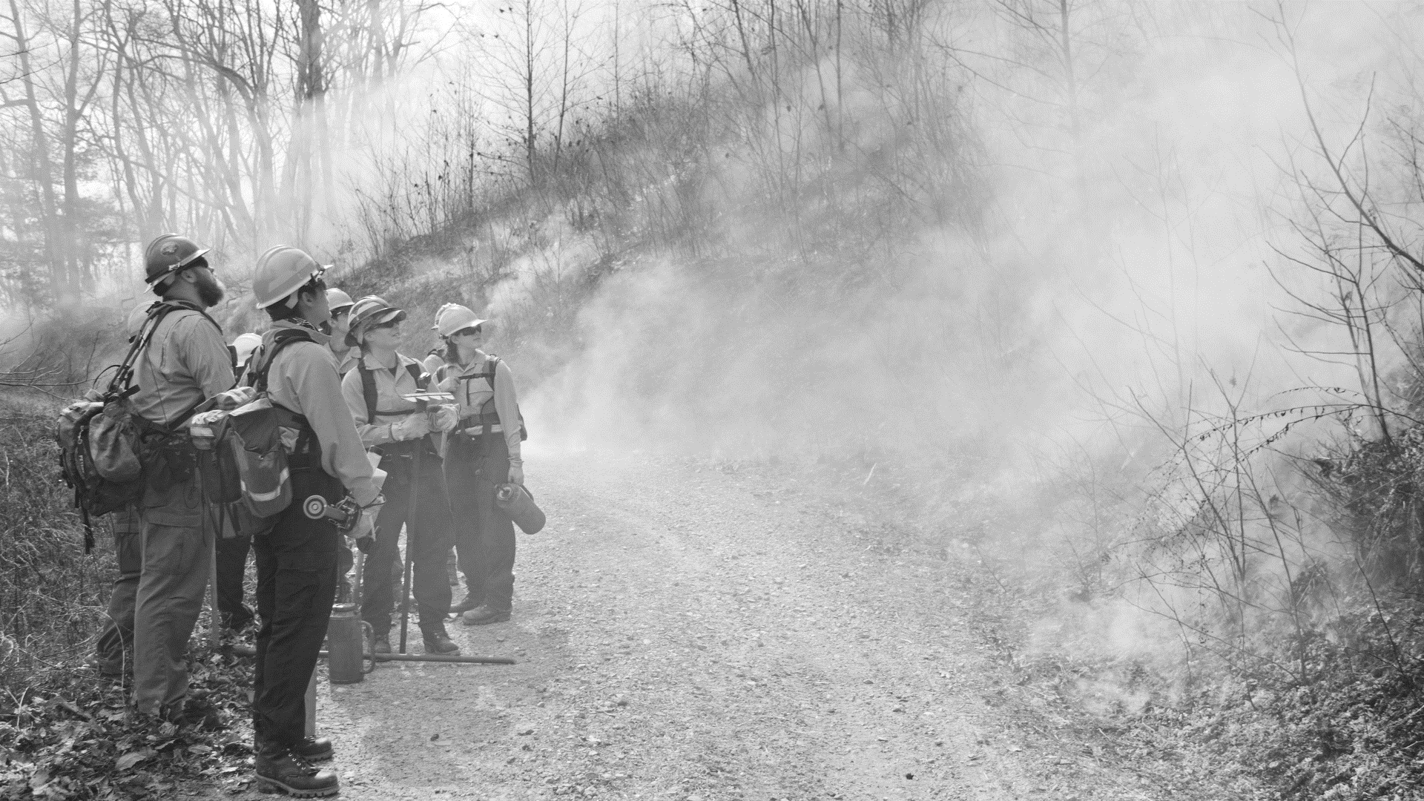
Particulate Matter size distribution
of vegetation fire smoke (in microns)
Photo by Alex Cantatore / @quickactcasusal
Notes:
Emissions from burning vegetation include
particulate matter, nitrogen oxides, carbon dioxide,
carbon monoxide, and volatile organic compounds, among others.
The level and duration of exposure to smoke
and the susceptibility of affected populations
are key areas for consideration when evaluating health impacts.
Groups expected to be more susceptible to the health impacts of smoke are
children, pregnant women, the elderly,
and individuals with pre-existing respiratory and cardiac diseases.
We understand that smoke from wildfires is a significant health issue.
This is one of the major reasons the Forest Service and CDC
have developed a working relationship.

Slide 16
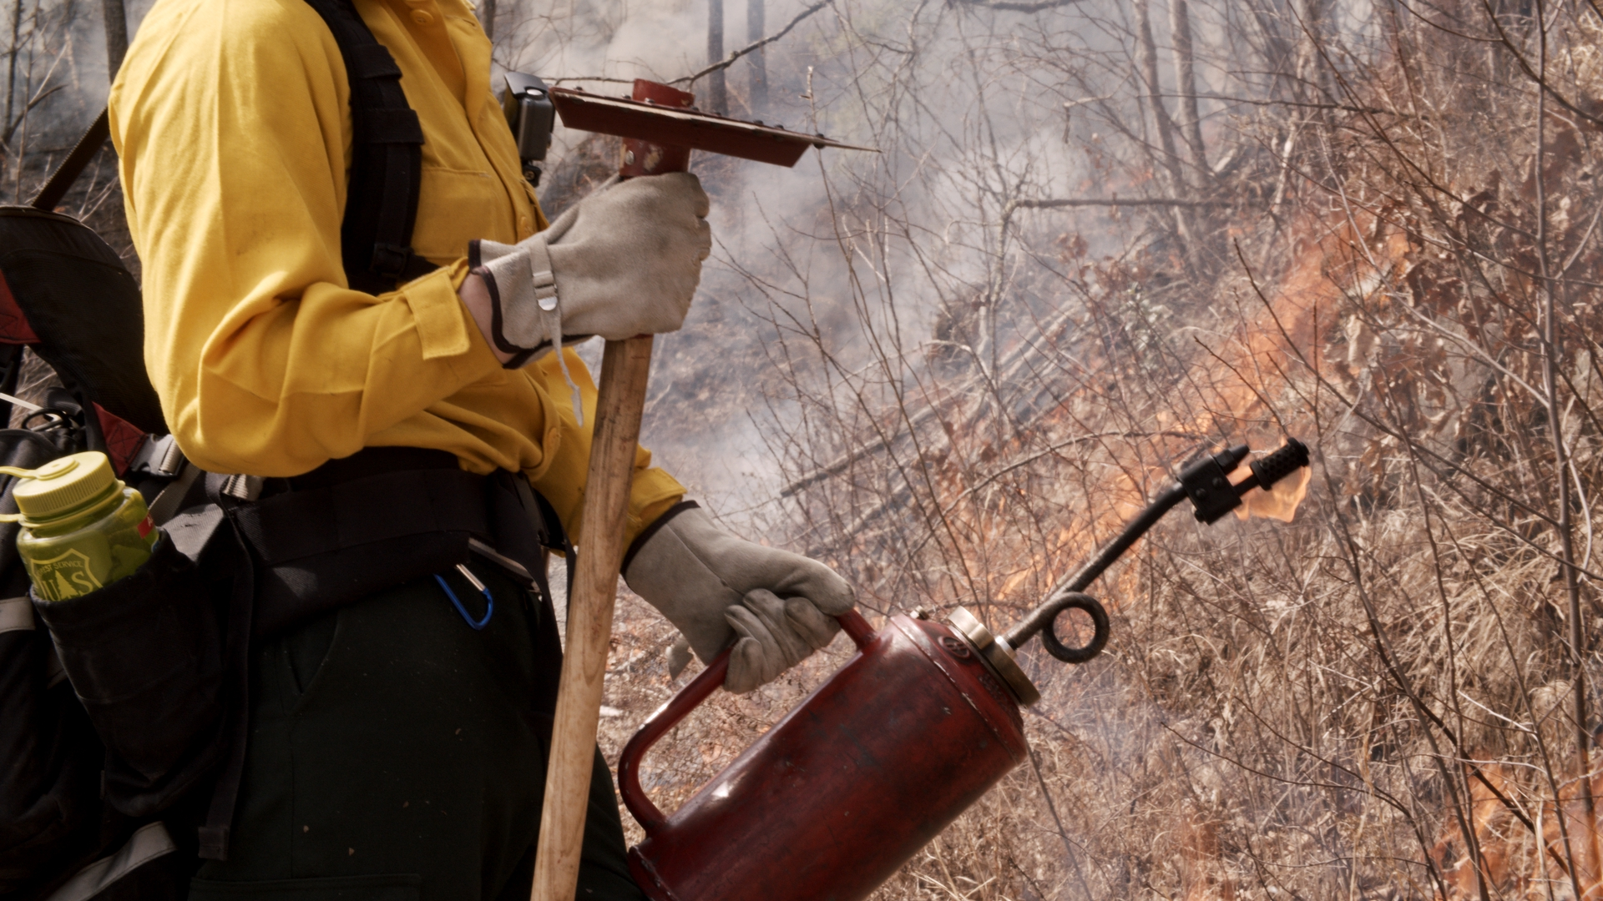
Good Fire is
when we choose the
conditions,
location,
time,
and intensity
of a controlled burn.
Photo by Alex Cantatore / @quickactcasusal
Notes:
These controlled burns still emit smoke.
It’s still harmful
and it still contains the same harmful mix of particulate matter.
The difference, and this is key,
is we get to choose the conditions.
We get to choose where and when we conduct a prescribed fire.
We can take advantage of favorable atmospheric conditions
that disperse smoke away from sensitive areas.
We can set fire when atmospheric conditions are likely to help
transport PM2.5 to the upper reaches of the mixing height.
Basic Smoke Management Practices have been designed
to reduce the impacts of smoke on individuals and communities.

Slide 17
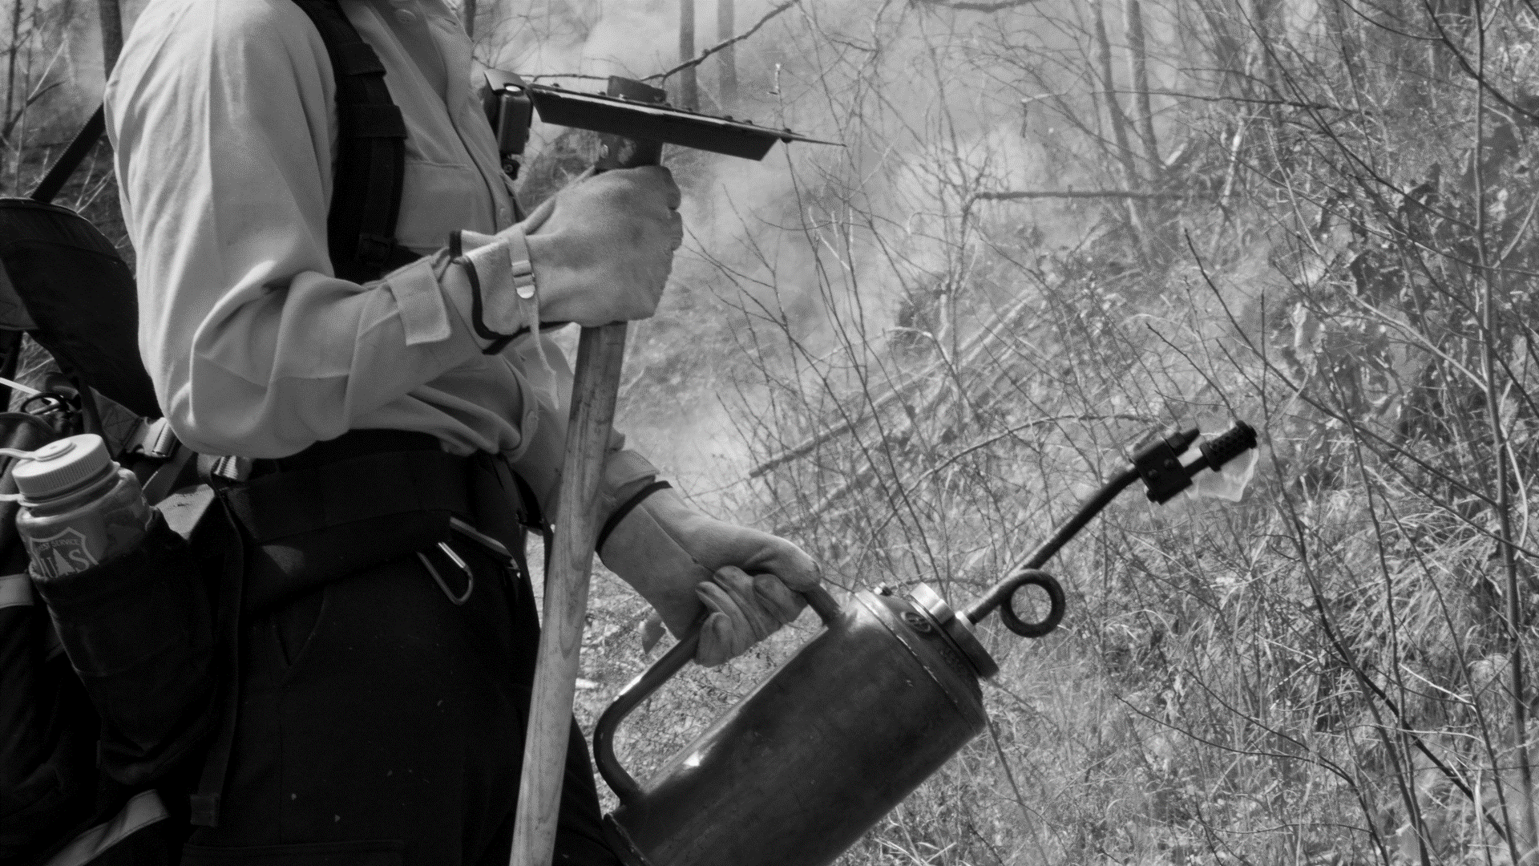
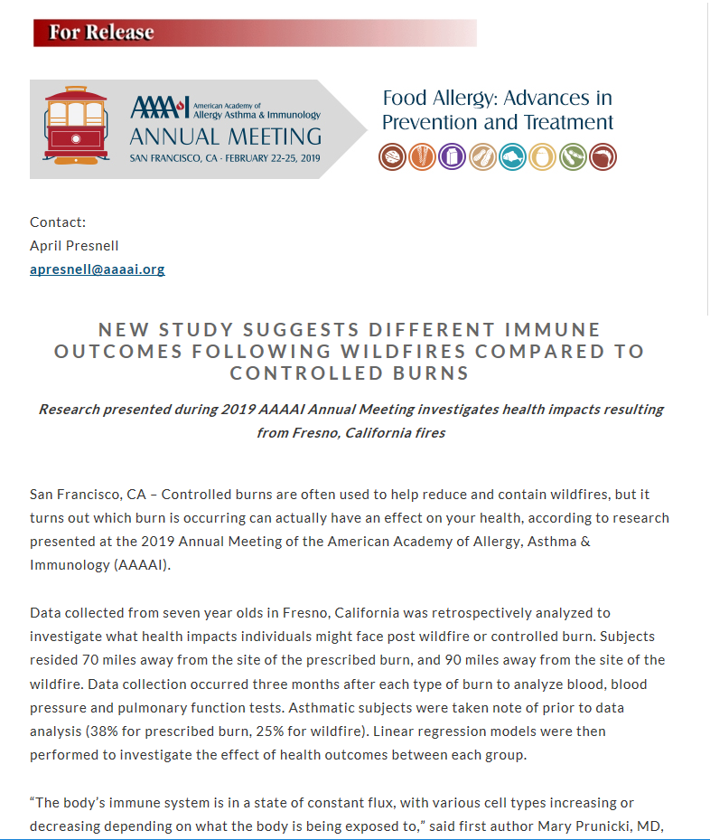
Photo by Alex Cantatore / @quickactcasusal
Notes:
It appears those management practices are working.
Research presented at the 2019 Annual Meeting
of the American Academy of Allergy, Asthma & Immunology
found pollutant levels were higher during wildfires
compared to prescribed burns.
The study collected data from 7-year-olds in Fresno, California.
One set of subjects had been potentially exposed to smoke from a wildfire 90 miles away
and another set had been potentially exposed to smoke from a prescribed burn 70 miles away.
The researchers then analyzed the health impacts the subjects faced.
With more studies that compare the public health impacts of wildfires and prescribed fire,
we might be able to get more good fire on the ground.

Slide 18
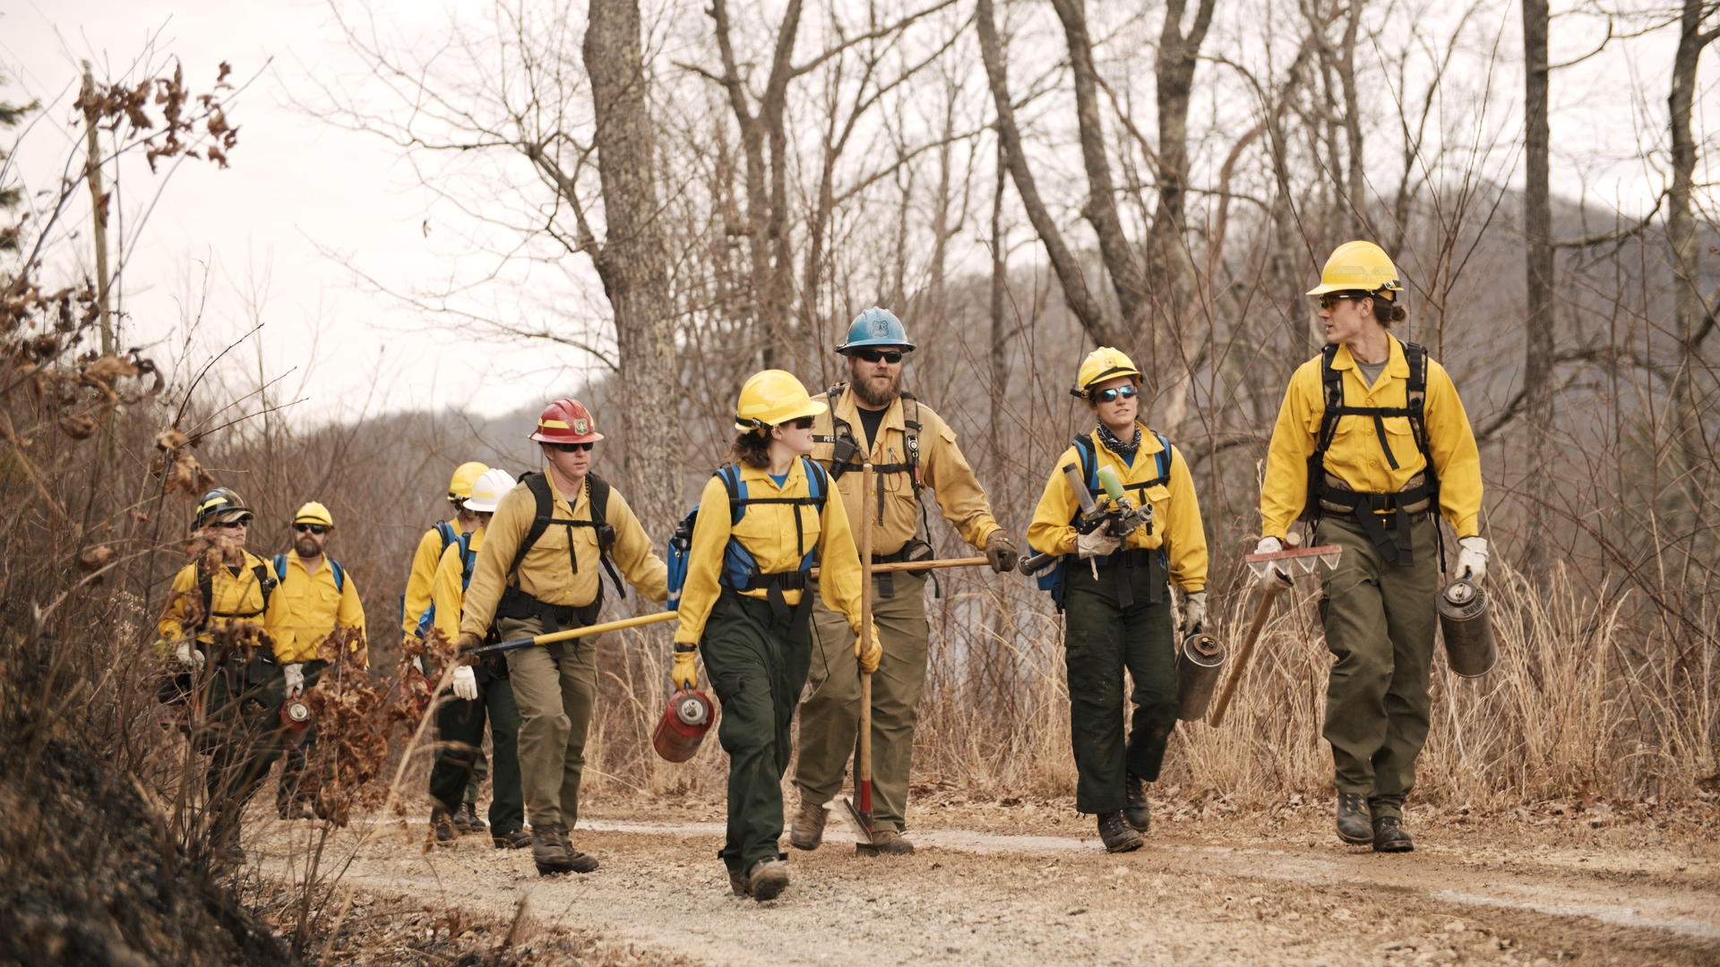
With our Federal, state,
local, and non-governmental partners, we can increase landscape resiliency, manage wildfires better, and
save lives and property.
Notes:
We believe that taking more active measures –
from selectively thinning forests,
to conducting more prescribe burns –
will help reduce wildfire and smoke from wildfire.
We believe that more scientific and medical studies
that compare the health impacts
of wildfire and prescribed fire are needed
so we can adapt and learn
and put more “good fire” on the ground.
And we are looking to partner with more groups and agencies,
Who want to
help increase forest resiliency across the landscape,
help us manage wildfires better, save lives and property,
and, help us reduce those emergency room visits
for respiratory illnesses because of wildfire smoke.

Slide 19
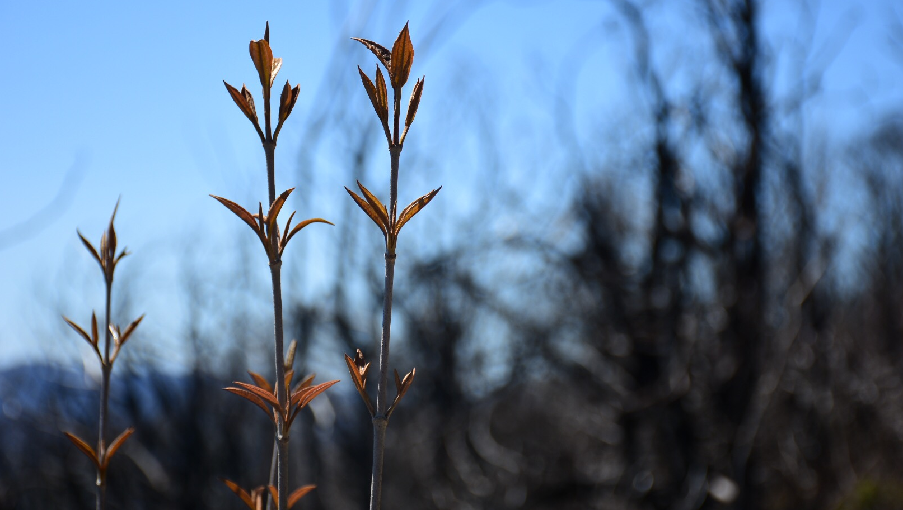
Ken Arney
Regional Forester,
Southern Region
USDA Forest Service
ken.arney@usda.gov
Notes:
Healthy forests provide many benefits to humanity –
clean water, clean air, wildlife habitat,
and wood for everyday needs like our homes and paper products.
Healthy forests also provide a place for recreation where can
re-create ourselves mentally and physically.
We in the Forest Service are committed to working with
health professionals to ensure we apply science
to have both healthy forests
and healthy Americans.
Thank you for your time.

