Slide 1

San Mateo County Health
CSTE Climatic Exposures and
Respiratory Health Outcomes Pilot
PRESENTED BY
Edwina Williams Tiffany Nicole Tsukuda
Epidemiologist Epidemiologist
Notes:
Morning,
My name is Edwina Williams and I am an epidemiologist with San Mateo County.
I am going to give a very brief overview of our project on climate exposures and respiratory health

Slide 2
Overview
Background
Methods
Current State
Reflection
Notes:
First, I’ll provide some background on our county and prior experience with wildfires
Then, I’ll go over our purpose and methods for this project
Lastly, I’ll share our progress and lessons learned thus far

Slide 3
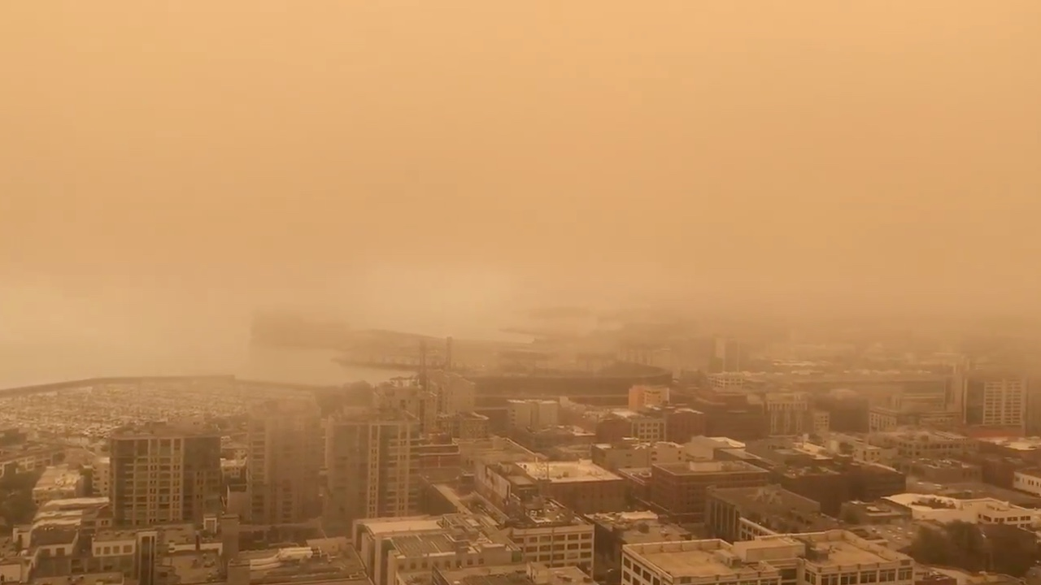
BACKGROUND
Wildfires and Public Health
Notes:
Image source: https://twitter.com/weatherbug/status/1014901943720869894

Slide 4
Background Methods Current State Reflection
San Mateo County
Population Profile
San Mateo County stretches the San Francisco Bay Area Peninsula and the northward boundary of Silicon Valley.¹ Among all California counties, San Mateo County ranks 2nd in overall health outcomes and health factors.²
Key Socioeconomic Indicators of Inequity and Vulnerability
$1,973
median
rent
$105,667
median household income
Sources: ¹San Mateo County Manager’s Office 2017-2019 San Mateo County Profile, ²University of Wisconsin Population Health Institute and Robert Wood Johnson Foundation County Health Rankings, ³U.S. Census Bureau 2013-2017 American Community Survey 5-Year Estimates
Notes:
San Mateo County is located near the San Francisco Area, stretching the Bay Area Peninsula to Silicon Valley
It is ranked 2nd in the state for overall health outcomes, according to the National County Health Rankings.
And is an affluent county with a median household income of 105k,
89% of our population has a High School degree or higher,
We have a low unemployment rate of 3%
And <1% are homeless
Total population: 718,451
Median household income $105,667 | Median rent $1,973
Rent burdened households (spending 30% or more of household income on rent): 49.6%
Below federal poverty level: 18.6% (Alameda County=24.6%)
Outdoor or manufacturing occupation: 19.1%
Age 65+: 13.4%
Sources: U.S. Census Bureau 2013-2017 American Community Survey 5-Year Estimates, San Mateo County Manager’s Office 2017-2019 San Mateo County Profile

Slide 5
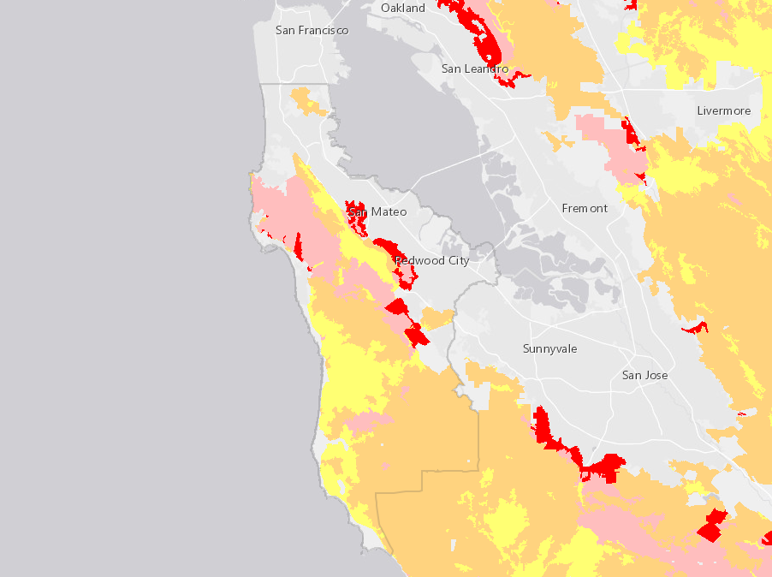

San Mateo County
Fire Hazard Severity Zones
Includes both proposed Fire Hazard Severity Zones for State Responsibility Area lands and draft Very High Fire Hazard Severity Zones for Local Responsibility Area lands.
FHSZ in Local Responsibility Areas (LRA)
Very High FHSZ
FHSZ in State or Federal Responsibility Areas (SRA)
Very High
High
Moderate
0
3
6 mi
Notes:
According to the California Department of Forestry and Fire Protection or Cal FIRE
A large percentage of San Mateo county is within a Fire Hazard Severity Zone
Of importance we have 8 cities in very high fire severity zones
As you can see in this map of the fire hazard severity zones in our county, we have Very High Fire Hazard Severity Zones (VHFHSZ) in eight cities, with the majority of developed housing in unincorporated San Mateo County in wildland-urban interface (WUI) areas that continue to expand as development is driven further into rural hillside parcels.
Source: CAL FIRE Fire Resource and Assessment Program. San Mateo County: Very High Fire Hazard Severity Zones in Local Responsibility Areas as Recommended by CAL FIRE. Wildland Hazards and Building Codes. http://egis.fire.ca.gov/arcgis/rest/services/FRAP/FHSZ/MapServer. Accessed March 22, 2019. FRAP | Esri, HERE, Garmin, NGA, USGS, NPS | Esri, HERE, NPS | Redwood City, CA: County of San Mateo San Mateo County GIS

Slide 6
Background Methods Current State Reflection
California Wildfires
and Air Quality (PM_{2.5}) in
San Mateo County
In 2018, there were 6,294 fires consuming over 876,147 acres in California. Last year’s Camp Fire in Butte County is the deadliest and most destructive wildfire in California history. During the Camp Fire, 24-hour maximum PM_{2.5} concentrations exceeded moderate AQI levels in San Mateo County.
AQI Unhealthy for Sensitive Groups: 101-150
PM_{2.5}: 40.5-65.4 μg/m³
AQI Moderate: 51-100
PM_{2.5}: 15.5-40.4 μg/m³
AQI Good: 0-50
PM_{2.5}: 0-15.4 μg/m³
Sources: Centers for Disease Control and Prevention National Syndromic Surveillance Program ESSENCE, San Mateo County Health, February to December, 2018
Notes:
Last year, there were nearly 6,300 fires in California
The most notorious of these fires was the Camp Fire in Butte County which occurred in November 2018
During this 18-day fire event, public health officials requested enhanced syndromic surveillance to monitor increases in respiratory and cardiovascular-related ED visits due to wildfire smoke-related PM_{2.5} exposure.
Average annual PM_{2.5}: 9.2 μg/m³⁾
As you can see from the graph, in November:
The maximum PM_{2.5} levels exceed prior week averages and moderate Air Quality Index levels,
Thus indicating a moderate health concern for a very small number of people who are unusually sensitive to air pollution.
Graph:
The time series was generated using PM_{2.5} data from the CDC National Syndromic Surveillance Program ESSENCE.
Dates are expressed along the x-axis and 24-hour maximum PM_{2.5} levels are expressed along the y-axis.
The blue dots represent major wildfire events occurring in California.
The grey line represents daily 24-hour maximum PM_{2.5} levels.
The red dots indicate a 24-hour maximum PM_{2.5} that exceeds the mean of the most recent 3-6 days of data and has a probability of less than 1% according to the Poisson assumption.
The yellow dots indicate an exceedance of the mean and a probability of less than 5%.
AQI levels:
The green horizontal line represents ‘good’ (0-50 PM_{2.5} concentrations)
The yellow horizontal line represents ‘moderate’ (51-100 PM_{2.5} concentrations)
The orange horizontal line represents ‘unhealthy for sensitive groups’ (101-150 PM_{2.5} concentrations)
According to CALFIRE and the U.S. Forest Service (http://cdfdata.fire.ca.gov/incidents/incidents_stats?year=2018), last year, there were about 6,300 fires throughout the state, covering over 876,147 acres.
Fire tracker: https://projects.sfchronicle.com/2018/fire-tracker/

Slide 7
Background Methods Current State Reflection
Enhanced Syndromic Surveillance: Weekly Percentage of ED Visits
Due to Asthma or RAD
During the first two weeks of the Camp Fire, there were higher than expected increases in 24-hour PM_{2.5} levels, weekly percentage of ED visits for possible smoke exposure or smoke inhalation, and weekly percentage of ED visits for asthma or reactive airway disease (RAD) exacerbation and other respiratory health effects associated with wildfire smoke exposure.
Source: Centers for Disease Control and Prevention National Syndromic Surveillance Program ESSENCE, San Mateo County Health (2018)
Notes:
During the Camp Fire we also saw an increase in the weekly percentage of ED visits
for possible smoke exposure or smoke inhalation
And for asthma or reactive airway disease (RAD) exacerbation and other respiratory health effects associated with wildfire smoke exposure,
San Mateo Medical Center, the county’s safety net hospital, had the highest average daily percentage of ED visits for all respiratory syndromes, excluding influenza-like illness and pneumonia.
During the fire, San Mateo County health officials requested enhanced syndromic surveillance for health effects associated with wildfire smoke exposure using San Mateo County Health’s Centers for Disease Control and Prevention’s (CDC) National Syndromic Surveillance Program (NSSP) BioSense Platform. During the first two weeks of the 18-day event, there were higher than expected increases in 24-hour PM_{2.5} levels, weekly percentage of ED visits for possible smoke exposure or smoke inhalation, and weekly percentage of ED visits for asthma or reactive airway disease (RAD) exacerbation and other respiratory health effects associated with wildfire smoke exposure, with the highest percentage of patients in the 0-4 years and 25-49 years age groups.
Chart interpretation:
Visit counts are color-coded in the time series charts.
Each distinct visit count represents a single patient and all the encounters associated with their visit within a 24-hour period.
A Red Alert or Yellow Warning point indicates that the mean daily count for that day is higher than what would normally be expected.
An alert is issued when the result exceeds 3 SDs above the mean of the moving baseline of the previous 28 days (with a 2-day buffer between the test day and the baseline).
This review of ED visit data does not attempt to establish a causal association between exposure to wildfire smoke and the end points described above, or any other underlying causes.
Due to small visit counts, data are not necessarily reflective of the true burden of smoke exposure-related health effects experienced by the population of San Mateo County.
Estimates of daily 24-hour maximum PM_{2.5} concentrations in San Mateo County from 2013 to 2017 are obtained from CDC NSSP’s ESSENCE Air Quality Data, which are provided by the Bay Area Air Quality Management District (BAAQMD) and California Air Resources Board (CARB) via the Redwood City and San Carlos Air Quality Stations.
The detection algo for weekly data is the CDC’s EARS C2 for adaptive control charts.

Slide 8
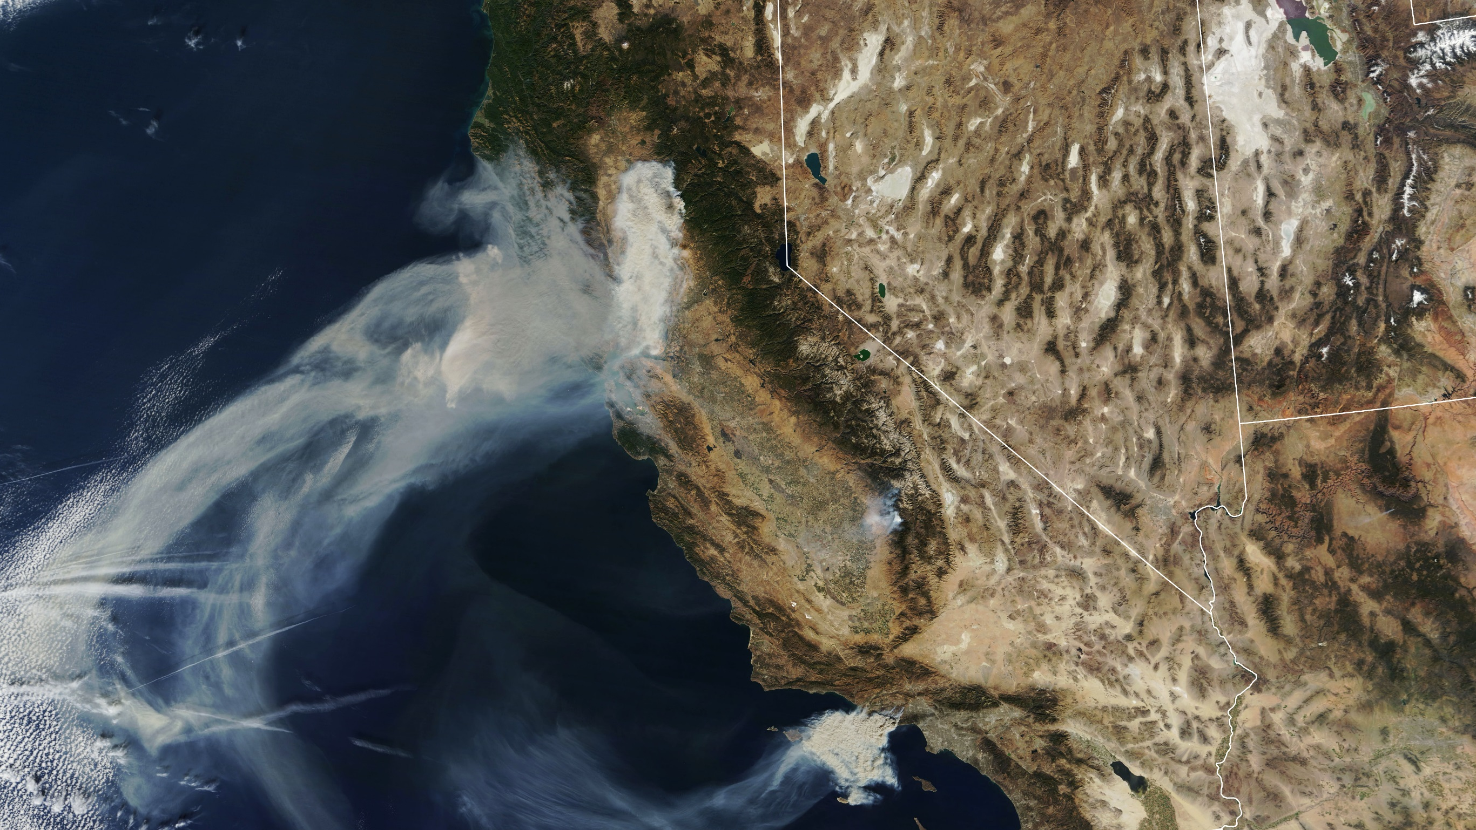

November 9, 2018
Natural color satellite image of the Butte County Camp Fire on November 9th (second day of the fire) provided by the NASA Earth Observing System Data and Information System (EOSDIS).
Strong winds pushed the fire to the south and southwest, tripling its size and spreading smoke over the Sacramento Valley and down to the San Francisco Bay Area.
Camp Fire
CALIFORNIA
San Mateo County
Hill and Woolsey Fires
Los Angeles
Notes:
Here’s a natural color satellite image taken on the 2nd day of the Camp Fire
Strong winds pushed the fire south, tripling its size and spreading smoke over the Sacramento Valley and SF Bay Area
San Mateo County is located just south of San Francisco and about 200-miles downwind of the Camp Fire. Strong winds pushed the fire to the south and southwest, tripling its size and spreading smoke over the Sacramento Valley and down to the San Francisco Bay Area.
Source: NASA Earth Observing System Data and Information System (EOSDIS) Worldview. Natural-color satellite image of the November 2018 Butte County Camp Fire taken by the MODIS instrument on the Terra satellite on November 15, 2018. https://worldview.earthdata.nasa.gov/. Accessed April 4, 2019.

Slide 9
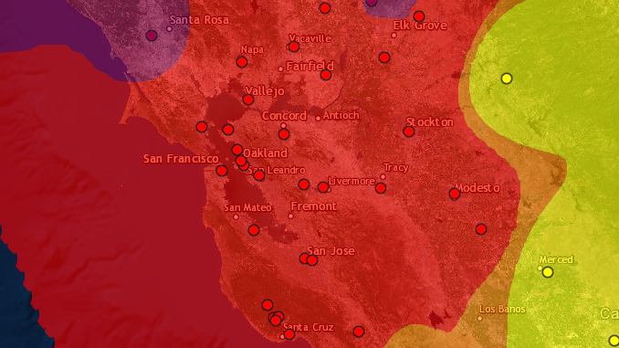

PM_{2.5}
On November 10th (third day of the Butte County Camp Fire) PM_{2.5} levels reached unhealthy levels.
U.S. Air Quality Index
Good (0 – 50)
Moderate (51 – 100)
Unhealthy for Sensitive Groups (101 – 150)
Unhealthy (151 – 200)
Very Unhealthy (201 – 300)
Hazardous (301 – 500)
No Data
Notes:
By the third day of the fire, PM2.5 levels were high and the Air Quality Index was at an unhealthy level throughout the entire Bay Area.
Source: EPA AirNow Interactive Map of Air Quality (https://gispub.epa.gov/airnow/)

Slide 10



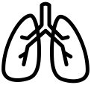



Background Methods Current State Reflection
Wildfire Smoke in San Mateo County: Public Health Inquiries & Emerging Concerns
During the 2018 Camp Fire, San Mateo County public health and emergency medical services officials received inquiries from staff, fire officials, hospitals, schools, media, and the public regarding these concerns:
Masking and Respirator Guidance & Effectiveness
Cleaner Air Shelters
& Home Air Filtration
Outdoor &
Agricultural Workers
Mobile Clinic &
Outreach Services
ED Visits &
Hospitalizations
School Safety
& Closures
Respiratory Health
Inequities
Animal Control
& Sheltering
Interagency Communication & Real-Time Resourcing
Incident Command &
All-Hazards Activation
Notes:
As you can imagine the Department of Health and Emergency Medical Services received a number of inquires on:
Masking guidance
Clean Air Shelters
School Closures
Sheltering animals and pets
Some of the operational challenges that emerged was coordinating communications and messaging across responding agencies and resourcing in real-time.
In addition, public health officials identified the need for targeting communities that were more likely to experience chronic disease exacerbations and respiratory health inequities.

Slide 11
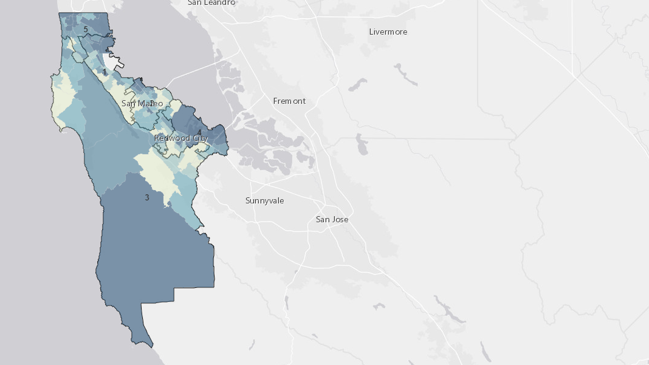
METHODS
Technical Approach
San Mateo County
CVI Index Values
> 46.5 – 61
> 41 – 46.5
> 37 – 41
> 31.2 – 37
22 – 31.2
Notes:
San Mateo County Community Vulnerability Index:
https://smcmaps.maps.arcgis.com/apps/View/index.html?appid=05eab60cb3d14db7b6d118108f324b4a&extent=-123.2231,37.0465,-121.3472,37.7600%27%20frameborder=%270%27%20scrolling=%27no%27
Vulnerability indicators:
No Health Insurance Coverage
Education – High School or Higher
Supplemental Security Income
Gross Rent as a Percentage of Income – Households Spending 35% or More
Poverty
Unemployment
Disability

Slide 12



Background Methods Current State Reflection
Statement of Purpose
Mission
Increase San Mateo County Health’s readiness to effectively monitor the socioeconomic, environmental, and climate-related determinants of health and health equity, and respond to the anticipated health and safety needs of sensitive or susceptible populations during a wildfire-related air pollution event.
Goal
Identify and engage priority populations, particularly sensitive or susceptible and historically hard-to-reach populations, in risk-reducing actions prior to, during, and following a wildfire-related air pollution event.
Expected Outcome
The resulting vulnerability index and surveillance action plan will have information that public health and emergency response officials can use to inform strategies for prioritizing and targeting public health and health care resources and services.
Notes:
The purpose of our project is to:
Monitor the social and environmental determinants of health
Identify and engage priority populations in risk-reduction before, during, and after a wildfire event
Inform public health and emergency response officials on strategies for prioritizing health resources
Emergent wildfires in California are expected to continue to increase in intensity, duration, and spread as climate change results in longer, warmer, and drier seasons.
Emergent wildfires in California are expected to continue to increase in intensity, duration, and spread as climate change results in longer, warmer, and drier seasons. As a public health agency, San Mateo County Health aims to: monitor the social and environmental determinants of health and health equity in our county; identify and engage priority populations in risk-reducing actions prior to, during, and following a wildfire pollution event; inform public health and health care preparedness and response strategies; and optimize resource allocation and utilization.

Slide 13
Background Methods Current State Reflection
Deliverable 1: Index Development Technical Process
Problem
Formulation
Assessment
and Analysis
Vulnerability
Characterization
Step 1:
Review Literature and
Verify Assumptions
Step 2:
Estimate Prior Respiratory Disease Burden and Relative Risk
Step 3:
Compile Vulnerability Index Candidate Data Sources
Step 4:
Develop
Vulnerability Index
Step 5:
Characterize
Vulnerability
Identify risk and vulnerability factors associated with wildfire smoke exposure.
Verify priority populations with subject matter experts, key informants, and stakeholders.
Define the problem and scope the assessment and analysis activities.
Develop a conceptual model.
Estimate 2013 to 2017 age-adjusted rates of pediatric and adult asthma, and COPD.
Estimate relative risks of asthma- and COPD-related ED visits and hospitalizations at exceedance of 24-hour average PM_{2.5} of 15.5 μg/m³.
Assess candidate data sources per inclusion criteria.
Compile, profile, and prepare selected data.
Compare existing vulnerability indices.
Review indicator selection approaches.
Select domains, candidate index indicator group, and decision-support indicators.
Develop vulnerability index.
Visualize spatial distribution of vulnerability.
Characterize San Mateo County population subgroups who are more likely to be sensitive or susceptible to the acute adverse respiratory health effects associated with wildfire smoke-related PM_{2.5}.
Notes:
To develop our surveillance capacity and readiness we have three major aims:
The first is to Characterize the population who are more likely to be susceptible to adverse respiratory health effects of wildfire smoke:
Specifically, we will describe temporal, spatial, and demographic measures of ED visits and hospitalizations for asthma and COPD
We are also adapting environmental and social vulnerability indices that consider factors known to define susceptibility of respiratory health effects due to high PM_{2.5} concentrations during wildfire events
Conduct retrospective surveillance for respiratory-related ED visits during and following previous wildfire events.

Slide 14











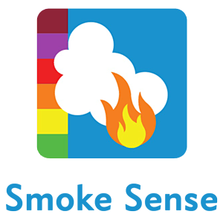

Background Methods Current State Reflection
Deliverable 2: Evaluation of Surveillance Capabilities
Passive and Enhanced
Syndromic Surveillance
(Prehospital/EMS Dispatch and ED)
Event-Based Surveillance
(Social Media, Word of Mouth, Local Press, Citizen Science)
Health Status Polls and Community Assessments
Natural Language Processing and Text Mining
Community Assessment for Public Health Emergency
Response (CASPER)
RODS LABORATORY
REAL-TIME OUTBREAK AND DISEASE SURVEILLANCE
at the Department of Biomedical Informatics
Notes:
Our 2nd aim is to assess the utility, scalability, and effectiveness of tools for collecting event-specific information, especially for hard to reach populations
To do this, we have developed a surveillance plan that uses
ESSENCE for syndromic surveillance
Our plan also includes Passive surveillance through tools such as
ReddiNet: daily census bed counts from hospitals in the count
RODS: Over-the-counter sales of medicines
FirstWatch: An early event detection system with alerts for cardiac arrest
We are also planning to conduct Rapid Community Assessment for Event-Based surveillance, using tools such as SurveyMonkey and Nextdoor to design and administer short surveys targeting specific neighborhoods or areas
An example would be designing a short questionnaire in Survey Monkey and administering it through NextDoor
Assess the prospective utility, reach, scalability, and effectiveness of successfully demonstrated county-wide tools and other methods for collecting event-specific, neighborhood community-level, point-in-time respiratory health status information from historically under-sampled and hard-to-reach populations during a wildfire event

Slide 15
Background Methods Current State Reflection
Deliverable 3: Syndromic Surveillance Optimization
Process
Review literature for respiratory health effects known to be caused by wildfire smoke.
Define sensitive or susceptible populations.
Select candidate respiratory endpoints and develop respiratory syndrome definitions.
Test and refine CDC NSSP ESSENCE queries (percent of probable records captured by each word in a query).
ESSENCE Respiratory Subsyndromes
AsthmaOrRAD Asthma or ReactiveAirwayDisease
AcuteBronchitis Bronchitis and not Chronic
Bronchitis Bronchitis
Pneumonia Bronchopneumonia or Pneumonia
Smoke Exposure and Respiratory End Points (ICD-10-CM Codes)
X01 Exposure to uncontrolled fire, not in building or structure (includes exposure to forest fire)
T59.811 Toxic effect of smoke, accidental (unintentional)
J70.5 Respiratory conditions due to smoke inhalation
J06.9 Breathing problems
R06.02 Shortness of breath
J44.9 Chronic obstructive pulmonary disease, unspecified
Notes:
Our 3rd aim is to Continue developing syndromic surveillance methods for detecting increases in respiratory-related ED visits during a wildfire event.
To do that we will continue reviewing the literature,
defining susceptible populations,
selecting candidate respiratory endpoints,
And testing and refining ESSENCE queries
During the Camp Fire, our public health officials requested enhanced syndromic surveillance to monitor for sudden or sustained increases in ED visits related to smoke exposure, such as asthma and COPD exacerbations, using our County’s CDC NSSP BioSense Platform. We initially tested the use of the respiratory syndrome. Given that we were in the 2nd month of flu season and we were already observing increases in both ED visits for respiratory infections and laboratory-confirmed respiratory infections, this query was too sensitive and we found that we had to add filters to tune out a lot of the noise. Next, we tested the respiratory subsyndrome
NSSP Subsyndrome
Subsyndrome: AsthmaOrRAD
Rule: Asthma or ReactiveAirwayDisease
Terms: ASTHM*, BRONCHASTHMA
Subsyndrome: AcuteBronchitis
Rule: Bronchitis and not Chronic
Terms: BRONCHIOLITIS. BRONCHITIS
Subsyndrome: Bronchitis
Rule: Bronchitis
Terms: BRONCHIOLITIS, BRONCHITIS
Subsyndrome: Pneumonia
Rule: Bronchopneumonia or Pneumonia
Terms: BRONCHOPNEUMONIA, PNEUMONIA

Slide 16
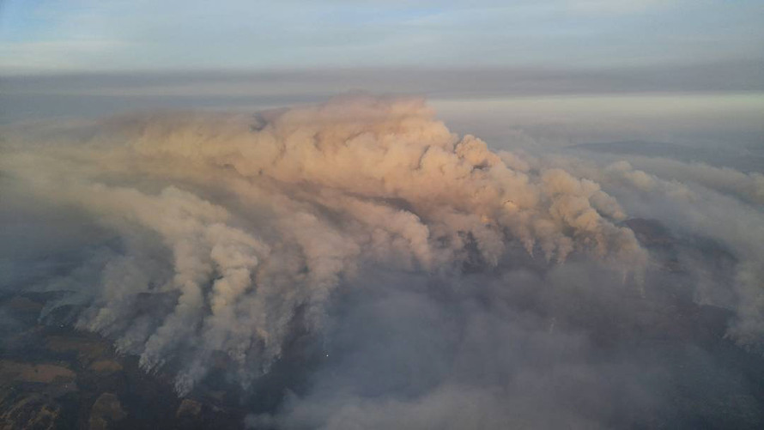
CURRENT STATE
Mid-Pilot Progress
Notes:
https://www.marketwatch.com/story/smoke-from-wine-country-wildfires-make-bay-area-air-quality-as-bad-as-beijing-2017-10-12
Greg Espiritu via Reuters
Smoke from wildfires are seen over Northern California’s Sonoma Valley.

Slide 17
Background Methods Current State Reflection
Mid-Progress Report
Assessed existing vulnerability and risk indexes and compared vulnerability measures.
Finalizing draft data analysis plan/technical document and surveillance action plan.
Completed descriptive analysis of ED visits with any diagnosis of asthma and COPD.
Conducted a logistic regression analysis predicting pediatric and adult chronic respiratory disease exacerbations and increased PM_{2.5} concentrations.
Began developing the individual indicator and decision-support layers.
Began developing the vulnerability index.
Consulted with Emergency Medical Services Public Health Emergency Preparedness and Response regarding the utility and feasibility of countywide mass communication systems.
Notes:
Thus far we have reviewed and compared current risk indices,
Conducted a descriptive and logistic regression analysis of ED visits for asthma and COPD
We are currently developing a modified vulnerability index
And waiting on approval of our surveillance plan and technical document

Slide 18
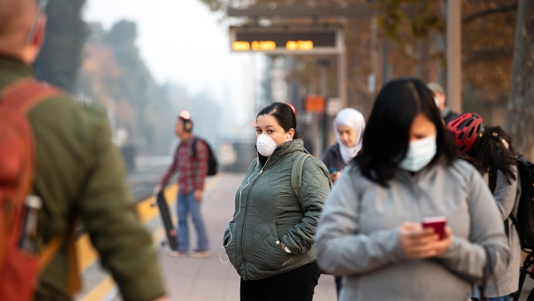
REFLECTION
Challenges & Successes
Notes:
Commuters wearing face masks wait for the 4:22 p.m. southbound train at the Menlo Park Station on Nov. 16. 'N95' masks can protect people exposed to smoke from inhaling unhealthy air particles. (Photo by Magali Gauthier.)
https://www.almanacnews.com/news/2018/11/20/menlo-park-to-distribute-1000-n95-masks-donated-by-facebook

Slide 19



Background Methods Current State Reflection
Reflection
?
Challenges
Establishing formal partnerships with subject matter experts
Balancing pilot-related tasks with day-to-day operational priorities and incoming data requests
Ambitious scope of work
Requires specific domain and technical knowledge and skills
Successes
Team cohesion, leadership support
Alignment with current countywide climate and health initiatives
Access to technical assistance and resources
Development of new tools to facilitate future analyses
New opportunities to participate in academic, state, national workgroups
Lessons Learned
More time needed for a data-driven inductive approach
Pilot timeline should be agile, scalable, and realistically achievable
Use existing vulnerability, health equity, and adaptive capacity work as a starting point/foundation from which to frame the local context
Notes:
Challenges
Establishing formal partnerships
Requires technical knowledge and skills
Successes
Development of new tools to facilitate analysis
Alignment with current county climate and health initiatives
Lessons Learned
More time is needed for a data-driven approach

Slide 20
Background Methods Current State Reflection
Acknowledgements
With gratitude to the San Mateo County Office of Sustainability, San Mateo County Information Services Division (ISD) County Geographic Information System (GIS) Services, California Department of Public Health (CDPH) Climate Change and Health Equity Program (CCHEP), and Council of State and Territorial Epidemiologists (CSTE). Data were obtained from the U.S. Census Bureau, U.S. National Oceanic and Atmospheric Administration (NOAA), National Aeronautics and Space Administration (NASA), U.S. Centers for Disease Control and Prevention (CDC) National Syndromic Surveillance Program (NSSP) BioSense Platform, California Office of Statewide Health Planning and Development (OSHPD), California Department of Forestry and Fire Protection (CAL FIRE), California Air Resources Board (CARB), Bay Area Air Quality Management District (BAAQMD). Specific acknowledgement is given to Corina Chung of SMC Health OEE, and Meredith Milet and Jason Vargo of CDPH CCHEP.

Slide 21

Thank you! For questions or comments, please contact:
Edwina Williams
Epidemiologist
Public Health, Policy and Planning
San Mateo County Health
ewilliams@smcgov.org
Tiffany Tsukuda
Epidemiologist
Public Health, Policy and Planning
San Mateo County Health
ttsukuda@smcgov.org
Karen Pfister
Supervising Epidemiologist
Public Health, Policy and Planning
San Mateo County Health
kpfister@smcgov.org

Slide 22
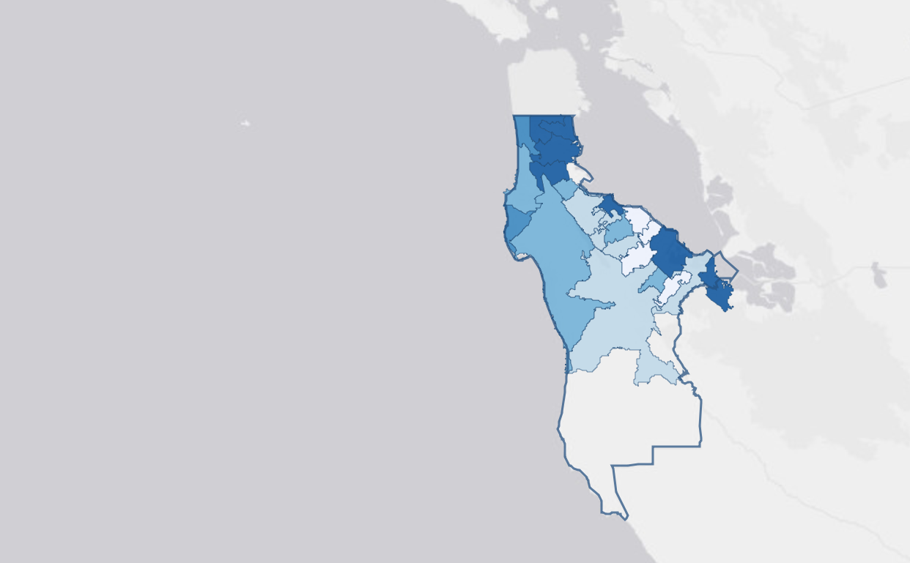
Background Methods Current State Future State Reflection
Age-Adjusted Rates of ED Visits Due to Asthma by Zip Code
Per 10,000 Population
41.8 – 67.1
36.0 – 41.8
24.6 – 36.0
17.0 – 24.6
9.2 – 17.0
N/A
Notes:
CalEnviroScreen is a screening tool that evaluates the burden of pollution from multiple sources in communities while accounting for potential vulnerability to the adverse effects of pollution. CalEnviroScreen ranks census tracts in California based on potential exposures to pollutants, adverse environmental conditions, socioeconomic factors and prevalence of certain health conditions. Data used in the CalEnviroScreen model come from national and state sources.
CalEnviroScreen 2.0 uses a suite of 19 indicators to characterize pollution burden (12 indicators) and population characteristics (7 indicators). Each indicator is assigned a score for each census tract in the state based on the most up-to-date suitable data. Scores are weighted and added together within the two groups to derive a pollution burden score and a population characteristics score. Those scores are multiplied to give the final CalEnviroScreen score.

Slide 23
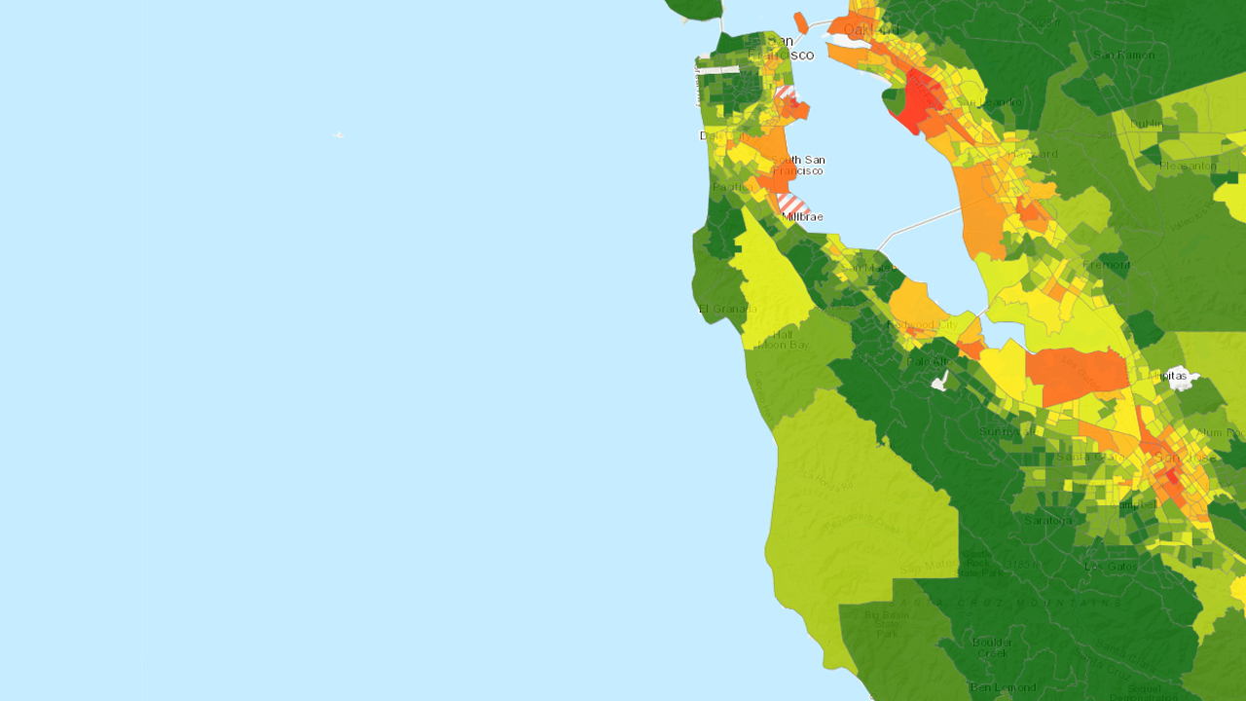


Background Methods Current State Future State Reflection
CalEnviroScreen 3.0: Pollution Burden and Characteristics of Vulnerability
CalEnviroScreen 3.0 Results
91 – 100% (Highest Scores)
81 – 90%
71 – 80%
61 – 70%
51 – 60%
41 – 50%
31 – 40%
41.8 – 67.1
21 – 30%
36.0 – 41.8
11 – 20%
24.6 – 36.0
1 – 10% (Lowest Scores)
41 – 50%
17.0 – 24.6
9.2 – 17.0
N/A
Notes:
CalEnviroScreen is a screening tool that evaluates the burden of pollution from multiple sources in communities while accounting for potential vulnerability to the adverse effects of pollution. CalEnviroScreen ranks census tracts in California based on potential exposures to pollutants, adverse environmental conditions, socioeconomic factors and prevalence of certain health conditions. Data used in the CalEnviroScreen model come from national and state sources.
CalEnviroScreen 2.0 uses a suite of 19 indicators to characterize pollution burden (12 indicators) and population characteristics (7 indicators). Each indicator is assigned a score for each census tract in the state based on the most up-to-date suitable data. Scores are weighted and added together within the two groups to derive a pollution burden score and a population characteristics score. Those scores are multiplied to give the final CalEnviroScreen score.

Slide 24
Background Methods Current State Future State Reflection
Conceptual Model
Source
Wildfires
Stressors
PM_{2.5}
Background stressors
Exposure
Pathways/Media
Outdoor air micro-environments
Indoor air micro-environments
In-vehicle micro-environments
Route
Inhalation
Receptors
San Mateo County
general population
Male
Female
Age <18 years
Age 18+ years
Age 30+ years
Age 65+ years
American Indian
or Alaska Native
Asian
Black or African American
Native Hawaiian
or Other
Pacific Islander
White
Hispanic or Latino
Respiratory
Endpoints
Asthma exacerbation
COPD exacerbation
Bronchitis
Pneumonia
Upper respiratory infection
Respiratory
symptoms (cough,
sore threat, wheeze)
Index and Decision-
Support Measures
Distribution of estimated values
Estimated percent of
population within specified ranges of index values
Notes:
For asthma, there are 3 indicators (age-adjusted rates of ED visits for asthma [this one will be included in the composite], pediatric (under 18) asthma [this one will be a decision-support layer], and adult (over 18) asthma [also a decision-support layer].
For COPD, the recommendation is to only include age 30+ w/ COPD.
The age 65+ group is used as an indicator by almost all the other indices we reviewed to capture the older adult population (who are more likely to be sensitive or susceptible).

Slide 25
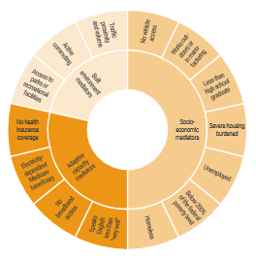
Background Methods Current State Future State Reflection
Candidate Indicators
PM_{2.5} exposure
Background Stressors
Increased susceptibility to chronic disease exacerbation
Increased susceptibility to infection
Acute adverse respiratory health outcomes
Notes:
We have ACS 2013-2017 estimates for all the socioeconomic indicators, except for ‘homeless,’ which we are getting from the SMC homeless count (https://data.smcgov.org/Health-Human-Services/Homeless-count-census-tracts/hhd7-e65q).
For the adaptive capacity indicators, ‘no health insurance coverage’ and ‘speaks English less than “very well”’ are from ACS, ‘electricity-dependent Medicare beneficiary’ is from https://empowermap.hhs.gov/, and no broadband access is from https://www.fcc.gov/reports-research/maps/connect2health/index.html.
All the built environment indicators are from ACS, except for ‘access to parks or recreational facilities,’ which come from Esri’s USA Recreational Areas (https://www.arcgis.com/home/item.html?id=4f14ea9215d1498eb022317458437d19) based on the County Health Rankings method (http://www.countyhealthrankings.org/app/california/2019/measure/factors/132/datasource).
For the disability and disease indicators: ‘Disability’ comes from ACS; ‘asthma’ and ‘COPD’ come from Morgan’s and Aracely’s OSHPD analyses; and ‘diabetes,’ ‘hypertension,’ and ‘obesity,’ come from SMC All Together Better (which all come from OSHPD, except for ‘obesity,’ which come from CHIS and 500 Cities).

Slide 26
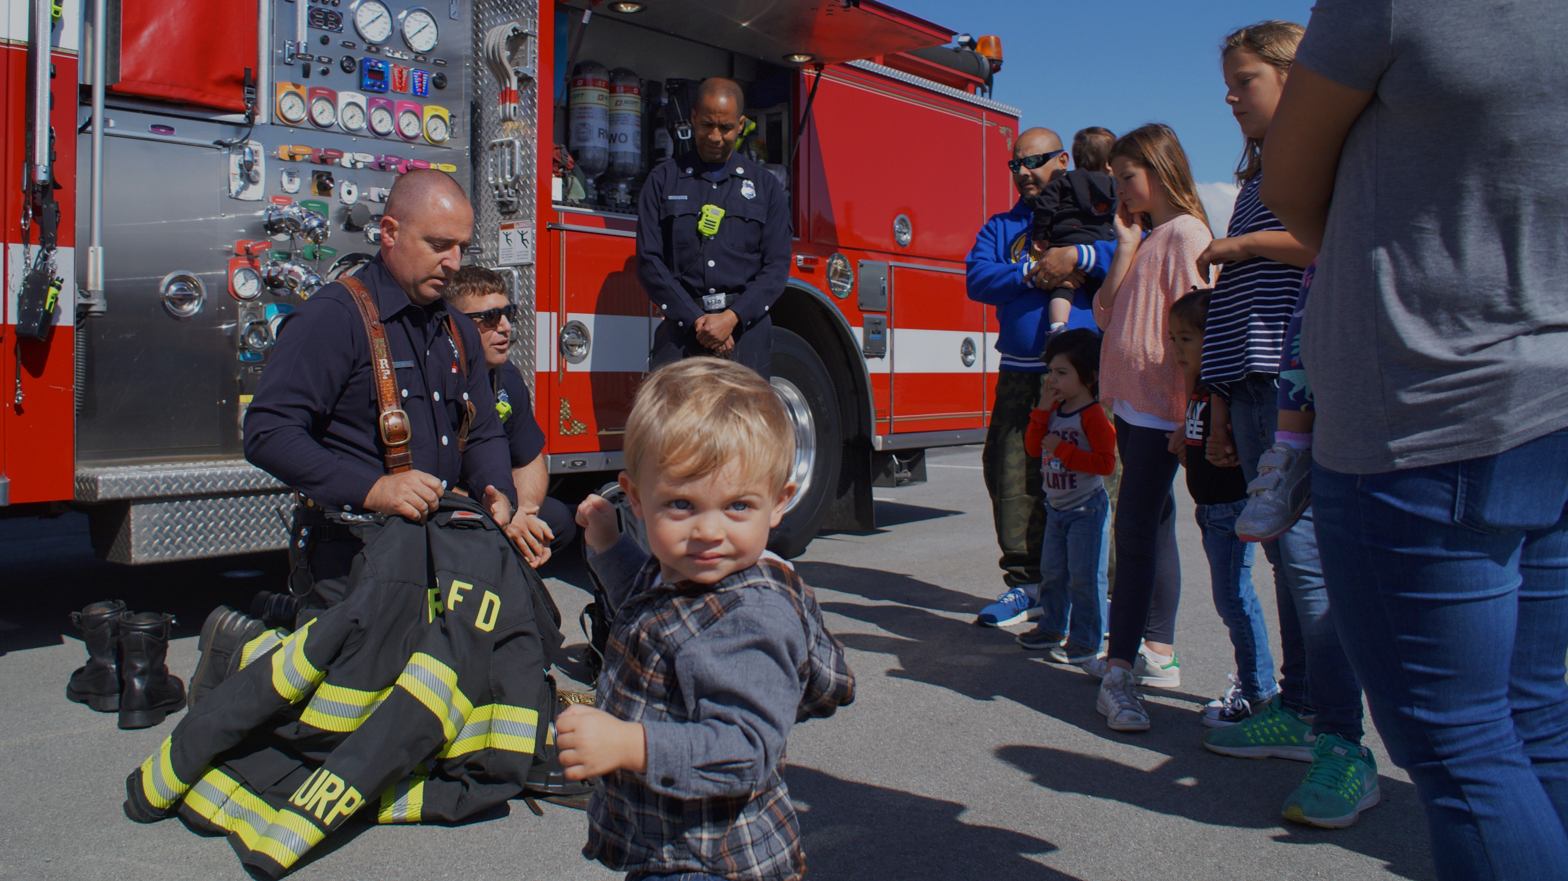
FUTURE STATE
Next Steps

Slide 27
Background Methods Current State Future State Reflection
Future State
Finalize the vulnerability index, including visualization and dissemination of Esri® Story Maps on public-facing County websites.
Develop a knowledge management resource for syndrome indicators and surveillance methods.
Evaluate and report pilot activities and findings.
Initiate the development of an asthma and respiratory disease registry for San Mateo County Health System patients.

