Slide 1
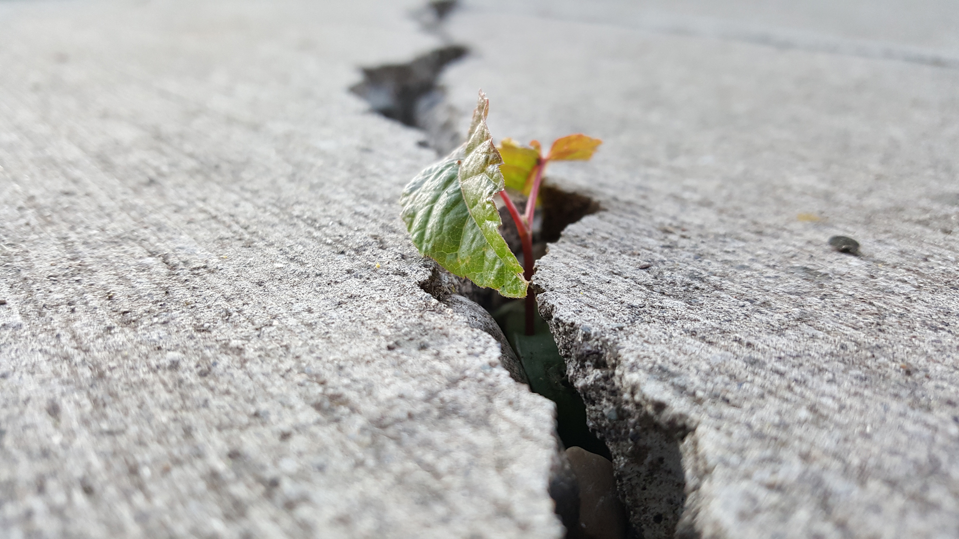
Urban Heat & Health
2019 Climate & Respiratory Health Summit
Evan Mallen
School of City & Regional Planning
Georgia Institute of Technology
esmallen@gatech.edu

Slide 2
annual weather related deaths
Sources: NWS, CDC, UCL
Notes:
Heat kills more people in the US annually than any other weather-related disaster combined

Slide 3
annual weather related deaths
Sources: NWS, CDC, UCL, Voorhees et al 2011

Slide 4
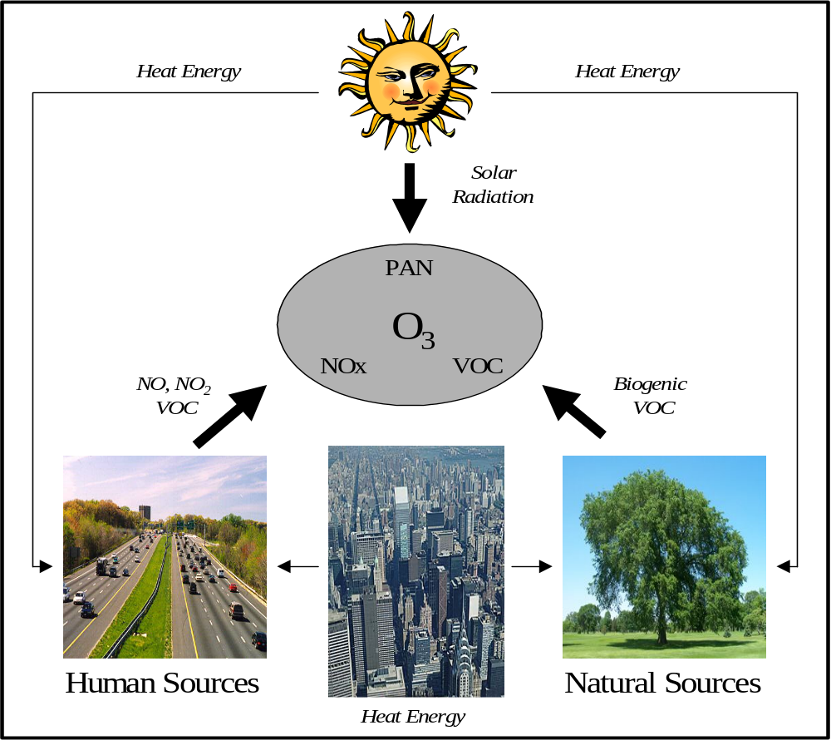
urban heat and ozone formation

Slide 5
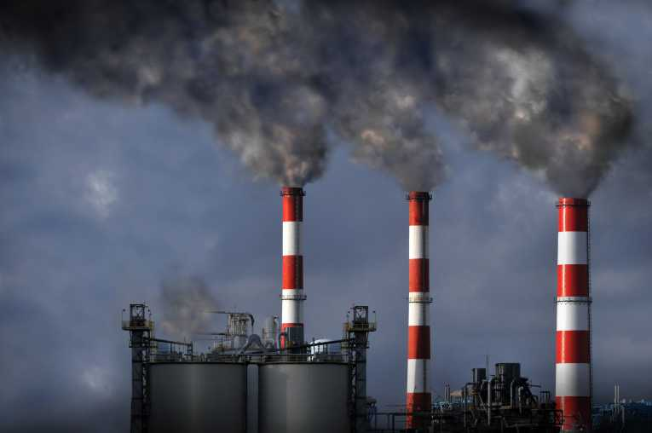
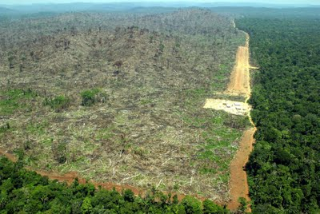
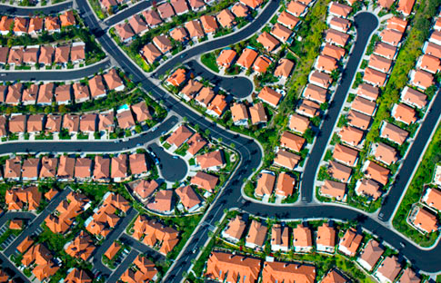

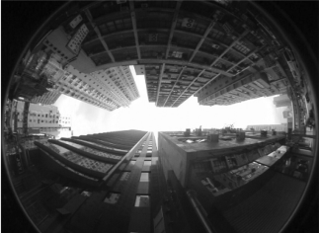
drivers of climate change in cities
global greeenhouse gas
emissions
loss of
vegetation
impervious
materials
waste
heat
urban
morphology
global greenhouse effect + urban heat island effect
Notes:
What else can modify the local climate?

Slide 6
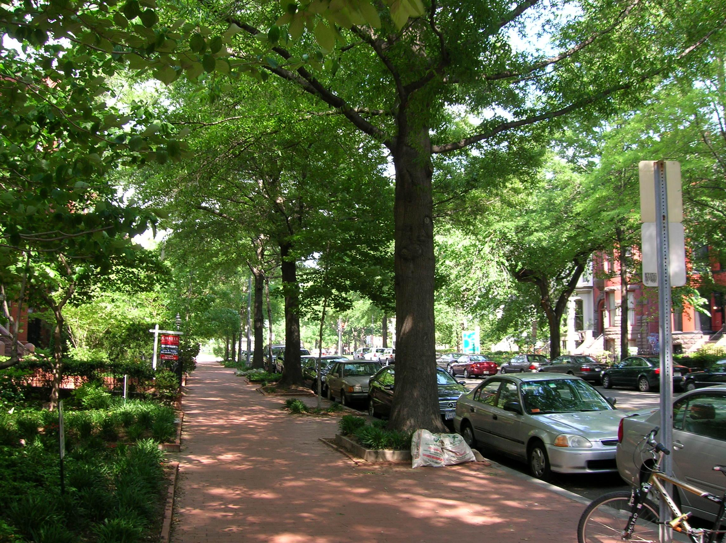
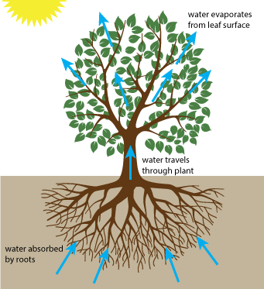
Shading:
Surface Temperature
Evapotranspiration:
Air Temperature
Goodspeed (2015)
woodlandtree.com
20 - 45 °F cooler than unshaded
2 - 9 °F cooler than unvegetated
Bowler et al., 2012; Yuan et al., 2007
Notes:
Shading prevents surface heat absorption, lowering effect of UHI

Slide 7
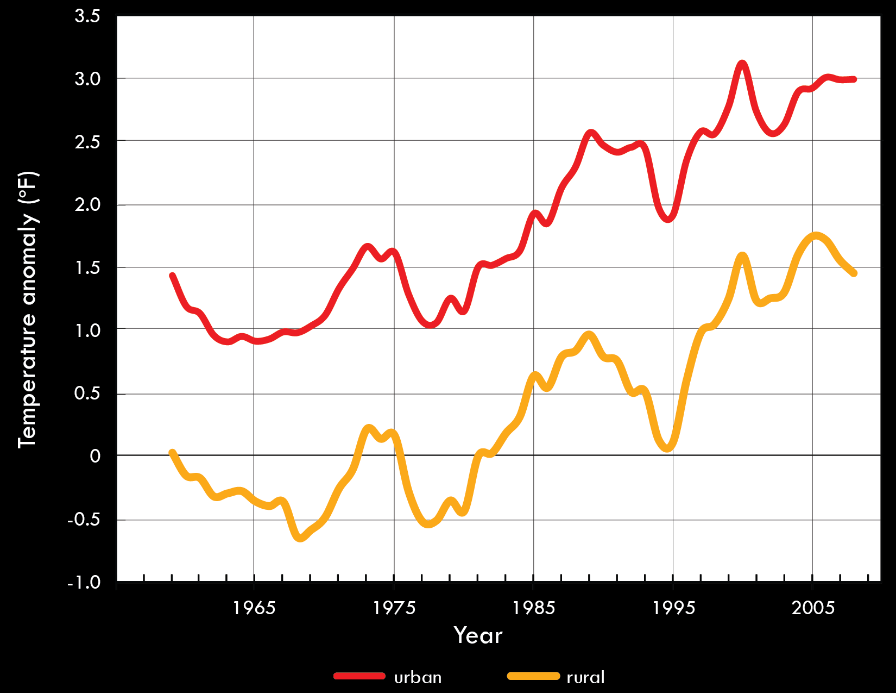
urban areas are warming more rapidly
over time than rural areas

Slide 8
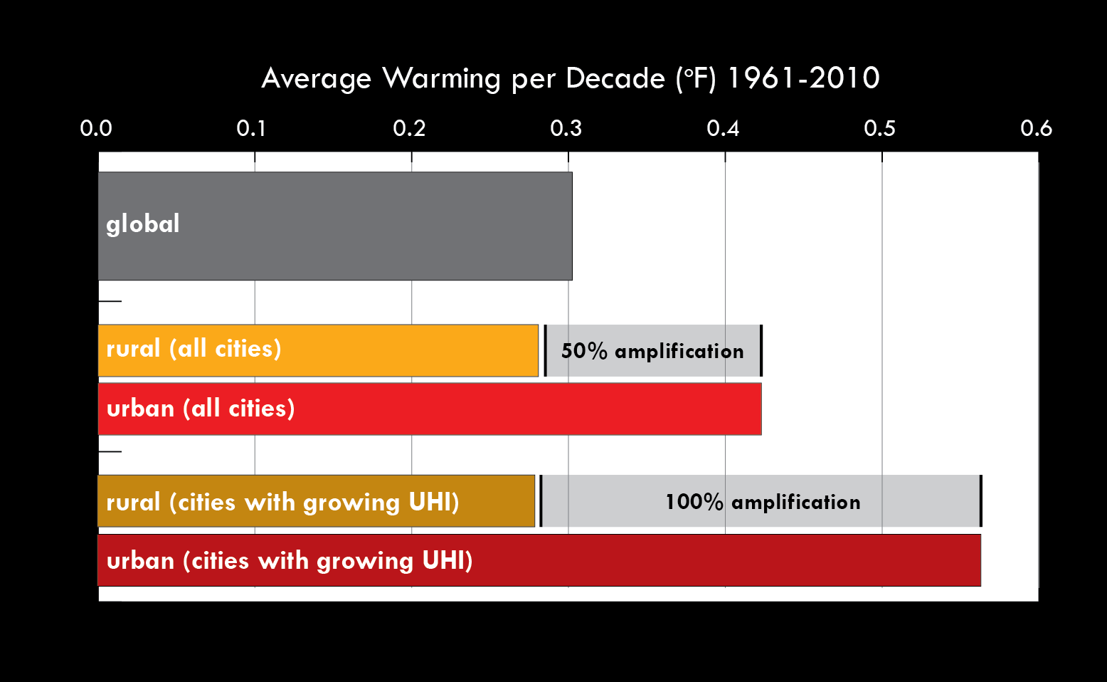
global vs. urban rates of warming (°F/decade): 1961-2010

Slide 9
Urban climate change rankings
Urban warming rankings
Warming per decade in excess of rural trend (°F)
warming in excess of rural trend (°F/decade)

Slide 10
Tunza Eco Generation
Notes:
UHI is often portrayed as a large blob of heat in a city. But the effect can actually be quite localized

Slide 11
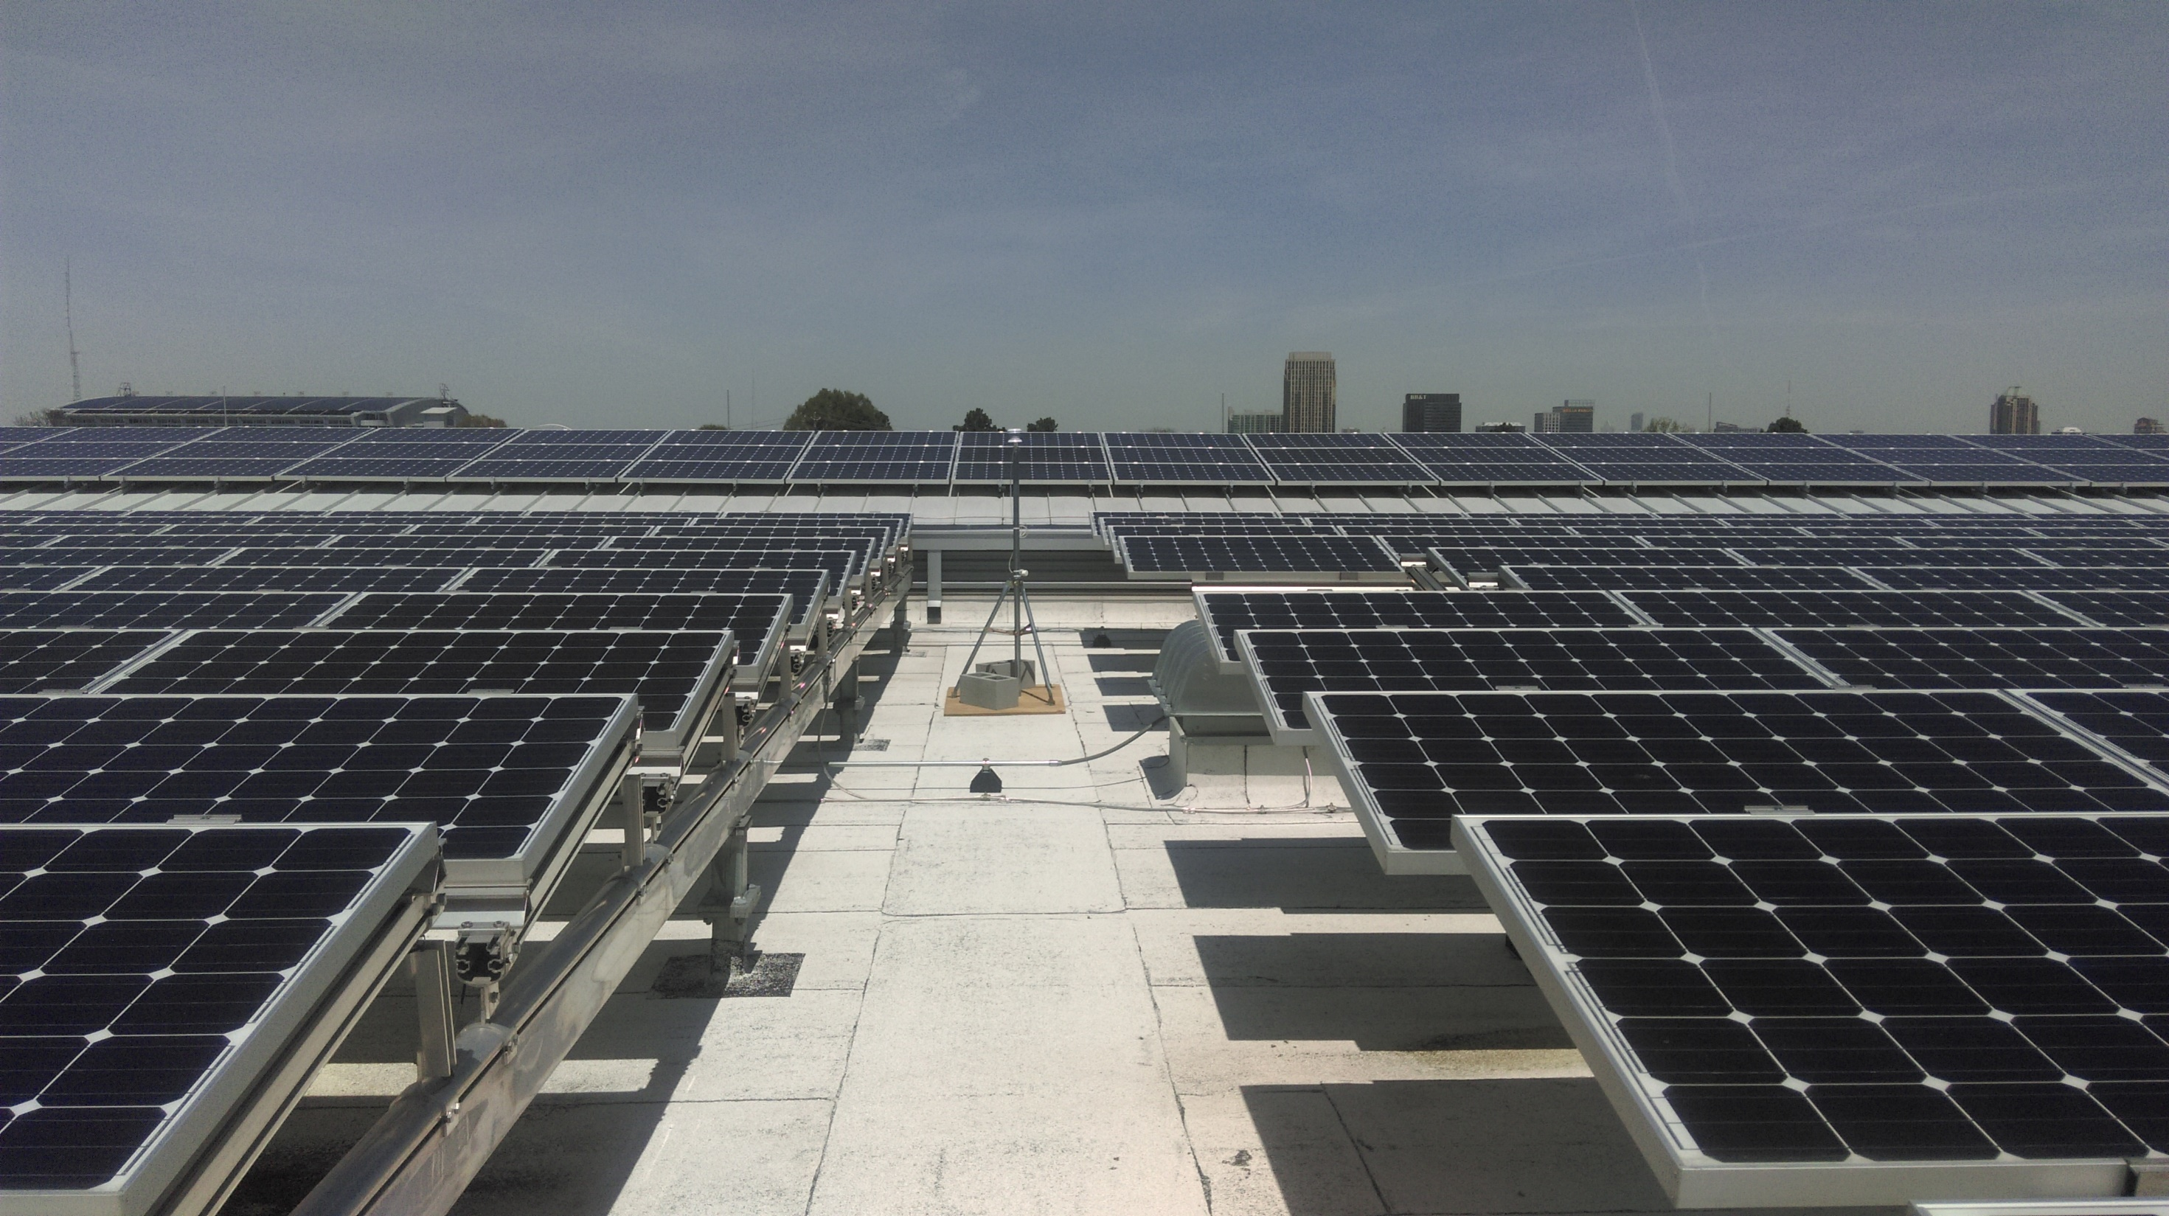
Georgia Tech Climate Network

Slide 12
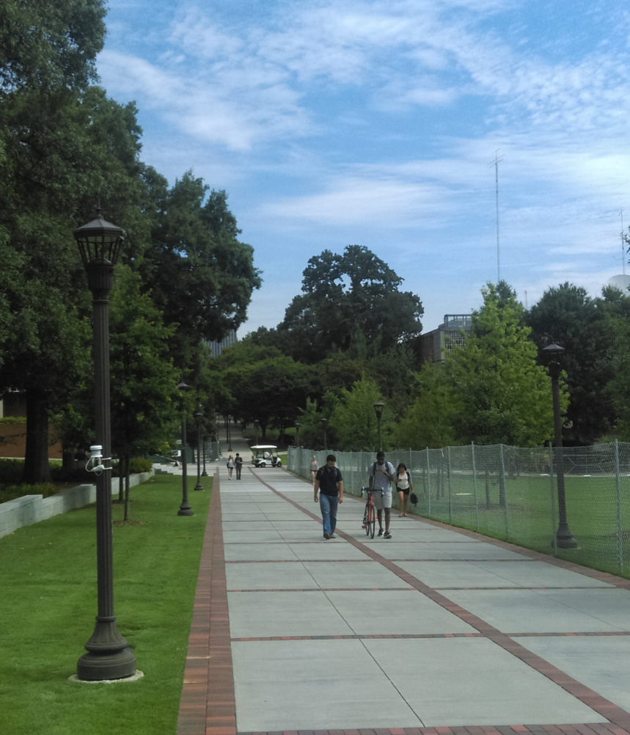
Georgia Tech Climate Network
Goal
  Analyze thermal environments of Georgia Tech’s microclimates related to the Urban Heat Island
  Inform planning and design decisions to enhance thermal comfort for pedestrians
44 total sites
  33 across campus microclimates
  12 deployed in Atlanta metro area
Operated by the School of City & Regional Planning’s Urban Climate Lab

Slide 13
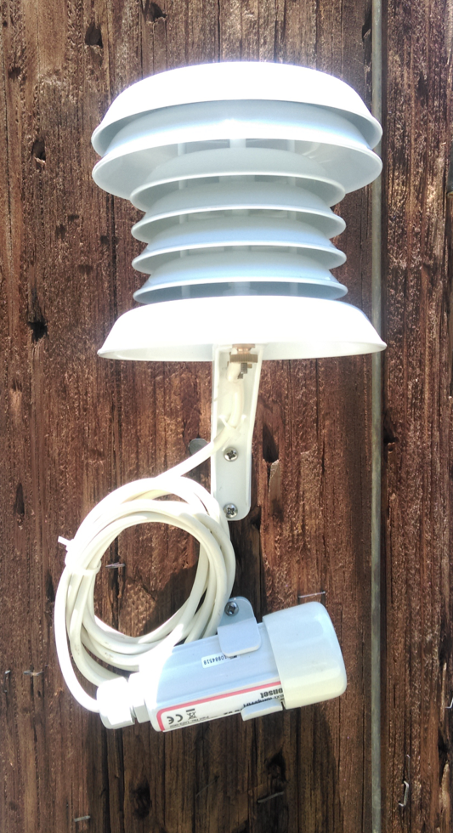
GTCN Sensors
Temperature and Relative Humidity
HOBO U23-002 Data Logger
Onset RS3 Solar Radiation Shield
2-meter height
5-minute intervals
75 days of logging between manual data collections

Slide 14
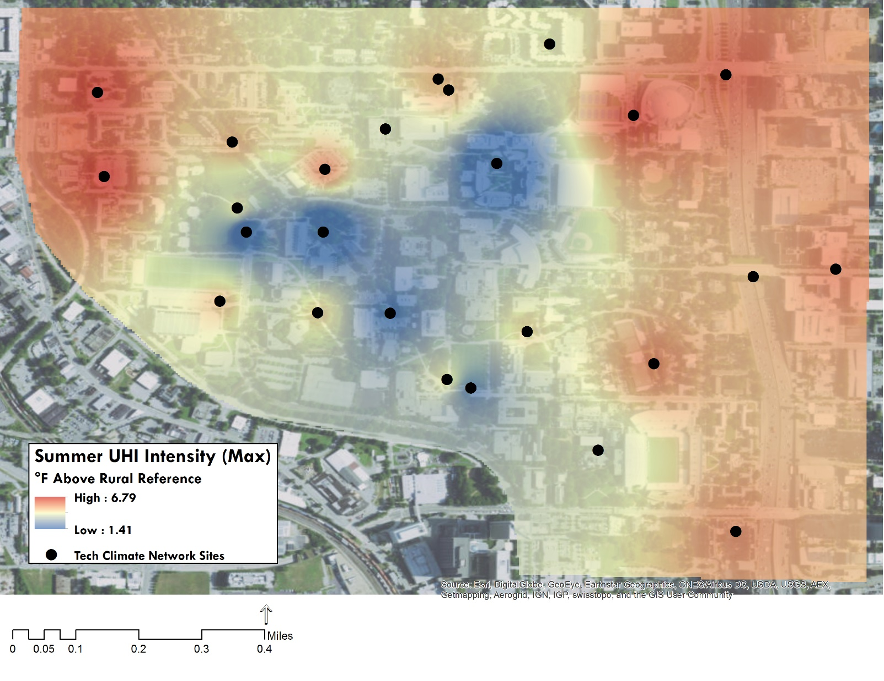
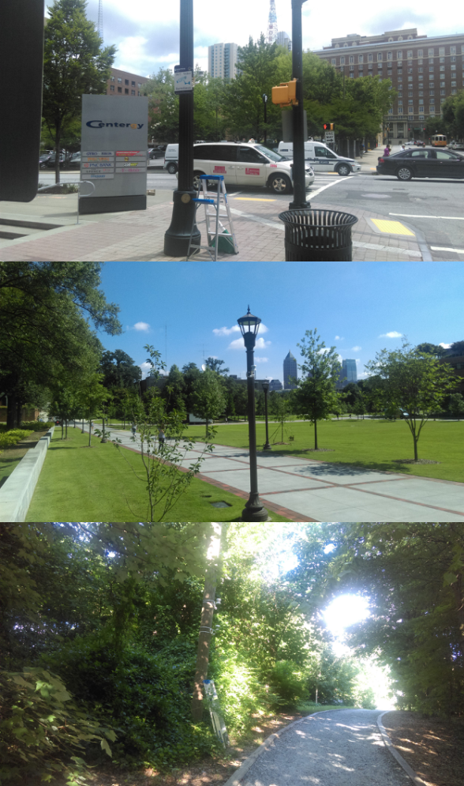
Notes:
This map shows the average maximum temperatures for the summer of 2017 as Urban Heat Island Intensities, or the temperature difference from our reference site in the Botanical Gardens. The images on the right represent the red (top), yellow (middle) and blue (bottom) environments. This shows that maximum daily temperatures in dense urban areas like Midtown were on average up to almost 7 degrees warmer than the reference, while densely vegetated areas were only about 1.4 degrees warmer. In fact, the blue area in the center is just below one very large tree, not even a dense forest. This makes means we have about a 5.5 degree difference on campus alone just due to the effects of the microclimates.

Slide 15
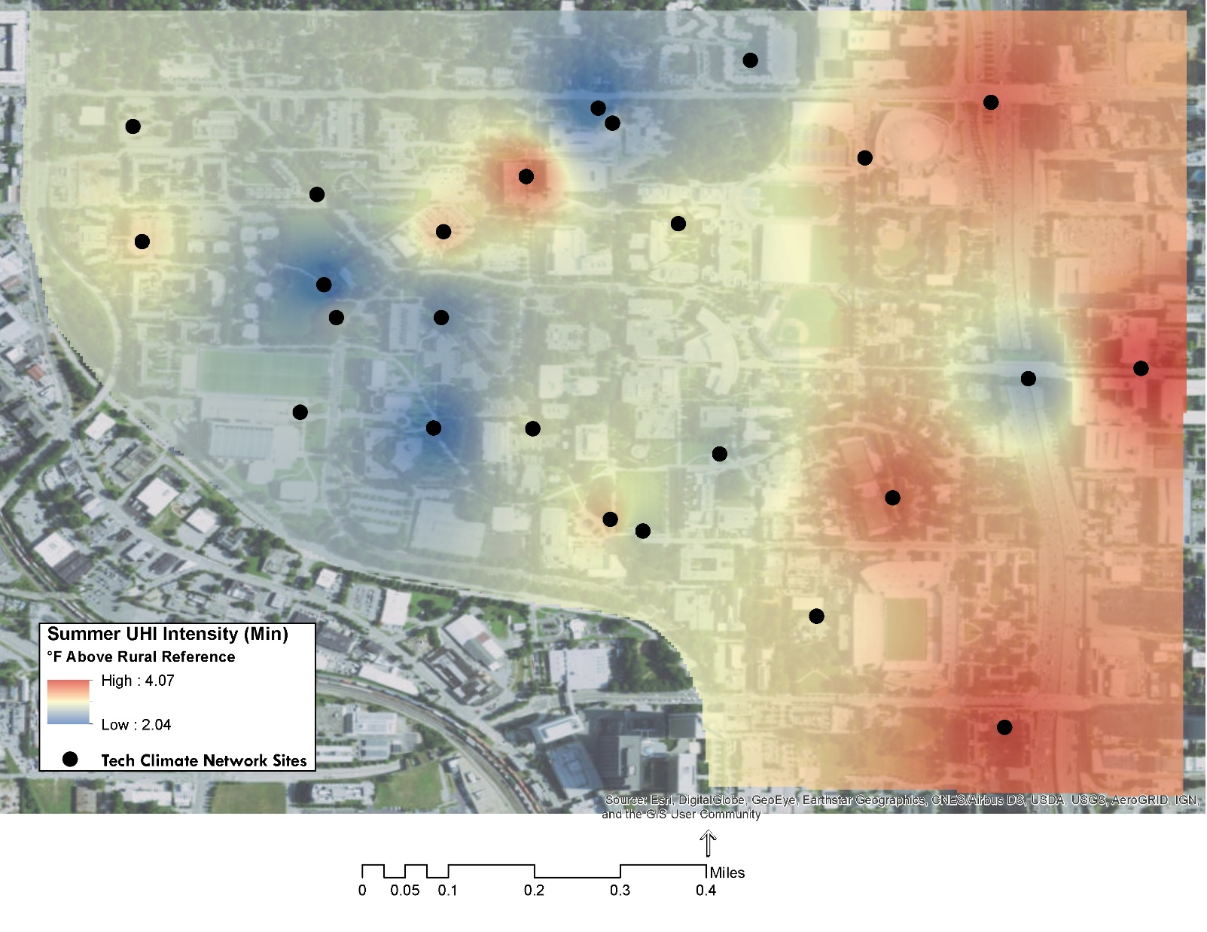
Notes:
This map shows minimum temperatures, highlighting that urban areas really do store the most heat and release slowly through the night. This is particularly important for public health, people need to be able to find relief from hot weather in the summer. If they can’t get an opportunity to cool their core body temperatures, then we start seeing heat-related illness and death.
But look here at the 5th street bridge. We have a significant cool island here thanks to the green infrastructure we’ve placed on that corridor. Let’s compare the 5th street bridge to the 10th street bridge.

Slide 16
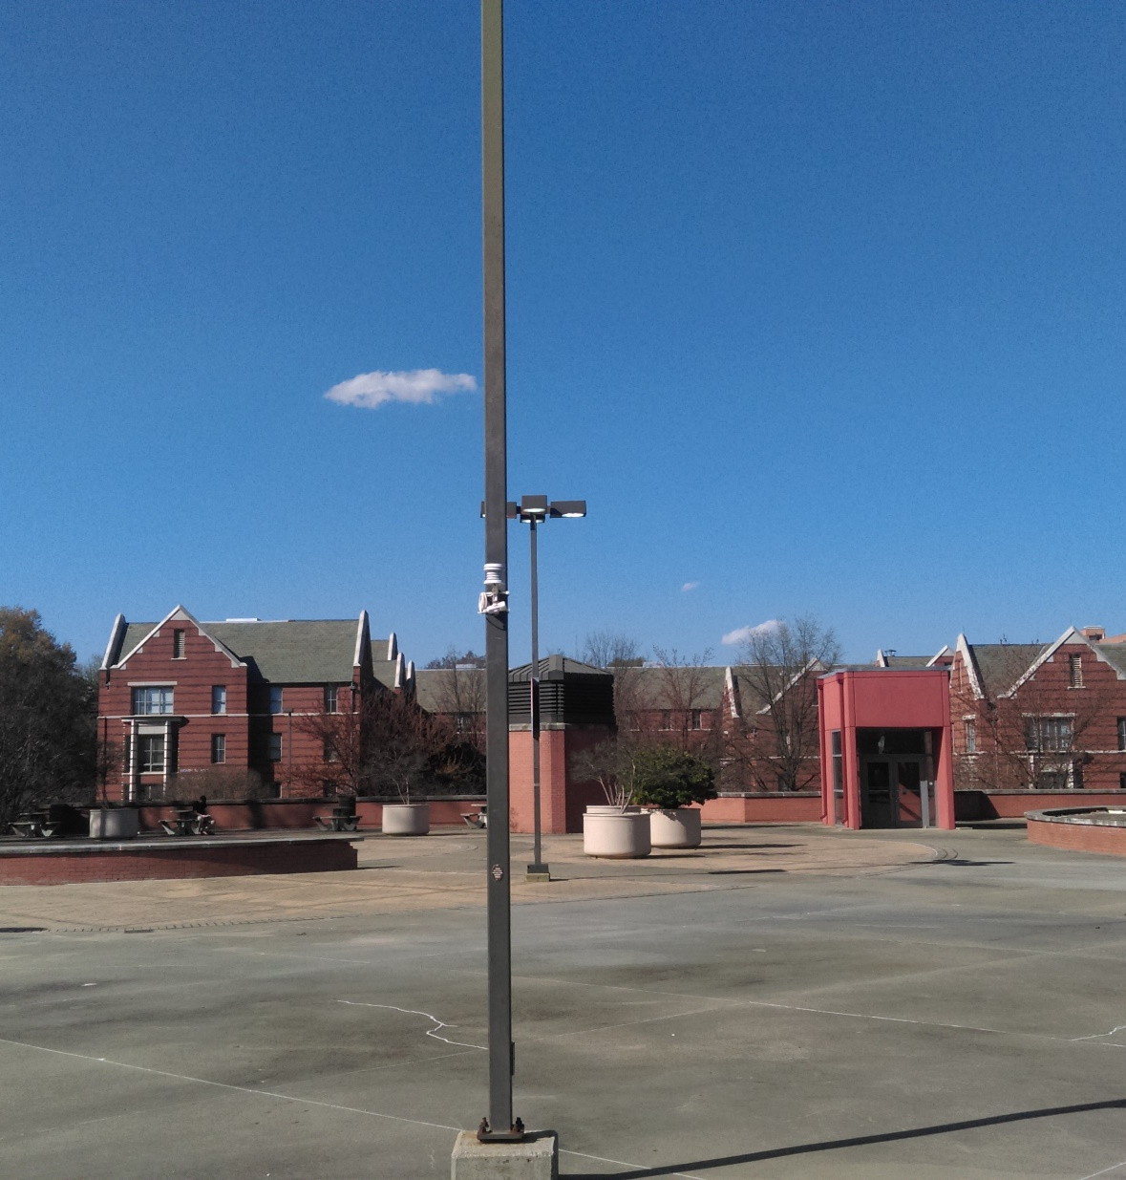
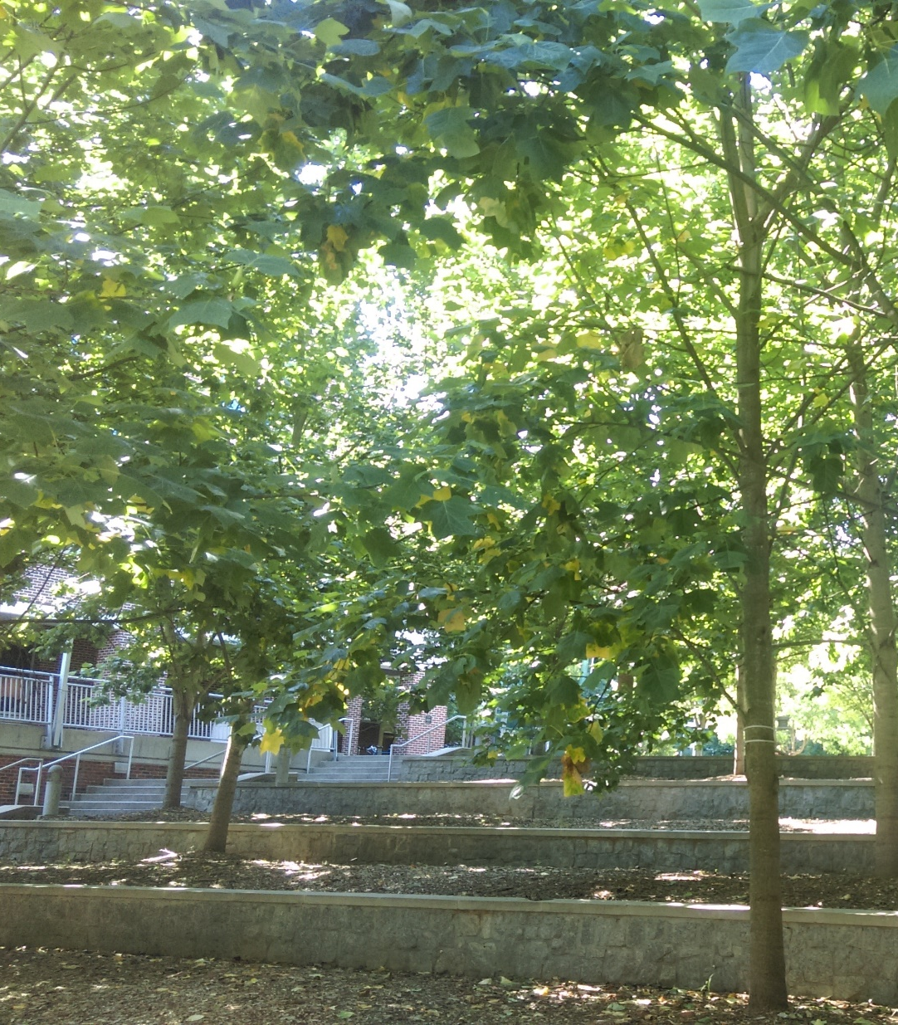
53 Days
7 Days
Notes:
This image illustrates the types of environments reflective of hot days.

Slide 17
B’More Cool Project
Notes:
https://earthzine.org/2016/02/23/bmore-cool-monitoring-the-urban-heat-island-at-high-density-for-health-and-urban-design/

Slide 18
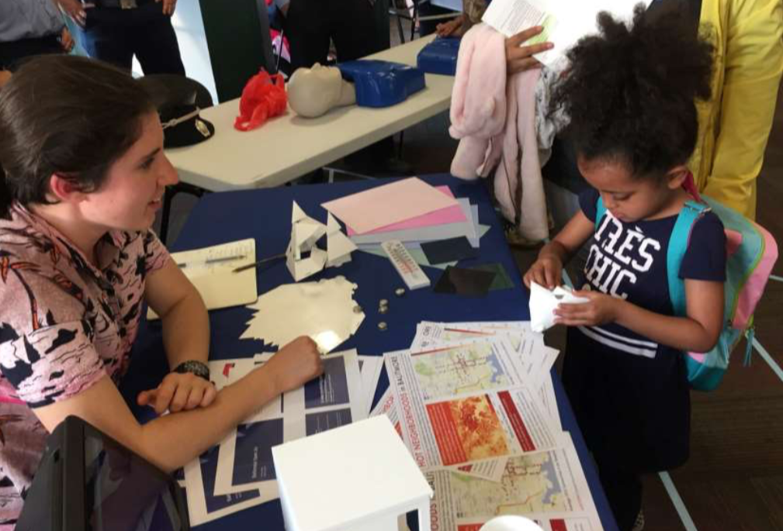

Slide 19
B’More Cool Project

Slide 20
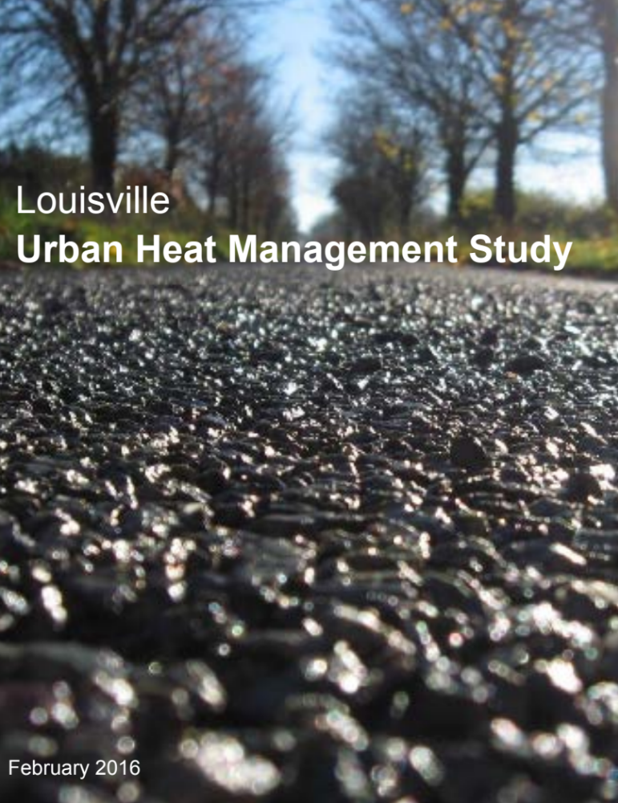

Slide 21
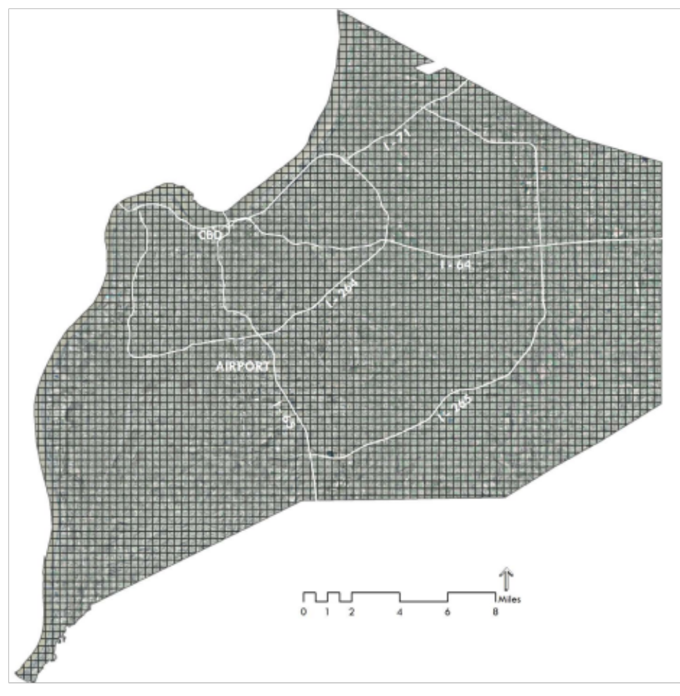
Weather and Research Forecasting Model (WRF)
study grid: 1/2km²

Slide 22
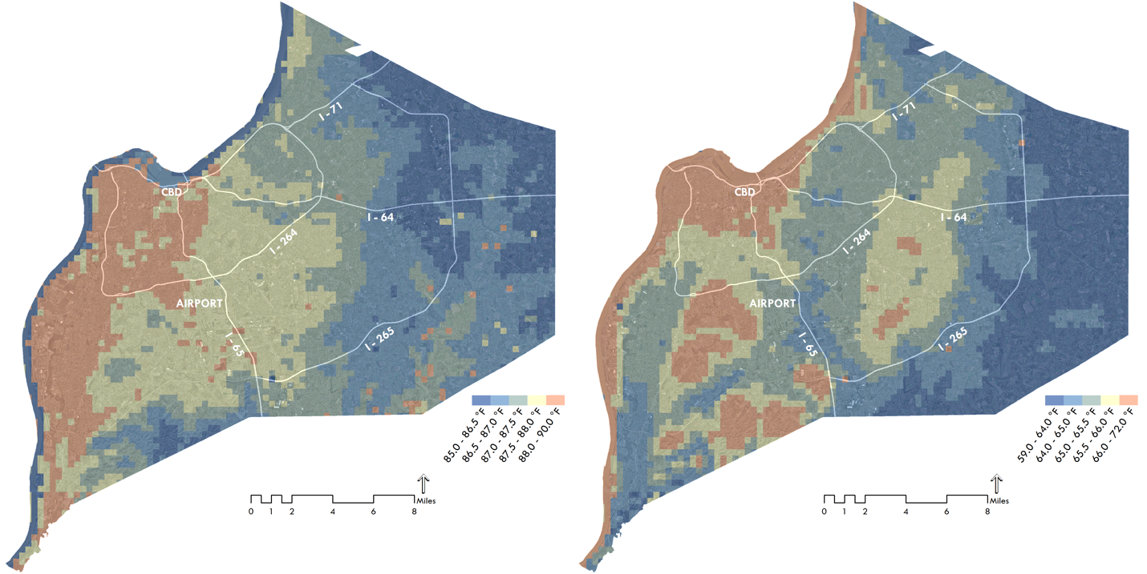
Daily Maximum Temperature
Daily Minimum Temperature
Notes:
Daily maximum UHI about 5 F on average, but minimum temperature ranged 13 F

Slide 23
cool materials scenario
assumes all building roofs,
roadways, and parking lots meet
a minimum standard for
reflectivity
Notes:
commercial roofs to exhibit an albedo of 0.88, all residential roofs to exhibit an albedo of 0.65, and all roads to exhibit an albedo of 0.44 (consistent with concrete) – values achievable with commercially available roofing and paving materials designed to be highly reflective

Slide 24
Cool Materials Scenario
Difference from Current Conditions
Notes:
Cooling up to 3 F in most heavily impacted areas

Slide 25
greening scenario
assumes 20-50% higher canopy
coverage over roadways
Zoning Class | Green Cover Minimum
Single Family Residential | 80%
Multifamily Residential | 70%
Commercial | 50%
Industrial | 40%
Public/Institutional | 60%
Parkland | 90%
Farmland | 100%
Vacant | 100%
Notes:
Greening amounted to about 450,000 new trees, 31 km2 of new grass

Slide 26
Greening Scenario
Difference from Current Conditions
Notes:
Cooling around 1-2 F cooler. While cool materials seemed to be more effective, it requires more area. Greening about 1.2 times more effective per square meter than cool materials.

Slide 27
combined strategies scenario
+

Slide 28
Combined Scenario
Difference from Current Conditions

Slide 29
Distribution of Heat-Related Mortality

Slide 30
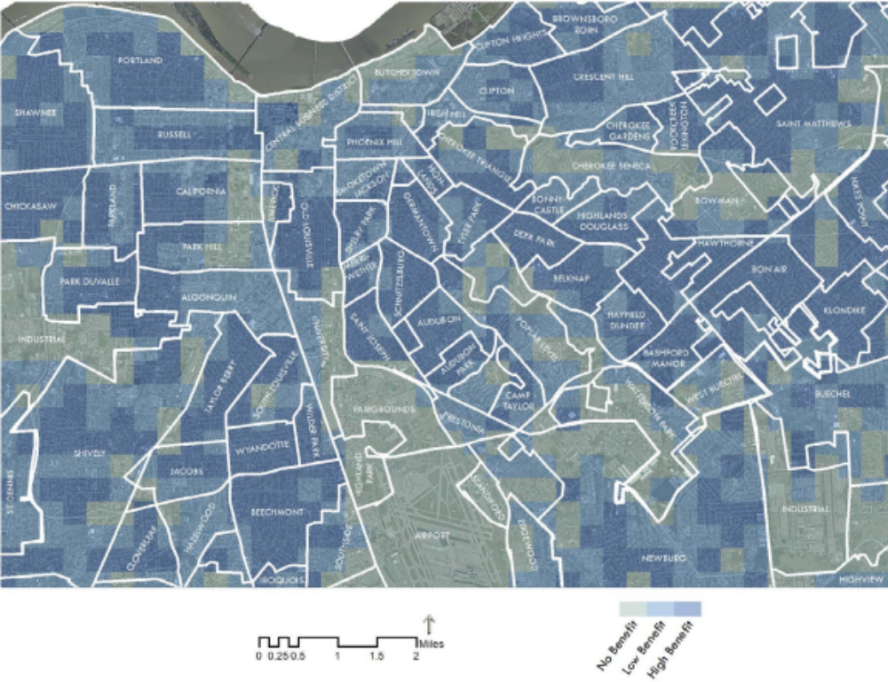
Avoided Mortality from Combined Scenario
Notes:
21.4% reduction in total heat-related mortality

Slide 31
Key Recommendations
Prioritize cool materials in industrial and commercial zones with limited opportunities for cost-effective vegetation
Implement vegetative strategies in residential zones where costs are low and population exposure is high
Combine vegetative and cool material strategies in every zone targeted for heat adaptation planning
New regulatory and economic incentive programs will be needed to bring about the land cover changes modeled in this study

Slide 32
Louisville Heat Management:
Green Heart Project

Slide 33
Louisville Heat Management:
Cool502
Notes:
Rebate of $1 per square foot of cool roofing installed, commercial or residential. Developed to reach goals based on the heat management study recommendations specifically targeting areas most in need of cooling.

Slide 34
In Summary
Urban development elevates and sustains extreme temperatures dangerous to human health
Urban heat island microclimates can be small, but targeted with specific response strategies
Prioritize a combination of mitigation strategies to optimize cooling potential and cost effectiveness
Effective heat mitigation will necessitate innovative policy incentives for distributed management

Slide 35
Thank you
Evan Mallen
esmallen@gatech.edu
urbanclimate.gatech.edu

