Slide 1

COUNCIL OF STATE AND TERRITORIAL EPIDEMIOLOGISTS
RESPIRATORY & CLIMATE CHANGE WORKGROUP
URBAN AIR AND HEALTH SUBGROUP
Co-Chairs: Margaret Eaglin (Chicago Dept. of Public Health)
Melissa Kretschmer (Arizona Dept. of Health Services)
Technical Advisors: Kazuhiko Ito (NYC Dept. of Health)
Ryan Michael (CDC, Climate and Health)

Slide 2
Objectives
Refine visions and goals of the sub-group
Identify pollutant(s) of focus
Identify product/outcome from subgroup research activities.
Evaluation/identification of current research activities
Identification of stakeholders/resources

Slide 3
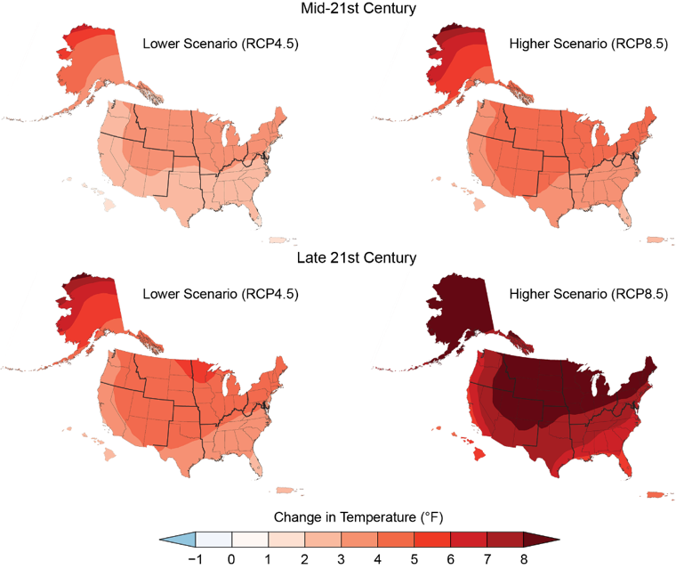
Projected Changes in U.S. Annual Average Temperature
Annual average temperatures across the United States are projected to increase over this century, with greater changes at higher latitudes as compared to lower latitudes, and under a higher scenario (RCP8.5; right) than under a lower one (RCP4.5; left).
Figure shows projected differences in annual average temperatures for mid-century (2036–2065; top) and end of century (2071–2100; bottom) relative to the near present (1986–2015).

Slide 4
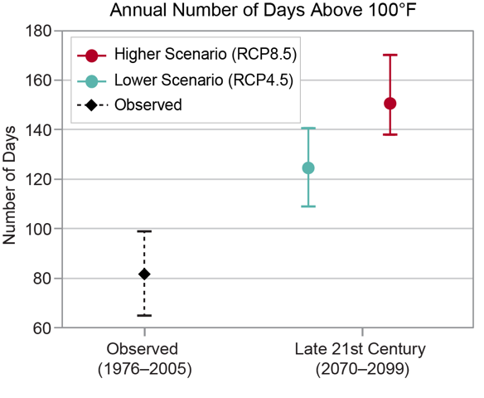
Projected Change in Very Hot Days by 2100 in Phoenix, Arizona
Average annual number of days above 100°F in Phoenix, Arizona, for 1976–2005, and projections of the average number of days per year above 100°F through the end of the 21st century (2070–2099) under the lower (RCP4.5) and higher (RCP8.5) scenarios.

Slide 5
Air Quality
Increasing Risks from Air Pollution
  Air pollution would increase the incidence of adverse respiratory and cardiovascular health effects, including premature death.
Increasing Impacts of Wildfires
  More frequent and severe wildfires due to climate change would further diminish air quality, increase incidences of respiratory illness from exposure to wildfire smoke, impair visibility, and disrupt outdoor recreational activities
Increases in Airborne Allergen Exposure
  Earlier spring arrival, warmer temperatures, changes in precipitation, and higher carbon dioxide concentrations can increase exposure to airborne pollen allergens
Notes:
Unless counteracting efforts to improve air quality are implemented, climate change will worsen existing air pollution levels.

Slide 6
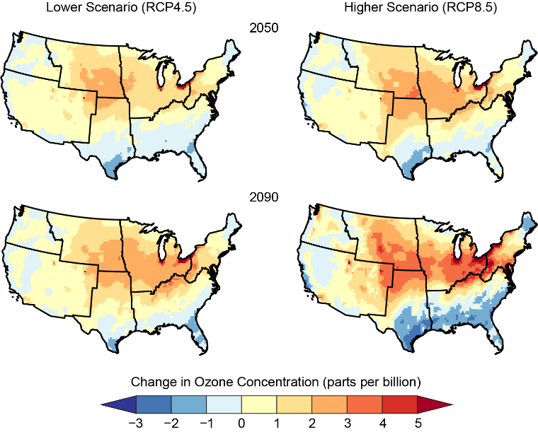
Projected Changes in Summer Season Ozone
Change in summer averages of the maximum daily 8-hour ozone concentration (as compared to the 1995–2005 average). Summertime ozone is projected to change non-uniformly across the United States
Changes are amplified under the higher scenario (RCP8.5) compared with the lower scenario (RCP4.5), as well as at 2090 compared with 2050.

Slide 7
Member Survey
Go to : PollEV.com/ryanmichael483
Or text RYANMICHAEL483 to 22333 once to join

Slide 8
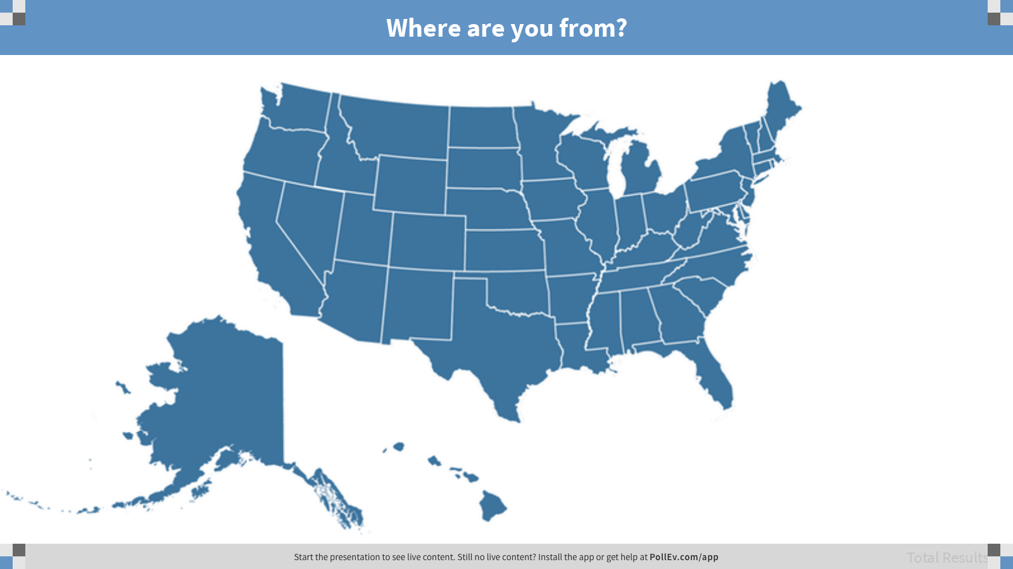
Notes:
Where are you from?
https://www.polleverywhere.com/clickable_images/U2MGjpZhezwNH67

Slide 9
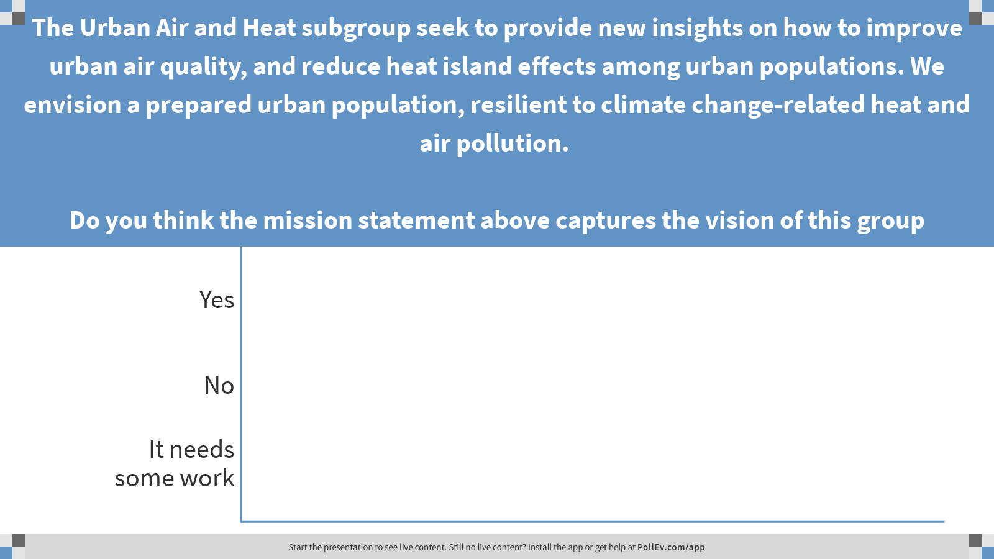
Notes:
The Urban Air and Heat subgroup seek to provide new insights on how to improve urban air quality, and reduce heat island effects among urban populations. We envision a prepared urban population, resilient to climate change-related heat and air pollution. Do you think the mission statement above captures the vision of this group
https://www.polleverywhere.com/multiple_choice_polls/4IhzpoQPjFJDNaK

Slide 10
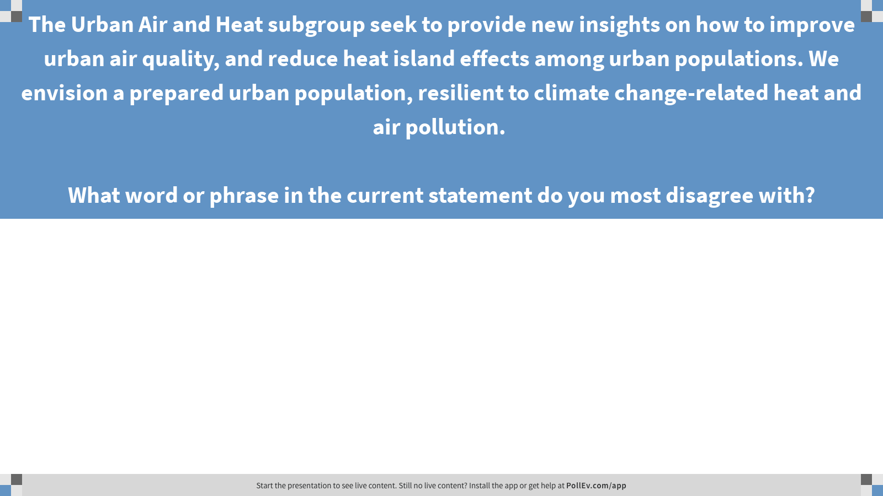
Notes:
The Urban Air and Heat subgroup seek to provide new insights on how to improve urban air quality, and reduce heat island effects among urban populations. We envision a prepared urban population, resilient to climate change-related heat and air pollution. What word or phrase in the current statement do you most disagree with?
https://www.polleverywhere.com/free_text_polls/oF0O5dzF2GdCOJm

Slide 11
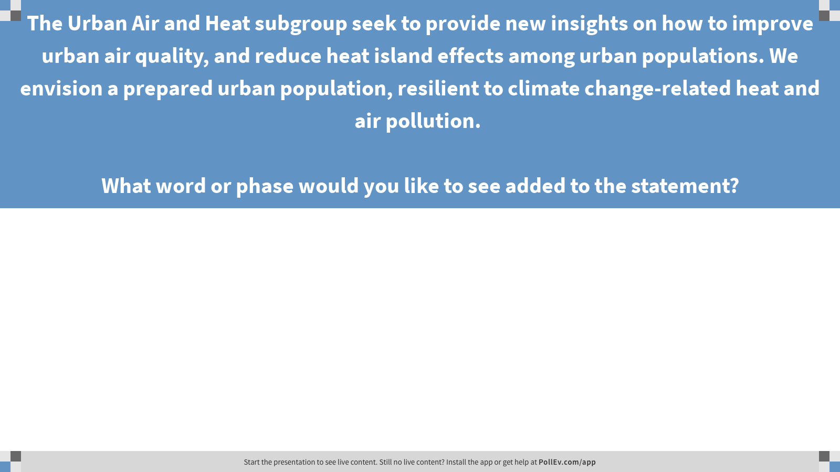
Notes:
The Urban Air and Heat subgroup seek to provide new insights on how to improve urban air quality, and reduce heat island effects among urban populations. We envision a prepared urban population, resilient to climate change-related heat and air pollution. What word or phase would you like to see added to the statement?
https://www.polleverywhere.com/free_text_polls/OW169xOVMETexbG

Slide 12
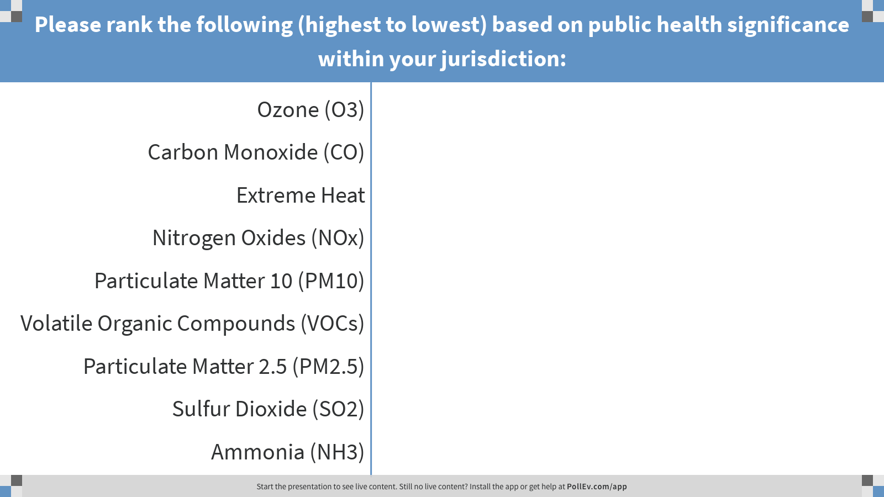
Notes:
Please rank the following (highest to lowest) based on public health significance within your jurisdiction:
https://www.polleverywhere.com/ranking_polls/bgDWeX1e0L6mNif

Slide 13
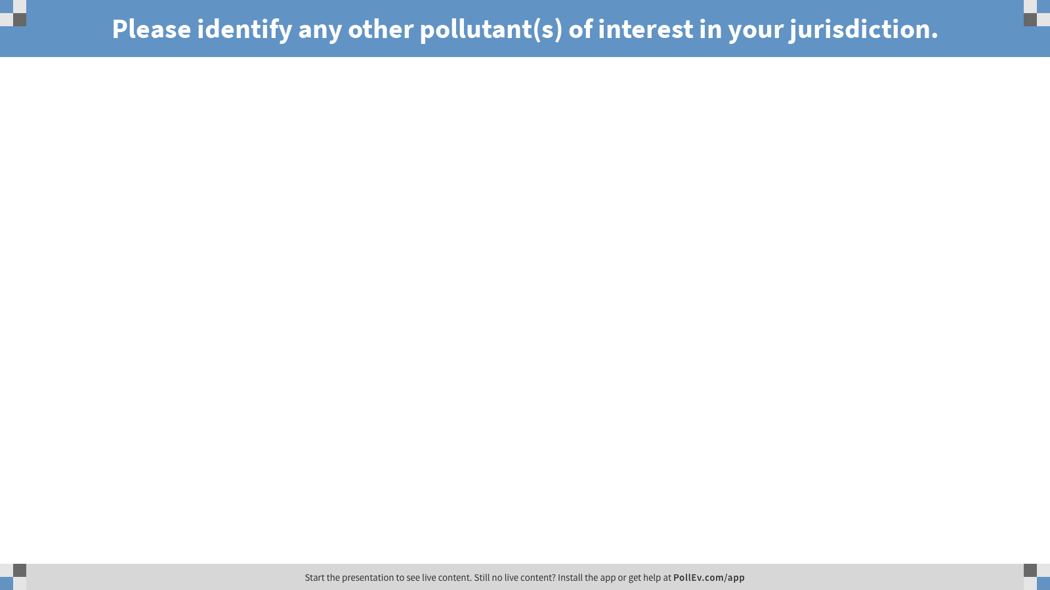
Notes:
Please identify any other pollutant(s) of interest in your jurisdiction.
https://www.polleverywhere.com/free_text_polls/P40v2sPVNq1kiB9

Slide 14
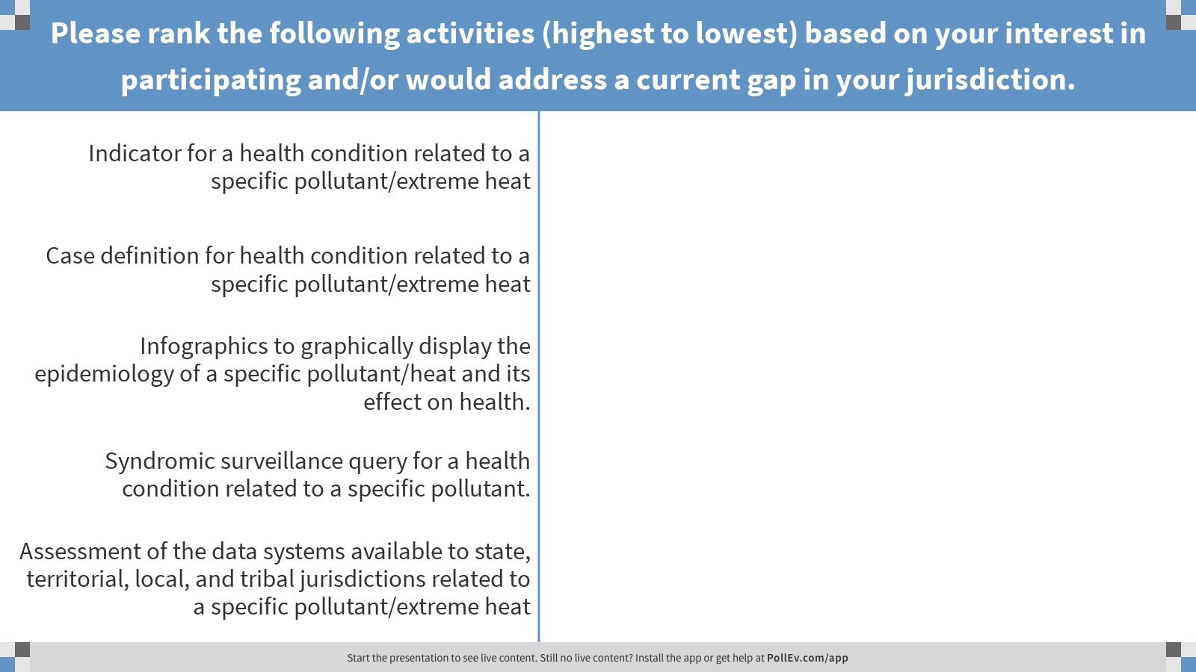
Notes:
Please rank the following activities (highest to lowest) based on your interest in participating and/or would address a current gap in your jurisdiction.
https://www.polleverywhere.com/ranking_polls/y8JxLkPR3s2qO30

Slide 15
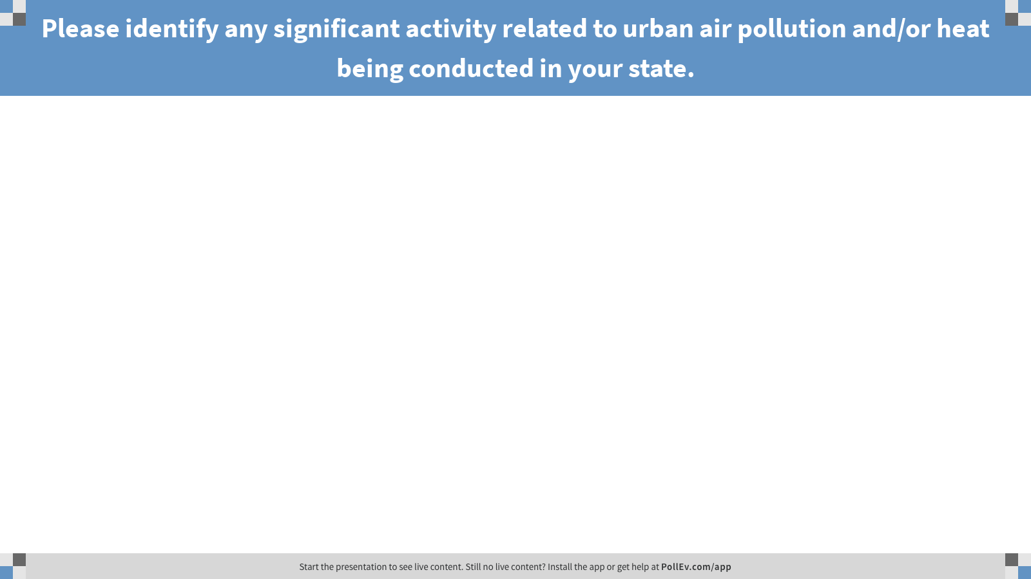
Notes:
Please identify any significant activity related to urban air pollution and/or heat being conducted in your state.
https://www.polleverywhere.com/free_text_polls/Z1RdTvQbx1VWHw2

Slide 16
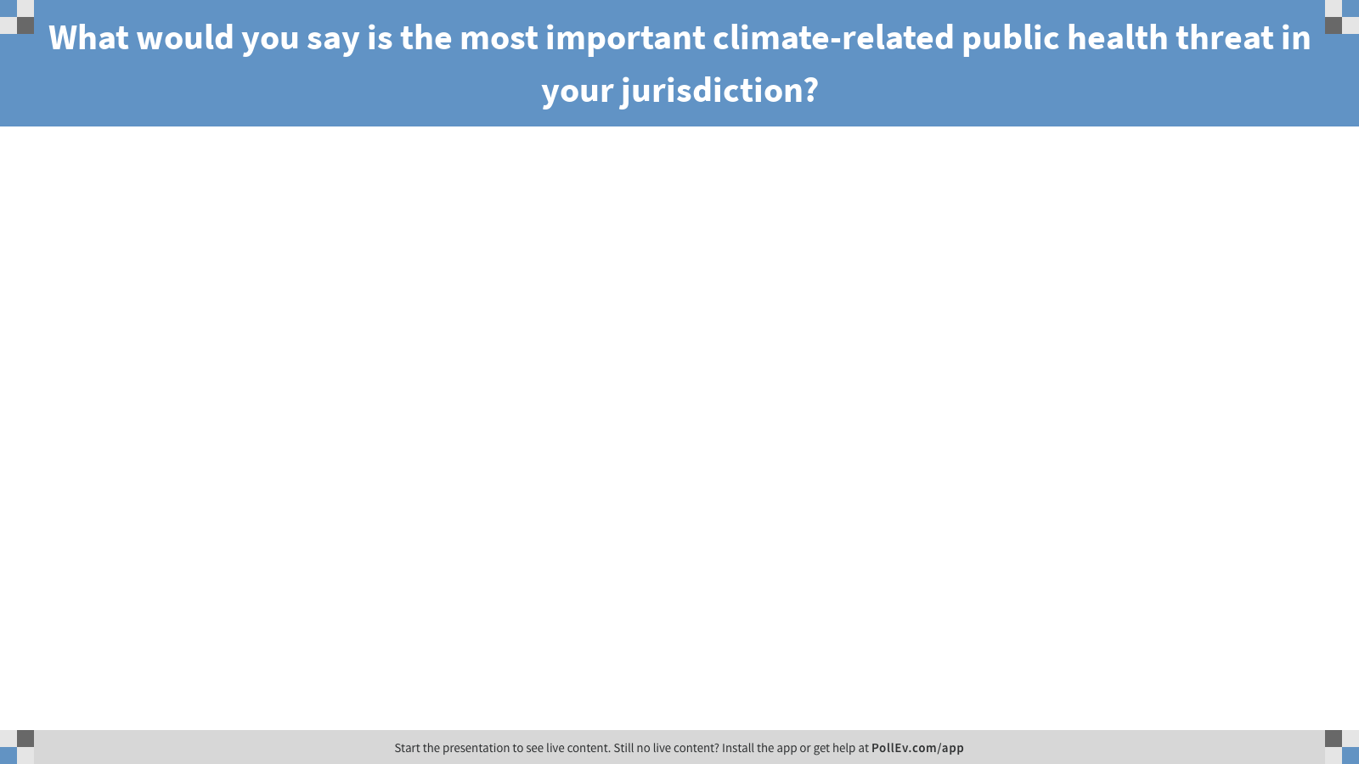
Notes:
What would you say is the most important climate-related public health threat in your jurisdiction?
https://www.polleverywhere.com/free_text_polls/dQd3DwW7m8aRxvX

Slide 17
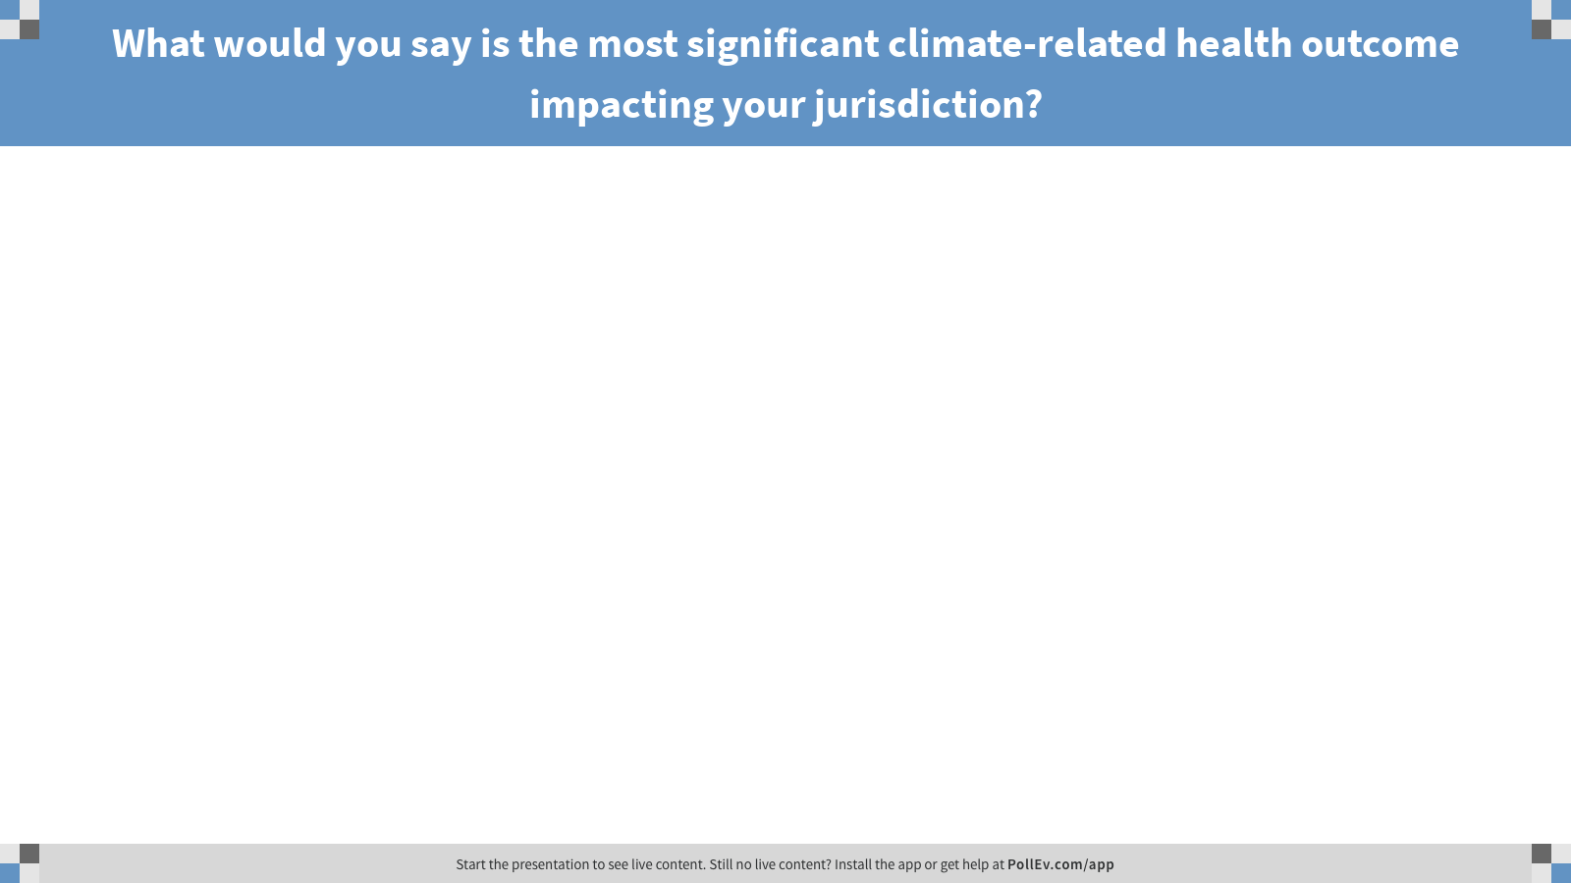
Notes:
What would you say is the most significant climate-related health outcome impacting your jurisdiction?
https://www.polleverywhere.com/free_text_polls/qw1RFUlRAHmsjlh

Slide 18
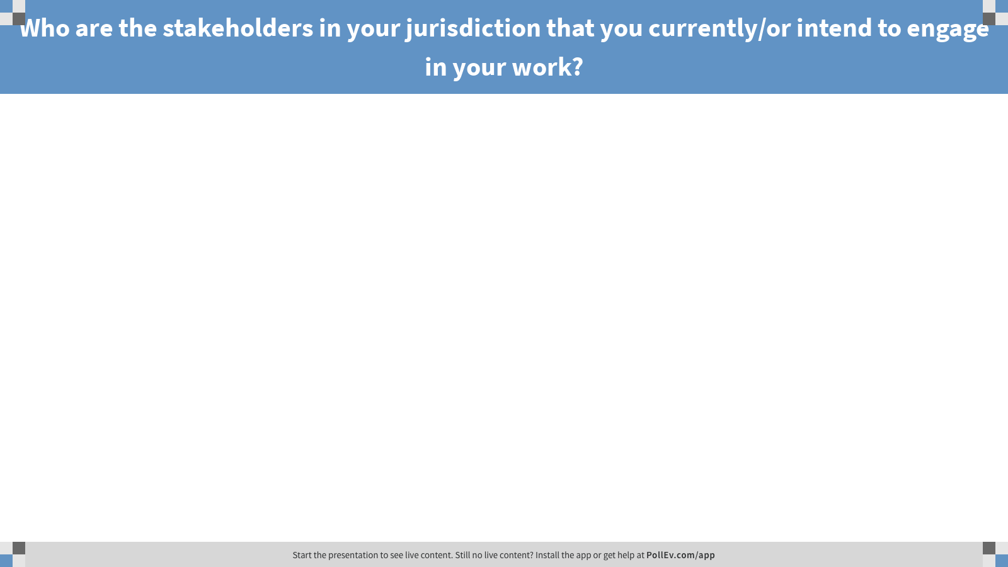
Notes:
Who are the stakeholders in your jurisdiction that you currently/or intend to engage in your work?
https://www.polleverywhere.com/free_text_polls/IENHOGSuL3jijci

Slide 19
Thank you!

