Slide 1
COVID-19 Pregnancy Status Reporting Workgroup
Thursday, January 27
3:00pm ET

Slide 2
Agenda
Welcome and Introductions (chat box)
Workgroup Overview: Background and Level-Setting Discussion
Open Forum: Reactions and Questions
February Meeting: Scheduling and Agenda Items
Adjourn

Slide 3
Housekeeping
This call is being recorded for internal notetaking purposes.
Feel free to use the chat box for comments and questions throughout the call as well as the “Raise Hand” feature.
CSTE will follow-up with an email to coordinate the next meeting and to share a link to the Basecamp page.

Slide 4
Workgroup Overview
Notes:
We’ll present an overview beginning with background on the project and expectations for the workgroup
CDC will share information on national covid case surveillance and the completeness of pregnancy status data

Slide 5


National COVID-19 case surveillance
State and jurisdictional health departments voluntarily send case data to CDC using the National Notifiable Diseases Surveillance System. Cases are reported using the CSTE national standardized case definition.
Pregnancy status is a variable on the case report form, but may require interview or medical record review
Investigating the Impact of COVID-19 during Pregnancy | CDC
Notes:
CLEARED – 1/20/21
For the national COVID-19 case surveillance, state and jurisdictional health departments voluntarily send case data to CDC using the National Notifiable Diseases Surveillance System.
Cases are reported using the CSTE national standardized case definition
A few key elements on the CRF are available in ELR-based case notification (e.g., DOB, age, sex, race/ethnicity, county, state).
The COVID-19 CRF includes current pregnancy status, but the variable may require interview or medical record review.
At the beginning of the response, the variable was in the list of underlying conditions on the COVID-19 CRF, but has since moved to the demographics section.
Also pregnancy status is collected in the GenV2 MMG for through reporting through NNDSS.

Slide 6
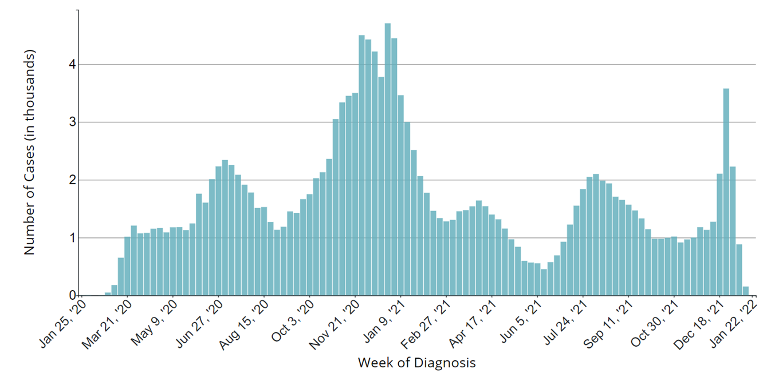

Pregnant people with laboratory-confirmed SARS-CoV-2 infection
(National COVID-19 Case Surveillance Data)*
Data lag
National COVID-19 case surveillance data: Pregnant people with laboratory-confirmed SARS-CoV-2 infection,* Jan 22, 2020–Jan 24, 2022
* Based on detection of SARS-CoV-2 in a clinical specimen by molecular amplification techniques
https://covid.cdc.gov/covid-data-tracker/#pregnant-population
Notes:
CLEARED – 1/20/21 ***edited
From NNDSS, CDC has been monitoring total cases of pregnant people with laboratory confirmed SARS-CoV-2 infection.
A total 16,873 infections have been reported in pregnant people as of January 17, 2022
Using date of diagnosis, the epi curve of lab confirmed cases among pregnant women has a similar pattern to the total population, and this has been tracking consistently throughout the response.
Recent data should be interpreted with caution, as there is about a 2-4 week delay in the data for a jurisdiction to confirm a case of SARS-CoV-2 in a pregnant woman and report it to CDC.
For example, the last couple of weekly reporting cycles, we are now seeing an uptick in cases related to Omicron during the week of Dec 25th which is about a 3 week lag.

Slide 7
Ascertaining Pregnancy Status
As of Jan 18, 2022, 21% of laboratory-confirmed cases in females have pregnancy status complete
  Completeness varies across jurisdictions ranging from 0-100%
  Varied over time with lower completeness during surges
Quality improvement efforts to complete variable through both active (e.g., contact tracing tool) and passive strategies (e.g., data linkages to vital records and administrative data)
Several jurisdictions continue to evaluate accuracy of pregnancy status variable on the COVID-19 Case Report Form
Notes:
CLEARED 1/20/21
Given that we need pregnancy status to conduct SET-NET surveillance, ascertaining accurate pregnancy status is critical.
Our team has been monitoring the completeness of the variable, which currently ranges from 24-49% depending on whether you take into account the UNK response option. This varied greatly across jurisdictions, likely due to high case load.
Our participating jurisdictions are trying to improve the quality of the pregnancy status variable through active strategies, such as adding pregnancy status, estimated date of delivery, and provider on their state's contact tracing tool, and through passive strategies like data linkages to vital records or admin data.
CDC and several juris continue to evaluate the accuracy of pregnancy status variable on the COVID-19 CRF

Slide 8
Sensitivity of COVID-19 CRF pregnancy status field
A total of 4,276 (IL) and 2,070 (TN) CRFs linked with a vital record and had at least one positive specimen during pregnancy (confirmed pregnant women with SARS-CoV-2 infection)
Manning et al. MCH Journal 2021
Notes:
Cleared
Analysis using data from IL and TN examined sensitivity of the COVID-19 case report form pregnancy field by comparing CRF data to the gold standard of CRF data linked to birth and fetal death certificates.
CRFs for women aged 15-44 years with laboratory-confirmed SARS-CoV-2 infection were linked to birth and fetal death certificates for pregnancies completed during January 1-December 31, 2020 in Illinois and Tennessee.
A total of 4,276 CRFs in Illinois and 2,070 CRFs in Tennessee linked with a vital record and had at least one positive specimen during pregnancy. These are considered to be confirmed pregnant women with SARS-CoV-2 infection during the study period.
Among the confirmed pregnancy women with SARS-COV-2 infection, the proportion that were identified as pregnant on the original CRF were similar across states (45% in Illinois and 42% in TN).

Slide 9
Sensitivity of CRF pregnancy status field varied significantly* by month of specimen collection in both states in 2020
Manning et al. MCH Journal 2021
* p<0.05
Notes:
Cleared
Authors also examined whether the sensitivity of the CRF pregnancy status field changed over time based on the month of specimen collection.
In both states, the sensitivity of the CRF pregnancy status field significantly by month, showing a general decline in sensitivity over time from March 2020 to December 2020

Slide 10
Purpose
CSTE convened this multidisciplinary workgroup of subject matter experts and public health partners to identify issues and needs around pregnancy status reporting via Electronic Lab Reports (ELR) for COVID-19 and to develop recommendations for the improvement of accuracy and completeness.

Slide 11
Goals
The COVID-19 Pregnancy Status Reporting Workgroup will:
  Conduct an STLT environmental scan to identify and review current practices, gaps, and opportunities for data improvement across the ELR/ECR pipeline, focused on pregnancy status reporting as part of jurisdictional ELR/ECR for COVID-19.
  Develop a CSTE guidance document that outlines the recommendations to improve pregnancy status reporting in ELR/ECR based on the results of the environmental scan and workgroup discussions.

Slide 12
Participation
Participation in workgroup calls will inform the environmental scan and final recommendations.
Workgroup members will have the opportunity to provide comments on products.

Slide 13
Timeline
January 2022 | First Workgroup call Establish regular monthly meeting time
February - March 2022 | Onboard consultant Begin literature review, prepare environmental scan
April 2022 | Conduct environmental scan (assessment questions, key informant interviews)
May – June 2022 | Draft recommendations and conduct internal reviews and edits
July 2022 | Conclude monthly Workgroup calls Finalize recommendations Publish recommendations on CSTE website

Slide 14
Open Forum
Notes:
Michael and Danica to facilitate

Slide 15
Questions to Consider
Providers, labs, HDs, others:
What are some barriers/challenges that exist for ELR of pregnancy status? Some successes/work arounds?
Known limitations of using ELR to ascertain pregnancy status?
Benefits/barriers of using ELR to ascertain pregnancy status?
Person-time required for ELR vs. other methods of pregnancy reporting?
Validity of using ELR to ascertain pregnancy status for case reporting?
Experience in other conditions to ascertain pregnancy status via ELR

Slide 16
February Meeting
Notes:
Zoom polls

Slide 17


CSTE National Office
2635 Century Parkway NE, Suite 700
Atlanta, Georgia 30345
770.458.3811
770.458.8516
misrael@cste.org

