Slide 1
COVID-19 Pregnancy Status Reporting Workgroup
Monday, August 22
1:00pm ET

Slide 2
Agenda
Welcome and Introductions (chat box)
Housekeeping
Level-Setting
Recommendations Document
  Review Process
  Current Suggestions & Revisions
Open Forum (time permitting)
Adjourn

Slide 3
Housekeeping
This call is being recorded for internal notetaking purposes.
Feel free to use the chat box for comments and questions throughout the call as well as the “Raise Hand” feature.
Reminder that all resources and the call schedule (4th Mondays at 1pm ET) are available on Basecamp- links in the reminder email and chat box.

Slide 4
Level-Setting
CSTE convened this multidisciplinary workgroup of subject matter experts and public health partners to identify issues and needs around pregnancy status reporting via Electronic Lab Reports (ELR) and to develop recommendations for the improvement of accuracy and completeness.
Initial focus on COVID-19 surveillance with consideration of applicability of recommendations for other threats.
Include consideration to leverage existing capacity to identify women who are pregnant at time of specimen collection of COVID-19 infection
  Utilize existing systems for data capture
  Develop recommendations for multiple levels of data capture not inhibiting existing efforts (i.e., eCR)
  Acknowledge multiple approaches may be needed to ensure adequate identification of pregnancy status
Surveilling health of pregnant women and their infants during pandemics and disasters has generally been difficult and untimely
  Prevents ability to monitor and respond during critical times in fetus development and/or neonatal periods

Slide 5
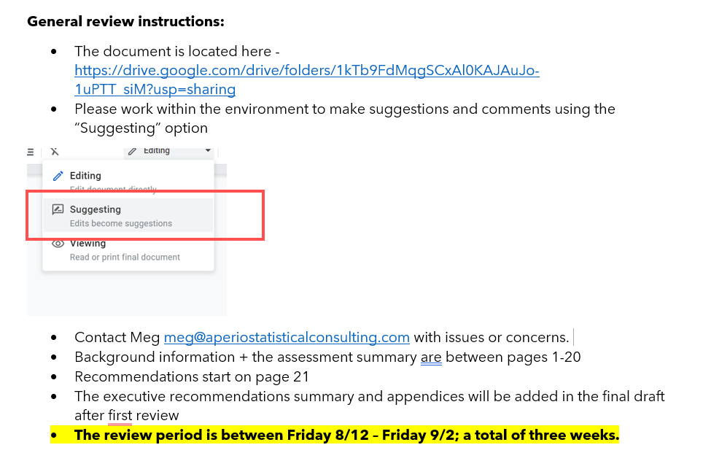
Review Guidelines

Slide 6
Review Notes
For this first draft recommendations were focused on conditions where the impact to the health of the mother, fetus or infant is known or unknown. This encompasses infectious conditions with known impacts on perinatal health, as well as emerging or reemerging diseases.
We are starting with phrasing “mother, fetus or infant”, but open to suggestions.
Recommendations are incremental and specific, but a different flow than previously discussed.
We need to retain a focus on COVID-19 WITH other conditions as that is the focus of the project’s funding.
For those with a laboratory background, please carefully review Recommendation II.
All workgroup members who provide edits to the document will be noted in the final version.
Please consider whether we need a section explaining current notifiable disease reporting processes in general. This was left out as the document audience is likely familiar with the reporting process.

Slide 7
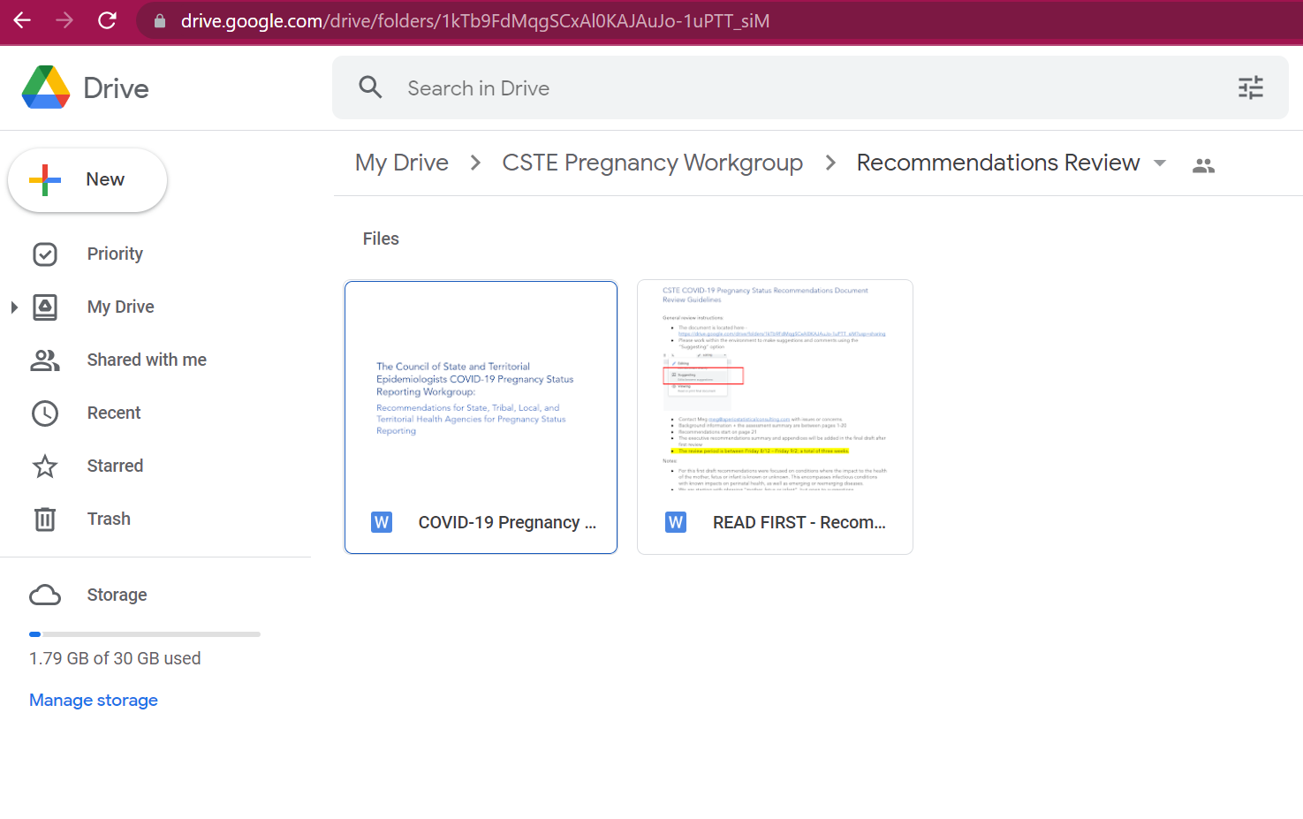
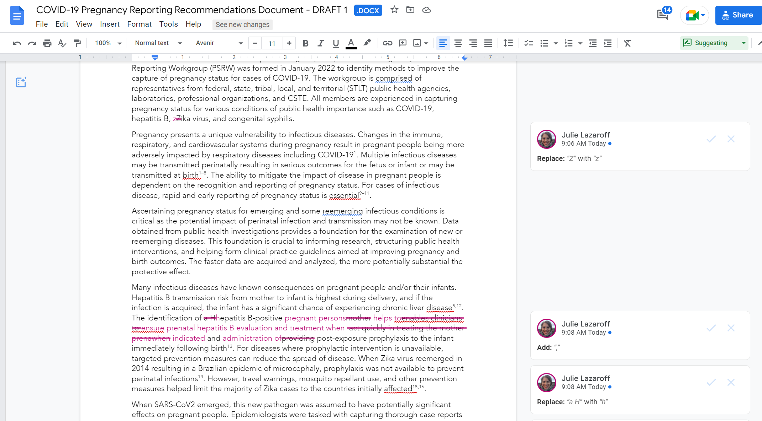

Slide 8
Open Forum
Opportunity to pose questions for discussion or share comments
Raise Hand feature or post in chat box

Slide 9


CSTE National Office
2635 Century Parkway NE, Suite 700
Atlanta, Georgia 30345
770.458.3811
770.458.8516
misrael@cste.org

