Slide 1
COVID-19 Pregnancy Status Reporting Workgroup
Monday, July 25
1:00pm ET

Slide 2
Agenda
Welcome and Introductions (chat box)
Housekeeping
Level-Setting
Review of Assessment Results
Review of Draft Recommendations Outline
Open Forum (time permitting)
Adjourn

Slide 3
Housekeeping
This call is being recorded for internal notetaking purposes.
Feel free to use the chat box for comments and questions throughout the call as well as the “Raise Hand” feature.
Reminder that all resources and the call schedule (4th Mondays at 1pm ET) are available on Basecamp- links in the reminder email and chat box.

Slide 4
Level-Setting
CSTE convened this multidisciplinary workgroup of subject matter experts and public health partners to identify issues and needs around pregnancy status reporting via Electronic Lab Reports (ELR) and to develop recommendations for the improvement of accuracy and completeness.
Initial focus on COVID-19 surveillance with consideration of applicability of recommendations for other threats.
Include consideration to leverage existing capacity to identify women who are pregnant at time of specimen collection of COVID-19 infection
  Utilize existing systems for data capture
  Develop recommendations for multiple levels of data capture not inhibiting existing efforts (i.e., eCR)
  Acknowledge multiple approaches may be needed to ensure adequate identification of pregnancy status
Surveilling health of pregnant women and their infants during pandemics and disasters has generally been difficult and untimely
  Prevents ability to monitor and respond during critical times in fetus development and/or neonatal periods

Slide 5
Project Timeline
CSTE-CDC RFP Consultant to identify recommendations for improving COVID-19 surveillance - Work Plan Schedule
TASK | ASSIGNED TO | PROGRESS | START | END
Compile and analyze assessment results. Synthesize with literature review, environmental scan, and SME interviews. | Aperio | 0% | 6/25/22 | 7/8/22
Host workgroup session. Review preliminary survey results. | Aperio, WG, CSTE | 0% | 6/27/22 | 6/27/22
Draft recommendations document to include recommendations to improve pregnancy status reporting for COVID-19 through ELR. | Aperio | 0% | 7/8/22 | 8/8/22
Host workgroup session. Review draft document progress and instructions for providing feedback. | Aperio, WG, CSTE | 0% | 7/25/22 | 7/25/22
Provide feedback on draft recommendations document. | WG | 0% | 8/8/22 | 8/26/22
Host workgroup session. Review feedback and instructions for final comments. | Aperio, WG, CSTE | 0% | 8/22/22 | 8/22/22
Incorporate edits, draft executive summary, and finalize document with the workgroup. | Aperio, WG | 0% | 8/26/22 | 9/12/22
Provide feedback on FINAL recommendations document. | WG | 0% | 9/12/22 | 9/23/22
Finalize recommendations document. | Aperio |  | 9/24/22 | 9/26/22
Host final workgroup session. Present FINAL document to the workgroup and publish for STLT use. | Aperio, WG, CSTE | 0% | 9/26/22 | 9/26/22
Assessment complete – findings revised by 7/29
Assessment summary & Recommendations outline on basecamp
Recommendations draft document
  Posted to GoogleDocs
  Editing allowed
  Open for four weeks
  Release slated for 8/1; may need through the first week of August

Slide 6
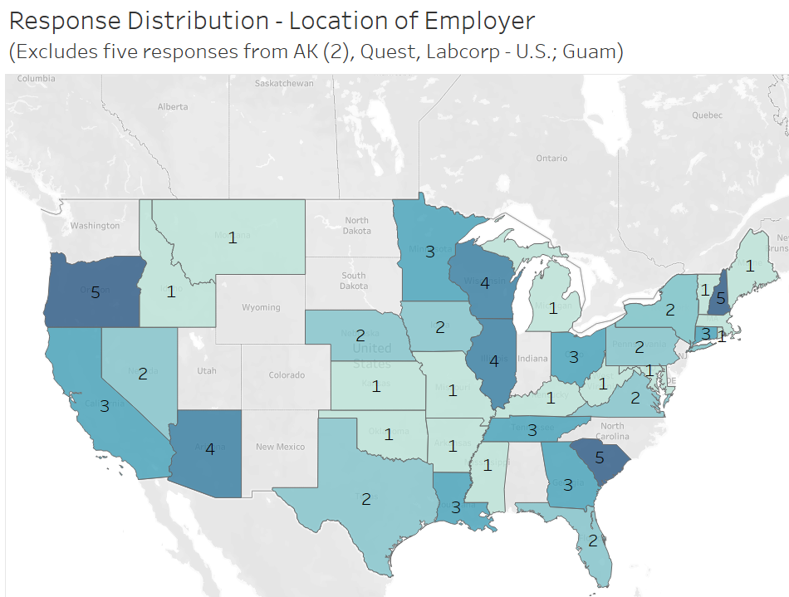
Assessment Findings
There were 112 responses across four assessments; 24 anonymous. Response distribution was as follows:
  STLT 74
  Federal 13
  Clinician 15
  Lab 14
Jurisdictions represented across all assessments included:
  41 states
  2 national organizations
  1 territory

Slide 7
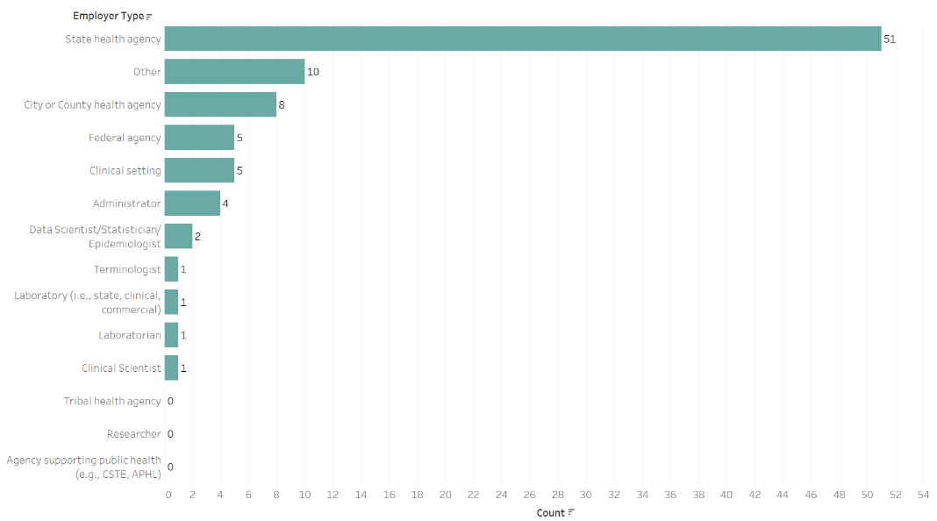
Respondent Profile
The majority of respondents were from state health agencies with 51 from state, 10 other, either city/county, five federal, five clinicians, and 10 from other agency types.

Slide 8
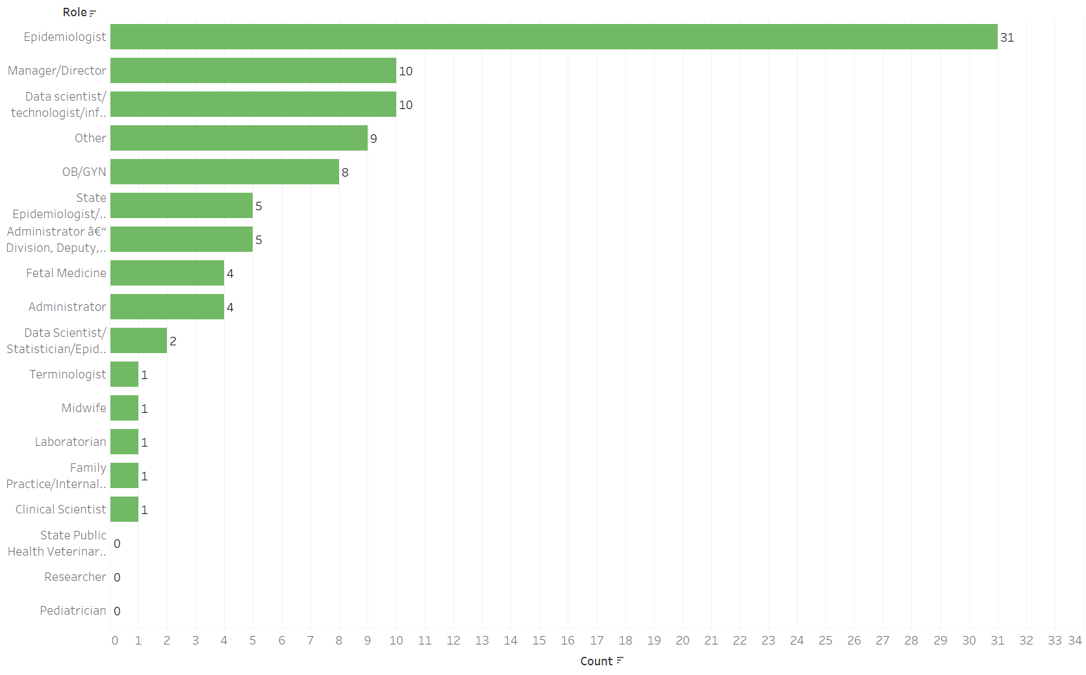
Respondent Profile
Respondent roles extended from epidemiologists (31), those in leadership roles (10), data scientists (10), and others (42).

Slide 9
State Agencies
Pregnancy status is most often obtained by patient interview, followed by ELR, provider outreach, eCR, and other fields. For non-COVID diseases, similar primary sources are used. For non-notifiable conditions of public health importance, vital statistics and hospital discharge data are the most common sources of pregnancy status. State agencies most often want a simple y/n question for obtaining pregnancy status.
In terms of barriers, inconsistency in reporting, coding, and receipt are major barriers. There is also reluctance to share data across bureaus.
Seven respondents indicated administrative law exists to require reporting of pregnancy status. Agencies do link to vital records to obtain recent birth information.
With regards to eCR, COVID-19 is the most commonly reported condition. Expansion of eCR is focused on enteric diseases, respiratory conditions, sexually transmitted and vaccine preventable diseases. Significant expansion is slated to occur in the next year for most, with additional expansion within five years.
The biggest barriers to implementing eCR are retention and the presence of staff with expertise along with external technical assistance. There was mention of CDC impeding a process and a vendor not delivering an enhancement.
States indicate status reporting is very important for 'notifiable conditions where the health of the mother or infant are impacted' or 'new or emerging diseases where the impact to mothers or infants is unknown', as well as COVID-19.

Slide 10
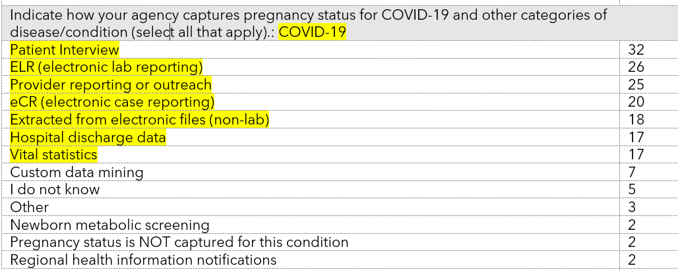
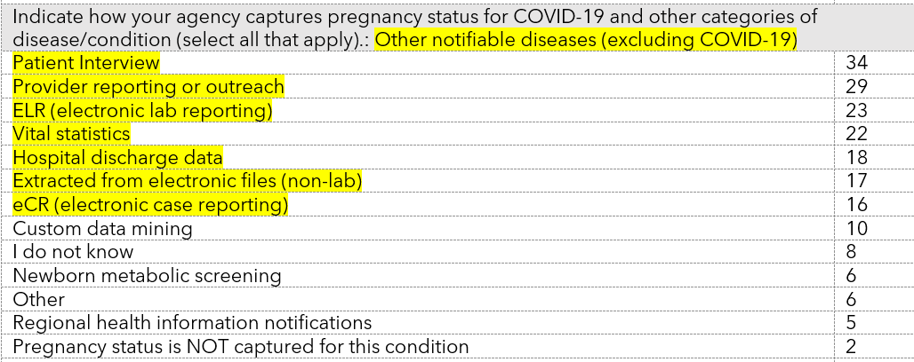
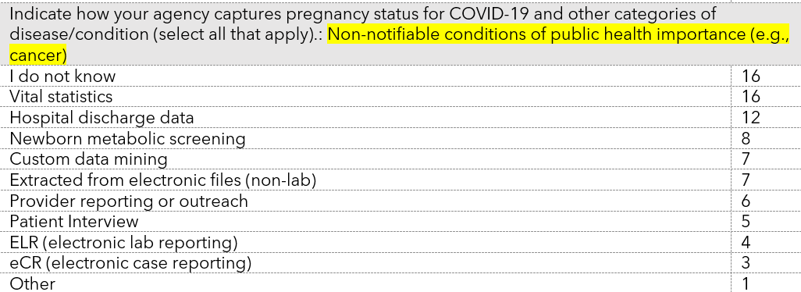

Slide 11
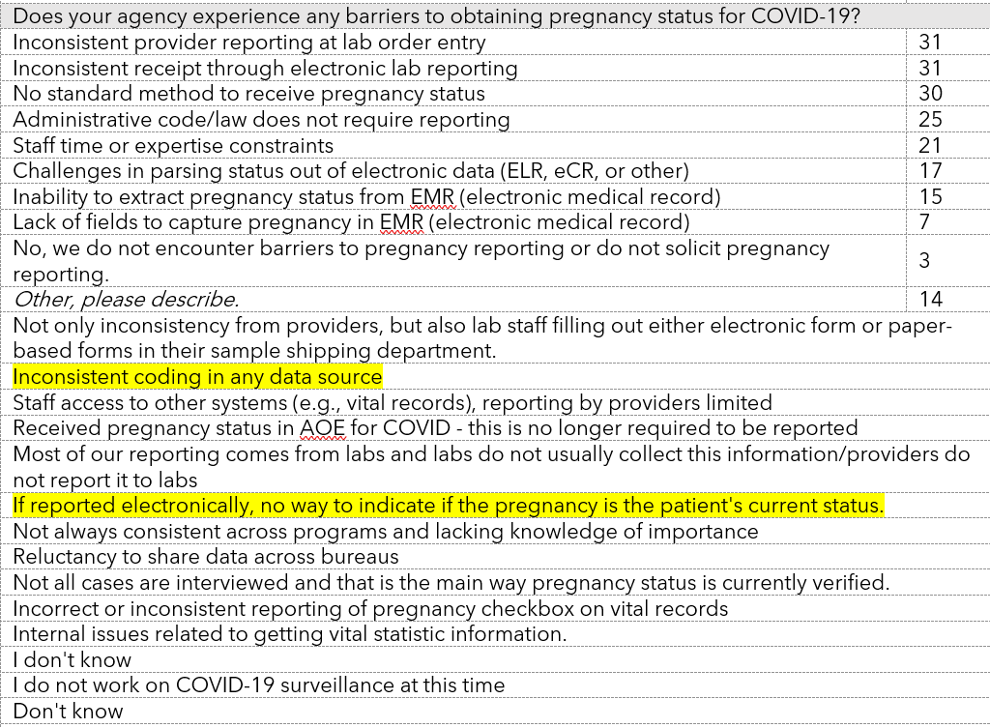

Slide 12
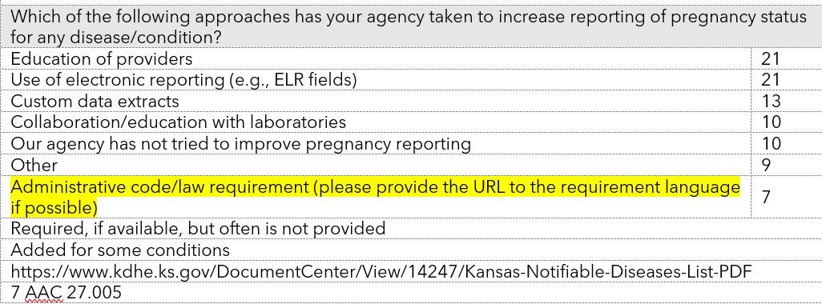
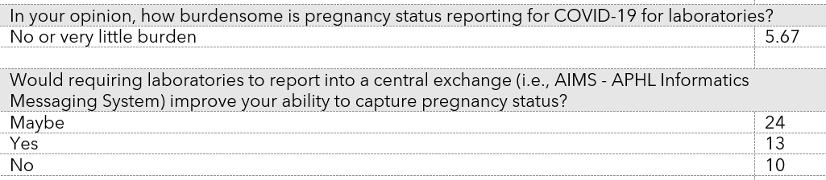

Slide 13
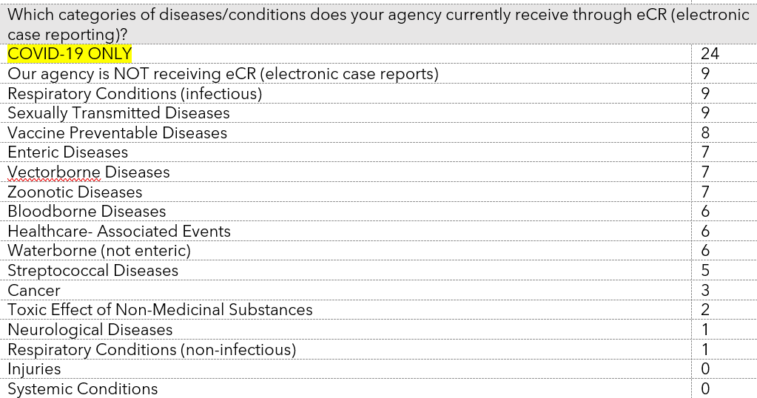
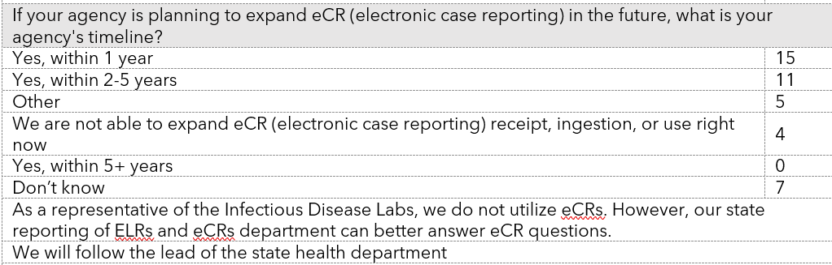

Slide 14
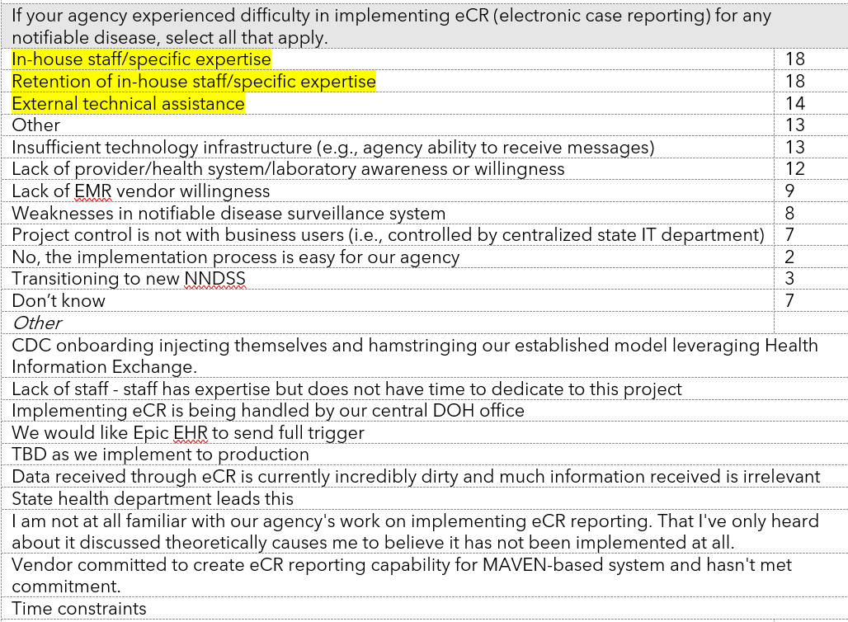

Slide 15
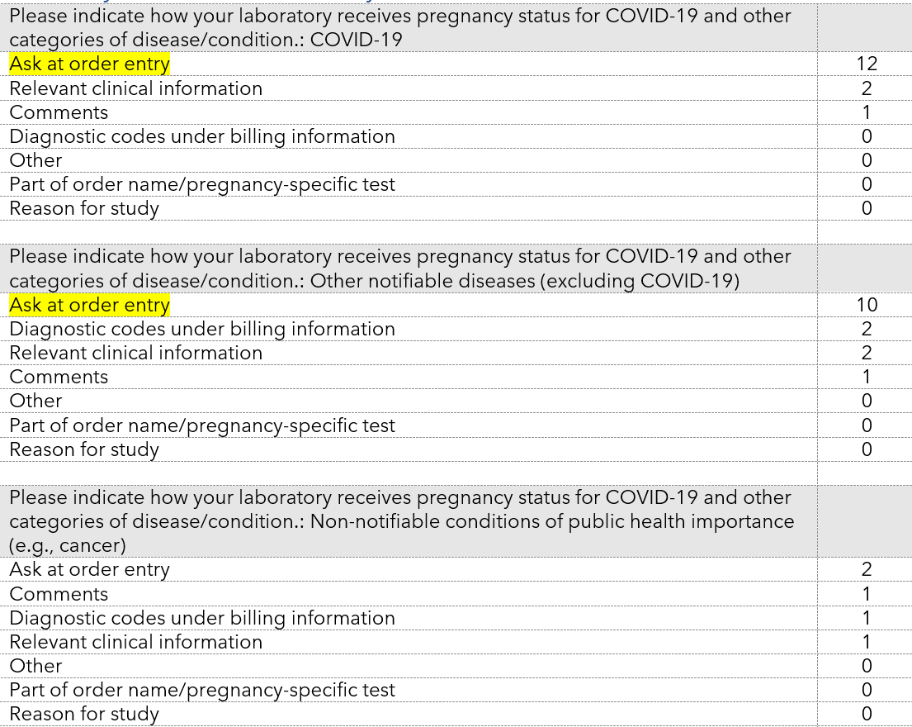
Laboratory
Ask at order entry (AOE) is the most commonly used field for capturing pregnancy status for COVID-19 and other notifiable conditions. Relevant clinical information and diagnostic codes are sparsely used. Status is reported to public health using the 'Other' HL7 field or in 'Relevant clinical information' or 'OBX'.
Pregnancy status is most often collected for COVID-19 and Zika, followed by HIV and Syphilis. Manual data entry is required on paper lab requisition forms.
Laboratories confirm a simple picklist is the best approach to capture pregnancy status. If status were a required reporting element, codification in AOE is preferred. Laboratories indicate reporting capture burden is 4.2/10 effort. However, laboratorians do not feel pregnancy status should be captured by them unless clinically relevant. Most have a field to capture but challenges with ensuring reporting happen.

Slide 16
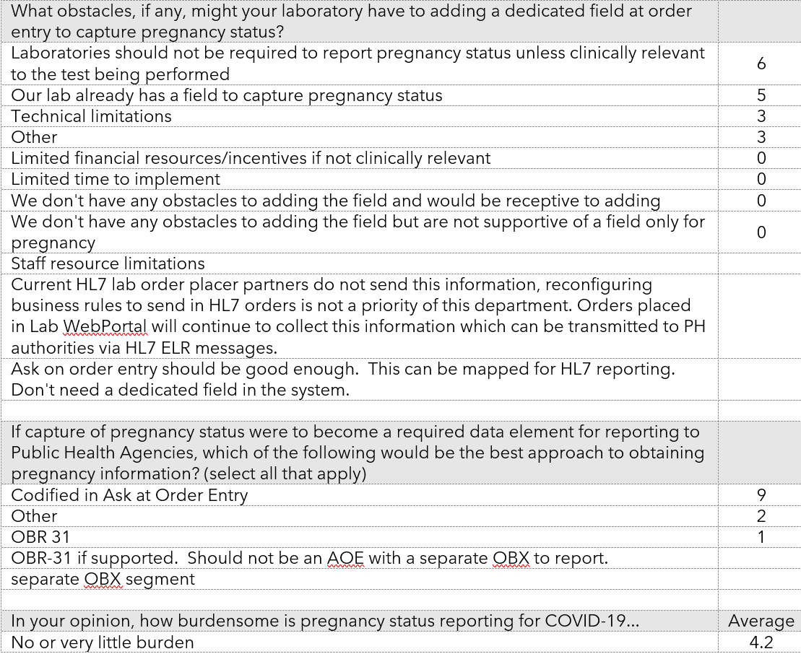

Slide 17
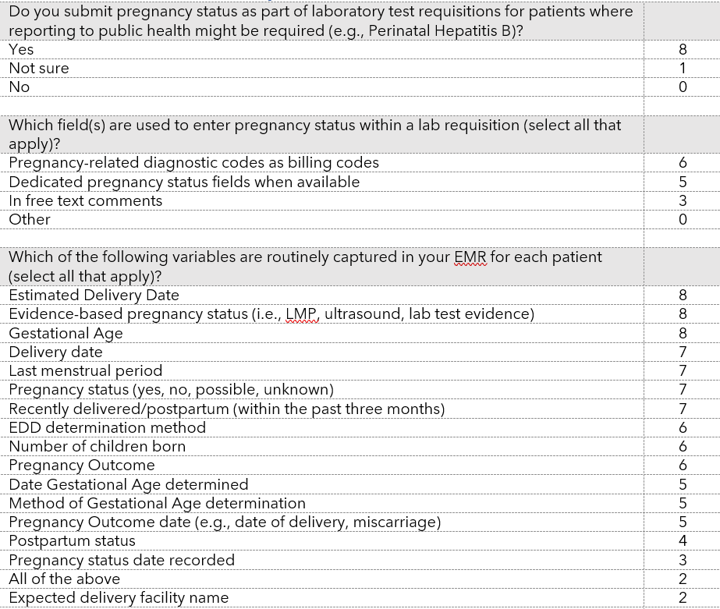
Clinician
Clinicians report pregnancy status as diagnostic billing codes and dedicated fields when available. Most standard variables for following pregnant patients are routinely captured.
In terms of barriers to reporting to public health, clinicians cite EMR is not programmed to report to public health and lack of awareness of the need to report. However, clinicians feel reporting of all notifiable and emerging conditions is important.

Slide 18
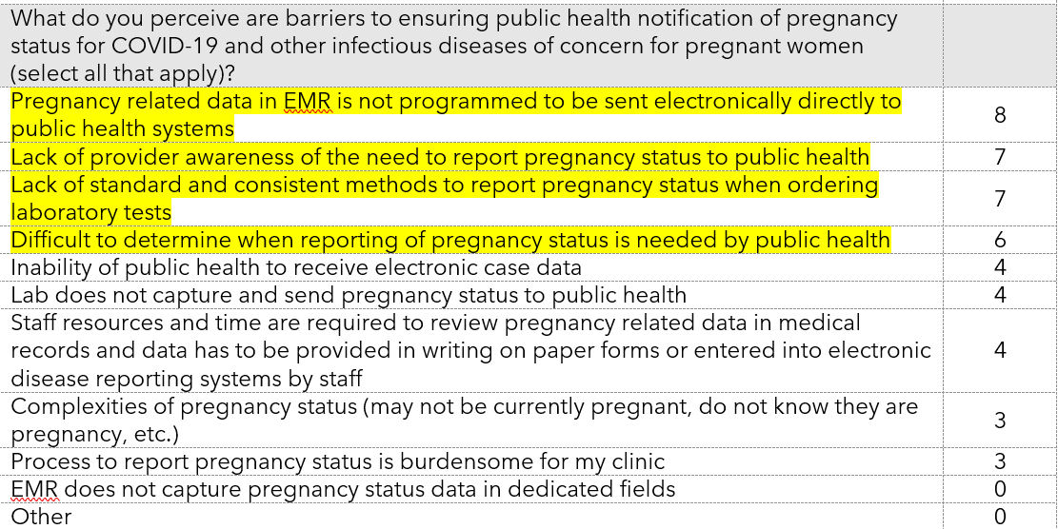
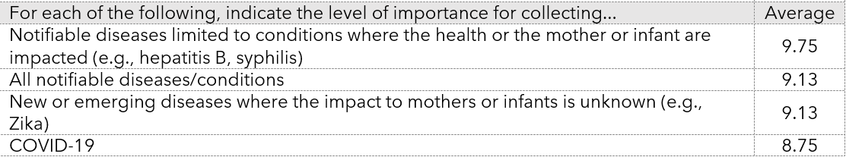

Slide 19
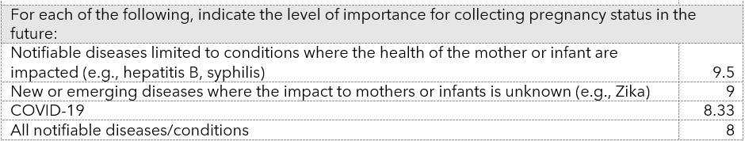
Federal Agencies
Responses were smaller for this assessment. When obtained for COVID-19, pregnancy status is retrieved from vital statistics, eCR, and other files. Respondents indicated capturing status required significant effort. Expanded use of eCR is believed to improve reporting along with other state-level efforts. Respondents believe reporting of pregnancy status for all notifiable conditions is important.

Slide 20
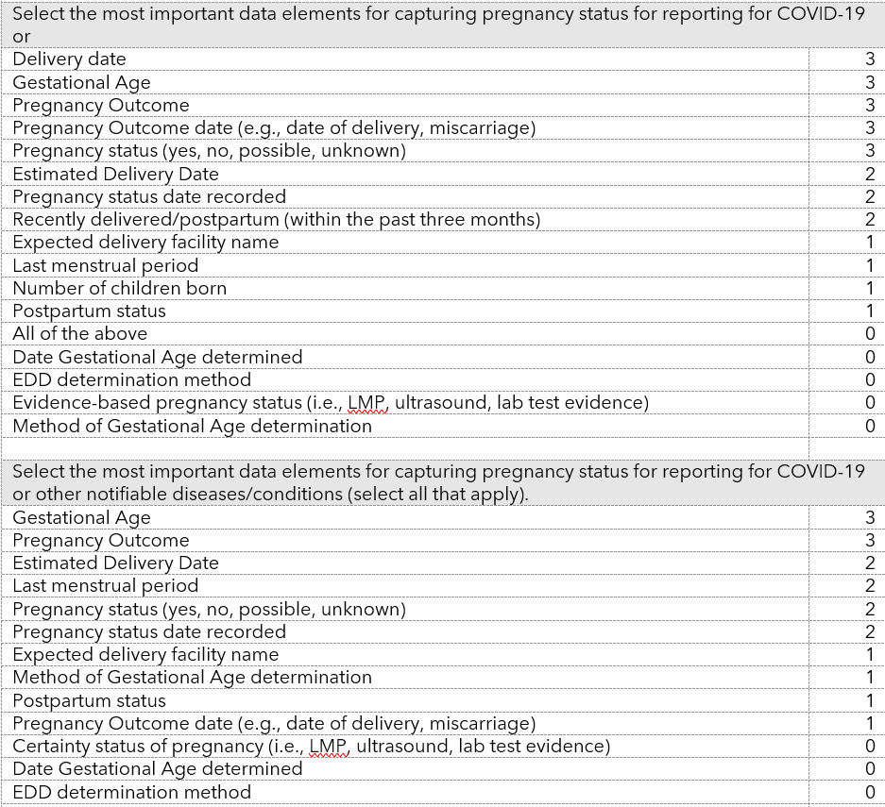

Slide 21
Open Forum
Opportunity to pose questions for discussion or share comments
Raise Hand feature or post in chat box

Slide 22


CSTE National Office
2635 Century Parkway NE, Suite 700
Atlanta, Georgia 30345
770.458.3811
770.458.8516
misrael@cste.org

