Slide 1
Covid-19 Seroprevalence Dashboard
Neal Freedman on behalf of NIH/CDC Covid-19 Serology working group

Slide 2
NIH and CDC are collaborating to develop a central repository of SARS-CoV-2 seroprevalence studies in order to provide a unified source of information about what studies are ongoing and have been completed, and to facilitate understanding of the prevalence of SARS-CoV-2 and how it has changed over time.
AIMS:
Develop a transparent and publicly accessible data warehouse to systematically document and track SARS-Cov-2 seroprevalence studies in the United States and associated test results.
Develop an interactive dashboard to visualize and compare SARS-Cov-2 seroprevalence data

Slide 3
COVID-19 cases worldwide and in the USA
Globally, >25 million cases and 850,000 deaths
Within USA, ~ 6 million cases and >182,000 deaths

Slide 4
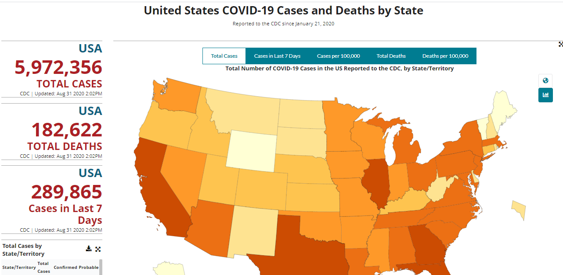

Slide 5
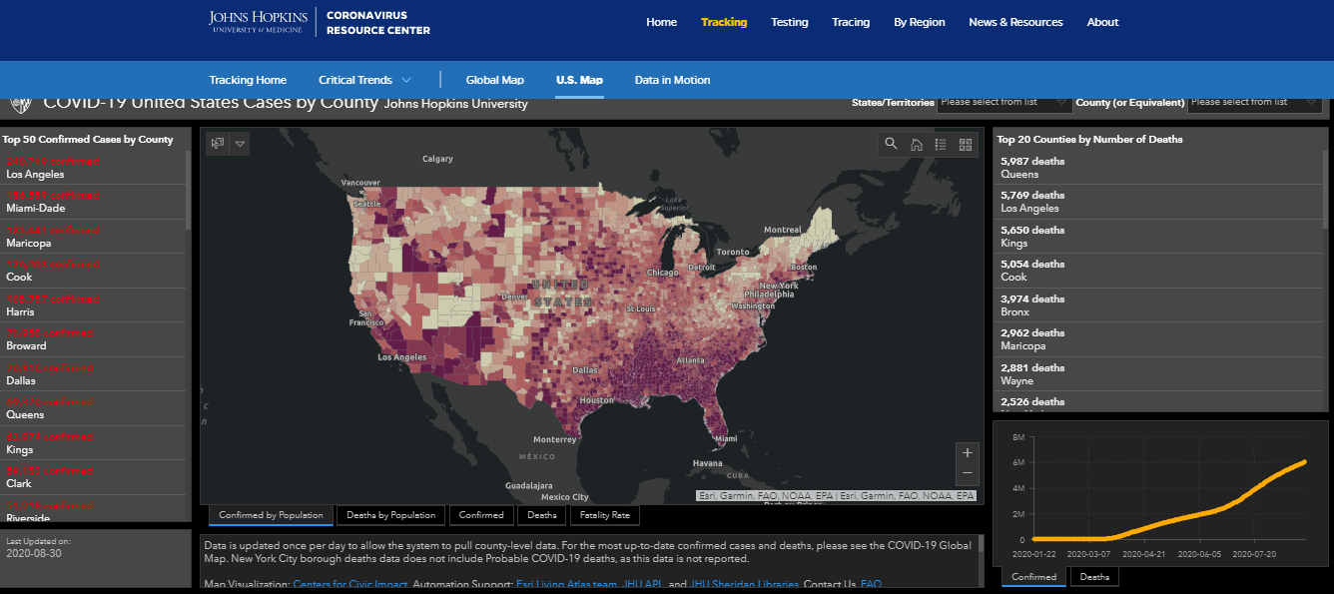

Slide 6
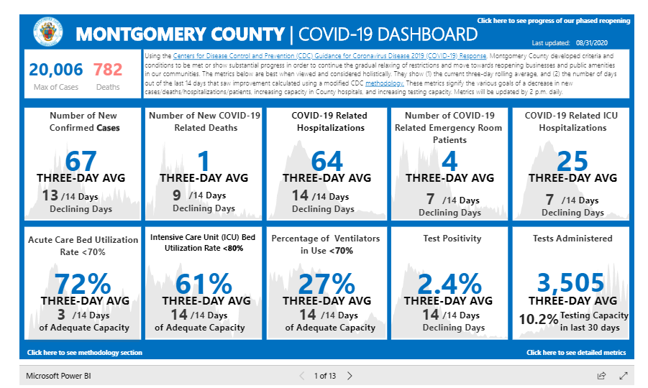

Slide 7
Importance of seroprevalence studies
By identifying people who have been infected, seroprevalence studies can provide information on how the virus is spreading.
Thus, it is critical to know the proportion of the population infected with SARS-CoV-2 and how this proportion varies by location, population, and time.
It is also important to understand which populations have not been adequately studied, to ensure that gaps in critical information can be filled and that health disparities can be identified and addressed.

Slide 8
Many studies have been initiated worldwide
  Very large national studies (such as CDC Commercial Laboratory Seroprevalence Survey)
  Smaller county-based studies
  Studies in the general population and studies among special populations (health care workers, pregnant women, etc)
  Cross-sectional and longitudinal studies

Slide 9
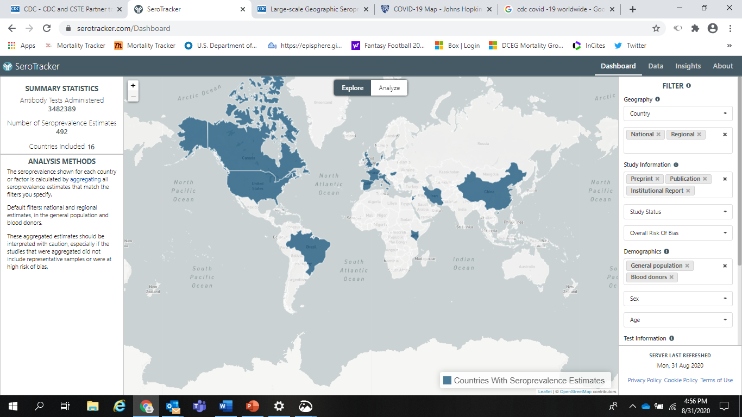

Slide 10
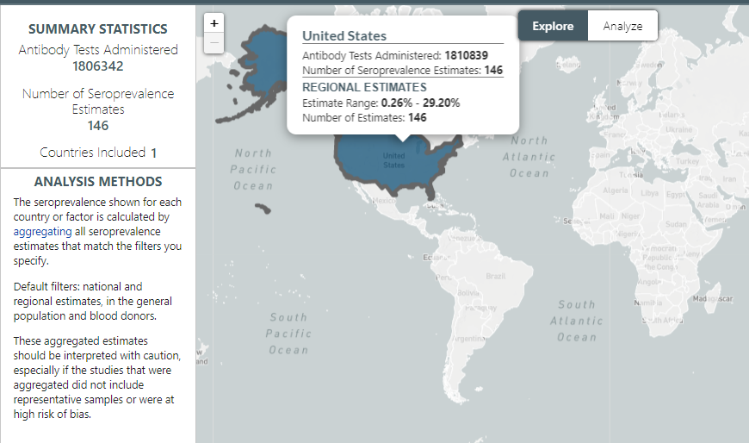

Slide 11
Challenges to understanding the literature
Studies published in both traditional journals and on websites and press releases
Many are hard to find without substantial effort
Hard to compare across key factors (geography, time, etc).
Large range in study quality
Lack of transparency and information sharing
  Information about studies only available at time of data release
  Duplicative effort

Slide 12
Covid-19 Seroprevalence Dashboard
(adapted from NCI Clinical Trials Reporting Program https://www.cancer.gov/about-nci/organization/ccct/ctrp)
Part 1)
- defined data collection elements
standard abstraction protocol
both in process and completed studies
Part 2)
a website that can display and sort studies
Includes a specific page with details for each study (and results where available)

Slide 13
Captured data fields
Study title, organization, contact information
Link to study
Study design
Study population
Study location
Collection period and frequency
Test and performance characteristics (sensitivity, specificity, etc)
Has data been generated? If so, where is it located
Seroprevalence results

Slide 14
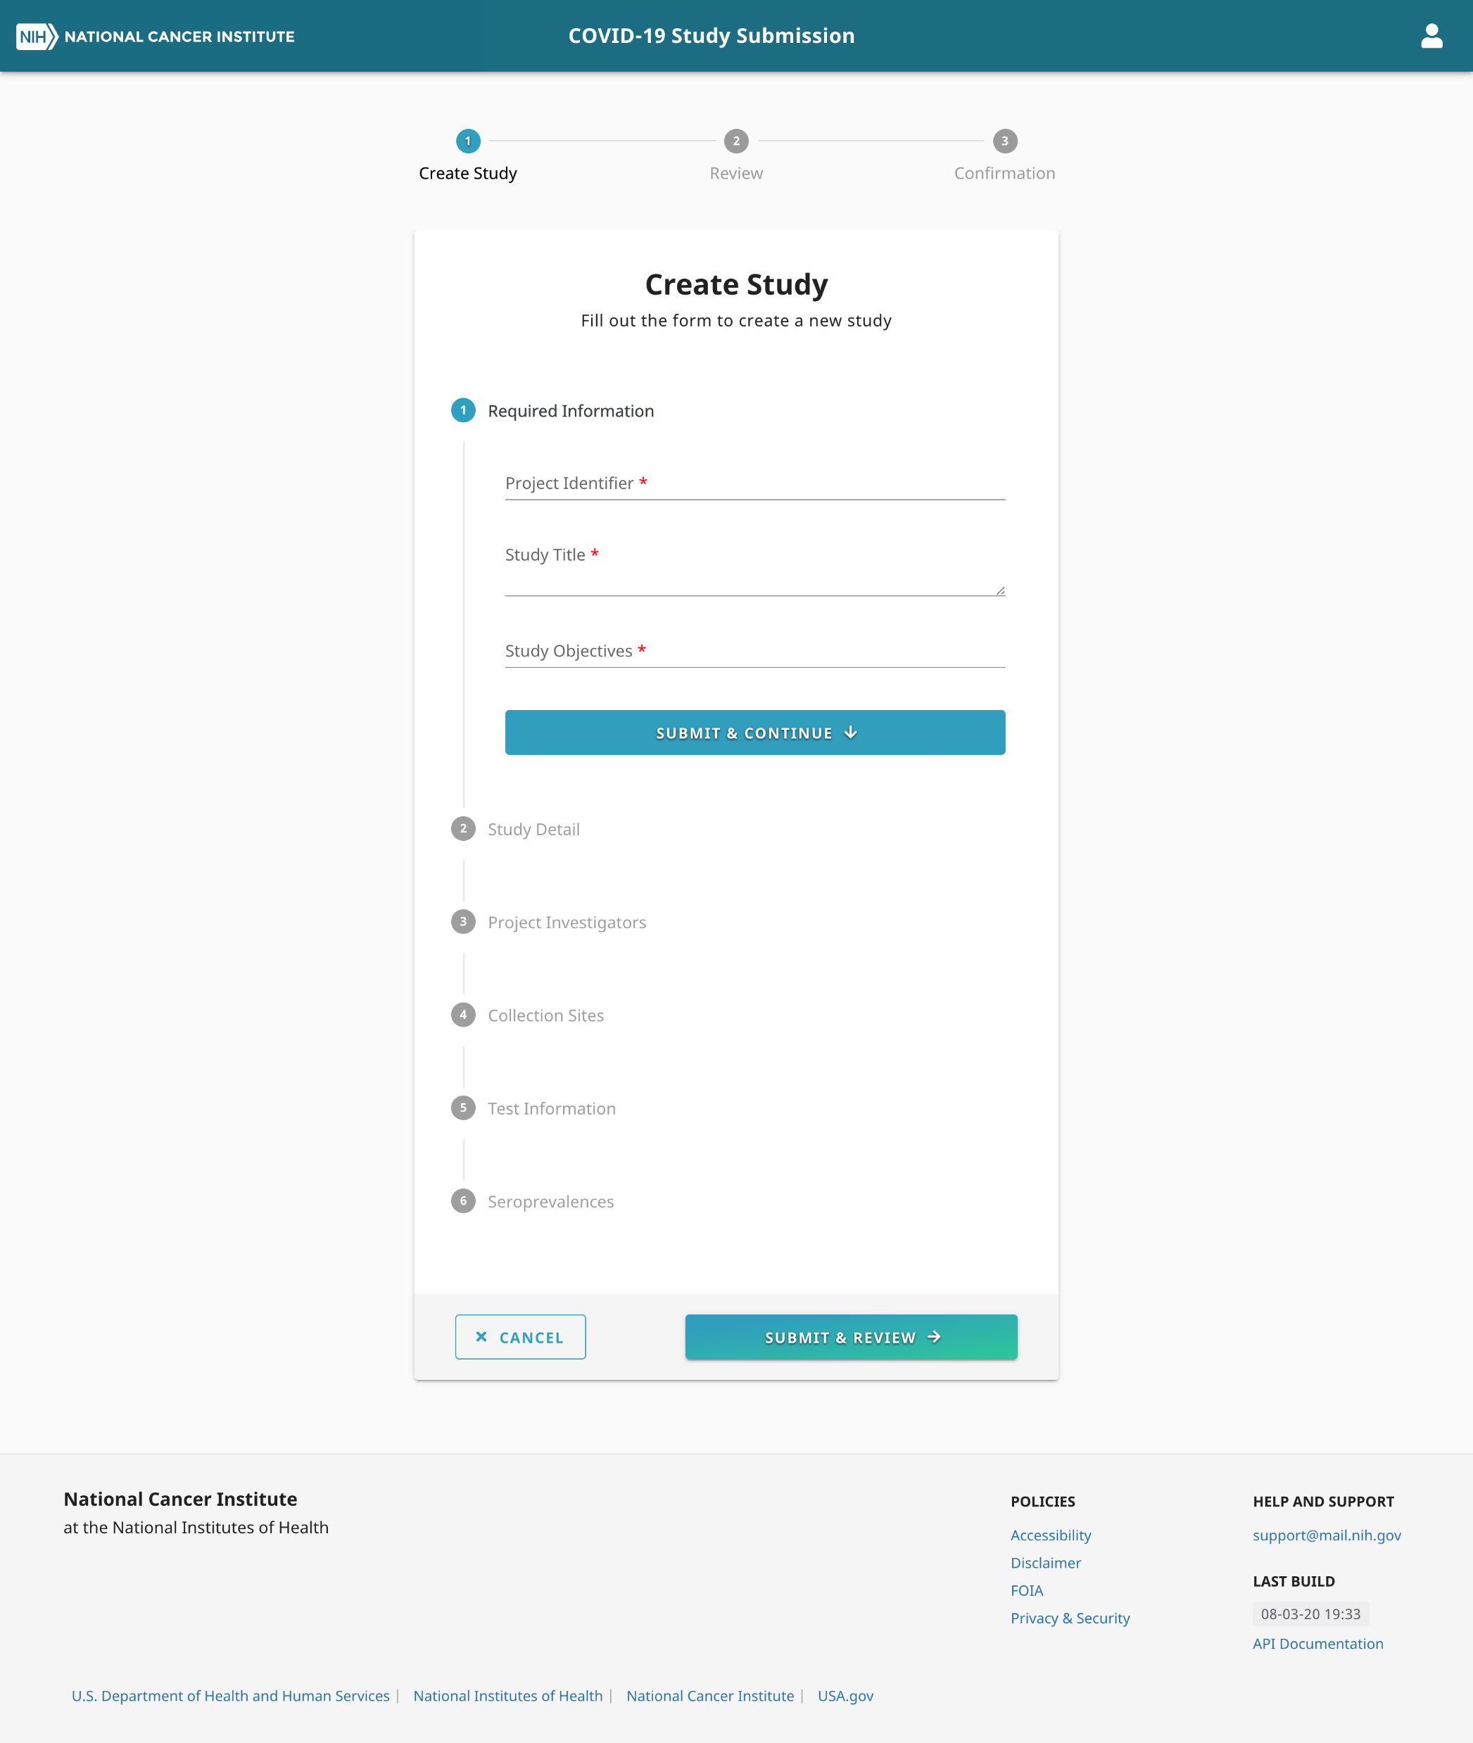

Slide 15
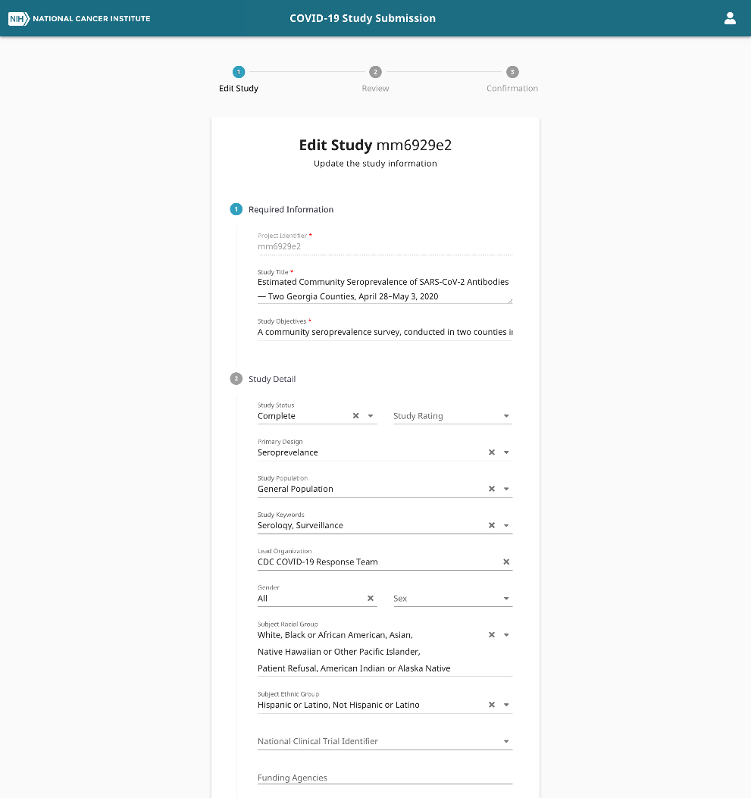

Slide 16
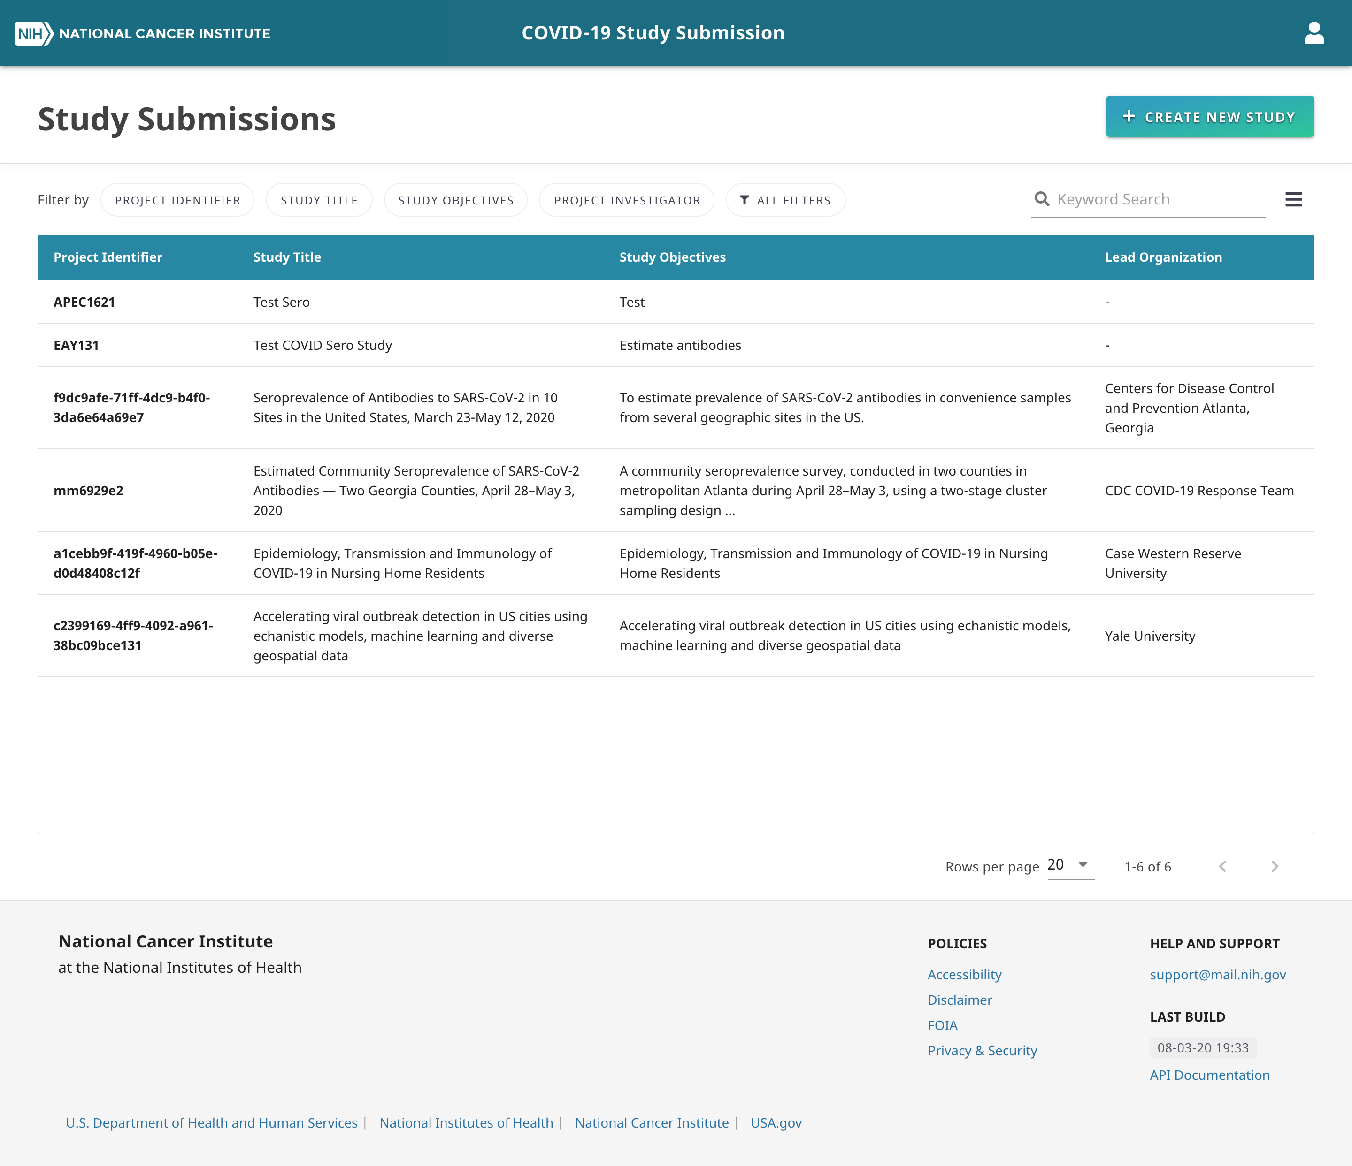

Slide 17
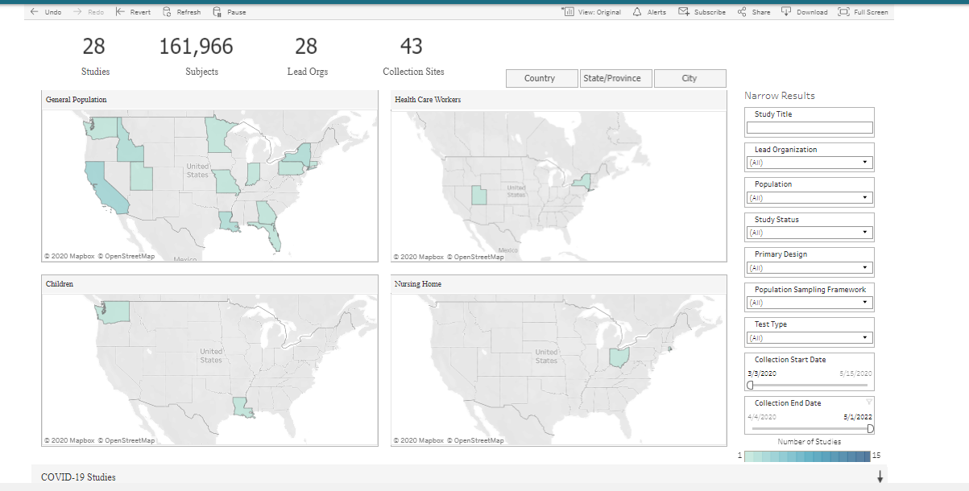

Slide 18
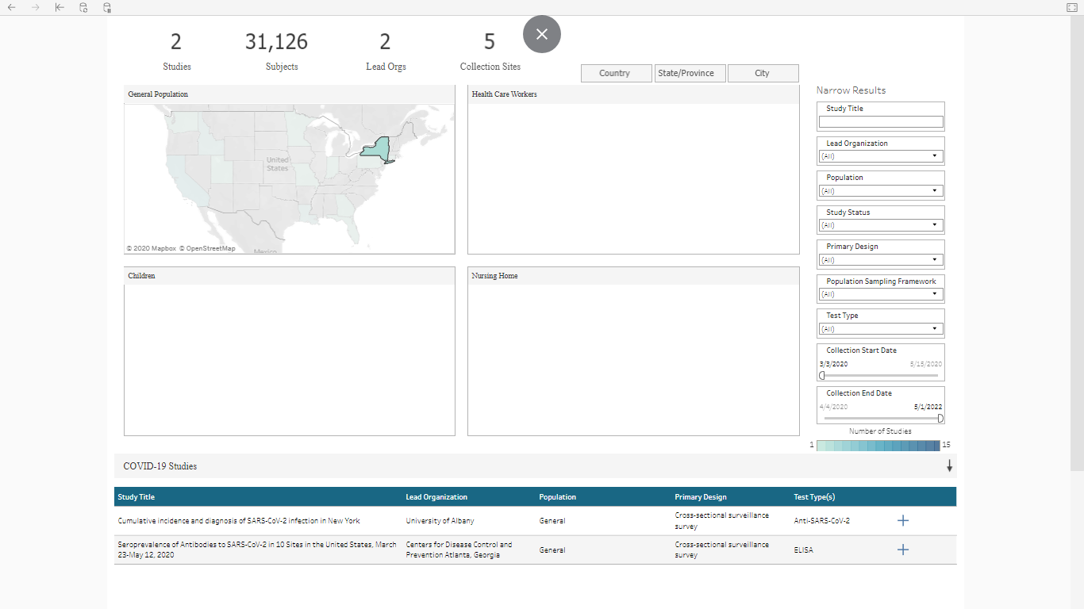

Slide 19
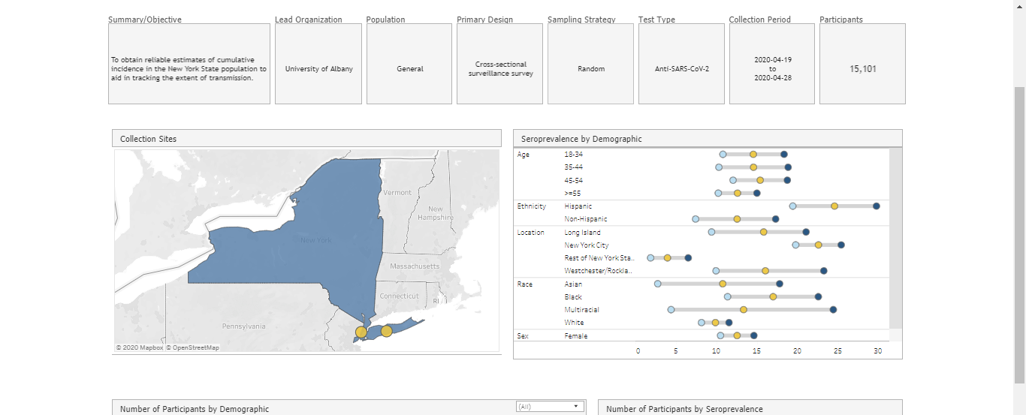

Slide 20
Thank you!

