Slide 1
State Disease Tables
Keegan McCaffrey

Slide 2
South Dakota
Monthly, Annual

Slide 3
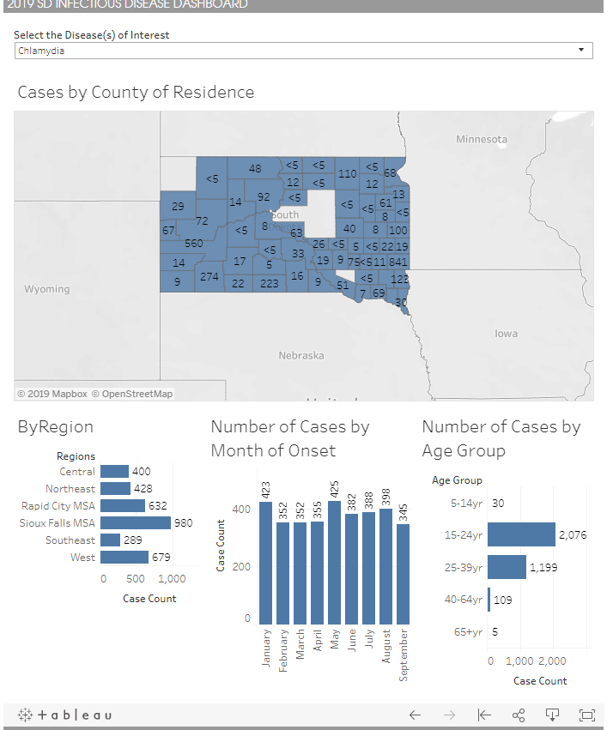
South Dakota Dashboard
Can Query by disease, monthly

Slide 4
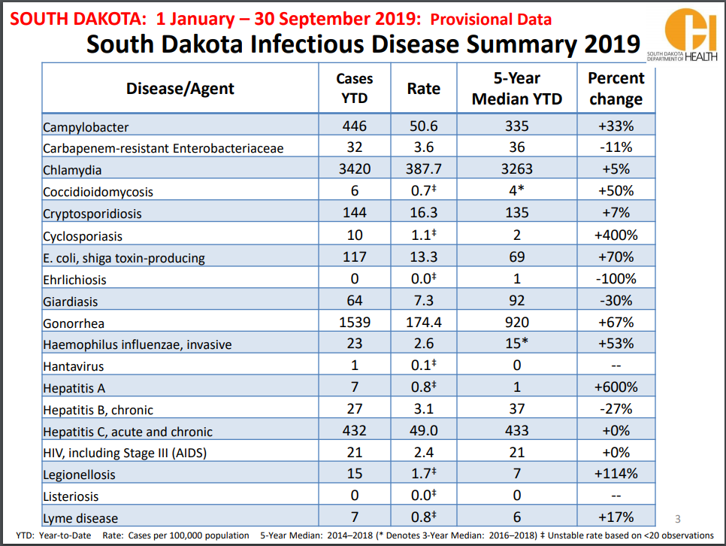
South Dakota Monthly Report

Slide 5
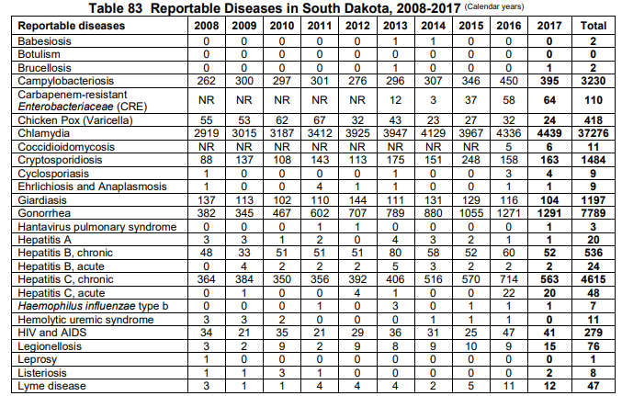
South Dakota Annual Report
Also available by county

Slide 6
Utah
Weekly, Monthly, Annual

Slide 7
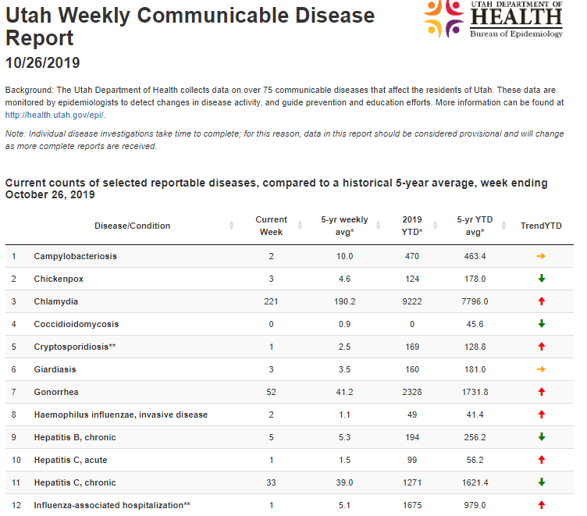
Utah Weekly
Select Diseases

Slide 8
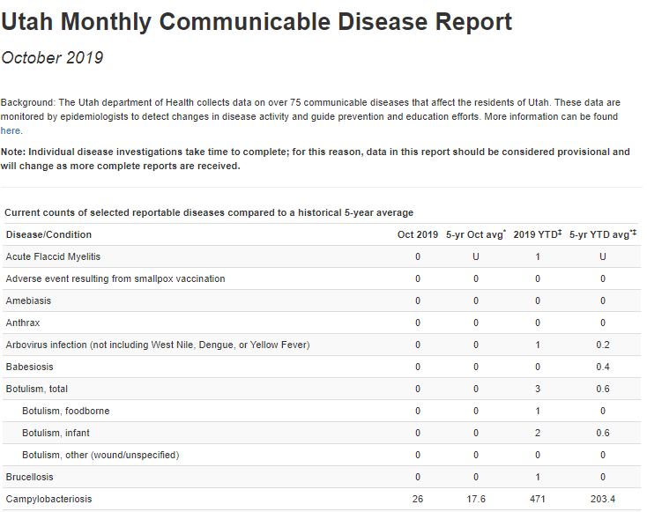
Utah Monthly

Slide 9

Utah Annual
Can select disease, LHD, or years

Slide 10
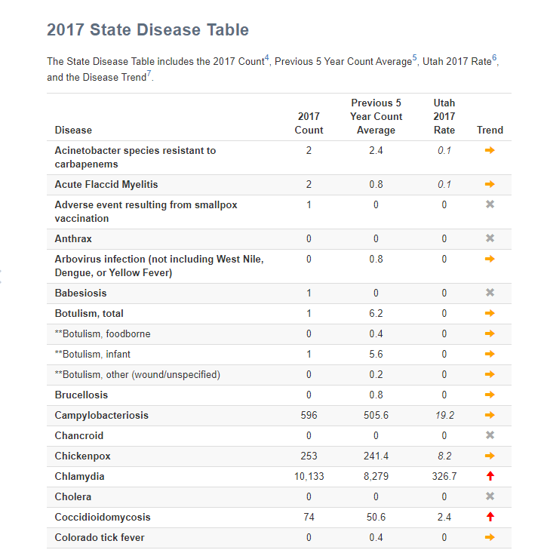
Utah Annual
Includes, comparisons by disease, past years, and jurisdictions

Slide 11
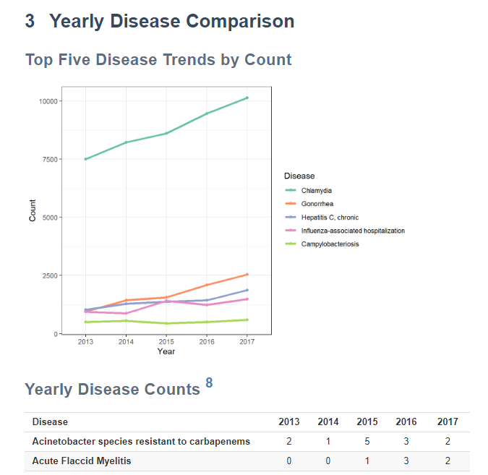
Utah Annual

Slide 12
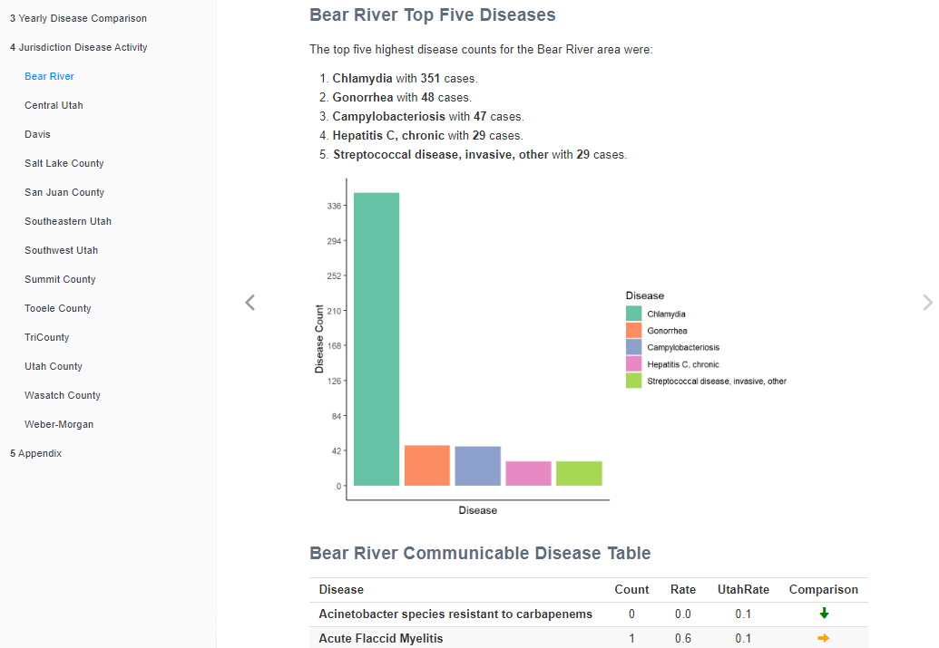
Utah Annual

Slide 13
Michigan
Weekly

Slide 14
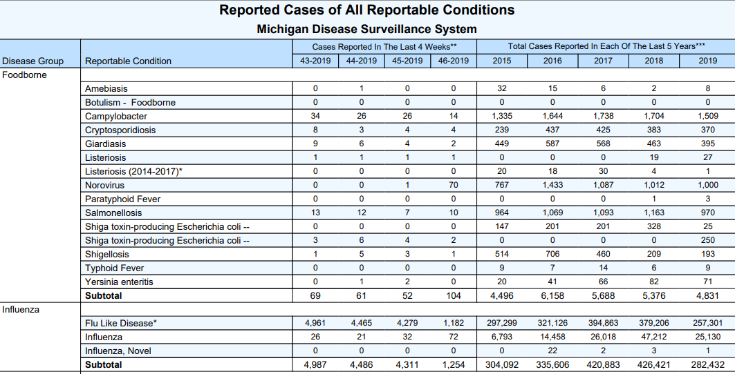
Michigan Weekly

Slide 15
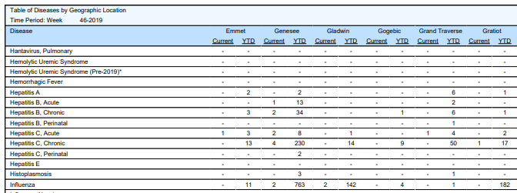
Michigan Weekly

Slide 16
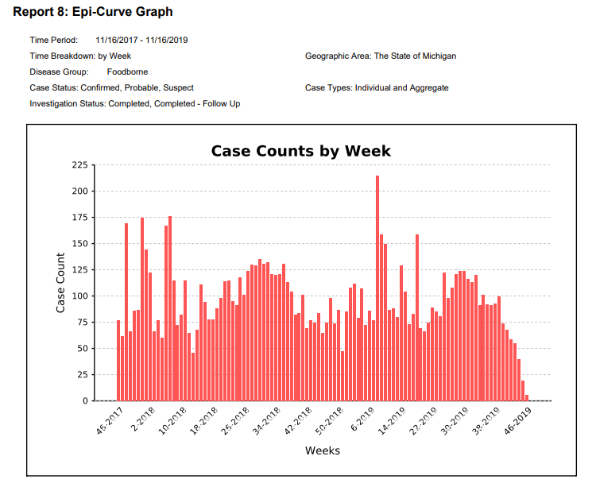
Michigan Weekly
Annual is the final weekly report

Slide 17
Washington
Annual

Slide 18
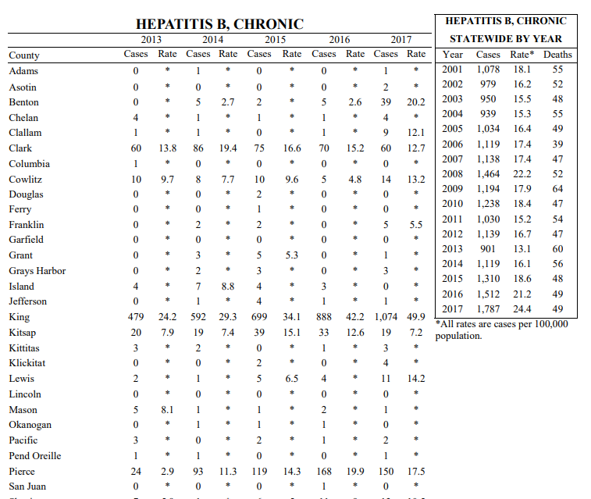
Washington Annual
Includes deaths

Slide 19
New Mexico
Weekly

Slide 20
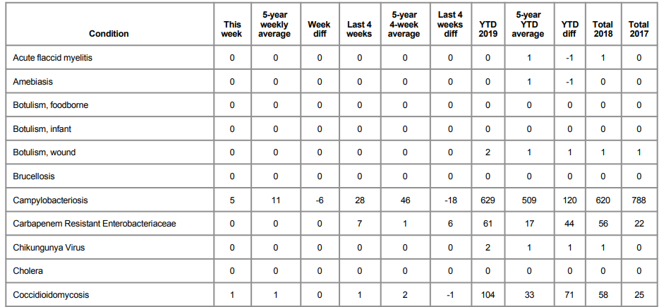
New Mexico Weekly

Slide 21
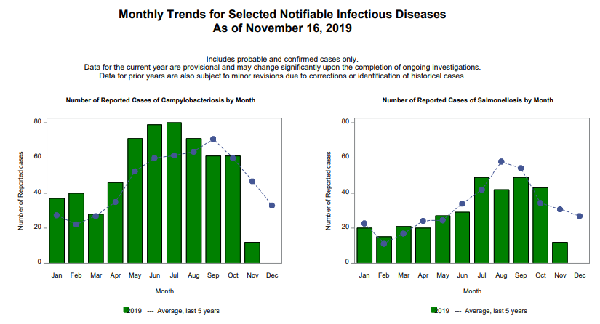
New Mexico Weekly

Slide 22
Tennessee
Weekly, Dashboard

Slide 23
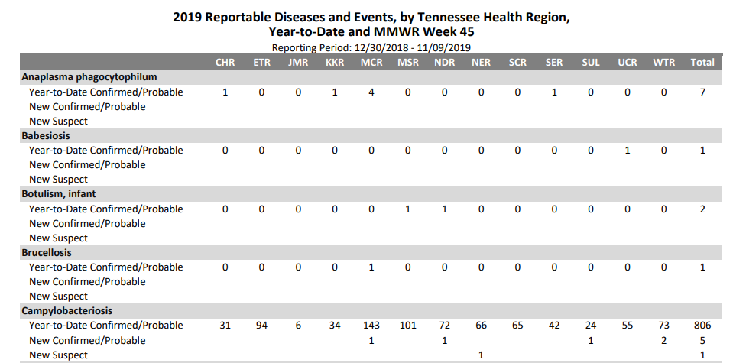
Tennessee Weekly

Slide 24
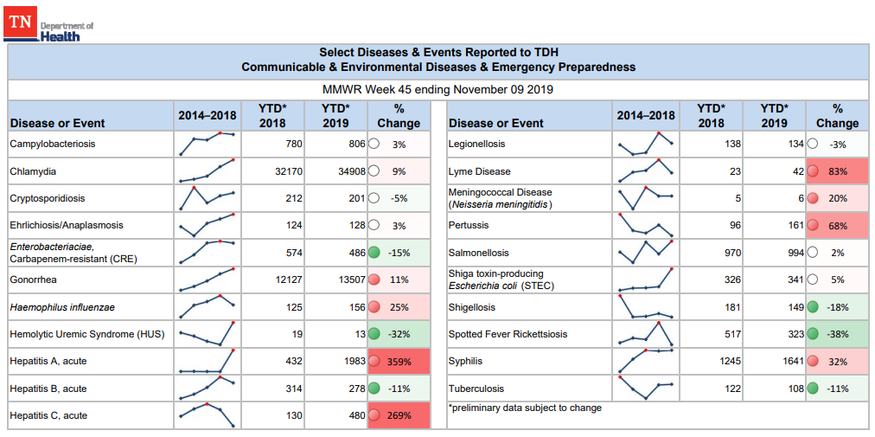
Tennessee Weekly (Select Diseases)

Slide 25
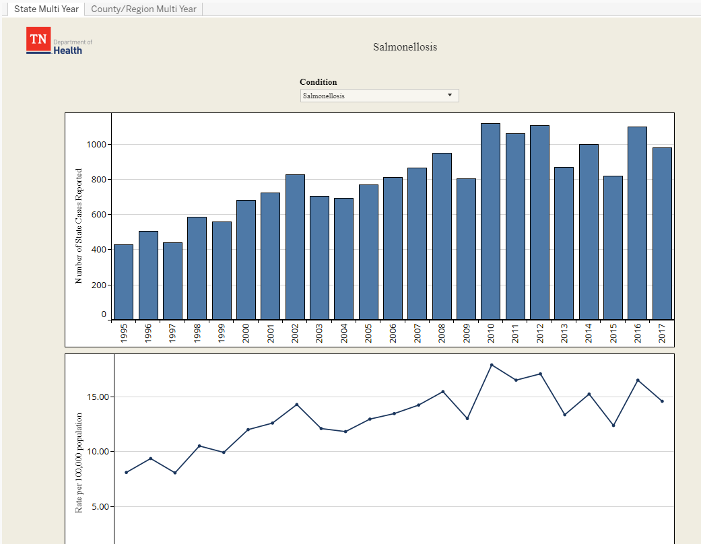
Tennessee Dashboard
Select Disease
Count, rate, table

Slide 26
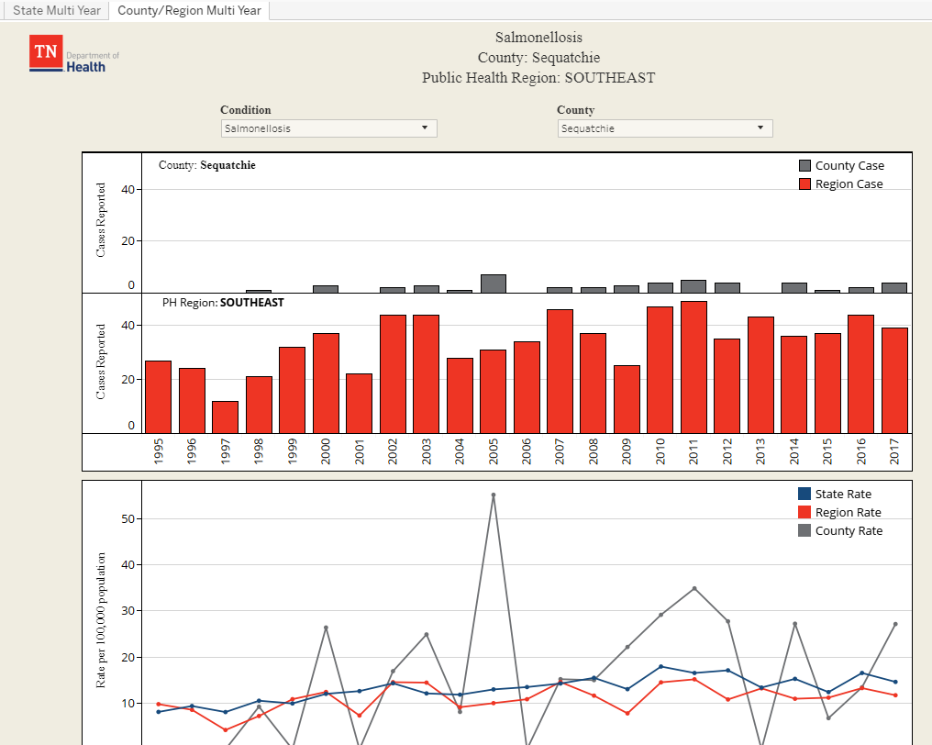
Tennessee Dashboard
Select Disease
Count, rate, table

Slide 27
Kansas
Weekly, Annual

Slide 28
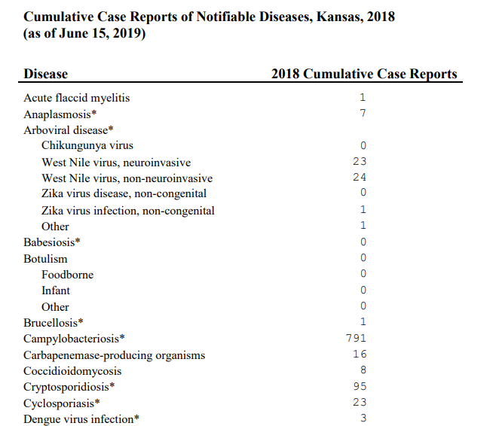
Kansas Weekly

Slide 29
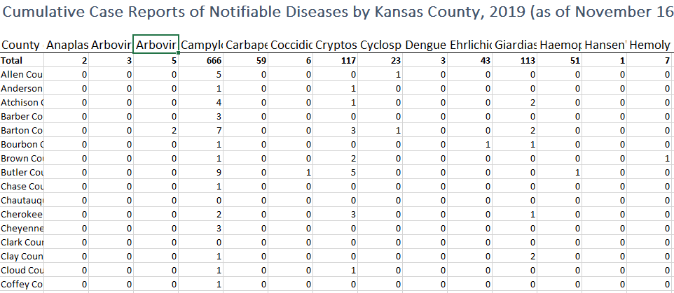
Kansas Weekly

Slide 30
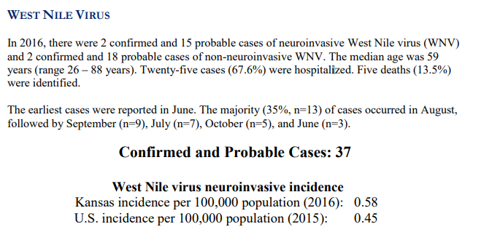
Kansas Annual
Disease Specific

Slide 31
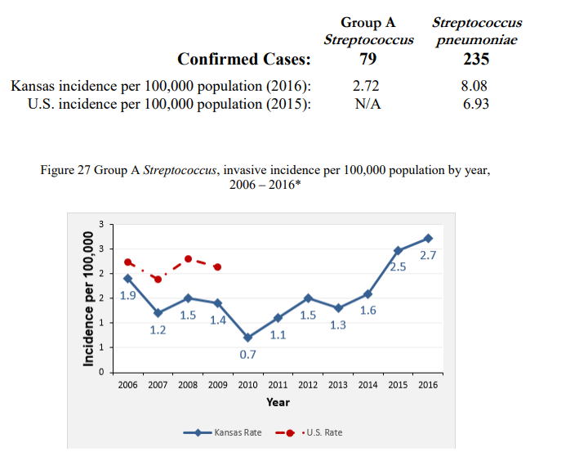
Kansas Annual
Disease Specific

Slide 32
Missouri
Weekly

Slide 33
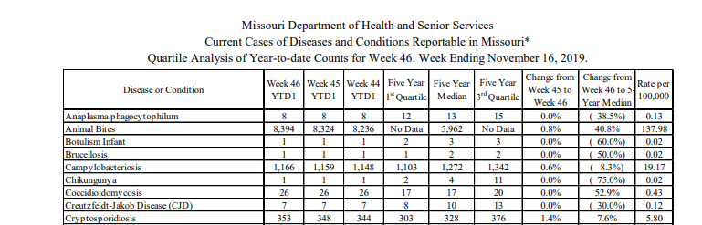
Missouri Weekly

Slide 34
Virginia
Annual

Slide 35
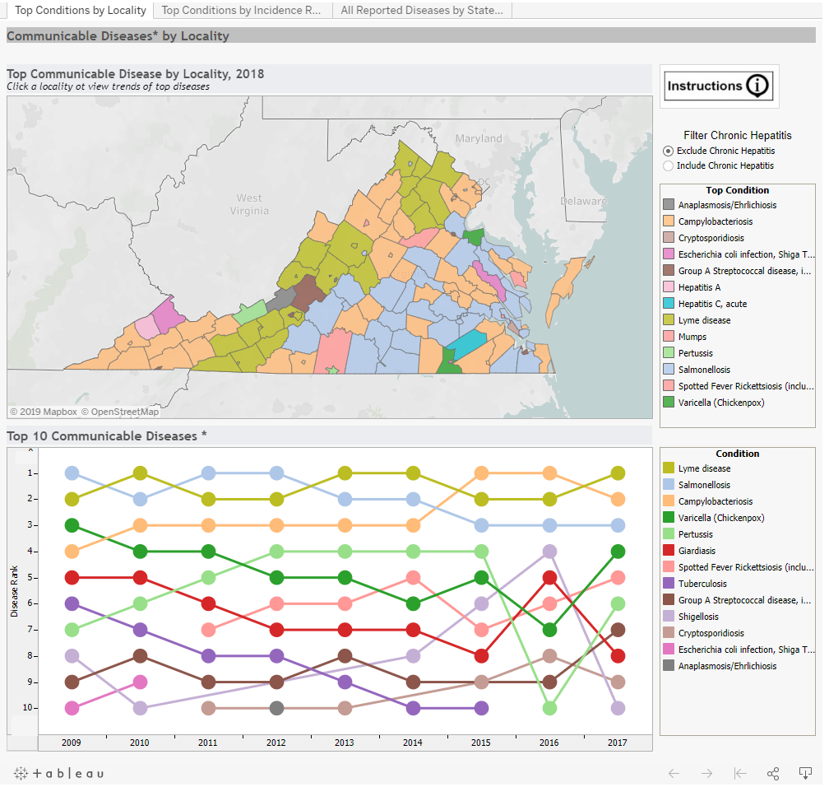
Virginia Annual

Slide 36
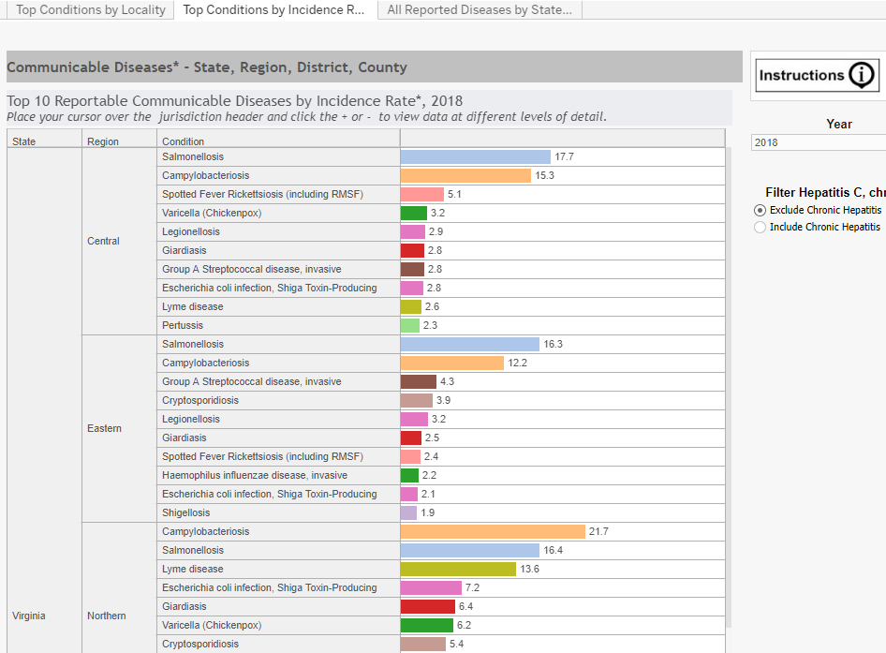
Virginia Annual

Slide 37
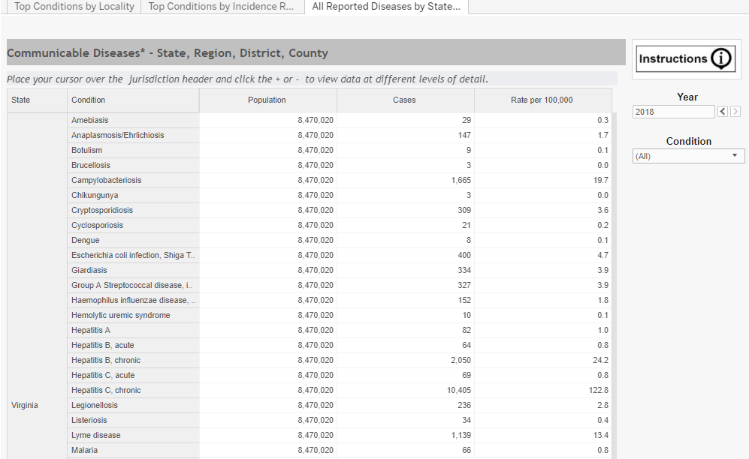
Virginia Annual

Slide 38
Summary (Random Sample of 10 States)
    Time Scale
      Weekly: 60%
      Monthly: 30%
      Annual: 90%
    Smallest Geographic Scale
      State: 20%
      Region: 20%
      County: 60%
    Visualizations: 60%
    Interactive: 40%
    Other Variables: (age, sex, death): 20%
    Data
      Counts: 100%
      Rates: 60%
      Indicators (i.e measure of increase/decrease): 50%
    System
      Tableau: 30%
      PDF: 60%
      Other:10%

