Slide 1
Data Standardization Work Group
Surveillance Practice and
Implementation Subcommittee (SPIS)
July 27 2018

Slide 2
Agenda
Date of Illness Onset Proposal
Recommendation for the Brief Process and Vetting
Diagnosis Date → Laboratory Dates
Prioritizing the Dates of Public Health Importance
  Event/Counting Date
  Generic v2 Timeline

Slide 3
Date of Illness Onset
Signs and symptoms in the position statements
  Variation by disease and position statement
  Recommendation:
    Refer to the signs and symptoms in the Case Classification
    Case Classification may reference the Clinical Criteria or the Clinical Description for detailed signs/symptoms

Slide 4
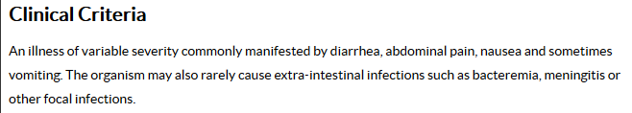
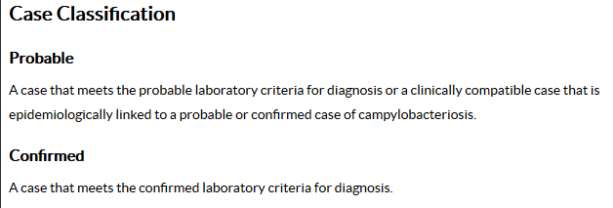
Campylobacteriosis (2015)

Slide 5
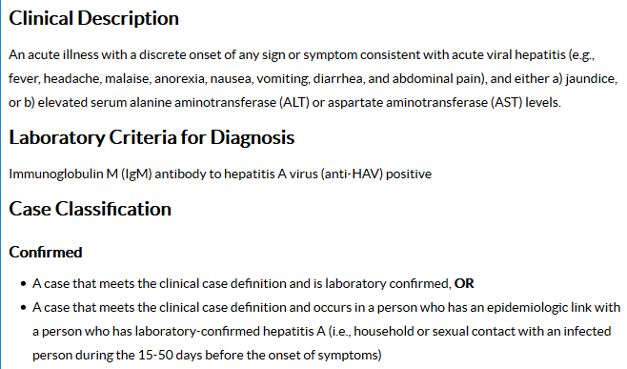
Hepatitis A (2012)

Slide 6
Implementation Actions
CSTE
  Brief process→ Publish→ Distribute
  Standardize the location of the signs/symptoms for the official case classification in the position statements
DSWG/SPIS
  Promote brief
  Review and update

Slide 7
Implementation Actions
STLT Health Departments
  Gap analysis for the surveillance system and procedures
  Surveillance system revisions:
    Do not require Date of Illness Onset
    Do not use substitution/calculation
    Create a discrete data elements for:
      Onset of signs/symptoms
      Onset of illness (if needed)
      Event date

Slide 8
Implementation Actions
CDC
  Revise the Data Element Name to Symptom Onset Date with the description:
    Reported date of the onset of symptoms of the condition being reported to the public health system.

Slide 9
Implementation Actions
CDC
  Revise the HL7 Implementation Notes:
    “For unknown date, OBX-5 MAY be populated with ‘99999999’”.
    Replace with directions to leave NULL
    Would need updated in the Arboviral MMG also
  Reference this document in the MMG Data Element Description

Slide 10
Brief Proposal

Slide 11
Brief Proposal
Overarching focus for all data elements
  Importance of standardizing application of the data elements
  Vetting process in diagram form
  Reference a repository
Repository on the CSTE website
  Host the recommendations made from this group for each data element
Draft to be shared for discussion on the August call

Slide 12
MMG Coordination

Slide 13
MMG Collaboration
S/I leadership will coordinate opportunities for involvement with the MMG development and CDC
DSWG activities
  Discuss guides during the comment period
  Share comments in the Smartsheet for discussion
  Basecamp space available to share onboarding resources
  Cross-jurisdiction collaboration during onboarding

Slide 14
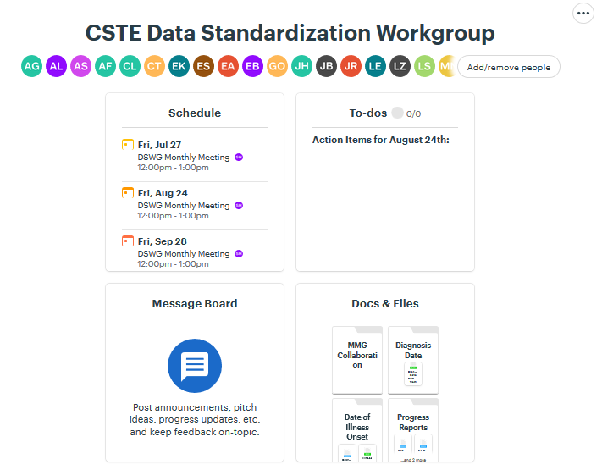
MMG Collaboration

Slide 15
MMG Collaboration

Slide 16
Diagnosis Date

Slide 17
Diagnosis Date
Approaches
  Clinical and laboratory dates vs. clinical only
  High-level guidance for prioritization/hierarchy of dates
    Per CSTE conference - condition-specific guidance beyond the scope of this work
  Include date type with reported date (with guidance for prioritization/hierarchy)
Proposal
  Address the component dates for Diagnosis Date (e.g., laboratory dates)
  Determine the scope of Date of Public Health Importance

Slide 18
Laboratory Dates

Slide 19
Laboratory Template
Data Element (DE) Name | Data Element Description
Observation Date/Time | The clinically relevant date/time of the observation
Results Rpt/Status Chng - Date/Time | Indicates the date and time that the results were reported or that a status changed
Specimen Collection Date | Date/time of observation in OBX segment for ELR infers the specimen collection date
Specimen Analyzed Date | Date/time associated with generation of the result
Specimen Collection Date/Time | The date the specimen was collected
Specimen Received Date/Time | The date/time the specimen is received

Slide 20
Epi/Interpretive Lab
Data Element (DE) Name | Data Element Description
Specimen Collection Date/Time | Date and/or time of collection of laboratory specimen
Specimen Received Date/Time | Specimen received date/time
Specimen Analyzed Date | The date the specimen/isolate was tested
Date/Time of Lab Result | Date result sent from reporting laboratory
Date Specimen Sent to CDC | Date Specimen Sent to CDC
Other laboratory dates?

Slide 21
Lab Side-by-Side
Lab Template | Interpretive Lab Questions
Observation Date/Time
Results Rpt/Status Chng - Date/Time | Date/Time of Lab Result
Specimen Collection Date | Specimen Collection Date/Time
Specimen Analyzed Date | Specimen Analyzed Date
Specimen Collection Date/Time | Specimen Collection Date/Time
Specimen Received Date/Time | Specimen Received Date/Time
 | Date Specimen Sent to CDC

Slide 22
Dates of Public Health Importance

Slide 23
Event Date
Data element plan
  Consensus discussions for component dates first
  Create a common vocabulary for conversations about higher-level case counting and aggregate dates
Event Date/case counting date
  What dates are important to in each jurisdiction (may differ by program) for counting a case?

Slide 24
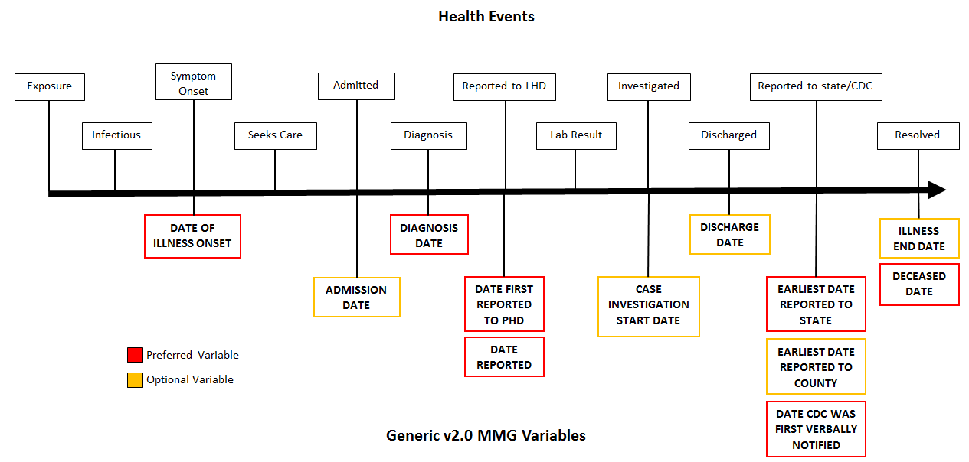
Genv2 Dates

Slide 25
For August
Smartsheet
  “Vote” to move the Date of Illness Onset proposal forward
  Share your component dates for the Event/Counting Date
  MMG onboarding progress for Smartsheet
Basecamp
  Review the draft of the Brief Proposal
  Post resources to the MMG Collaboration folder
  Post onboarding collaboration interest to the Message Board

Slide 26
Schedule
  Meet monthly on the 4th Friday from 1-2pm ET/ 12-1pm CT
    August 24th
    September 28th
    October 26th
    November 30th (5th Friday due to the holiday)
    December 28 (cancelled)

Slide 27

How to Engage
  Email:
    Molly Crockett: Molly.Crockett@MassMail.State.MA.US
    Shannon Harney: Shannon.Harney@tn.gov
https://3.basecamp.com/3164497/join/1guTDJpympSc

