Slide 1
Data Standardization Work Group
Surveillance Practice and
Implementation Subcommittee (SPIS)
August 31 2018

Slide 2
Agenda
Date of Illness Onset Proposal
  Thanks for reviewing and comments!
  Vetting next steps TBD
Brief Proposal
  In review and pending steering committee
Lab Dates
MMG Collaboration
Schedule
For September

Slide 3
Laboratory Dates

Slide 4
Laboratory Template
 |  | Data Element (DE) Name | Data Element Description
Specimen Collection |  | Observation Date/Time (Required) | The clinically relevant date/time of the observation
 |  | Specimen Collection Date/Time (Optional) | The date the specimen was collected
 |  | Specimen Collection Date (Optional) | Date/time of observation in OBX segment for ELR infers the specimen collection date
Specimen Received |  | Specimen Received Date/Time (Preferred) | The date/time the specimen is received
Test/ Result |  | Specimen Analyzed Date (Optional) | Date/time associated with generation of the result
Result Report |  | Results Rpt/Status Chng - Date/Time (Optional) | Indicates the date and time that the results were reported or that a status changed

Slide 5
Epi/Interpretive Lab
 |  | Data Element (DE) Name | Data Element Description
Specimen Collection |  | Specimen Collection Date or Specimen Collection Date/Time (Preferred) | Date and/or time of collection of laboratory specimen
Specimen Received |  | Specimen Received Date/Time (Preferred) | Specimen received date/time
Test/ Result |  | Specimen Analyzed Date (Preferred) | The date the specimen/isolate was tested
Result Report |  | Date/Time of Lab Result (Preferred) | Date result from reporting laboratory
Sent to CDC |  | Date Specimen Sent to CDC (Preferred) | Date specimen sent to CDC

Slide 6
Questions for Discussion
Is this date captured in your surveillance system?
Is this date important to infectious disease surveillance in your jurisdiction/surveillance system?
  Surveillance within the jurisdiction
  Calculation of other dates
  Reporting to CDC
Are other dates substituted for this date if it is missing?
How complete is this date in your system?
  Paper versus ELR?

Slide 7
Specimen collection date
Date specimen was collected*
Observation date/time
(OBR.7) - TS
Specimen Collection Date
(OBX.14) - TS
Specimen collection date/time
(LAB163/68963-8) - TS
Specimen collection date/time
(SPM.17) - DR
Specimen collection date
(LAB163/33882-2) - DT
Lab Template
Lab Interpretive
*Per HL7 2.5.1 implementation guide, OBR.7, OBX.14, and SPM.17 should hold the same date

Slide 8
Specimen received date
Date specimen was received by laboratory
Specimen Received date/time
(SPM.18) - TS
Specimen received date/time
(LAB595) - TS
Lab Template
Lab Interpretive

Slide 9
Test/result date
Date testing was performed on specimen/
result was generated
Specimen Analyzed Date
(OBX.19) - TS
Specimen Analyzed date/time
(45375-3) - TS
Lab Template
Lab Interpretive

Slide 10
Result report date
Date result was reported out
Results Rpt/Status Chng - Date/Time (OBR.22)
Date/Time of Lab Result
(82773-3) - TS
Date of Lab Result
(LAB167/82772-5) - DT
Lab Template
Lab Interpretive

Slide 11
Other laboratory dates
Specimen accession date (specimen received date?)
Date specimen sent to CDC (LAB516/85930-6) - TS

Slide 12
MMG Collaboration
Share your progress for MMG onboarding:
  Form View: https://app.smartsheet.com/b/form/46331c4ee8414a92934ef2a985b3d5f7
  Sheet View:
  https://app.smartsheet.com/b/publish?EQBCT=e03228bbabd64a7cbe88ba8a56d1763b

Slide 13
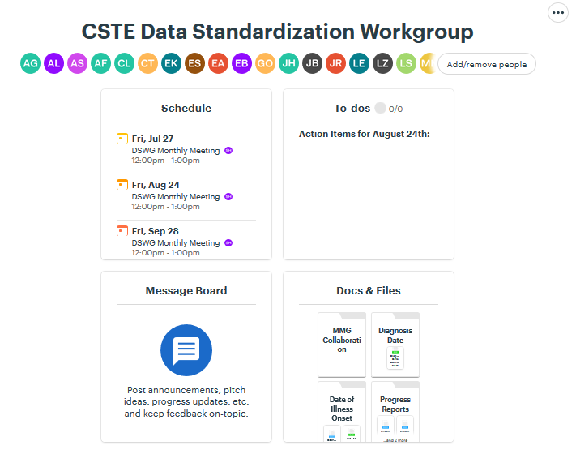
MMG Collaboration
Upload MMG onboarding resources to Basecamp:
  https://3.basecamp.com/3164497/buckets/6938668/vaults/1207954123

Slide 14
MMG Collaboration
Post questions, ideas and opportunities for MMG collaboration to the Message Board:
  https://3.basecamp.com/3164497/buckets/6938668/messages/1212060285

Slide 15
MMG Collaboration
Draft Lyme and Tickborne Rickettsial Diseases MMG External Review Period
  August 24 – September 21, 2018
    Use the official feedback form and send comments to edx@cdc.gov; Subject Line: Draft Lyme and TBRD MMG Feedback
    Kick-off call: September 6, 2018 from 3-4:00 EST
    Guide available under the MMGs in Development tab at:
    https://wwwn.cdc.gov/nndss/case-notification/message-mapping-guides.html
  SPIS call next Friday, September 7, 2018 from 1:30-3:00 EST
    Please review the guide ahead of time and bring comments for discussion

Slide 16
Lyme/TBRD MMG Kick-Off
Upcoming CSTE-hosted Webinar
The CDC, in collaboration with CSTE, has scheduled an informational webinar for September 06, 2018 at 3:00 – 4:00 (EST). The purpose of this webinar is to provide you with an overview of the Lyme and Tickborne Rickettsial Diseases MMG development process and a high-level overview of the Draft Lyme and Tickborne Rickettsial Diseases MMG’s content and layout as well as to remind the meeting participants of the external review and comment period.
Webinar Information
Topic: Draft Lyme and Tickborne Rickettsial Diseases External Review Webinar
Date: Thursday, September 6, 2018
Time: 3:00 pm, Eastern Daylight Time (New York, GMT-04:00)
Session number: 799 909 616
Session password: epi1234
-------------------------------------------------------
To join the training session
-------------------------------------------------------
1. Go to https://cste.webex.com/cste/k2/j.php?MTID=t1510f9a71eea26166a59a5b3afab128a
2. Enter your name and email address.
3. Enter the session password: epi1234
4. Click "Join Now".
5. Follow the instructions that appear on your screen.
-------------------------------------------------------
To join the session by phone only
-------------------------------------------------------
To receive a call back, provide your phone number when you join the training session, or call the number below and enter the access code.
Call-in toll-free number (US/Canada):1-877-668-4490
Access code: 799 909 616

Slide 17
Schedule
Tentative topic schedule for the rest of 2018:
  September 28th: Diagnosis Date
  October 26th: Report Dates
  November 30th: Event Date (5th Friday)
  December 28th: Cancelled

Slide 18
For September
Review the Diagnosis Date options and be prepared for discussion
  Will be posted to Basecamp for review
Share your Event Date component dates and algorithm:
  Form View: https://app.smartsheet.com/b/form/4aabb6f3e3c14a02b3704f69518fd413
  Sheet View: https://app.smartsheet.com/b/publish?EQBCT=fef5acea351449238e5b4483659b5d3c

Slide 19

How to Engage
  Email:
    Molly Crockett: Molly.Crockett@MassMail.State.MA.US
    Shannon Harney: Shannon.Harney@tn.gov
https://3.basecamp.com/3164497/join/1guTDJpympSc

