Slide 1
Data Standardization Workgroup
March 22, 2019

Slide 2
Agenda
Draft data element brief
MMWR Week/Year
Action Items

Slide 3
Draft data element brief
Notes:
1:30-1:55pm: 20-25 minutes

Slide 4
Preparing a CSTE Brief
Intend to package 4 data elements into one brief:
  Date of onset (already reviewed by DSWG)
  Report dates
  Lab dates
  Diagnosis date – coming soon

Slide 5
Preparing a CSTE Brief
End of July deliverable to complete this process of review & approvals by:
  DSWG
  SPIS [subcommittee]
  Subcommittee chair, CSTE PM
  Steering Committee chair, CSTE President, and Executive Director in consultation with full EB
  Membership comment period on website for 3 weeks
  Final review if changes made by Steering Committee Chair in consultation with Executive Director and President

Slide 6
Feedback please!
Report Dates & Lab Dates
On this call
Within the next two weeks (by 4/5)
Diagnosis date
Will send to DSWG for review in April
4/26 DSWG call: additional discussion or review as needed
Submit compiled brief to SPIS for May call

Slide 7
Highlights
Please see full drafts in email or BaseCamp
They have many more details!
MMG-related suggestions:
Intent is recommendations towards any planned updates to GenV2 OR development of GenV3.

Slide 8
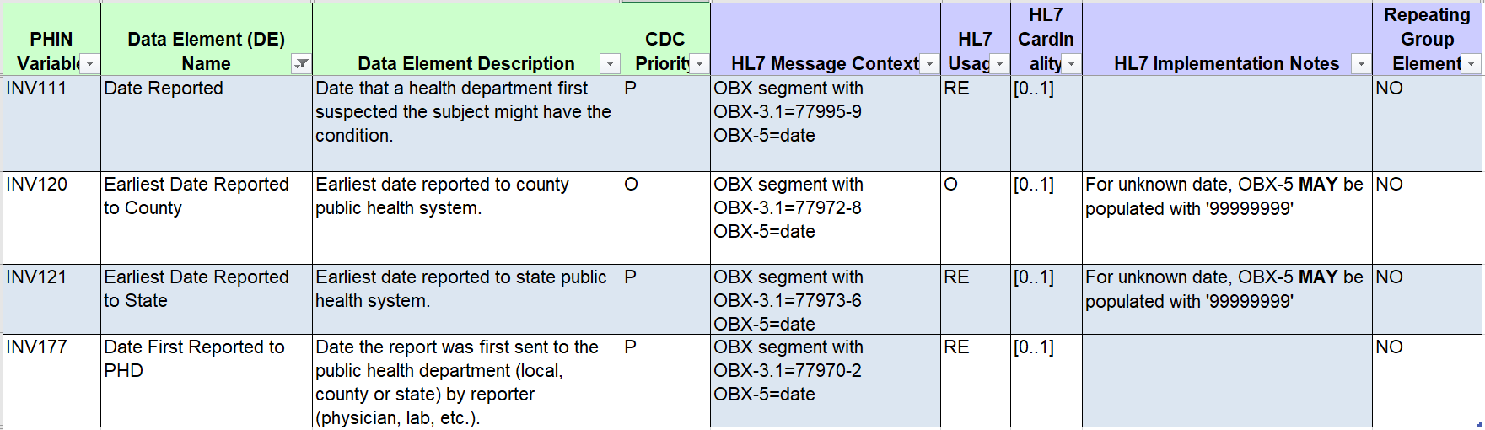
Report dates

Slide 9
Date First Reported to PHD
Recommended Implementation:
Date First Reported to Public Health Department should be defined as the earliest date a report for the case was received by a public health agency in the jurisdiction, whether a state/territory or county/local agency.
  ***Use as the primary report date field for the case.
  May be used alone, or with any of the other three elements.
  May be a calculated field if these other report dates exist.

Slide 10
Date First Reported to PHD
Date First Reported to Public Health Department should be defined as the earliest date a report for the case was received by a public health agency in the jurisdiction, whether a state/territory or county/local agency.
As currently written, the following are left to jurisdiction discretion:
  Definition of “report”
    May be variation in what we would each count as that first report (telephone call vs. formal provider/lab report, or variation in sources)
  How to operationalize “received”
    Weekends? ELR system vs processing into surveillance system? Etc.
Suggestion to rename to “Earliest Date Received by PH”
Notes:
Gloss over the

Slide 11
Earliest Date Reported to State and
Earliest Date Reported to County
Recommended Implementation:
Earliest Date Reported to State should be defined as the earliest date a report for the case was received by the state public health agency.
Earliest Date Reported to County should be defined as the earliest date a report for the case was received by the county/local public health agency.
Recommend inclusion only at jurisdiction’s discretion – not valuable or applicable to all jurisdictions
Suggest making these both optional

Slide 12
Date First Suspected by PH
(currently Date Reported)
Recommended Implementation:
The data element Date Reported should be renamed to Date First Suspected by Public Health and represent the date that a health department “first suspected the subject might have the condition” as defined currently for Date Reported.
To be used at jurisdiction’s discretion
Likely sparsely populated or same as the Date First Reported to State/County/PHD
As currently written: If Date First Suspected is included, is part of the calculation for Date Reported to PHD

Slide 13
Date First Suspected by PH
(currently Date Reported)
Or do we recommend removing this element altogether?
(Jurisdictions can of course keep their own version.)
Value in having this as a separate data element?

Slide 14
Lab dates
Lab Interpretive repeating group | Laboratory Template
Specimen Collection Date/Time | Specimen Collection Date/Time (SPM-17)
 | Specimen Collection Date (OBX-14)
 | Observation Date/Time (OBR-7)
Specimen Received Date/Time | Specimen Received Date/Time (SPM-18)
Specimen Analyzed Date/ Time | Specimen Analyzed Date (OBX-19)
Date/Time of Lab Result | Results Rpt/Status Change Date/Time (OBR-22)

Slide 15
Specimen Collection Date
Recommended Implementation:
Specimen Collection Date (i.e., Specimen Collection Date/Time (repeating group), Specimen Collection Date/Time (SPM-17), Specimen Collection Date (OBX-14) and Observation Date/Time (OBR-7))
should be interpreted as the date a clinical specimen was collected from the patient for the laboratory testing relevant to the condition being reported to a public health agency.

Slide 16
Specimen Received Date
Recommended Implementation:
Specimen Received Date/Time (repeating group) and Specimen Received Date/Time (SPM-18)
should be interpreted as the date the specimen was received by the performing laboratory for the condition being reported to a public health agency, be it county/local or state
Consider removing from surveillance MMGs

Slide 17
Result Date
Recommended Implementation:
Result date may reflect either the date the specimen was analyzed or the date the latest result was released for reporting.
If the surveillance system captures and stores both Specimen Analyzed Date and the date a result was reported out, both data elements should be maintained and reported accordingly.
If only one result date is available, that date can be used to populate Specimen Analyzed Date/Time/Specimen Analyzed Date (OBX-19) and Date/Time of Lab Result/Results Rpt/Status Change.

Slide 18
MMWR Week and Year

Slide 19
MMWR Week & Year
Used by CDC NNDSS to assign cases to specific week and year (all formats – HL7, NETSS, NBS)
  Weekly/annual tables online
  Annual data reconciliation
  Some programs use for internal work (analysis, completeness, publication)
Jurisdictions populate this data element in a variety of ways
  Single date (varies)
  Hierarchy/algorithm (varies)
Guidance document published online here:
  https://wwwn.cdc.gov/nndss/document/MMWR_week_overview.pdf

Slide 20
What is most important?
  Disease relevance - date is epidemiologically meaningful
  Consistency and comparability - date represents consistent data point across cases, conditions, and jurisdictions and unlikely to change over time for each case

Slide 21
NNDSS Messages
Date of disease onset
Date of diagnosis
Date of laboratory result
Date of first report to public (community) health system
State or MMWR report date
  Source: https://wwwn.cdc.gov/nndss/document/MMWR_week_overview.pdf

Slide 22
NEDSS Messages
Date of illness onset
Date of diagnosis
Date of specimen collection
Date of laboratory result
Date of first report to public health
Date of first report to CDC
  Source: https://wwwn.cdc.gov/nndss/document/MMWR_week_overview.pdf

Slide 24
Practical considerations
  Timing of CDC reporting
    Variable across jurisdictions
    Reports for previous weeks will show up in cumulative counts but not weekly counts
  Data completeness
    Epidemiological fields may be blank and require a hierarchy that includes lab or reporting dates.
  Usefulness
    MMWR Week/Year may not satisfy jurisdictional needs for case counting/analysis
  Potential for other options
    Possibility of data tables/views by >1 date

Slide 25
MMWR Week Example
Symptom Onset
Date Unknown
Clinical Diagnosis
Date Unknown
Specimen Collection
Mar 2 (Week 9)
Lab Result/Reported to PHD
Mar 6 (Week 10)
Case classified, sent to CDC
March 11 (Week 11)
MMWR Week
(first report, week 12)
NNDSS Hierarchy: Week 10
NEDSS Hierarchy: Week 9
Date first reported to PHD: Week 10
Date first reported to CDC: Week 11

Slide 26
MMWR Week Example
Symptom Onset
Feb 23 (Week 8)
Clinical Diagnosis
Mar 1 (Week 9)
Specimen Collection
Mar 2 (Week 9)
Lab Result/Reported to PHD
Mar 6 (Week 10)
Case classified, sent to CDC
March 11 (Week 11)
MMWR Week
(final report, week 15)
NNDSS Hierarchy: Week 8
NEDSS Hierarchy: Week 8
Date first reported to PHD: Week 10
Date first reported to CDC: Week 11

Slide 27
What is most important?
  Disease relevance - date is epidemiologically meaningful
    Pros: More likely to approximate when disease occurred
    Cons: Likely requires hierarchy due to missing data; may change frequently as data are collected;
  Consistency and comparability - date represents consistent data point across cases, conditions, and jurisdictions and unlikely to change over time for each case
    Pros: Allows more accurate comparisons; can select well-populated date; rarely changes
    Cons: Potential variation in time lag from illness to selected date; less epidemiologically meaningful

Slide 28
Action Items
Send comments on Lab Dates and Report Dates drafts by 4/5
  Report Date Draft: https://3.basecamp.com/3164497/buckets/6938668/uploads/1660865101
  Lab Date Draft: https://3.basecamp.com/3164497/buckets/6938668/uploads/1660862278
Watch for Diagnosis Date draft and send comments

Slide 29
How to Engage
  Email:
    Molly Crockett: Molly.Crockett@MassMail.State.MA.US
    Laura Erhart: laura.erhart@azdhs.gov
Join us!
Helpful to have perspectives from
variety of jurisdictions and program areas and
from informatics/surveillance side and disease-specific areas.

