Slide 1
Data Standardization Workgroup
April 26, 2019

Slide 2
Agenda
Draft data element brief
Report Dates
Diagnosis Date
Action Items

Slide 3
Draft data element brief
Notes:
1:30-1:55pm: 20-25 minutes

Slide 4
Preparing a CSTE Brief
Intend to package 4 data elements into one brief:
  Date of onset (already reviewed by DSWG)
  Report dates
  Lab dates (already reviewed, minor comments incorporated)
  Diagnosis date

Slide 5
Preparing a CSTE Brief
End of July deliverable to complete this process of review & approvals by:
  DSWG
  SPIS [subcommittee]
  Subcommittee chair, CSTE PM
  Steering Committee chair, CSTE President, and Executive Director in consultation with full EB
  Membership comment period on website for 3 weeks
  Final review if changes made by Steering Committee Chair in consultation with Executive Director and President

Slide 6
Timeline
Discuss any changes or suggestions for Diagnosis Date and report dates on this call
Workgroup should send any last minute thoughts or edits by COB Friday, April 26
Laura, Molly, and Gretl will incorporate edits and compile the four date elements into a single brief by May 1
Compiled brief will be distributed to SPIS membership on May 1 or 2
Brief will be discussed on May 3 SPIS call

Slide 7
Highlights
Please see full drafts in email or BaseCamp
They have many more details!
MMG-related suggestions:
Intent is recommendations towards any planned updates to GenV2 OR development of GenV3.

Slide 8
Report Dates
Notes:
1:30-1:55pm: 20-25 minutes

Slide 9
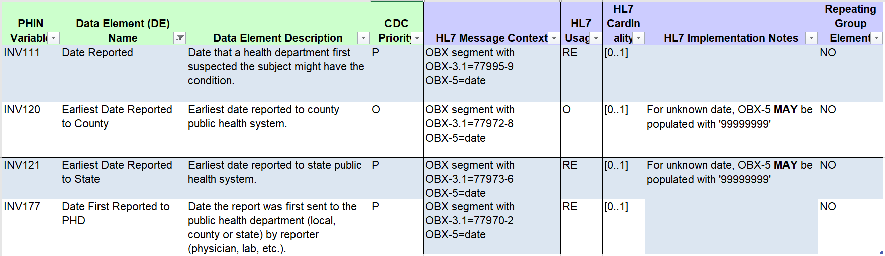
Report dates

Slide 10
Renaming
Old | New
Date First Reported to Public Health Department | Date First Received by Public Health Department
Earliest Date Reported to State | Date First Received by State
Earliest Date Reported to County | Date First Received by Local Health Department

Slide 11
Date First Received by PHD
Recommended Implementation:
Date First Received by Public Health Department
should be defined as the earliest date a report for the case was received by a public health agency in the jurisdiction, whether a state/territory or county/local agency.
  ***Use as the primary report date field for the case.
  May be used alone, or with either of the other two elements.
  May be a calculated field if these other report dates exist.

Slide 12
Date First Received by PHD
Clarifies that this is the date RECEIVED by PHD, not the date a report was SENT (if different)
Date a report was SENT is a different concept
  May be useful for some jurisdictions – identifying compliance with reporting regulations or for detecting problems with data transmissions
  We are not recommending inclusion of this separate concept in the MMGs.
Notes:
Gloss over the

Slide 13
Date First Received by PHD
“Report” may be a formal printed or electronic record, but may also include other methods.
  Examples given, but ultimately left to jurisdiction’s discretion.
What if the report was sent elsewhere first?
  “If a case report is triaged through multiple jurisdictions, the data element should reflect receipt by an agency within the jurisdiction responsible for submitting the report to CDC. For example, the data element need not capture the date the case was first received by a public health agency in a different state.”
Notes:
Gloss over the

Slide 14
Date First Received by State and
Date First Received by LHD
Recommended Implementation:
Date First Received by State should be defined as the earliest date a report for the case was received by the state public health agency.
Date First Received by Local Health Department should be defined as the earliest date a report for the case was received by the local public health agency.
Recommend inclusion only at jurisdiction’s discretion – not valuable or applicable to all jurisdictions
Suggest making these both optional in GenV2 MMG

Slide 15
Date Reported
Currently defined as: Date that a HD first suspected the subject might have the condition.
Recommended Implementation:
Removal from Generic v2.0 MMG

Slide 16
Diagnosis Date
Notes:
1:30-1:55pm: 20-25 minutes

Slide 17
Diagnosis Date
Summary of discussion points:
  Huge variation in importance across jurisdictions and programs
  Many using lab dates either as sole basis for Diagnosis Date, as proxies when clinical information is missing, or as part of an algorithm
  No consensus on choice of lab or other proxy date. Collection date might be preferred for some, result date for others
    Variation in specifics of lab dates (first, first positive etc.)

Slide 18
Diagnosis Date
Summary of discussion points (continued):
  Outside the scope of this workgroup to provide condition-specific recommendations; variability in the meaning of ‘Diagnosis Date’ across conditions would remain
  Dates being used as proxies are typically captured elsewhere in surveillance systems, and often captured elsewhere in MMGs
    Lab dates currently not captured as part of core GenV2 elements, but addition of such data elements could be proposed
  Collecting clinical and laboratory dates as separate, discrete data elements may provide clarity about the meaning of each date as well as which information is available for a particular case

Slide 19
Diagnosis Date
Recommended Implementation:
  Diagnosis Date should represent clinical diagnosis only. Other dates relevant to diagnosis, such as laboratory dates, should be captured in separate, discrete data elements.
  As other dates are captured separately, jurisdictions can choose to use any combination of date types as needed for internal use.
  If data element cannot be populated as described above, it should not be sent. Substitution of another date is not recommended
  Implementation of this definition of Diagnosis Date may require the addition of one or more laboratory-related data elements to future updates of GenV2 or to GenV3

Slide 20
Diagnosis Date
Data Sources:
  Provider report, provider interview, or medical record/chart review
    Documentation of the earliest visit date at which the clinician identified the specific condition of interest as a presumptive suspected or final diagnosis.
  Electronic case reports
    Visit/encounter date associated with an eICR or other electronic case report for a particular condition.

Slide 21
Diagnosis Date - Concerns
Concerns remain:
  Clinical diagnosis may be difficult to obtain/rarely populated
  Concerns about reliability of a clinical Diagnosis Date as reported
  Specific date concept/epidemiological time point represented by current use of Diagnosis Date may be lost
Notes:
Gloss over the

Slide 22
Diagnosis Date - Options
Move forward with clinical Diagnosis Date (including recommendations to make sure that other data elements frequently used in Diagnosis Date calculations are captured in GenV2/3)
Move forward with clinical Diagnosis Date and address concerns about need for a hierarchical data element in MMWR Week/Event Date/Summary date discussions
Replace clinical Diagnosis Date with a different concept (with a different name) that would allow for a hierarchical data element using both clinical and laboratory information

Slide 23
Action Items
Send last-minute comments on Diagnosis Date and Report Dates drafts TODAY
  Report Date Draft: https://3.basecamp.com/3164497/buckets/6938668/uploads/1720604310
  Diagnosis Date Draft: https://3.basecamp.com/3164497/buckets/6938668/uploads/1720606396
Next meeting will be at 1pm on Friday, May 10 – moved up due to Memorial Day weekend and proximity to CSTE conference.
Watch for Smartsheet survey to prepare for MWMR Week/CDC Reporting date(s) discussion on May 10

Slide 24
How to Engage
  Email:
    Molly Crockett: Molly.Crockett@MassMail.State.MA.US
    Laura Erhart: laura.erhart@azdhs.gov
Join us!
Helpful to have perspectives from
variety of jurisdictions and program areas and
from informatics/surveillance side and disease-specific areas.

