Slide 1
Data Standardization Work Group (DSWG)
January 27, 2023

Slide 2
CSTE Data Standardization Workgroup Meeting​
Please mute phone/ headset/ computer audio!​
Agenda
Welcome
DSWG Process/Meeting Logistics
Hospitalization Data Elements
  Scope
  Background & existing standards
  Items for core surveillance
Wrap-Up & Adjourn

Slide 3
Welcome New Members!

Slide 4
DSWG Meeting Logistics

Slide 5
Process overview
Pre-meeting:
  Polling of DSWG members to gauge current practices and identify areas of agreement
  Gather background on what exists
  Advertise topic among CDC programs & CSTE to recruit participation
Meeting:
  Introduce topic, What is in/out of scope
  Background: Existing standards?
  What is part of core surveillance?
  Polling as needed throughout
  Identify what we still need to define/discussion/work out
Post-meeting:
  Survey to group to:
    Solicit additional feedback for follow-up items
    Opportunity for participants to provide more info on any areas of concern from meeting
  Compile and document agreed-upon items

Slide 6
Meeting ground rules
Cameras on!
Discussion Guidelines
  "Raise" your hand
  When called, state your name and affiliation
  Stay on point, be brief, and within the context of the discussion in progress
  80/20 consensus
  Co-Chairs/moderators' prerogative to move the discussion forward as needed
    Post-meeting survey provided for additional input
  Be courteous: Don't interrupt others and be open to new ideas

Slide 7
Hospitalization

Slide 8
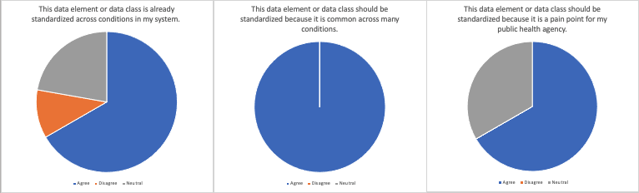
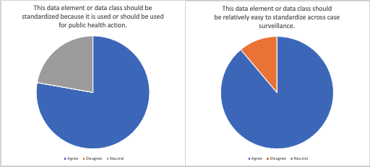
Why hospitalization?
1
2
3
Already standardized across conditions in my system.
Should be standardized because it is common across many conditions.
Should be standardized because it is a pain point for my public health agency.
Should be standardized because it is used or should be used for public health action.
Should be relatively easy to standardize across case surveillance.
4
5
n= 9
Key
Blue = Agree
Orange = Disagree
Grey = Neutral

Slide 9
Hospitalization: In Scope
In scope:
Hospitalization as an indicator of severity of disease.
  Similar to what is used in GenV2
Identifying elements and structure for core surveillance
Agree upon common definitions and/or value sets for elements in core surveillance

Slide 10
What is "core surveillance"?
Data elements/data classes that are valuable for data exchange or interoperability
  Do you want to receive it as part of interjurisdictional exchange?
  Do you want an efficient way to ingest?
  Utility across multiple conditions -- would you want the elements available for many conditions or to add as a block?
  Focus on what is needed across public health, not what should be part of next-generation Gen V2

Slide 11
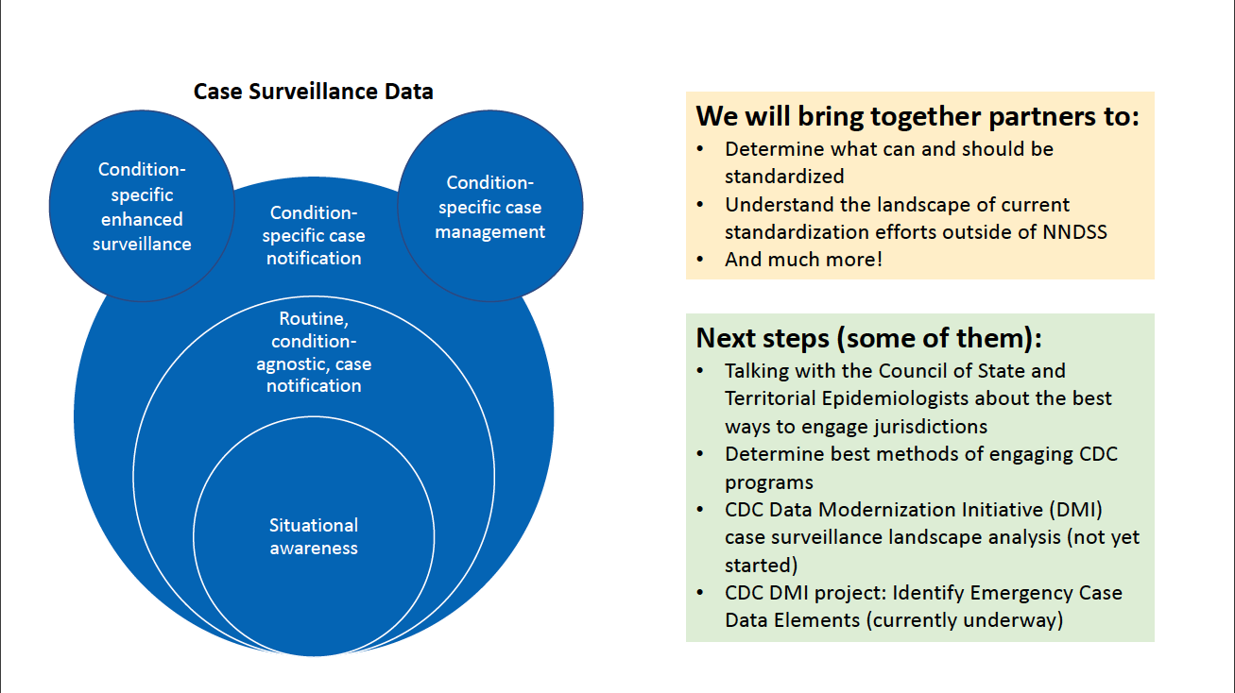
Core surveillance
We may table certain items to revisit at a later phase or after further consideration​

Slide 12
Hospitalization: Out of Scope
Out of Scope:
Hospital/healthcare information as an exposure or risk factor.
  Separate concept from hospitalization as an indicator of severity
  Examples: Legionella, Ebola, HAI MDROs
Standardizing of data elements that are mainly for research purposes or non-core elements that need significant discussion
Condition-specific guidelines (e.g., timelines or criteria (ex. ICD-10) for defining hospitalization)
Data exchange mechanism for sending/sharing

Slide 13
Potential data elements related to hospitalization
Hospitalized? (yes/no)
Admission date
Discharge date
Duration of hospitalization
Admission location
ICU admission (yes/no)
ICU admission dates
ICU discharge dates
Capability to capture multiple hospitalization for a condition/case

Slide 14
Background Information: Hospitalization (CDC)

Slide 15
U.S. Core Data for Interoperability (USCDI)
Hospitalization
  Derive from Encounter Information (v3)
    Encounter Location: place where patient's care is delivered
    Encounter Type: category of health service
  Derive from Facility Information (draft v4)
    Facility Type: category describing available services or resources
    (e.g., hospital, pharmacy)
    Facility Name: Word(s) by which facility is known
Admission and Discharge dates
  Related to Encounter Time: date/times related to encounter (e.g., check in, start and stop)
  Explanation of Benefits data class (comment) likely driving some content
    Member Admission Date & Member Discharge Date
ICU data elements
  No specific concepts identified
  Depending on how encounter information is aligned could potentially derive
Notes:
No value set within USCDI for encounter location, this may be address or location type such as hospital, ICU; similarly for encounter type which is linked to a HL7 FHIR encounter type, value set is mapped to CPT codes
NOTE: Explanation of Benefit is a data class at the comment level of USCDI. Not included in slide. However, Member Admission Date and Member Discharge Date are listed

Slide 16
Health Level 7 (HL7)
HL7 v2
  Admit, Discharge and Transfer (ADT) messages used for syndromic surveillance, health information exchanges (HIEs), etc.
    Patient class (= inpatient), admit date, discharge date
FHIR (Fast Healthcare Interoperability Resources)
  Encounter Resource
    Encounter.class (code indicating class of service provided)
    Encounter.period.start or .end (start and end time of the encounter)
    Encounter.length (actual quantity of time the encounter lasted)
    Encounter.location (list of locations patient has been, potentially capture ICU)
    Encounter.serviceprovider (can capture hospital name)
  Organization Resource
    Organization.name (captures hospital name)
  eiCR/eCR profile for FHIR
    Encounter https://hl7.org/fhir/us/ecr/StructureDefinition-eicr-encounter.html
    Organization list is specific to US Public Health entities https://hl7.org/fhir/us/ecr/StructureDefinition-us-ph-organization.html
Notes:
Encounter resource with a classification for inpatient or related value that may indicate hospitalization. HL7.TERMINOLOGY\ActCode - FHIR v4.0.1 more specifically HL7.TERMINOLOGY\ActEncounterCode - FHIR v4.0.1 where =inpatient acute, =inpatient encounter;
There are additional data elements within FHIR US Core profile that may offer additional indications of hospitalized (Ex: encounter.hospitalized).
In addition to these data elements that provide the necessary information, an additional required element of Encounter.status must be provided.
For eiCR/eCR organization:
This Organization profile represents an organization involved in public health. It is based on the US Core Organization profile and establishes the core elements, extensions, vocabularies and value sets for representing organizations for public health.
Usage:
Derived from this Resource Profile: Responsible Agency Organization, Routing Entity Organization, Rules Authoring Agency Organization
Refer to this Resource Profile:
Examples for this Resource Profile: Acme_Labs, Health Authority West, Salem Medical Center, YMCA
For access to all FHIR artifacts for the eCR profile: https://hl7.org/fhir/us/ecr/toc.html
For access to all FHIR artifacts for FHIR's current release (4.3.0): http://hl7.org/fhir/toc.html
FHIR version 5 is anticipated to be released in the fall.

Slide 17
Electronic Case Reporting (eCR)
Hospitalization derived from
  Facility Type/Hospital Unit
  Clinical Data Architecture (CDA) Mapping
    ClinicalDocument/componentOf/encompassingEncounter/location/healthCareFacility/code
      Concepts representing classification of patient encounter such as ambulatory (outpatient), inpatient, emergency, home health or others due to local variations.
    ClinicalDocument/componentOf/encompassingEncounter/location/healthCareFacility/serviceProviderOrganization/name
Admission and Discharge Date/Time
  Specific data elements in profile
  CDA Mapping
    ClinicalDocument/encompassingEncounter/effectiveTime/low
    ClinicalDocument/encompassingEncounter/effectiveTime/high
ICU content potentially derived from similar content as hospitalization as well as Encounter
  ClinicalDocument/componentOf/encompassingEncounter/code
Notes:
Encounter Type also collected, CDA mapping: ClinicalDocument/componentOf/encompassingEncounter/code

Slide 18
Case Notifications to CDC
Message Mapping Guides (MMGs)
Generic v2
Other MMGs
  Malaria, COVID, FDD, RIBD, Anthrax (dev)
  Repeating block for admission (52455-3) and discharge dates (52525-3)
Hospitalized (77974-4) | Was subject hospitalized because of this event?
Admission Date (52455-3) | Subject’s most recent admission date to the hospital for the condition covered by the investigation.
Discharge Date (8649-6) | Subject's most recent discharge date to the hospital for the conditions covered by the investigation.
Duration of Hospital Stay in Day (78033-8) | Subject's duration of stay at the hospital for the condition covered by the investigation.
Hospital Name (58237-9) | If admitted, what is the name of the hospital?
Hospital Record Number (46106-1) | Hospital record number, if subject was hospitalized
Hospital ICU (309904001) | Was the patient admitted to an intensive care unit (ICU)?
ICU Admission Date (95367-9) | Date of first ICU admission
ICU Discharge Date (95368-7) | Date of first ICU discharge
Notes:
Talking point... some dont' have a repeating block, but a 2nd hospitalization admit and discharge date to capture readmissions
Other wording for ICU: During any part of the hospitalization, did the subject stay in an Intensive Care Unit (ICU) or a Critical Care Unit (CCU)?

Slide 19
Discussion: Hospitalization
(Co-Chairs)

Slide 20
What should be part of core surveillance??
Think about the CONCEPT – we will work on the exact question or value-set later
Potential data elements related to hospitalization
  Hospitalized? (yes/no)
  Admission date
  Discharge date
  Duration of hospitalization
  Admission location
  ICU admission (yes/no)
  ICU admission dates
  ICU discharge dates

Slide 21
Potential data elements related to hospitalization:
Hospitalized? (yes/no)
Admission date
Discharge date
Duration of hospitalization
Admission location
ICU admission (yes/no)
ICU admission dates
ICU discharge dates

Slide 22
Potential data elements related to hospitalization:
Hospitalized? (yes/no)
Admission date
Discharge date
Duration of hospitalization
Admission location
ICU admission (yes/no)
ICU admission dates
ICU discharge dates

Slide 23
Potential data elements related to hospitalization:
Hospitalized? (yes/no)
Admission date
Discharge date
Duration of hospitalization
Admission location
ICU admission (yes/no)
ICU admission dates
ICU discharge dates

Slide 24
Potential data elements related to hospitalization:
Hospitalized? (yes/no)
Admission date
Discharge date
Duration of hospitalization
Admission location
ICU admission (yes/no)
ICU admission dates
ICU discharge dates

Slide 25
What’s next?
For further discussion:
  Definitions of selected items
  Value sets of selected items, as applicable
  Capability to capture multiple hospitalizations for a condition/case
Look for polls/survey/items to review before the next meeting
Join our WG: last Friday of each month at 1pm EDT
  Next meeting February 24, 2023

Slide 26
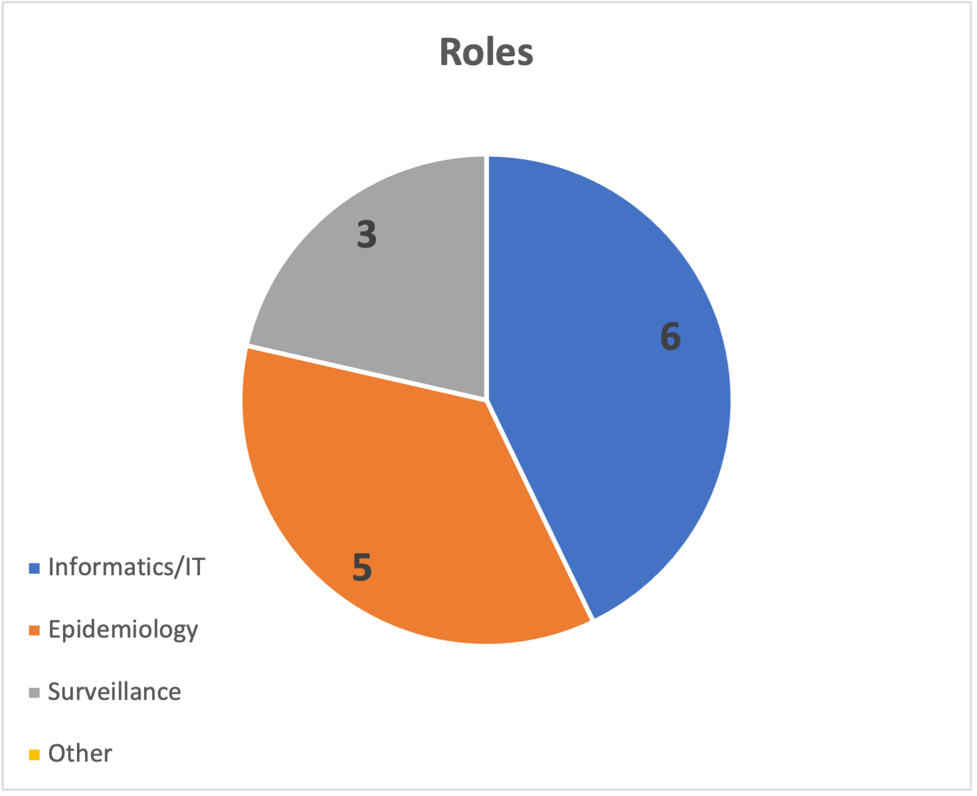
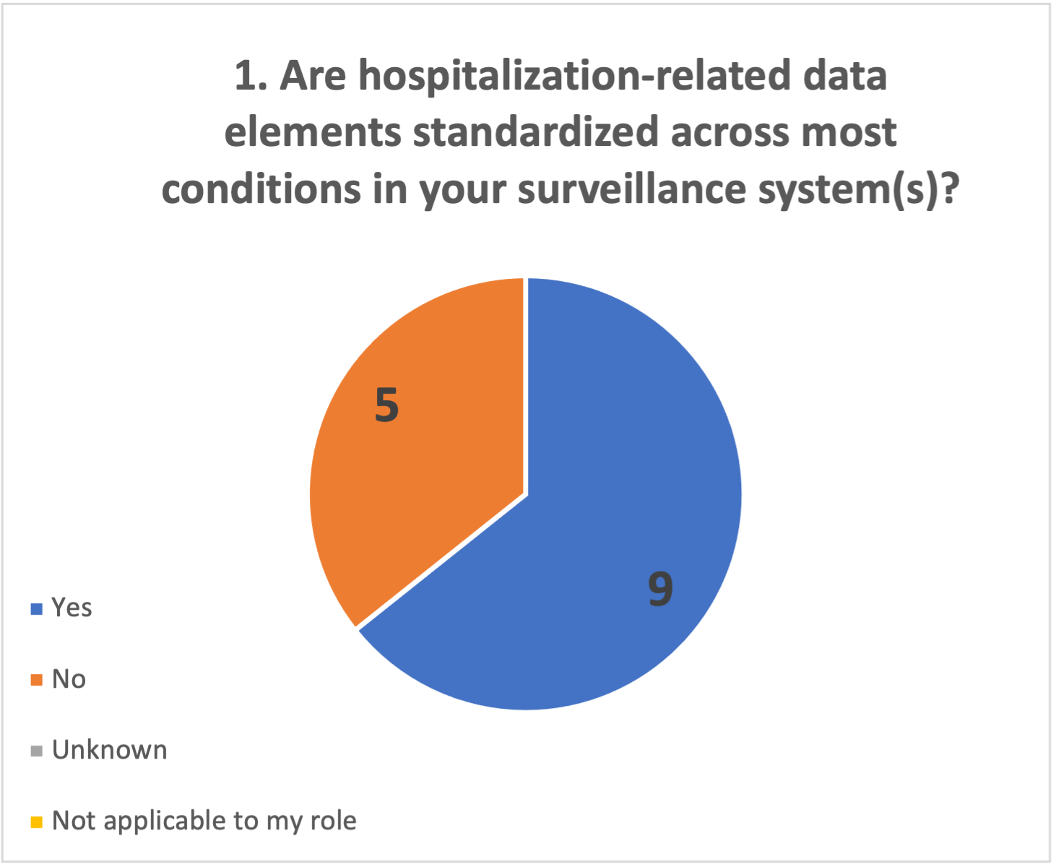
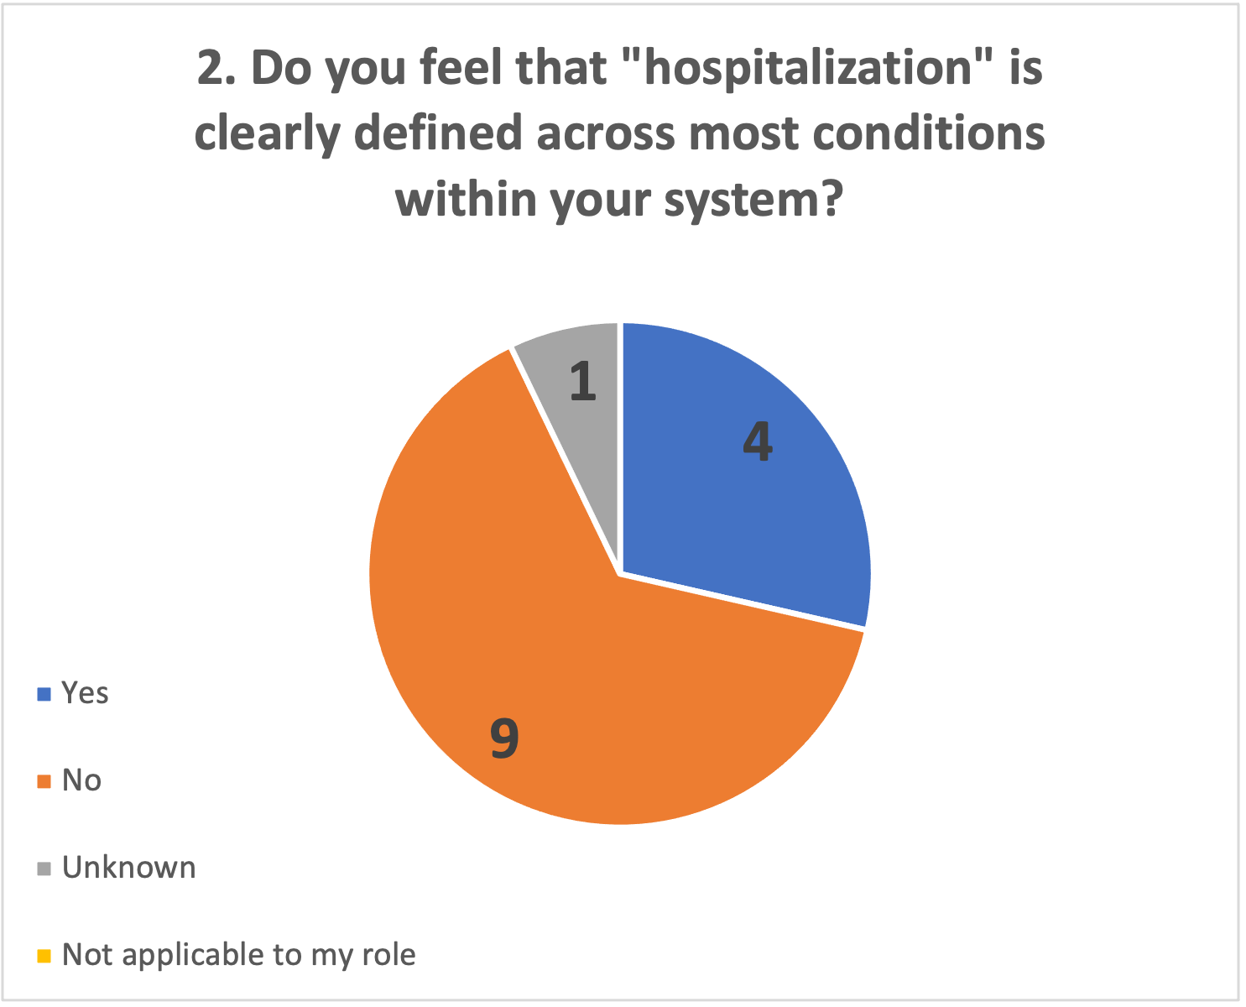
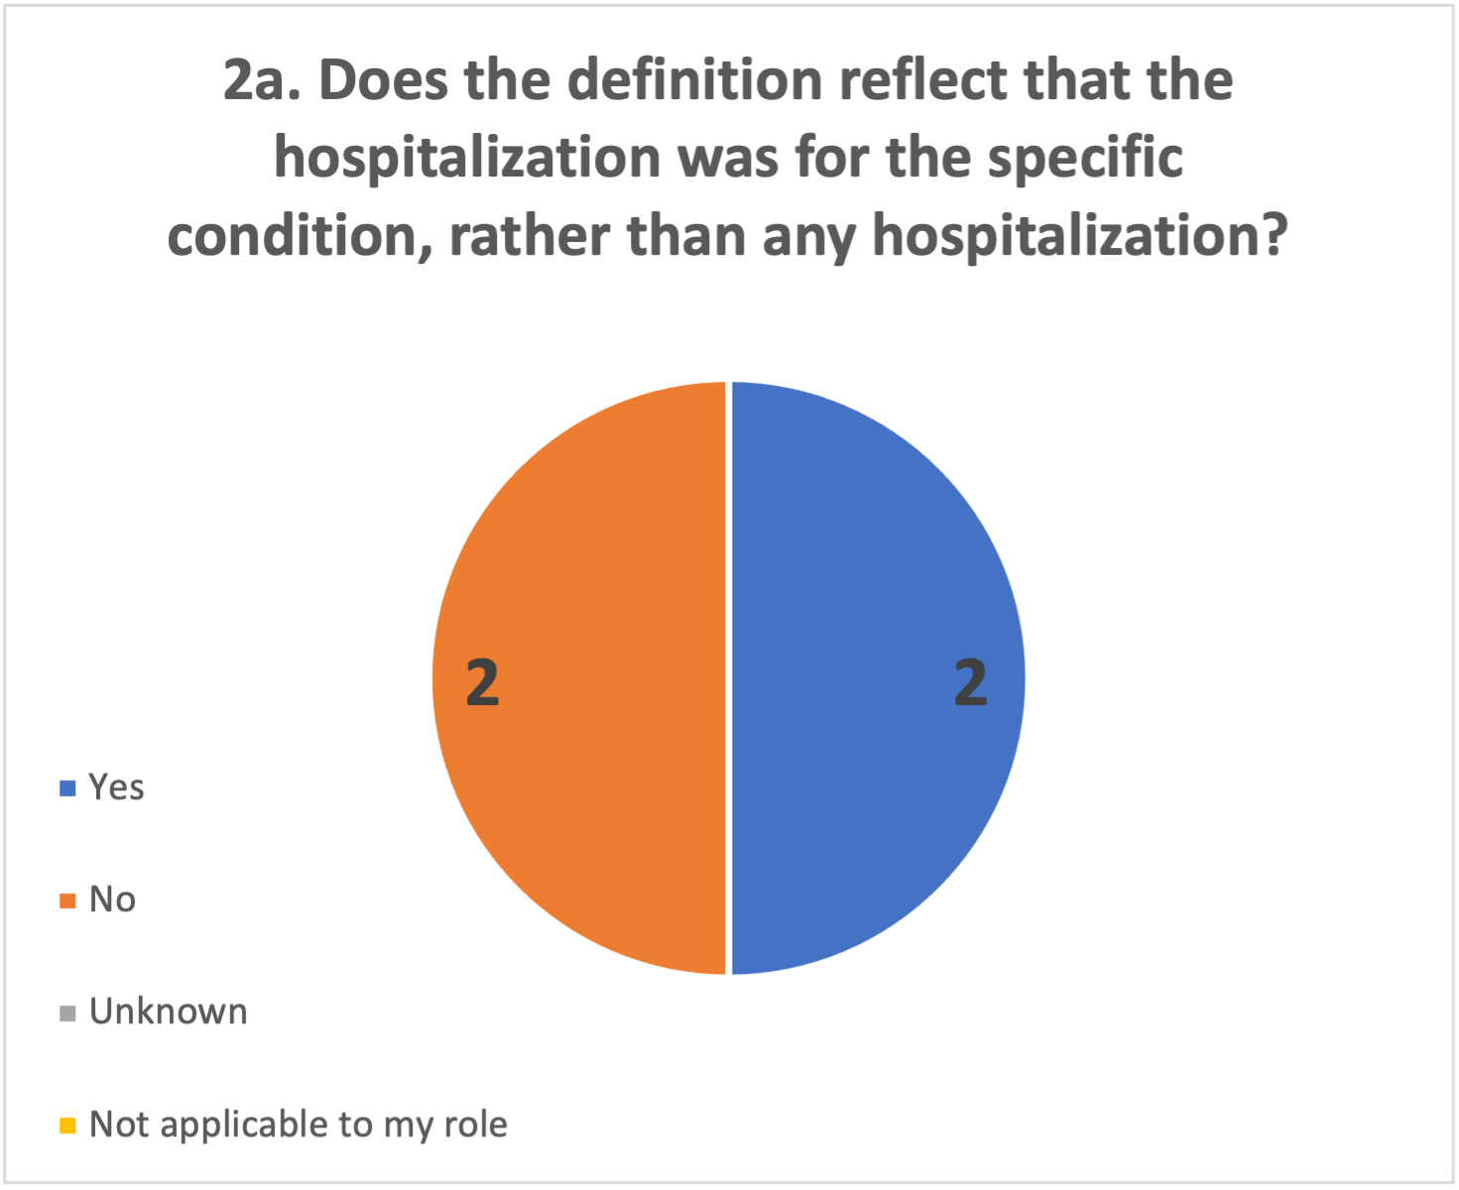
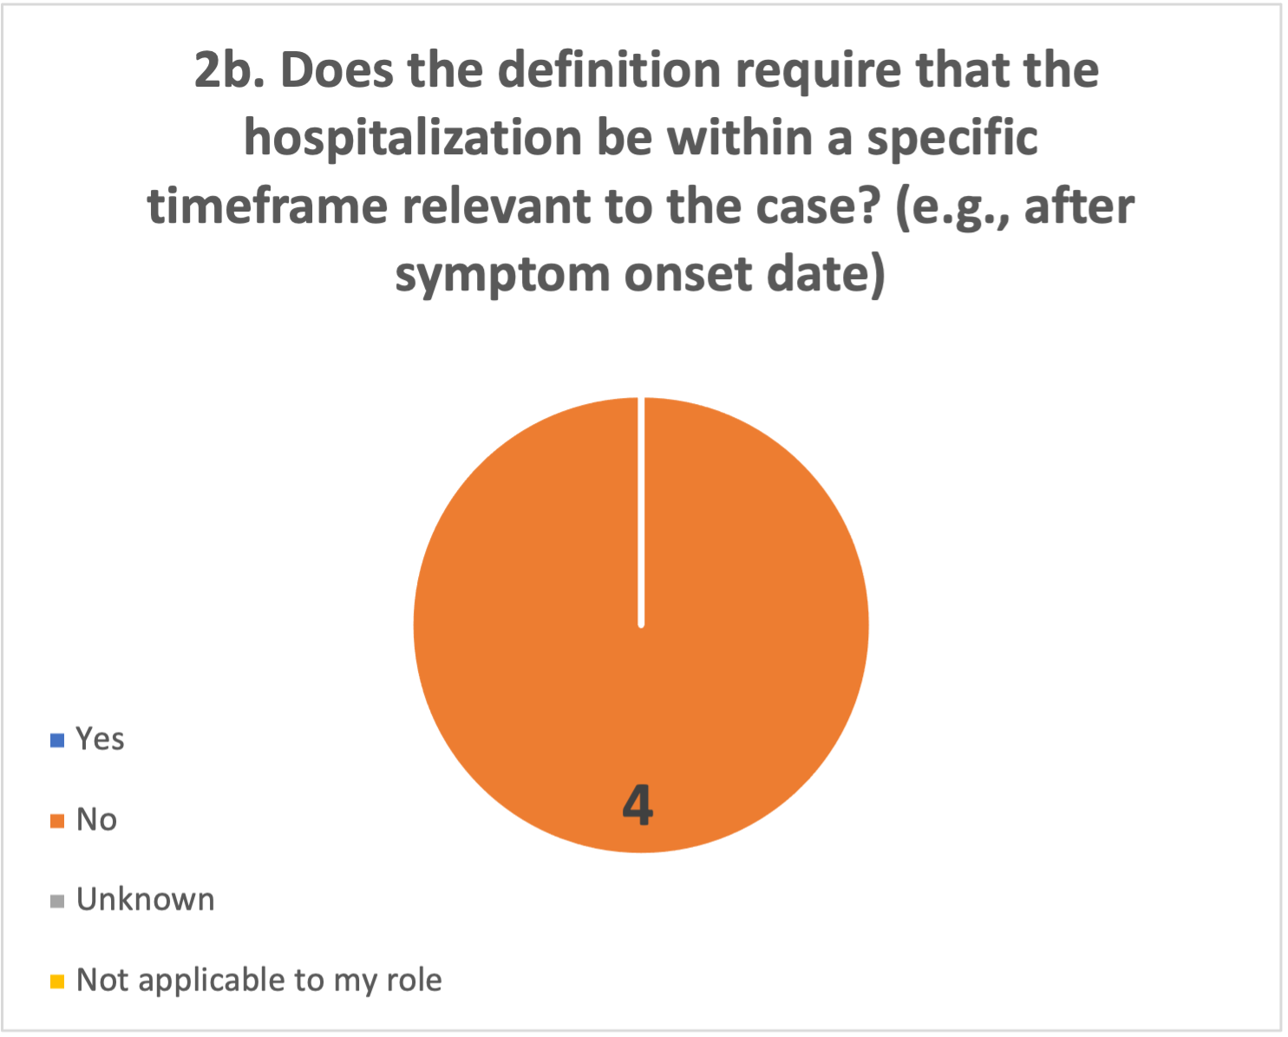
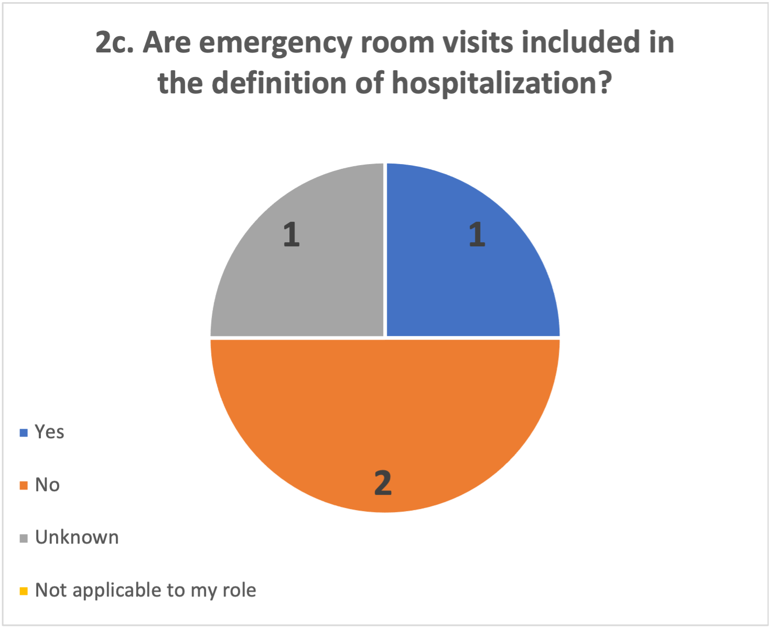
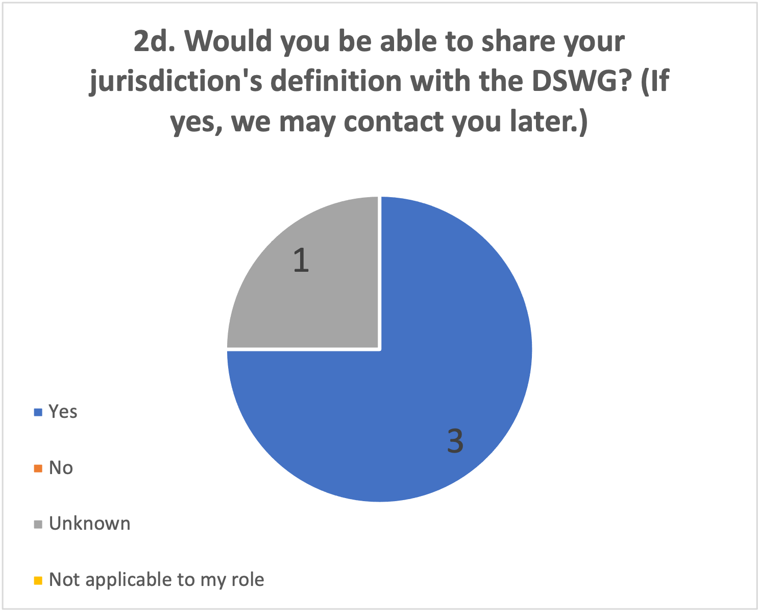
Hospitalization (Pre-Meeting Poll)
Notes:
Jurisdictions Represented
Kentucky CHFS
Philadelphia Department of Public Health
New York State Department of Health
Virginia Department of Health
State of WI - DHS
CA DPH
Arizona Dept of Health Services
East Shore District Health Department
Ingham County Health Department (MI)
nyc dohmh, sti
Minnesota Department of Health
Mississippi State Department of Health
Nebraska DHHS
Connecticut Dept of Public Health

Slide 27
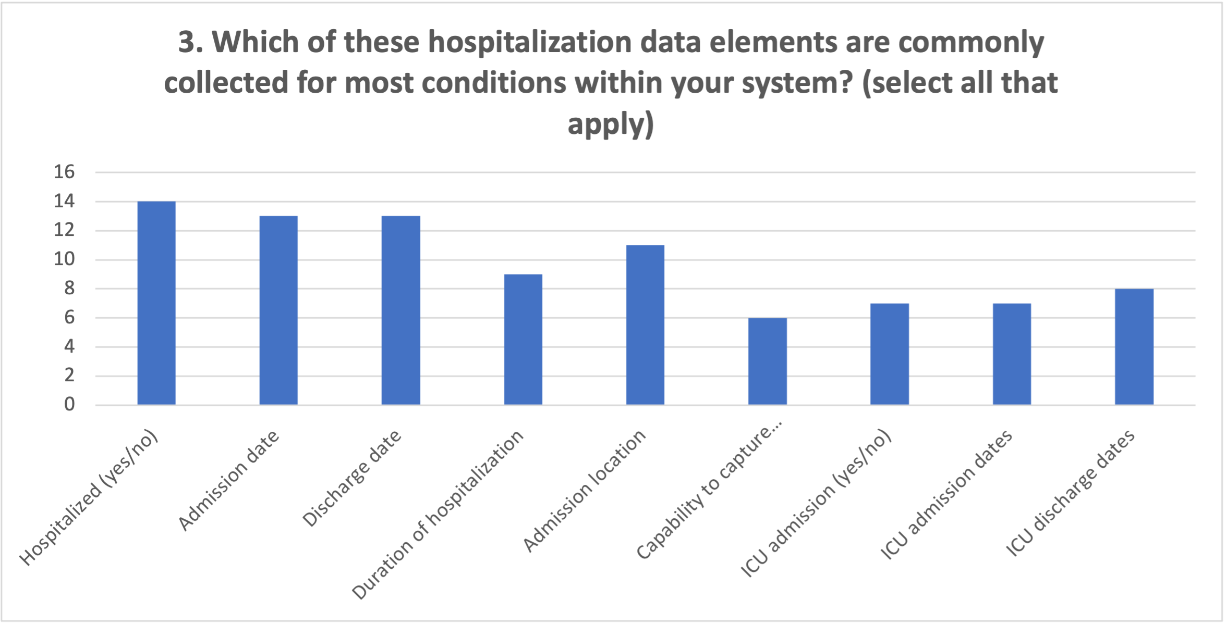
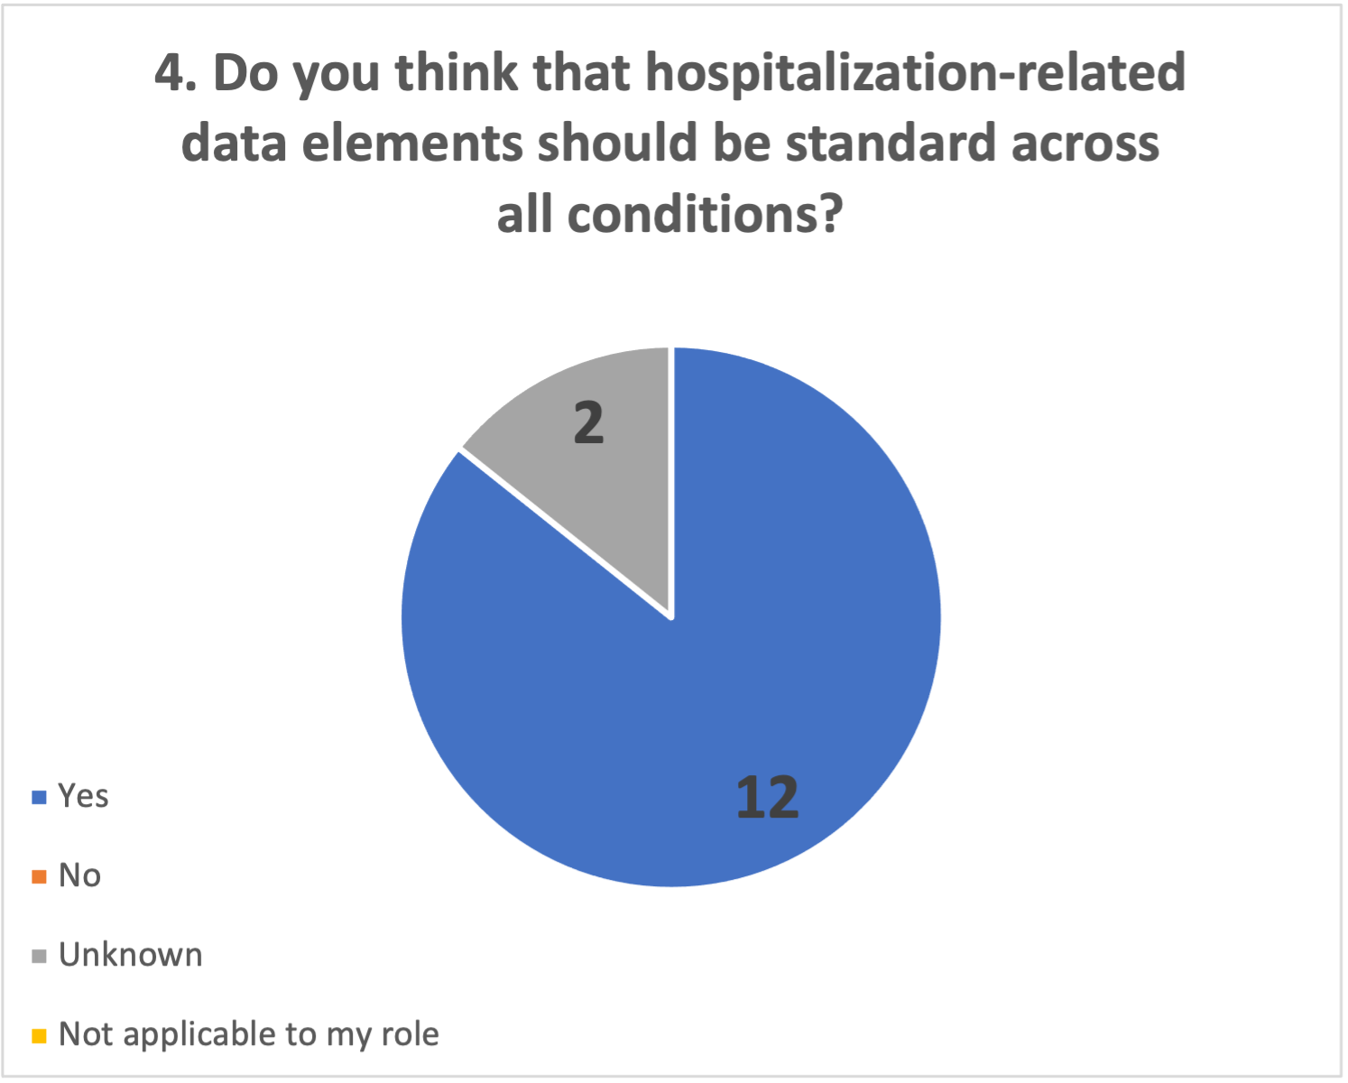
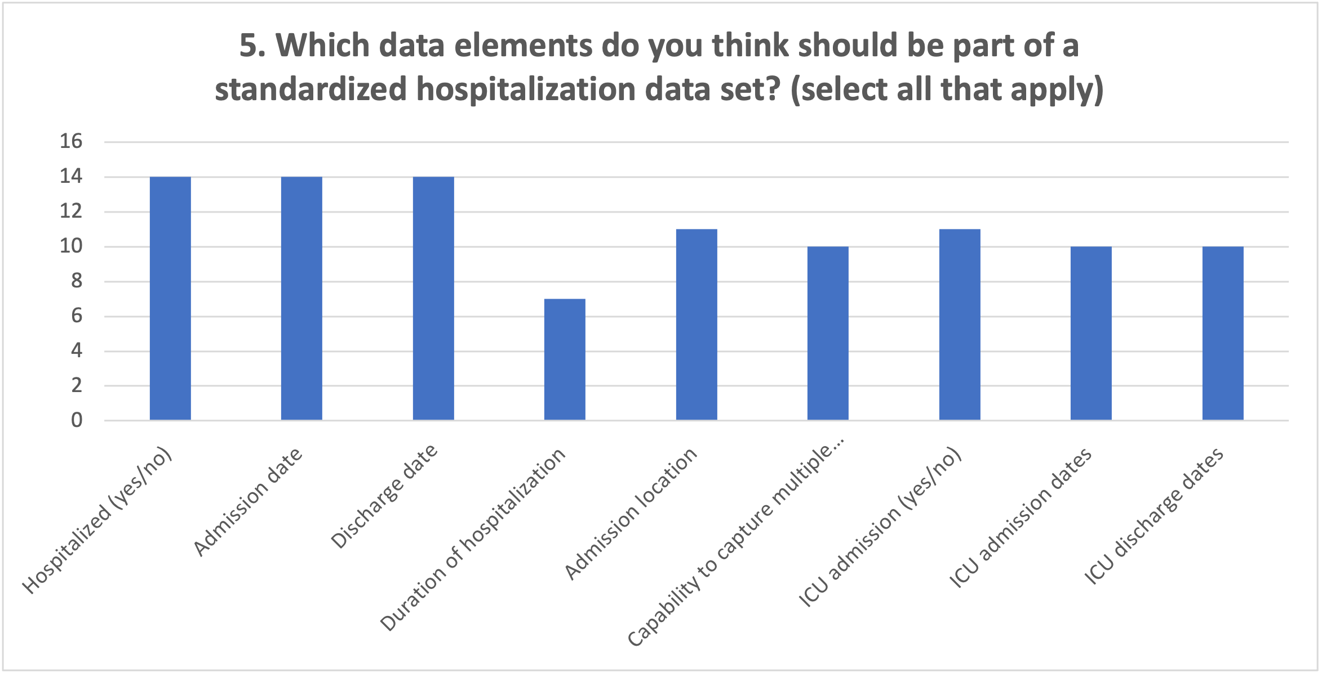
Hospitalization (Pre-Meeting Poll)

Slide 28
Data Class/Elements Poll Results

Slide 29
Potential Data Elements / Data Classes
Various aspects to standardize across these data classes – e.g., questions and value sets, vs. how data are collected/stored in surveillance system.
Health Equity/Social Determinants of Health (SDOH)
Sexual Orientation and Gender Identity (SOGI)
Pregnancy
Tribal affiliation
Race/ethnicity
Disability
Industry and occupation
Travel
Hospitalization
Underlying conditions, exposures, and risk factors
Signs and symptoms/clinical manifestation
Laboratory observations
Immunization history
Medications
Reporting source & information source
Case identifiers, including CDC emergency response case ID
Lab identifiers (to link case and lab data)
Other, specify

Slide 30
Prioritizing Data Elements to Work On
Factors to consider:
Considered core data, maybe already standard across conditions
  May incorporate results of the case data for emergency response project
Very common across conditions (although may not be standardized across conditions)
Other standardization work is going on
  + Well established standard exists
  - Standards work underway will inform our action (may want to wait)
Pain points for jurisdictions or CDC
Simplicity – what can we make progress on in the shorter term?
Data that results in public health action, importance of the data
Others?

Slide 31
Poll
This data element or data class is already standardized across conditions in my system.
This data element or data class should be standardized because it is common across many conditions.
This data element or data class should be standardized because it is a pain point for my public health agency.
This data element or data class should be standardized because it is used or should be used for public health action.
This data element or data class should be relatively easy to standardize across case surveillance.

Slide 32
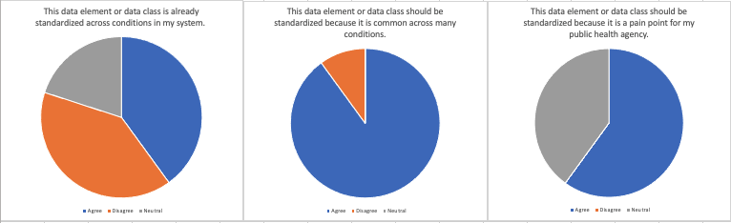
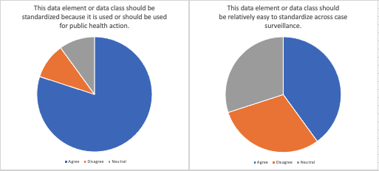
Travel
Summary: Consensus to tackle travel. Danielle has been researching some of the pain points for some of the programs. Need to better ensure dates of travel are captured accurately. If we can circle back to this with more detail to the group that would also be helpful but there is a lot of agreement on this data element. One item to help shape conversations would be Tier 1, minimum bucket, and then how to qualify if it needs a deeper dive down to Tier 3. Need to qualify true spread. This has been discussed in the DSWG for a long time.
n = 10
Key
Blue = Agree
Orange = Disagree
Grey = Neutral

