Slide 1
Data Standardization Work Group (DSWG)
March 31, 2023

Slide 2
CSTE Data Standardization Workgroup Meeting​
Please mute phone/ headset/ computer audio!​
Agenda
Welcome & overview
Hospitalization Data Elements Discussion Continued
  Review of what is in/out of scope
  Data sources: eCR/RCKMS presentation: Sarah Gaunt, John Loonsk and Shaily Krishan
  Core surveillance data elements: continued polling
  Defining "hospitalization"
Next up: Travel!
Wrap-Up & Adjourn

Slide 3
Welcome, new members!

Slide 4
Meeting ground rules
Discussion Guidelines
  "Raise" your hand
  Use the chat to provide feedback and ask questions
  When called, state your name and affiliation
  Stay on point, be brief, and within the context of the discussion in progress
  80/20 consensus
  Co-Chairs/moderators' prerogative to move the discussion forward as needed
    Post-meeting survey provided for additional input
  Be courteous: Don't interrupt others and be open to new ideas
Active participation encouraged for all!
Chats, voting, comments, etc.
Includes STLT jurisdictions + CDC Programs + CSTE, etc.

Slide 5
Hospitalization

Slide 6
Hospitalization: In Scope
In scope:
Hospitalization as an indicator of severity of disease.
  Similar to what is used in GenV2
Identifying elements and structure for core surveillance
  Data elements/data classes that are valuable for data exchange or interoperability
  For situational awareness or routine, condition-agnostic case surveillance
Identify common definitions and value sets for elements in core surveillance, implementation/interpretation notes
For case-based surveillance (not syndromic, not aggregate reporting)

Slide 7
Hospitalization: Out of Scope
Out of Scope:
Hospital/healthcare information as an exposure or risk factor.
  Separate concept from hospitalization as an indicator of severity
Standardizing of data elements that are mainly for research purposes or non-core elements that need significant discussion
Condition-specific guidelines (e.g., timelines or criteria (ex. ICD-10) for defining hospitalization)
Data exchange mechanism for sending/sharing

Slide 8
Data sources for Hospitalization

Slide 9
Data sources for data elements
Compilation of possible data sources for hospitalization data elements presented in Jan WG, with shared spreadsheet/notes
USCDI
eCR (CDA, HL7 & FHIR)
(ELR)
As part of standardization, can we map incoming data elements to our selected core elements?
Can we make recommendations for how data from the electronic sources are integrated?
...can we automate the population of these core elements...?

Slide 10
Hospitalization in eCR/RCKMS
  Shaily Krishan
  Sarah Gaunt John Loonsk

Slide 11
Hospitalization in eCR
EHRs are a tremendous data opportunity for public health
How EHRs store data
  Not always in the format of the standards – mappings involved
  HL7 FHIR is explicitly an “interface” / “API” standard
How clinical standards are designed
  Usually not specific “yes / no” questions
  Frequently “generic” structures like an “observation” and then coded content internal to them
What EHRs send out
  Regulatory tools to structure EHR data exchange are still maturing
  Some increasing consistency will come from market consolidation

Slide 12
Hospitalization in CDA & FHIR eICR Standards
Hospitalization (class of encounter) information is located:
  CDA: ClinicalDocument/componentOf/encompassingEncounter/code
  FHIR: Encounter.class
  Both the above elements use the value set https://terminology.hl7.org/ValueSet-v3-ActEncounterCode.html
    IMP | inpatient encounter
      A patient encounter where a patient is admitted by a hospital or equivalent facility, assigned to a location where patients generally stay at least overnight and provided with room, board, and continuous nursing service.
    ACUTE | inpatient acute
      An acute inpatient encounter.
    NONAC | inpatient non-acute
      Any category of inpatient encounter except 'acute’.
    OBSENC | observation encounter
      An encounter where the patient usually will start in different encounter, such as one in the emergency department (EMER) but then transition to this type of encounter because they require a significant period of treatment and monitoring to determine whether or not their condition warrants an inpatient admission or discharge. In the majority of cases the decision about admission or discharge will occur within a time period determined by local, regional or national regulation, often between 24 and 48 hours.
    SS |short stay
      An encounter where the patient is admitted to a health care facility for a predetermined length of time, usually less than 24 hours.

Slide 13
Hospitalization in CDA & FHIR eICR Standards
EHRs generally do not have a specific data element that records that a patient was hospitalized due to a particular condition or diagnosis
However, a combination of the following can be used:
  class of encounter
    and
  encounter diagnosis
Encounter diagnosis is located:
  CDA: Encounters Section (entries required)(V3)/Encounter Activity (V3)/Encounter Diagnosis (V3)/Problem Observation (V3)
  FHIR: Composition (eICR Composition).encounter (eICR Encounter).diagnosis

Slide 14
Observed Data Example
54282 eICRs from three different EHRs and over 10 different provider organizations:
6772 are coded as inpatient (12.4%)
12676 are coded as emergency (23.3%)
27371 are coded as ambulatory/outpatient (50.4%)
981 are observations (1.8%)
4417 are various (seemingly locally defined) responses (8.1%)
2066 are Null (3.8%)
So about 88% of the data are easily usable to determine type of encounter (including if it was a hospitalization).
Quality Assurance working group has identified rules for this element. HCOs will be tested for it and we should see incremental improvement in consistency over time.

Slide 15
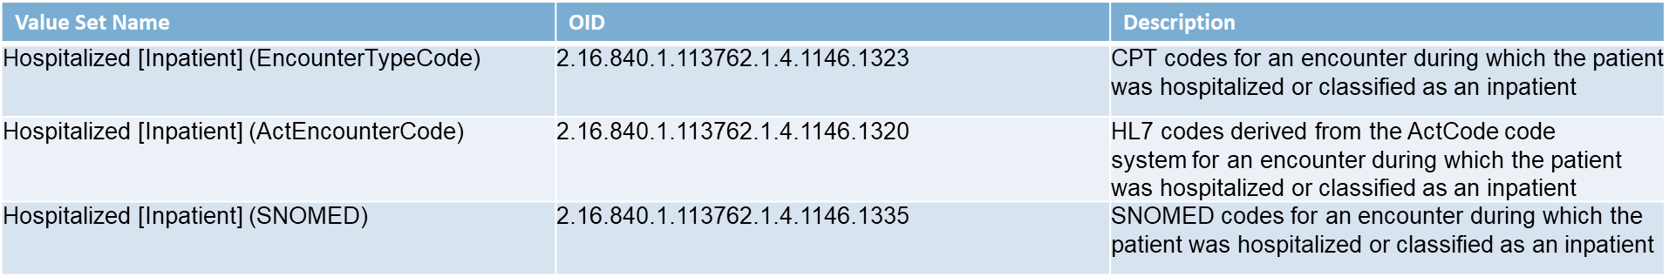
Implementing Hospitalization in RCKMS
RCKMS uses 3 hospitalization value sets mapped to data elements found in the “Encounter Activity” section in the eICR
Value sets contain codes related to inpatient hospitalization

Slide 16
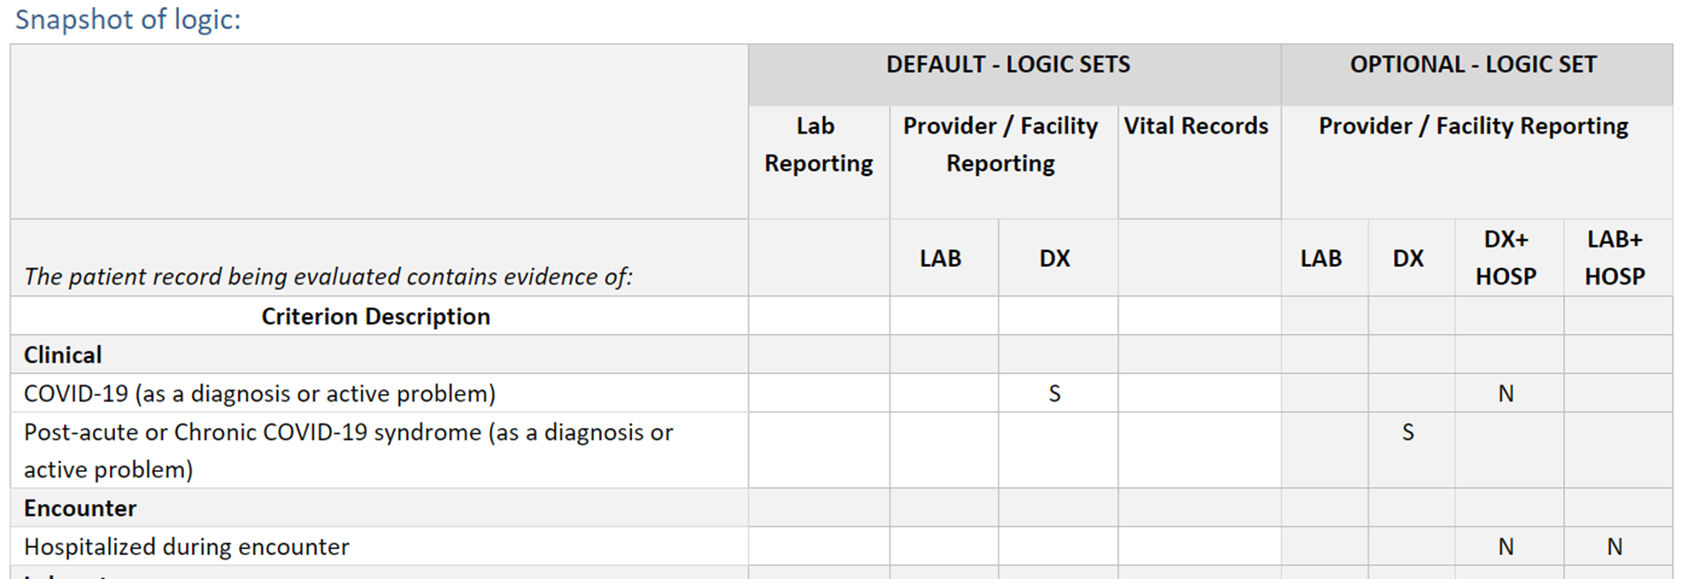
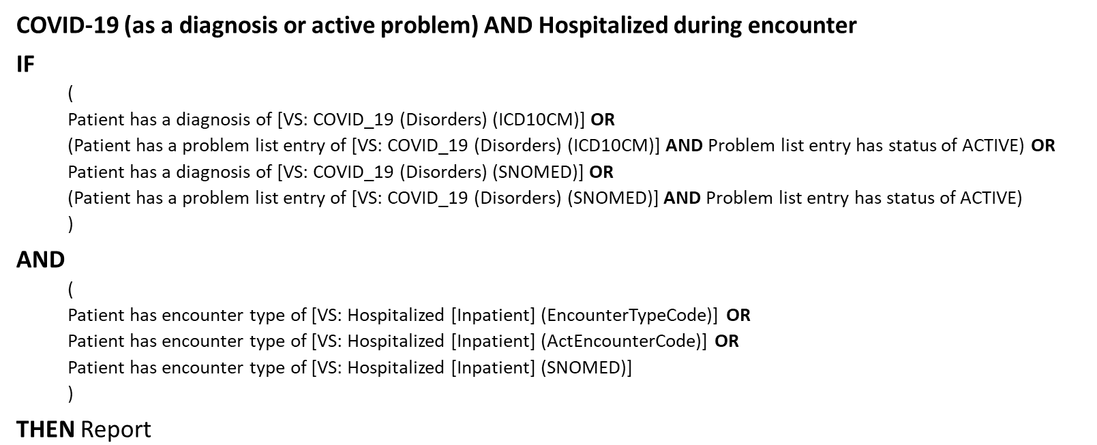
Value Sets & Rules for Hospitalization in RCKMS
Conditions using hospitalization in RCKMS
COVID-19
Influenza-Associated Hospitalizations
Multisystem Inflammatory Syndrome in Children (MIS-C)
Respiratory Syncytial Virus (RSV)-Associated Mortality
Staphylococcus aureus Infection
Varicella

Slide 17
Core data elements

Slide 18
Data Element/Concept | Part of "core surveillance"? | Use or Notification Level
Hospitalization (Y/N) | Yes | Jurisdiction + CDC
Admission date & discharge date | Yes | Jurisdiction + CDC (weak support)
Admission to ICU or specialty care (Y/N) | Yes (weak support) | Yes (weak support)
ICU/specialty care dates of admission/discharge | Yes (weak support) | Jurisdiction only (weak support)
Facility name or identifier | Yes Need to identify recommendation for ID vs. Name vs. both | Jurisdiction only (weak support)
Multiple hospitalizations captured within a case (vs. single hospitalization) | Yes | Jurisdiction + CDC (weak support)
Admission department/ location/unit within the facility | No (weak support for No)

Slide 19
Polling process
Focus on in-meeting polls only
  Share questions in advance for consideration
Poll questions will be shown first on a slide before poll opens
  Opportunity for clarifications & questions
Questions will be mostly Yes/No
  Removing the "unsure" / "unknown" option
  Feel free to abstain if you don't have a preference or don't feel strongly
  We will try to gauge lack of clarify via N and reactions
Opportunity for limited discussion on questions with a big split

Slide 20
Question 1
The re-polling questions reflect areas where we already have weak support (50%-<80% agreement) for a recommendation.
Should admission to ICU/specialty care units be included as part of core surveillance? For example: Was the patient admitted to the ICU or another specialty care unit as part of this hospitalization?
  Yes
  No

Slide 21
Question 2
2. Is admission to ICU/specialty care units (Y/N) appropriate for inclusion in routine case notifications to CDC?
  Yes
  No
Yes = appropriate to send to CDC
No = core surveillance elements for jurisdictional use only

Slide 22
Question 3
3. Should the dates of ICU/special care unit admission/discharge be captured as part of core surveillance?
  Yes
  No

Slide 23
Question 4
4. Are the dates of ICU/special care unit admission/discharge appropriate for inclusion in routine case notifications to CDC?
  Yes
  No
Yes = appropriate to send to CDC
No = core surveillance elements for jurisdictional use only

Slide 24
Question 5
5. The WG indicated strong support for collecting hospital admission/discharge dates as core elements. Are hospitalization admission and discharge dates appropriate for inclusion in routine case notifications to CDC, or are they core surveillance elements for jurisdictional use only?
  Yes – appropriate to send to CDC
  No – jurisdictional use only

Slide 25

Upcoming: Travel data

Slide 26
What’s next?
April workgroup meeting: Focus on TRAVEL data elements
We will start drafting the hospitalization elements write-up – for further review, questions & feedback.
Look for polls/survey/items to review before the next meeting
Join our WG: last Friday of each month at 1pm EDT
  Next meeting April 28, 2023

